Slide 1
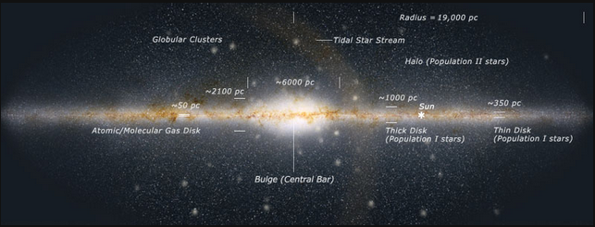
Milky Way Disk

Slide 2
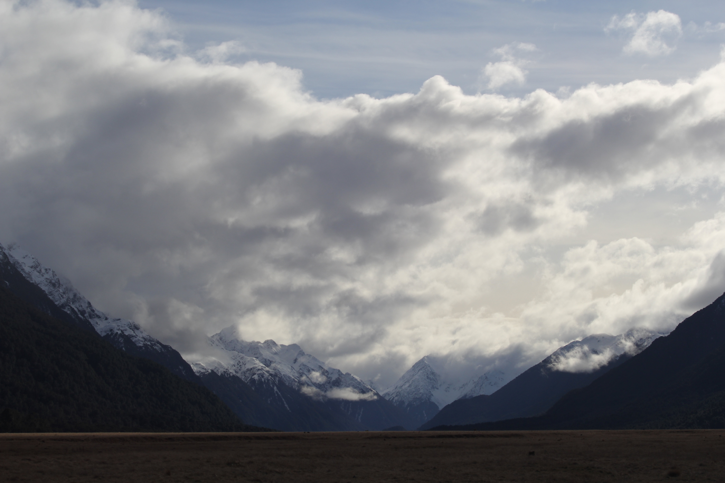
Assignments
http://www.astro.gsu.edu/~thenry/GALACTIC/
Thursday 15 FEB Level 0 … Refs … DONE
Thursday 22 FEB Level 1 … Outline … DONE
Thursday 21 MAR Level 2 … 1st Draft … 4 weeks later
Thursday ?? APR Level 3 … 2nd Draft … 2 weeks later
Thursday ?? APR Level 4 … submit … 3 weeks later

Slide 3
Milky Way Neighborhood (2024)
 | RA | DEC | Size (kpc) | Dist (kpc) | Bits / # Globulars / References
Milky Way | --- | --- | 40 | 0 | warp, bar, 2-4 arms, LMC, SMC, Sgr dSph, ~150 globulars
Andromeda M31 | 00:43 | +41:16 | 50 | 730 | warp, bar, 2? arm / ring, M32, M110, ~460 globulars
Triangulum M33 | 01:33 | +30:39 | 19 | 912 | AGN, flocculent, 54 globulars
Bode’s M81 | 09:55 | +69:03 | 27 | 3675 | AGN low-luminosity, thick disk only?, N globulars
Pinwheel M101 | 14:03 | +54:20 | 59 | 6500 | Nearly face-on, circular, > 10^12 stars, 150 globulars
Whirlpool M51 | 13:30 | +47:13 | 38 | 7800 | M52 companion, bridge starburst

Slide 4
Milky Way Disk

Slide 5
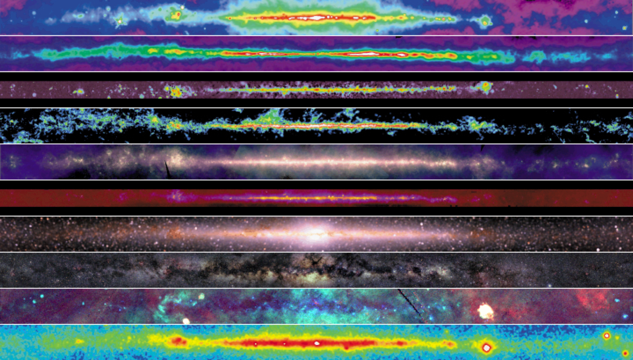
Milky Way Disk
R
R
R
R
I
I
I
V
X
G
Notes:
10 views of the MW disk

Slide 6
Milky Way Disk
RADIO (408 MHz) from high-energy e⁻ moving through interstellar mag field at ~c
shock waves from SN accelerate e⁻
RADIO (1.4 GHz = 21cm) from atomic H tracing warm ISM
ideal tracer of the MW disk, warp?
RADIO (115 GHz) from molecular H₂ inferred from CO tracing cold ISM
clumpy tracers of spiral arms = giant molecular clouds (GMCs)
Notes:
H2 is tough to detect directly at interstellar conditions
The characterization of giant molecular clouds (GMCs) – the sites of nearly all star formation activity in the local Universe – is an important step towards understanding how stars are born. Molecular hydrogen (H₂) is the most abundant molecule in the interstellar medium (ISM), but its rotational emission lines are not excitable at the temperatures found in most GMCs. However, the second most abundant molecule is carbon monoxide (CO), which has rotational transitions that are easily excitable within typical GMCs, making CO a good tracer of molecular gas. Additionally, the lower levels of CO emit at a frequency that can be observed from the ground. Therefore, CO has become the favoured tracer for studying molecular gas in GMCs.

Slide 7
Milky Way Disk
long-IR (12/60/100 microns from IRAS) thermal emission from dust
dust is heated by starlight … star formation regions
What temps
sampled?
mid-IR (6.8-10.8 microns from WISE) from molecules like PAHs in gas clouds
embedded red giants, planetary nebulae, and massive stars
What temps
sampled?
near-IR (1.2-3.5 microns from COBE) from K giants in the disk seen through dust
clear evidence of bulge
What temps
sampled?

Slide 8
Milky Way Disk
OPTICAL (0.4-0.6 microns) primarily stars ≤1 kpc because dust blocks emission
dark patches map emission in H₂ and IR maps
… it really does match the H₂ (remember: CO) map

Slide 9
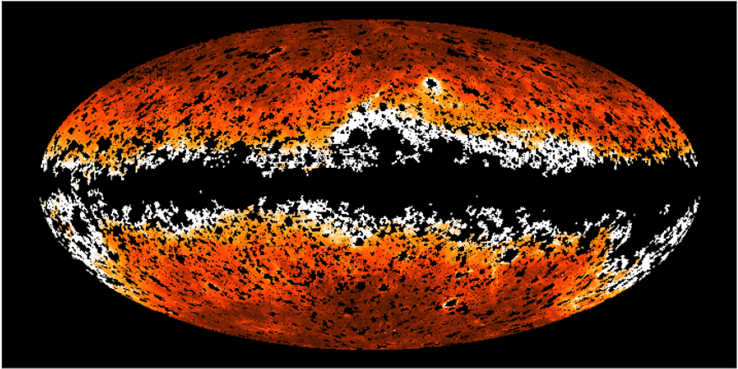
Milky Way Disk
UV (1344-1786 Å from GALEX) shows that the MW disk is “missing”
H atoms and dust block UV photons
X-RAY (0.25/0.75/1.5 keV from ROSAT) hot shocked gas
dark patches are cold clouds
Crab Pulsar
Vela Pulsar Geminga Pulsar
GAMMA (energy > 300 MeV from Compton) cosmic rays hitting H nuclei in clouds
galactic center
What are
the dots?
Notes:
Geminga 250 pc in Gemini
Vela 300 pc in Vela --- spins 11X/sec, brightest persistent source of gamma rays
Crab 2200 pc in Taurus
Closest pulsar is at 85 pc PSRJ0108-1431
gamma rays (energies > 1 GeV shown) produced by energetic particles accelerated in shock waves of supernovae remnants colliding with gas atoms

Slide 10
Milky Way Disk
R
R
R
R
I
I
I
V
X
G

Slide 11
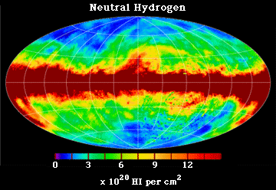
Milky Way: Radio 21cm
Dickey & Lockman (1990)

Slide 12
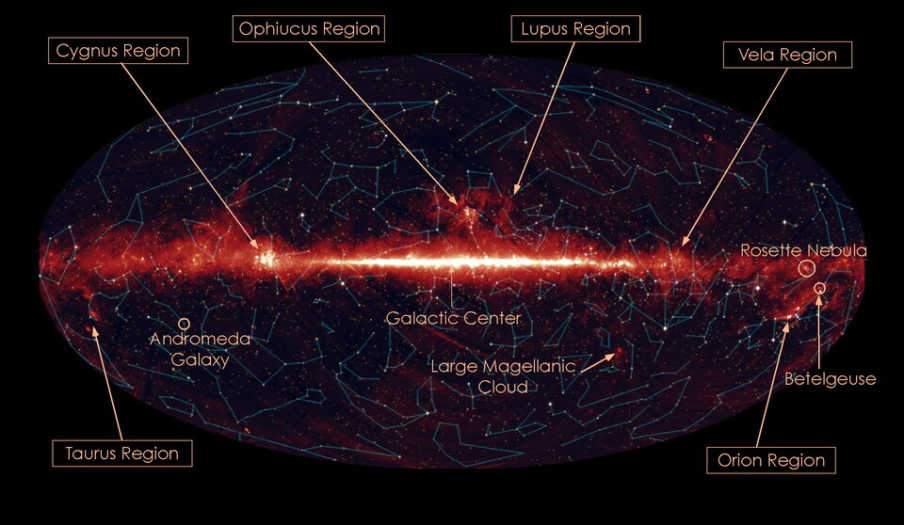
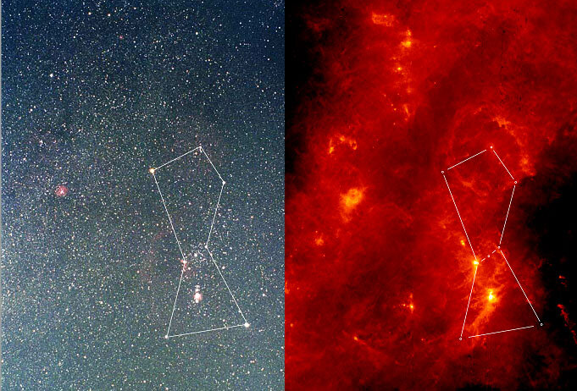
Milky Way: IR 9 microns
AKARI Mission (2007)

Slide 13
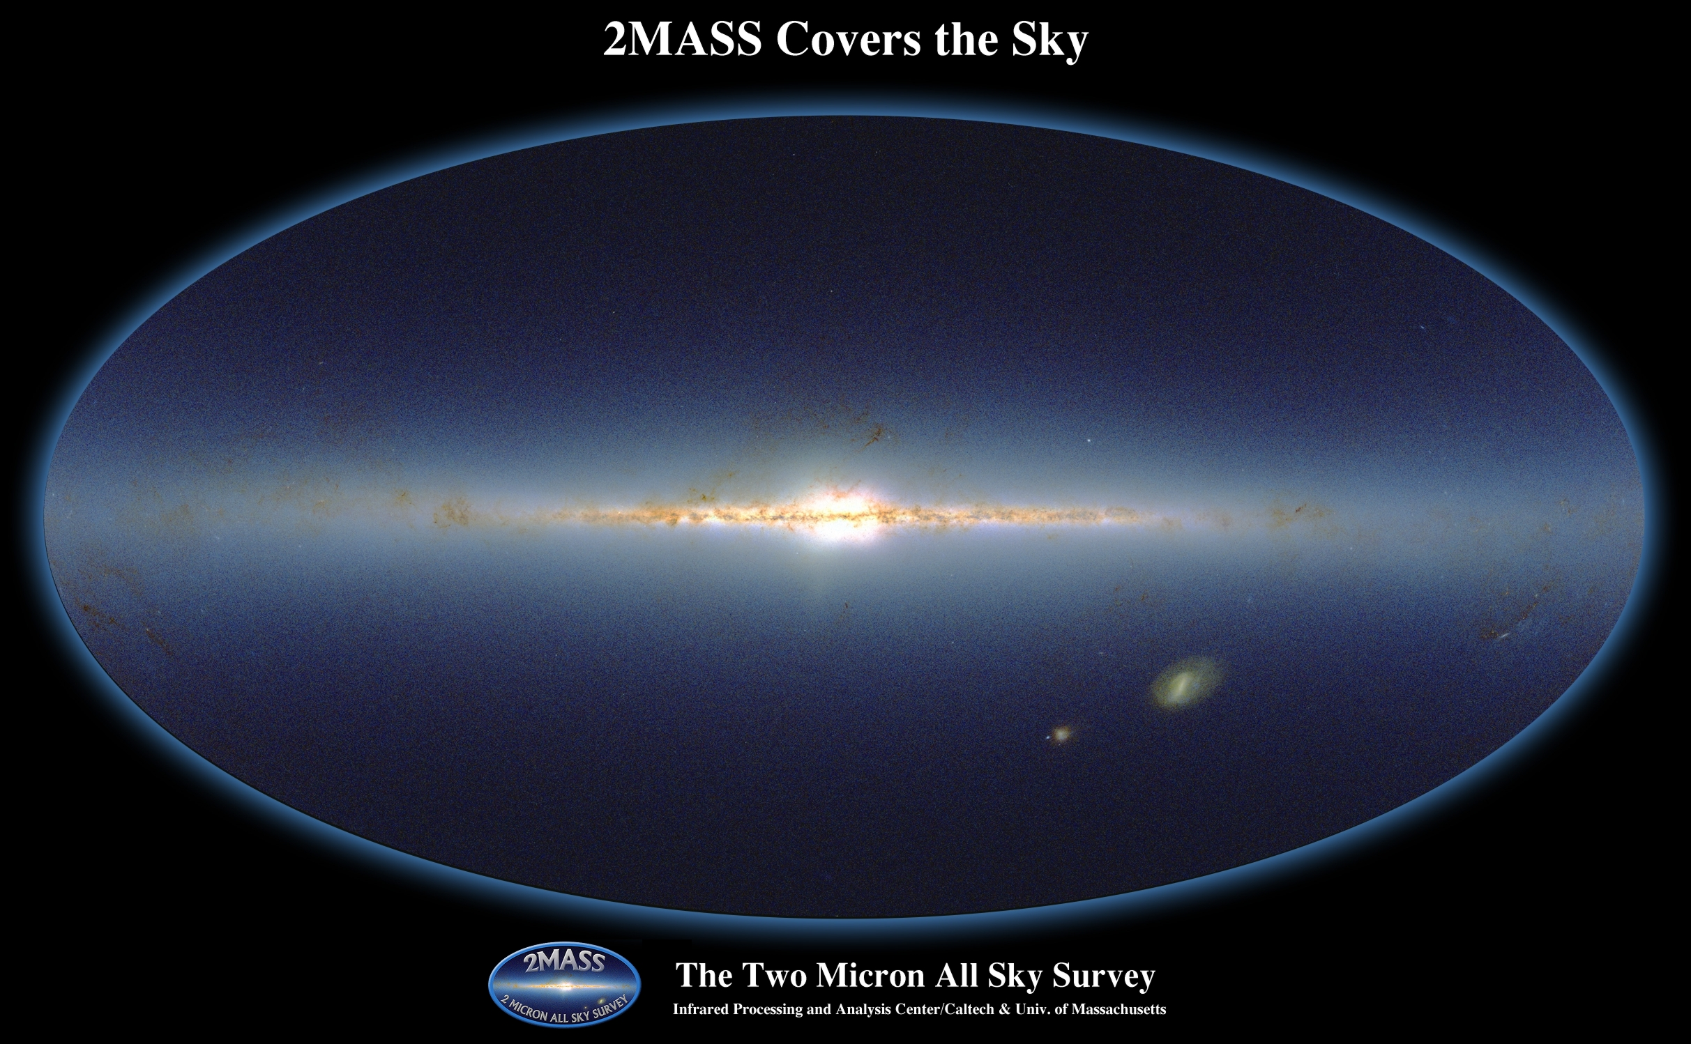
Milky Way: Infrared 2MASS
dwarf Sagittarius
galaxy
~ 0.1 billion point sources (of ~ 0.5 billion total)

Slide 14
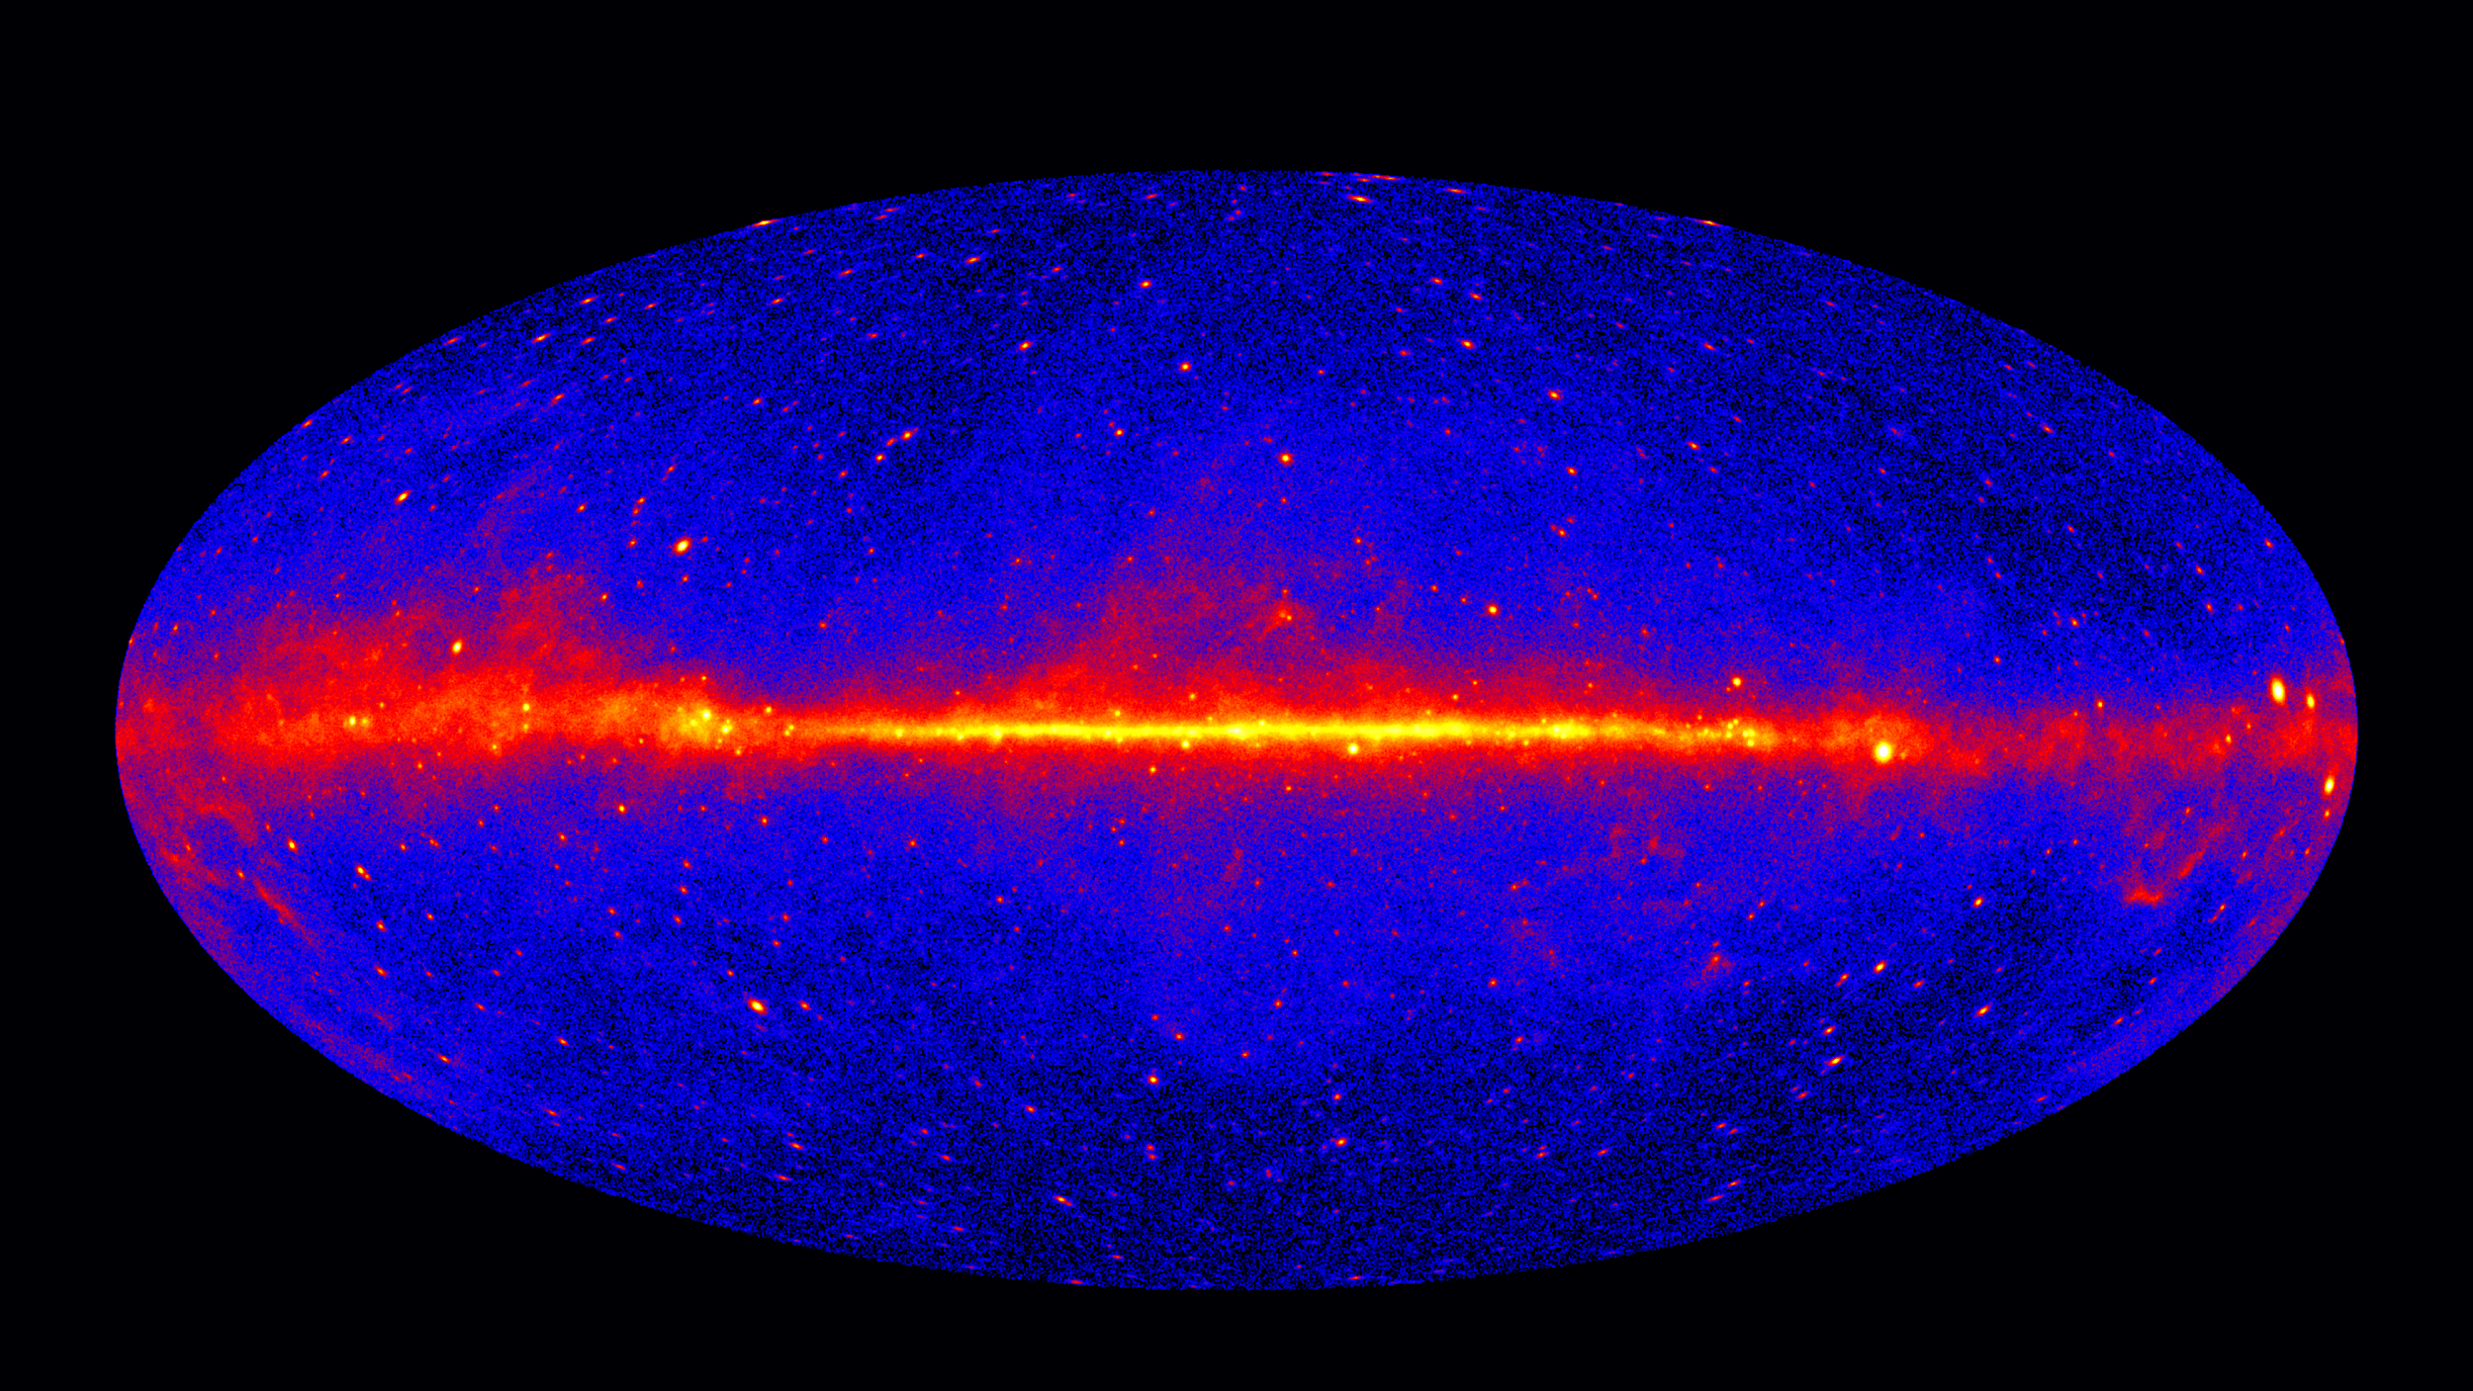
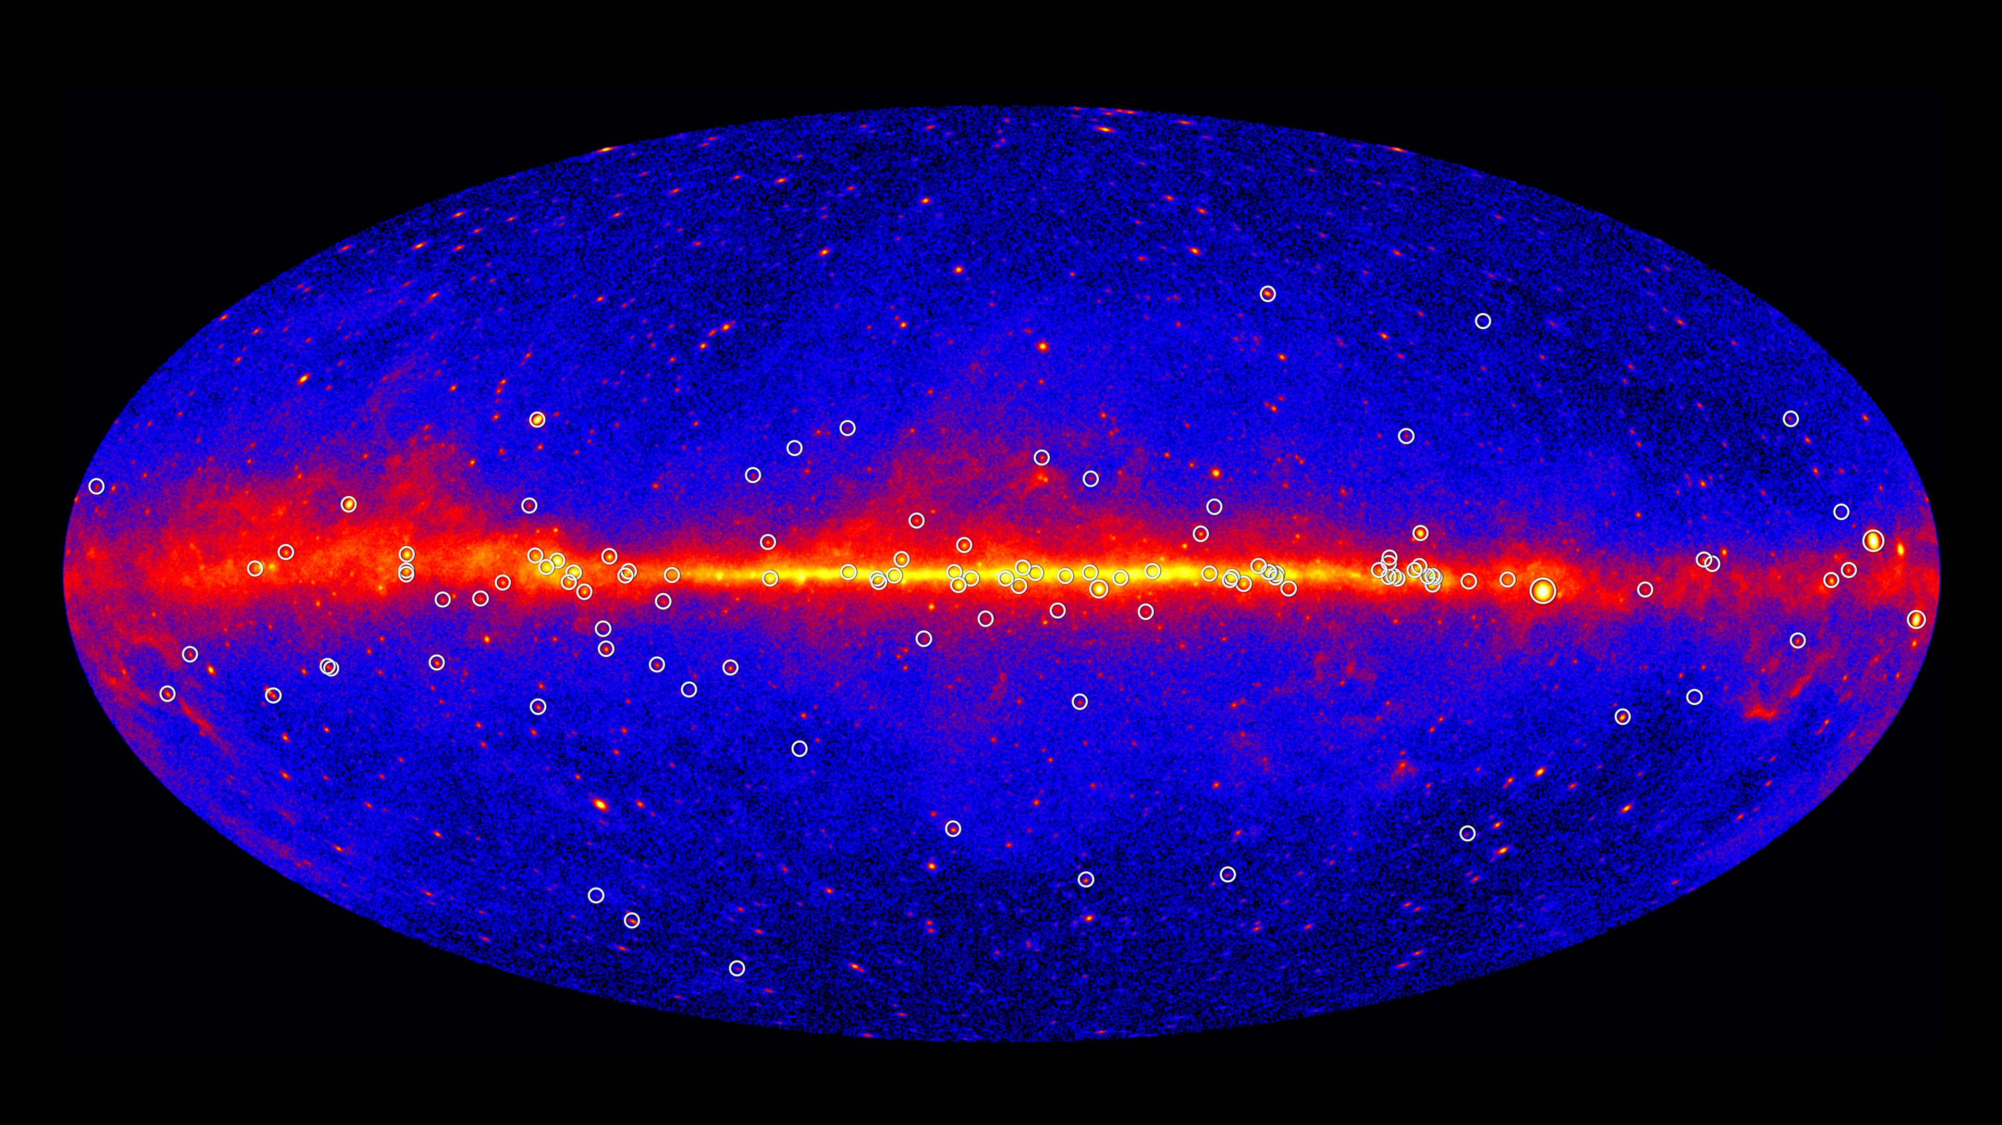
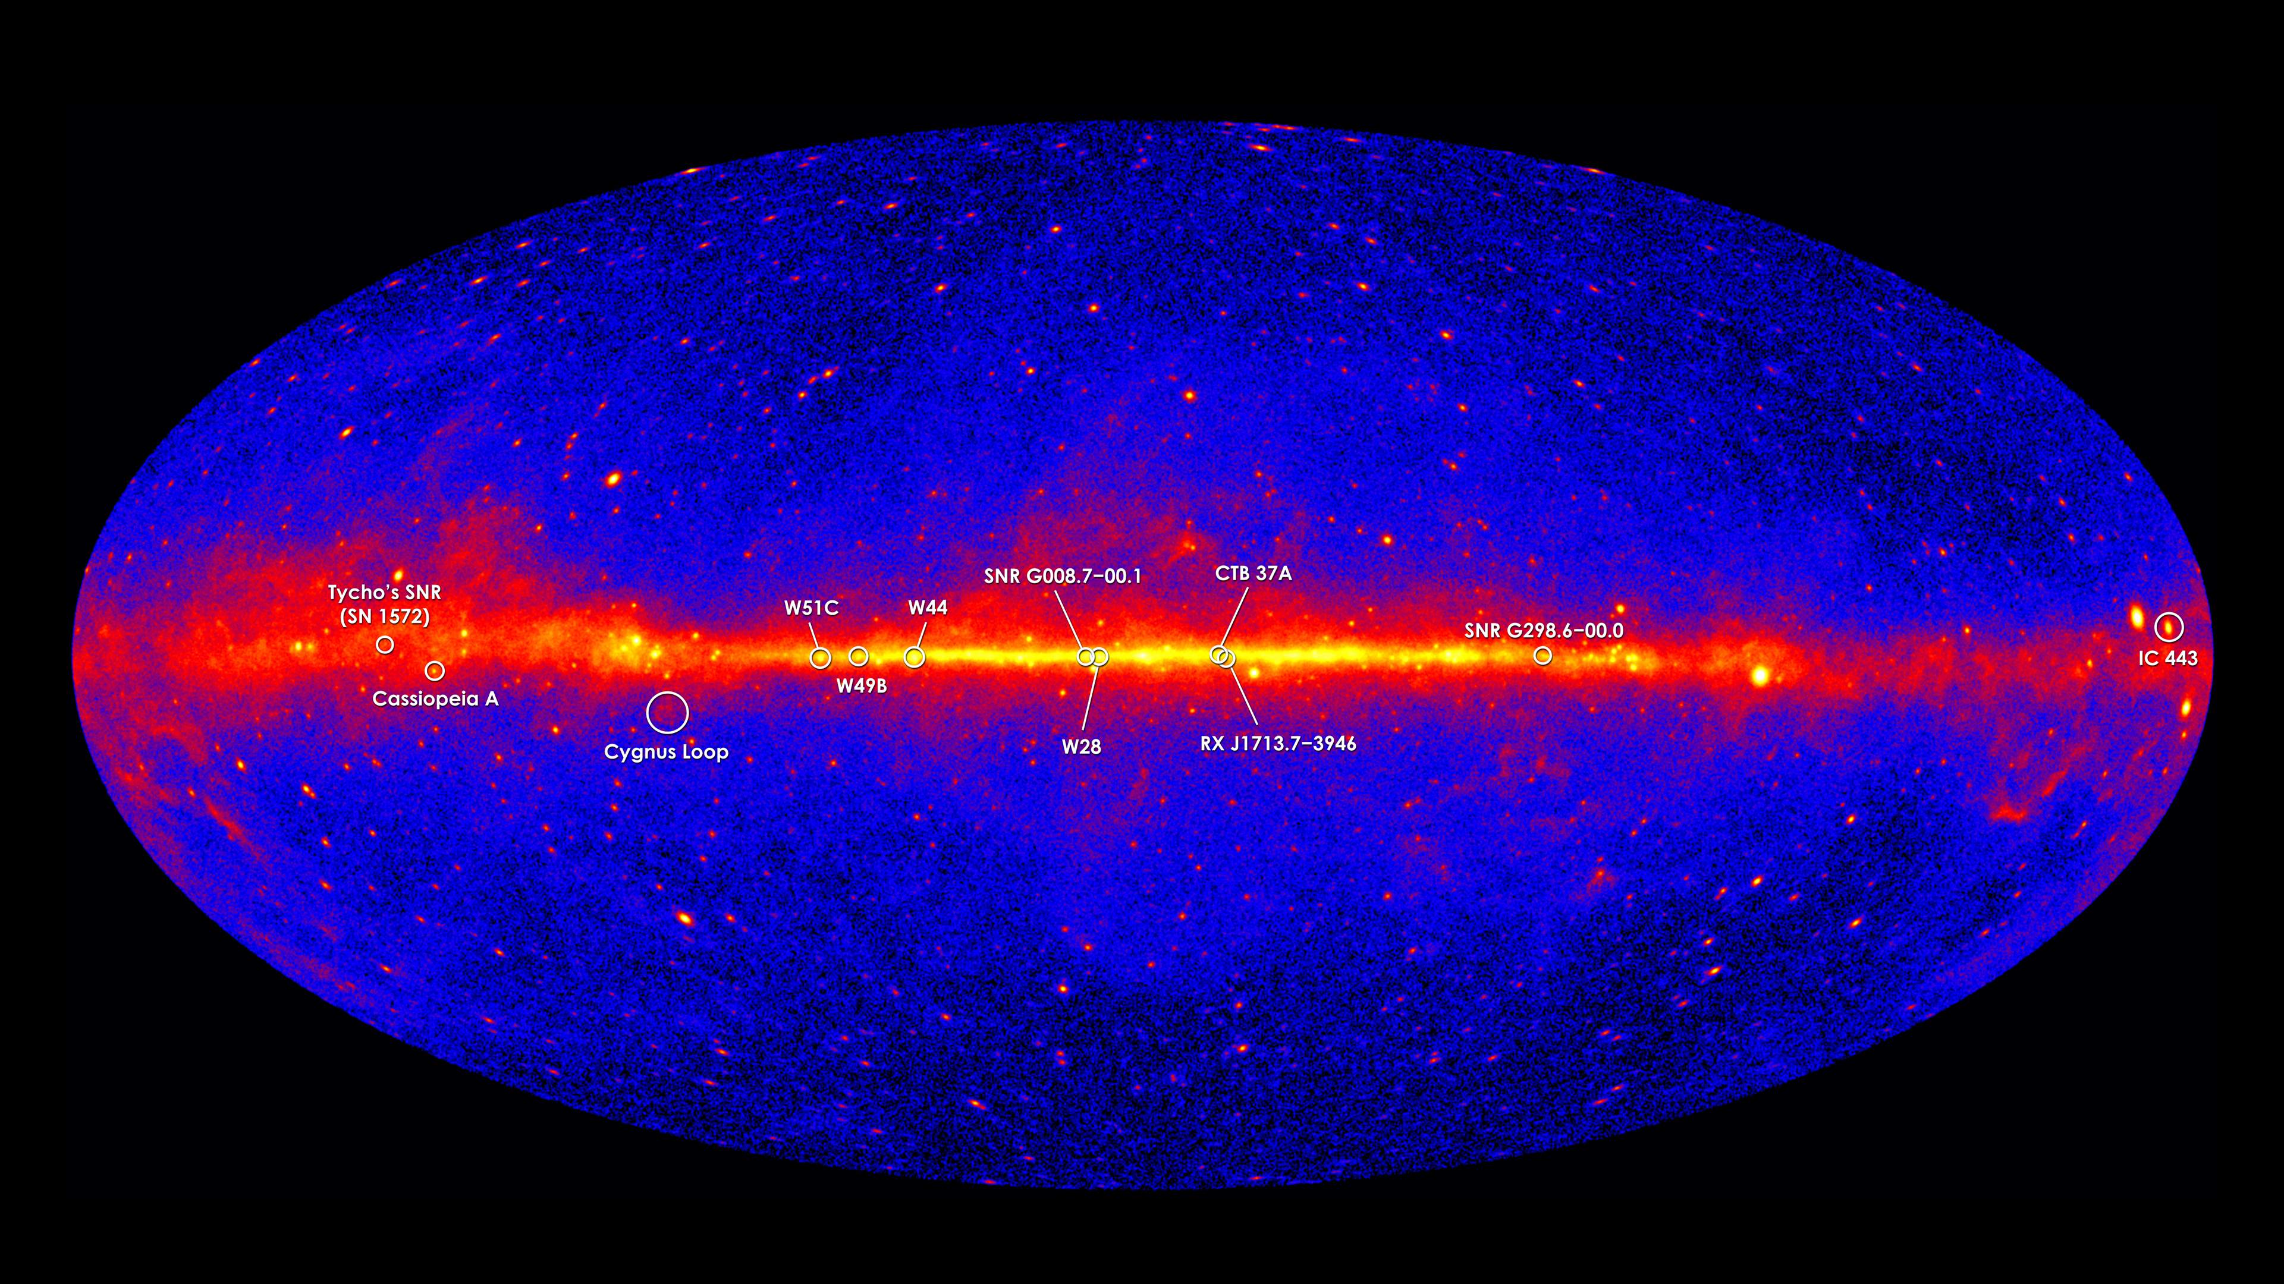
Milky Way Disk: Gamma
https://ishivvers.github.io/maps/pulsars.html
https://ishivvers.github.io/maps/sne.html
SN remnants
pulsars
Fermi 5-year map
Notes:
gamma rays (energies > 1 GeV shown) produced by energetic particles accelerated in shock waves of supernovae remnants collide with gas atoms
Vela pulsar (spins 11X/sec) is brightest persistent source of gamma rays

Slide 15
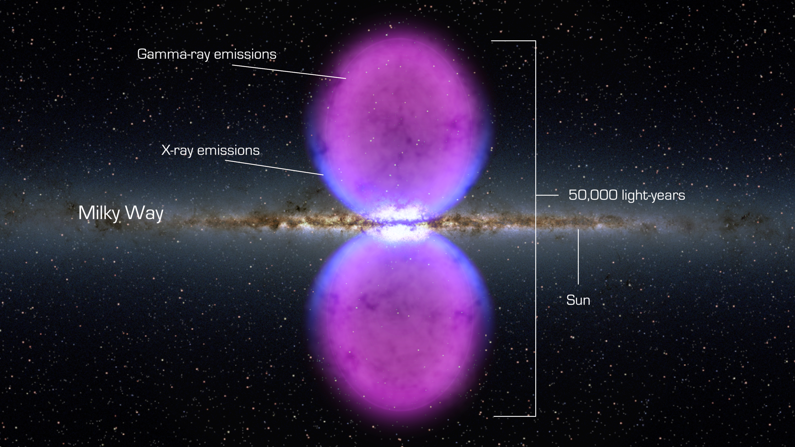
Milky Way Disk: Gamma
Fermi Bubbles
movie: https://www.nasa.gov/mission_pages/GLAST/news/new-structure.html

Slide 16
Milky Way Formation
Four Phases 1. early star formation in ENORMOUS contracting cloud
globular clusters as substantial blobs
halo stars old
halo stars have random motion
2. collapse of gas to disk … shape
3. star formation in disk … young stars now
4. absorbing other galaxies/GCs … star streams
HALO FIRST … DISK LAST
In which phase does disk heating occur?
Notes:
ANSWER: all phases

Slide 17
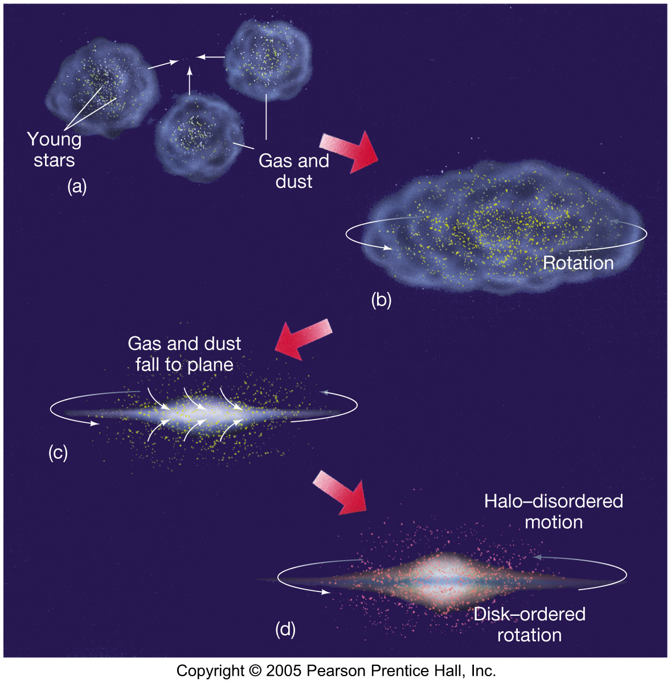
Formation

