Slide 1
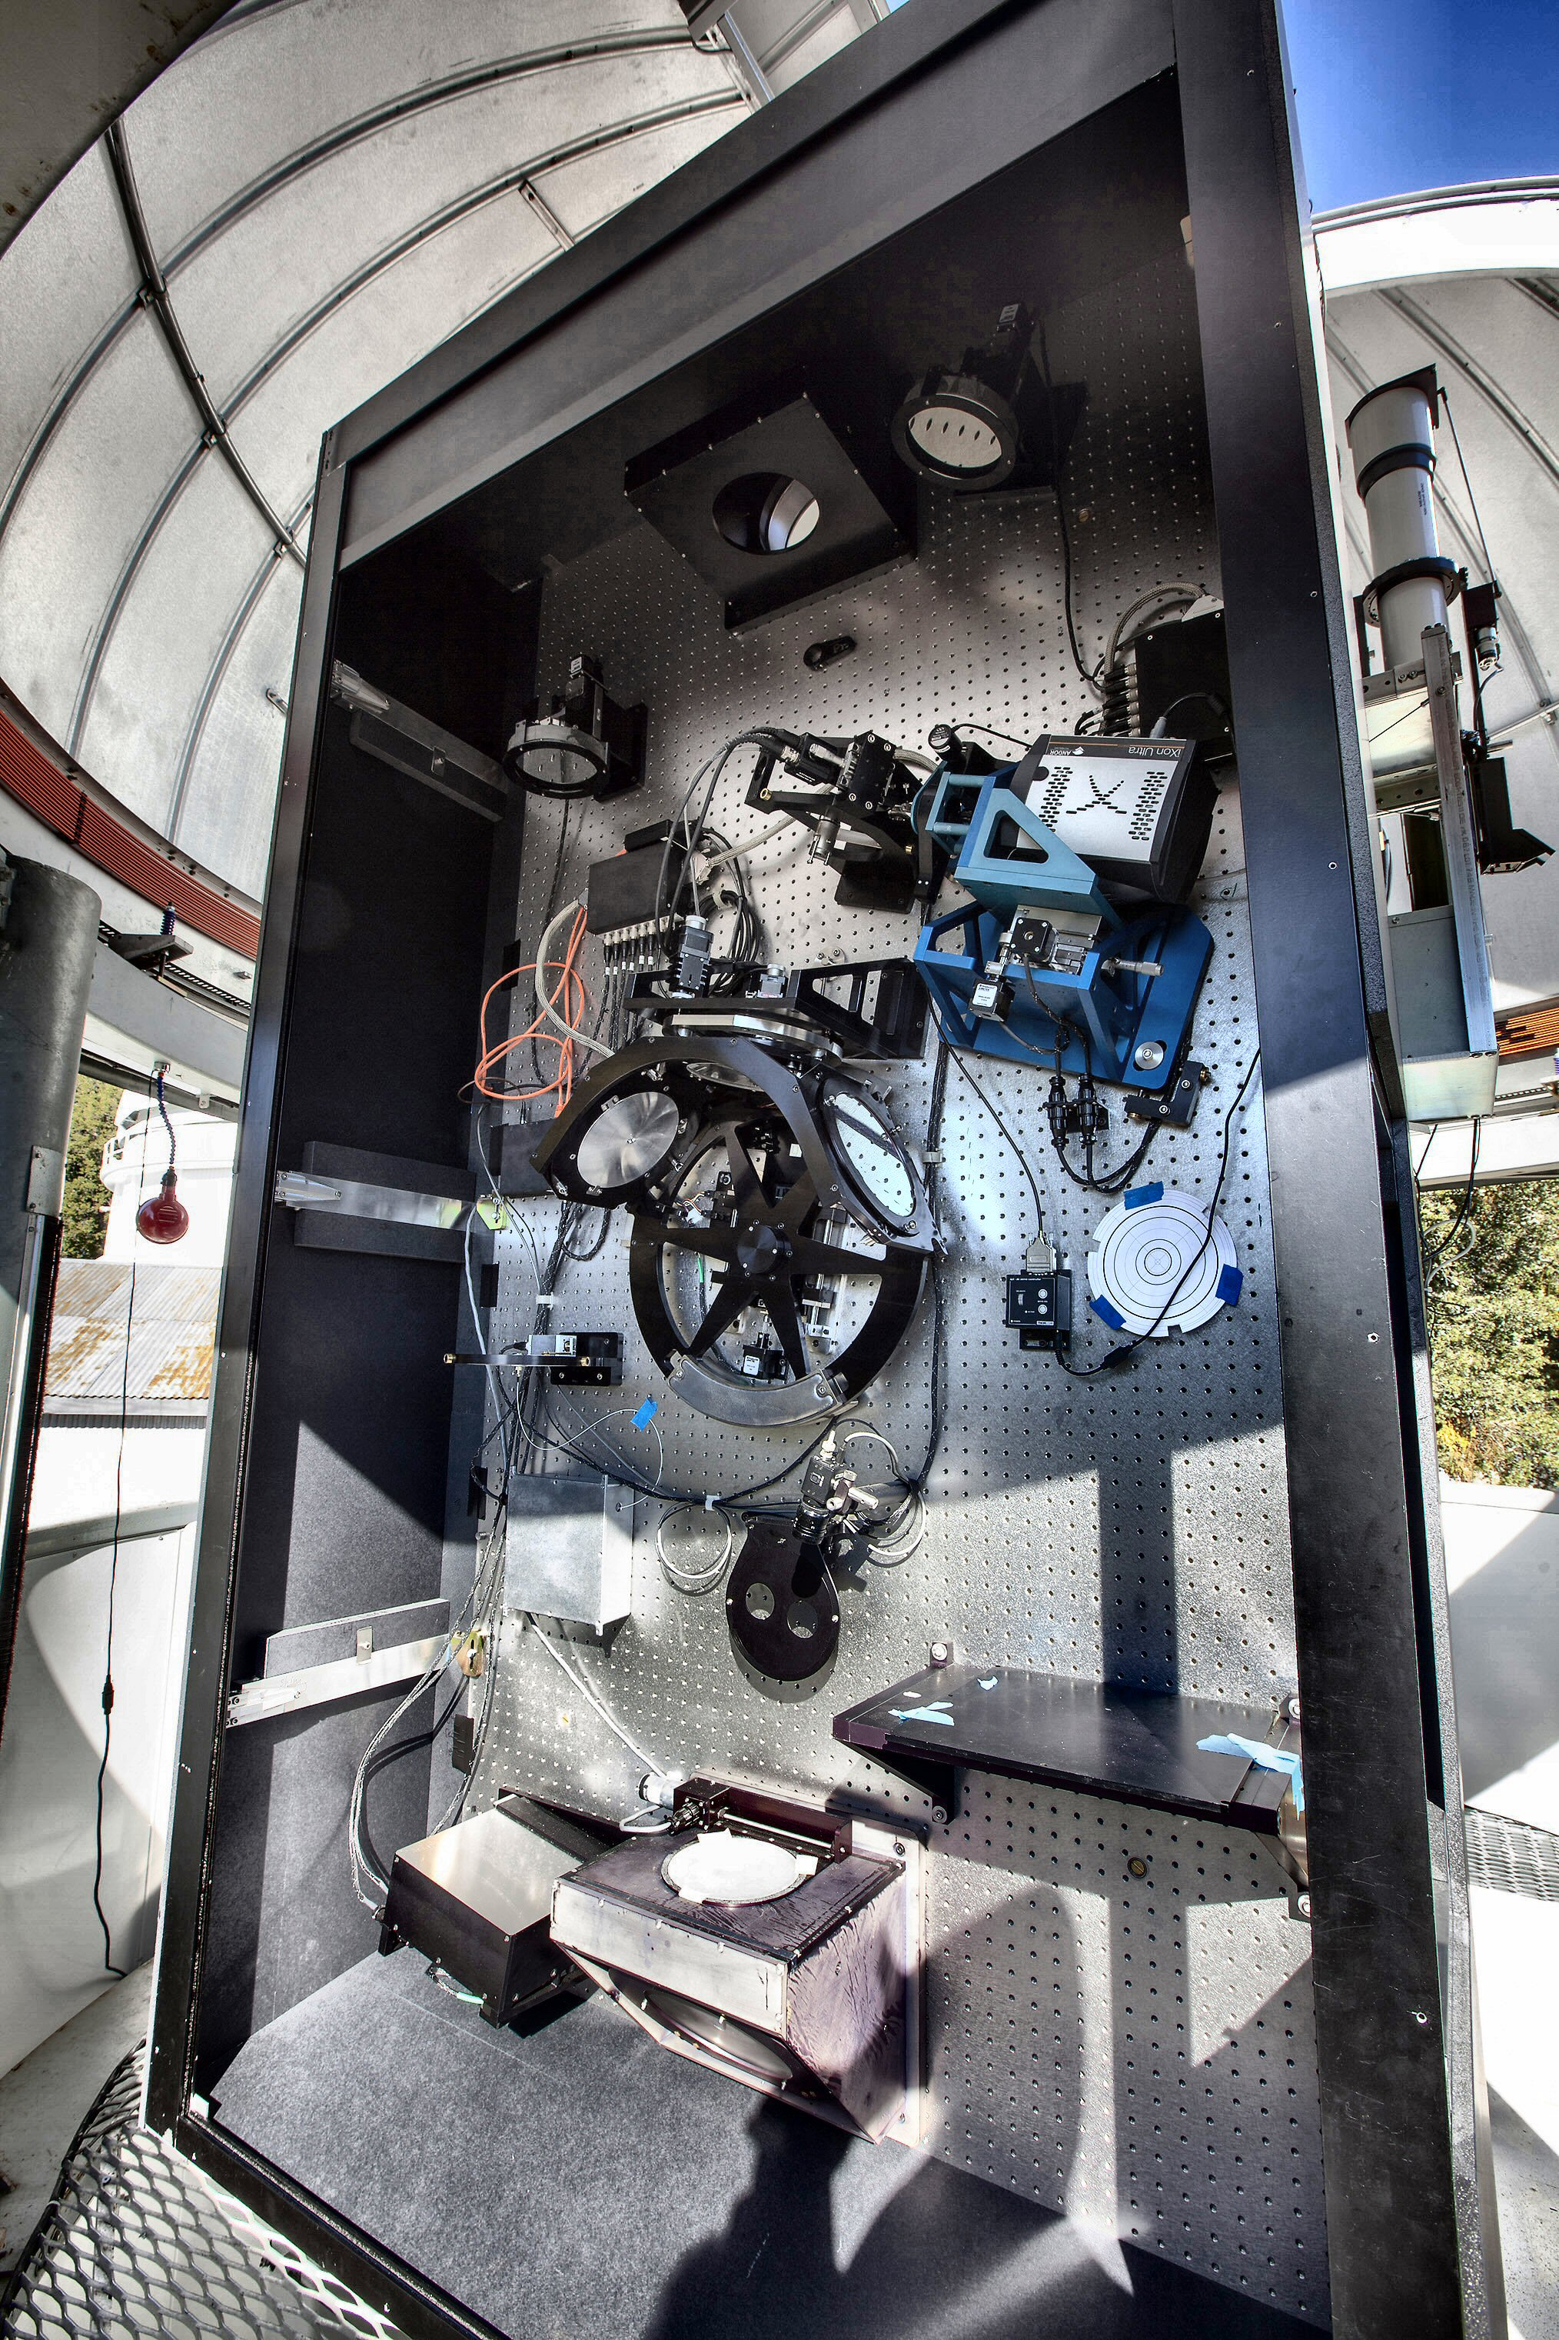
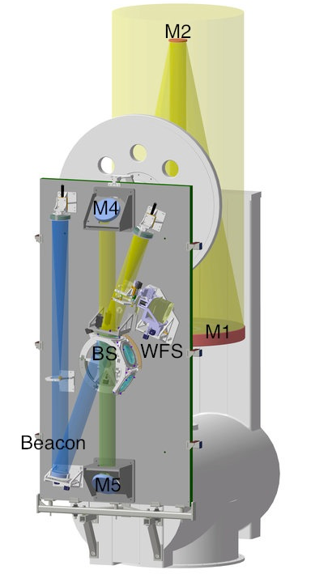
CHARA-AO Phase I : Telescope WFS

Slide 2
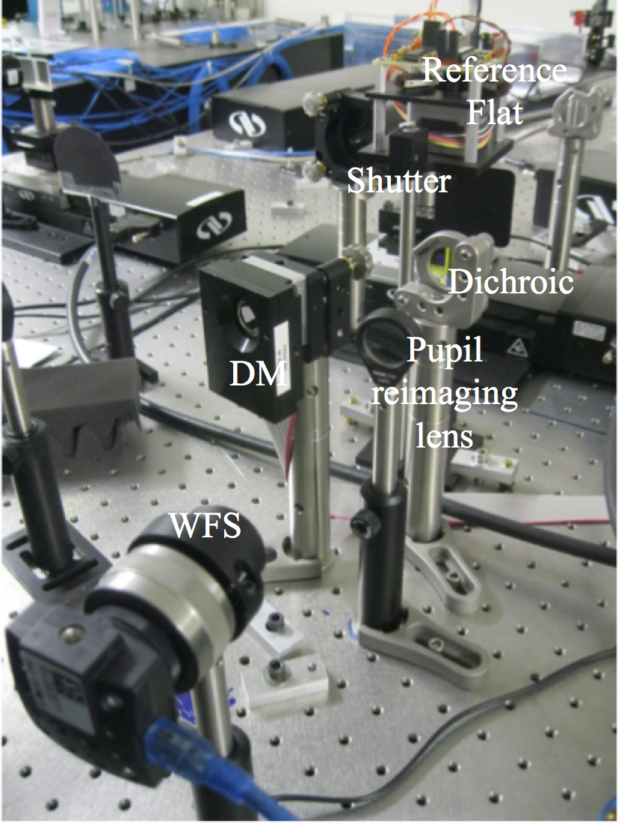
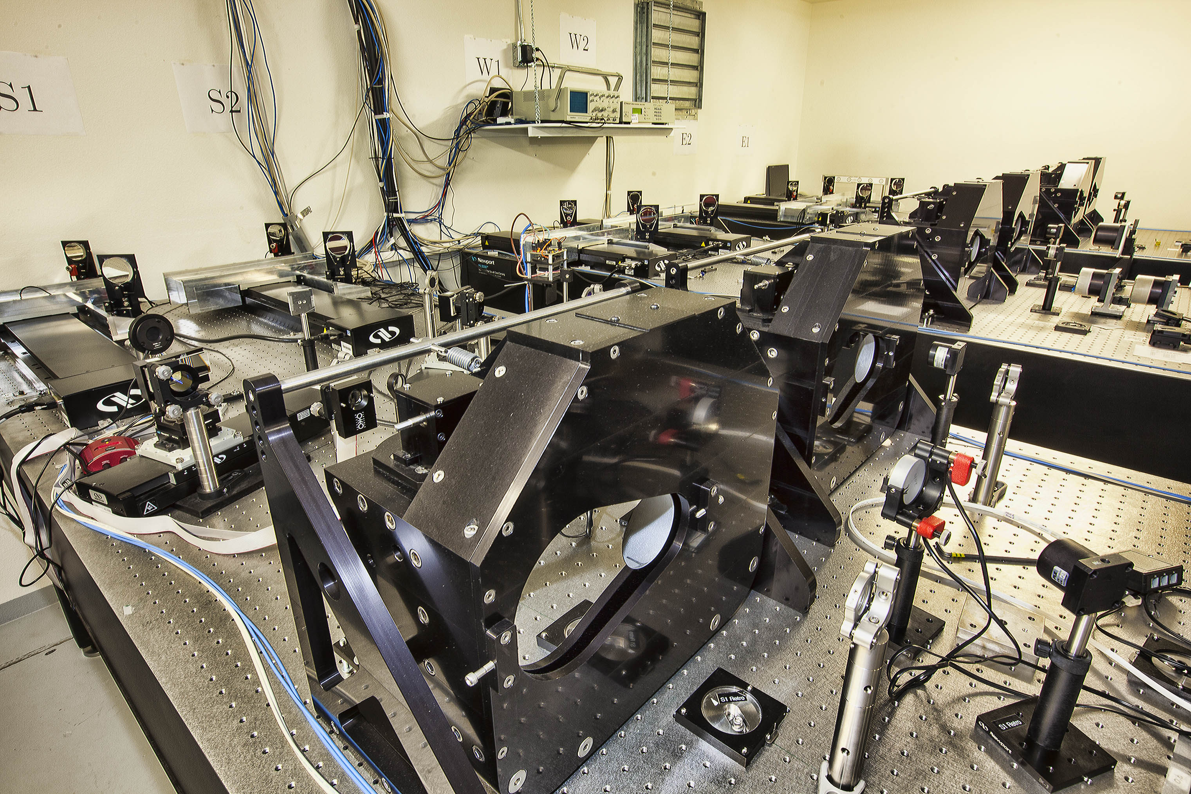
CHARA-AO Phase I : Lab AO

Slide 3
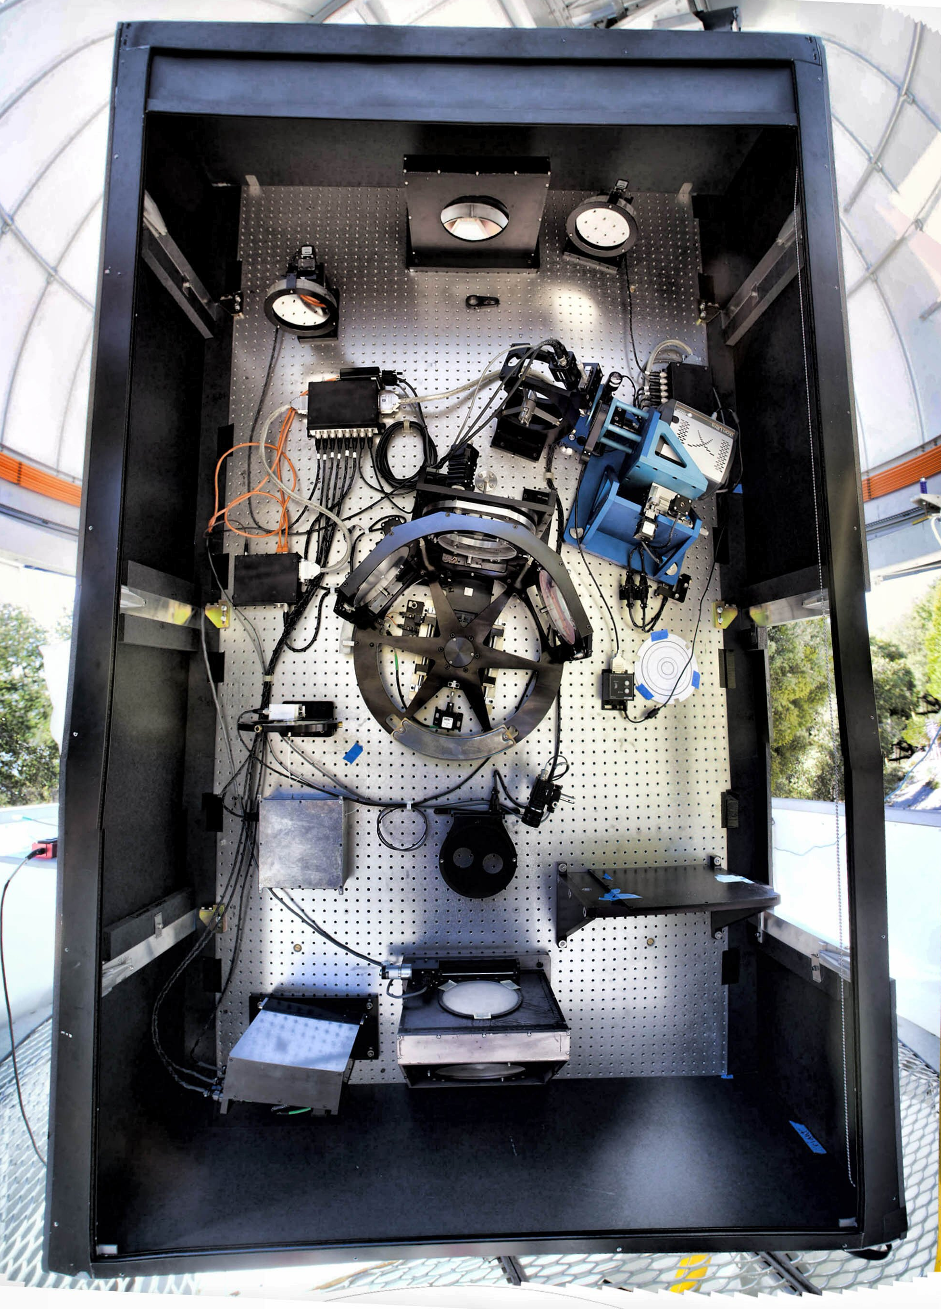
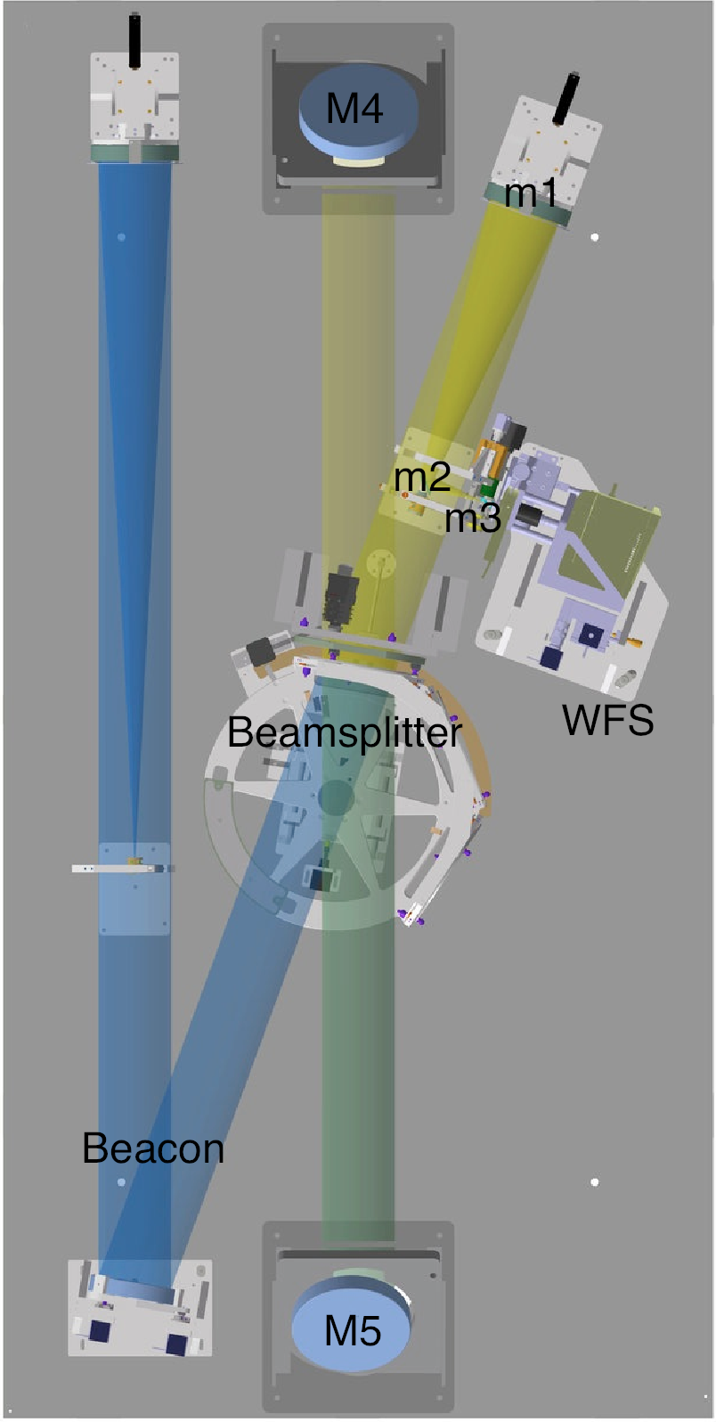
CHARA-AO Phase II : Telescope DMs
Phase II funds replacing M4 with a deformable mirror at each telescope which will enable us to correct for atmospheric seeing and increase scientific throughput.

Slide 4
Phase I : Current Status
Phase I funding ended this past June. All hardware is now in place.
We still have much to learn about alignment and use of this system.
All LABO and telescope WFS systems have been installed and tested on sky.
A great deal of automation has been added….. but of course there is more to come.

Slide 5
The CHARA Array Adaptive Optics Program

Slide 6
Phase II : Current Status
Phase II funding began September 2015, and lasts for 3(4) years.
An RFP was sent out in January 2016 and we got responses from 7 vendors.
Negotiations began with the vendor ALPAO last April.
Delivery of first mirror is expected now.

Slide 7
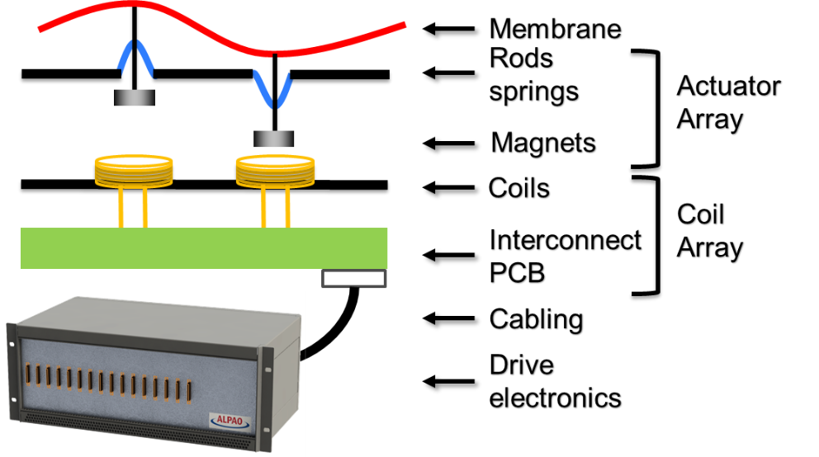
ALPAO Technology

Slide 8
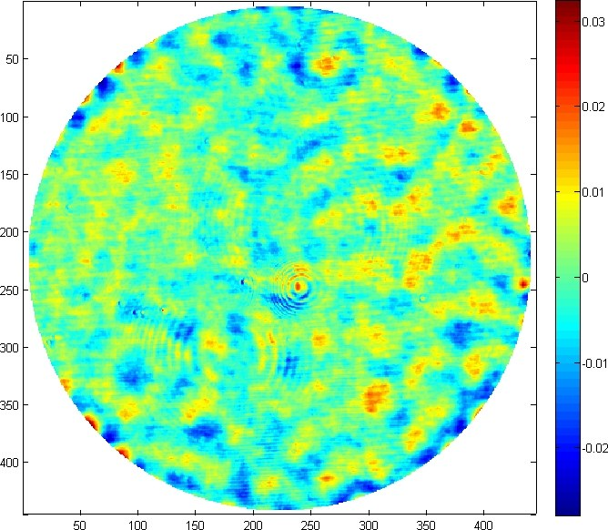
Best Flat <30nm RMS as Modeled

Slide 9
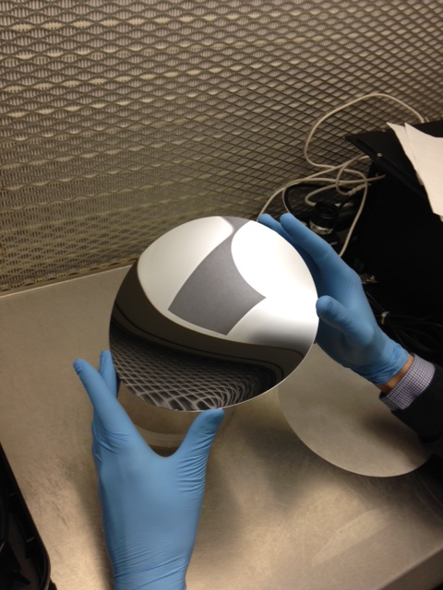
The first membrane as delivered.

Slide 10
Current Status.
A complete DM including all actuators has been built but still does not meet the specification for default flat.
They believe this is caused by pre-stressing the membrane in the manufacturing process and and are now waiting for new membranes for further tests.
We expect that by end of 2018, and the end of the funding, all hardware will be in place.
We will, no doubt, have more to learn from an operational point of view.

