Slide 1
Budget, personnel, and timing scenarios
Theo ten Brummelaar

Slide 2
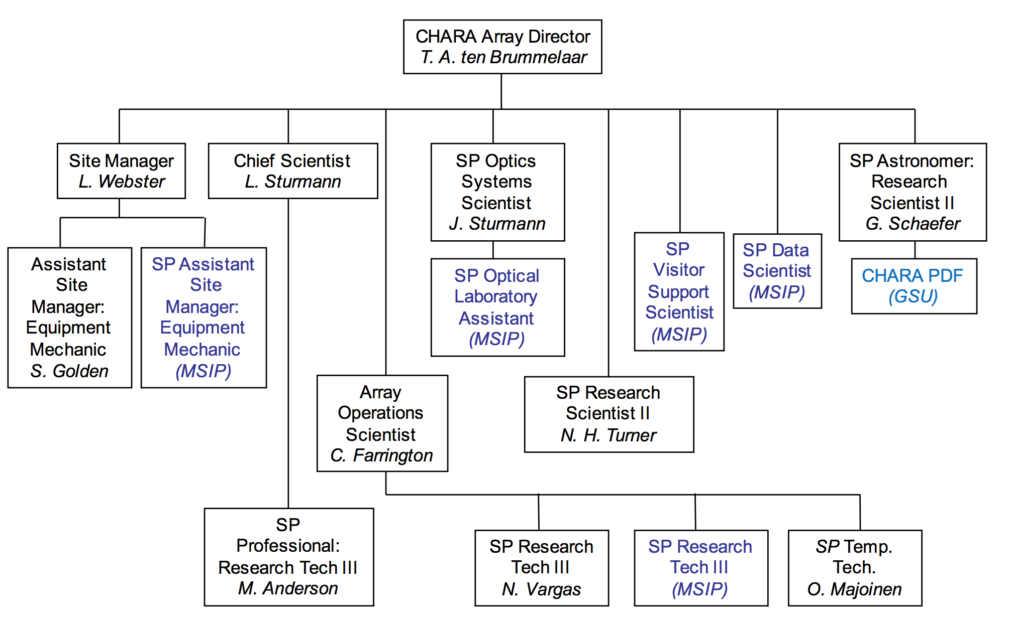
CHARA Organization Chart

Slide 3
College Support
Comes on a yearly basis and while not guaranteed is unlikely to be completely removed.
Last year about $0.5M, about 2/3 of which is salary.
Also pays Utilities.
Some of the overhead money from the NSF grants also comes back to the project.

Slide 4
MSIP : Enabling Milliarcsecond Astrophysics: Open access for the CHARA Array
$4M over 5 years to provide 50-75 nights per year of open access to the CHARA Array through the NOAO TAC process.
Five new positions: Visitor Support Scientist, Data Scientist, Machinist/Technician, Assistant Site Manager, & a third Array Operator. These positions are now all filled.
Funding for equipment upgrades and spare parts.
Travel support for VSS, DS, and PI’s awarded time at the Array.
Ends September 2021 – time to reapply 2020.

Slide 5
NSF: Fundamental Stellar Parameters and Astrophysics from the CHARA Array
Asked for $2.2M over 5 years.
Got $1.1M over 4 years.
Difference covered by overhead and MSIP money.
Ends September 2021 – time to reapply 2020. The same time as the MSIP grant, and I don’t think this is a coincidence.

Slide 6
Other outside support.
KSU provides about $15k per year for observing support.
Exeter will provide $100k over 2-3 years for observing and engineering of MIRCx.
Michigan provides some salary support for TtB as part of MYSTIC program.
Hopes of obtaining some funding from Nice if (when?) SPICA is funded.
DARPA/IARPA and other punters in the Satellite imaging game?

Slide 7
The Bottom Line
We are OK until after the next Federal election ;-)
In 2020 it will be time to write the next MSIP and/or other NSF proposal.
My feeling is that the NSF want to fold the two together which is fine.
Given this….. 2020/2021 is the time to start on the next big project.

