Slide 1
Context within U.S. and International Interferometry Plans
Theo ten Brummelaar

Slide 2
“Interferometry is inevitable”
A quote from Stephen Rinehart.
Said before his interferometer plummeted 70,000 feet and smashed into many small pieces.

Slide 3
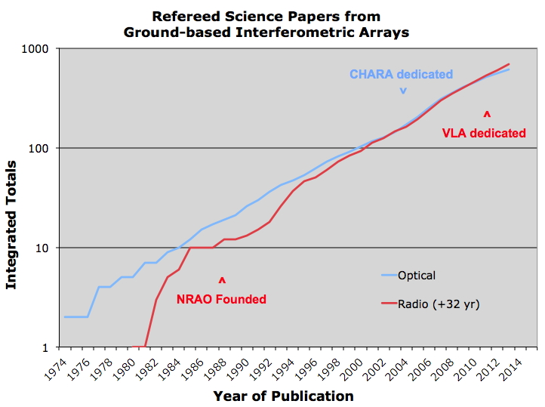

Slide 4
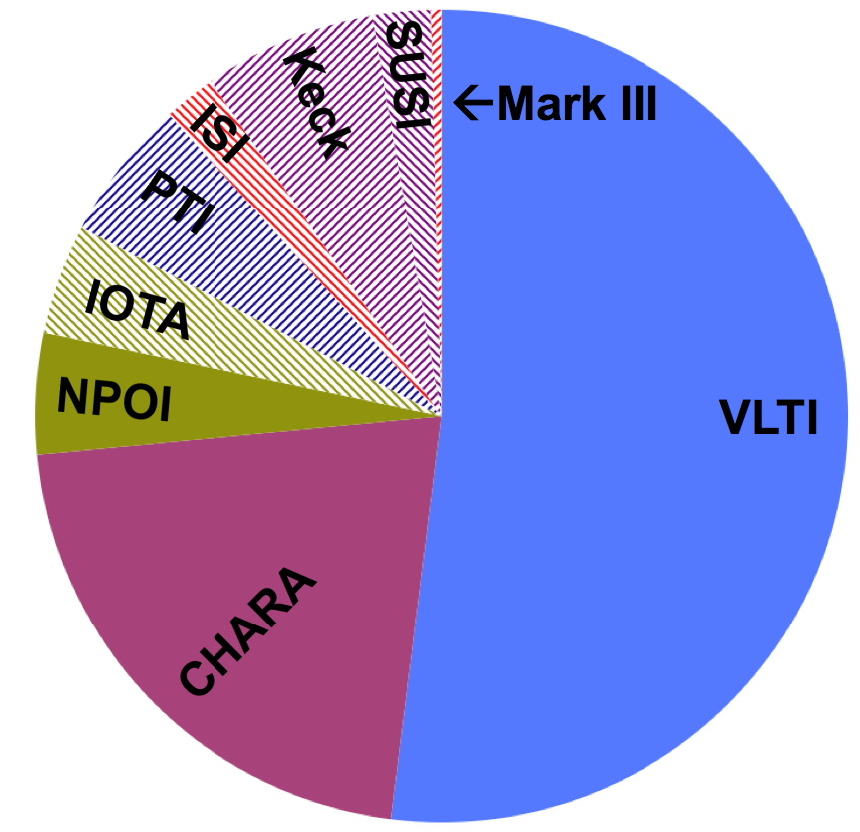
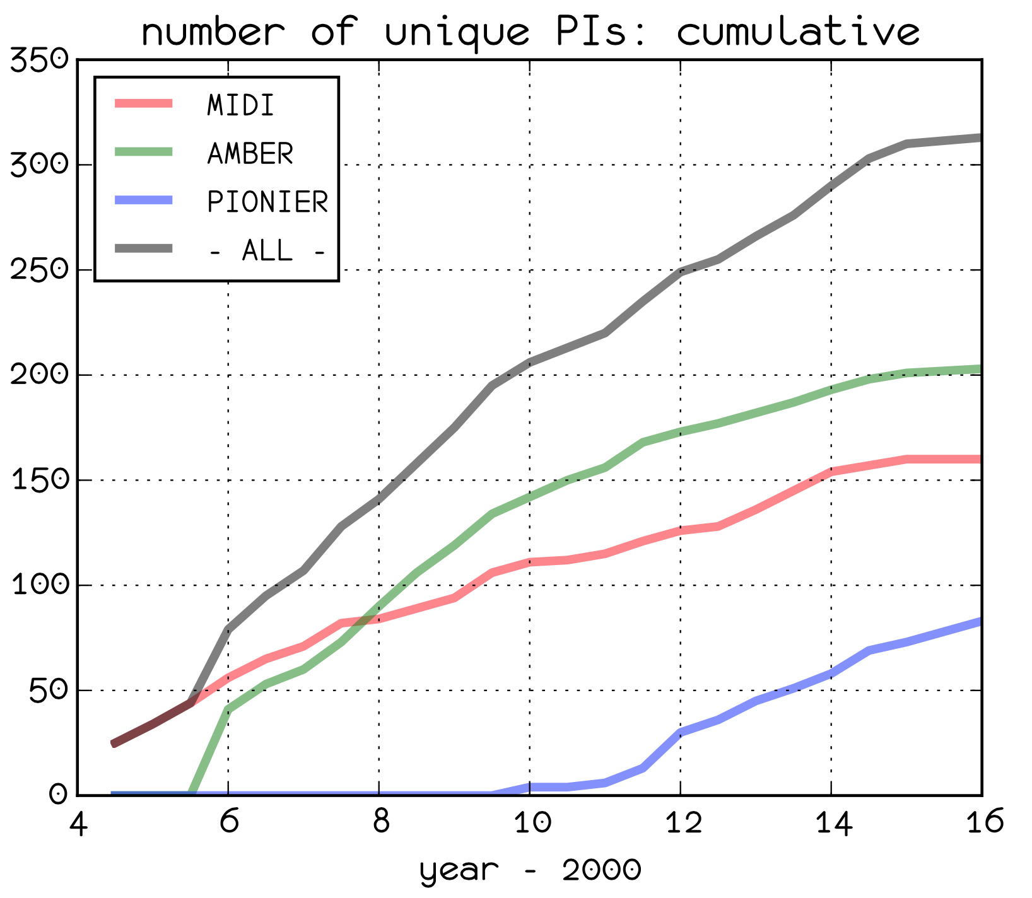

Slide 5
VLTI
Well funded (for now) on the basis of GRAVITY.
If GRAVITY fails things could go very wrong for them very quickly.
Now building AO systems for the ATs, to be installed next spring.
No known plans for more, or larger, telescopes or baselines.

Slide 6
LBTI
Well funded (for now) on the basis of the NASA funded exo-zodi light survey.
If this fails things could go very wrong for them very quickly
It doesn’t seem to be going as well as one would hope.
LINC-NIRVANA still funded but somewhat de-scoped.

Slide 7
NPOI
Standard Navy funding somewhat reduced.
New injection of $3M from NRL to add three 1m telescopes over then next few years.
This funding based on “Space Situational Awareness” interests of the Navy.
They hope to also add AO for these scopes using this money.
These scopes are planned to be movable.

Slide 8
MROI
Have $25M over five years from the Airforce for SSA work. They are now completing the second year.
This will fund three telescopes, delay lines, and so on.
The object is to demonstrate baseline bootstrapping and the magnitude limits required to image non-stellar targets.
Funding beyond this for the remaining 7 planned scopes, or operations beyond 2022 is not yet in place.

Slide 9
What about CHARA?
We are OK for now and the AO program will be completed over then next year or so.
If the MSIP program goes well we will establish ourselves as an open resource.
If we don’t do this I think we will not be in a good position during the next MSIP (or whatever it is called then) round in 2020.
This, as far as I can see now, is the best source for money to expand the hardware as well.
What about SSA? Things are definitely moving in that direction, though it is not clear to me how that can help the existing CHARA infrastructure.

