Slide 1
Disc Misalignments & Modelling the Inner AU of HD 143006
Issy Codron, University of Exeter
Stefan Kraus, Tyler Gardner, Sorabh Chhabra, Daniel Mortimer, Owain Snaith, Yi Lu
John Monnier, Antoine Mérand, and MIRC-X/MYSTIC Team
Notes:
Hello everyone, I’m issy, a 2nd year phd student from the university of Exeter working with Stefan Kraus and today i’ll be talking about disc misalignments and modelling the inner AU of hd 143006

Slide 2
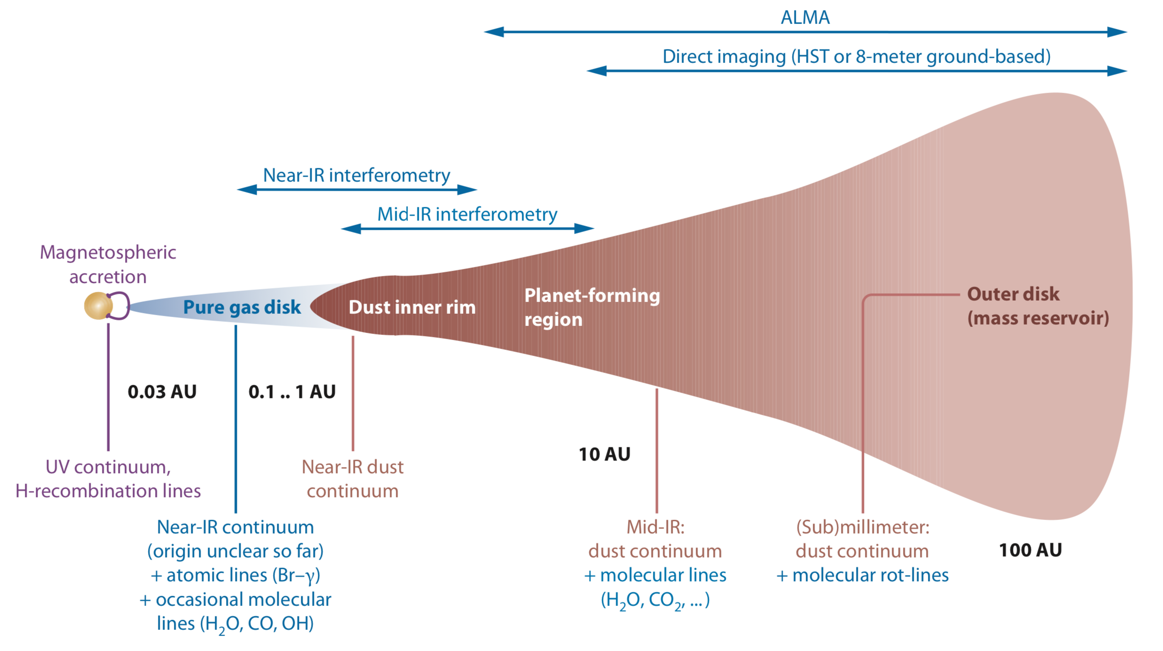
Protoplanetary Discs
Dullemond & Monnier 2010
Notes:
Just a super quick overview, I’m sure every disc person has seen this diagram but just to recap, this is a disc. These a dust and gas rich disc surrounding pre-main-sequence stars serve as “planetary nurseries”, and whilst we have a pretty good understanding of the outer disc regions…

Slide 3
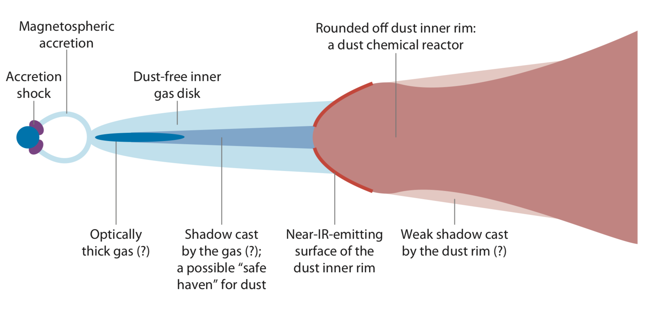
Inner Regions of Protoplanetary Discs
0.1-1 AU
Sublimation region
~1500-2000K
Dullemond & Monnier 2010
Notes:
The inner regions still hold some mystery. This is where my focus lies, in imaging and/or modelling the sublimation region.

Slide 4
Motivation
Recent years have seen exoplanet discoveries increase greatly
To understand how planetary systems form, need to understand the structure and evolution of protoplanetary discs
A valuable point in disc evolution is the transitional disc stage – thought to be a strong link to planet formation around young stars
Sample of ALMA continuum images of transitional discs (Francis L., & van der Marel N. 2020)
Notes:
So why am I focusing on this?
Well we’ve seen a large increase in exoplanet discoveries in recent years, but the process of planet formation, and the building blocks of planet formation, still need more understanding. Probing the inner region of proplanetary discs, as well as understanding the structure and evolution of discs, may help us with our understanding of planet formation
A valuable point within protoplanetary disc evolution, is the transitional (or pre-transitional) disc stage, as it’s thought to have a strong link to planet formation around young stars

Slide 5
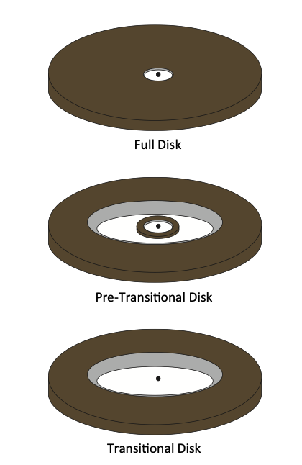
Transitional Discs
Substantial clearing
Identified by SEDs, showing small amount of NIR excess
Dust distribution of discs have inner hole
Disc clearing mechanisms:
Grain growth
Photoevaporation
Planets
Misaligned inner/outer discs
Espaillat, C. et al. 2014
Notes:
Transitional discs are objects that have substantial clearing
Identified by SEDs, showing small amount of NIR excess
Meaning that dust distribution of discs have inner hole
Different reasons for why gaps appear/disc clearing mechanisms
Grain growth
Photoevaporation
Planet formation/planets
Misaligned inner/outer discs

Slide 6
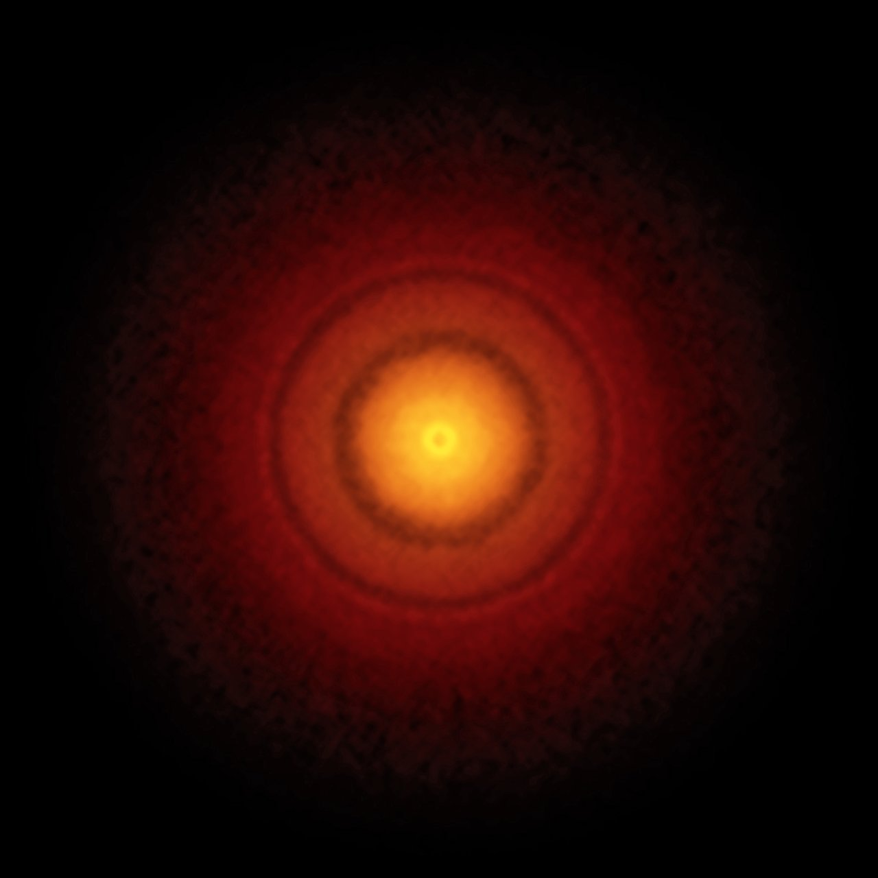
Observing Transitional Discs
Numerous probing techniques:
Sub(mm) interferometric imaging (eg. Dong et al. 2017)
Line kinematics (eg. Boehler et al. 2018; Loomis et al. 2017)
MIR interferometry (eg. Kraus et al. 2013; Kluska et al. 2018)
Scattered light imaging (Benisty et al. 2018; Bohn et al. 2022)
IR interferometers provide milliarcsecond angular resolution
Complex disc structure revealed
Investigate disc warping
Credit: S. Andrews (Harvard-Smithsonian CfA); B. Saxton (NRAO/AUI/NSF); ALMA (ESO/NAOJ/NRAO)
Notes:
(Since their first identifications through the use of NIR and MID photometry), numerous other techniques have been used to probe that inner dust cavity as you can see here.
The high angular resolution obtained using infrared interferometers mean that we can see some really cool and complex disc structure, and also resolve the very inner regions, meaning we can investigate disc warping. The sub milliarcsecond resolution we can get with the MIRC-X instrument at chara is therefore super valuable and useful as observational results can have some implications of our understanding of planet formation

Slide 7
My focus: HD 143006
T Tauri star (spectral type G7)
4.58L$⊙$
1.8M$⊙$
165pc in Upper Sco region
5-11Myr
(Benisty et al. 2018; Andrews et al. 2018; Gaia collaboration et al. 2018)
Multiple ring/gap features + asymmetry
Credit: ALMA (ESO/NAOJ/NRAO, S. Andrews et al.; NRAO/AUI/NSF, S. Dagnello
Notes:
Whilst I’m not focusing on the planet forming areas of the disc, my current focus has been on the disc surrounding the relatively old T Tauri star HD 143006.

Slide 8
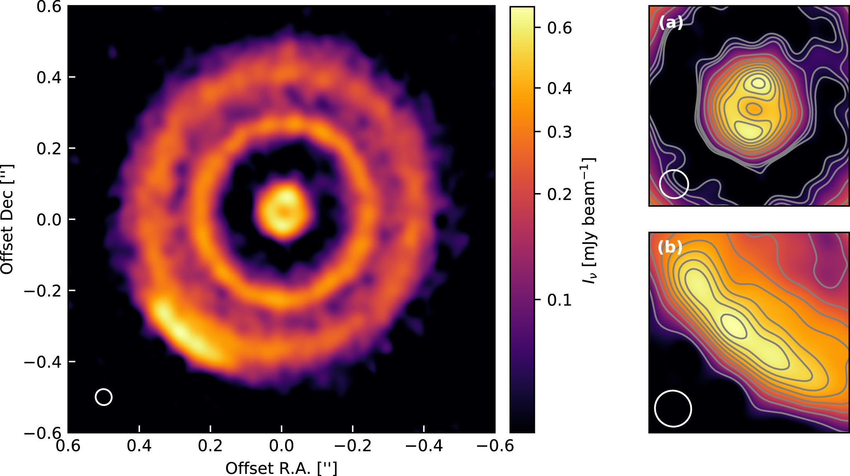
HD 143006 Features
Well resolved disc and centrally depleted cavity at 0.88mm continuum (ALMA, Barenfeld et al 2016)
DSHARP survey by Andrews et al 2018 in 1.25mm continuum, analysed by Perez et al 2018 also show bright rings
Perez et al 2018
Notes:
Multiple observations of this object has shown some really interesting morphological features
ALMA observations carried out by Barenfeld et al 2016 showed that the disc was well resolved and showed a centrally depleted cavity at the 0.88mm continuum – indicative of transitional discs.
Very high angular resolution observations (0.046”) were carried out as part of the DSHARP survey, with its 1.25mm continuum emission anaylsed by Perez et al 2018, seen in the figure on the left
3 bright rings were detected at 8, 40, and 64 AU, alongside a large gap between 10 and 30 AU.
An asymmetry can also be seenin the bottom left corner

Slide 9
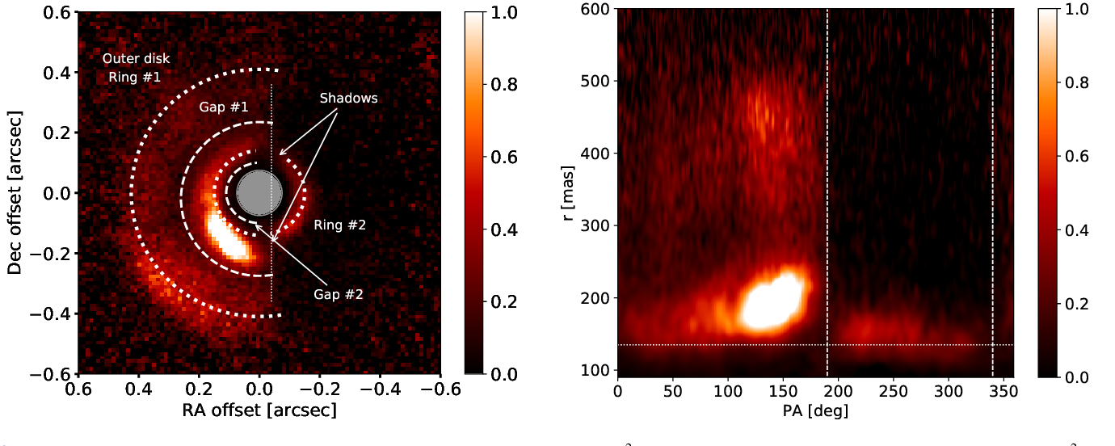
HD 143006 Features
Benisty et al 2018
Notes:
Further work done by Benisty et al 2018 with Polarised scattered light images in j-band from VLT/SPHERE observations show presence of rings and gaps and large scale asymmetry
The shadows indicated are located at 190 and 340 degrees as seen in the right hand image
The dark region (gap 2) is given to be 18AU, which was seen just outside the detection limit preventing the observer from determing a possible inner edge to this dark region, as well as detecting rings inside this 10AU limit.
HOWEVER NIR excess in the SED for HD143006 indicate that there is hot dust at the submilimation radius (from lazareff et al 2017)

Slide 10
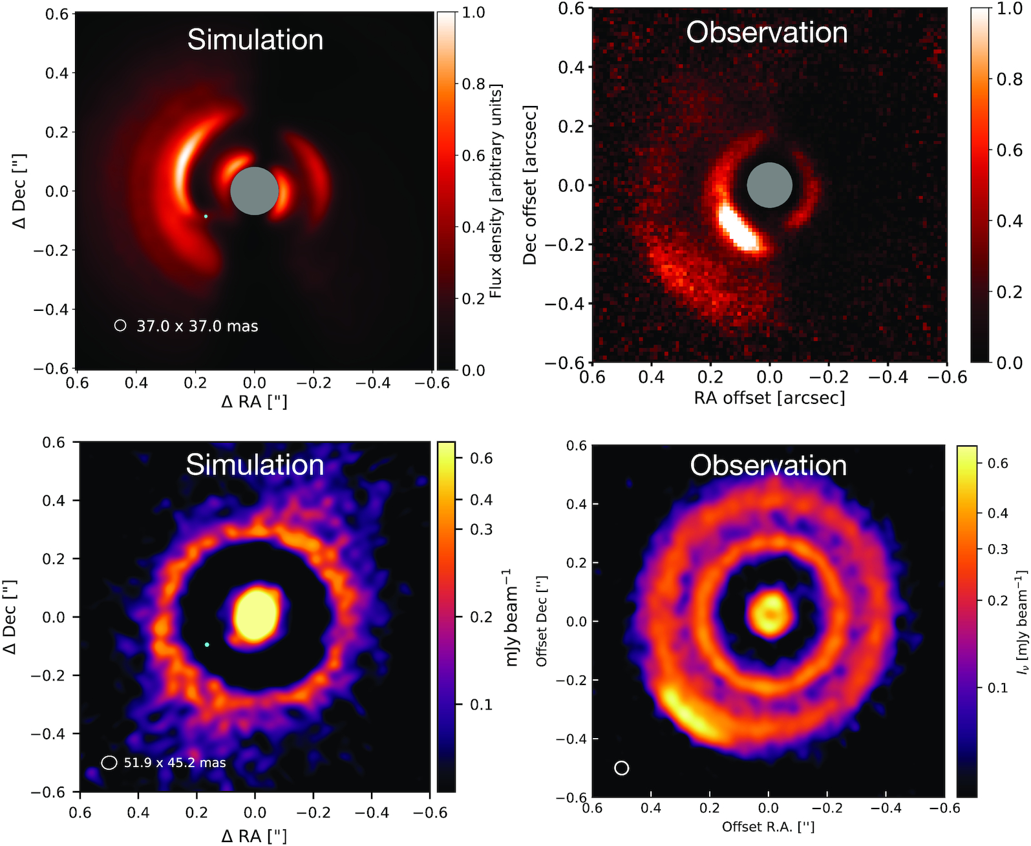
HD 143006 Features
Hydrodynamical simulations from Ballabio et al (2021) comparing ‘binary + planet’ model with simulations
Simulation Parameters:
Binary Separation = 2au
Mass ratio = 0.2
Orbital inclination = 60$°$
10M_{Jup} planet at 32au
Notes:
A more recent study looked at recreating these features using 3D hydrodynamical simulations by ballabio et al 2021
3 different models were simulated
1: inclined binary
2: misaligned planet around a single star
3: inclined binary with planetary companion
The above plot shows the binary + planetary companion simulation, which best matched observations seen in Benisty 2018 and Perez 2018.
The caveats being that they do not manage to match some of the mm continuum features seen with ALMA – in particular the second gap at larger radii (51au), as well as the bright arc/asymmetry in the south east

Slide 11
Goals
Geometrical modelling of data
Investigate disc misalignment and shadows
Investigate possible binary
Notes:
So where I’m coming in, is taking that high angular resolution data from the MIRC-X instrument from CHARA, supplementing that data with PIONIER data, extract inclination and position angles, and then investigate possible misalignment with inner & outer disc and hopefully that helps us constrain the inner disc morphology, and matches nicely with the features we see in the outer disc
As well investigate possible binary in data

Slide 12
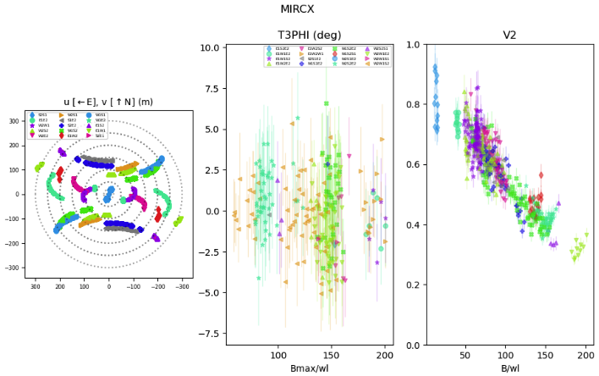
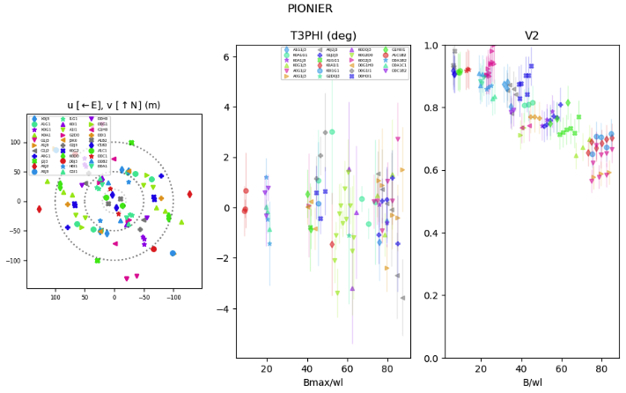
CHARA + VLTI Dataset
MIRC-X (H-band), CHARA
5T and 6T observations from 2020 & 2021
PIONIER, VLTI
Observations from 2013 (3 spectral channels) , 2019 & 2021 (6 spectral channels)
Notes:
The data used were all taken before I began my PhD –I was an observer last summer where we obtained both MIRCX and MYSTIC data on HD143006, but due to weather conditions the data was basically unusable
The plots are showing the uv coverage, closure phase (t3phi) and visibility for each instrument

Slide 13
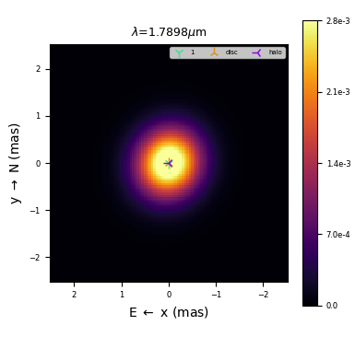
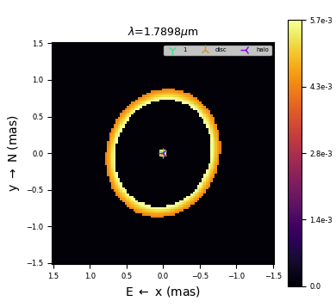
PMOIRED Modelling
Parametric Modeling of Optical InteRferomEtric Data (Merand, 2022)
Simple geometric models used to constrain inclination angle and position angle
GridSearch to look for binary signal
Model | Inclination Angle ($°$) | Position Angle ($°$) | $${χ2}_{r}$$
Gauss | 26.8 $±$ 2.8 | 150.7 $±$ 5.4 | 1.41
Ring | 32.3 $±$ 2.6 | 155.5 $±$ 3.5 | 1.52
Gauss + Binary comp. | 26.9 $±$ 2.80 | 151.6 $±$ 5.6 | 1.36
Ring + Binary comp. | 31.5 $±$ 2.30 | 155.8 $±$ 4.20 | 1.42
Notes:
Once all my data was reduced and calibrated, I used Antoine Merands geometrical modelling tool – PMOIRED – to model my inner disc geometry
I ran 2 sets of models, a simple gaussian model and a simple ring model, both with and without a binary companion. I was really only focusing on the inclination and position angles, so only simple models were used

Slide 14
PMOIRED Modelling
Ring model with m=1 modulation gave i = 23$°$ +- 5$°$, PA = 168$°$ +- 2.4$°$ (H-band PIONIER, Benisty et al 2018)
Model | Inclination Angle ($°$) | Position Angle ($°$) | $${χ2}_{r}$$
Gauss | 26.8 $±$ 2.8 | 150.7 $±$ 5.4 | 1.41
Ring | 32.3 $±$ 2.6 | 155.5 $±$ 3.5 | 1.52
Gauss + Binary comp. | 26.9 $±$ 2.80 | 151.6 $±$ 5.6 | 1.36
Ring + Binary comp. | 31.5 $±$ 2.30 | 155.8 $±$ 4.20 | 1.42
Notes:
Even though i was only using simple models, I’m pretty happy with the consistency between models so I’m going to somewhat confidently say that they’re well constrained.
Comparing with the values found in Benisty 2018, the inclinations are within error bars, position angle slightly out. However as PIONIER only probes a small region, alongside limited angular resolution of those observations, this is only a rough estimate for their inner disc geometry and they themselves state that their inner disc results are not well constrained

Slide 15
PMOIRED Modelling
Detection criterion to investigate statistical significance of ${χ2}_{r}$ drop
$\text{BIC} =−2\ln{ℒ}+k \ln{n}$
k = number of free parameters
n = number of data points
$ℒ$ = likelihood function (given by -2 $ℒ$=${χ2}_{r}$)
Model | $${χ2}_{r}$$
Gauss | 1.41
Ring | 1.52
Gauss + Binary comp. | 1.36
Ring + Binary comp. | 1.42
Model | $$∆\text{BIC}$$
Gaussian | -7
Ring | 20
Notes:
Relatively small reduced chi squareds for all, with smallest being associated with the gaussian, but assuming ring models as “more correct” due to being more physically representative of transition disc with dust depleted cavity
What I was interested in checking for here was how statistically significant these drops in reduced chi squareds were when adding in a binary component
Binary models had drops in chi squared, especially with binary ring model
To investigate these drops, I calculated the models’ Bayesian information criterion value, and the differences in that value when adding a binary component to the model
For the gaussian models, the delta BIC implies no signifance in the chi squared drop at all, but ring model shows some significance in the decrease
As the drops are also small, it still isn’t significant ENOUGH to mean anything concrete, and more data is needed
Important to be wary that even with a “better model” from the chi squared, this doesn’t necessarily add to the confidence in a binary detection.

Slide 16
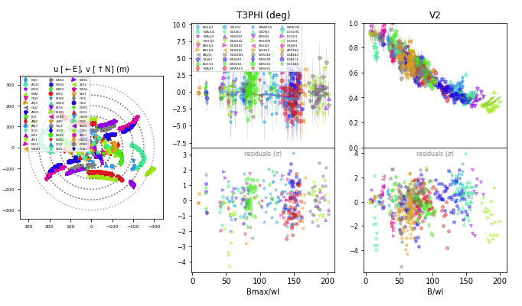
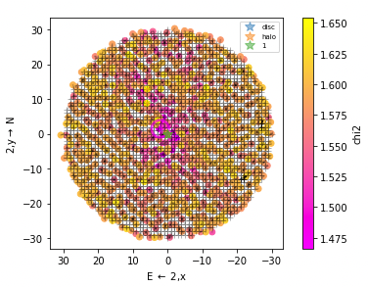
Binary Search
Flux ratio: 0.008
X = 1.7mas
Y = 3.5mas
Ballabio et al simulated separation: 2AU (12mas)
Notes:
Binary grid search was carried out on 1 observing run (2 nights), as this was largest and cleanest dataset. On the left you can see the UV coverage, closure phase and the visibility, on the right is the gridsearch for a possible binary
Currently rerunning for more epochs as wide set binary may vary position faster. More data needed. Grid search does pick out a position for binary but lots of pink dots (possible locations) still seen. No significant drop in chi squared.
With ballabio simulation, I’d be expecting a circumprimary disc not circumbinary since my sublimation rim is around 0.1AU (0.097-0.12AU)
No significant detection, more likely just data artifact as closure phase signal also quite low
The flux ratio fitted for the possible detected binary was 0.008, implying anything brighter we should have picked up. Even if this isn’t a real detection (which I don’t think it is) it can at least give some idea of the contrast of the suspected binary

Slide 17
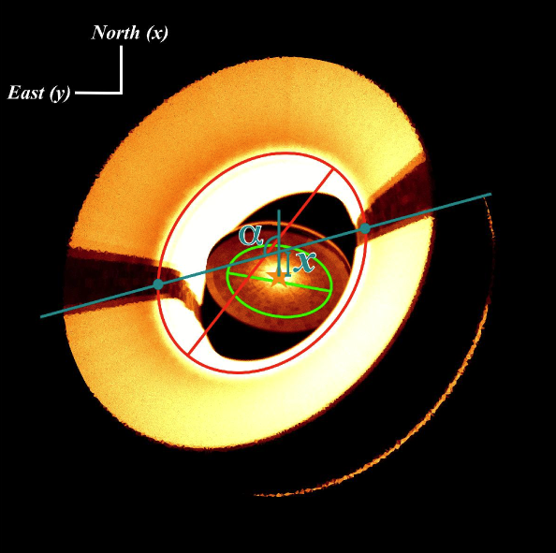
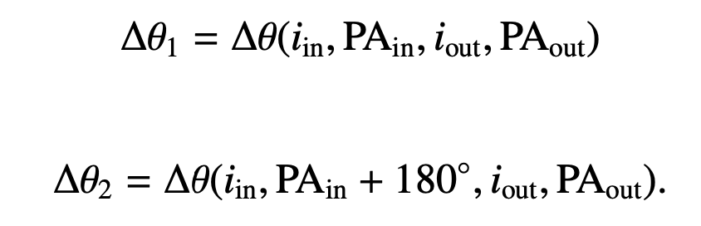
Disc Misalignment
Illustration disc with misaligned planes
$∆θ$ = angle between 2 normal vectors defined by planes of inner and outer disc
Inner disc (this study):
i = 32$°$
PA = 155$°$
Outer Disc (Perez et al 2018)
i = 16.2 +/- 0.3$°$
PA = 167 +/- 1$°$
$$∆θ_{1}=16.5°$$
or
$$∆θ_{2}=48.0°$$
Min et al 2017
$∝=$position angle of shadows
x=projected offset of central star
Notes:
Figure on left is a representation of shadows caused on outer disc from a misaligned inner disc
Values on the right are what I used to calculate the misalignment
The thetas on the bottom right are why I have 2 values – dependent on inner and outer disc orientation
Misalignment values I obtained were 4.1 and 60.8 (2 values depending on disc orientation)
Previous values found in literature ->
Perez et al 2018 found anlges of 8 and 41, favouring the larger due to pressure scale height – discrepancy most likely from using different inner and outer angles
Benisty 2018 found that a misalignment of 30 best reproduced overall disc morphology of scattered light shadows but also stated the value is model dependent and requires exact geometry of inner disc which was not well constrained
And simulations by ballabio 2021 favoured a more significant misalignment so I think the larger angle is the more correct one?
Whether or not this misalignment is caused by a binary, I don’t think I’ve got a significant enough detection to claim this, so more data is needed to check for a binary signal

Slide 18
Shadow Position
$$PA=325°$$
or
$$PA=339°$$
$∝=$position angle of shadows
x=projected offset of central star
Benisty et al 2018
Min et al 2017
Notes:
The values I found were for the first shadow, which depending on disc orientation is either 325 or 339 degree (or -35 or -21 degrees )
Benisty et al 2018 – Shadows found at 340º and 190º so in good agreement with the first shadow and am pretty happy with this result!
as for position of the 2nd shadow, in a vertically extended disc, the lines connecting the two shadows may not go through the central star, and have an offset. In that case, the two shadow position angles may not be 180 degrees apart, as seen by Benisty+ 2018 being 150 degrees apart

Slide 19
Goals
Geometrical modelling of data
Investigate disc misalignment and shadows
Investigate possible binary
Notes:
Heres a quick reminder of the goals I was trying to achieve

Slide 20
Summary
Found inclination and position angles for inner disc through simple geometric modelling
i = 32.3$°$ $±$ 2.6$°$, PA = 155.5$°$ $±$ 3.5$°$
Investigated binary but no concrete evidence/strong detection
Disc misalignment angle
$∆θ_{1}=16.5°$ or $∆θ_{2}=48.0°$
Position angle of shadow in disc
PA₁ = $325°$ or PA₂= $339°$
Notes:
Here are the outcomes of my work

Slide 21
Future Work
Introduce disc scale height in model to reproduce observed PA offset between shadows
Constrain disc scale height from 3D raytrace model
Record deep MIRC-X (H-band) + MYSTIC (K-band) data set at single epoch to put tight constraints on binary companion
Further modelling with PMOIRED
Notes:
My next steps with this work will be to….

Slide 22
Thank you!

