Slide 1
News from the CHARA Array
Douglas Gies CHARA Director, Regents’ Professor Department of Physics and Astronomy Georgia State University, Atlanta, Georgia, USA dgies@gsu.edu

Slide 2
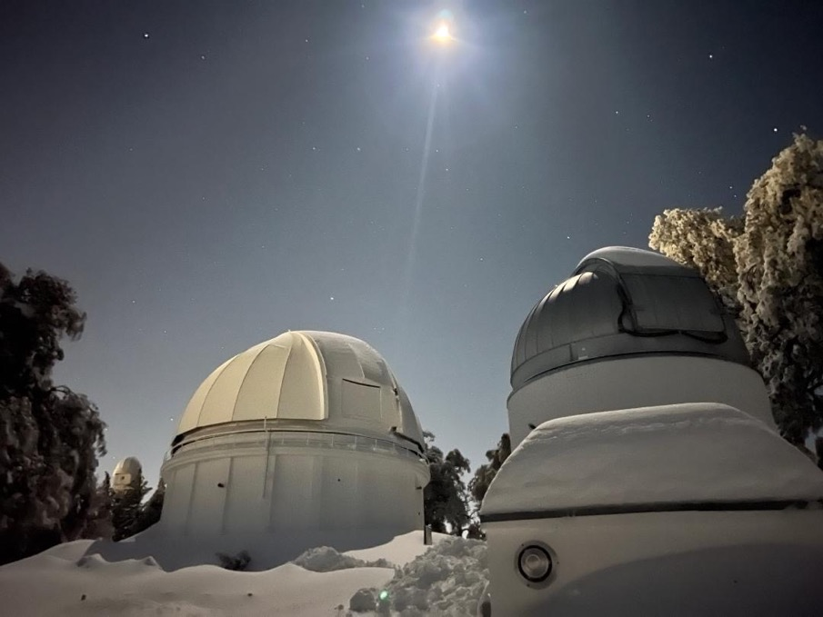
CHARA in 2023
Hello from Atlanta! Thanks to Dean Rosen, LOC (Alicia Rice, Jeremy Jones, Gail Schaefer, Rebecca Bays), CHARA staff
Introduction to this meeting
Snow Storm 2023
Instrumentation
Scientific Activity
Future Directions

Slide 3
ANNUAL CHARA SCIENCE MEETINGS https://www.chara.gsu.edu/news/meetings
2005 Paris
2006 Tucson
2007 New York
2009 Nice
2010 Pasadena: Caltech
2011 Atlanta
2012 Atlanta
2013 Flagstaff
2014 Ann Arbor
2015 Atlanta
2016 Nice
2017 Pasadena: Carnegie
2018 Paris
2019 Flagstaff
2021 Virtual
2022 Exeter, UK
2023 Atlanta

Slide 4
Special participants from the beginnings of CHARA
Hal McAlister: Founder and First Director
Theo ten Brummelaar: Director of the Array (2015-2022) 30 years since start April 26, 1993
Steve Ridgway: KPNO/NOAO/NOIRLab; CHARA planner, implementer
Bill Hartkopf: Construction phase; speckle interferometry; USNO
Don Hutter: Postdoctoral Fellow at GSU; USNO/NPOI
[Bill Bagnuolo: GSU scientist, CHARA planner]

Slide 5
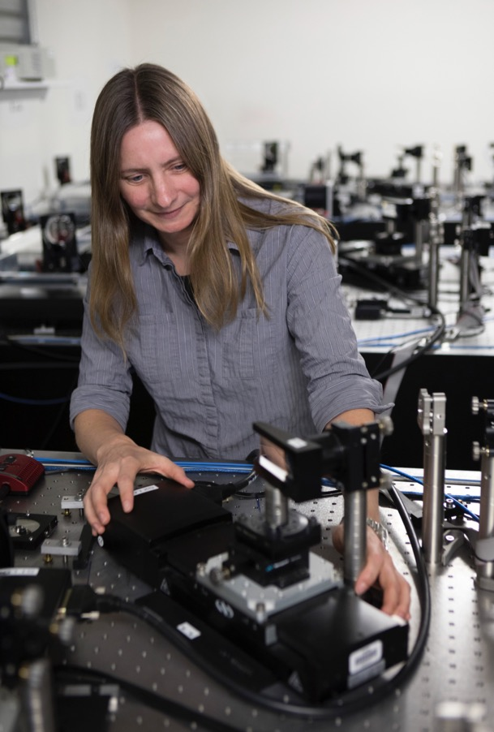
New Director of the CHARA Array (May 2022): Dr. Gail Schaefer

Slide 6
Accolades 2022
Hal McAlister was appointed Fellow of the American Astronomical Society
Theo ten Brummelaar received the Fizeau Lifetime Achievement Award
Deepak Raghavan (CHARA PhD 2009) received the GSU Distinguished Alumni Award
Robert Klement appointed as ESO Fellow at VLTI, Chile
Caleb Abbott, PhD; now postdoc at Univ. Notre Dame

Slide 7
Snow storm 2023
Major storm hit California Feb. 23-26 and Feb. 28 – Mar. 1 delivering four feet of snow to Mount Wilson Observatory
Road access was cut off for 12 days stranding a dedicated CHARA staff group (Woods, Castillo, Webster, Anderson), a team from Nice (Mourard, Geneslay, Lecron), and Mount Wilson Institute staff (Cendejas, Urrea)
Red Box Road is now re-opened for once daily traffic only
A dig out is underway, but start of observing will be delayed

Slide 8
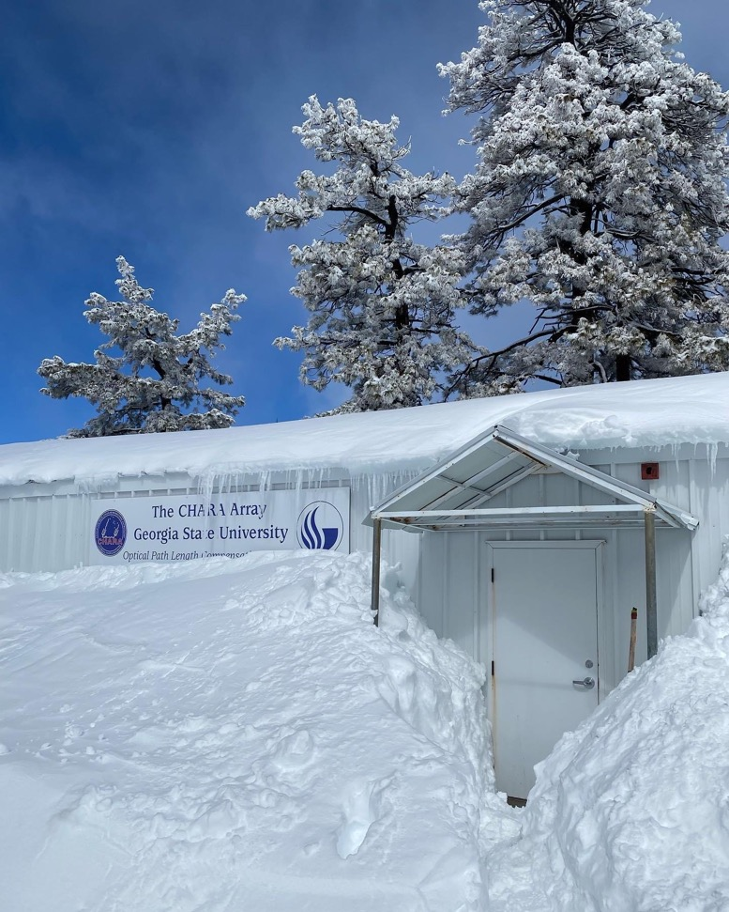
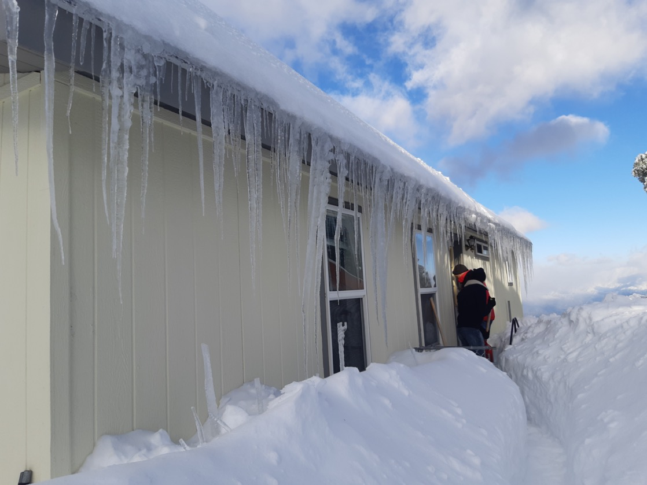
Snow!

Slide 9
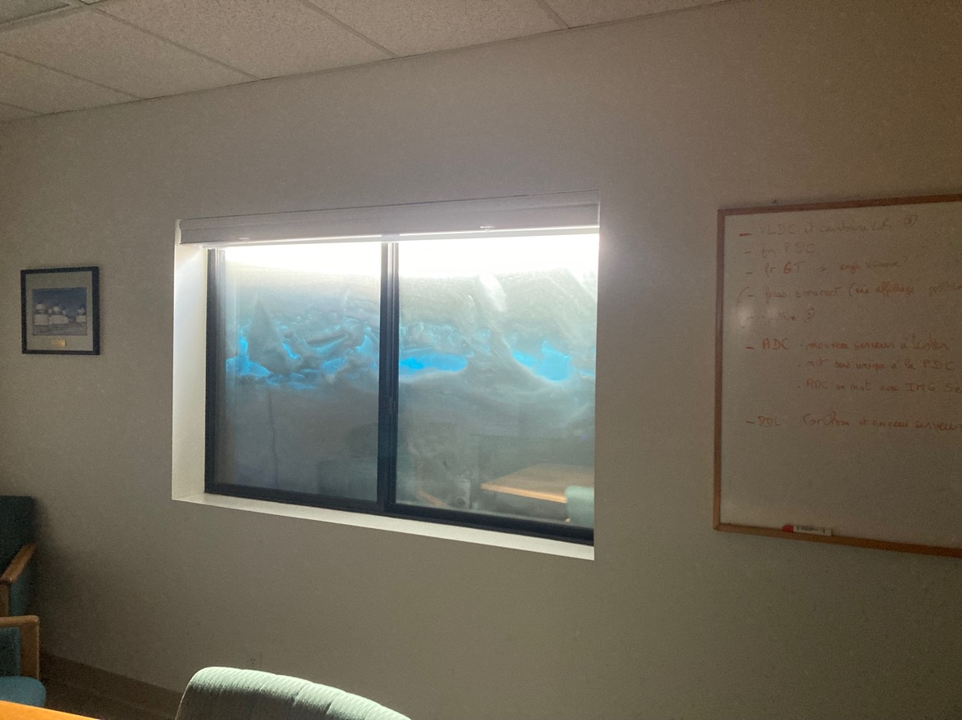
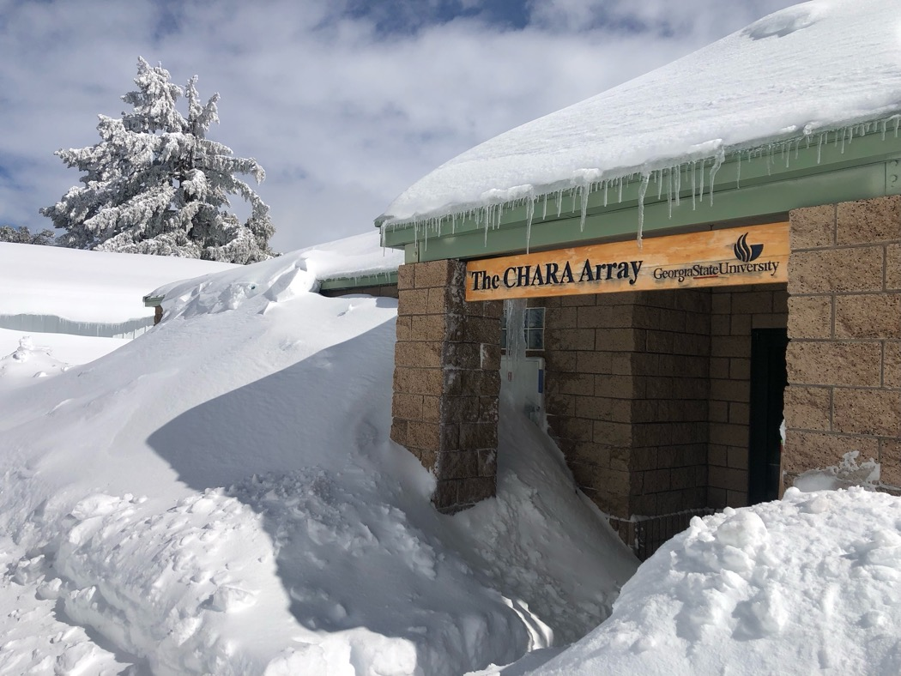
More snow!

Slide 10
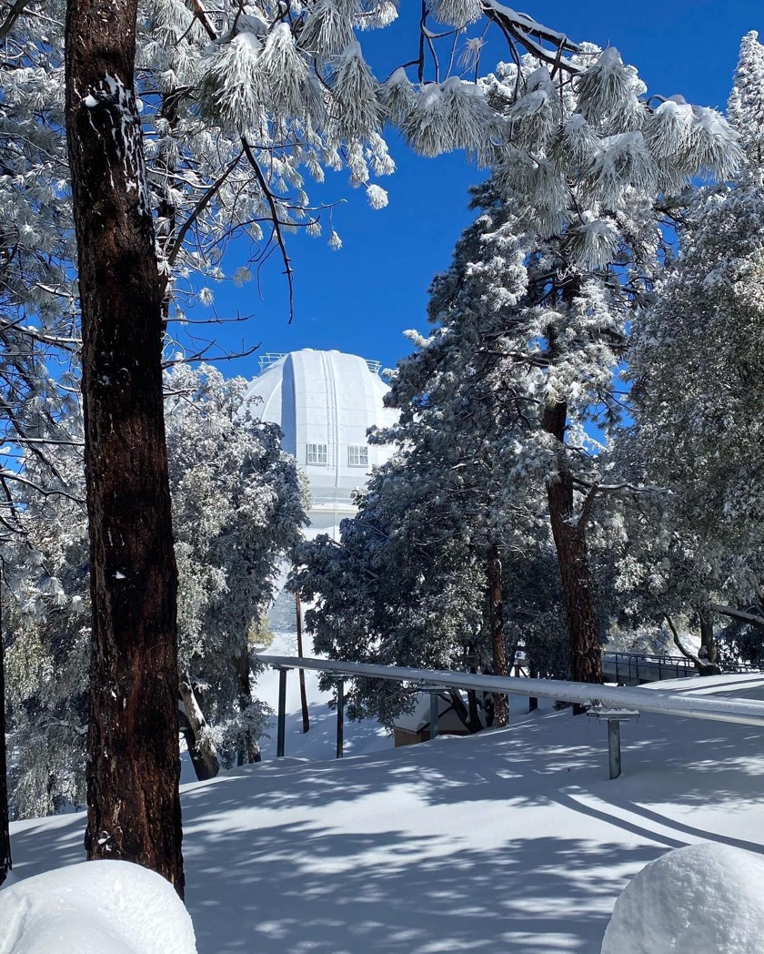
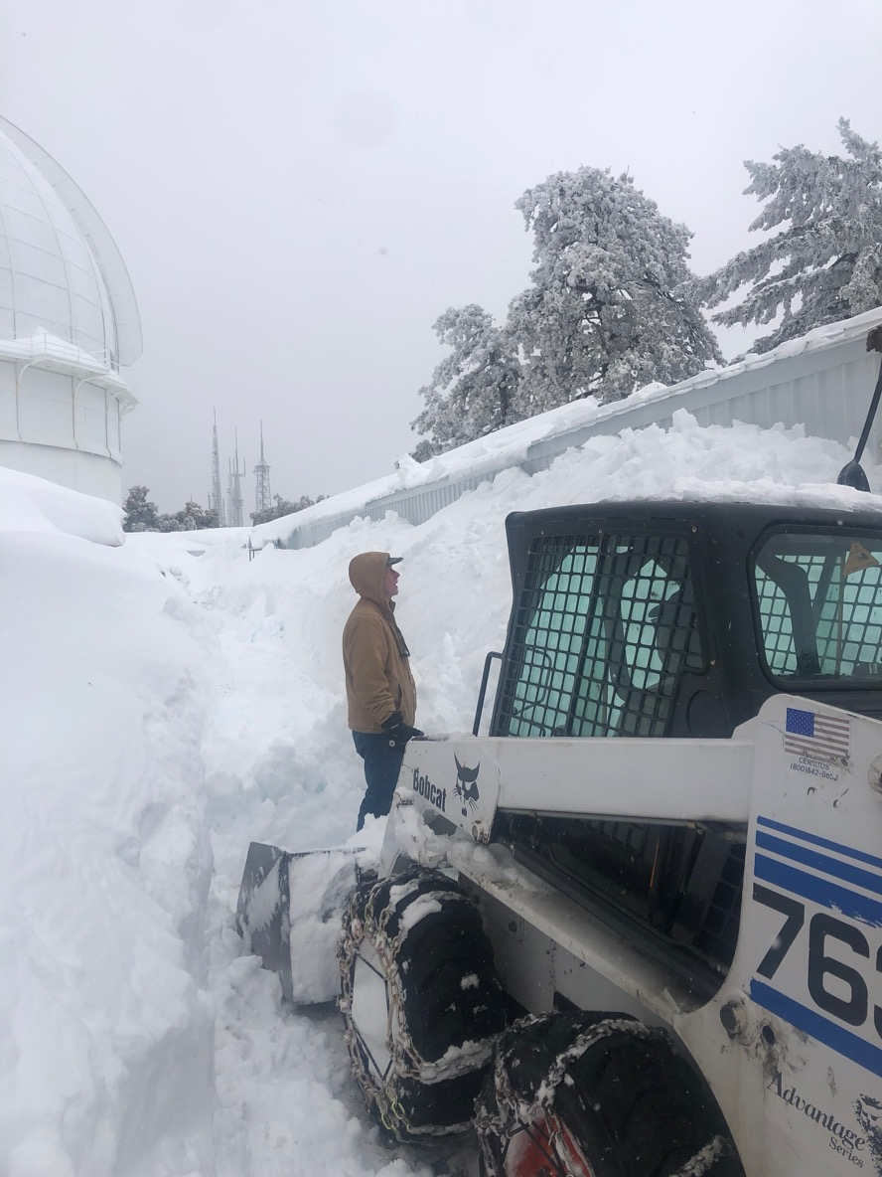
Even more snow!

Slide 11
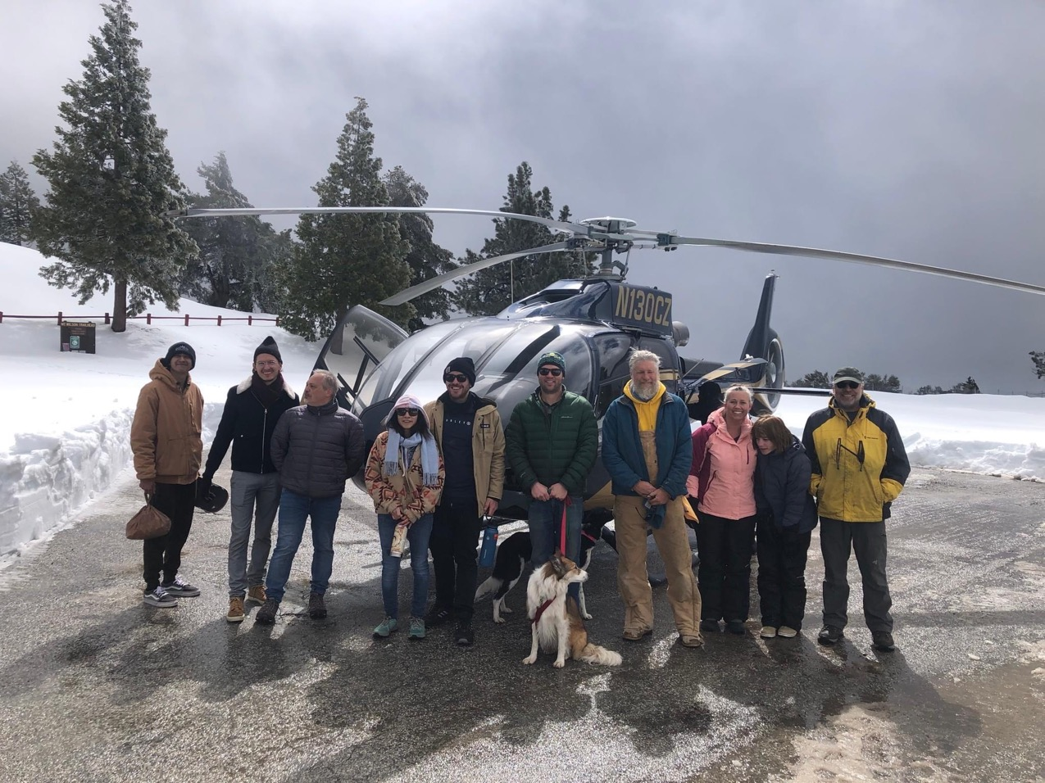
Airlift, March 6:
Supplies up / 6 people, 2 dogs down

Slide 12
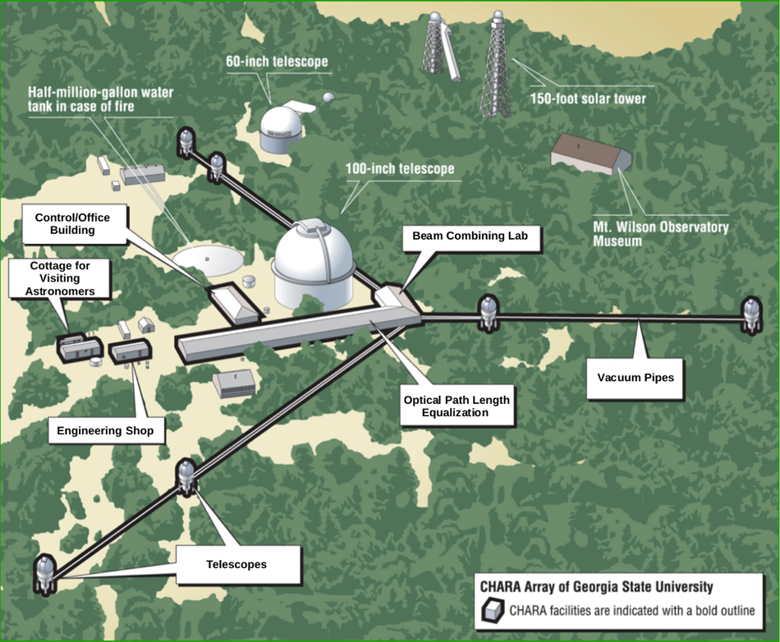
Instrumentation
Six 1 m telescopes with baselines of 34 to 331 m in length; acts like one enormous telescope
Angular resolution inversely proportional to wavelength; beam combiners for 0.6 to 2.2 $μ$m
Resolves objects to 0.2 milliarcsec (10 million $×$ smaller than the Moon)
Creates 15 separate samples of spatial size and orientation in sky
Ideal for making images of stars and their environments
12

Slide 13
Beam Combiners [Monnier, Kraus, Ibrahim, Lanthermann, Mourard, Pannetier]
Mode | Telescopes | Band | Typical limit Mag= | Best performance Mag= | Spectral Resolution R= | Science Drivers
Acquisition, AO, Tiptilt Tracking | 6 | V-R | 10.0 | 12.0
CLASSIC | 2 | H or K band | 7.0 | 8.5 | Broad band | Diameters
CLIMB | 3 | H or K band | 6.0 | 7.0 | Broad band | Binaries, Disks
Silmaril* | 3 | H or K band | 11 | 12 | Broad band | AGN
MIRC-X | 6 | H-PRISM50 H-GRISM190 | 6.5 5.5 | 7.5 6.5 | 50 190 | Imaging, Binaries, Disks
MYSTIC | 4,6 | K-PRISM49 | 6.5 | 7.5 | 49 | Imaging, Binaries, Disks
PAVO | 2 | 630-900 nm | 7.0 | 8.0 | 30 | Diameters
SPICA* | 6 | 600-860 nm | … | … | 140,4400,13000 | Surveys

Slide 14
Instrumentation innovations
Adaptive Optics Telescope AO at each of six telescopes; Lab AO for six beams in OPLE building [Matt Anderson, Theo ten Brummelaar]
Delay line control system New hardware/software [Tim Buschmann, Nils Turner]
Telescope drives Replacement of original direct drive motors [Nic Scott]
Mobile telescope New seventh telescope using fiber optics transport for very small and very large baselines [Robert Ligon, Chris Farrington, Nic Scott]
14

Slide 15
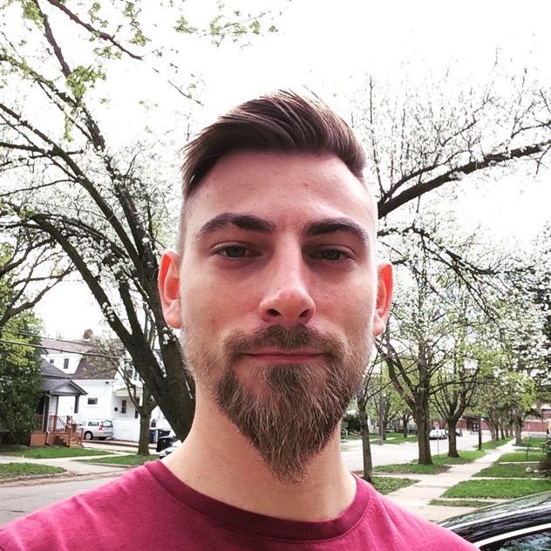
Scientific Activity (in 236 refereed papers)
Guest observer program through NOIRLab [Schaefer]
45 nights/semester
Next round due March 31 for 2023B (August – December)
New Visitor Support Scientist Cyprien Lanthermann
https://www.chara.gsu.edu/astronomers/journal-articles
15

Slide 16
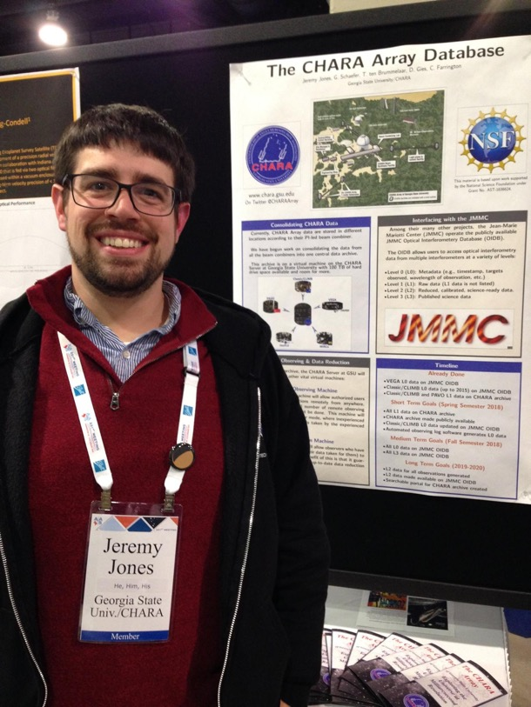
Scientific Activity – more help available
Remote observer access
Data archive
Software for data reduction and data analysis
Data Scientist Jeremy Jones
16

Slide 17
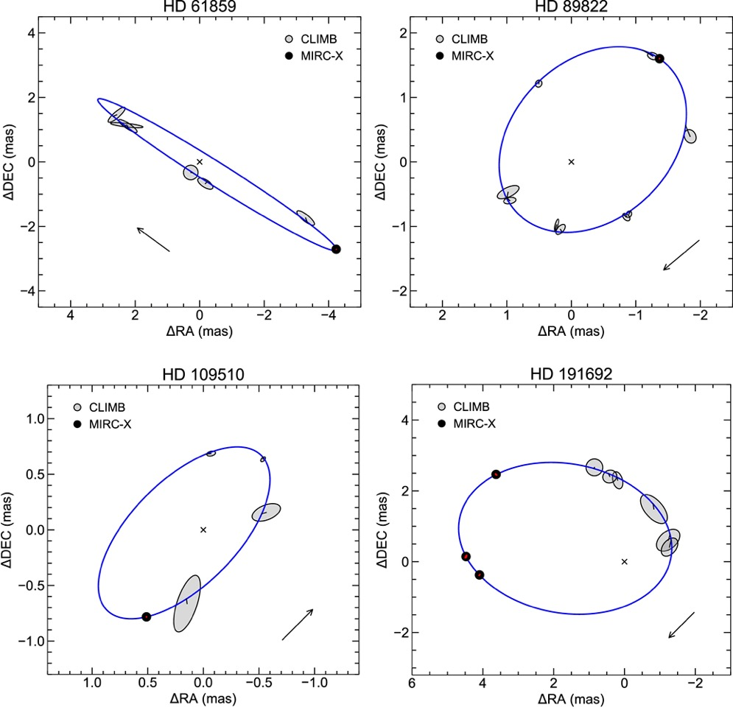
Binary and multiple star systems
Masses, distance, and evolutionary state (Lester et al. 2022, Gardner et al. 2022)
Sorting out multiples; 6 stars in Castor system (Torres et al. 2022)
17

Slide 18
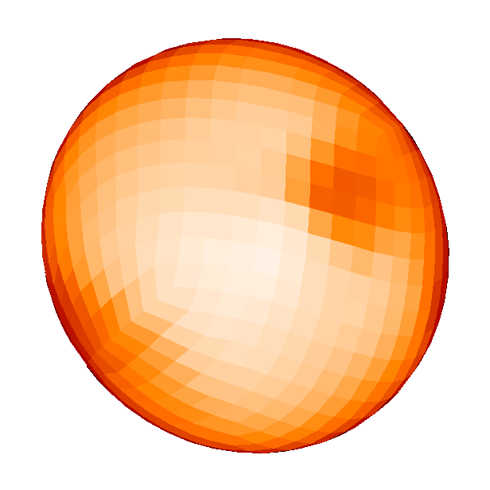
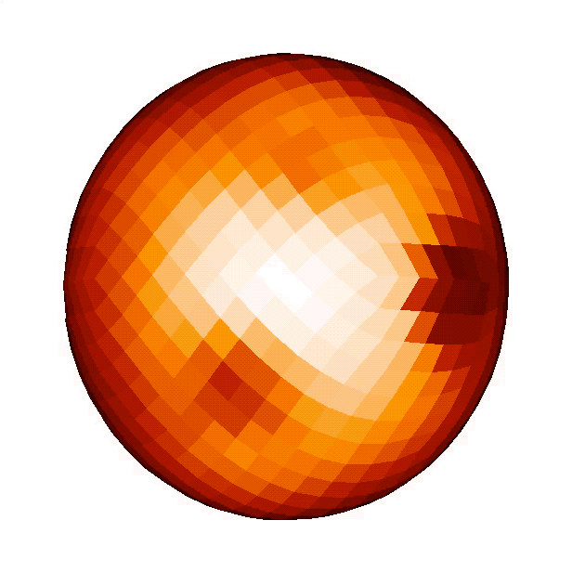
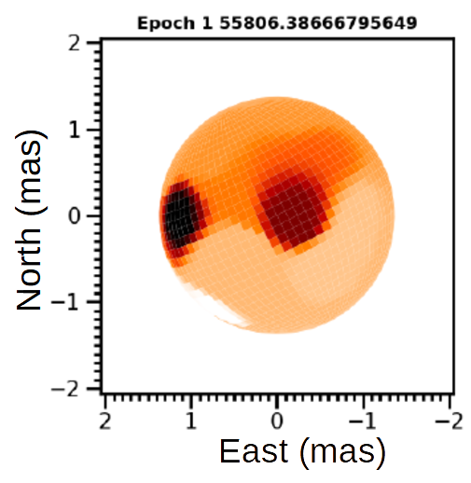
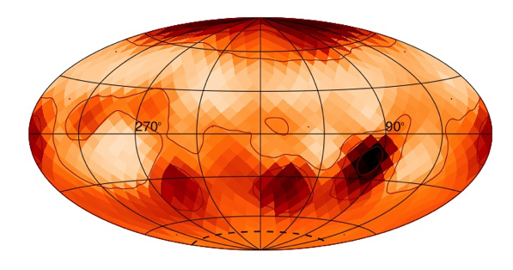
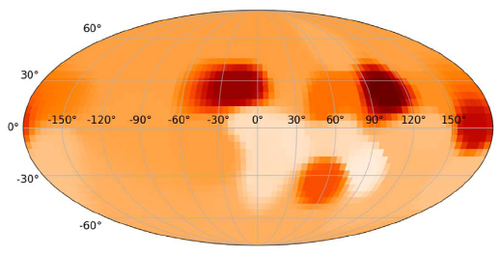
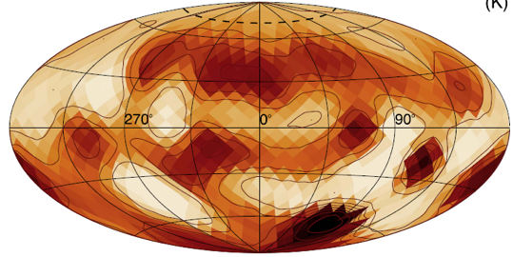
Imaging starspots
$ζ$And
θ=2.5 mas
$σ$ Gem
θ=2.4 mas
$λ$ And θ=2.7 mas
Roettenbacher et al. (2016)
Roettenbacher et al. (2017)
Martinez et al. (2021)

Slide 19
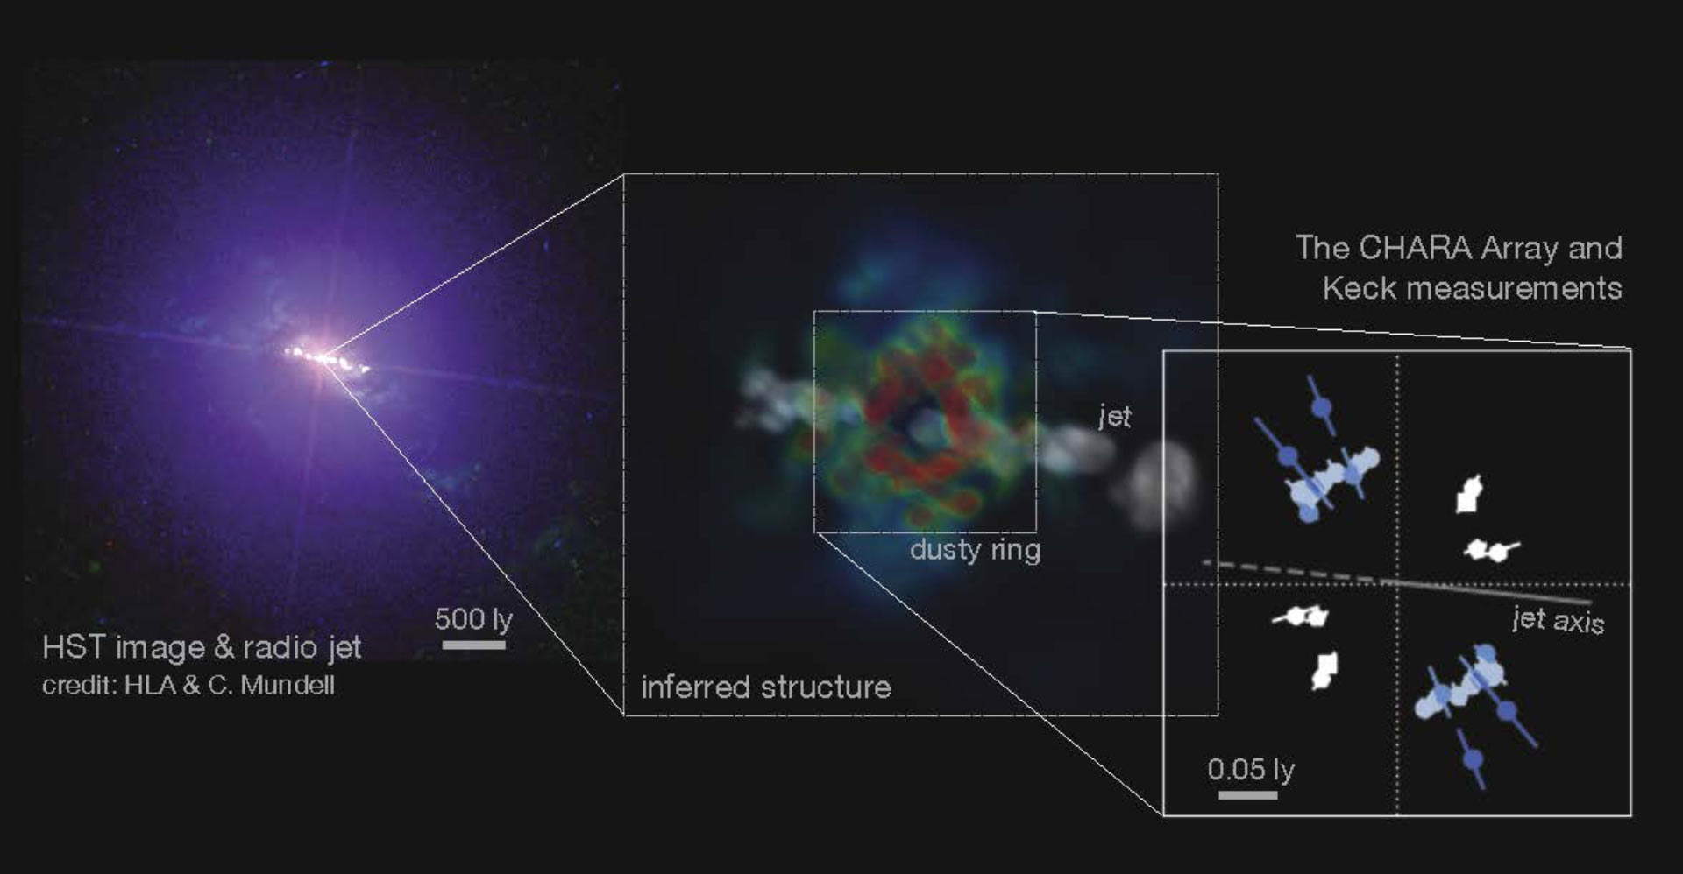
Supermassive black hole in NGC 4151 (50 million light years distant; Kishimoto et al. 2022)
19

Slide 20
Future Directions: Astro2020 Papers & Report
General (Ridgway), CHARA (Gies), NPOI (van Belle), MROI (Creech-Eakman)
CHARA Michelson Array https://ui.adsabs.harvard.edu/abs/2019BAAS...51g.226G/abstract
Expansion of the Array at MWO
Twelve 2-m aperture telescopes, up to 1 km (and longer) baselines
Beam transport by fiber optics
Use (expanded) OPLE/BCL and current beam combiners

Slide 21
A future with our key scientific partners
University of Michigan [John Monnier]
University of Exeter [Stefan Kraus]
Observatoire de la Cote d’Azur [Denis Mourard]
Observatoire de Paris [Vincent Coude du Foresto]
Université de Limoges [Ludovic Grossard]
University of Sydney [Peter Tuthill]
Australian National University [Mike Ireland]
Kyoto Sangyo University [Makoto Kishimoto]
NSF’s National Optical-Infrared Astronomy Laboratory (NOIRLab) [Steve Ridgway]

Slide 22
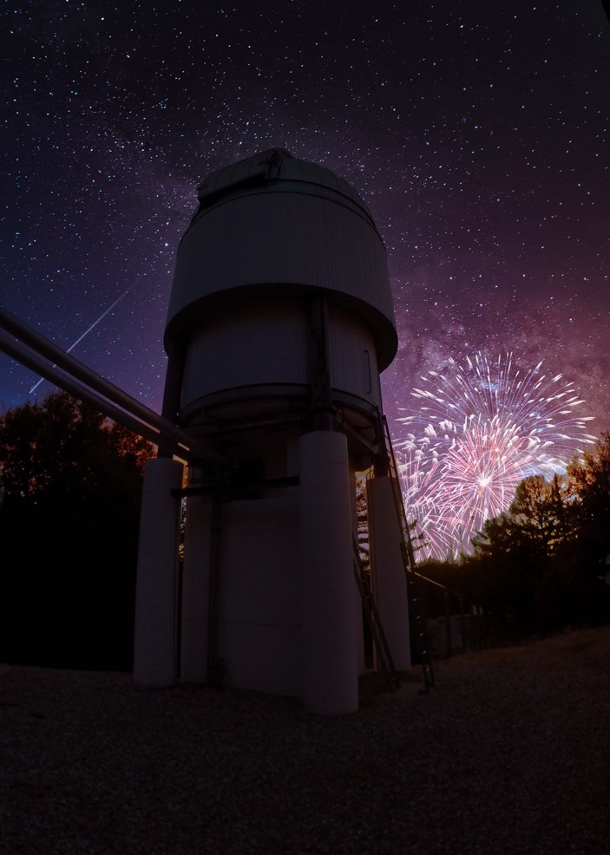
Conclusions
Burst of activity at the CHARA Array
Growing community of users through the open access program
Exciting opportunities with new combiners (MIRC-X, MYSTIC, SPICA, SILMARIL)
Mobile telescope and fiber optics beam transfer experiments ahead
We are grateful for support from NSF, the GSU College of Arts and Sciences, and the GSU Office of the Vice President for Research and Economic Development.

