Slide 1
Imaging the Inner AU of Herbig Be Star V1295 Aql
Noura Ibrahim
Team: John Monnier, Stefan Kraus, Jean-Baptiste Le Bouquin, Narsireddy Anugu,Fabien Baron, Theo Ten Brummelaar, Claire L. Davies, Jacob Ennis, Tyler Gardner, Aaron Labdon, Cyprien Lanthermann, Antoine Mérand, Evan Rich, Gail H. Schaefer, Benjamin R. Setterholm

Slide 2
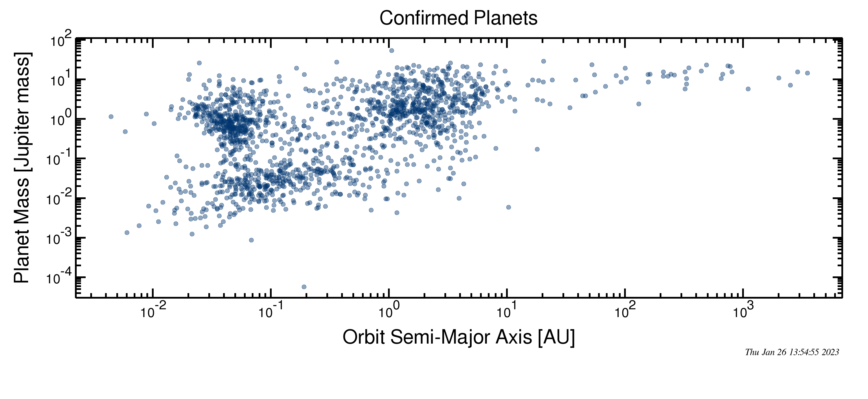
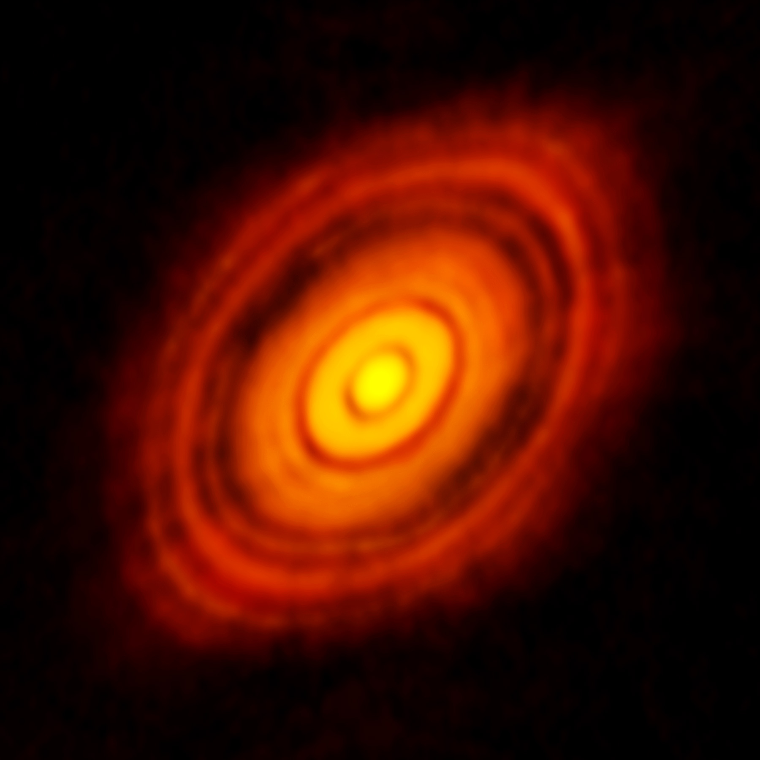
Motivation
The field of exoplanets is growing exponentially
It is great to detect these planets but it is also very important to understand their origin stories
ALMA gave us a better understanding of just how young a star can be to host planet formation
Found evidence of planet formation in young star Tauri (10⁵ -10⁶ yrs)
"Birth of Planets Revealed in Astonishing Detail in ALMA's 'Best Ixmage Ever' - NRAO: Revealing the Hidden Universe". nrao.edu.
Notes:
Start with motivation then narrow down to the star. Go wider about planet formation. ALMA exoplanets, areas that are not easy to study with alma and how it affects planet formation and accretion on the star. Maybe hot jupiters migrations. Meausurng temp and density to see if we can get in situ planet formation. A lot of variability from other monitoring surveys. HST young stars show var at weak timescale from the inner region. Var in disk scale height (instability interaction with stuff).
MAterial getting onto a star in terms of magnetosphere
V1295 is relatively massive (add mass and spectral type)
Narrative with interferometry. Making images is hard so we are modeling more.Visibility is Fourier component of the image

Slide 3
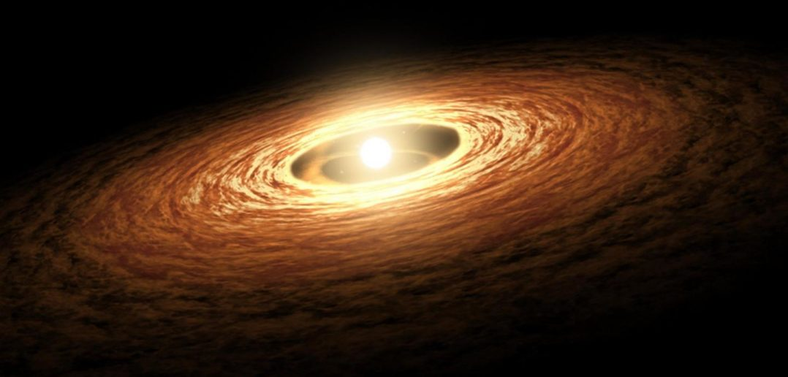
Protoplanetary Disks
Dust and gas- rich disks that surround many pre-main sequence stars
Remnants of the star formation process
Disk can host a future planetary system
Different regions have different physics
NASA/JPL-Caltech

Slide 4
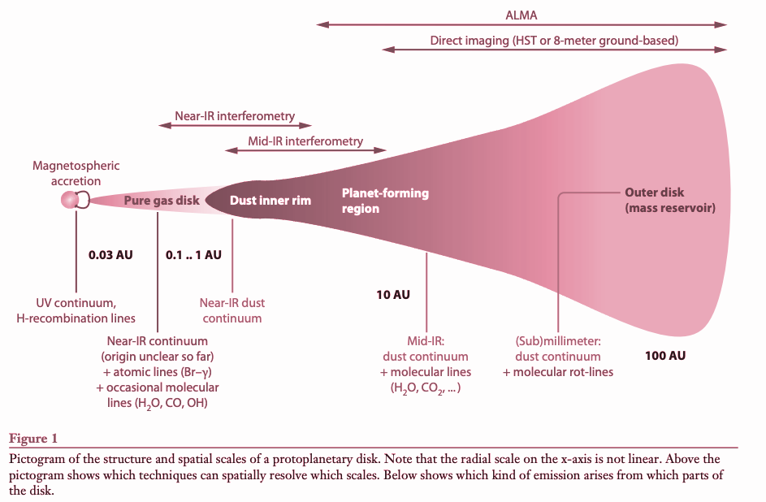
C.P. Dullemond and J.D. Monnier, 2010
Notes:
This is a representation of the protoplanetary disk structure. We can see that the outer radius can be pretty large. It can be anywhere from 10s AU to 1000 AU. In contrast, the inner disk radius is on the order of 0.02 AU which is basically a few stellar radii. So from inner radius to outer radius we are looking at a scale of 10s to hundreds of thousand. To demonstrate just how different the outer and the inner regions are we can look at orbits. This disk follows keplerian motion so for every orbit in the outer disk, we get up to 10 million orbits in the inner region. That also means that processes are much faster in the inner region since the dynamic timescales are so much shorter.
Temperatures also differ a great deal. The inner region has temperatures greater than 1000 K while the outer region has much colder temperatures at about 10-30 K
As evident by the properties I just described, different regions in the disk will require different methods of observation and will have different physics going on. The outer region is studied with telescopes in the FIR and millimeter wavelengths. The middle region is studies with mid IR observations, and then the very inner region are studied with NIR observations.
I study the inner AU region

Slide 5
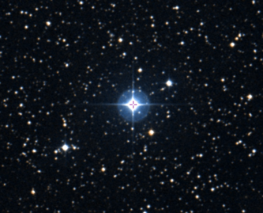
V1295 Aquila (HD 190073) – Really “cool” star :)
Herbig Be star (spectral type B9)
847 pc away
780 L☉
6 M☉
Narrow emission line feature
Weak detected magnetic field
Almost face on!
Simbad

Slide 6
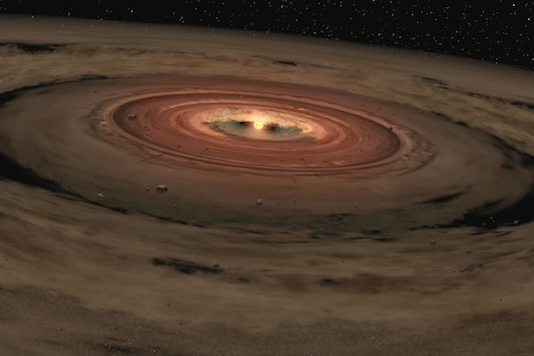
Why are the Herbig Accretion Disks Interesting?
High luminosities and strong excess emission in the NIR and mm wavelengths
Observe accretion and planetary formation
Most of the excess is from the inner AU surrounding the star
>100 pc away -> Cannot use optical or IR telescopes
Need milli-arcsec resolutions
Long-baseline Interferometry!!
https://www.spaceanswers.com/

Slide 7
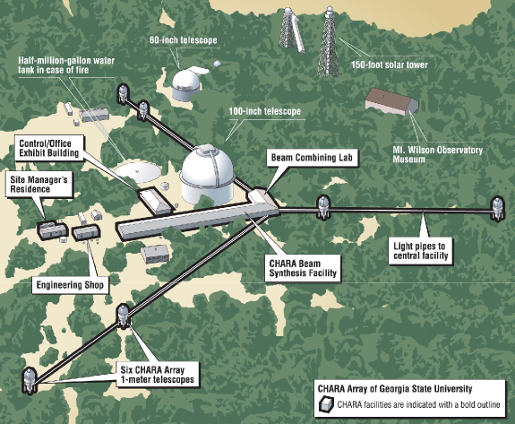
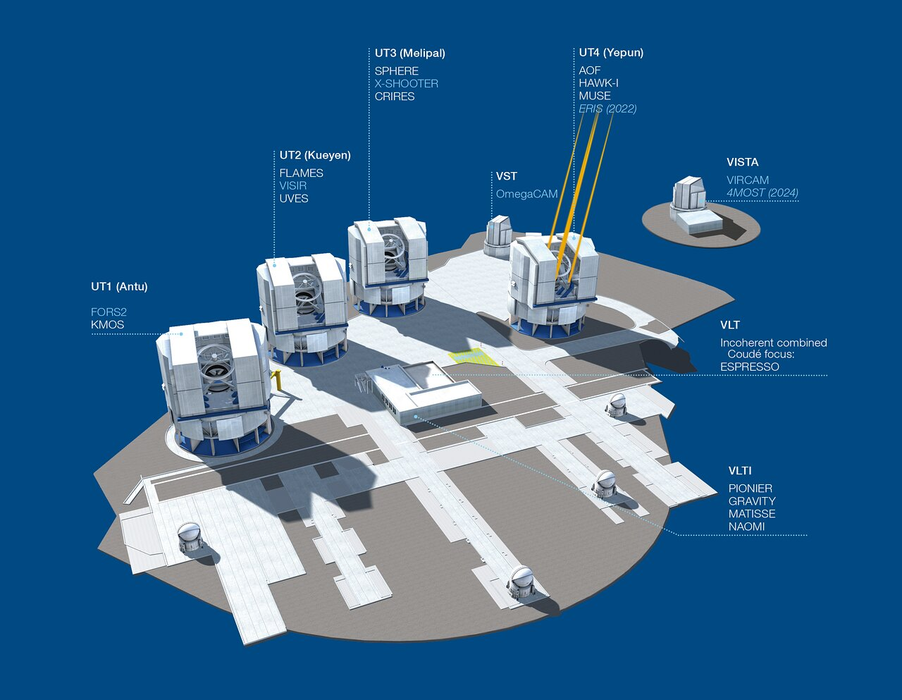
Data Collection
CHARA: https://www.chara.gsu.edu/instrumentation/chara-array
Coordinated observations between CHARA and VLTI in the summer of 2019
Assuming Keplerian rotation, this disk has a rotational period of 225.8 days
Squared visibilities and closure phases were obtained with
o MIRC-X instrument @ CHARA
- 0.5 mas max angular resolution in H-band ->
6 nights -> resolve a change every ~13 days
o PIONIER @ VLTI
- 2.5 mas max angular resolution in H-band ->
7 nights -> resolve a change every ~40 days
We split the data accordingly into two epochs, A and B
VLTI: https://www.eso.org/public/images/vlt/

Slide 8
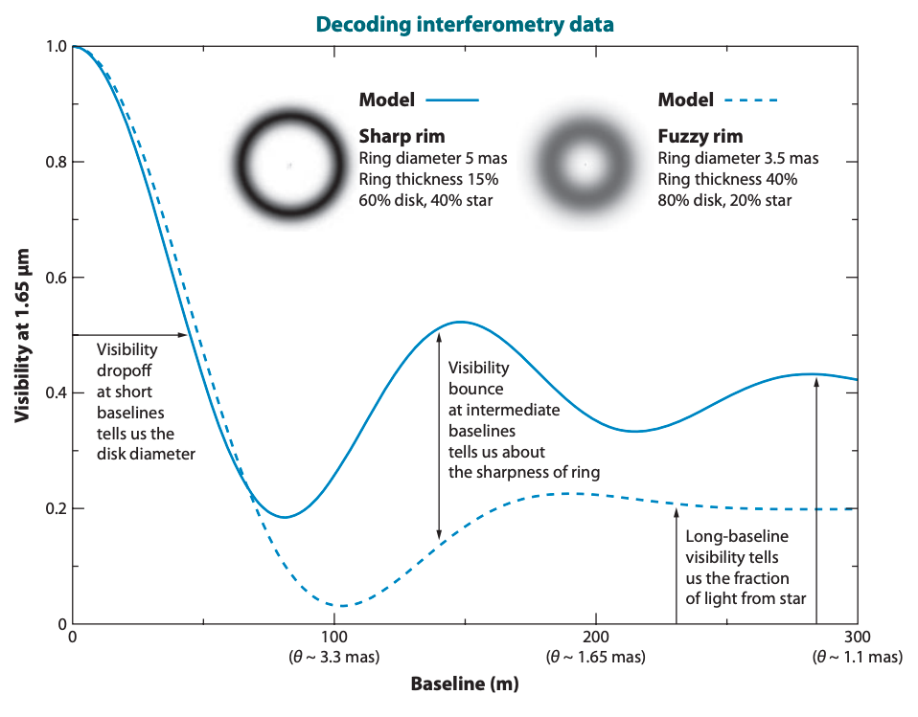
In Theory
C.P. Dullemond and J.D. Monnier, 2010
Notes:
First show the thing on the keft. Visibility goes down and then we expect a bounce and stuff that helps us constrain the fuzziness. What Ben found 4 years ago. His is very sparse and we can model a gaussian. We can do better. VLTI look like it goes down and doesn’t go down. It would agree with ben unless we had the chara which we need. “Recent results” “New results” we are able to improve with chara instruments. Maybe even show VLTI first. Point out how it visually goes up. Presumably what we see is a wavelength spread.
What we learned from the raw data. We see with better coverage that we do see a bounce. We have small closure phases.
Now we can fit some models

Slide 9
Recent Results
Setterholm et al 2018

Slide 10
Recent Data
(Ibrahim et al 2023)
λ [μm]
v [ N →] (m)

Slide 12
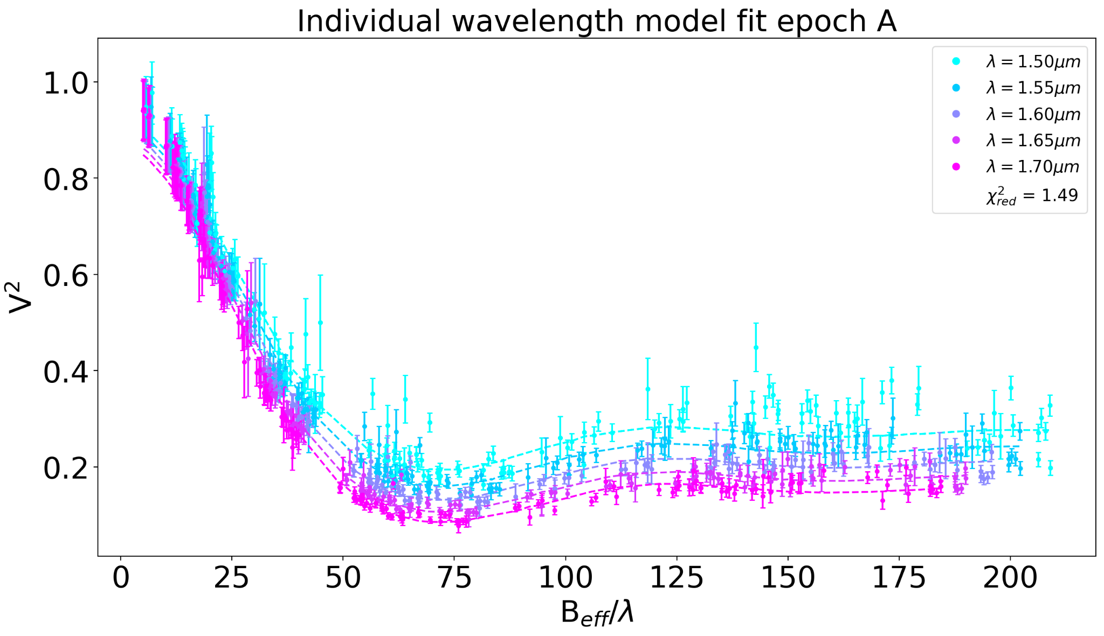
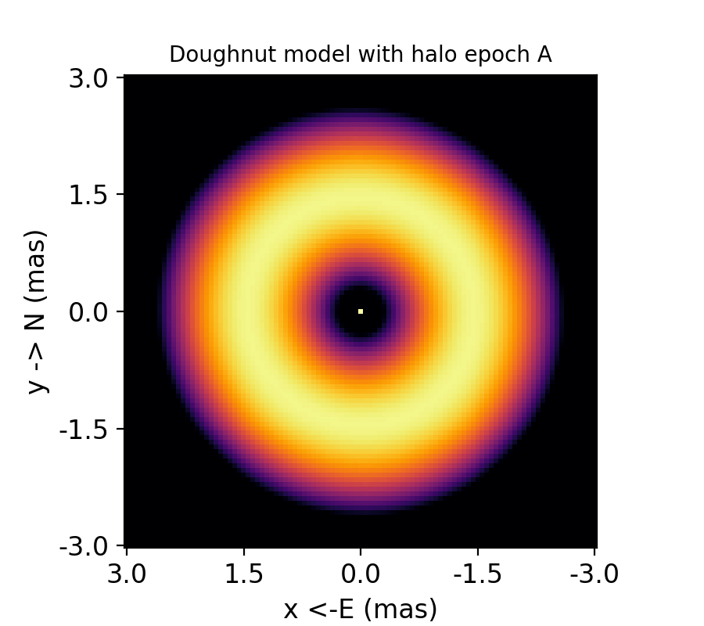
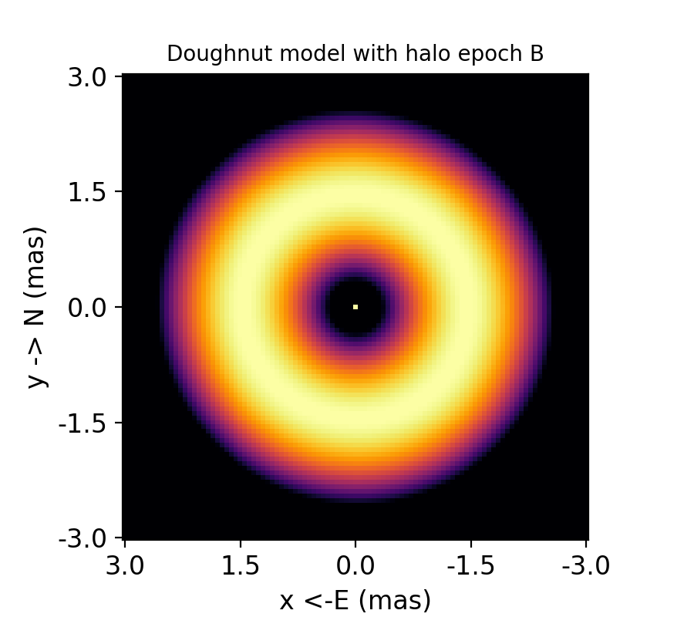
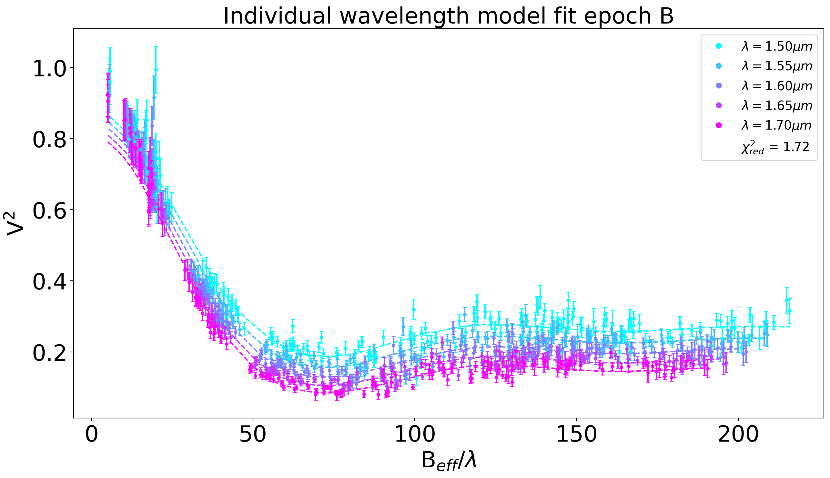
Geometric modeling with PMOIRED (Mérand, 2022)
Parabolic

Slide 13
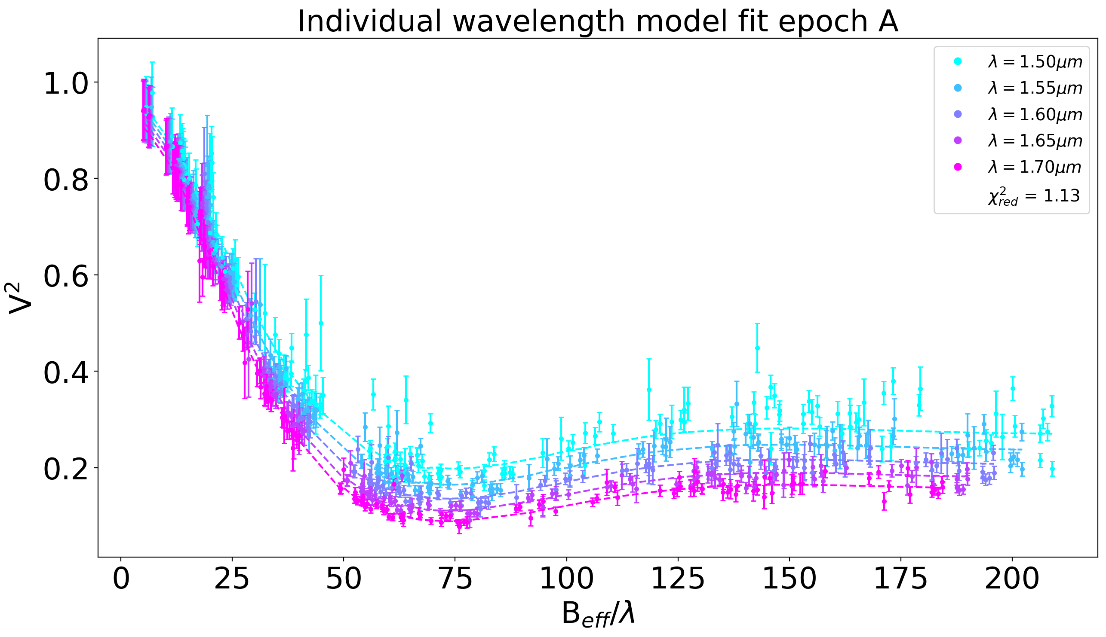
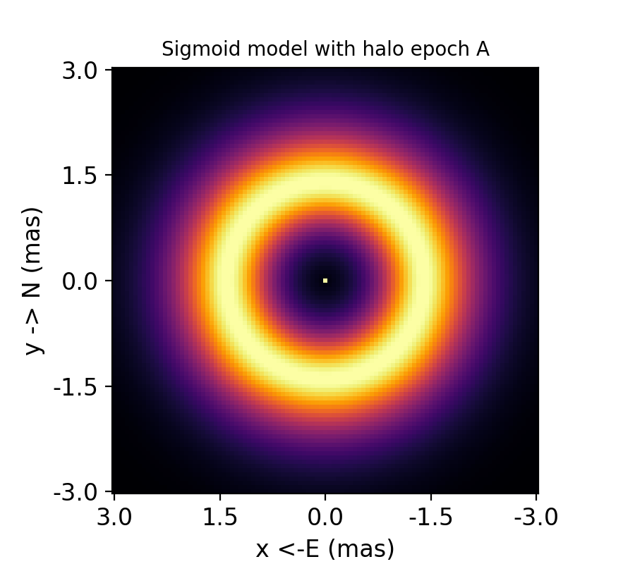
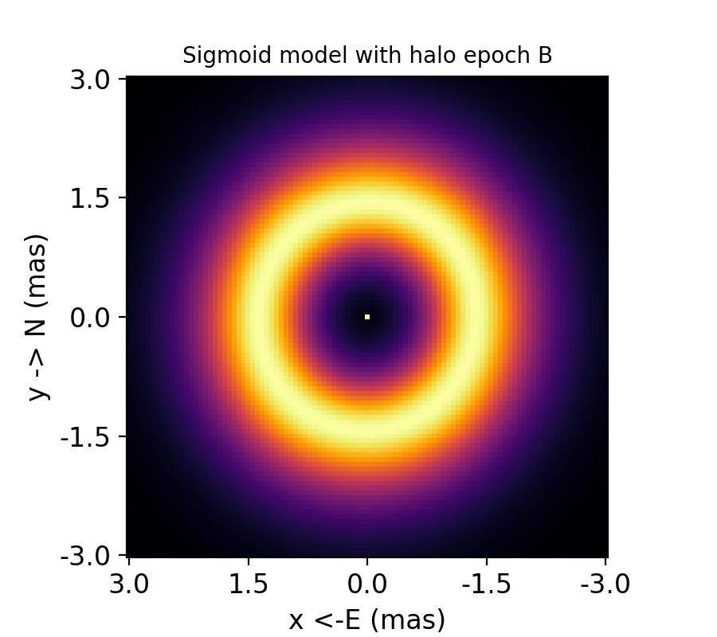
Geometric modeling with PMOIRED (Mérand, 2022)
Double Sigmoid

Slide 14
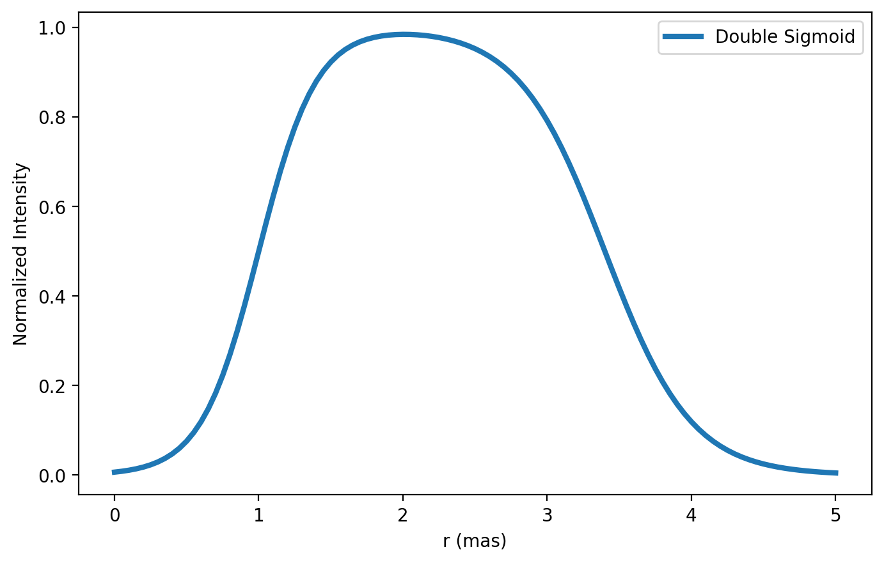
Geometric modeling with PMOIRED (Mérand, 2022)
Double Sigmoid

Slide 15
Geometric modeling with PMOIRED (Mérand, 2022)
Double Sigmoid

Slide 16
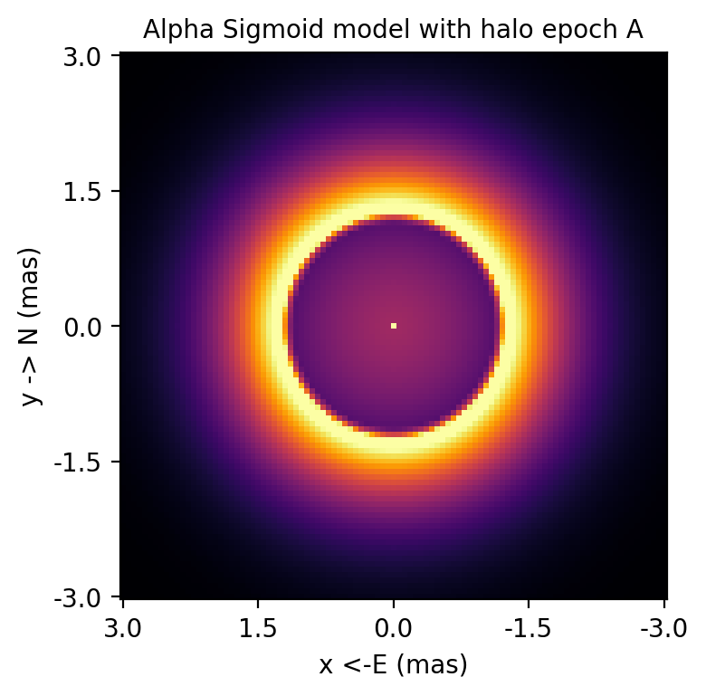
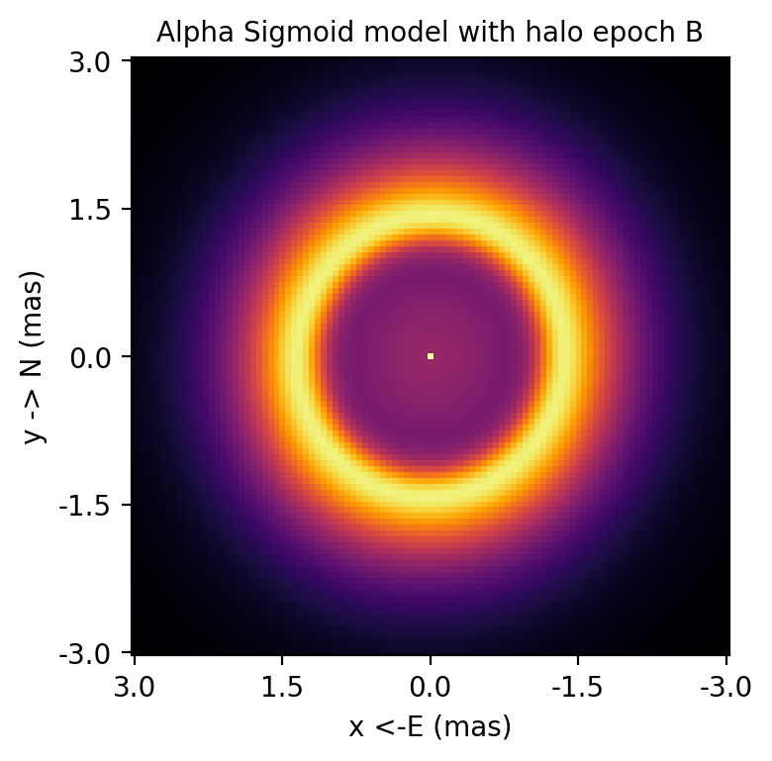
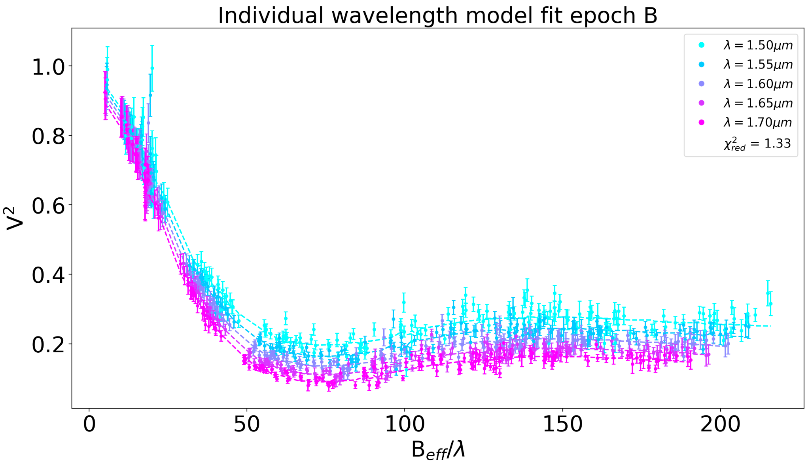
Geometric modeling with PMOIRED (Mérand, 2022)
α Double Sigmoid

Slide 17
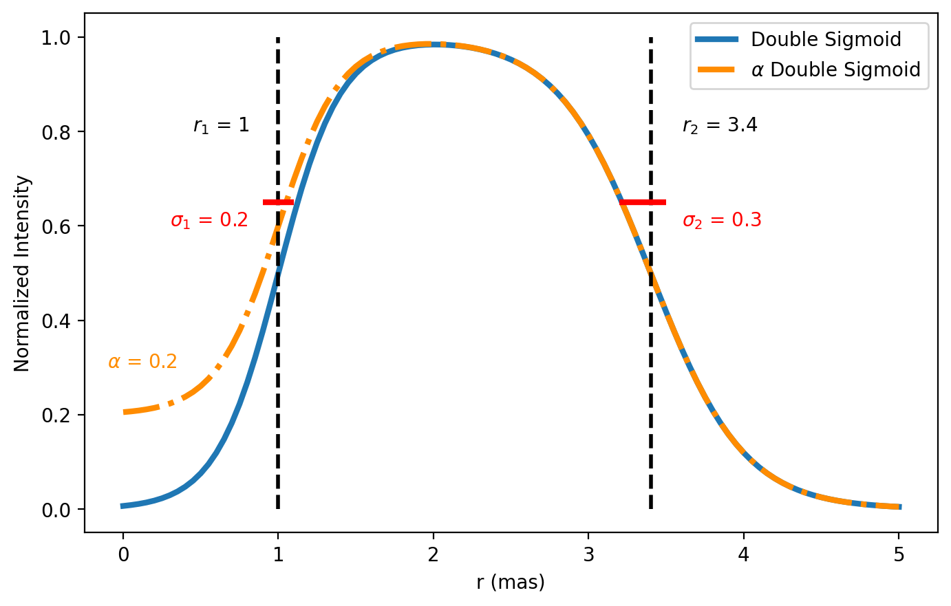
Geometric modeling with PMOIRED (Mérand, 2022)
α Double Sigmoid

Slide 18
Geometric modeling with PMOIRED (Mérand, 2022)
α Double Sigmoid

Slide 19
However,
We have non-zero closure phases…
But large closure phase χ²_{Red}
Double sigmoid model for example:
A:
Symmetric χ²_{Red} : 2.9
Az Asymmetric χ²_{Red} : 2
B:
Symmetric χ²_{Red} : ~4
Az asymmetric χ²_{Red} : 2.2
We cannot rely on simple azimuthal asymmetry to model the non-zero closure phases

Slide 20
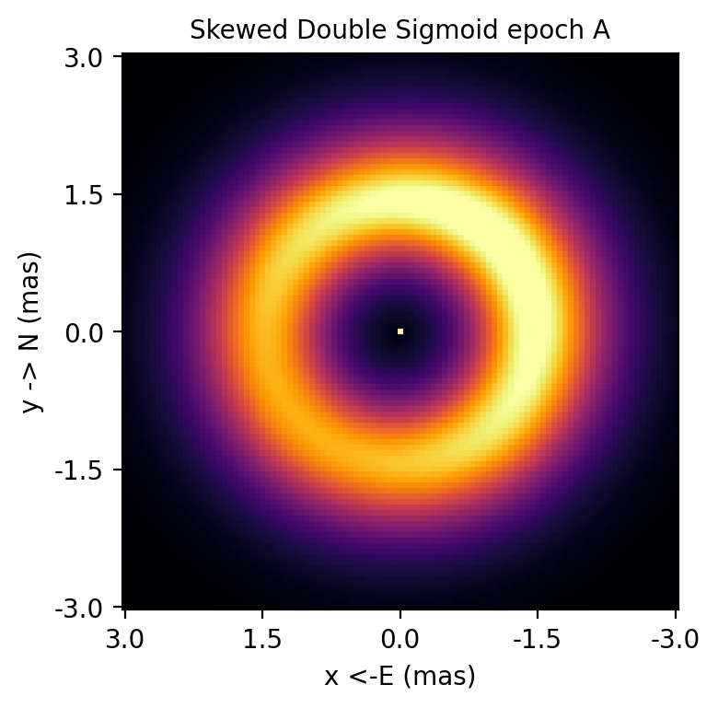
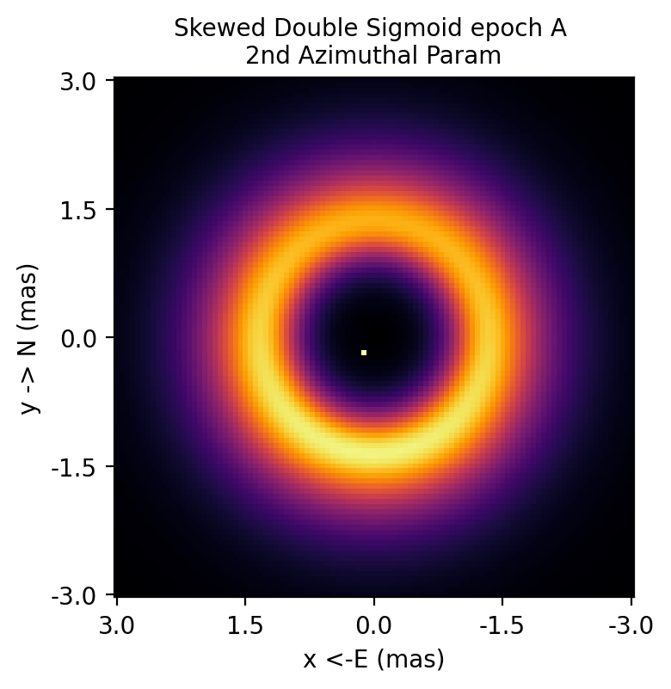
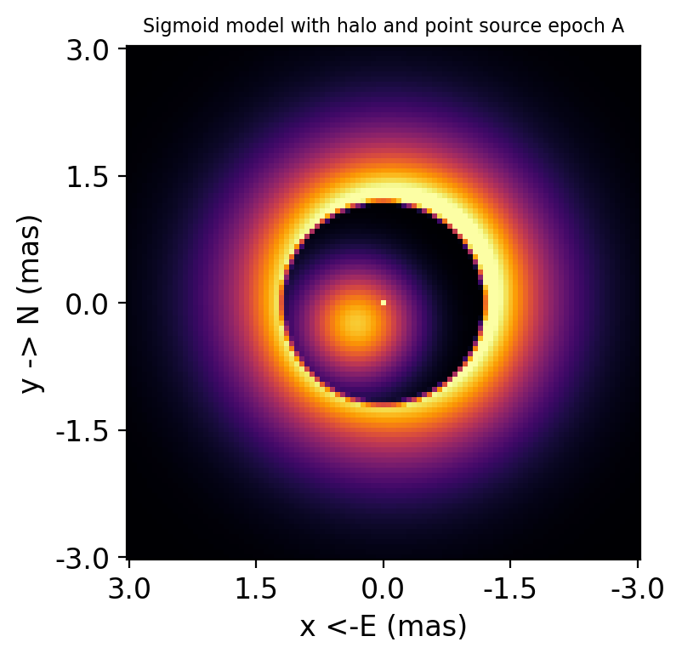

Slide 21
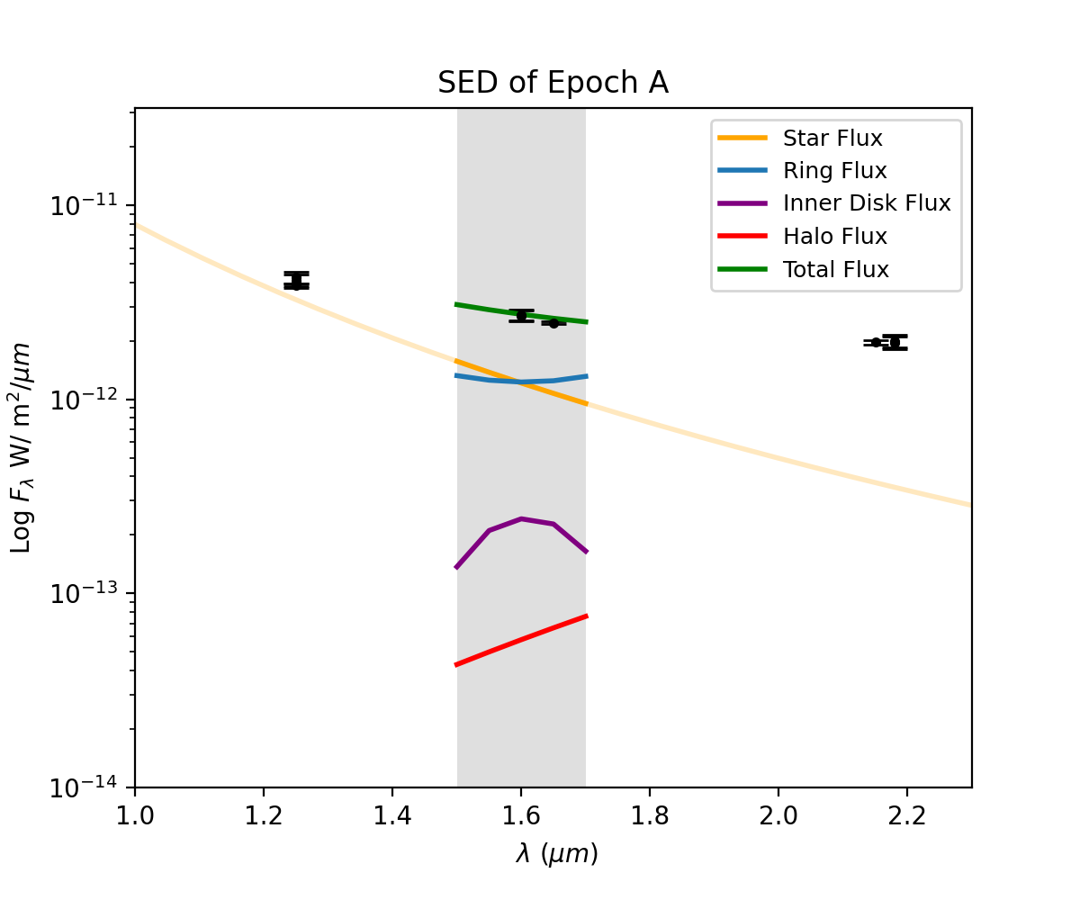
Imaging
SPARCO 2014
Assume grey spectrum but allow a spectral tilt for the disk and the star
Fix the star to have a slope of λ⁻⁴
Fit for the slope of the disk flux ~λ^{-0.08}
Flux contributions:
Star 41%
Ring ∼56%
Inner region ∼15%
Halo 4.6%

Slide 22
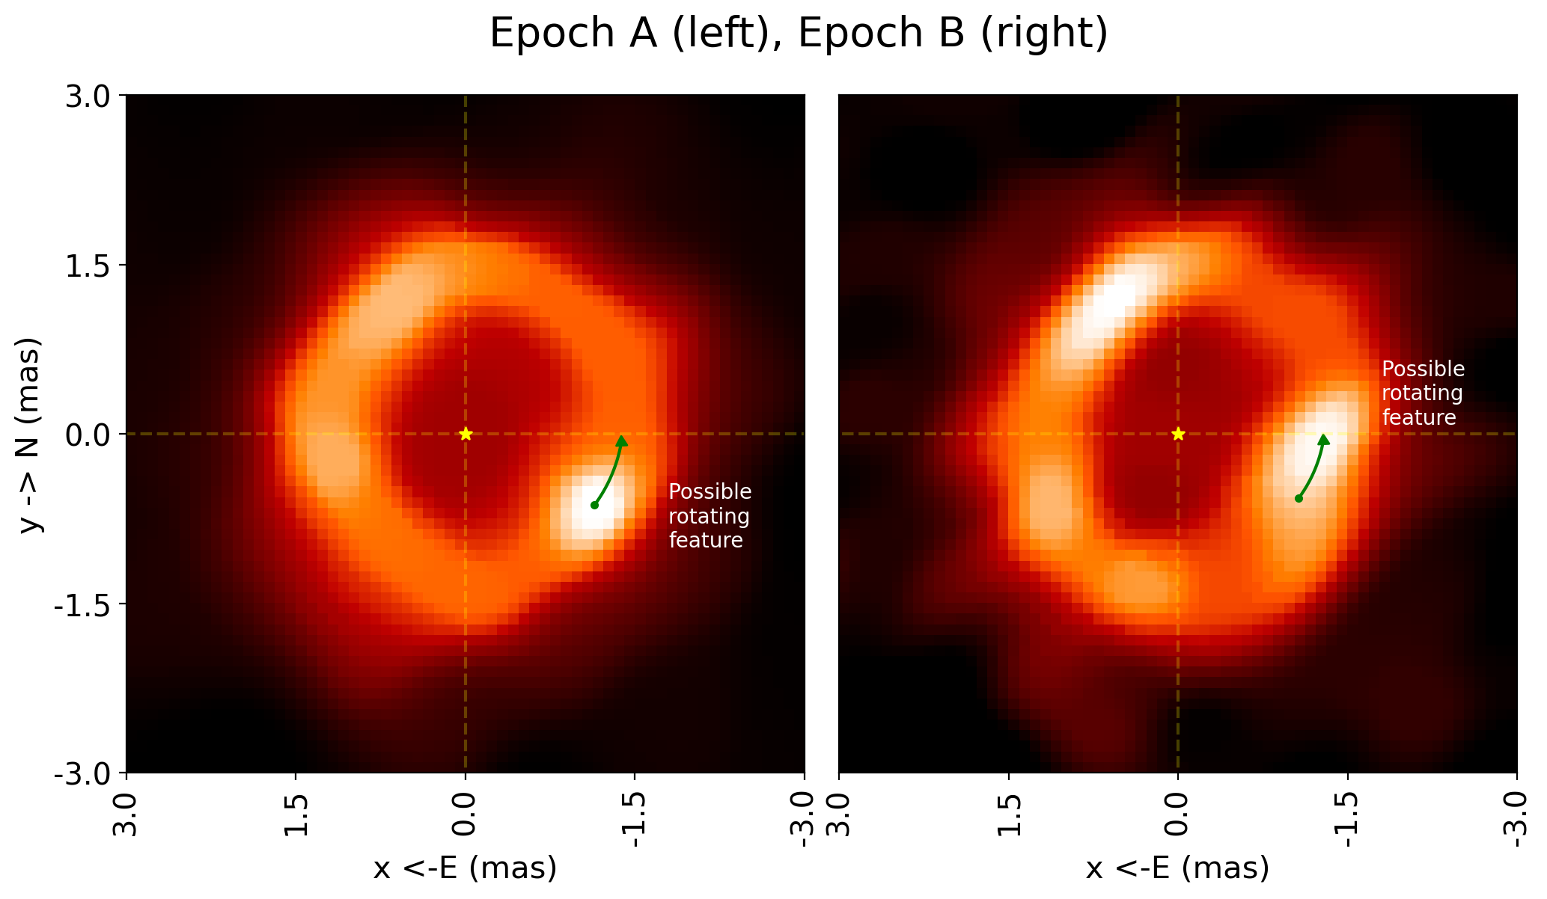

Slide 23
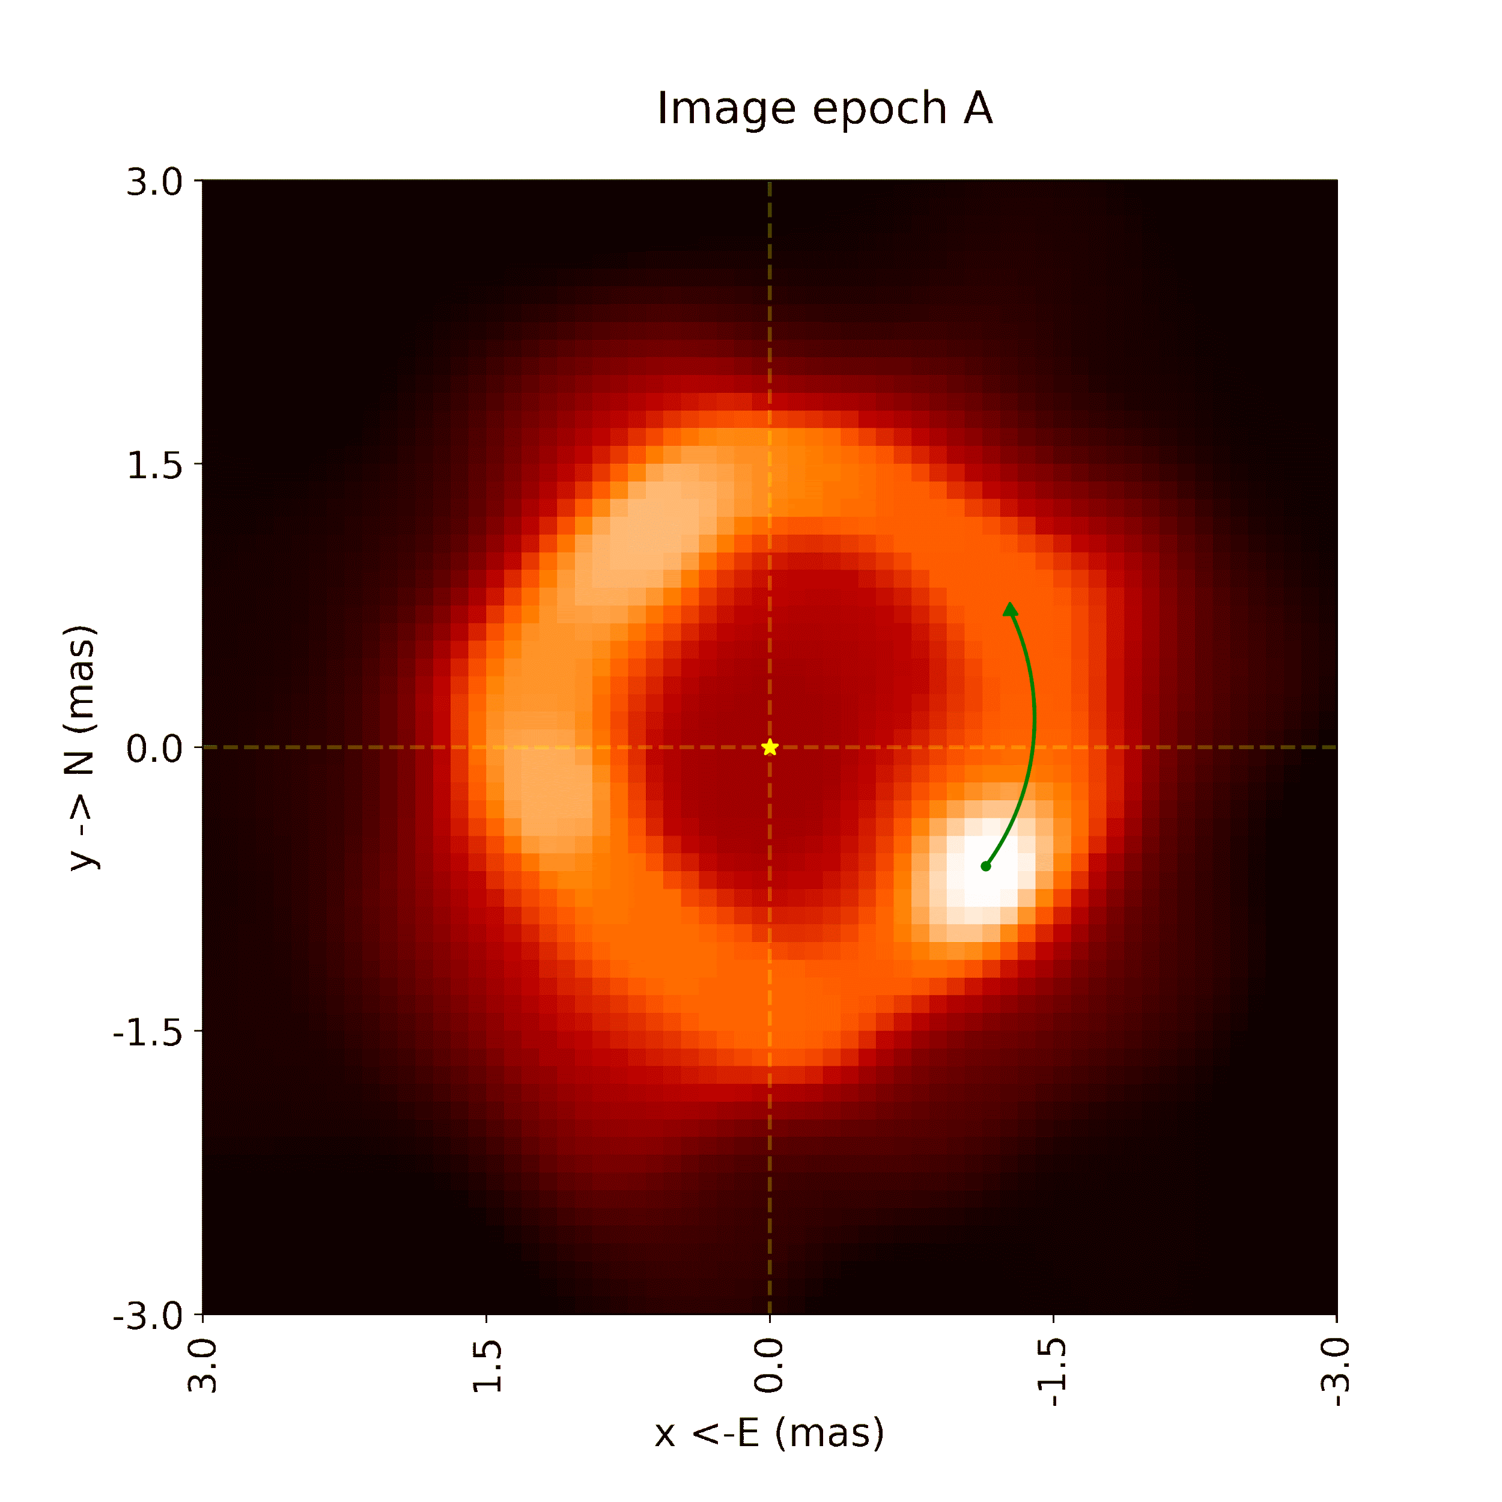
Expect a rotation of 63º
Measure a rotation of 27º

Slide 24
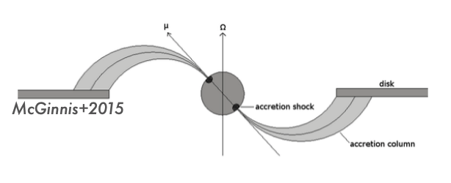
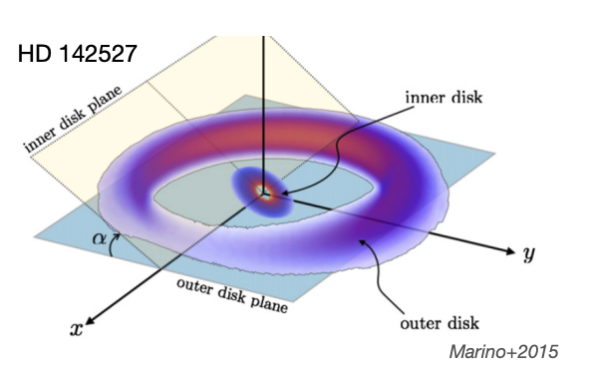
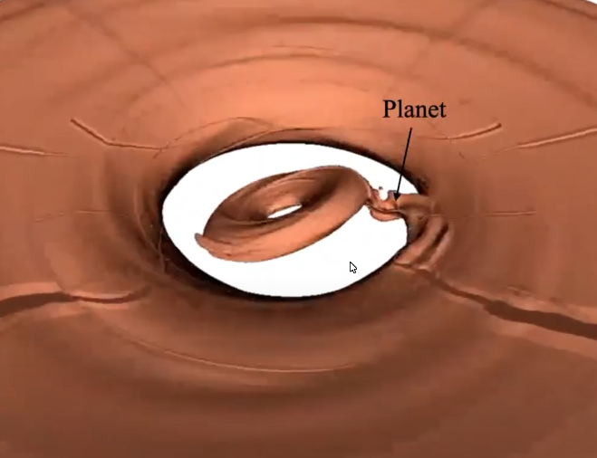
Temporal Variability in Disks
J. Kobus + 2020 ~10% of disk sample have temporally variable brightness distributions.
Symmetrical variations
Asymmetric variations
There is already evidence that the inner disk is dynamic
Dippers
Turbulent accretion
Shadowing by the inner disk on the outer disk
Zhaohuan Zhu + 2022

Slide 25
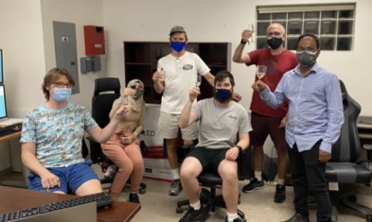
Future Work
More data with CHARA + VLTI
H+K images with new MIRC-X and MYTSIC data
Investigate wavelength independence further
Investigate the off-center star models
Currently doing lots of observing of T Tauri stars

Slide 26
Summary
With more sensitive instruments and improved data, we were tested multiple simple geometric models, both symmetric and asymmetric
We were able to produce convincing evidence of a ring-like structure with an inner cavity, and some evidence of changes.
The modified α Double Sigmoid model showed that the inner and outer rims are relatively smooth, with the inner rim having a sharper profile due to the dust destruction front. We also see that the disk is almost face-on with inclination angles ≤ 20°
The modeling revealed the fractions of flux contributed by each component. The star contributes 41%, the halo 4.6%, and the disk 56% with ~ 15% of that disk flux coming from inside the inner rim
The best simple model to fit the closure phases is a skewed Double Sigmoid ring with an off-center star, which was backed up by the imaging.
The imaging revealed possible evidence of rotating sub-AU features. This change could be caused by dynamics in the outer disk, or it could be an artifact.

Slide 27
Thank you!
Any questions ?
inoura@umich.edu

