Slide 1
Welcome to GSU
Dean Sara Rosen
College of Arts & Sciences
Georgia State University
Notes:
Monday, March 13, 2023, 9:20 a.m.
Happy Monday, everybody!
I’m Sara Rosen, dean of the College of Arts & Sciences at Georgia State University.
It is my distinct pleasure to welcome you to GSU for the 2023 CHARA Science Meeting.
This is the 17th meeting since 2005, and the first to be held in Atlanta since 2015.
We are so excited to bring the CHARA community together to discuss recent developments and scientific results at the CHARA Array.

Slide 2
Introduction
A bit about myself
Georgia State University campuses
College of Arts & Sciences
CHARA and the Department of Physics & Astronomy
Notes:
To tell you a little more about myself, I have served as dean of the College of Arts & Sciences for over 6 years since I came to GSU in 2016.
Previously, I was at the University of Kansas, where I served as Senior Vice Provost for Academic Affairs for 5 years, as well as interim provost for a time, and other roles.
My academic expertise is in the field of linguistics.
Add a line about your particular area of focus

Slide 3
Introduction
A bit about myself
Georgia State University campuses
College of Arts & Sciences
CHARA and the Department of Physics & Astronomy
Notes:
Again, I’m honored to welcome you to Georgia State
GSU is among the 10 largest universities in the U.S., with an enrollment of more than 52,000 students.
We have 6 campuses around the Atlanta metro area, including our traditional campus in downtown Atlanta, and 5 campuses that are part of our 2-year Perimeter College.
Georgia State’s wide footprint also includes facilities like Indian Creek Lodge, where we are today, plus the Language Research Center at Panthersville, Hard Labor Creek Observatory in Rutledge, Georgia, and of course the CHARA Array at Mount Wilson, California.
At GSU, we’re very proud of our reputation as a national leader in graduating students from diverse backgrounds.
Georgia State is ranked by U.S. News & World Report as the No. 1 public university in the country for undergraduate teaching.
We’re also ranked as the No. 2 most innovative university and No. 6 for the first-year student experience we provide. →
Our diverse and fast-growing research portfolio is also a point of pride at GSU.
For five consecutive years, Georgia State has been among the top 20% nationally in research expenditures, according to the NSF HERD report.
And the Chronicle of Higher Education lists GSU as having the 5th fastest-growing research portfolio in the country.
Research spending contributes significantly to Georgia State’s $2.8 billion-dollar economic impact in the state of Georgia.

Slide 4
Introduction
A bit about myself
Georgia State University campuses
College of Arts & Sciences
CHARA and the Department of Physics & Astronomy
Notes:
Arts & Sciences is the largest academic unit at Georgia State’s Atlanta campus, and we like to say that we are the intellectual heart of the university.
The college consists of 22 academic departments and institutes, plus 17 research centers, that span the humanities, the social & behavioral sciences, and the natural & computational sciences.
In enrollment, we have about 13,000 undergraduate majors and nearly 2,000 graduate students in the college.
We teach the core curriculum to all 4-year students on the Atlanta campus, and we are home to numerous research hubs that are driving research innovation and growth at GSU.

Slide 5
Arts & Sciences = Research + Discovery
Life
&
Health
Sciences
Social Change,
Conflict
& Resilience
Digital
Innovation
Matter,
Energy,
Earth,
and Space
Global
Language
&
Culture
Mind, Brain
& Behavior
Notes:
Much of the college’s research connects to one or more of the overarching research hubs shown here in the slide:
Social change, conflict, and resilience;
Digital innovation;
Life and health sciences;
Global language and culture;
Mind, brain, and behavior; and
Matter, energy, Earth, and space
As dean, I never stop marveling at the breadth of fascinating research and scholarship being done under the umbrella of the college.

Slide 6
Introduction
A bit about myself
Georgia State University campuses
College of Arts & Sciences
CHARA and the Department of Physics & Astronomy
Notes:
Our Physics & Astronomy faculty include internationally-distinguished scientists, whose research spans everything from the very small, at the nano-scale, to the very big, at the galactic level.
CHARA is the department’s crown jewel project, which supports world-class science in the discipline of astronomy.

Slide 7
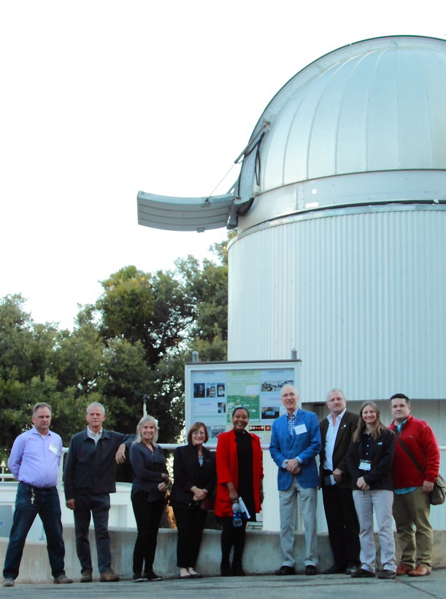
CHARA Array at Mount Wilson Observatory
My visits to our “western campus” to meet staff
Role of CHARA in scholarship and training of the next generation of scientists
Participants at this meeting include 10 past GSU PhDs 10 current GSU PhDs 5 GSU undergraduate students
Notes:
I’ve had the pleasure of visiting the CHARA array 3 times as dean.
We like to call Mount Wilson our “western campus.”
Add a line or two about your experiences visiting the CHARA array
Operating a highly specialized, world-class instrument like this is a huge distinction for the department, the college, and GSU.
The observing program supports GSU faculty, collaborating scientists, and visiting scientists from around the world.
The CHARA array has enabled advancements in stellar astrophysics and has contributed to the detection of planetary systems, imaging of developing stars, and studies of other phenomena such as novae [NO-vay].
In addition, the array supports our academic programs as we train the next generation of scientists.
Our students benefit from the unparalleled opportunity of observing time at the CHARA array.
In fact, we have 5 undergraduates, 8 Ph.D. students, and 9 former Ph.D. students participating in this year’s meeting.

Slide 8
This meeting
March 13-14
Indian Creek Lodge
17th meeting since 2005
First in Atlanta since 2015
50 in-person plus 60 online participants through Webex
Participants from 13 countries
Notes:
In total, we are joined by nearly 100 participants from 9 different countries, representing our large CHARA consortium and the growing community of open access observers.
This includes 48 participants joining in person and another 43 joining virtually.
As I said earlier, this is the 17th meeting since 2005, and the first to be held in Atlanta since 2015.
The purpose for the Science Meeting is to discuss recent science results and technical developments at the CHARA array.
This includes work on the next generation of beam combiners and progress on adding a mobile telescope to the array, which will be the array’s 7th telescope.

Slide 9
CHARA Imaging Workshop
March 16-17
Aderhold Learning Center
GSU Downtown Campus
Introduction to interferometry
Summary of observing strategies
Overview of modeling and imaging software packages
Notes:
Following our Science Meeting, there is an Imaging Workshop being held Thursday-Friday this week at the Aderhold Learning Center on our downtown campus.
This will be a hands-on workshop that will provide instruction, demonstrations, and advice to students and other scientists on getting the most from their observations with the CHARA array.
Participants are encouraged to bring their own interferometric data to work on, though there will be sample data sets available.

Slide 10
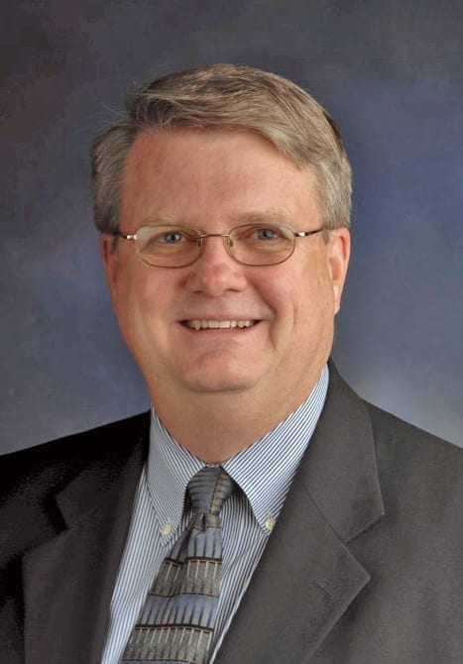
Special Participants
Dr. Hal McAlister GSU Regents’ Professor Emeritus CHARA Director (Founder), 1985 - 2015
Presenting this morning on “The History of CHARA and Interferometry at Mount Wilson”
Notes:
There are several special participants this year who I would like to recognize briefly…
First is Dr. Hal McAlister, Regents’ Professor Emeritus of Physics & Astronomy and founding director of CHARA.
Dr. McAlister will present this morning on the history of CHARA and interferometry at Mount Wilson.

Slide 11
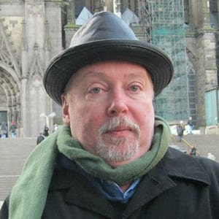
Special Participants
Dr. Theo ten Brummelaar Director of the CHARA Array, 2015-2022, and key instrument scientist since the start of the project
Now living in Sydney, Australia, but continues to work on several projects underway.
Participant who travelled farthest to attend!
Notes:
Dr. Theo ten Brummelaar, former director of the CHARA array from 2015-2022, has traveled all the way from Sydney, Australia to attend in person.

Slide 12
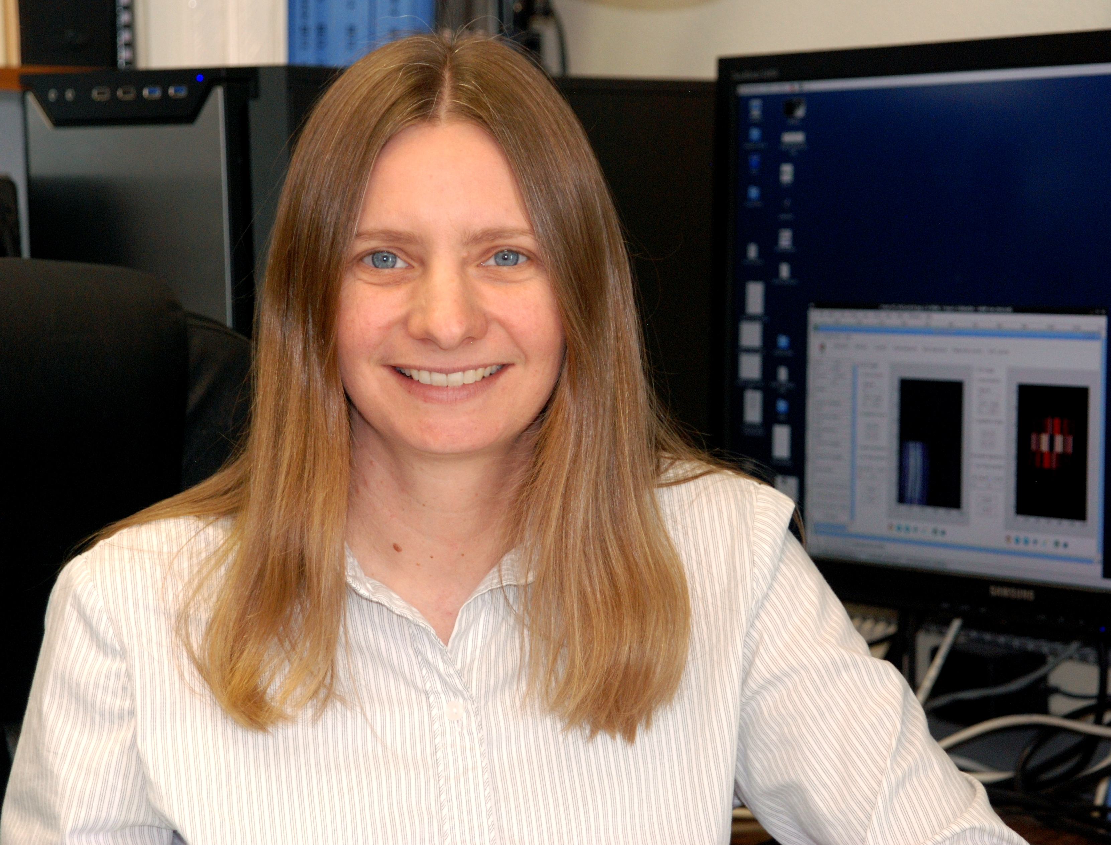
Special Participants
Dr. Gail Schaefer Director of the CHARA Array since May, 2022
First CHARA Meeting with Gail in this leadership role
Looking forward to working together in the years ahead
Notes:
Dr. Gail Schaefer is joining the meeting for the first time in the role of director of the CHARA array.
Dr. Schaefer stepped into the director role in May last year, and I look forward to continuing to work with Dr. Schaefer in the years ahead.

Slide 13
Special Participants
Dr. Bill Hartkopf Early CHARA faculty member
Dr. Denis Mourard Collaborator from Univ. Nice, France
Dr. John Monnier Collaborator, Univ. of Michigan
Dr. Stefan Kraus Collaborator, Univ. Exeter, United Kingdom
Notes:
We are also joined by…
Dr. Bill Hartkopf, an early CHARA faculty member
Dr. John Monnier, a collaborator from the University of Michigan at Ann Arbor
Dr. Denis Mourard, a collaborator from the University of Nice in France; and
Dr. Stefan Kraus, a collaborator from the University of Exeter in the UK

Slide 14
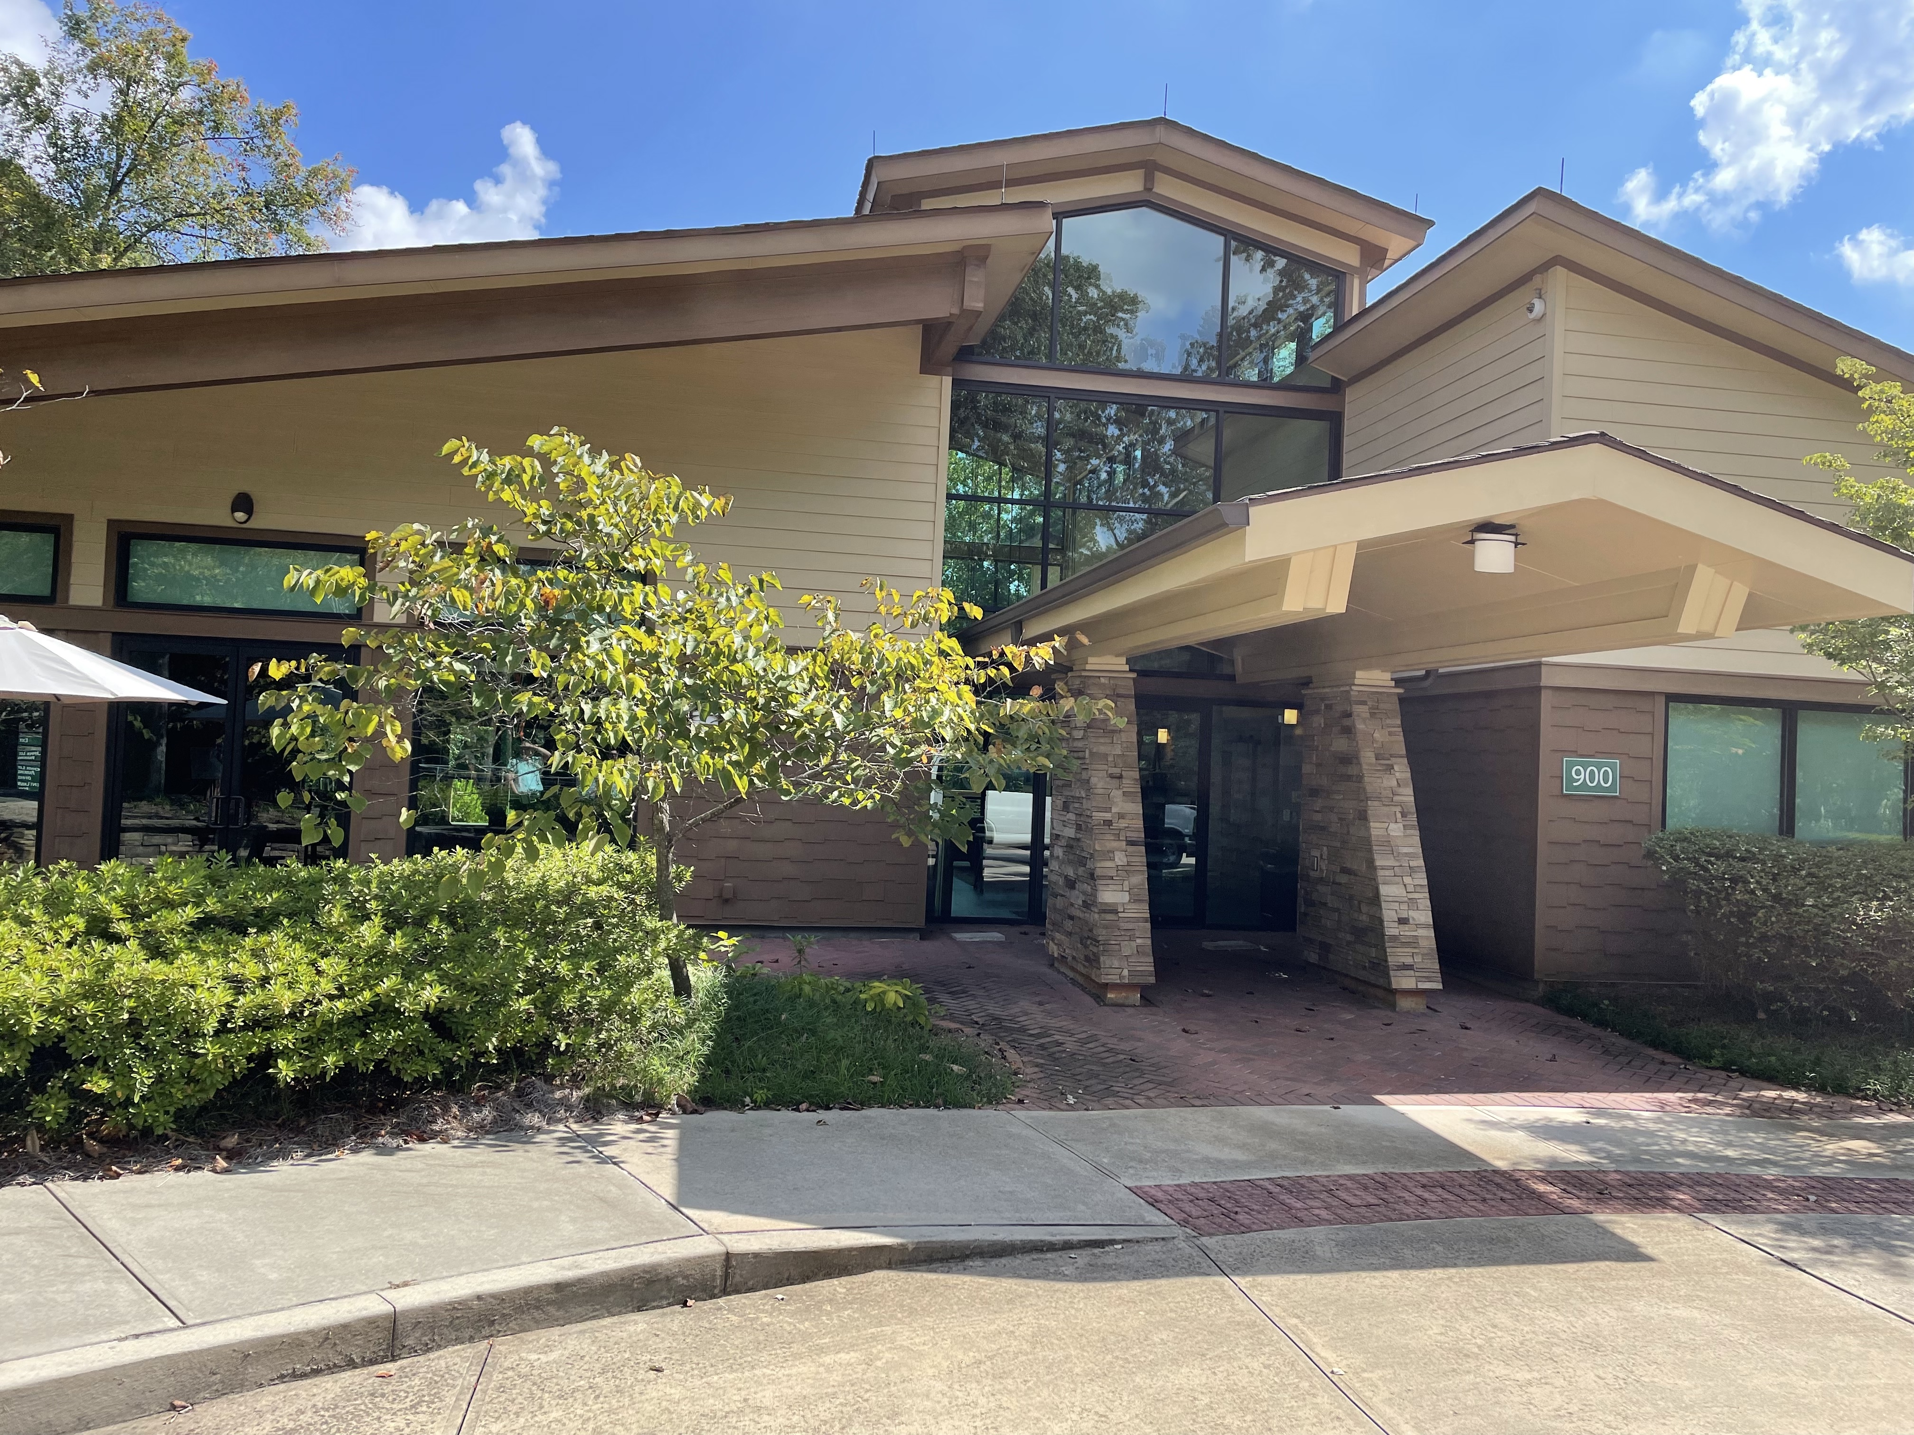
Best wishes for a successful week of: exciting science new opportunities in instrumentation innovative methods in data analysis
Enjoy springtime in Atlanta!
Notes:
Although not listed in a slide, I also want to recognize Dr. Doug Gies for his efforts in organizing this meeting, and for his outstanding leadership of the center.
In just a moment, Dr. Gies will share some updates with you from the CHARA array.
On behalf of all of my colleagues at GSU, I want to wish everyone a productive meeting, and a successful week of exciting science, new opportunities in instrumentation, and innovative methods in data analysis.
For those of you here in person, I hope you enjoy springtime in Atlanta. There’s yellow pollen everywhere!
Now I will turn it over to Dr. Gies to update you on CHARA news.

