Slide 1
Age Calibrations with Resolved Binaries in Nearby Clusters
Eric Sandquist
with
Leslie Morales, Rex Lam, Chris Danner
and many thanks to CHARA/CLIMB/MIRCX/MYSTIC people!!

Slide 2
Mass and Age Standard Stars – Studying Timing Reliability In Cluster Territory
MASS – STRICT
Notes:
title of uber-project

Slide 3
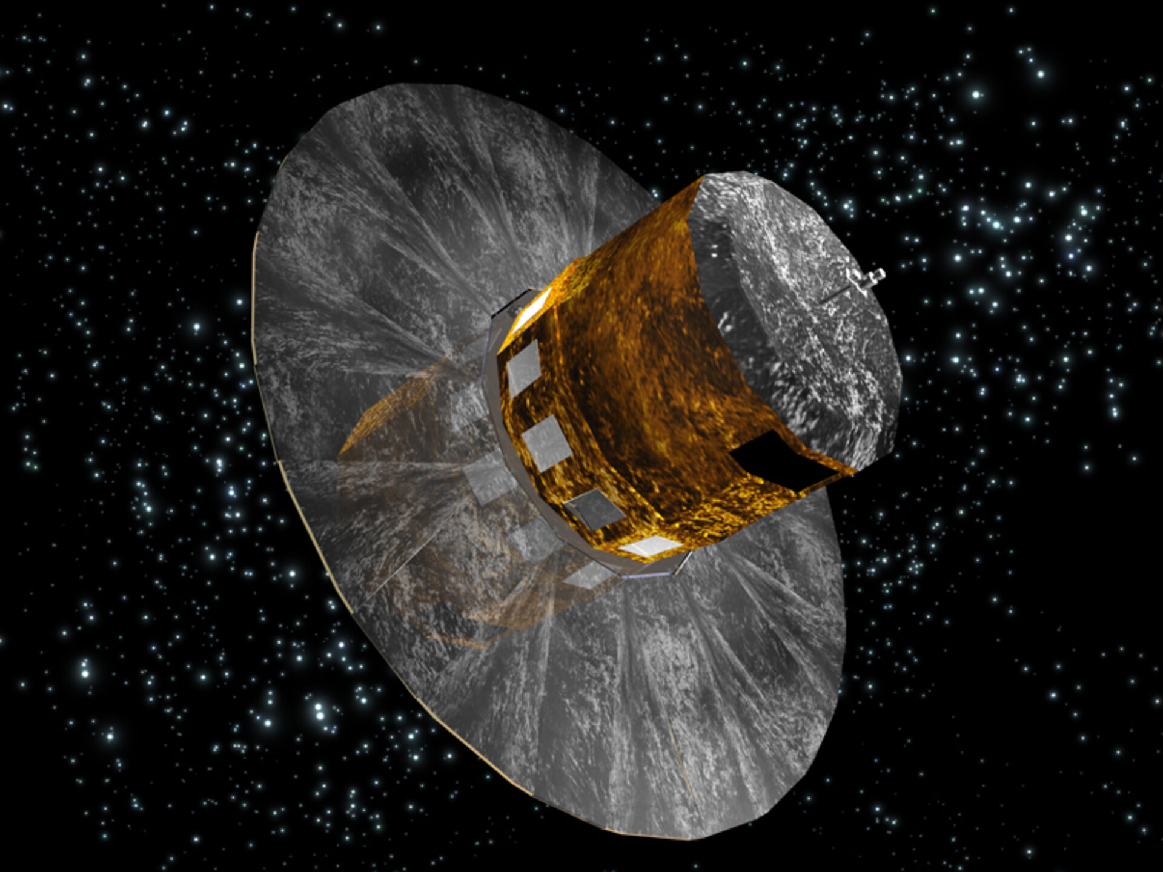
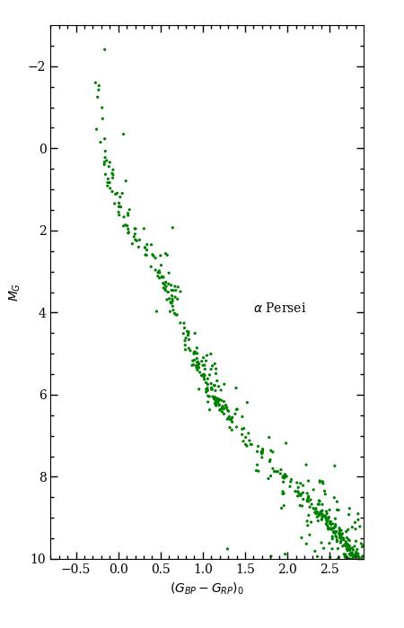
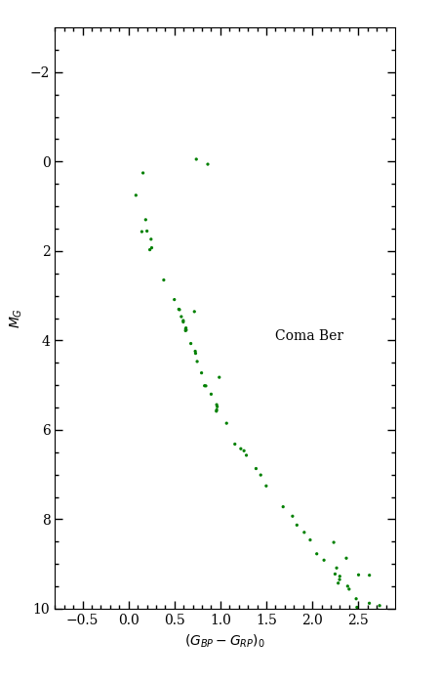
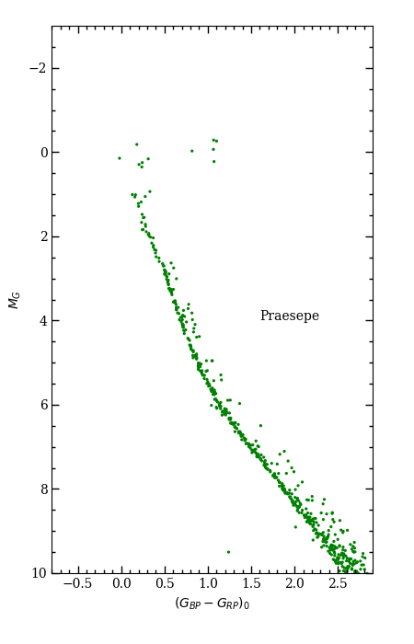
Gaia Color-Magnitude Diagrams
100 Myr
500 Myr
600 Myr
Notes:
gorgeous CMDS
many age dating techniques can be tested
if we are honest with ourselves, isochrone fitting ages usually are uncertain in the first digit
(convection in core! uncertainties directly affect age!)

Slide 4
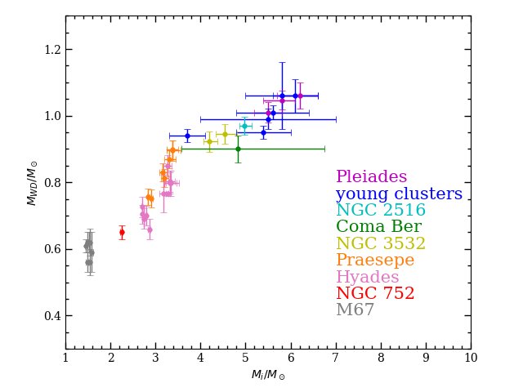
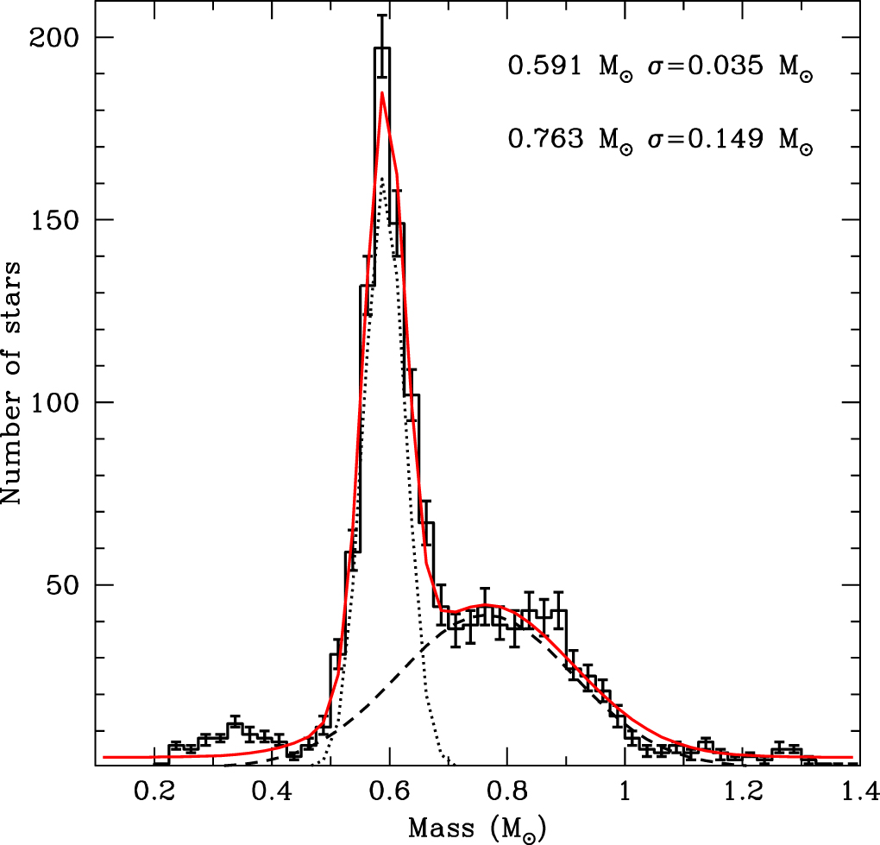
White Dwarf Initial-Final Mass Relation (IFMR)
sources:
Cummings et al. (2018)
Richer et al (2021)
Marigo et al. (2021)
Heyl et al. (2022)
Notes:
➔new kind of WD (ONeMg instead of CO) above 1.05 Msun?
uncovers the uncertainties in our understanding of WD production
clusters provide us the main means of translating to progenitor star
shows clusters constraining transition from 1.0 to 0.6 Msun: Praesepe, Hyades, M37 (Cummings et al. 2015), NGC 6633 (Williams & Bolte 2007)
most massive WD in NGC 2516
8.5+/-1.5 Msun from SN
***M35 and NGC 2516 are the critical ~1Msun WDs near 5-6 Msun initial mass

Slide 5
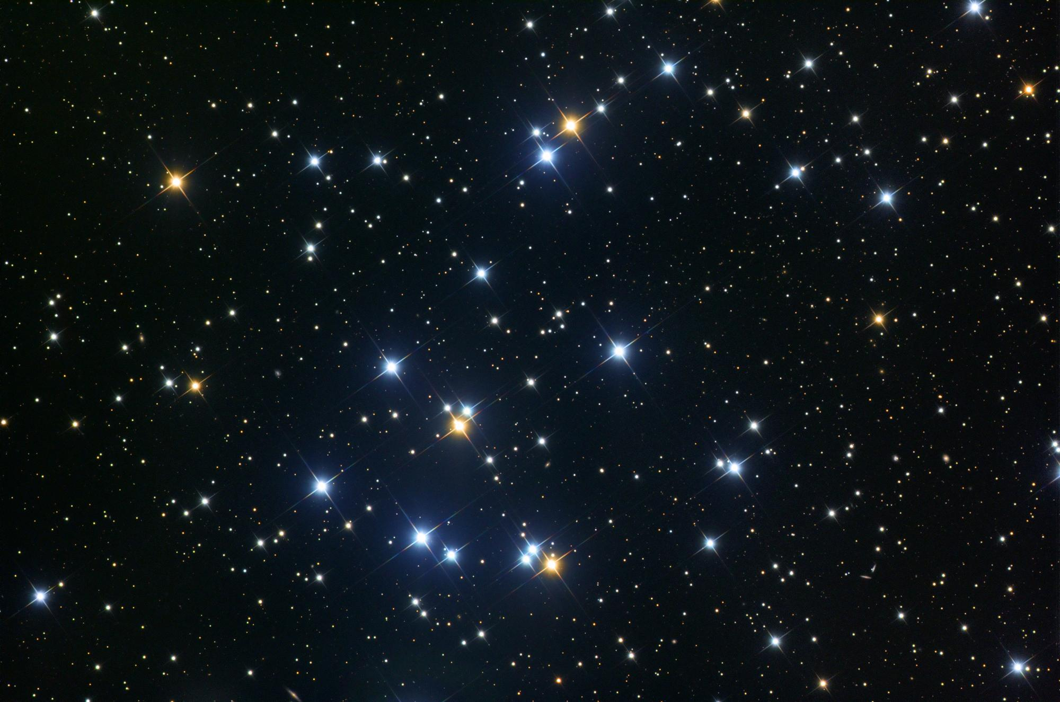
Praesepe (M44)
~ 600 Myr
ε Cnc
P=35.14d
credit: Joseph L. Sendón
Notes:
show CMD to prove accurate age from interferometry
omega = 261° i≈80°

Slide 6
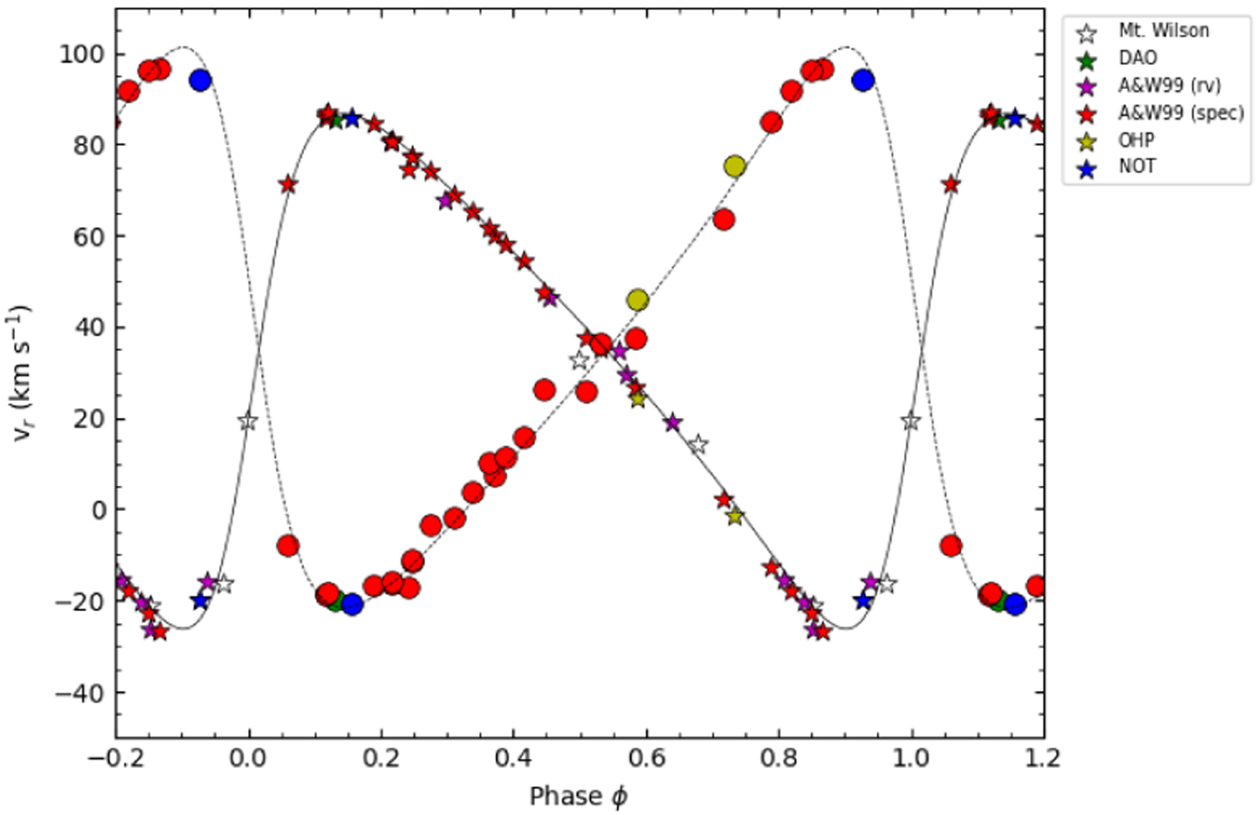
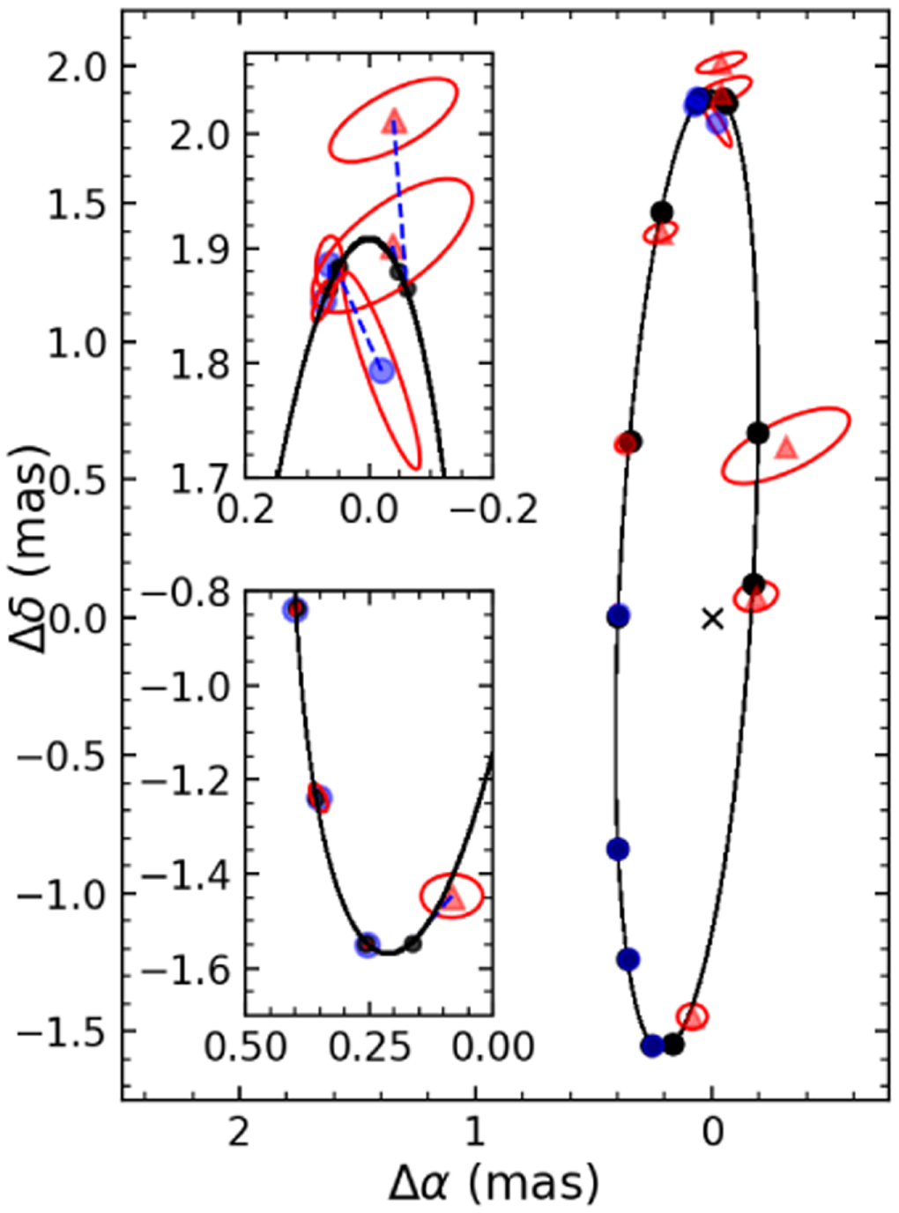
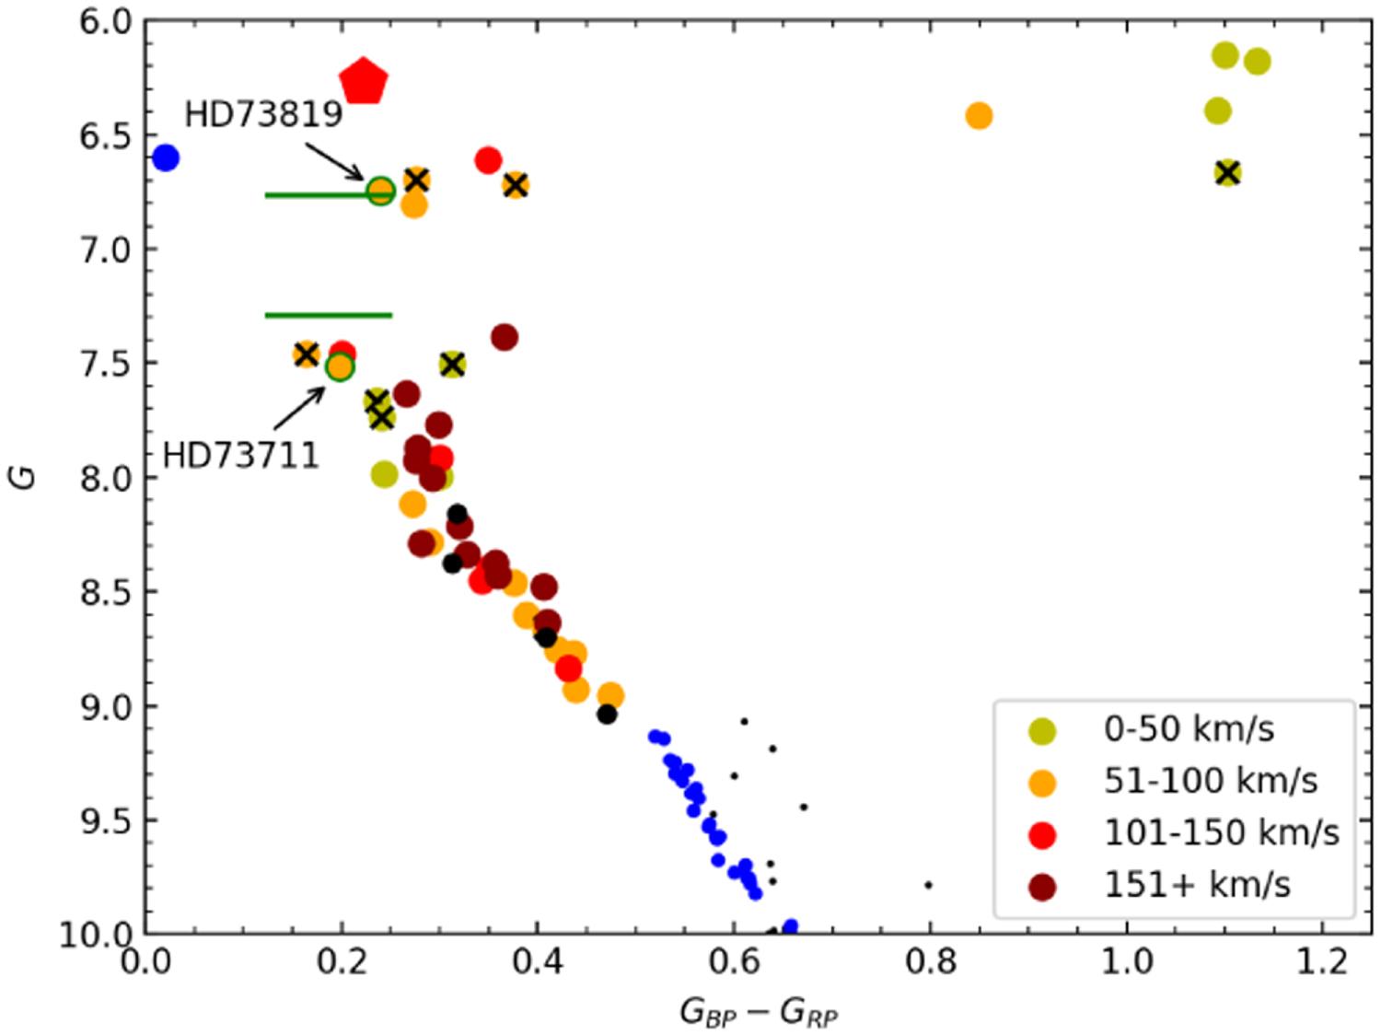
𝜀 Cnc
age: 637±19 Myr
$$M_{1}=2.420±0.008 M_{⊙}$$
$$M_{2}=2.226±0.004 M_{⊙}$$
CLIMB
MIRCX
Morales et al. 2022
Notes:
show CMD to prove accurate age from interferometry
5 sigma uncertainties on positions
omega = 261° i≈80°

Slide 7
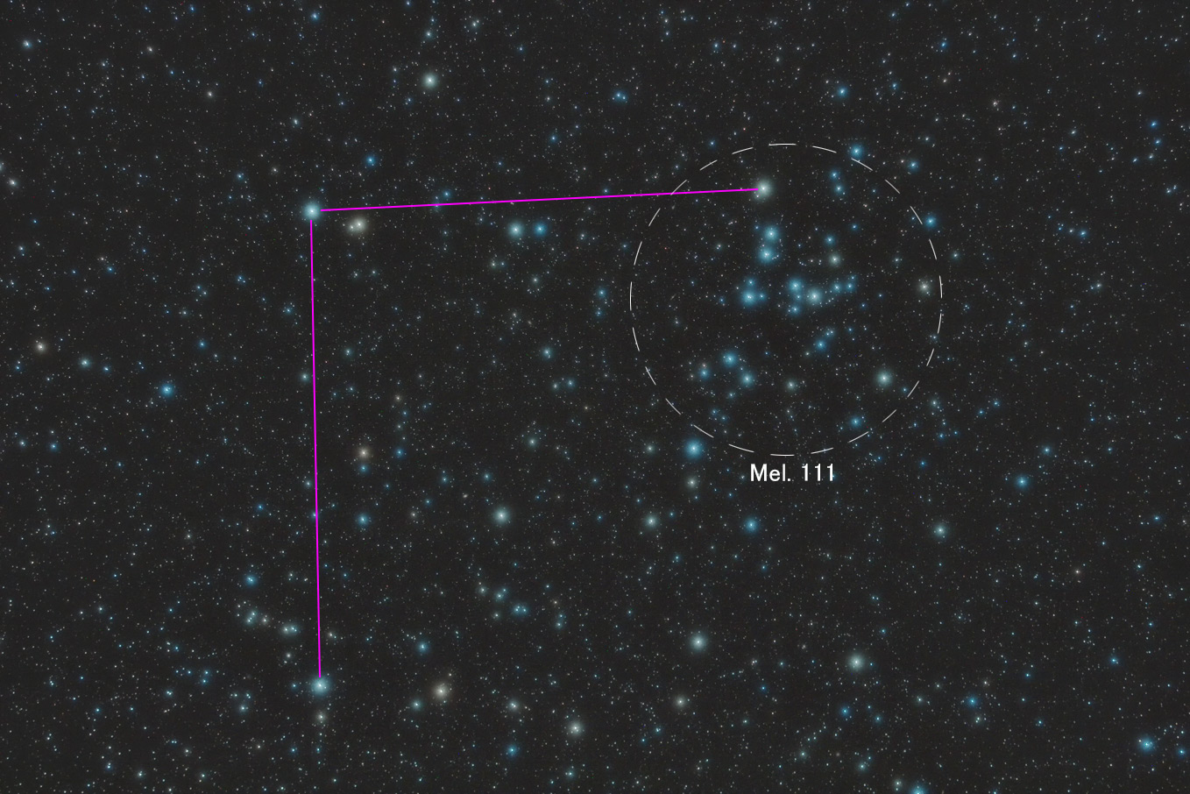
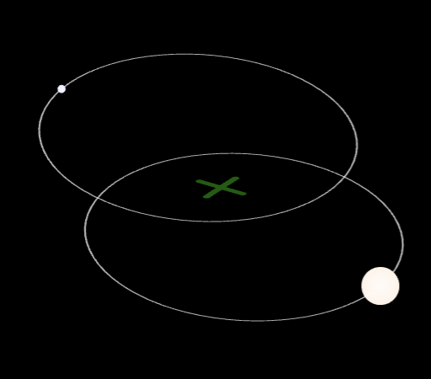
Coma Ber
~ 500 Myr
31 Com
12 Com
P=396.45d
credit: Naoyuki Kurita
Notes:
resolved both giants in the cluster
12 Com: G7 giant + A3 dwarf

Slide 8
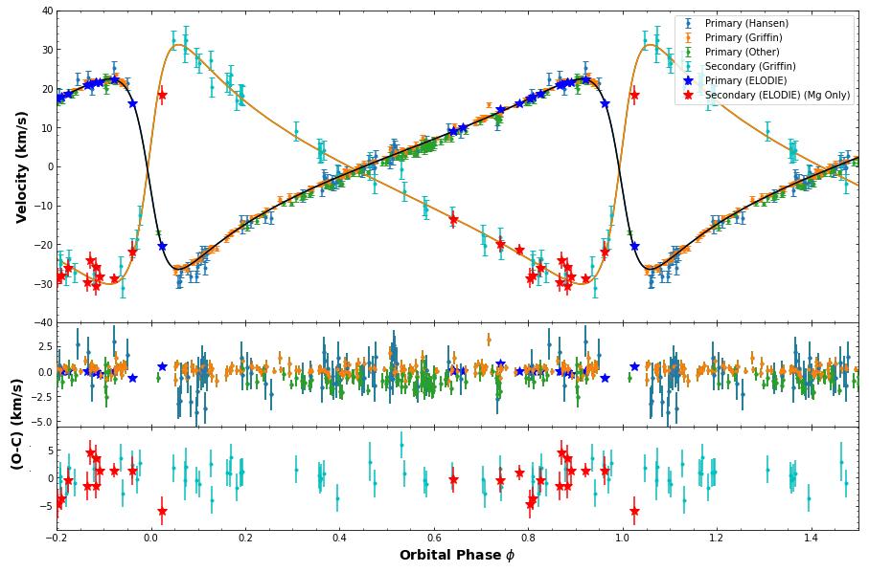
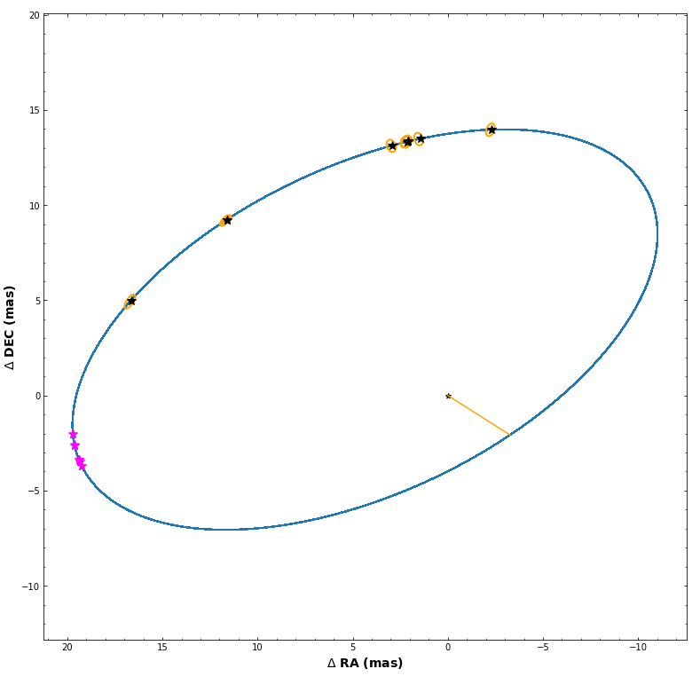
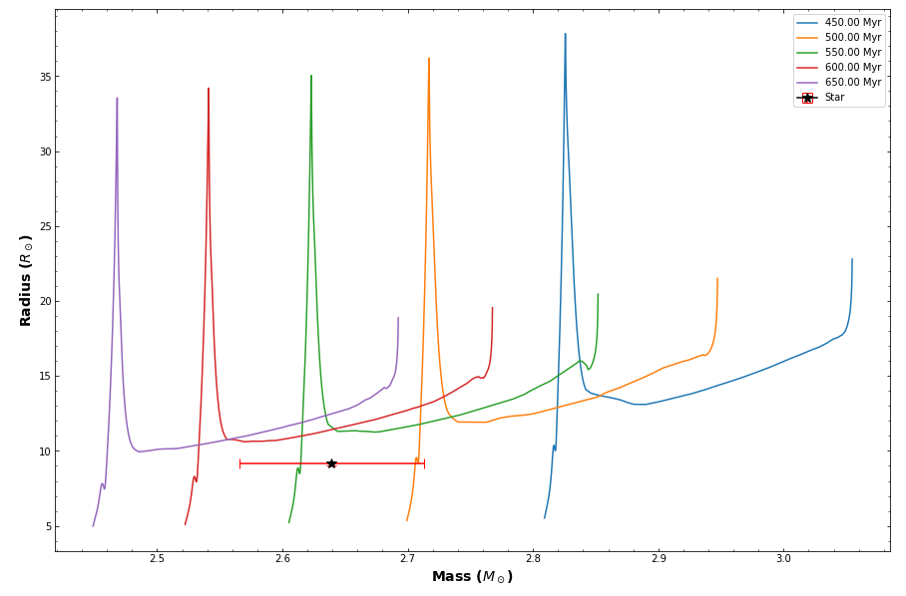
12 Com
age: 533±41 Myr
$$M_{1}=2.64±0.07 M_{⊙}$$
$$M_{2}=2.10±0.03 M_{⊙}$$
MIRCX
PTI
Lam et al. (submitted)
Notes:
Julie Vinter Hansen 1940 orbit
omega = 261° i≈80°

Slide 9
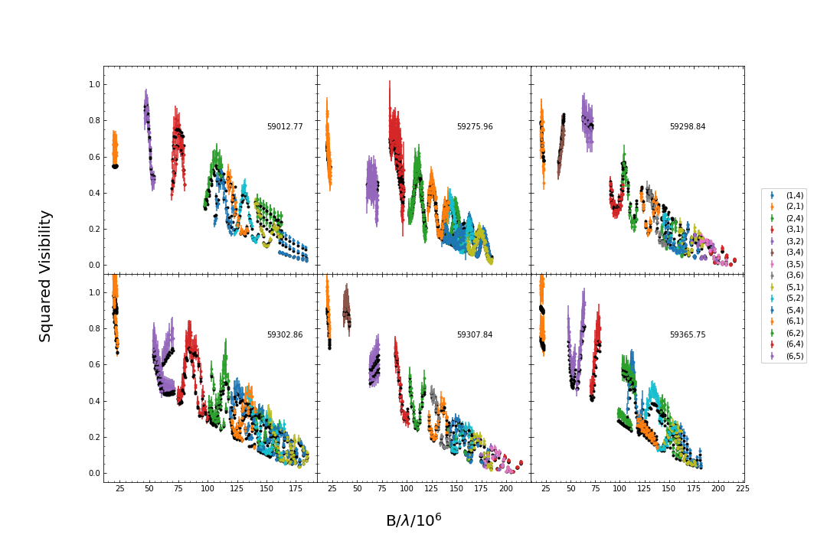
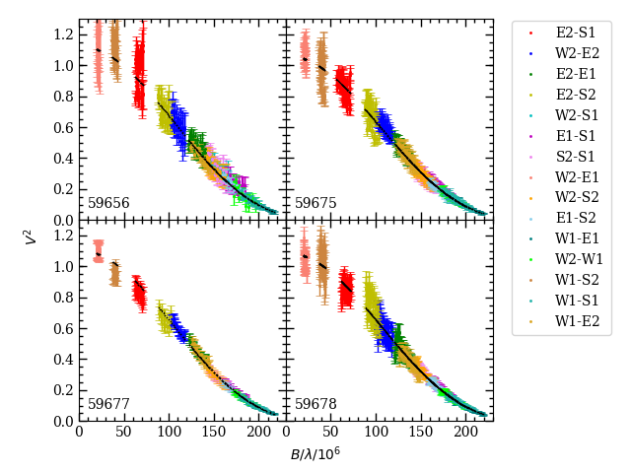
12 Com
$R_{12}=9.12±0.12 R_{⊙}$
31 Com
$R_{31}=8.36±0.15 R_{⊙}$
Lam et al. (submitted)
Notes:
Julie Vinter Hansen 1940 orbit
omega = 261° i≈80°

Slide 10
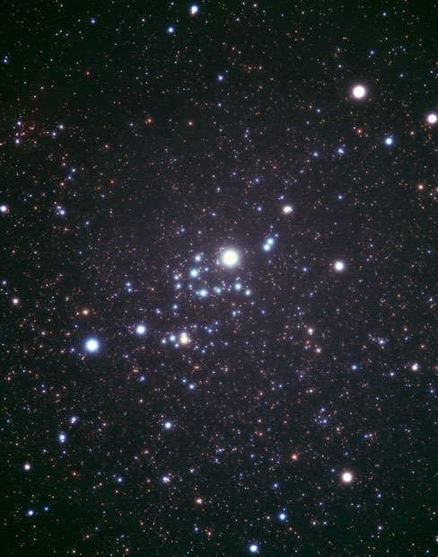
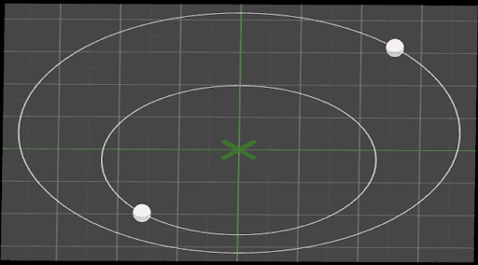
𝛼 Per
~ 100 Myr
HD 21278
P=21.69d
credit: Naoyuki Kurita
Notes:
omega = 261° i≈80°

Slide 11
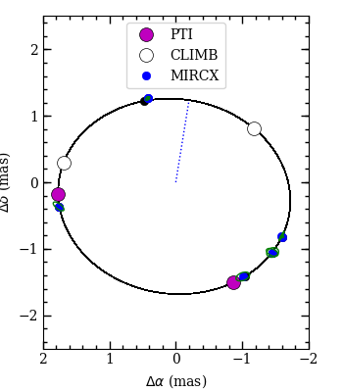
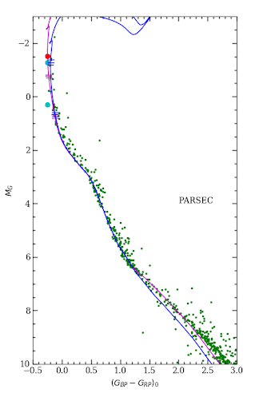
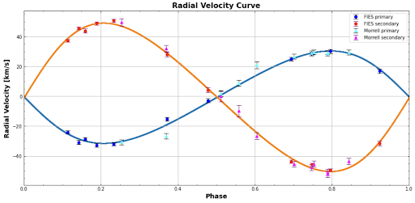
HD 21278
age: 101±10 Myr
$$M_{1}=4.55±0.07 M_{⊙}$$
$$M_{2}=2.83±0.06 M_{⊙}$$
Danner et al. (in prep.)
Notes:
omega = 261° i≈80°

Slide 12
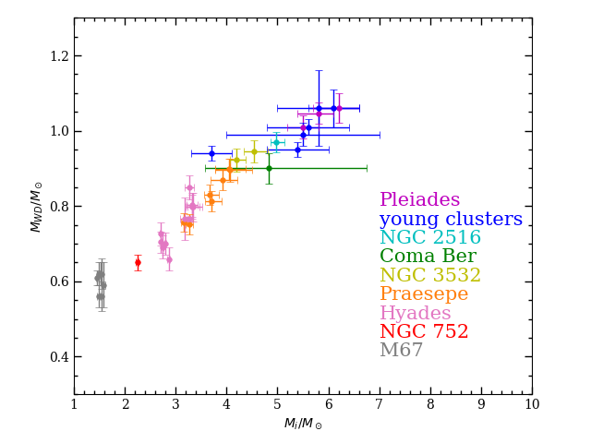
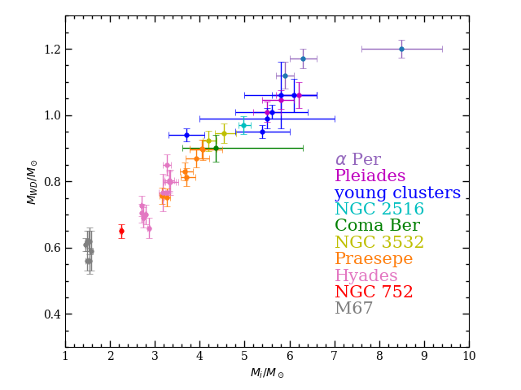
White Dwarf Initial-Final Mass Relation
sources:
Cummings et al. (2018)
Richer et al (2021)
Marigo et al. (2021)
Heyl et al. (2022)
Miller et al. (2022)
Notes:
8.5+/-1.5 Msun from SN

