Slide 1
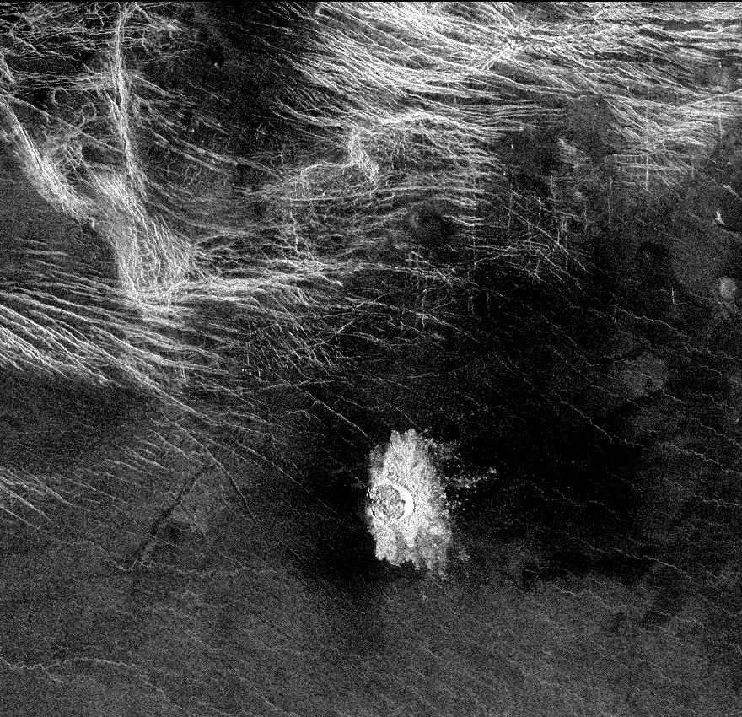
Where
is
this?
Notes:
VENUS by MAGELLAN: Crater Stephania is located at 51.3 degrees latitude, 333.3 degrees longitude in northern Sedna Planitia on Venus. With a diameter of 11 kilometers (6.8 miles) it is one of the smaller craters on Venus. Because many small meteoroids disintegrate during their passage through the dense atmosphere, there is an absence of craters smaller than 3 kilometers (1.9 miles) in diameter, and even craters smaller than 25 kilometers (15.5 miles) are relatively scarce. The apron of ejected material suggests that the impacting body made contact with the surface from an oblique angle. Upon closer observation it is possible to delineate secondary craters, impact scars from blocks ejected from the primary crater. A feature associated with this and many other Venusian craters is a radar-dark halo. Since dark radar return signifies a smooth surface, it has been hypothesized that an intense shock wave removed or pulverized previously rough surface material or that a blanket of fine material was deposited during or after the impact.

Slide 2
Homework
THURSDAY, 05 SEP SSE!
.pdf of Icarus or Planetary Science Journal article
by the beginning of class
Get 5 points in Solar System Explorers.
TUESDAY, 10 SEP
write 3 sentences each on 2 topics
you might want to explore for your project

Slide 3
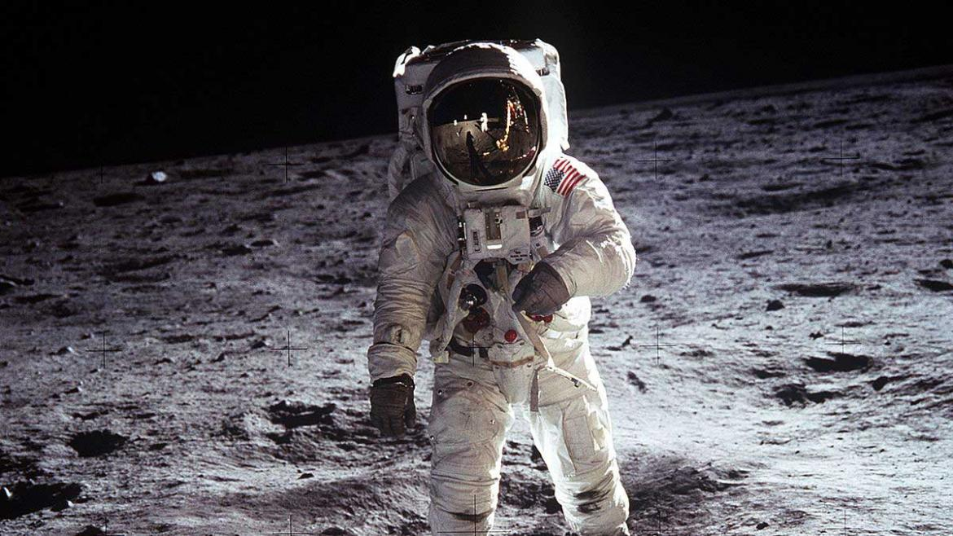
Solar System Overview II

Slide 4
Planet Orbits
Mercury
Venus
Earth
Mars
Jupiter
Saturn
Uranus
Neptune
a (AU)
0.39
0.72
1.00
1.52
5.20
9.54
19.19
30.07
P (yr)
0.24
0.62
1.00
1.88
11.86
29.46
84.01
164.79
e
0.206
0.007
0.017
0.093
0.048
0.056
0.046
0.009
Notes:
Venus is most circular with e = 0.007

Slide 5
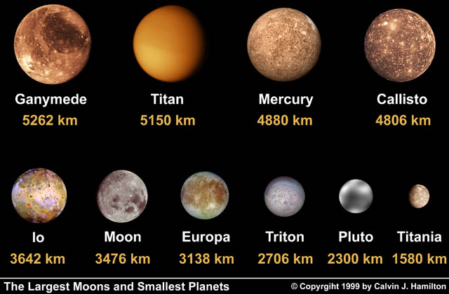
The 7 Moons (+ interlopers)
X
X
X

Slide 6
Terrestrial Planet Surface

Slide 7
Surface Variability

Slide 8
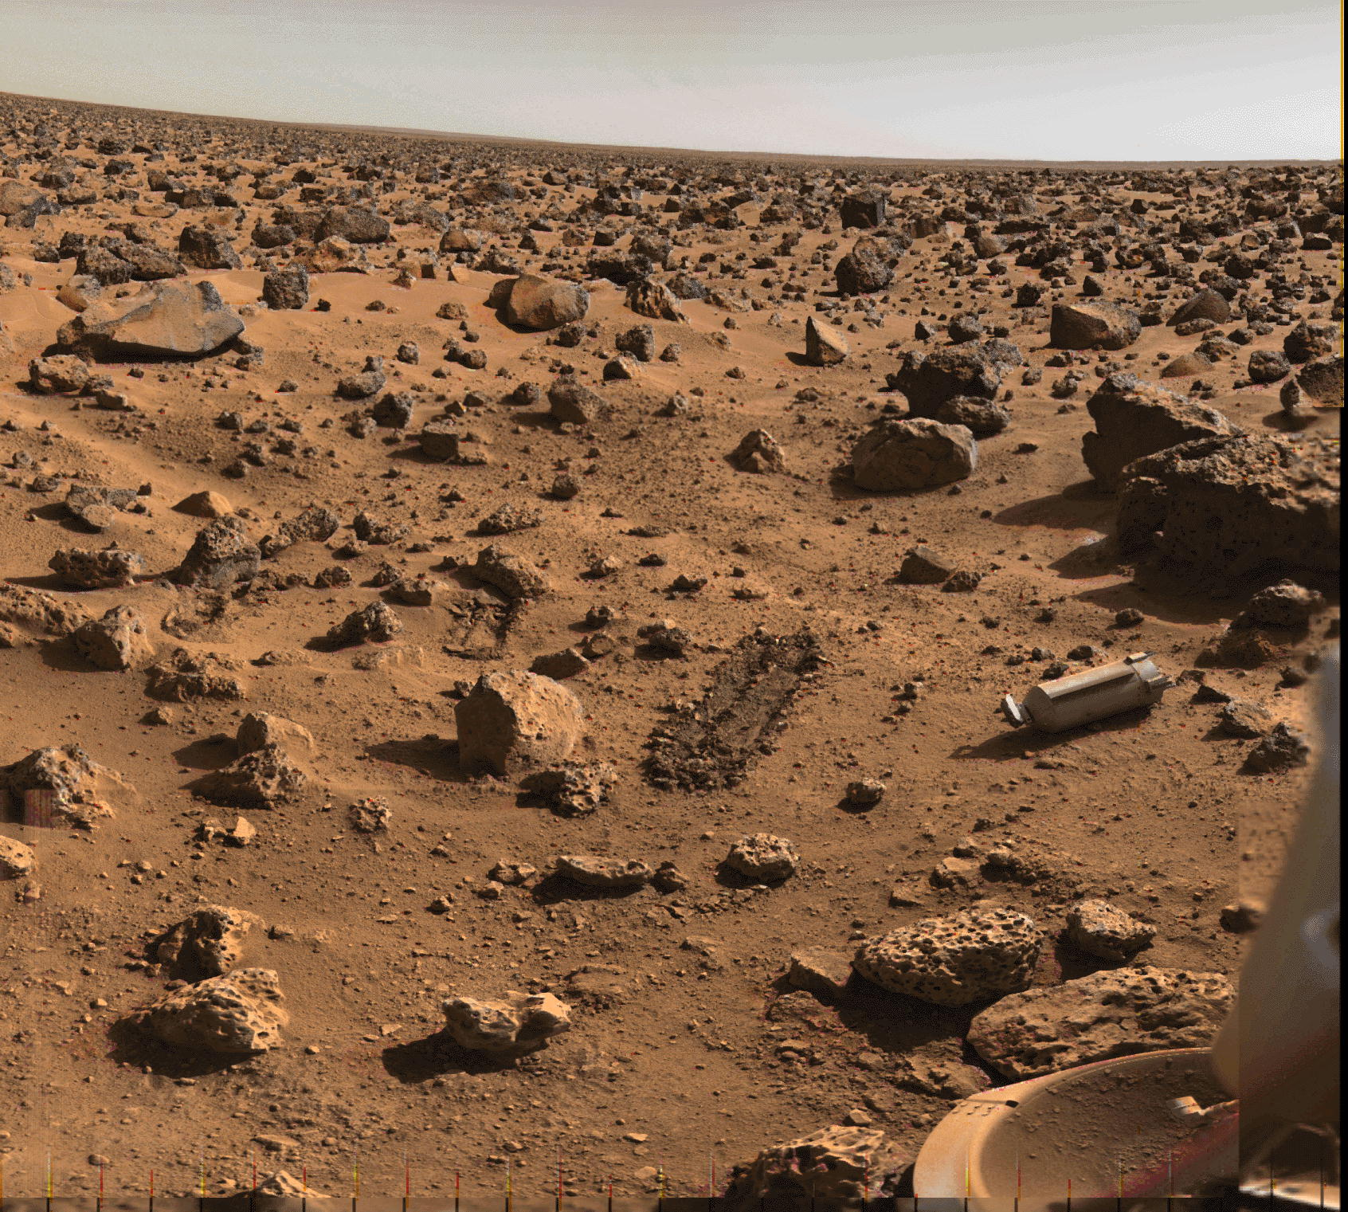
…we can land/work on surfaces

Slide 9
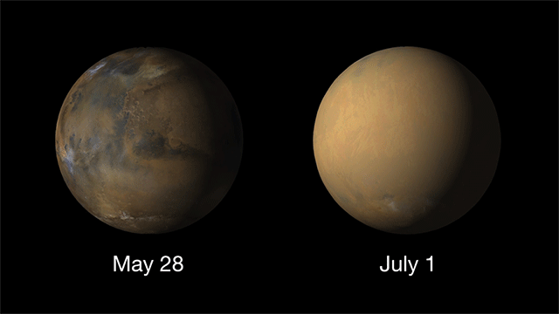
… sometimes (2018)
Notes:
Martian dust storm of 2018

Slide 10
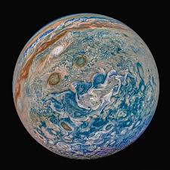
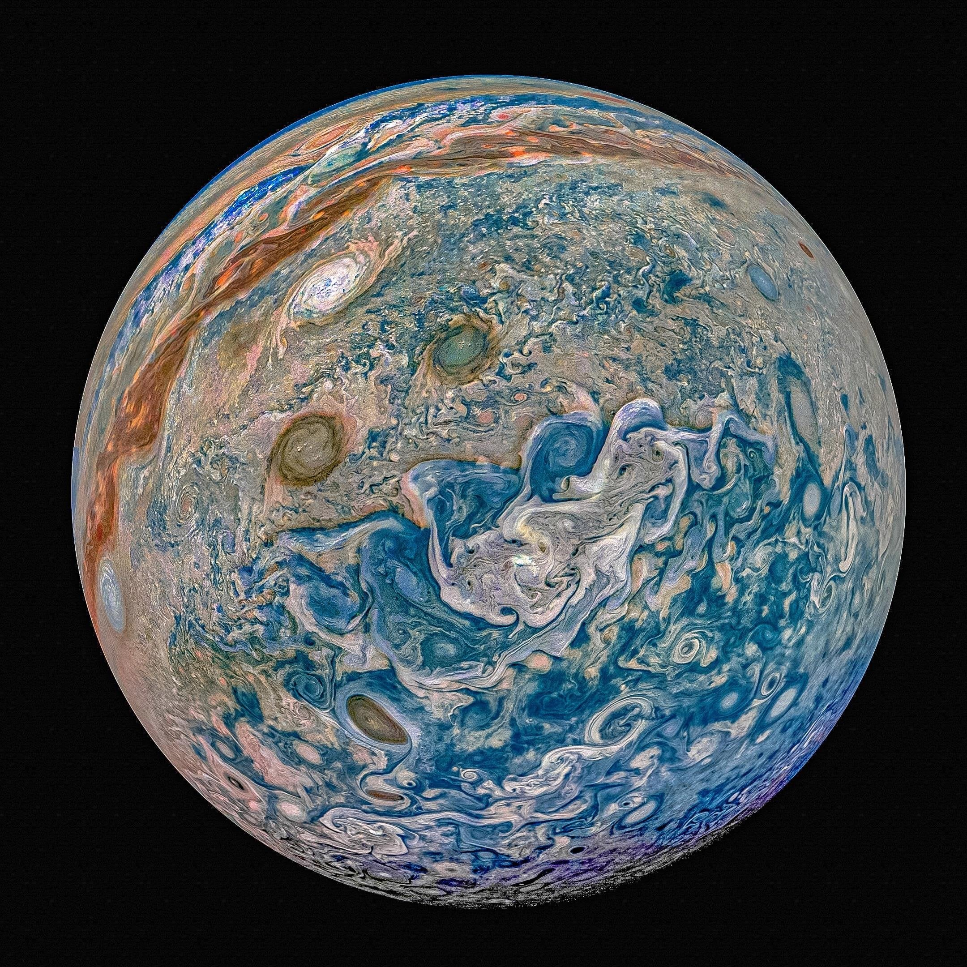
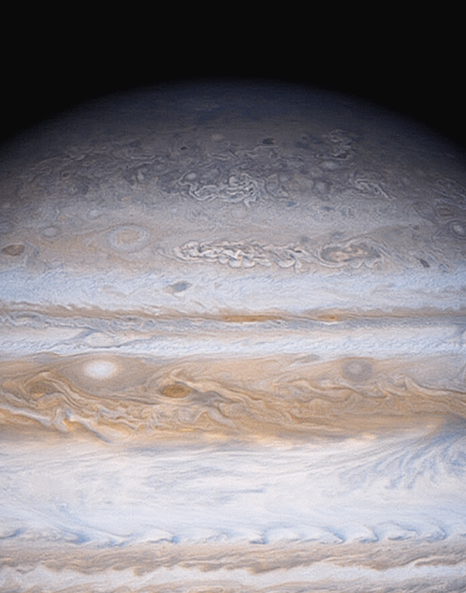
Jovian Planet “Surface”
2,160 × 2,160
Notes:
Jupiter clouds by Voyager 1

Slide 11
Jovian Planet “Surface”
Notes:
Jupiter clouds by Juno

Slide 12
Possible Projects
hot topics
Perseverance/MAVEN/MRO/Curiosity/Mars Express results
Juno at Jupiter
New Horizons results … Pluto … Arrokoth (SSE!)
TESS discoveries of other solar systems
outstanding objects
Jovian moons
edge of the Solar System … TNOs … KBOs … SDOs
comet chemistry
planet formation
the “Nice Model”
disks and timescales in Solar System formation
life in the Solar System
organisms on Titan, Enceladus, Europa, Mars
human mission to Mars
humans in space
database project … INDEPENDENT AND NEW
minor planets
exoplanet statistics
Notes:
MAVEN = Mars Atmospheric and Volatile EvolutioN
MRO = Mars Reconnaissance Orbiter … launched 2005 AUG 12
SSE! for previous name = Ultima Thule

Slide 13
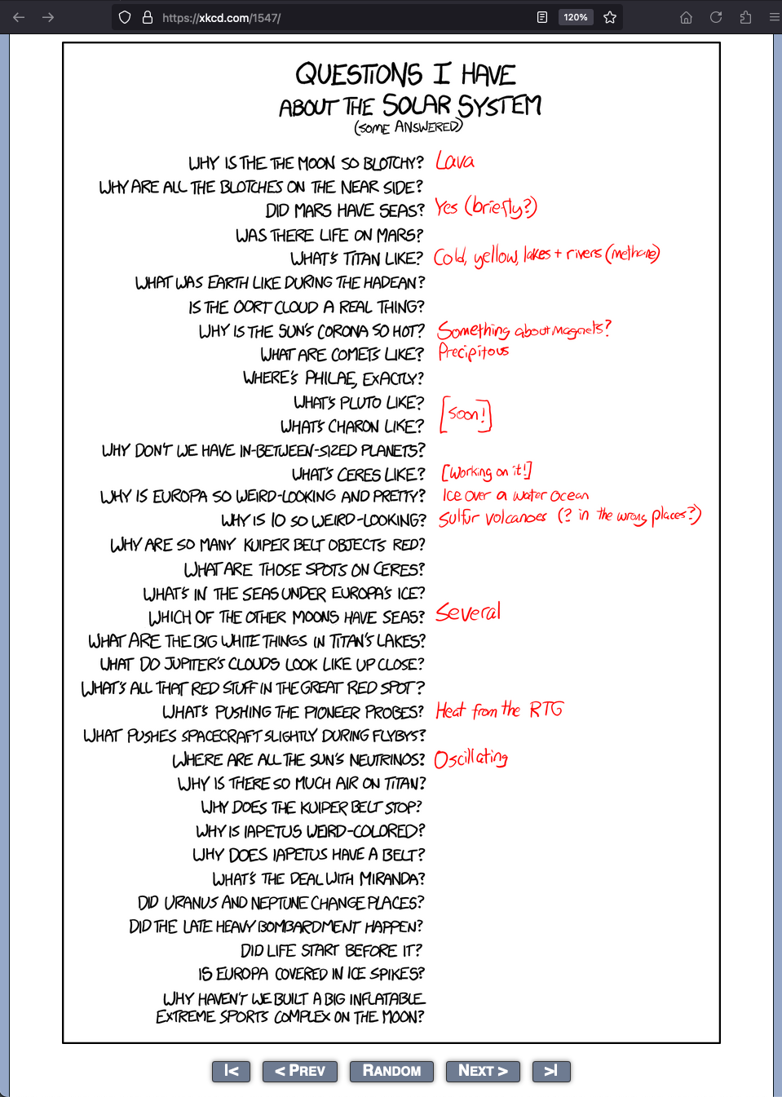
Possible Projects

Slide 14
Planet Characteristics
Characteristic Terrestrial Jovian
location
spacing
mass
size
density
composition
surface
albedo
rotation
magnetics
moons
rings
0.4-1.5 AU 5.2-30.1 AU
close wide
0.05-1.0 Earths 14.5-318 Earths
0.4-1.0 Earth radii 3.9-11.2 Earth radii
3.9-5.5 g/cm³ 0.7-1.6 g/cm³
rocky gaseous/icy
solid any?
0.1-0.7 0.4-0.5
slow fast
none/weak strong (integrated)
none/few many
none all
Notes:
0.05 Earth masses = Mercury
Jupiter rotates in 9:56 hours … Saturn 10:42 … Uranus 17:14 … Neptune 16:06

Slide 15
obliquities (tilts)

Slide 16
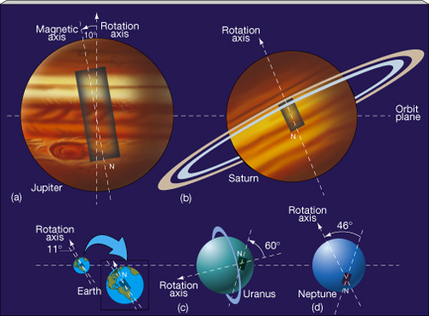
bizarre bar magnets

Slide 17
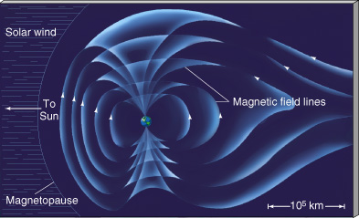
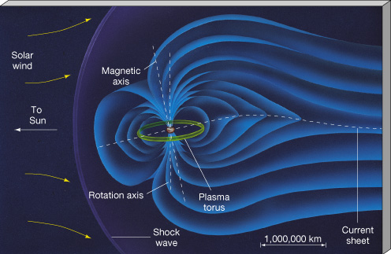
magnetospheres
Earth has strongest terrestrial
surface mag field = 0.3 G
mag moment = 8x10²⁵ G/cm³
enough to protect us from charged particles
Mercury, Ganymede wimpy
Venus, Io, Europa, Callisto induced
Mars patchy crustal
Jupiter has strongest jovian
surface mag field = 4.3 G
mag moment = 20000X Earths
Io plasma torus complicates
affects all Galilean satellites
Sat/Ura/Nep surface mag fields similar strength to Earth’s
Notes:
solar UV releases electrons to create Venusian ionosphere, which interacts with solar wind

Slide 18
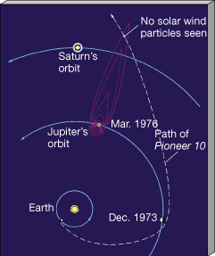
Jupiter’s magnetotail

Slide 19
trends in the Solar System
size with distance from the Sun
composition with distance
spacing of planets with distance
# moons with planet mass
rotation speeds with mass
magnetic fields with mass (integrated magnetospheres)
non-trends in the Solar System
surface gravities not radically different
obliquities do not behave
7 large moons are worlds of their own:
Moon, Io, Europa, Ganymede, Callisto, Titan, Triton
What about the small bodies?

Slide 20
…………………………

