Slide 1
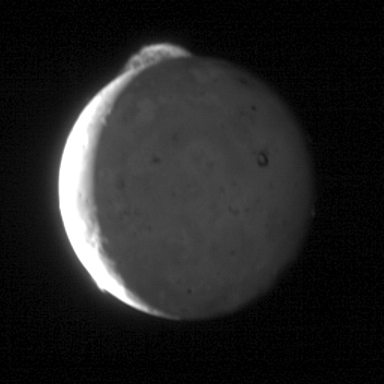
Where is this?
Notes:
This five-frame sequence of New Horizons images captures the giant plume from Io's Tvashtar volcano. Snapped by the probe's Long Range Reconnaissance Imager (LORRI) as the spacecraft flew past Jupiter over an 8-minute span, with two minutes between frames, from 23:50 to 23:58 Universal Time on March 1, 2007. Io was 3.8 million kilometers (2.4 million miles) from New Horizons.
This first-ever "movie" of an Io plume clearly shows motion in the cloud of volcanic debris, which extends 330 kilometers (200 miles) above the moon's surface. Only the upper part of the plume is visible from this vantage point -- the plume's source is 130 kilometers (80 miles) below the edge of Io's disk, on the far side of the moon. The knots and filaments that allow us to track the plume's motion are still mysterious, but this movie is likely to help scientists understand their origin, as well as provide unique information on the plume dynamics.
Io's hyperactive nature is emphasized by the fact that two other volcanic plumes are also visible off the edge of Io's disk: Masubi at the 7 o'clock position, and a very faint plume, possibly from the volcano Zal, at the 10 o'clock position. Jupiter illuminates the night side of Io, and the most prominent feature visible on the disk is the dark horseshoe shape of the volcano Loki, likely an enormous lava lake. Boosaule Mons, which at 18 kilometers (11 miles) is the highest mountain on Io and one of the highest mountains in the solar system, pokes above the edge of the disk on the right side.
The pictures were part of a sequence designed to look at Jupiter's rings, but planners included Io in the sequence because the moon was passing behind Jupiter's rings at the time.

Slide 2
Homework
TODAY, 05 SEP
.pdf of Icarus or Planetary Science Journal article
TUESDAY, 10 SEP --- HAND IN PRINTED
write 3 sentences each on 2 topics
you might want to explore for your project
TUESDAY, 10 SEP --- SPACESHIP NAME
SSE!

Slide 3
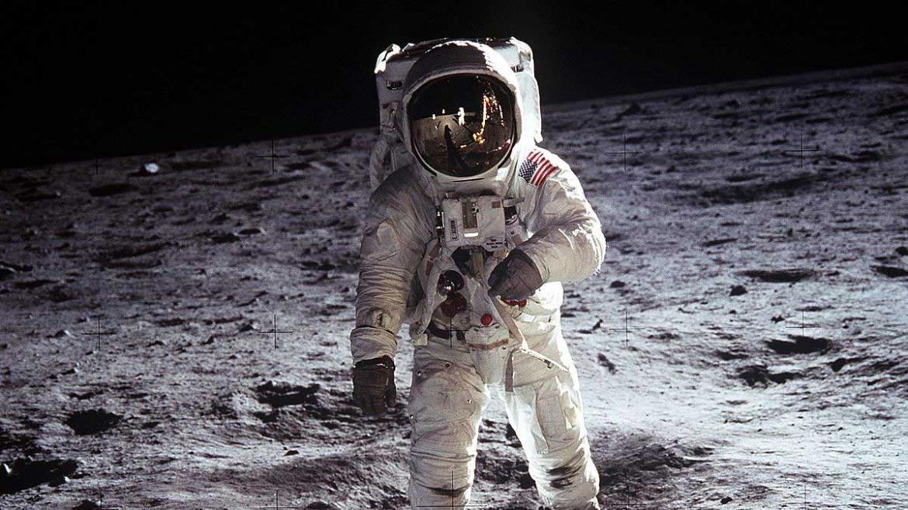
Solar System Overview III
Notes:
Buzz Aldrin Apollo 11

Slide 4
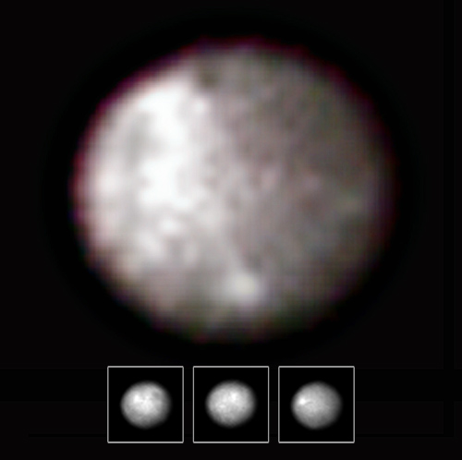
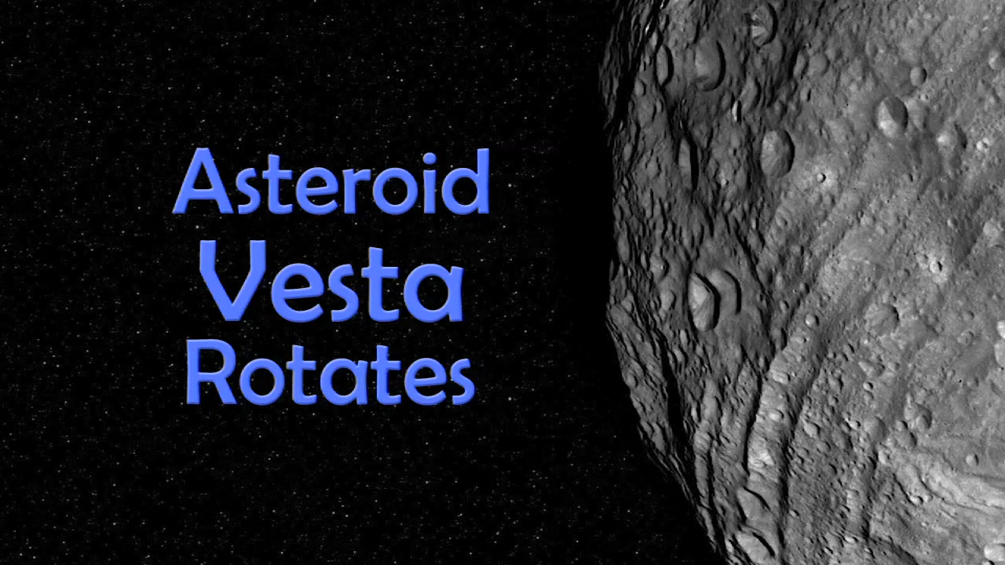
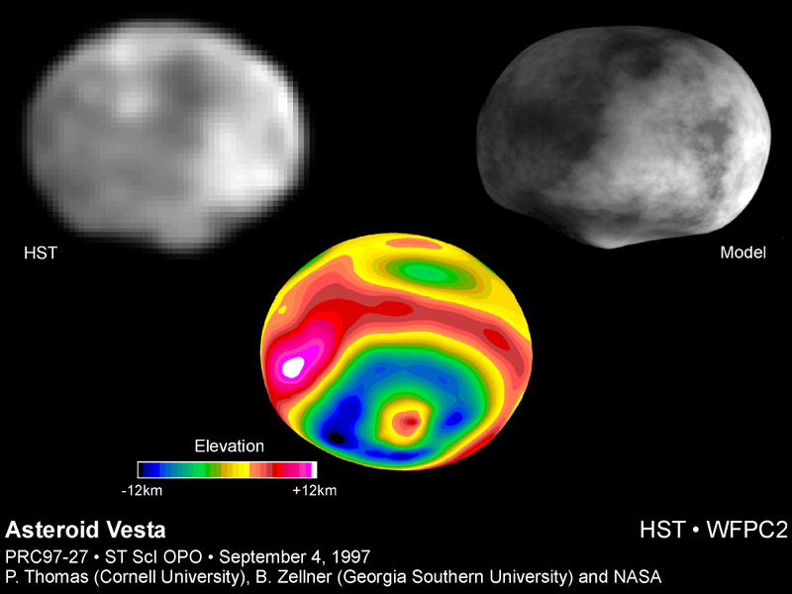
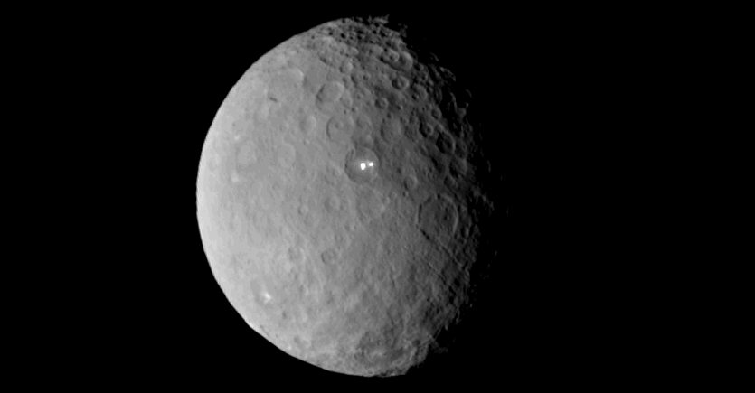
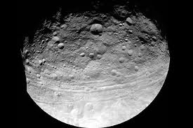
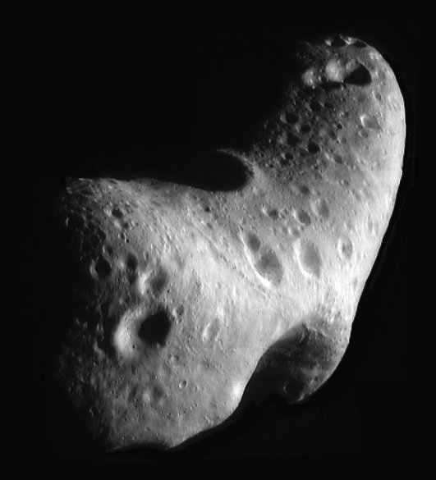
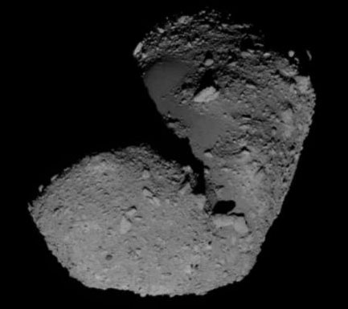
Asteroids
Ceres
940 km
Vesta
530 km
SSE!
Eros
33x13x13 km
Itokawa
0.5x0.3x0.2 km
Notes:
DAWN took Ceres and Vesta movies.
Ceres white spots are sodium carbonate, good for washing clothes …
NEAR spacecraft took Eros image.
HAYABUSA spacecraft took Itokawa image.

Slide 5
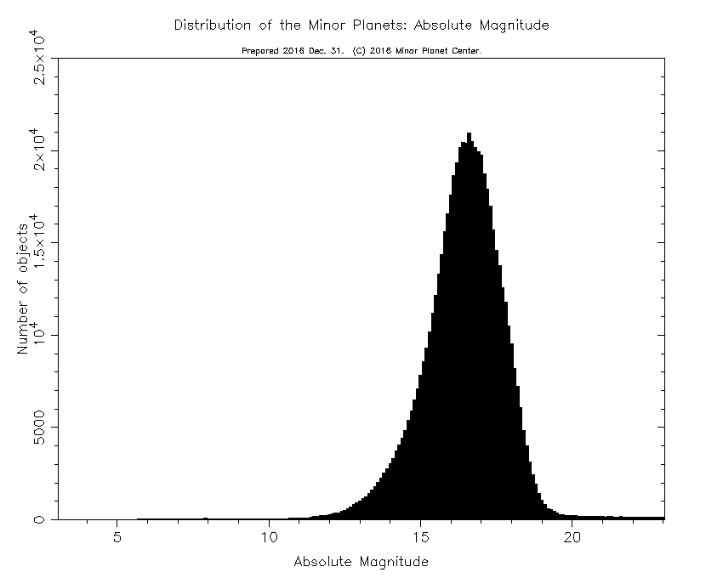
Absolute Magnitude = H
V magnitude if 1 AU from Earth and 1 AU from Sun
while having phase angle of 0 degrees
(an impossible scenario)
H = 16 means diameter of 2-4 km
Notes:
estimate size from H, but varying albedos lead to different size estimates

Slide 6
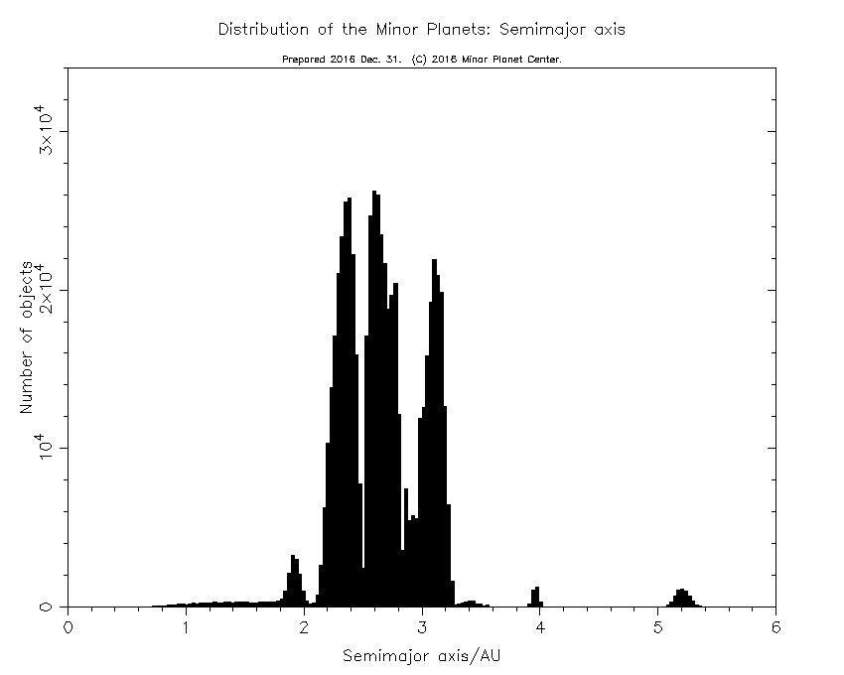
Asteroids
semimajor axis
Asteroid
orbital
semimajor axes
Trojans
Venus has 1
Earth has 2
Mars has 17 +
Jupiter has 13976 +
Uranus has 2 ?
Neptune has 31 +
Trojans
Earth has 1
Mars has 6 +
Jupiter has 6609 +
Neptune has 7 +
?!
Hildas
Hildas
SSE!
SSE!
Notes:
Hildas are in 3:2 resonance with Jupiter
Trojan counts: Venus 2024 Earth 2024 (1 found by WISE in 2010 … 300m at L4) Mars 2024 Jupiter 2024 Uranus 2024 Neptune 2024
Jupiter perturbs Saturn’s Trojans and maybe Neptune perturbs Uranus’ Trojans so they do not have stable Trojan orbits/populations on timescales over the age of the SS.

Slide 7
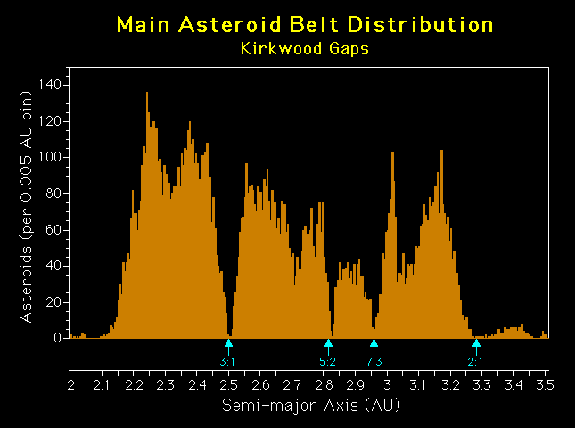
Main Belt

Slide 8
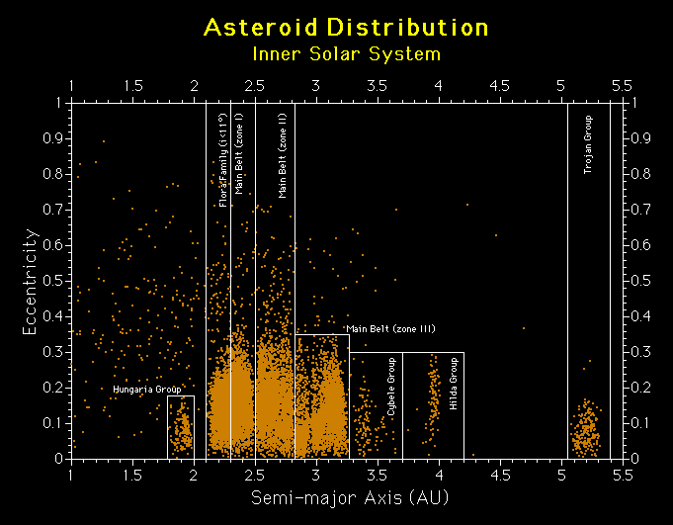

Slide 9
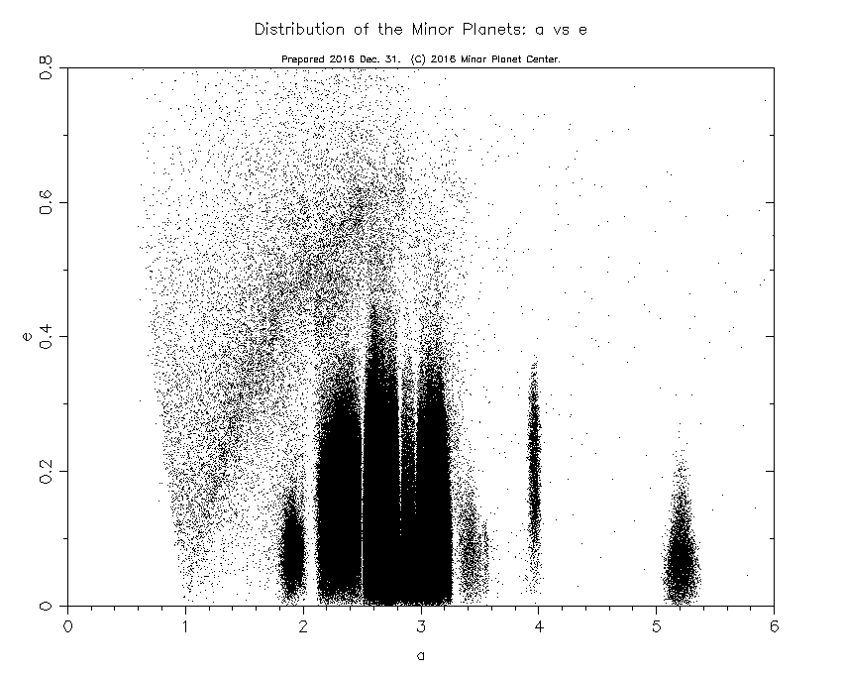

Slide 10
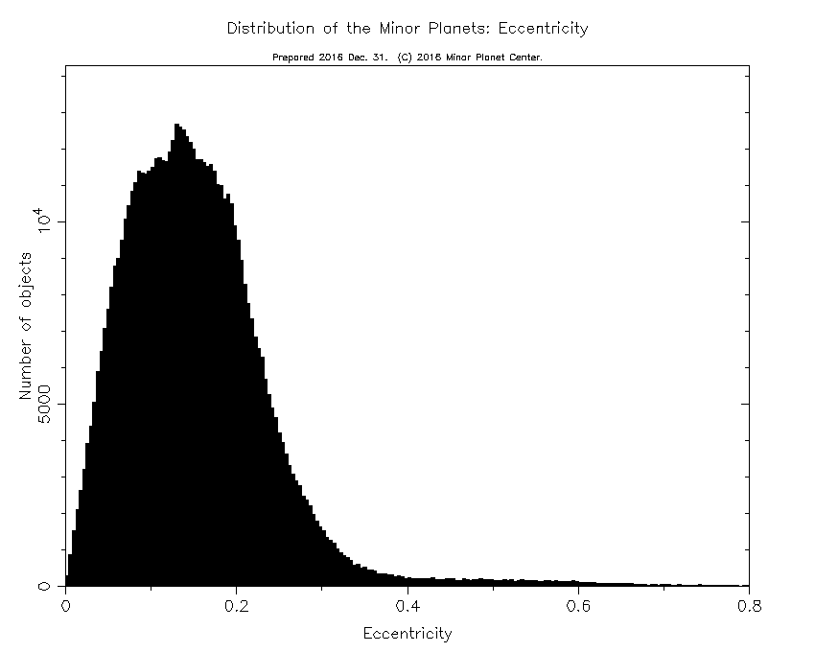
Asteroid
orbital
eccentricities

Slide 11
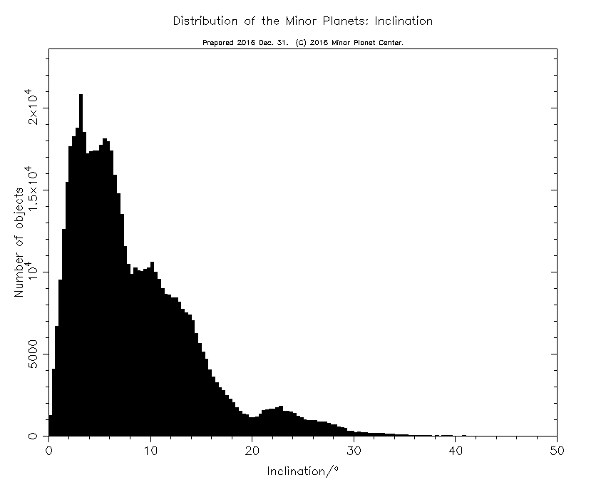
Asteroid
orbital
inclinations

Slide 12
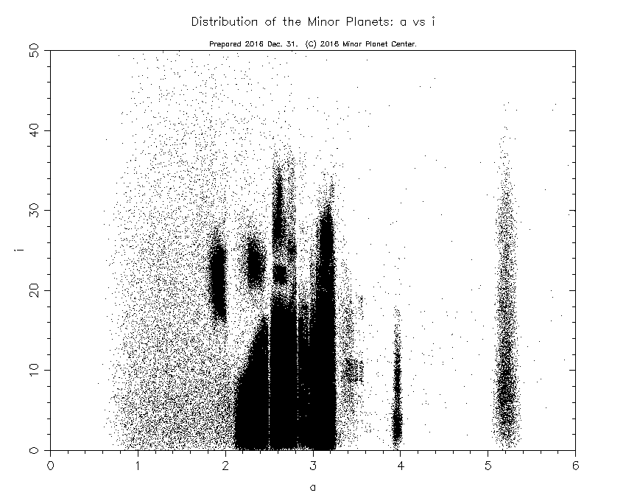
Notes:
inclination really splits out the groups

Slide 13
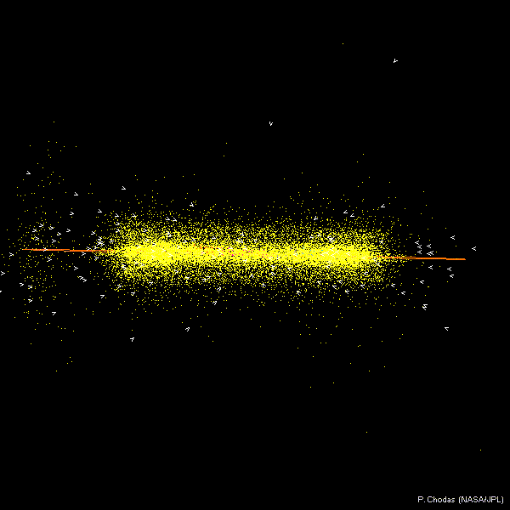

Slide 14
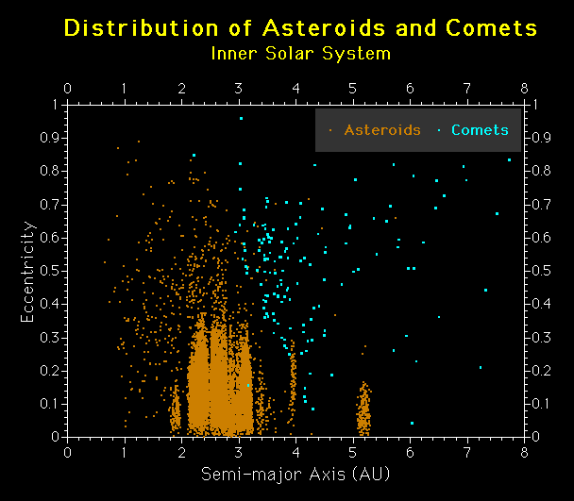

Slide 15
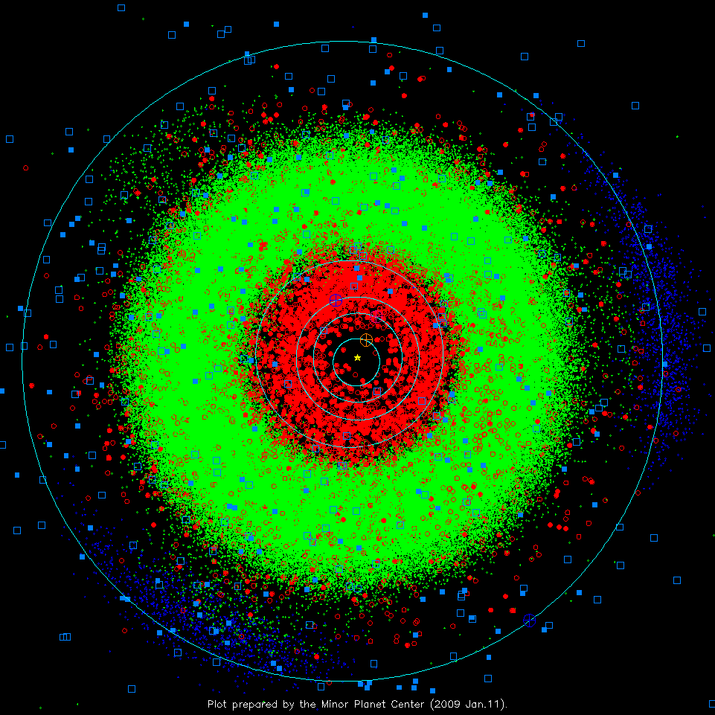
Inner S.S.
2009
ASTEROIDS
green dots: “normal” m.p.
red dots: < 1.3 AU periastron
filled: > 1 opposition obs.
blue dots: Jupiter Trojans
COMETS
solid blue sqr: numbered
open blue sqr: others
Notes:
3 sprays of green dots at 4 AU are the Hildas in 3:2 resonance with Jupiter … eccentric orbits with P = 7.9 years = 2/3 Jupiter’s

Slide 16
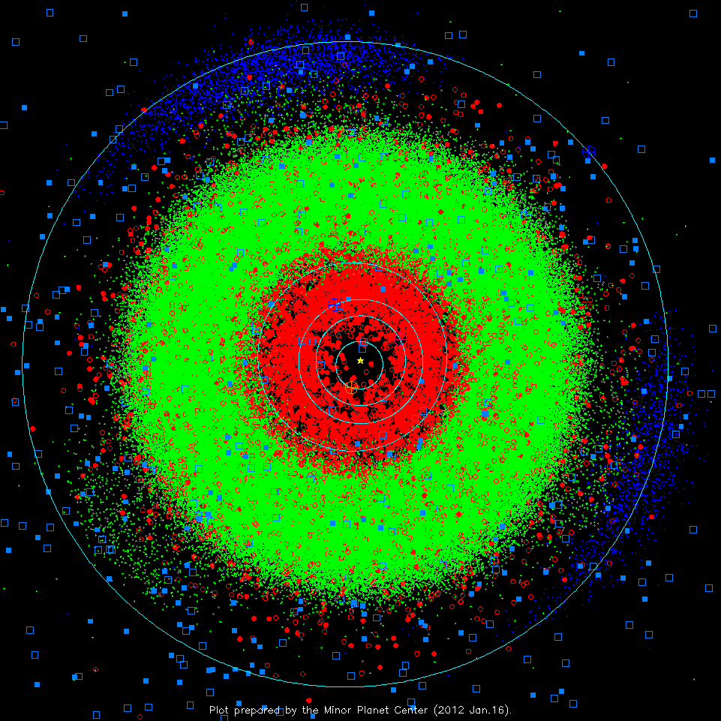
Inner S.S.
2012
ASTEROIDS
green dots: “normal” m.p.
red dots: < 1.3 AU periastron
filled: > 1 opposition obs.
blue dots: Jupiter Trojans
COMETS
solid blue sqr: numbered
open blue sqr: others
Notes:
3 sprays of green dots at 4 AU are the Hildas in 3:2 resonance with Jupiter

Slide 17
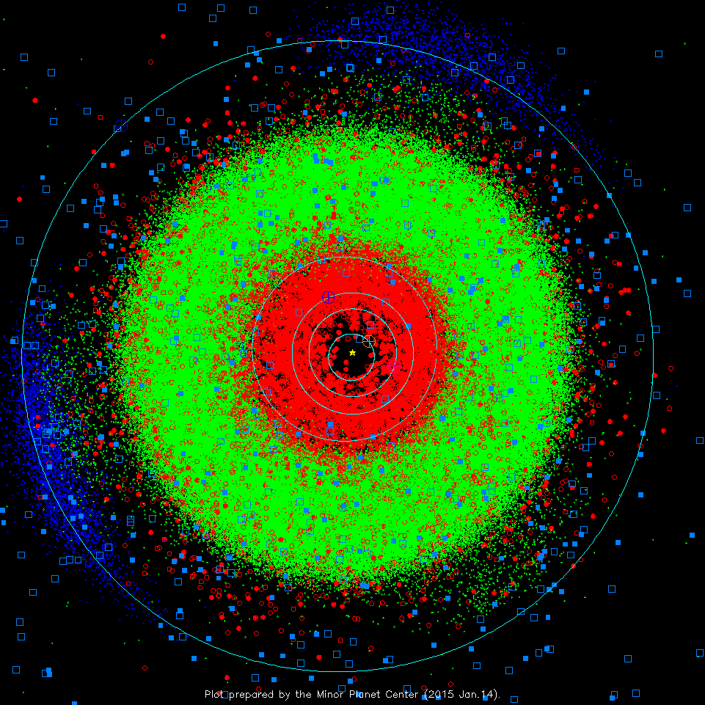
Inner S.S.
2015
ASTEROIDS
green dots: “normal” m.p.
red dots: < 1.3 AU periastron
filled: > 1 opposition obs.
blue dots: Jupiter Trojans
COMETS
solid blue sqr: numbered
open blue sqr: others
Notes:
3 sprays of green dots at 4 AU are the Hildas in 3:2 resonance with Jupiter

Slide 18
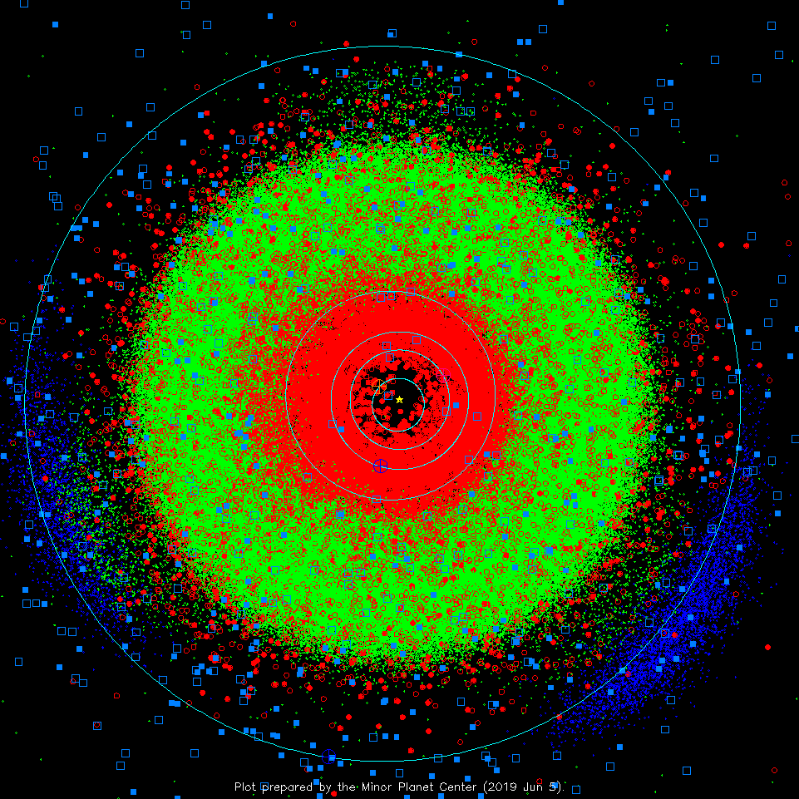
Inner S.S.
2019
ASTEROIDS
green dots: “normal” m.p.
red dots: < 1.3 AU periastron
filled: > 1 opposition obs.
blue dots: Jupiter Trojans
COMETS
solid blue sqr: numbered
open blue sqr: others
Notes:
3 sprays of green dots at 4 AU are the Hildas in 3:2 resonance with Jupiter
check on 29 AUG 2022 gave no more recent plot than this one

Slide 19
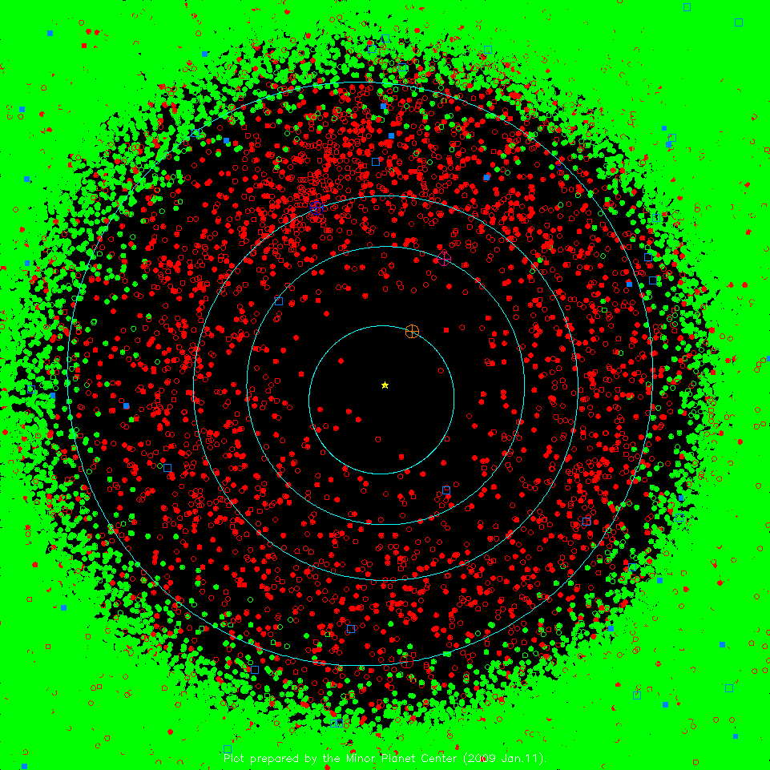
Zoom-in
2009
ASTEROIDS
green dots: “normal” m.p.
red dots: < 1.3 AU periastron
filled: > 1 opposition obs.
blue dots: Jupiter Trojans
COMETS
solid blue sqr: numbered
open blue sqr: others

Slide 20
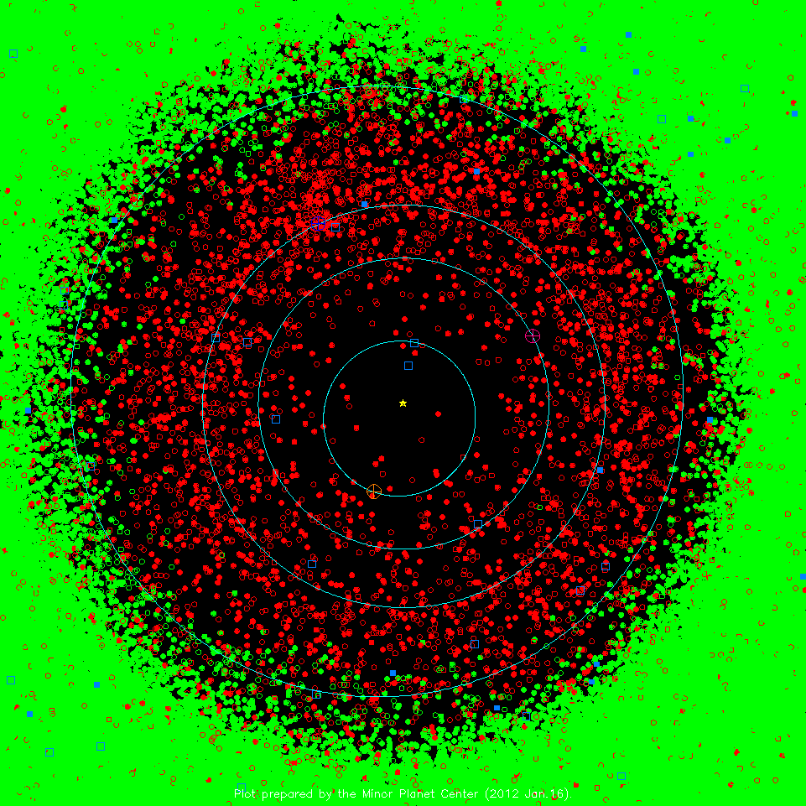
Zoom-in
2012
ASTEROIDS
green dots: “normal” m.p.
red dots: < 1.3 AU periastron
filled: > 1 opposition obs.
blue dots: Jupiter Trojans
COMETS
solid blue sqr: numbered
open blue sqr: others

Slide 21
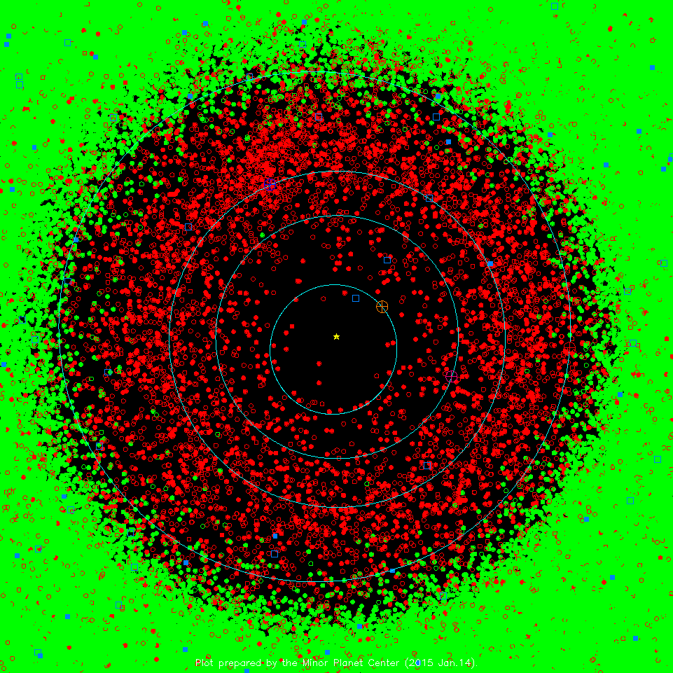
Zoom-in
2015
ASTEROIDS
green dots: “normal” m.p.
red dots: < 1.3 AU periastron
filled: > 1 opposition obs.
blue dots: Jupiter Trojans
COMETS
solid blue sqr: numbered
open blue sqr: others

Slide 22
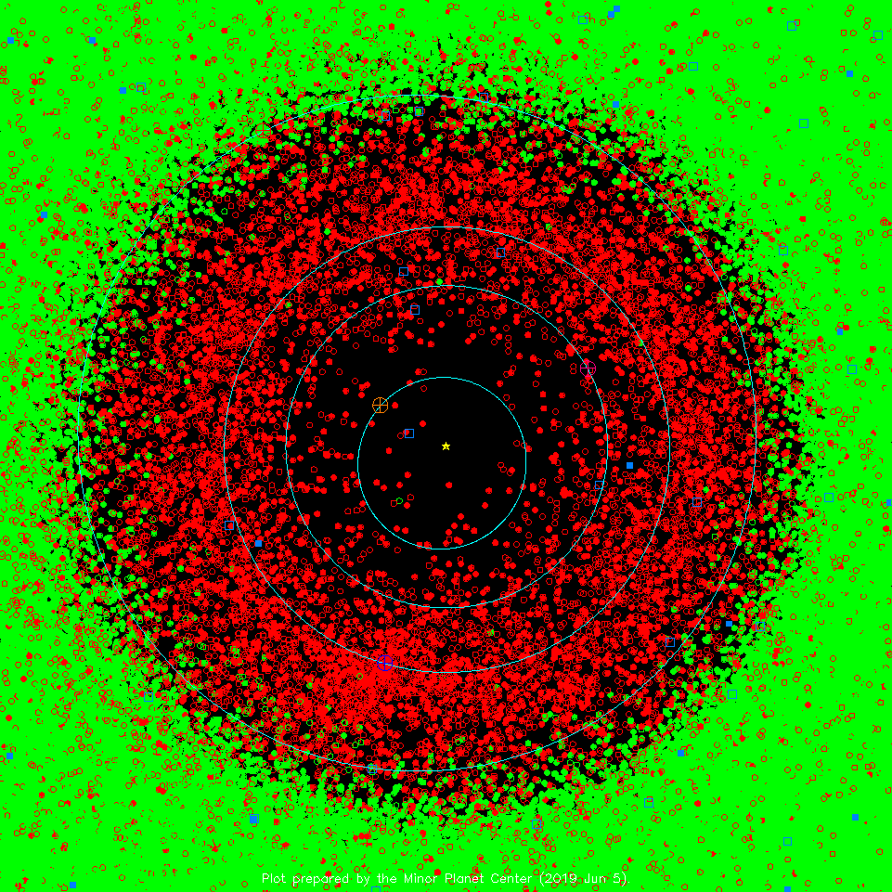
Zoom-in
2019
ASTEROIDS
green dots: “normal” m.p.
red dots: < 1.3 AU periastron
filled: > 1 opposition obs.
blue dots: Jupiter Trojans
COMETS
solid blue sqr: numbered
open blue sqr: others
Notes:
check on 29 AUG 2022 gave no more recent plot than this one

Slide 23
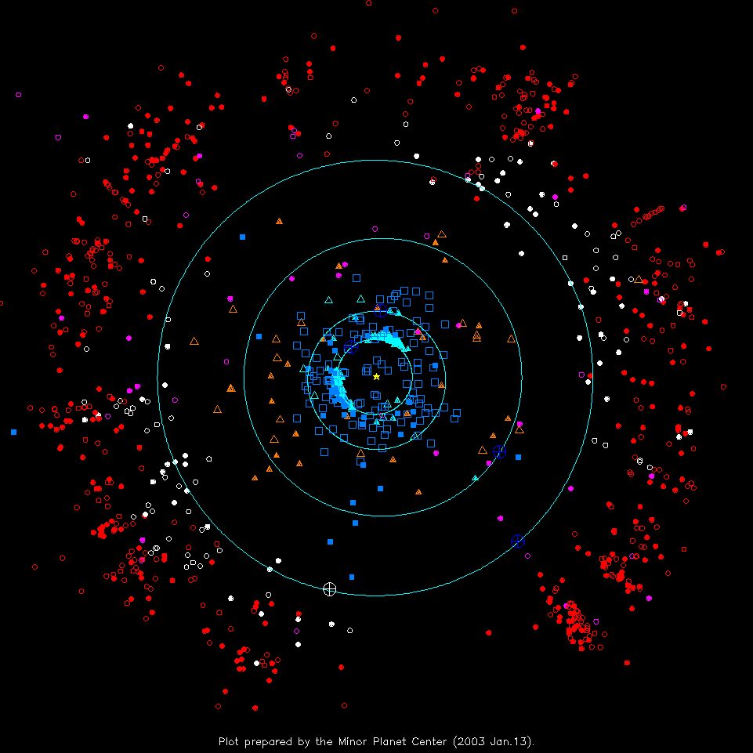
Outer S.S. 2003
TNOs
red: classical KBOs
white: Plutinos
magenta: scattered disk
OTHERS
orange tri: Centaurs
cyan tri: “unusual”
COMETS
solid blue sqr: numbered
open blue sqr: others
Notes:
Pluto at perihelion in 1989
cyan tri: “unusual” have high eccentricities

Slide 24
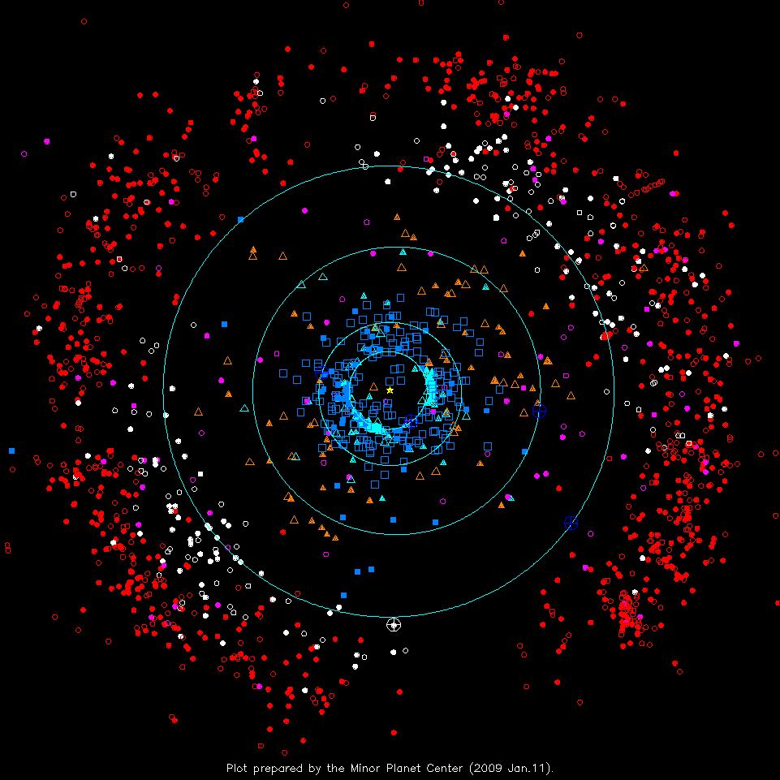
Outer S.S. 2009
TNOs
red: classical KBOs
white: Plutinos
magenta: scattered disk
OTHERS
orange tri: Centaurs
cyan tri: “unusual”
COMETS
solid blue sqr: numbered
open blue sqr: others
Notes:
more objects, not just pencil beams, pencil beams have spread, blue planets have moved,Pluto/KBOs have moved
cyan tri: “unusual” have high eccentricities

Slide 25
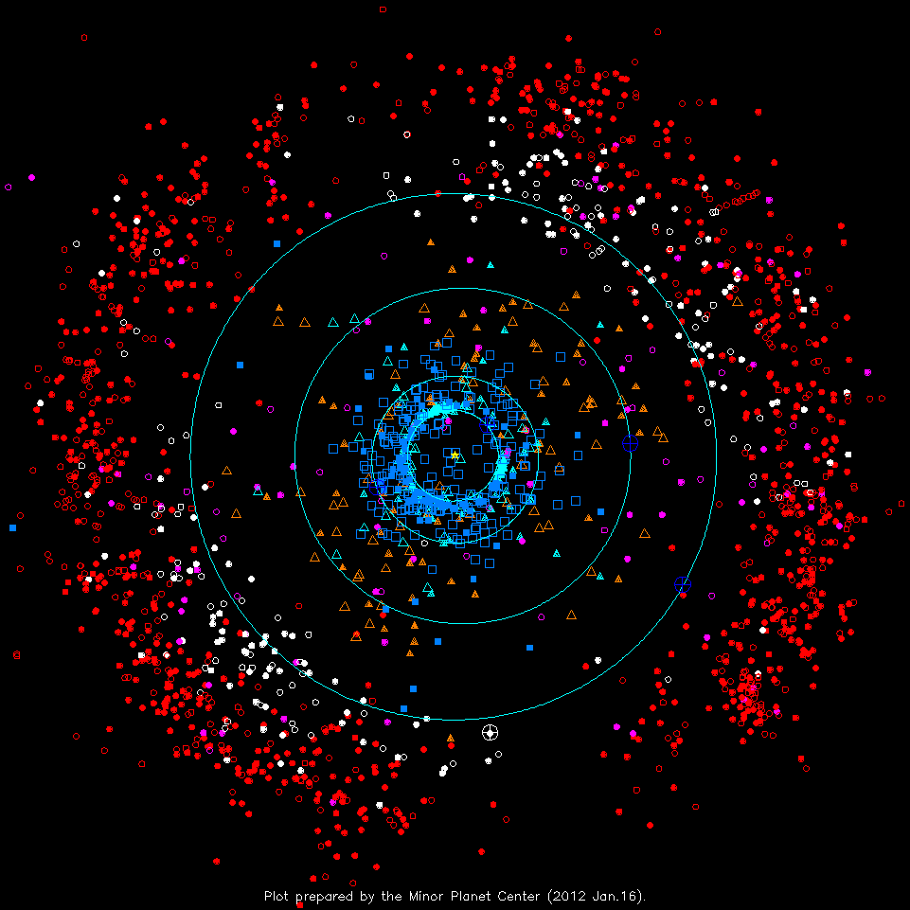
Outer S.S. 2012
TNOs
red: classical KBOs
white: Plutinos
magenta: scattered disk
OTHERS
orange tri: Centaurs
cyan tri: “unusual”
COMETS
solid blue sqr: numbered
open blue sqr: others
Notes:
more objects, not just pencil beams, pencil beams have spread, blue planets have moved,Pluto/KBOs have moved
cyan tri: “unusual” have high eccentricities

Slide 26
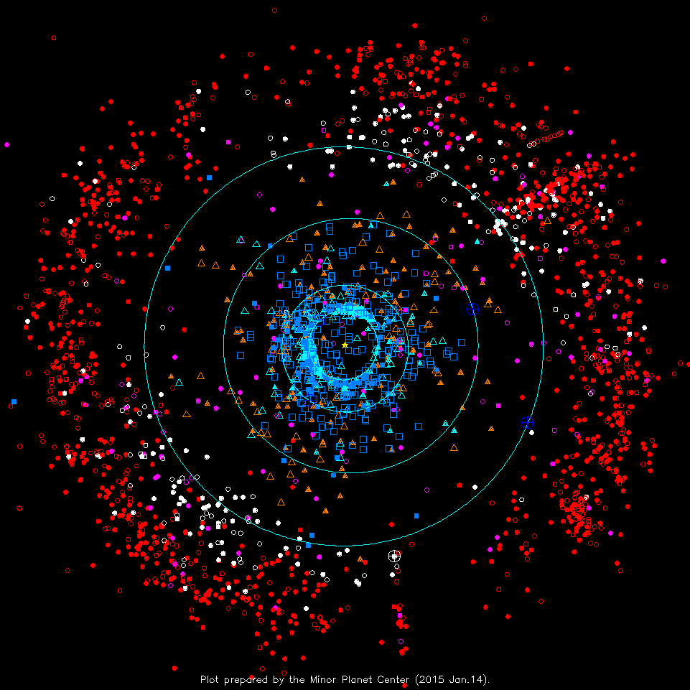
Outer S.S. 2015
TNOs
red: classical KBOs
white: Plutinos
magenta: scattered disk
OTHERS
orange tri: Centaurs
cyan tri: “unusual”
COMETS
solid blue sqr: numbered
open blue sqr: others
Notes:
more objects, not just pencil beams, pencil beams have spread, blue planets have moved,Pluto/KBOs have moved
cyan tri: “unusual” have high eccentricities

Slide 27
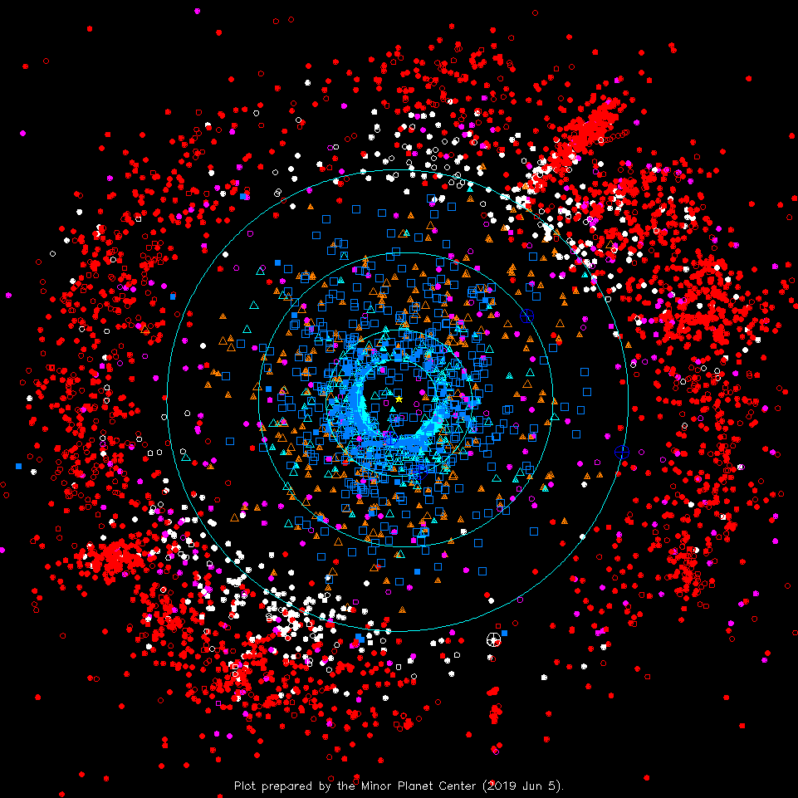
Outer S.S. 2019
TNOs
red: classical KBOs
white: Plutinos
magenta: scattered disk
OTHERS
orange tri: Centaurs
cyan tri: “unusual”
COMETS
solid blue sqr: numbered
open blue sqr: others
Notes:
SDO = Scattered Disk Object
2P Encke has shortest period 3.3yr of any comet known

Slide 28
Outer S.S. 2019
Plutinos/KBOs
Pluto
Quaoar
Ixion
Varuna
Orcus
Centaurs/SDOs
Chiron
Sedna
Nessus
Asbolus
Eris
Comets
1P Halley
2P Encke
Notes:
SDO = Scattered Disk Object
2P Encke has shortest period 3.3yr of any comet known
check on 29 AUG 2022 gave no more recent plot than this one

Slide 29
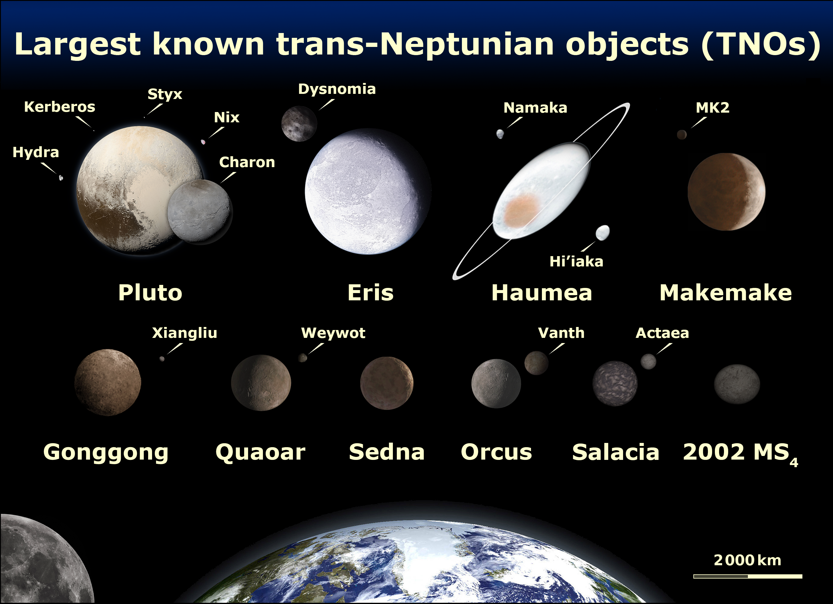
Styx
Hydra
Kerberos
Nix
Notes:
TNOs are Pluto, Charon, Nix (goddess of night), Hydra (water monster), Makemake
SDOs are Eris, Dysnomia
Haumea spins in 4 hours

Slide 30
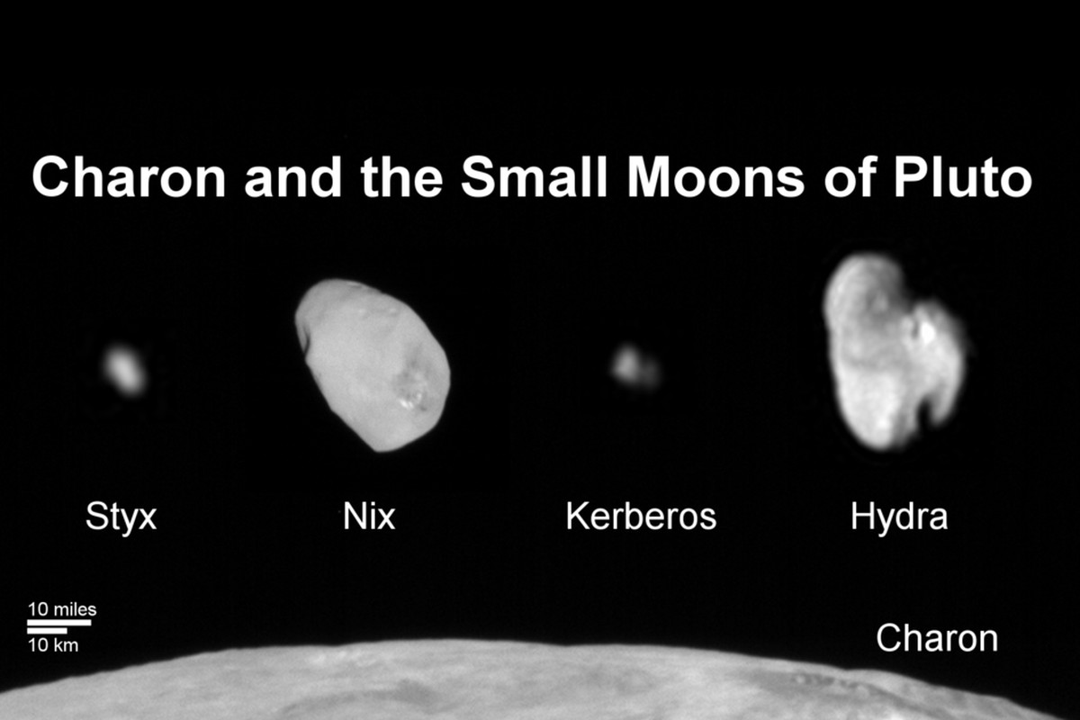
The Pluto System: 2012
Pluto Has 5 Moons
SSE! SSE! SSE! SSE!

Slide 31
The Pluto System: 2012
Pluto Has 5 Moons

Slide 32
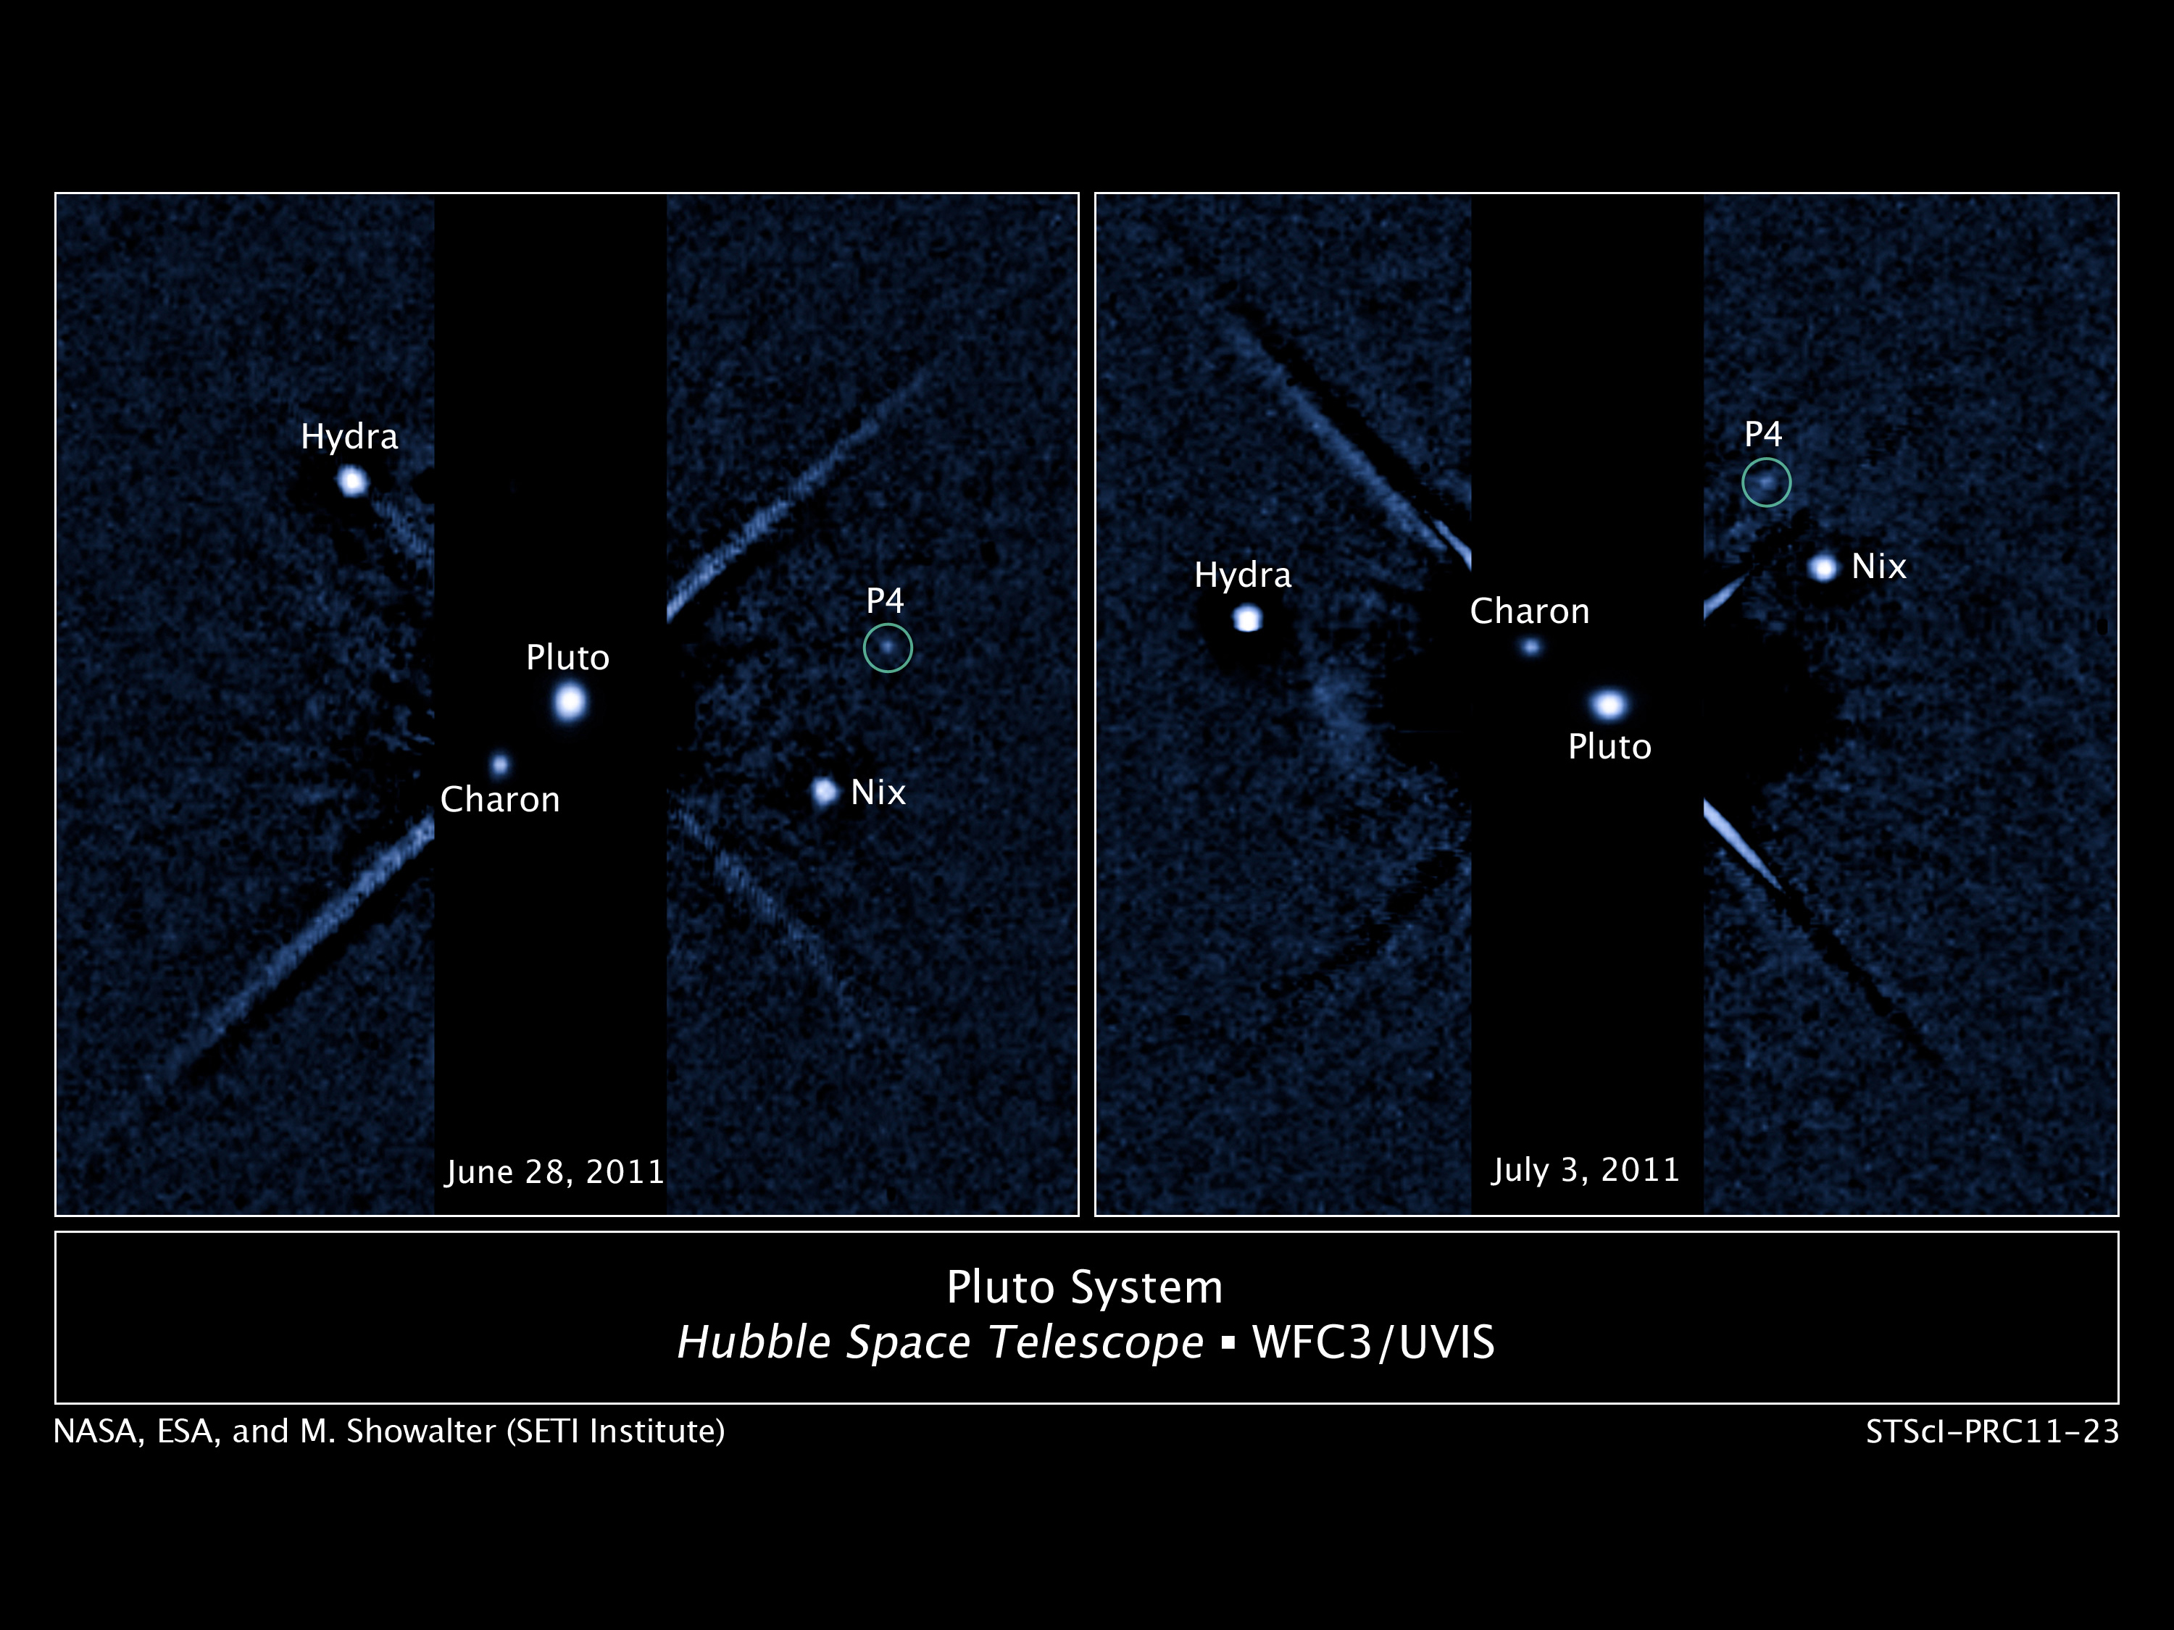
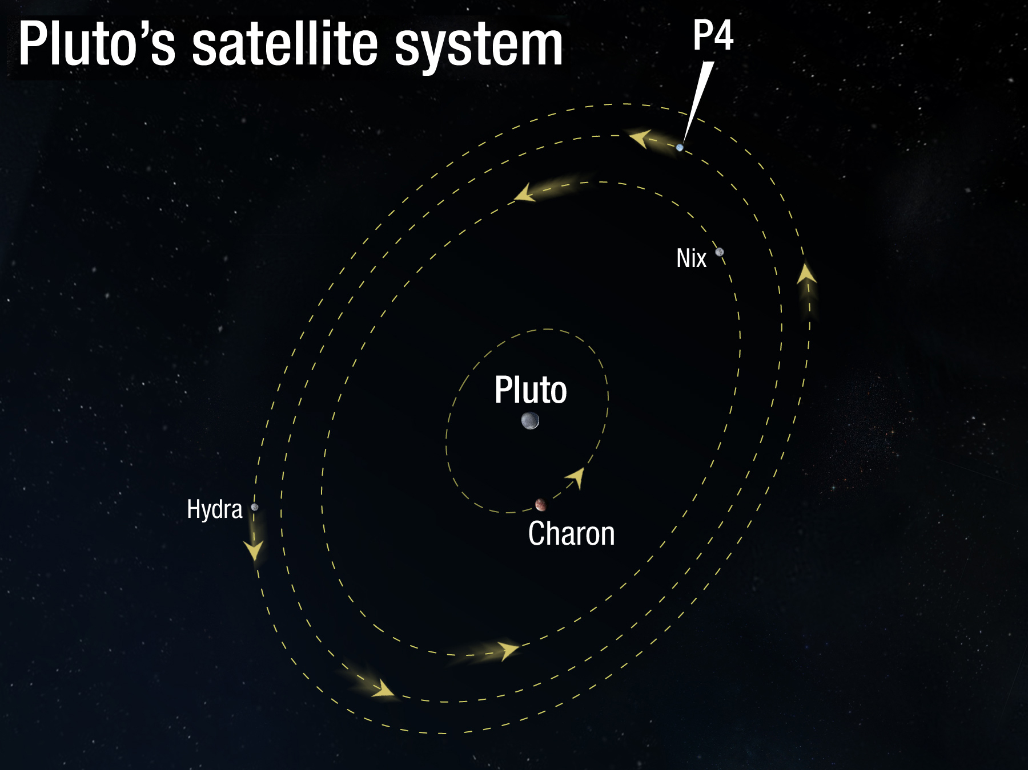
The Pluto System: 2011
Hydra
Nix
Notes:
Charon = 1043 km
Hydra ~ 113 km
Nix ~ 32 km
P4 = Kerberos ~ 13-34 km

Slide 33
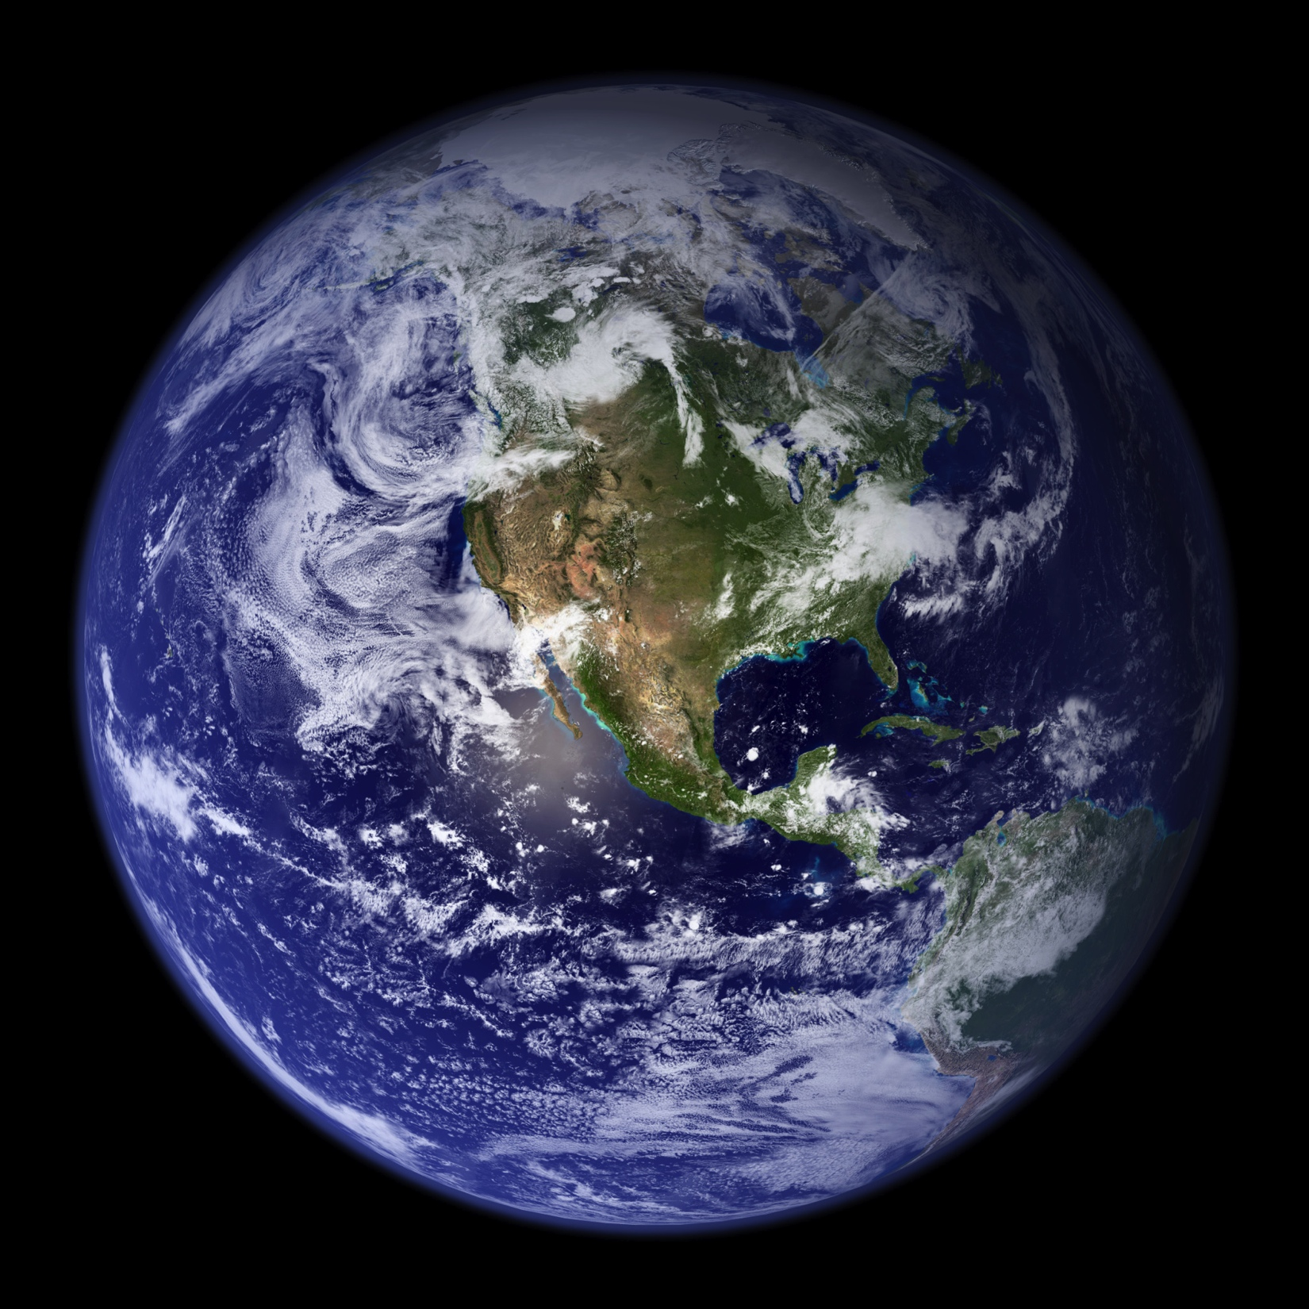
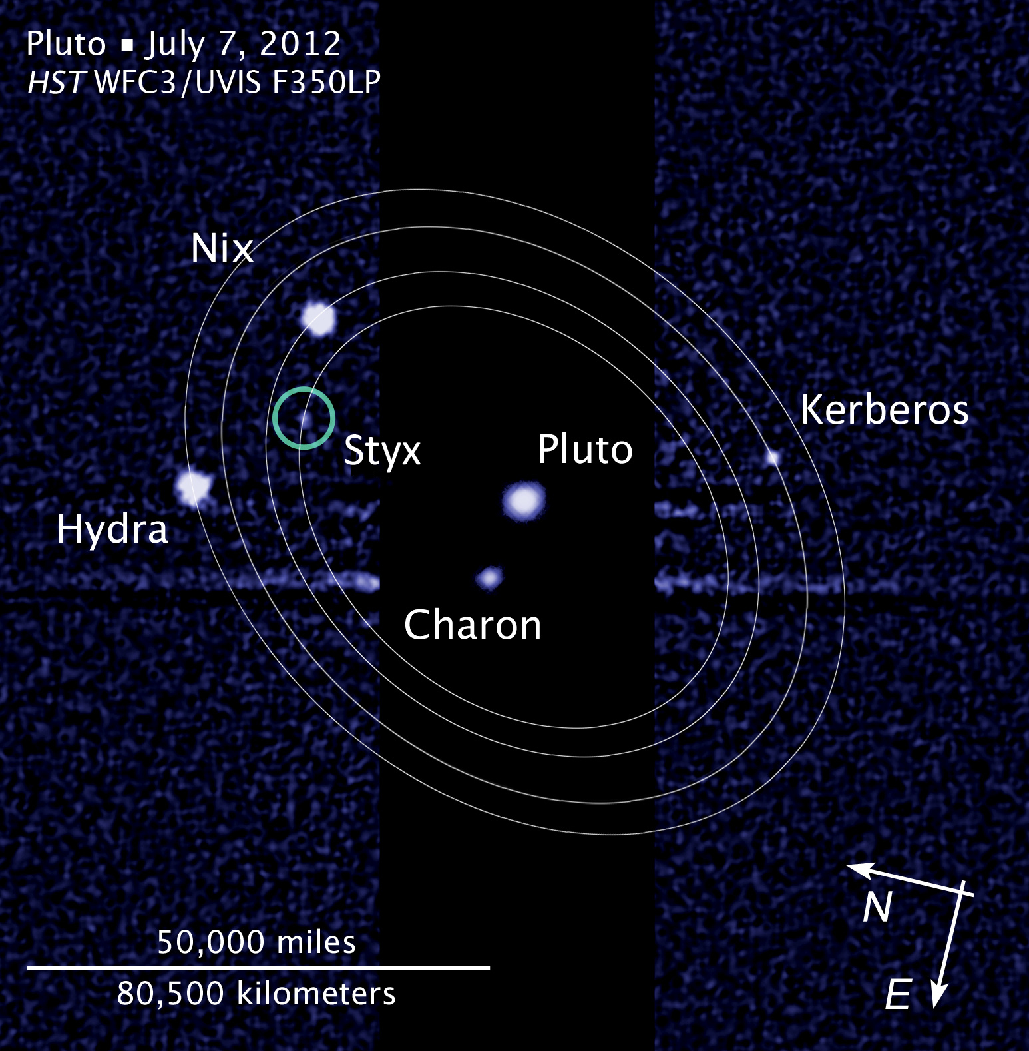
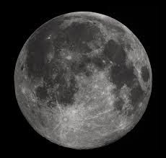
The Pluto System: 2012
The Pluto System: 2012
dist X 2
Notes:
Earth-Moon distance needs to be doubled to be to scale

Slide 34
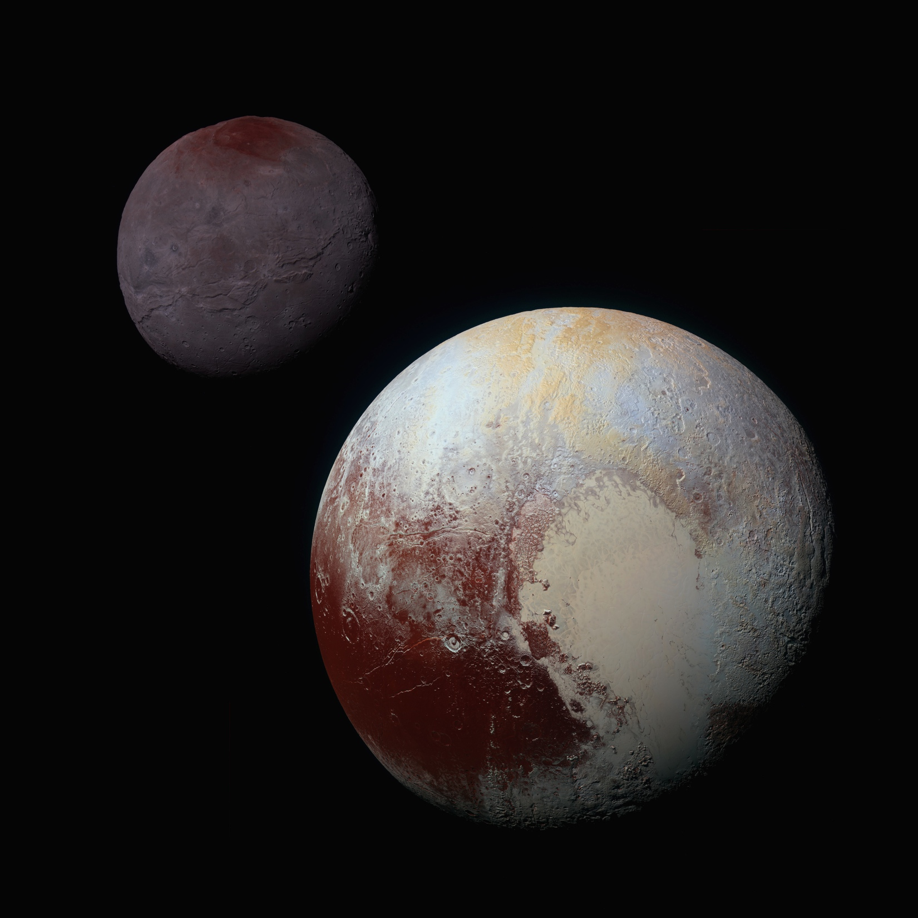
The Pluto System: 2012
The Pluto System: 2015

Slide 35
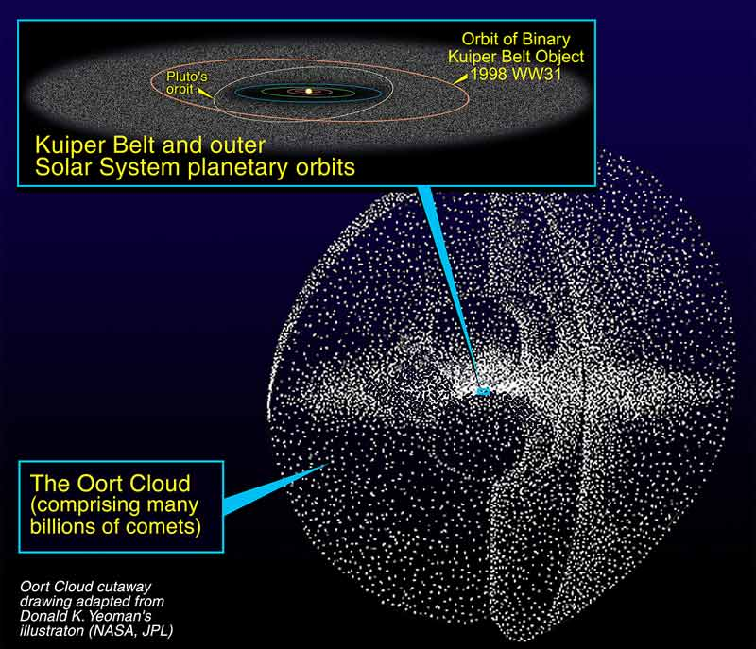
The Outer Limits
PAPER TOPIC: Where is the Oort Cloud really?

Slide 36
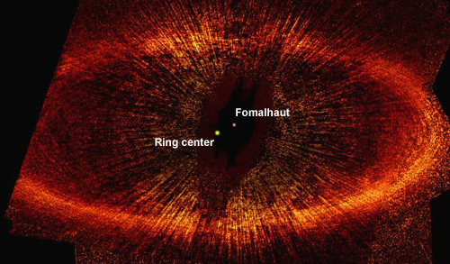
Disk: Protostellar or Debris?

Slide 37
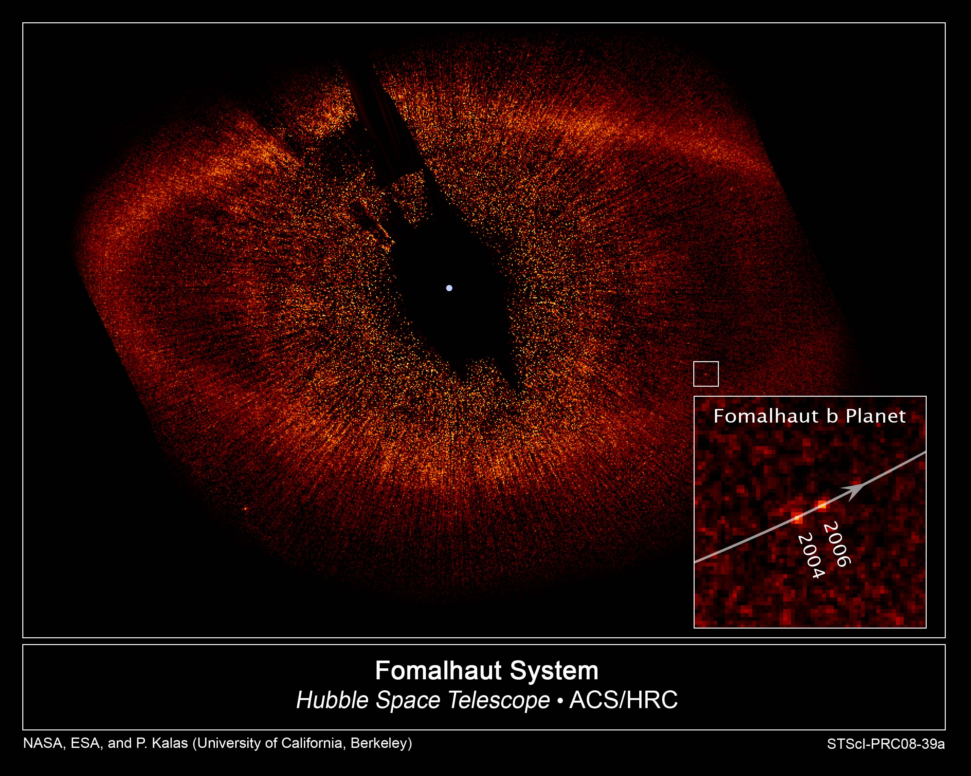
Fomalhaut Planet
NOT A PLANET
background star
movie
Notes:
Planetary Sciences
37
“planet” just inside ring and would have orbital period 872 years … turns out to be dust cloud from collision

Slide 38
…………………………

