Slide 1
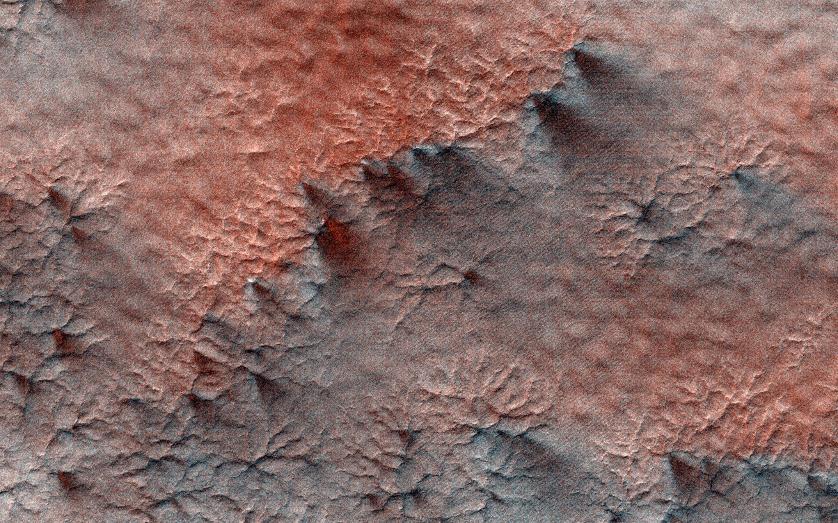
Where is this?
Notes:
This terrain looks like lumpy sediment on top of patterned ground. The lumpy sediment is likely just loosely consolidated because it is covered with spidery channels. This landform is uniquely Martian, formed in the spring as seasonal dry ice turns directly into gas that erodes channels in the surface.

Slide 2
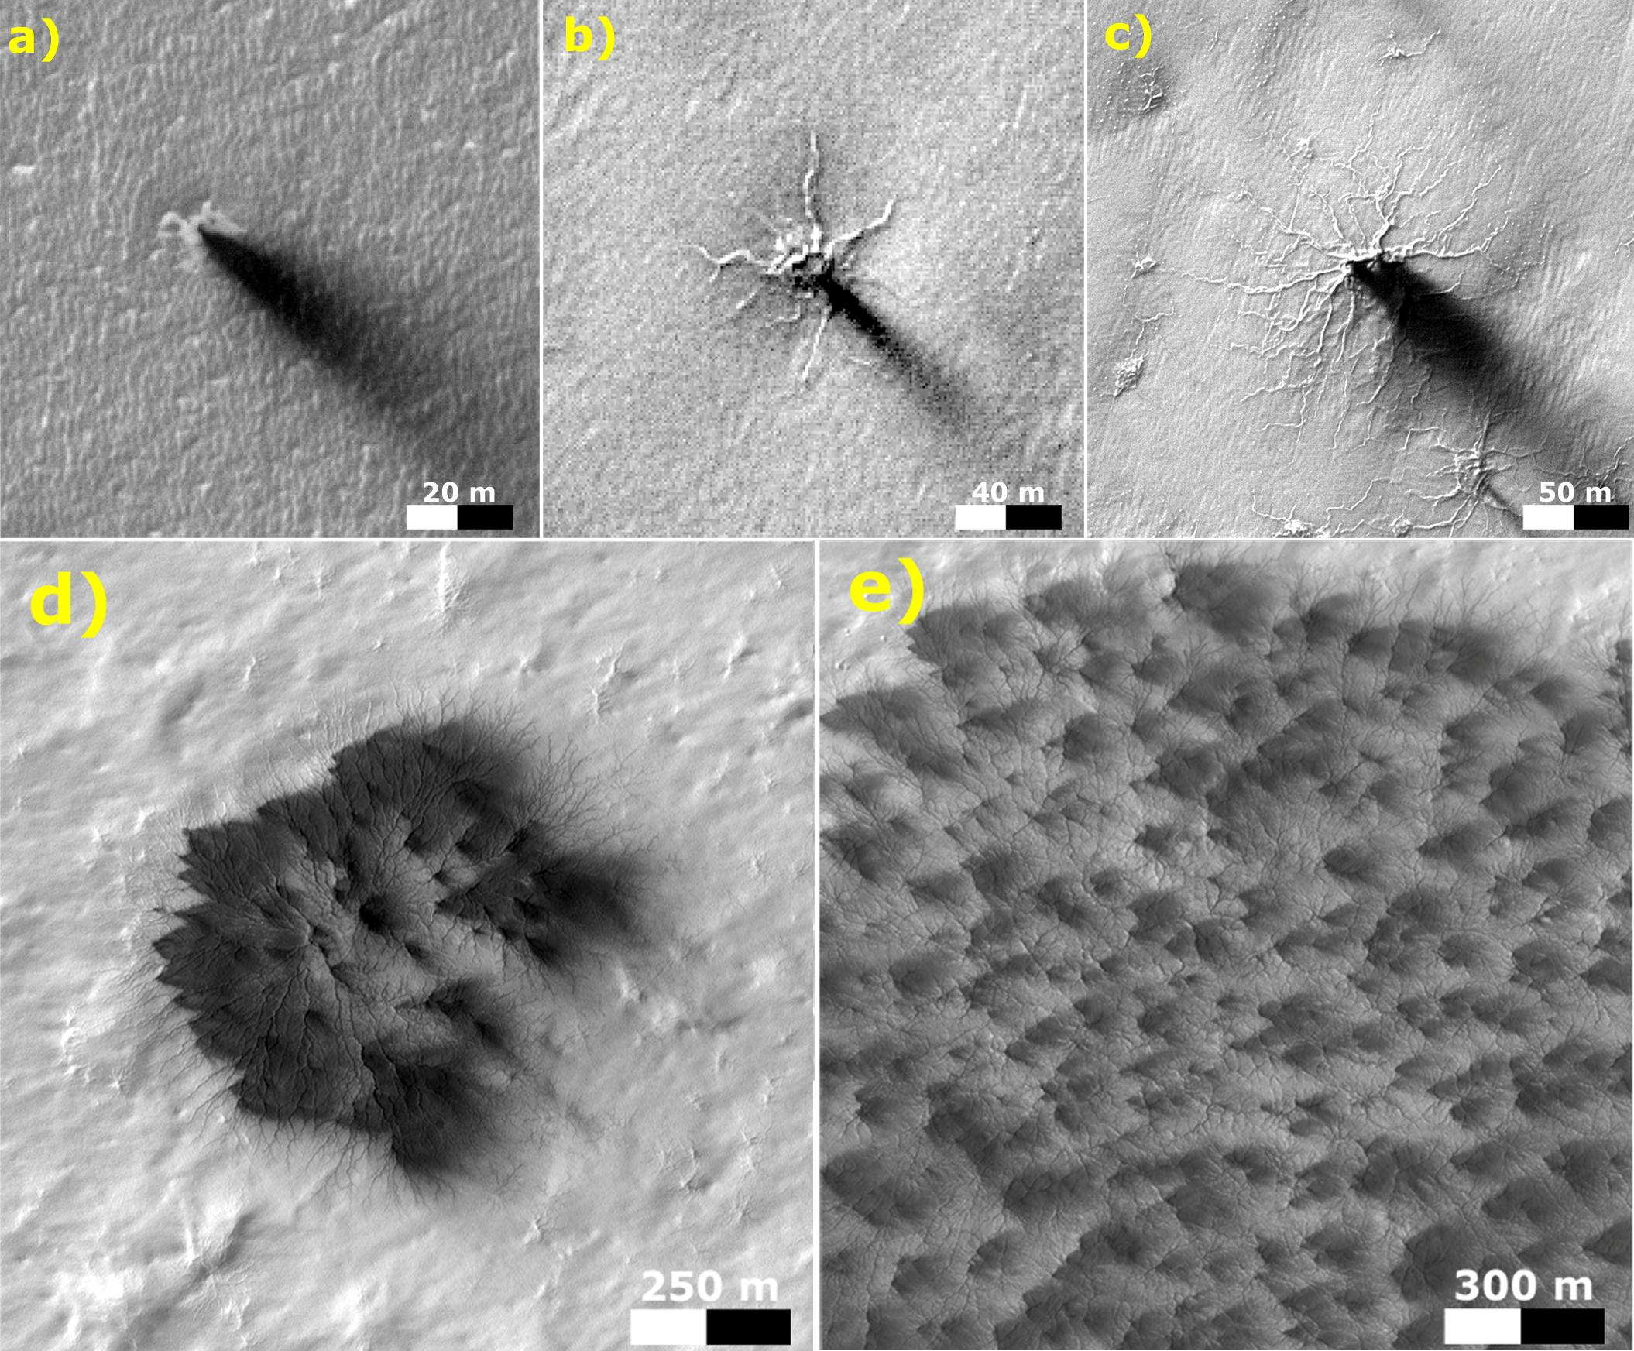
Where is this?
Notes:
MARS by MARS RECONNAISSANCE ORBITER: These five images from the High Resolution Imaging Science Experiment (HiRISE) camera on NASA's Mars Reconnaissance Orbiter show different Martian features of progressively greater size and complexity, all thought to result from thawing of seasonal carbon-dioxide ice that covers large areas near Mars' south pole during winter. The sequence illustrates possible stages in development of a type of Martian terrain called "araneiform," from Latin for spider-shaped. They range from a depression with one trough (upper left) to a broad network of "spiders" (lower right). Each image has a scale bar in meters, from 20 meters (66 feet) in the upper-left image to 300 meters (984 feet) in the lower-right one. Each image also includes dark "fans" that result from the same thawing process. Carbon-dioxide ice, better known as "dry ice," does not occur naturally on Earth. On Mars, sheets of it cover the ground during winter in areas near both poles, including the south-polar regions with spidery terrain. The dark fans appear in these areas each spring.
Spring sunshine penetrates the ice to warm the ground underneath, causing some carbon dioxide on the bottom of the sheet to thaw into gas. The trapped gas builds pressure until a crack forms in the ice sheet. Gas erupts out, and gas beneath the ice rushes toward the vent, picking up particles of sand and dust. This erodes the ground and also supplies the geyser with particles that fall back to the surface, downwind, and appear as the dark spring fans.
These five images are excerpts from HiRISE observations PSP_002718_0950, taken Feb. 24, 2007, at 85 degrees south latitude, 82 degrees east longitude, and ESP_011842_0980, taken Feb. 4, 2009, at 81 degrees south latitude, 76 degrees east longitude.

Slide 3
Homework
TODAY --- HAND IN PRINTED
write 3 sentences each on 2 topics
you might want to explore for your project
TODAY --- SPACESHIP NAME SSE!
pass the magic …
THURSDAY, 12 SEP
SSE!

Slide 4
Solar System Explorers 2024
Rules:
Goal is roughly once each week (Thursdays).
You will know the topic a week in advance.
You will draw one mini-Mars each week. You will answer the week’s question in order of your mini-Mars values. The value on your mini-Mars determines the number of points you can earn that round: 1-3 earns 1 point, 4-6 earns 2 points, 7-9 earns 3 points, and mega-Mars 10 earns 4 points.
You may not re-use or re-attempt an answer already mentioned. Be careful not to effectively repeat an answer already given.
5. You must be clear in your answer, and I will be the final judge of whether points will be awarded. Partial points may be awarded.
Results will be posted on the course website.
This game is for learning and fun,
NOT for bickering, backstabbing, or browbeating …
but it does affect your grade (slightly).

Slide 5
Solar System Explorers: 12 SEP
Describe something you have already learned in this course that you did not know previously (you may use information from Chapter 1 of the book).
1.
2.
3.
4.
5.
6.
7.
8.
9.
10.
11.
12.
13.
14.
15.
16.
17.
18.
19.
20.

Slide 6
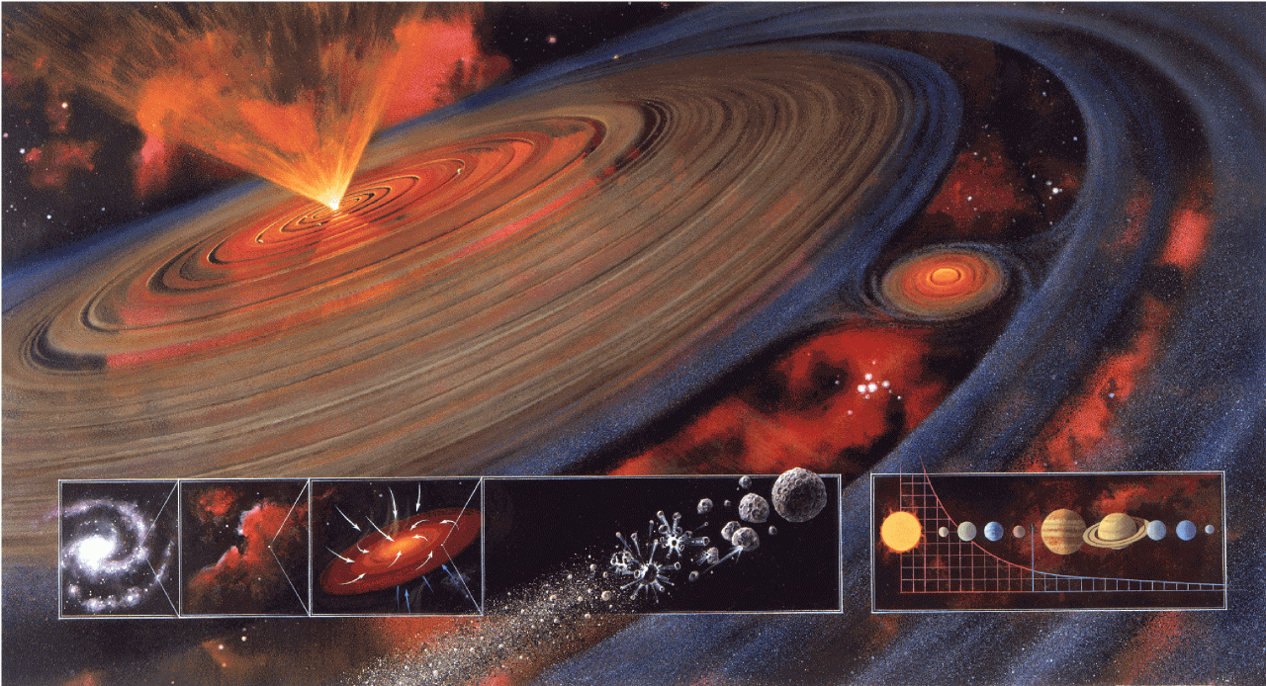
Solar System Formation I

Slide 7
Clues to Solar System Formation
Internal Motion Clues
Internal Bodies Clues
External Clues

Slide 8
Internal Motion Clues to S.S. Formation
???
planets are isolated
planetary orbits are roughly circular
3. planetary orbits are roughly coplanar
4. planetary orbits are prograde (all)
5. moons’ orbits are prograde
6. … but not all
7. planetary rotations are prograde
8. … but not all
9. cometary orbits have high a, e, i
10. many moons are tidally locked and/or in resonance

Slide 9
Internal Bodies Clues to S.S. Formation
???
Sun contains 99.8% of Solar System mass
98% of angular momentum resides in planet orbits
planet types/compositions depend on location (beware Moon)
planetary atmospheres contain ice fractions dependent on temp
all planets, large moons differentiated (were warm)
16. rapid impact cratering widespread, past >>> today
17. chondritic meteorites are 4.56 ± 0.01 Gyr old (Pb isotopes)
18. meteorites have mineralogical differences, rapid heating/cooling
19. asteroids old, size distribution implies collisional evol (0.05 M_{moon})
20. TNOs and Oort comets old and unevolved
PAPER TOPIC: How does the Kuiper Belt fit into S.S. origin?
Notes:
Pb isotopes come from 232Th (14 Gyr half-life), 235U (0.7 Gyr), 238U (4.5 Gyr)

Slide 10
External Clues to S.S. Formation
???
21. clouds of gas/dust observed
22. proplyds observed at very young ages --- a few million years
23. T Tauri stars observed
24. substantial disks observed at 10-100 million years
25. no disks seen (yet) past ~ 1 billion years
26. planets and planetary systems now detected
PAPER TOPIC: What’s the latest on disk statistics with age?

Slide 11
Formation Scenarios
1. CAPTURE free floaters, planet theft
2. COLLISION passing star, Sun fragmented
3. CONDENSATION nebular hypothesis

Slide 12
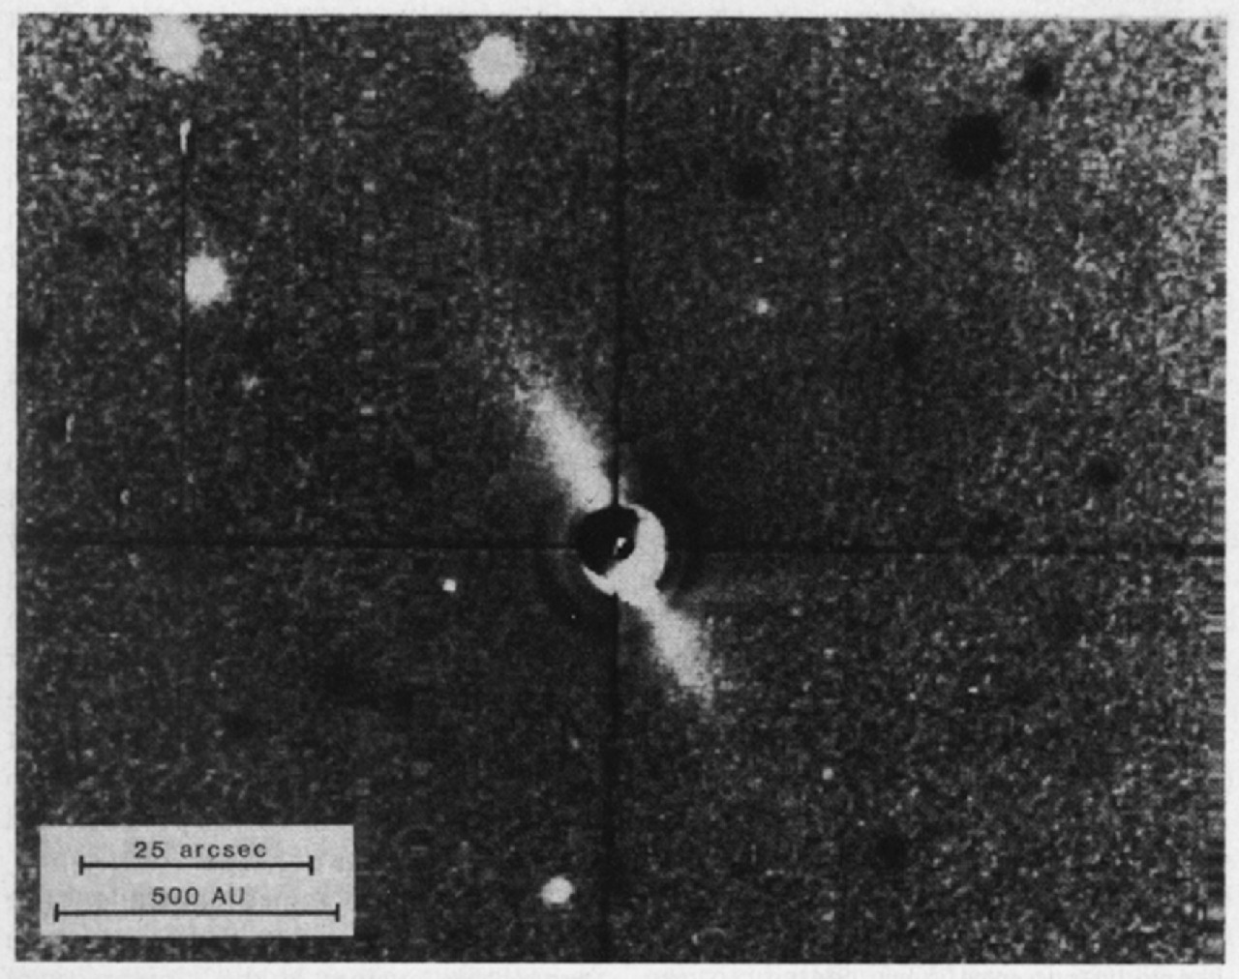
beta Pictoris Disk (1984)
Notes:
Data from the IRAS satellite in 1983 first revealed that the star is emitting more thermal radiation at far-infrared wavelengths than is normal for this type of star. Brad Smith and Rich Terrile then obtained an optical image of what appears to be a needle-like reflection nebulosity around the star (shown above). This image was a cornerstone for the paradigm that nearby stars which emit more far-infrared radiation than can be explained by the star alone are surrounded by circumstellar dust disks. Many more images were subsequently obtained by several research groups.

Slide 13
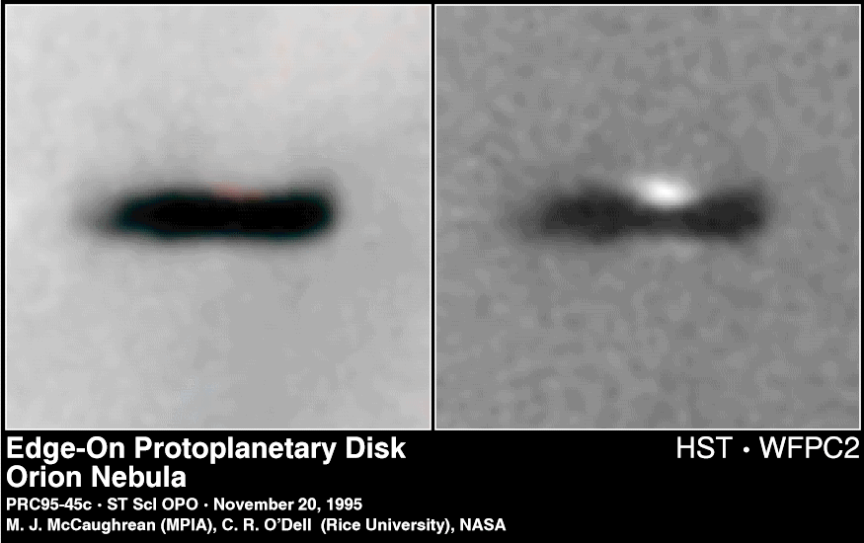
Orion Proplyd

Slide 14
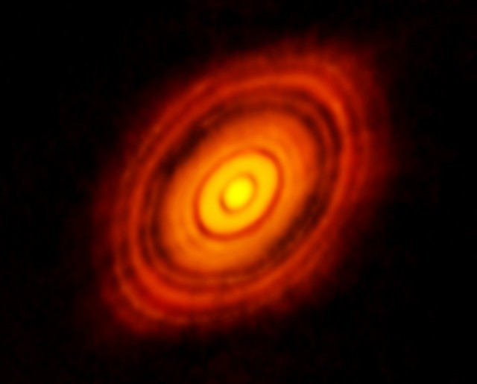
HL Tau with ALMA
HL Tau
T Tauri star
140 pc
K9 pms
~ 1 M⦿
~ 200 AU
~ 5 AU resolution
~ 1 Myr

Slide 15
Condensation to a Solar System
I. molecular cloud core before t = 0
II. freefall collapse t = 0.1 to 1 Myr
III. protostar / disk evolution t ~ 1 to 10+ Myr
IV. baby star / clearing / planet building t ~ 100 Myr
V. evolution of Solar System t > 100 Myr

Slide 16
Solar System Construction

Slide 17
I. Molecular Cloud Core
T ~ 10-30 K
primarily H₂ and He, traced by CO, CN, OH, HCN, H₂O, etc.
Jeans mass is minimum mass for collapse (PE in vs. KE out):
M_{J} ~ (k/G μ m)^{3/2} T^{3/2} / ρ^{1/2}
assumes thermal pressure only (no turbulence, rotation, mag fields)
k = Boltzmann constant μ = mean particle weight
T = temp m = mass of H
G = grav constant ρ = density
key attributes: temperature and density
shock mechanism needed to start the process …
hot star outflows, supernovae, spiral density waves
Notes:
cloud will collapse if the potential energy holding it together exceeds kinetic (thermal) energy trying to make it expand
k = Boltzmann constant, T = temp, G = grav constant, u = mean particle weight, m = mass of H, p = density
for typical molecular cloud conditions, Jeans mass is 100 Mo and Jeans radius is 1 pc

Slide 18
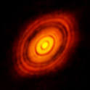
II. Freefall Collapse
0.1 to 1 Myr
timescale for collapse, t_{ff} ~ ρ^{-1/2} (inside-out)
angular momentum problem results in disk formation
fragmentation may occur if cloud rotating
… multiple star system
contraction by ~1000X likely

Slide 19
III. Protostar / Disk Evolution
1 to 1000 Myr (mass-dependent)
vertical collapse of disk
protostar stage occurs when infrared radiation trapped
magnetic braking of protostar when gas becomes ionized
viscous torques move material in and out
chemical evolution
Sun reflects initial composition of disk
but … disk chemistry depends on distance from Sun
Notes:
stellar birthday considered various ways --- opacity = 1 … deuterium fuses … H fuses

Slide 20
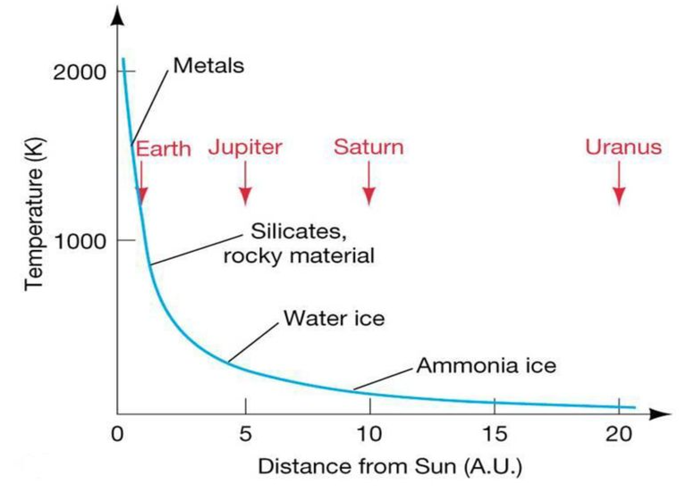
Differentiation in Solar Nebula
Notes:
uncompressed (zero pressure) density decreases from Mercury through Earth

Slide 21
Disk Condensation Chemistry
*** assumes chemical equilibrium, low pressures of solar nebula ***
2000K pretty much everything vaporized
1400K Fe and Ni form an alloy
1300K magnesium silicates (Mg/Si/O)
1200K feldspars (Ca/Na/K/Al/Si/O)
700K 1 AU carbon form transition CO → CH₄ (beware Pluto … solneb not eq)
500K iron oxide (FeO), olivines/pyroxenes (Mg/Fe/Si/O)
[ 373K 2 AU H₂O liquid ]
300K nitrogen form transition N₂ → NH₃ (beware Triton … solneb not eq)
[ 273K H₂O ice ]
180K 3 AU pure H₂O ice (hydrated silicates at warmer temps)
120K 4 AU ammonia clathrate (NH₃ . H₂O)
[ 77K N₂ liquid ]
70K methane clathrate (CH₄ . 6H₂O)
40K CH₄ and Ar ices
25K CO and N₂ ices
*** disequilibrium chemistry is norm beyond several AU ***
Notes:
Mercury has Fe core; Venus has Fe-Ni; Earth has Fe-Ni; Mars has Fe-Ni or Fe-FeS
Pluto has N2 ice with traces of CO and CH4

Slide 22
Ices/Liquids in the Solar System
phase transitions at one atmosphere pressure while cooling
373K H₂O liquid
273K H₂O ice
240K NH₃ liquid
195K NH₃ ice
194K CO₂ ice (sublimates)
111K CH₄ liquid
90K CH₄ ice
77K N₂ liquid
63K N₂ ice
331K Earth (hot)
268K Mars (hot)
186K Mars (cold)
185K Earth (cold)
124K Jupiter
95K Saturn
72K Enceladus
59K Uranus, Neptune
45Kv Pluto
38Kv Triton
Notes:
wat ... amm … car … met … nit

Slide 23
…………………………
Notes:
23

