Slide 1
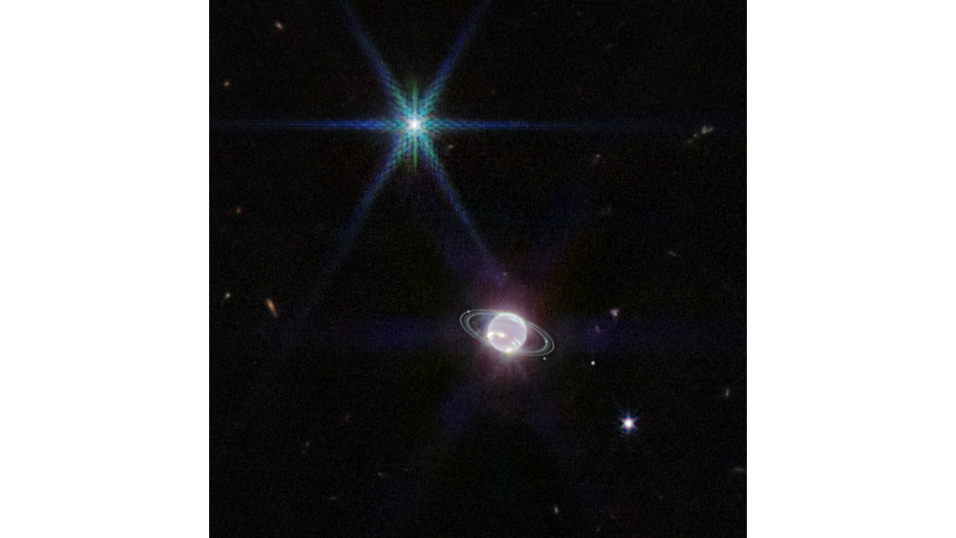
Where is this?
Notes:
Neptune has 14 known satellites, and seven of them are visible in this image.Triton, the bright spot of light in the upper left of this image, far outshines Neptune because the planet’s atmosphere is darkened by methane absorption at infrared wavelengths. Triton reflects an average of 70 percent of the sunlight that hits it.
This terrain looks like lumpy sediment on top of patterned ground. The lumpy sediment is likely just loosely consolidated because it is covered with spidery channels. This landform is uniquely Martian, formed in the spring as seasonal dry ice turns directly into gas that erodes channels in the surface.

Slide 2
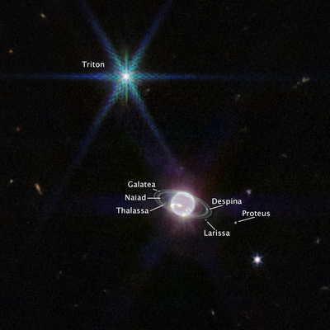
Where is this?
Notes:
Neptune has 14 known satellites, and seven of them are visible in this image.Triton, the bright spot of light in the upper left of this image, far outshines Neptune because the planet’s atmosphere is darkened by methane absorption at infrared wavelengths. Triton reflects an average of 70 percent of the sunlight that hits it.
This terrain looks like lumpy sediment on top of patterned ground. The lumpy sediment is likely just loosely consolidated because it is covered with spidery channels. This landform is uniquely Martian, formed in the spring as seasonal dry ice turns directly into gas that erodes channels in the surface.

Slide 3
SSE Spaceship
SSE!
Odysseus
The Best Astro Transport (The BAT Mobile)
The Cosmic Orbit Haven
The NRY
Research Expedition for Cosmic ObservatioNs Ship (RECONS)
Rimor (Latin for explorer)
Master Astronomers Rising Though Adversity (MARTA)

Slide 4
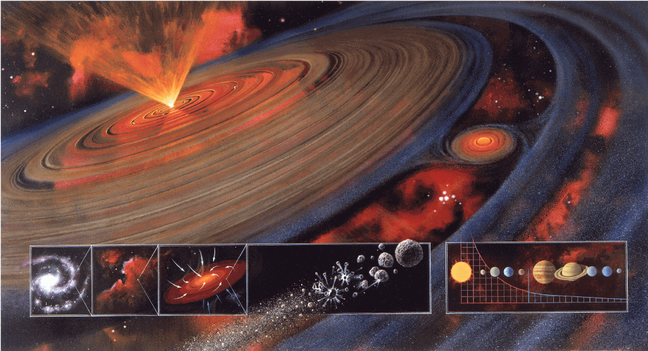
Solar System Formation II

Slide 5
Condensation to a Solar System
I. molecular cloud core before t = 0
II. freefall collapse t = 0.1 to 1 Myr
III. protostar / disk evolution t ~ 1 to 10+ Myr
IV. baby star / clearing / planet building t ~ 100 Myr
V. evolution of Solar System t > 100 Myr

Slide 6
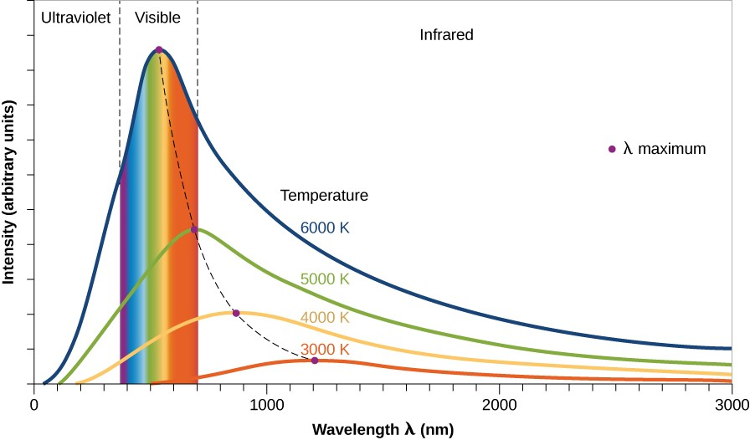
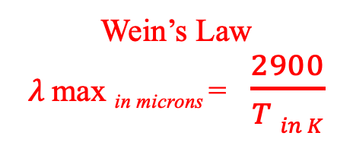
III. Protostar / Disk Evolution
BLACKBODIES yield TEMPERATURES, imply WAVELENGTHS

Slide 7
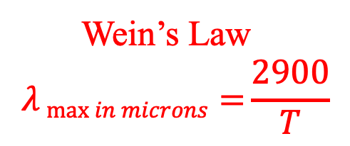
IRAS (1983): The Turning Point
IRAS excesses at 12, 25, and 60 microns over stellar photosphere
Aumann (1985) gives nice statistics of IRAS catalog:
756 sources corresponding to stars
504 dwarfs or subgiants
267 have 12 and 25 micron fluxes
36 have 12, 25, and 60 micron fluxes
12 are “Vega-like” with significant 60 micron fluxes
14% of A-type stars (N = 6)
3% of F-type stars (N = 4)
< 1% of G/K-type stars (N = 2)
detecting protostellar disks or debris disks?
Notes:
IRAS also had 100 micron band
those percentages must be out of the 504 dwarfs or subgiants because the numbers are about 42 A stars, 132 F stars, > 200 G/K stars, ## M stars
protoplanetary disk = massive, hot … debris disk = low mass, cold

Slide 8
Disks
protostellar disks
“high” mass ... “hot”
debris disks
low mass … cold
Notes:
protoplanetary disk = massive, hot … debris disk = low mass, cold

Slide 9
beta Pictoris Disk
A5V star, 19.3 pc, 20 (?) Myr old
brightest infrared excess of any main sequence star detected by IRAS
circumstellar debris disk first imaged by Smith & Terrile (1984)
disk almost edge on, extends beyond 2000 AU (!) at optical wavelengths
temperature/color profile indicates large blackbodies not present
two (or more) disks, clear within 80 AU (inner void from 10 micron flux)
… ice sublimates in inner disk leaving grains, or planet clearing?
bottom line: beta Pic has (at least) double disk,
cleared in 20 (?) Myr
Notes:
emission intensity transition at 100 AU … models indicate albedo ~0.35 for grains in outer disk

Slide 10
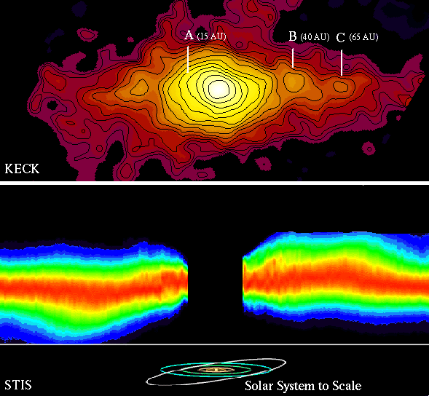
beta Pictoris Disk
MIRLIN map:
15 AU ring tilted
40 AU ring opp. tilt
65 AU ring asymmetric
STIS image:
warp in disk is real
(exaggerated here)

Slide 11
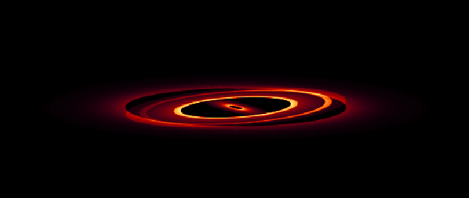

beta Pictoris Disk Model
model must match:
brightness
color (temps)
inclination
extent
(don’t forget star)
80 deg
89 deg

Slide 12
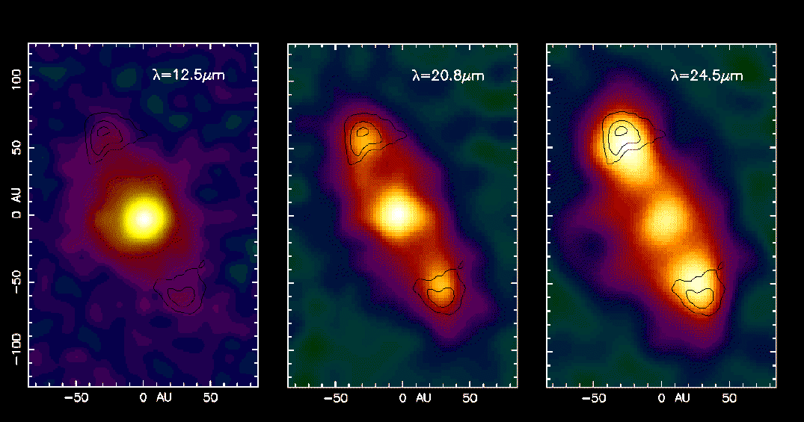
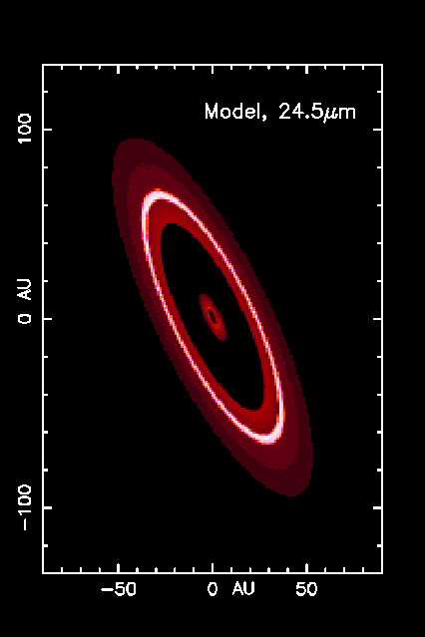
HR 4796A Disk
A0 star, 67 pc, 10 (?) Myr old discovered by Koerner et al. (1998)
outer ring structure from different temp samples
stellar photosphere fades (but still there)
dust brightens … disk stretches
central star has excess flux … hot dust in close, cleared to Kuiper Belt
10 (?) Myr double disk … transition between protostellar + debris disks

Slide 13
The IRAS Fab Four
Name SpType L distance age i r_{in} r_{out} T_{dust} M_{dust}
(suns) (pc) (deg) (AU) (AU) (K) (Moons)
Vega | A0V | 60 | 7.8 | 200 Myr | 85 | 80 | 120 | 80 | 0.2
Fomalhaut | A3V | 13 | 7.7 | 200 Myr | < 30 | 100 | 140 | 40 | 1.4
beta Pic | A5V | 9 | 19.3 | 20 Myr | > 80 | 20 | 2000+ | 85 | 3.0
eps Eri | K2V | 0.3 | 3.2 | 500 Myr | 70 | 50 | 80 | 35 | 0.1
The Fab Fifth
HR 4796A | A0 | 18 | 67 | 10 Myr | 72 | 55 | 80 | 65: | ?

Slide 14
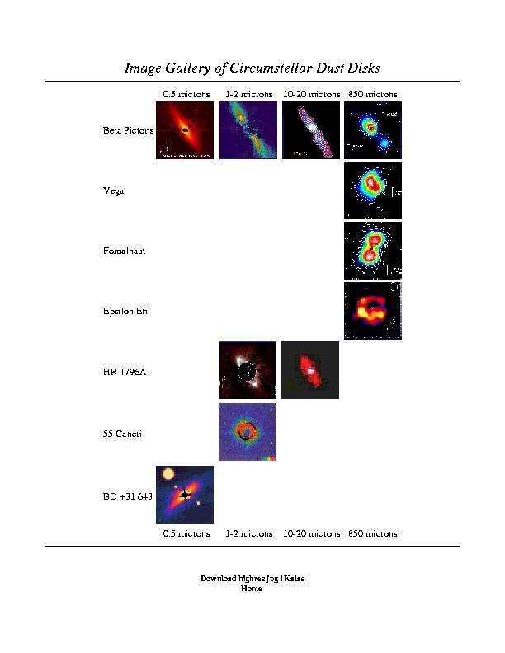
Disk Photo Gallery
multi-wavelength study crucial
optical: stellar photosphere
near-IR: warm dust
far-IR: cool dust
sub-mm: very cold dust
radio: molecular contents
high resolution
flows

Slide 15
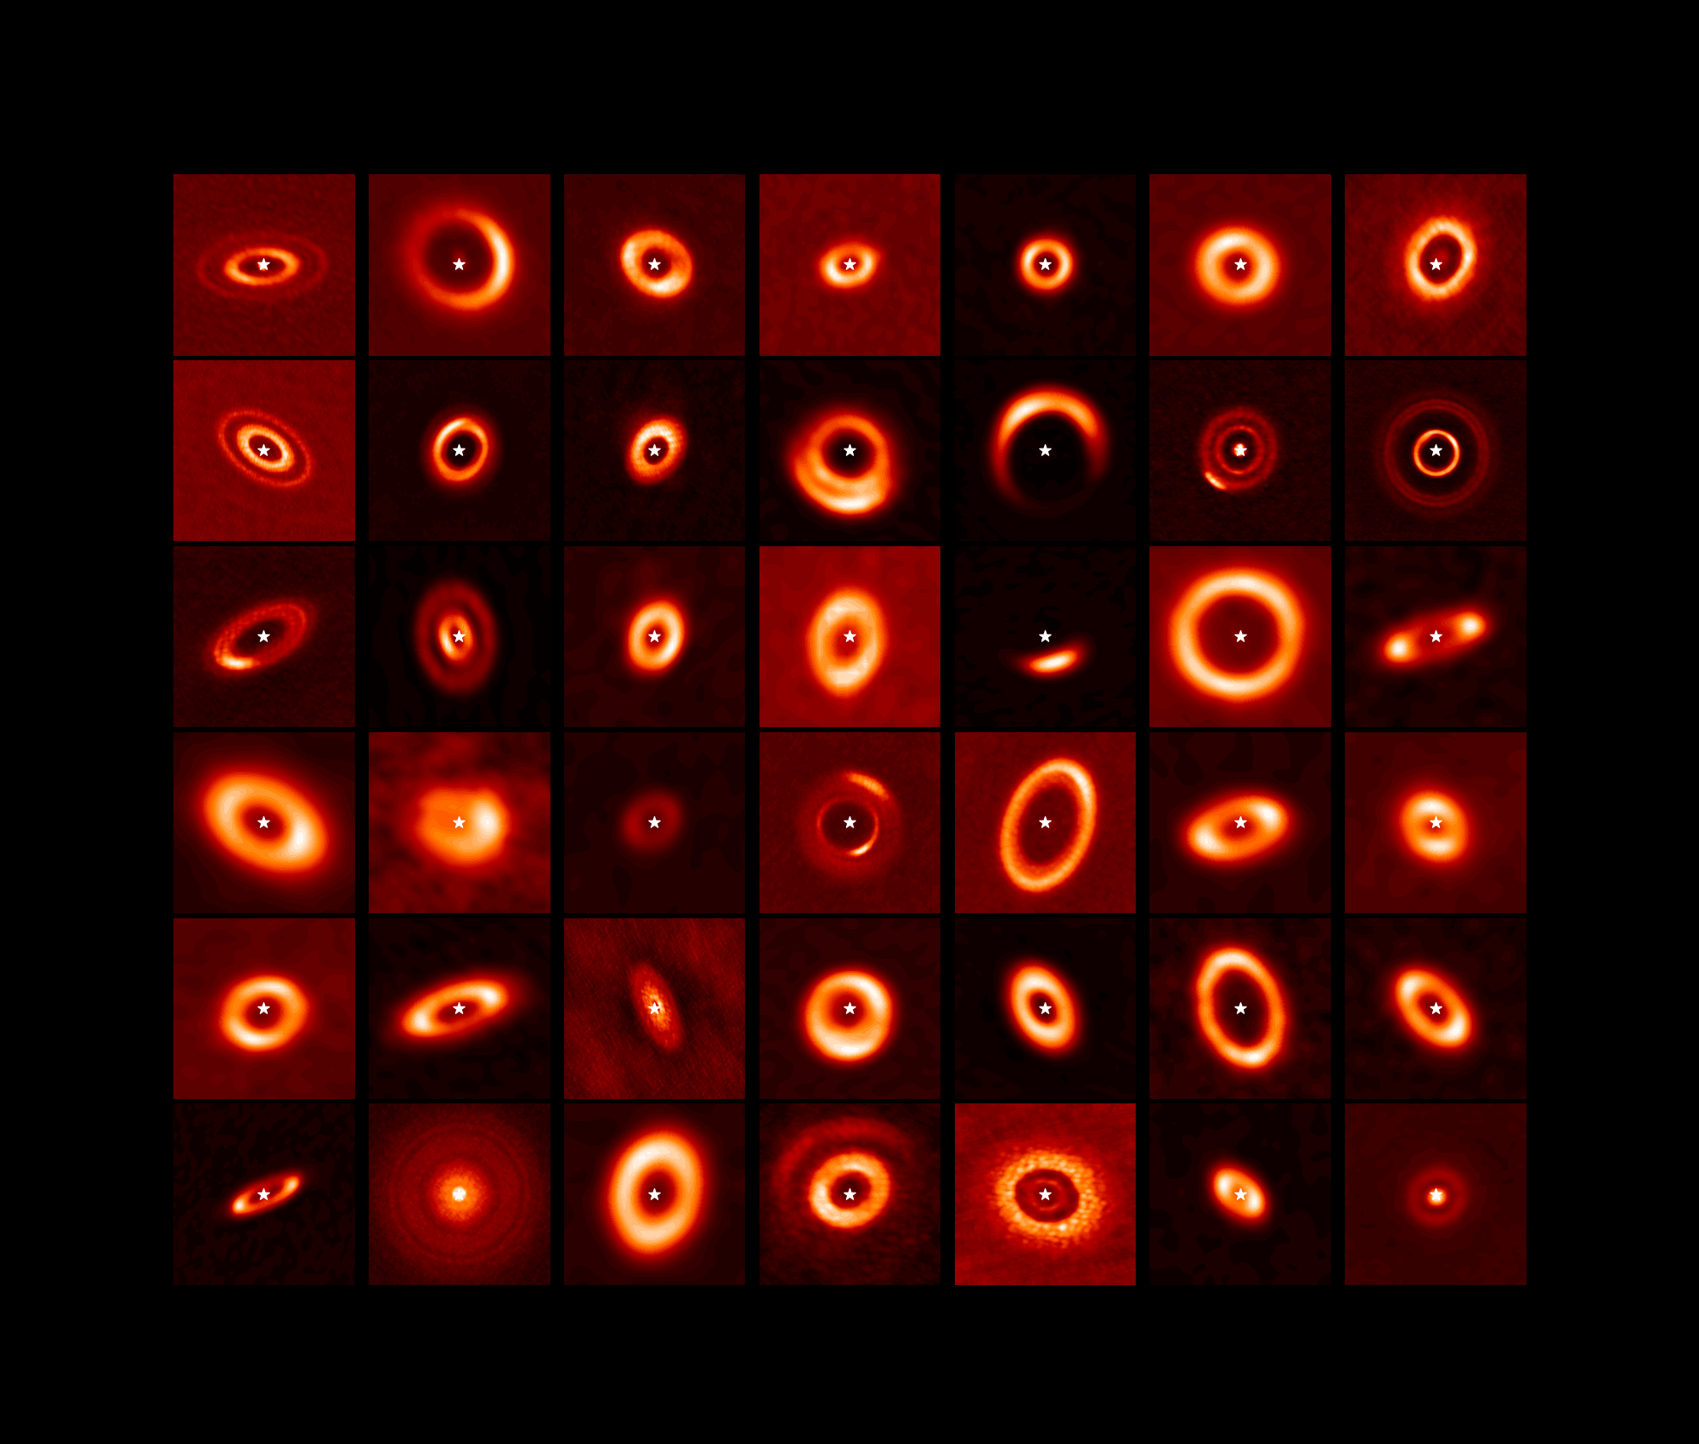
ALMA Disks
N. van der Marel

Slide 16
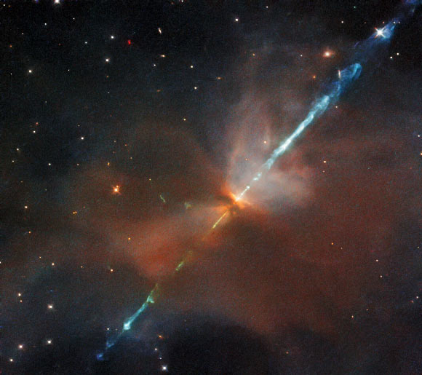
IV. Baby Star / Planet Building
THE STAR
core temp reaches 10⁶ K, deuterium fuses…10⁷ K, H fuses
T Tauri phase --- bipolar outflow, gas cleared
HH (Herbig-Haro) objects --- gas jettisoned
HST image of HH 24
in Orion
Notes:
T Tauri stars have conical jets
HH objects are bright blobs of nebulosity where jets collide with ISM, typically found near the youngest T Tauri stars

Slide 17
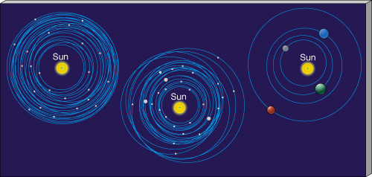
IV. Baby Star / Planet Building
THE PLANETS
buildup of terrestrial planets ~100 Myr
slow accumulation of small bodies
not much mass involved
buildup of giant planets ~10 Myr (need to have gas around)
all giant planets have roughly the same heavy element mass…
5, 15, 300, 300 X solar heavy/light element ratios in J/S/U/N
H and He total mass varies wildly!
fraction of total mass: 90% J, 75% S, 10% U, 10% N
PAPER TOPIC: Why two kinds of giant planets?
Notes:
98% of Sun’s mass is H+He
Jup mass 2x10^27 ~ 20X Nep
Nep mass 1x10^26

Slide 18
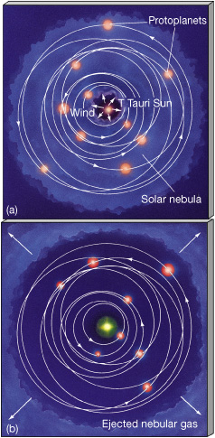
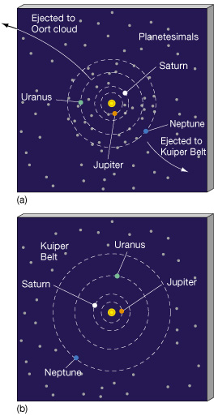
Clearing of Debris
GAS
“DUST”

Slide 19
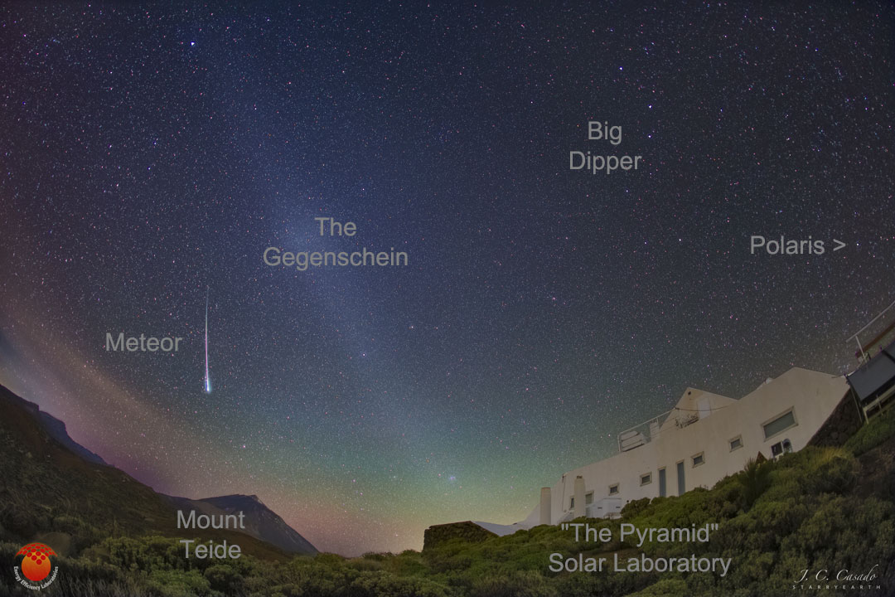
Dust Remains
Notes:
Gegenschein is dust in opposition to the Sun’s position

Slide 20
The Nice Model
problem: Jupiter, Saturn, Uranus, Neptune
NOT in circular, coplanar orbits
 | a (AU) | e | i (deg)
Jupiter | 5.20 | 0.048 | 1.30
Saturn | 9.54 | 0.056 | 2.49
Uranus | 19.19 | 0.046 | 0.77
Neptune | 30.07 | 0.009 | 1.77
solution: wandering giant planets (Tsiganis et al. 2005)
interactions with disk of planetesimals

Slide 21
The Nice Model
details: start with 4 Jovians with e and i ~ 0.001
Jupiter 5.45 AU
Saturn < 8.65 AU (1:2 resonance)
Ice Giant 1 11-13 AU
Ice Giant 2 13.5-17 AU
add 1000-5000 bodies with total mass 30-50 Earths
located beyond Jovians, extends to 30-35 AU
EVOLVE!
http://lucy.swri.edu/2018/04/24/Nice-Model.html
Jupiter moves in … Saturn drifts out
Jup:Sat resonance 1:2 strongest ... kaboom!
Ice Giants migrate out wildly
Ura/Nep swap in 50% of simulations
Notes:
those 3000 bodies have masses ¼ Mercury or 6XPluto

Slide 22
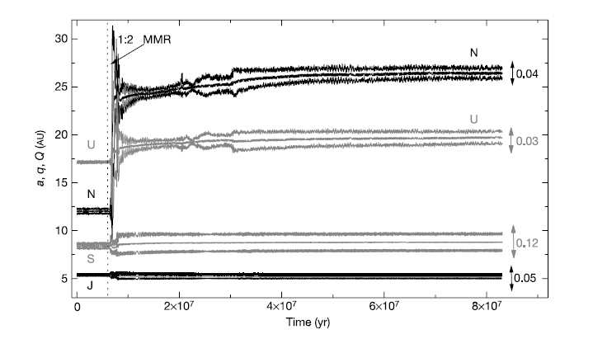
The Nice Model
Tsiganis et al. 2005
Notes:
this is one simulation … note short period of time
a is semimajor axis, q is perihelion, Q is aphelion
e noted on right, maximum during last 2 Myr shown

Slide 23
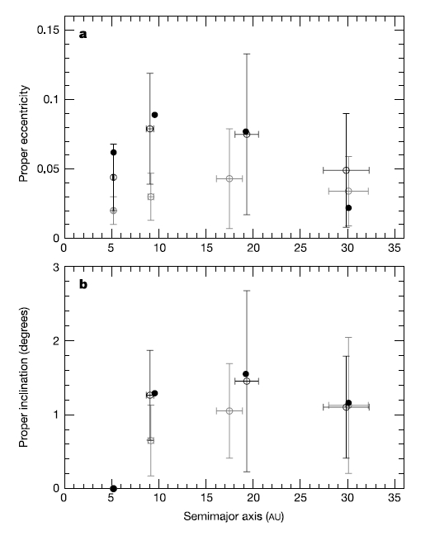
migration stops when
disk nearly depleted
→ present day
solid: today
gray: 0 Sat-IG encounters
black: ≥ 1 Sat-IG encounter
more disk mass?
more stability
Jup-Sat too far apart
final e too small
Tsiganis et al. 2005
Notes:
final Jup-Sat separation depends on initial mass of disk
IG = Ice Giant

Slide 24
The Nice Model
“Our model
statistically reproduces all aspects of the orbits of the giant planets.
[a, e, i for Jup/Sat/Ura/Nep]
It is consistent with the existence of regular satellites,
with the observed distributions of Jupiter’s Trojans,
perhaps with the existence of Neptune’s Trojans, and
does not contradict the distribution of main-belt asteroids.”
Tsiganis et al. 2005

Slide 25

V. Evolution of Solar System
SSE! SSE! SSE!
Name any characteristic of the SS that is different today than how the SS looked at age 10 Myr.

Slide 26
V. Evolution of Solar System
“the Nice Model”
happens in the first ~10 million years
continuous bombardment (craters, regolith, oceans?)
giant impacts (Moon origin, Venus retrograde?, Uranus tilt?)
tidal locking of moons (many)
resonances that cause evolution (Io-Eur-Gany, Kirk gaps, Plutinos)
captures (asteroids, Triton)
changing atmospheres (Venus, Earth, Mars, Titan, Pluto)
ring systems/toroids (Io)
icecaps (Mercury, Earth, Moon, Mars)
erosion (Earth, Mars, Titan)
vulcanism (Venus, Earth, Mars, Io, Enceladus, Triton)
life

Slide 27
Solar System Explorers: 12 SEP
Describe something you have already learned in this course that you did not know previously (you may use information from Chapter 1 of the book).
1. Chandra looked at SS objects
2. Different structures to MBA and Saturn because of densities
3. Titan has subsurface water oceans
4. Comets called jurads can form during stellar death
5. Jupiter’s magnetotail reaches to Saturn’s orbit
6. Some MBAs have cometary activity
7. Mercury is almost entirely Fe core
8. An extrasolar comet has been detected
9.
10.
11.
12.
13.
14.
15.
16.
17.
18.
19.
20.

Slide 28
Solar System Explorers: 19 SEP
Describe a dynamical situation in the Solar System involving 2 or more bodies that is unusual, in the sense that it is not a simple orbit.
1.
2.
3.
4.
5.
6.
7.
8.
9.
10.
11.
12.
13.
14.
15.
16.
17.
18.
19.
20.

Slide 29
…………………………
Notes:
29

Slide 30
HR 4796A Disk Details
A0 star, 67 pc, ~10 Myr old
circumstellar disk discovered by Koerner et al. (1998)
… disk inclined by 72 deg
emission intensity increases (!) with radius, implying inner hole 40-70 AU
… clearance out to Kuiper Belt?
ring width is < 17 AU from NICMOS observations
… corresponding to thin Kuiper Belt, or shepherding planets?
dust beyond clearing could be due to smashing comets
8.8/10.3/12.5 micron flux excess implies inner disk with T ~ 160 K at ~10 AU
… similar temp to zodiacal dust in our Solar System
bottom line: HR 4796A has double disk in a transition state at 10 Myr
… between massive protostellar disks and more tenuous debris disks

