Slide 1
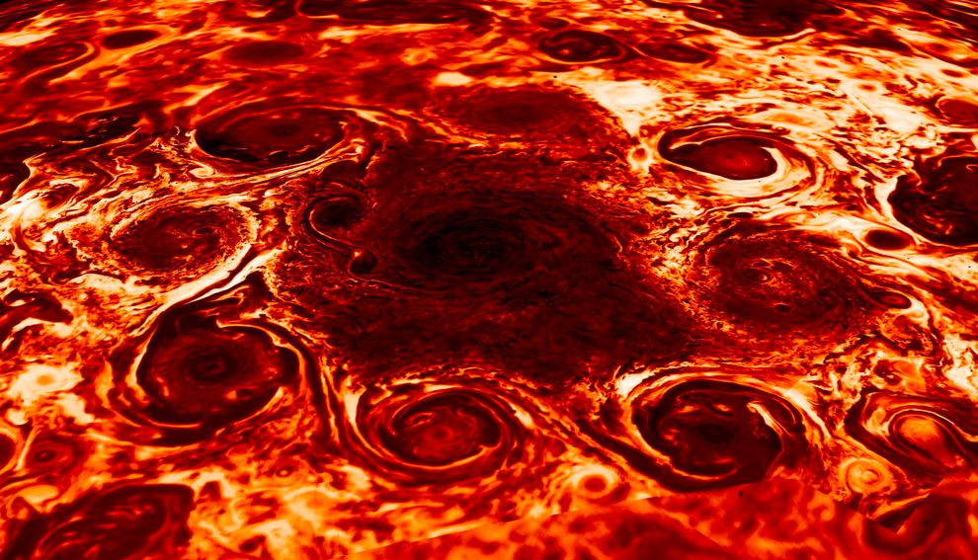
Where is this?
260K
85K
Notes:
JUNO at JUPITER: The north pole (infrared composite image) features one cyclone surrounded by eight similarly sized cyclones with diameters for all averaging between 2,500 to 2,900 miles. The dark areas represent temperatures of around 85 K, while the lighter areas are as warm as 261 K. Its south pole, shown below during an earlier flyby, includes a single cyclone surrounded by five swirling counterparts with diameters for all ranging between 3,500 to 4,300 miles.

Slide 2
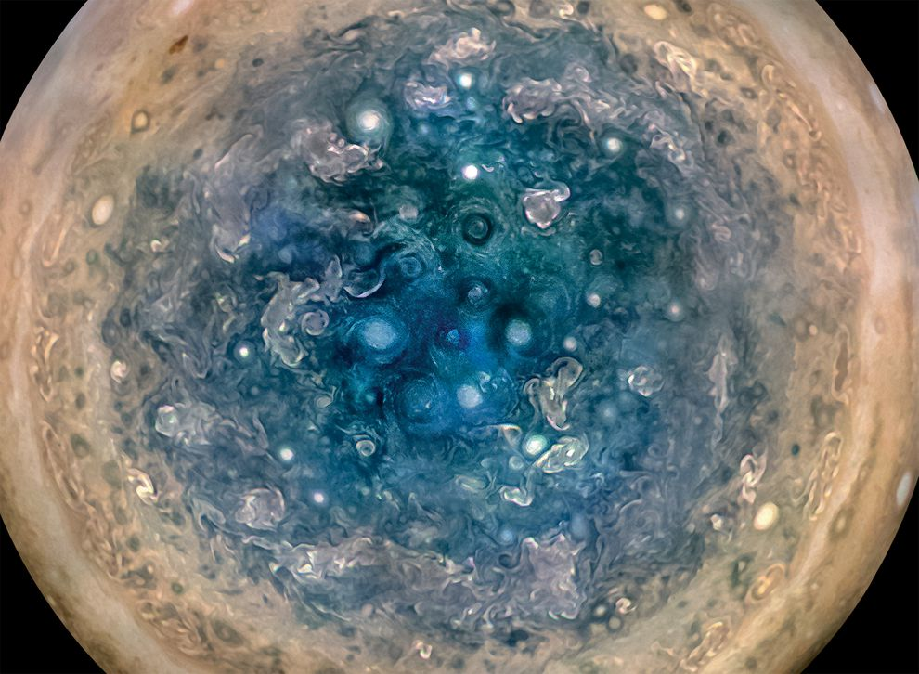
Where is this?
Notes:
JUNO at JUPITER: The south pole (visible composite image, color-enhanced) taken on 16 DEC 2017. Not representative of what would be seen with the naked eye.

Slide 3
Research Paper Level 1
due Tuesday, 01 OCT (class start)
Outline of your research project (worth 10 points)
use AAS Overleaf LaTeX link on website
the more original, the better
hand in printed version
10 pieces required:
1. Abstract 2+ sentences
2. Introduction 2+ sentences … why do we care?
3. Motivation 2+ sentences … why do YOU care?
4. Sections listed … Sample, Observations/Data, Results …
5. Discussion 2+ sentences
6. Tables 2+ listed
7. Figures 2+ listed
8/9/10. three REFEREED references

Slide 4
Solar System Explorers: 03 OCT
How does the Sun affect objects in the Solar System?
1.
2.
3.
4.
5.
6.
7.
8.
9.
10.
11.
12.
13.
14.
15.
16.
17.
18.
19.
20.
NONE TODAY

Slide 5
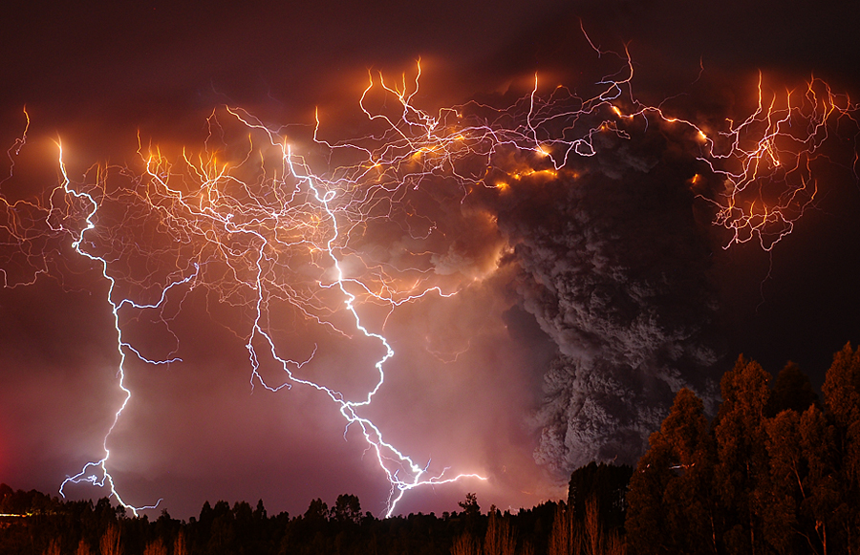
Energy Transport
photo: Francisco Negroni
Notes:
eruption of Puyehue Cordon-Caulle volcano on June 5, 2011 in Chile

Slide 6
Terms
obliquity
albedo
clathrate
effective vs. equilibrium temperature
thermal skin depth
thermal conductivity (watts m⁻¹ K⁻¹)
specific heat capacity (erg g⁻¹ K⁻¹)
adiabatic lapse rate … superadiabatic
hydrostatic equilibrium
radiative transfer
Notes:
watt = power = 1 joule/second
erg = energy = 10-7 joule

Slide 7
Energy Transport in Planets
CONDUCTION
CONVECTION
RADIATION

Slide 8
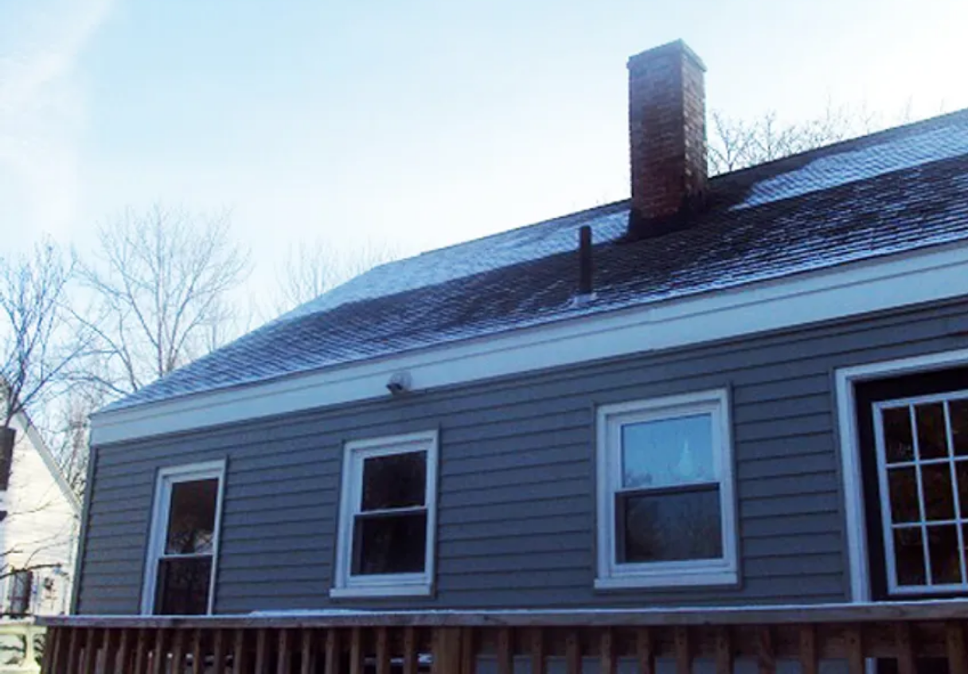
Energy Transport in Planets
CONDUCTION (solids) --- transport of energy by particle collisions
https://www.greenbuildingadvisor.com/article/the-street-side-energy-audit

Slide 9
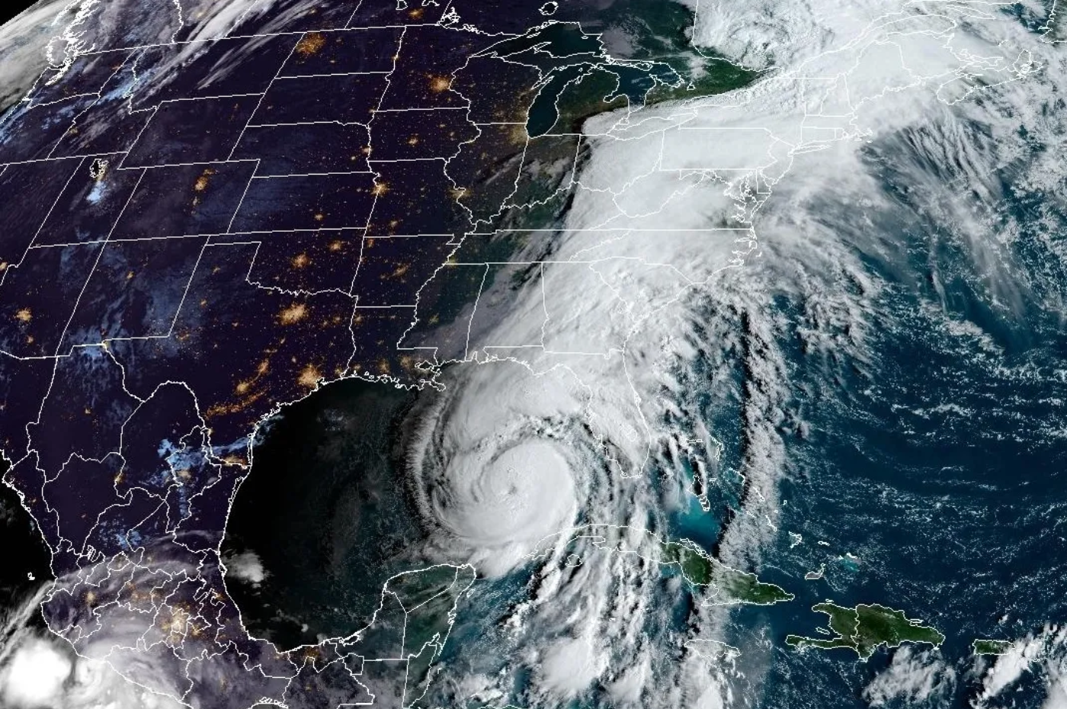
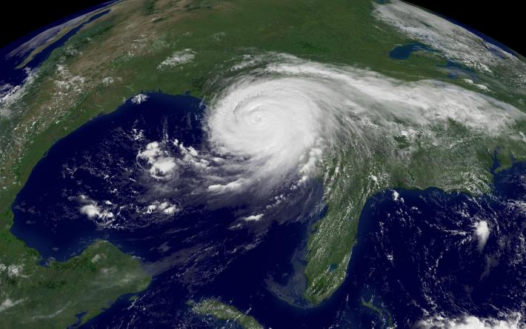
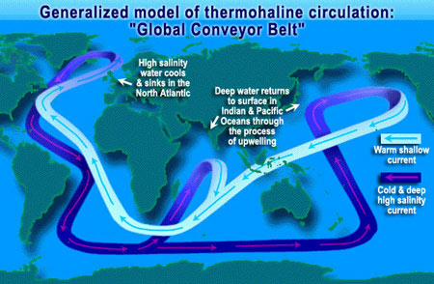
Energy Transport in Planets
CONVECTION (gases/fluids) --- motion in a fluid caused by density
gradients that are the result of temperature differences
photo: NASA
Notes:
Katrina

Slide 10
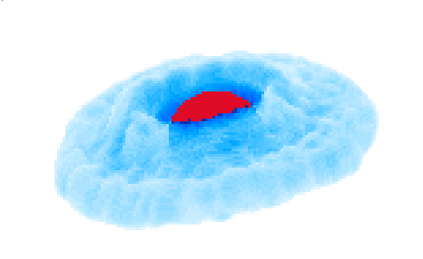
Energy Transport in Planets
RADIATION (gases) --- transport of energy by photons
SSE!

Slide 11
Energy Transport in Planets
RADIATION (gases) --- transport of energy by photons
Jupiter at radio wavelengths with surrounding cloud of
electrons trapped in magnetosphere
Notes:
two kinds of radiation --- thermal from Jupiter and synchrotron from electrons

Slide 12
Conduction
operates below planetary surfaces
temperature variations of the surface vary daily, depending on the
thermal skin depth:
L_{T} = (2 K_{T} / ω_{rot} ρ c_{p})^{1/2}
where K_{T} thermal conductivity in watts m⁻¹ K⁻¹
… surface material
ω_{rot} rotation rate of the planet
ρ density of the planet at the surface
… surface compaction
c_{p} specific heat capacity = energy required to
raise temp of 1 g by 1 K
temp variations are largest at surface
exponential dropoff with “skin depth” equal to L_{T}
conduction takes time, so heating/cooling not immediate … seasons significant
surface is insulator at night because conductivity depends on … temperature
observations are made at radio wavelengths

Slide 13
Thermal Conductivity, K_{T}
it really is a useful, measurable thing (units are watts m⁻¹ K⁻¹)
Styrofoam | 0.01 | Soil | 0.3-1.4 (dry-wet)
SSE! | 0.03 | Glass | 1.1
Wood | 0.1 | Concrete | 1.7
Body fat | 0.2 | SSE! | 80
Water / Ice | 0.6 / 2.2 | Diamond | 900-2320
Notes:
land heats and cools faster than water
body fat keeps you warmer than water

Slide 14
Thermal Conductivity, K_{T}
it really is a useful, measurable thing (units are watts m⁻¹ K⁻¹)
Styrofoam | 0.01 | Soil | 0.3-1.4 (dry-wet)
Air | 0.03 | Glass | 1.1
Wood | 0.1 | Concrete | 1.7
Body fat | 0.2 | Iron | 80
Water / Ice | 0.6 / 2.2 | Diamond | 900-2320
Notes:
land heats and cools faster than water
body fat keeps you warmer than water

Slide 15
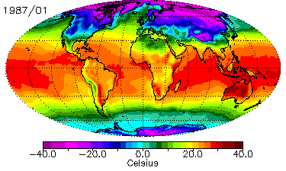
Land Heats/Cools Faster than Water
NOAA GLOBE data

Slide 16
Convection
operates in planetary atmospheres (near surfaces), liquid, and molten environments
occurs when the temp decreases with height so rapidly that pressure equilibrium
not reached … rising blobs of gas/liquid continue to rise
if adiabatic lapse rate (dT/dz) followed, then no convection ~ 10 K/km in Earth atm
if superadiabatic conditions, convection occurs (temp gradient steeper than adiabatic)
derivation of adiabatic lapse rate begins with assumption of hydrostatic equilibrium,
when pressure and gravity forces are balanced:
dP/dz = – g(z) ρ(z)
swap variables via equation of state (relates pressure, temp, and density in a material)
for the ideal gas law:
P = ρ R T / μ
assume first law of thermodynamics (energy conserved) and that no heat is exchanged
with surroundings (i.e. the air blob moves adiabatically)
dT/dz = – g(z) / c_{P}
c_{p} is specific heat capacity (erg g⁻¹ K⁻¹) at constant pressure
Notes:
adiabatic lapse rate --- rate at which atmospheric temperature decreases with increasing altitude in conditions of thermal equilibrium.

Slide 17
Convection
adiabatic lapse rate dT/dz = – g(z) / c_{P}
c_{p} is specific heat capacity (erg g⁻¹ K⁻¹) at constant pressure
atm c_{P} dT/dz
Venus
Mars
Earth
5 K/km
10 K/km (dry)
5 K/km (wet)
CO₂ 8.3 X 10⁶ 11 K/km
CO₂ 8.3 X 10⁶
N₂ + O₂ 1.0 X 10⁷
Hiker’s Rule: SSE!
temperature drops 5F per 1000 feet … 9 K/km !
Notes:
Venus has minimal convection because lower atmosphere is ~isothermal

Slide 18
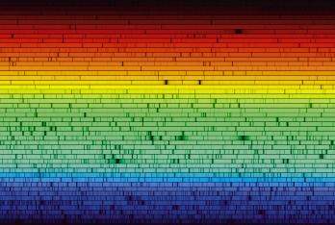
Radiation
heat transport by radiation in atmospheres where optical depth not large or small
typically upper troposphere (where we live) and stratosphere (where we fly)
PHOTONS interact with ATOMS and MOLECULES
observe interaction using spectroscopy

Slide 19
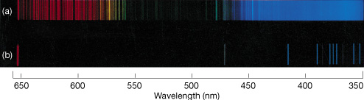
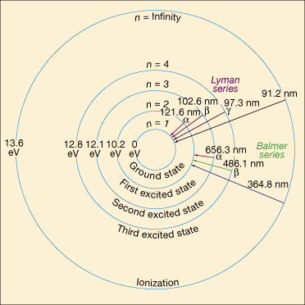
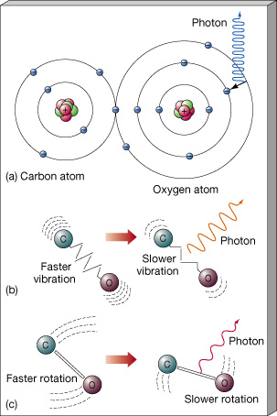
Atomic and Molecular Spectra
H₂
H
Notes:
atoms vs. molecules
discuss Lyman-alpha forest and H-alpha feature uses

Slide 20
Radiation Affects Matter
B_{ν} blackbody radiation
I_{ν} specific intensity (blackbody is one example)
J_{ν} mean intensity (integral of I_{ν} over solid angle / solid angle)
Einstein A coeff: probability/time emission occurs A_{ul}
Einstein B coeff: probability/time event occurs B_{lu} J_{ν} (normal absorption)
B_{ul} J_{ν} (stimulated emission)
Classic Case: “When in thermodynamic equilibrium…” the following are true
1. isotropic blackbody radiation field B_{ν} = I_{ν} = J_{ν}
2. absorption rates = emission rates N_{l} B_{lu} J_{ν} = N_{u} A_{ul} + N_{u} B_{ul} J_{ν}
3. temperature of gas determines number
density of atoms in given energy state N_{i} ~ e ^{– E}_{i}^{/kT}

Slide 21
Radiative Transfer
What does “radiative transfer” actually mean?
→ used when the primary way that energy is transported is via photons!
→ pressure-temperature profile is determined by the following radiative
transfer equation, where dI_{ν} is the change in intensity inside a gas blob:
dI_{ν} / dτ_{ν} = – I_{ν} + S_{ν}
where I_{ν} is the incident intensity to the gas parcel, and S_{ν} is the source function
(effectively, these are absorption and emission factors)
τ is the optical depth, given by
τ_{ν} = ∫ α(z) ρ(z) dz
in which α(z) is the extinction (absorption + scattering) and ρ(z) is the density
Integrating the first equation (assuming S_{ν} does not vary with τ) yields
I_{ν} (τ_{ν}) = S_{ν} + e^{-τ}ν ( I_{ν,o} – S_{ν} )

Slide 22
Radiative Transfer
I_{ν} (τ_{ν}) = S_{ν} + e^{-τ}ν ( I_{ν,o} – S_{ν} )
real world considerations…what intensity, I_{ν} , do you see?
Note: for gas is in LTE, the source function is a blackbody function, S_{ν} = B_{ν}
If τ_{ν} >> 1, then the second term goes away and I_{ν} = S_{ν}
thick atmosphere --- emission determined entirely by the source function
within the atmosphere
If τ_{ν} << 1, then e^{-τ}ν ~ 1, the source function becomes irrelevant, and I_{ν} = I_{ν,o}
thin atmosphere --- incident radiation completely defines measured radiation
If τ_{ν} ~ 1, source function and incident intensity battle it out to see which has the stronger effect on what you see
If the gas is non-emitting, S_{ν} = 0 and any incident radiation is attenuated by the optical depth in a directly observable way … I_{ν} = I_{ν,o} e^{-τ}ν

Slide 23
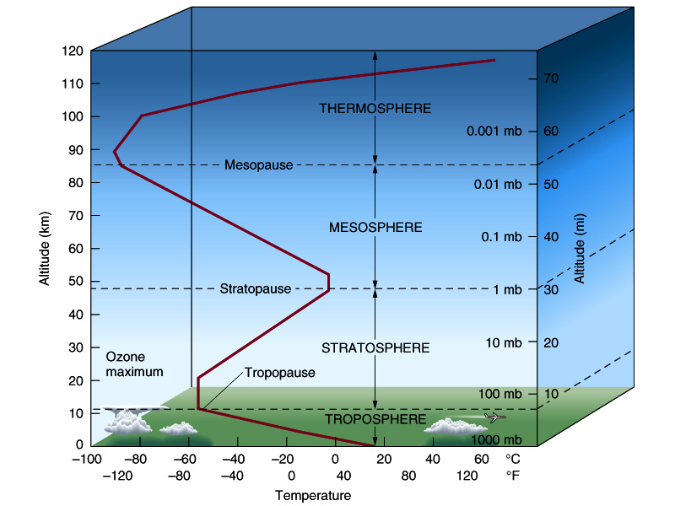
Energy Transport in Earth’s Atm
radiation
dominates
(UV photons)
radiation
dominates
(ozone +
greenhouse
effect)
convection
dominates
(adiabatic
lapse rate)
SSE!
Notes:
SSE! which one dominates on/in the ground? = conduction

Slide 24
What’s it all good for?
conduction measurements
probe surfaces to various depths in radio for temp variations …what’s it made of?
convection measurements
atmospheric structure and temperature variations …where are the molecules?
photochemical rates of reaction at various levels …where is the chemistry?
radiation measurements
colors are seen at various wavelengths … what’s in the atmosphere/on surface?
temperature profiles with height … where is it raining, and what is it?
if T_{eff} ≠ T_{equil} then you know something is fishy…

Slide 25
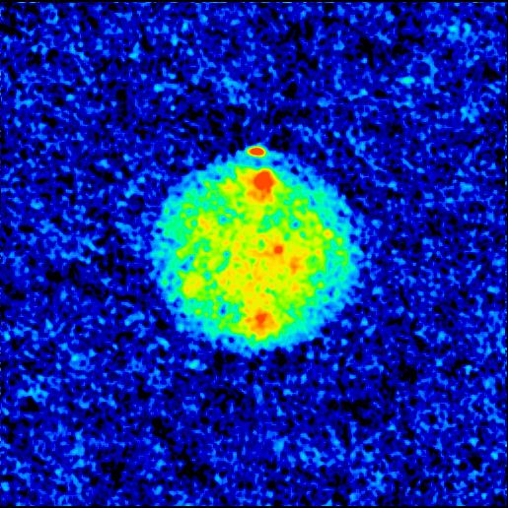
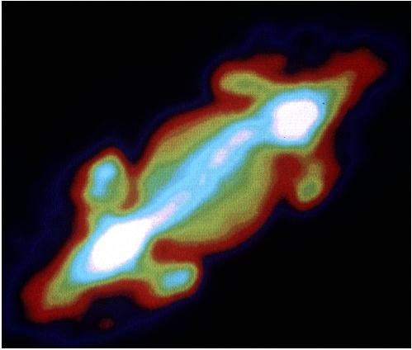
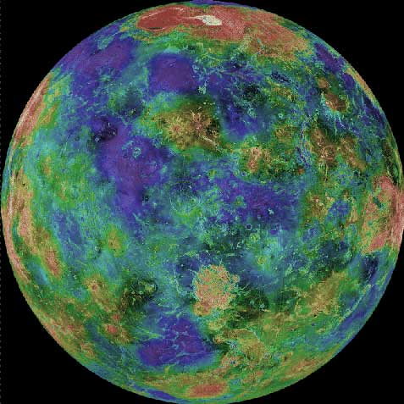
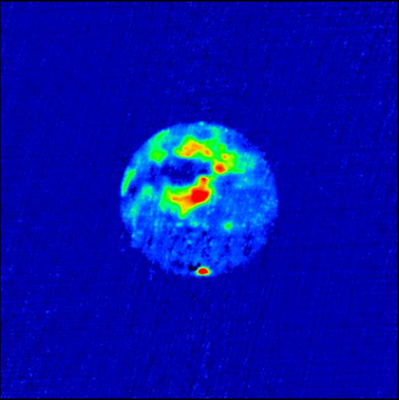
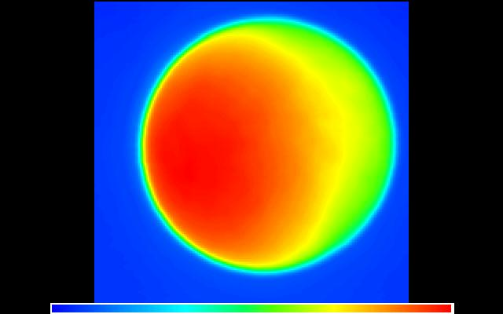
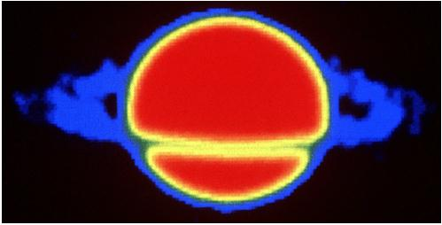
Planets at Radio Wavelengths
Jupiter
Venus
Mercury
Mars
Moon
Saturn
Notes:
Jupiter, Venus, Mercury, Mars, Moon, Saturn

Slide 26
…………………………
Notes:
26

Slide 27
Reality Check
Greenhouse effect…does it make sense?
Assuming an atmosphere that is in radiative equilibrium and LTE (g = ground)
T_{g} ⁴ = T_{eff} ⁴ ( 1 + 0.75 τ_{g} )
Implies that
Venus has optical depth to ground = 119
Earth has optical depth to ground = 0.6
Mars has optical depth to ground = 0.2

