Slide 2
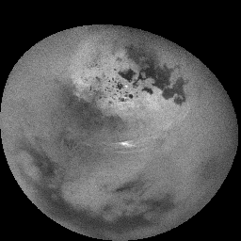
Where is this?
11 hour movie
Notes:
NASA's Cassini spacecraft watched clouds of methane moving across the far northern regions of Saturn's largest moon, Titan, on Oct. 29 and 30, 2016.
Several sets of clouds develop, move over the surface and fade during the course of this movie sequence, which spans 11 hours, with one frame taken every 20 minutes. Most prominent are long cloud streaks that lie between 49 and 55 degrees north latitude. While the general region of cloud activity is persistent over the course of the observation, individual streaks appear to develop then fade. These clouds are measured to move at a speed of about 14 to 22 miles per hour (7 to 10 meters per second).
There are also some small clouds over the region of small lakes farther north, including a bright cloud between Neagh Lacus and Punga Mare, which fade over the course of the movie. This small grouping of clouds is moving at a speed of about 0.7 to 1.4 miles per hour (1 to 2 meters per second).
In 2016, Cassini has intermittently observed clouds across the northern mid-latitudes of Titan, as well as within the north polar region -- an area known to contain numerous methane/ethane lakes and seas see PIA19657 and PIA17655. However, most of this year's observations designed for cloud monitoring have been short snapshots taken days, or weeks, apart. This observation provides Cassini's best opportunity in 2016 to study short-term cloud dynamics.
Models of Titan's climate have predicted more cloud activity during early northern summer than what Cassini has observed so far, suggesting that the current understanding of the giant moon's changing seasons is incomplete.
The mission will continue monitoring Titan's weather around the 2017 summer solstice in Titan's northern hemisphere.
The movie was acquired using the Cassini narrow-angle camera using infrared filters to make the surface and tropospheric methane clouds visible.

Slide 3
Research Paper Level 1
due Tuesday, 01 OCT (class start)
Outline of your research project (worth 10 points)
use AAS Overleaf LaTeX link on website
the more original, the better
hand in printed version
10 pieces required:
1. Abstract 2+ sentences
2. Introduction 2+ sentences … why do we care?
3. Motivation 2+ sentences … why do YOU care?
4. Sections listed … Sample, Observations/Data, Results …
5. Discussion 2+ sentences
6. Tables 2+ listed
7. Figures 2+ listed
8/9/10. three REFEREED references

Slide 4
Solar System Explorers: 03 OCT
How does the Sun affect objects in the Solar System?
1.
2.
3.
4.
5.
6.
7.
8.
9.
10.
11.
12.
13.
14.
15.
16.
17.
18.
19.
20.

Slide 5
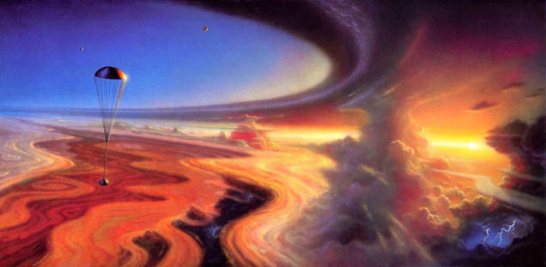
Planetary Atmospheres I
art by Alan Gutierrez

Slide 6
Planetary Atmospheres I
heated/energized from above by Sun
photochemistry
heated/energized from below by the planet
internal heat
greenhouse effect
volcanism
winds
clouds
storms
… various effects on surface evolution

Slide 7
SSE!
What is the primary component of Earth’s atmosphere?
…
N2
What is the primary component of Titan’s atmosphere?
…
N2
What is the primary component of Neptune’s atmosphere?
…
H2
What is the primary component of Europa’s atmosphere?
…
O2

Slide 8
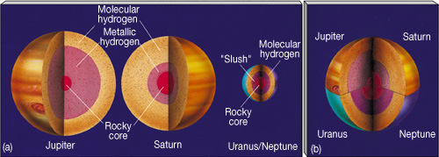
Overview
all planets + 7 dwarfs + Pluto have them (8 for real; 8 are wimpy)
Terrestrial thin skins (200 km thick, or < 5% R)
Gas Giants enormous (~ 20% R at Jup, ~ 45% R at Sat)
Ice Giants moderate (~ 20-30% R)
note: T at base of atm = 6800K (J), 6100K (S), 2500K (U/N) … huge fluid spheres
Super
Soup
-------

Slide 9
16 Atmospheres
PLANETS OTHERS
comp (> 1%) P (bar) H (km) comp (> 1%) P (bar) H (km)
Mercury | O Na He | < 10 ⁻¹² | 13 to 95 | Moon | He Ar | 10 ⁻¹⁵ | 65
Venus | CO₂ N₂ | 92 | 16 | Io | SO₂ | 10 ⁻⁸
Earth | N₂ O₂ H₂O | 1.0 | 8.5 | Europa | O₂ | 10 ⁻¹²
Mars | CO₂ N₂ | 0.006v | 11 | Ganymede | O₂ | < 10 ⁻¹¹
Jupiter | H₂ He | 10 ⁺⁶ | 24 | Callisto | CO₂ O₂? | 10 ⁻¹¹
Saturn | H₂ He | 10 ⁺⁶ | 47 | Titan | N₂ CH₄ Ar | 1.5 | 20
Uranus | H₂ He CH₄ | 10 ⁺⁵ | 25 | Triton | N₂ | 10 ⁻⁵
Neptune | H₂ He CH₄ | 10 ⁺⁵ | 23 | Pluto | N₂ | 10 ⁻⁵ | 33
HP(z) = kT(z) / g(z) μ m
Notes:
Terrestrial pressures at surface … Jovian pressures at base of molecular layers shown on p 276-277 figures in 2nd edition
Terrestrial scale heights at surface … Jovian scale heights at 1 bar
N2 has triple bond, so very stable
O2 has double bond
Titan has 98.4% N2, 1.6% CH4
Jovian scale heights larger because H2 and He are so light

Slide 10
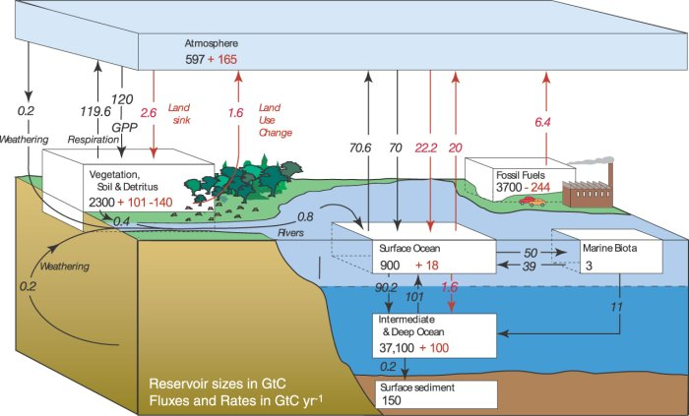
Earth’s Atmosphere: Carbon
https://gml.noaa.gov/education/behind_the_scenes/gases.html
one
way
arrow
black = pre-industrial … red = human changes
… sequester the carbon somewhere that is NOT the atmosphere
Notes:
Earth’s carbon is locked in oceans!
The black pre-industrial carbon values show the carbon cycle and the balance that existed without human emissions. The red values indicate the effects that the human emissions have had on the carbon cycle. Increased emissions have increased levels of carbon in the atmosphere, pressuring the ocean and land biosphere to accept more carbon and limiting their future effectiveness as CO₂ sinks.

Slide 11
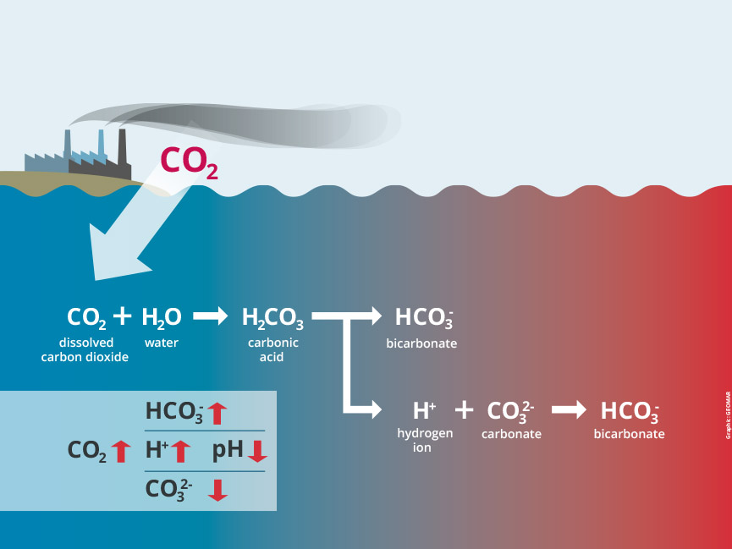
Ocean Acidification
more acidic
Notes:
Hydrogen ions H+ decrease pH = acidification

Slide 12
Scale Height
using hydrostatic equilibrium and ideal gas law:
dP = – g(z)ρ(z)dz P = ρ k T / μ m
find the atmospheric pressure as a function of altitude:
P(z) = Po e ^{– ∫ dz/HP(z)}
with the pressure scale height given by
HP(z) = kT(z) / g(z) μ m
where μ = mean molecular weight (in amu) m = 1.67 x 10⁻²⁴ g (one amu)
so, pressure drops by factor of e in one scale height
turns out to be the ~same for all substantial atmospheres: 10–50 km
…because T, g, and μ balance
(at least in Jovian atmospheres near P = 1 bar)
Notes:
adiabatic lapse rate was dT/dz = – g(z) / c_{P}
now we’re talking about dP/dz

Slide 13
16 Atmospheres
PLANETS OTHERS
comp (> 1%) P (bar) H (km) comp (> 1%) P (bar) H (km)
Mercury | O Na He | < 10 ⁻¹² | 13 to 95 | Moon | He Ar | 10 ⁻¹⁵ | 65
Venus | CO₂ N₂ | 92 | 16 | Io | SO₂ | 10 ⁻⁸
Earth | N₂ O₂ H₂O | 1.0 | 8.5 | Europa | O₂ | 10 ⁻¹²
Mars | CO₂ N₂ | 0.006v | 11 | Ganymede | O₂ | < 10 ⁻¹¹
Jupiter | H₂ He | 10 ⁺⁶ | 24 | Callisto | CO₂ O₂? | 10 ⁻¹¹
Saturn | H₂ He | 10 ⁺⁶ | 47 | Titan | N₂ CH₄ Ar | 1.5 | 20
Uranus | H₂ He CH₄ | 10 ⁺⁵ | 25 | Triton | N₂ | 10 ⁻⁵
Neptune | H₂ He CH₄ | 10 ⁺⁵ | 23 | Pluto | N₂ | 10 ⁻⁵ | 33
at base of molecular layers
at 1 bar, H₂ and He very light
H_{P}(z) = kT(z) / g(z) μ m
Notes:
Terrestrial pressures at surface … Jovian pressures at base of molecular layers shown on p 276-277 figures in 2nd edition
Terrestrial scale heights at surface … Jovian scale heights at 1 bar
N2 has triple bond, so very stable
O2 has double bond
Titan has 98.4% N2, 1.6% CH4
Jovian scale heights larger because H2 and He are so light

Slide 14
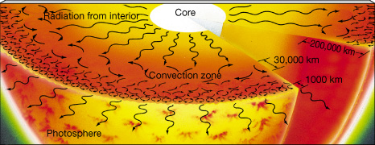
Sun
8 layers: C … R … C … P … C … T … C … S
core … radiative zone … convective zone … photosphere
chromosphere … transition zone … corona … solar wind

Slide 15
SSE!
How is a planetary atmosphere different from a stellar atmosphere?
1.
2.
3.

Slide 16
Top 10 Differences Between Planetary and Stellar Atmospheres
Upper atmosphere heated by Sun.
Lower atmosphere heated by planet.
Volcanoes may add localized heating and chemical species.
Chemical reactions abundant at (generally) low T.
Clouds cause radical changes in opacity.
Phase transitions alter temp environment.
Crust and/or ocean will interact with atmosphere.
Weathering by atmosphere may change albedo.
Storms may alter pressure/temp structure in atmosphere.
Life may affect composition and energy balance.

Slide 17
Generic Characteristics
EXOSPHERE
particles escape
THERMOSPHERE (IONOSPHERE) radiation sets temp
UV 100−1000 Å photons blast e⁻, charged particles (aurorae)
MESOSPHERE radiation sets temp
isothermal (or temp drop) portion of atmosphere
mesopause forms second temp minimum on Earth + Titan
STRATOSPHERE radiation (some convection)
temp increases with altitude
TROPOSPHERE convection sets temp
temp drops with altitude
clouds tend to form here
Notes:
radiation dumps heat into ozone in stratosphere

Slide 18
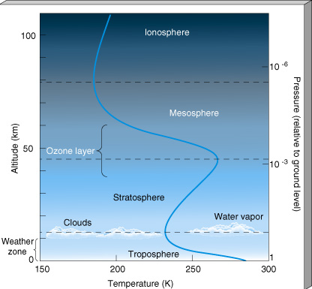
Earth
THERMO (IONO):
temp increase due to UV abs.
ionization of O₂
MESO: temp drop due to less
O₃ absorption, CO₂ cooling
STRATO: temp increase due
to O₃ absorption (UV+IR)
TROPO: weather
clouds at tropopause

Slide 19
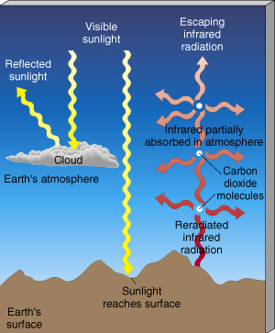
Earth Greenhouse
6 greenhouse gases
H₂O
CO₂
CH₄
N₂O
CFCs
O₃
Notes:
N2O = nitrous oxide

Slide 20
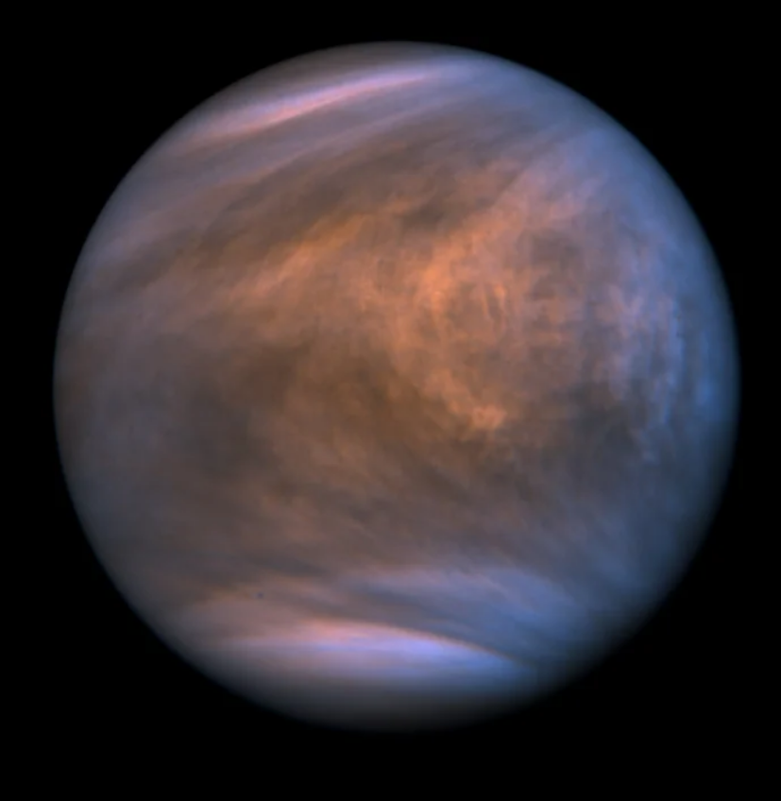
Venus
Venus by Akatsuki UV imager

Slide 21
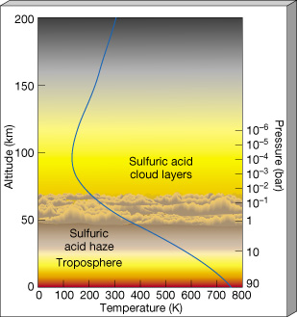
Venus
THERMO: 300 K vs 100 K day/night
because CO₂ very efficient radiator
MESO: isothermal
[ STRATO: there really isn’t one! ]
TROPO: greenhouse due to CO₂
diurnal/latitudinal/temporal temp
variations less than 5K

Slide 22
Venus vs. Earth : height

Slide 23
Venus vs. Earth : pressure

Slide 24
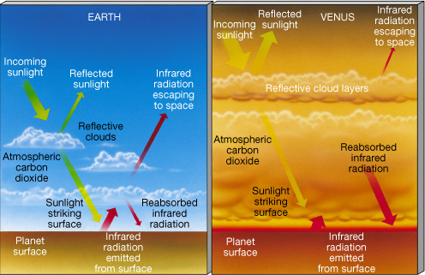
Earth vs. Venus Greenhouses
Notes:
how much more light does Venus receive than Earth? … about a 2X via 1/R²

Slide 25
…………………………
Notes:
25

