Slide 1
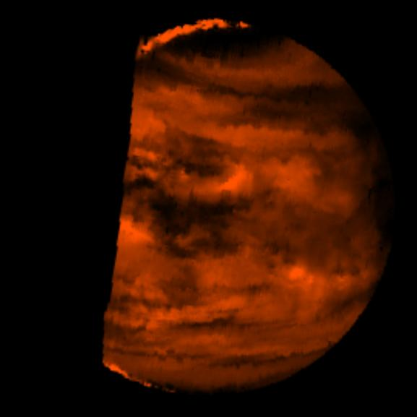
Where is
this?
high sunlit clouds
night side
at 2.3 microns
cold clouds
lower atm
Notes:
VENUS BY GALILEO: This false-color image is a near-infrared map of lower-level clouds on the night side of Venus, obtained by the Near Infrared Mapping Spectrometer aboard the Galileo spacecraft as it approached the planet's night side on February 10, 1990. Bright slivers of sunlit high clouds are visible above and below the dark, glowing hemisphere. The spacecraft is about 100,000 kilometers (60,000 miles) above the planet. An infrared wavelength of 2.3 microns (about three times the longest wavelength visible to the human eye) was used. The map shows the turbulent, cloudy middle atmosphere some 50-55 kilometers (30- 33 miles) above the surface, 10-16 kilometers or 6-10 miles below the visible cloudtops. The red color represents the radiant heat from the lower atmosphere (about 400 degrees Fahrenheit) shining through the sulfuric acid clouds, which appear as much as 10 times darker than the bright gaps between clouds. This cloud layer is at about -30 degrees Fahrenheit, at a pressure about 1/2 Earth's surface atmospheric pressure. Near the equator, the clouds appear fluffy and blocky; farther north, they are stretched out into East-West filaments by winds estimated at more than 150 mph, while the poles are capped by thick clouds at this altitude.

Slide 2
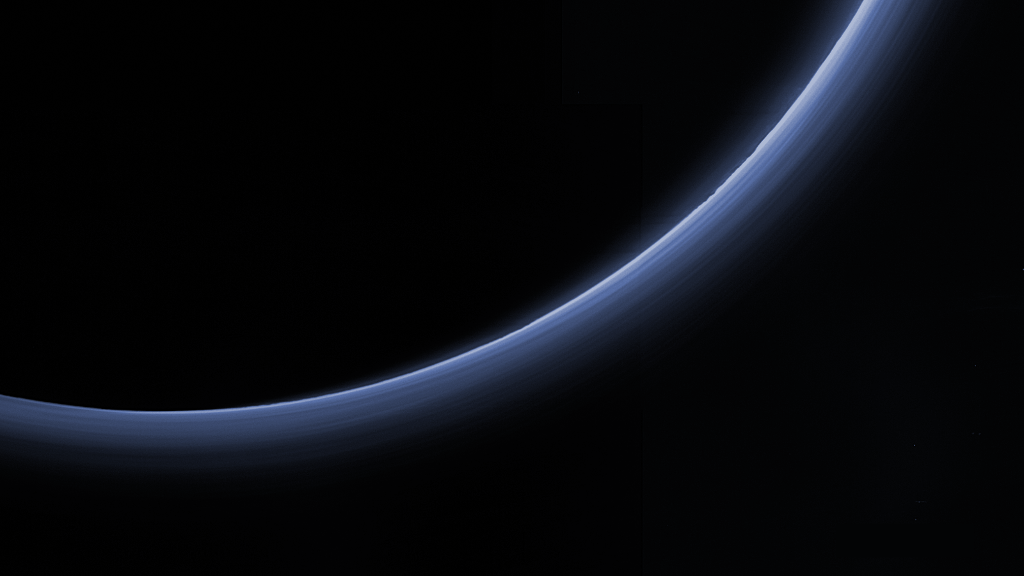
Where is this?
Notes:
Pluto by New Horizons
The upper left image samples temperatures near the top of Neptune's troposphere (near 100 millibar pressure, which is one-tenth the Earth atmospheric pressure at sea level). The hottest temperatures are indicated at the lower part of the image, at Neptune's south pole. The lower two images, taken 6.3 hours apart, sample temperatures at higher altitudes in Neptune's stratosphere. They do show generally warmer temperatures near, but not at, the south pole. They also show a distinct warm area which can be seen in the lower left image and rotated completely around the back of the planet and returned to the earth-facing hemisphere in the lower right image.
The images were obtained with the Very Large Telescope in Chile, using an imager/spectrometer for mid-infrared wavelengths on Sept. 1 and 2, 2006.

Slide 3
Planetary Atmospheres III
Notes:
Pluto by New Horizons

Slide 4
Solar System Explorers
for Tuesday, 04 OCT
look over equation sheet
be ready to answer a few questions

Slide 5
SSE!
Which terrestrial world’s atmosphere has the largest scale height?
…
Titan
In which wavelength regime should you observe atmospheres
to detect molecular rotation transitions?
…
radio
Name one of the cloud decks expected in the gas giants’ atmospheres.
…
ammonia
ammonium hydrosulfide
water

Slide 6
Jovian Compositions
Jupiter Saturn Uranus Neptune
H₂ 86% | H₂ 88% | H₂ 83% | H₂ 82%
He 14% | He 12% | He 15% | He 15%
 |  | CH₄ 2% | CH₄ 3%
at least
1%
CH₄ 2000 | CH₄ 4500
H₂O > 400 | H₂O ? | H₂O ? | H₂O ?
NH₃ 700 | NH₃ 500 | NH₃ < 150 | NH₃ < 150
H₂S 80 | H₂S 460 | H₂S 300 | H₂S 1000
Ne 20 | Ne ? | Ne ? | Ne ?
Ar 16 | PH₃ 7 |  | C₂H₆ 2
PH₃ 5 | C₂H₆ 3 |  | CO 1
ppm

Slide 7
Jovian Atm Highlights
Jupiter
extreme convection … belts/zones … Great Red Spot
enrichment of atmosphere by Io
Saturn
puffiest atmosphere of jovians
He rain has depleted He from outer layers
Uranus
cold enough for CH₄ clouds to condense
NH₃ condensed out/into NH₄SH clouds, so not observed
Neptune
CH₄ trend continues … increases from Jup min to Nep max
NH₃ condensed out/into NH₄SH clouds, so not observed
recall conditions in solar nebula …
CO preferred above 700 K, CH₄ preferred below 700 K, CH₄ ice below 80 K
N₂ preferred above 300 K, NH₃ preferred below 300 K, NH₃ ice below 150 K

Slide 8
Tenuous Atmospheres
temporary, due to
sputtering --- physical lifting off surface (but not v_{esc})
energetic particles from solar wind
energetic particles from nearby planet/magnetosphere
micrometeorite bombardment
… all 8 tenuous atmospheres
capture of solar wind … Mercury, Moon
volcanoes (Io … SO₂) and/or geysers (Enceladus … H₂O … Triton … N₂)
sublimation of ices … Mars, Io, Triton, Pluto

Slide 9
16 Atmospheres
PLANETS OTHERS
comp (> 1%) P (bar) H (km) comp (> 1%) P (bar) H (km)
Mercury | O Na He | < 10 ⁻¹² | 13 to 95 | Moon | He Ar | 10 ⁻¹⁵ | 65
Venus | CO₂ N₂ | 92 | 16 | Io | SO₂ | 10 ⁻⁸
Earth | N₂ O₂ H₂O | 1.0 | 8.5 | Europa | O₂ | 10 ⁻¹²
Mars | CO₂ N₂ | 0.006v | 11 | Ganymede | O₂ | < 10 ⁻¹¹
Jupiter | H₂ He | 10 ⁺⁶ | 24 | Callisto | CO₂ O₂? | 10 ⁻¹¹
Saturn | H₂ He | 10 ⁺⁶ | 47 | Titan | N₂ CH₄ Ar | 1.5 | 20
Uranus | H₂ He CH₄ | 10 ⁺⁵ | 25 | Triton | N₂ | 10 ⁻⁵
Neptune | H₂ He CH₄ | 10 ⁺⁵ | 23 | Pluto | N₂ | 10 ⁻⁵ | 33
H_{P}(z) = kT(z) / g(z) μ m
Notes:
Terrestrial pressures at surface … Jovian pressures at base of molecular layers shown on p 276-277 figures in 2nd edition
Terrestrial scale heights at surface … Jovian scale heights at 1 bar
N2 has triple bond, so very stable
O2 has double bond
Titan has 98.4% N2, 1.6% CH4
Jovian scale heights larger because H2 and He are so light

Slide 10
Clouds
Venus H₂SO₄ (sulfuric acid)
evaporates
Earth H₂O
Mars CO₂ (high, 50 km)
H₂O (low, 10 km)
Titan hydrocarbon smog
CH₄ below
Jupiter NH₃
+ NH₄SH
Saturn H₂O
“solution cloud”
Uranus CH₄
+ H₂S
Neptune NH₄SH
H₂O
“solution cloud”
form on all planets where the temp
drops below condensation point of
gases in atmosphere
1. non-equilibrium conditions in atm
2. absorbed incoming radiation heats
3. can alter surface heating pattern
4. can block outgoing infrared photons
theoretical for Jovians!
NH₃ + H₂S → NH₄SH
“solution cloud” = H₂O+NH₃+H₂S
KEY TREND:
further from Sun … colder
more cloud decks
Notes:
see/read first paragraph of section 4.4 on page 100
NH4SH = ammonium hydrosulfide
H2S = hydrogen sulfide

Slide 11
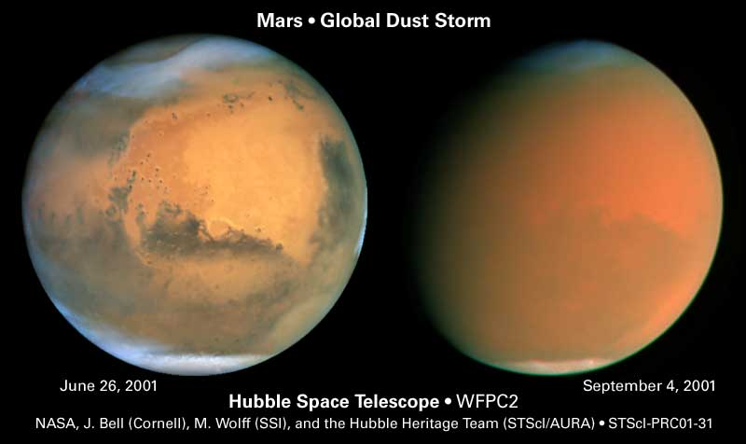
Weather

Slide 12
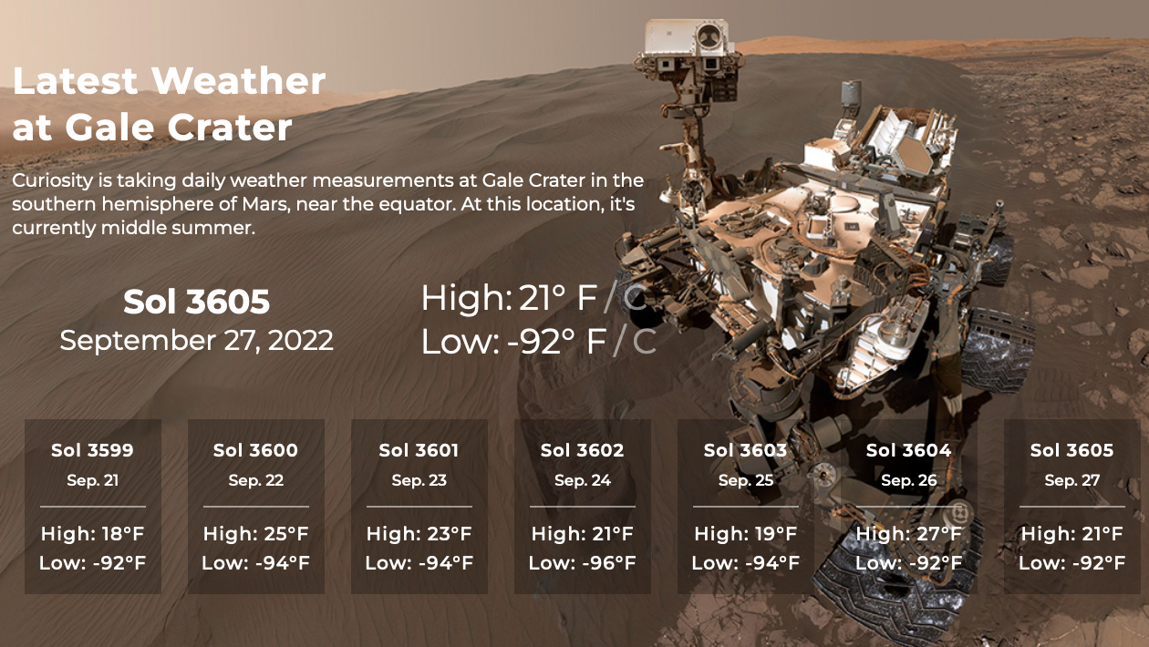
Weather
Notes:
Perseverance is nuclear powered … all ok
Curiosity is nuclear powered … all ok
Opportunity was solar powered … last response 10 JUN 2018, after 5111 sols
Spirit was solar powered … last response 22 MAR 2010, after 2208 sols

Slide 13
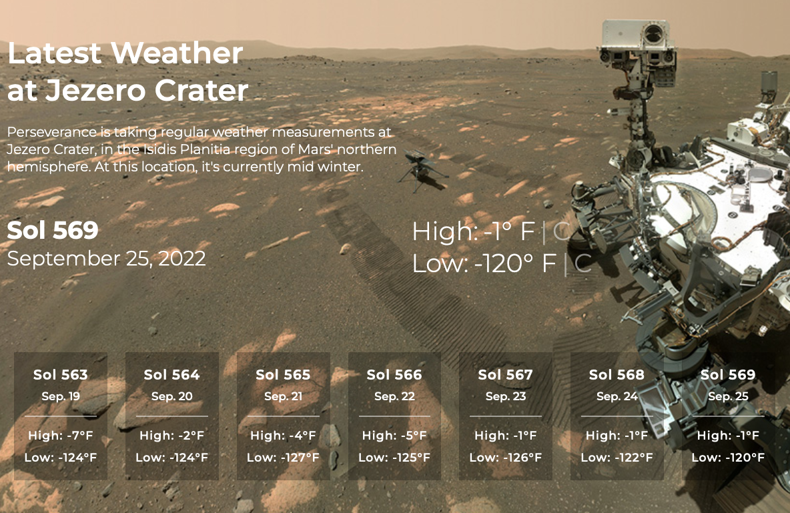
Weather
Notes:
Perseverance is nuclear powered … all ok
Curiosity is nuclear powered … all ok
Opportunity was solar powered … last response 10 JUN 2018, after 5111 sols
Spirit was solar powered … last response 22 MAR 2010, after 2208 sols

Slide 14
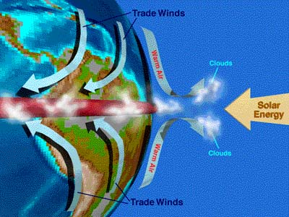
Weather
IN GENERAL …
solar heating leads to
Hadley cells --- subsolar point heated, poles not
hot air rises, move towards low pressure poles, air cools and sinks
thermal tidal winds --- hot day side, cold night side
substantial atmospheres ΔT/T < 1%, tenuous can be large (Mars 20%)
condensation flows --- sublimation/condensation of gas
Mars (CO₂), Triton and Pluto (N₂ + CH₄)
Notes:
slow-rotating Venus has 1 Hadley cell … Earth has 3/hemisphere … Jovians have many

Slide 15
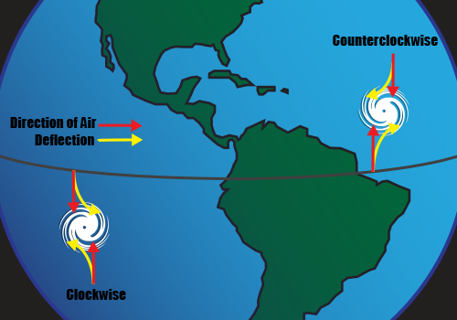
Weather: Earth
EARTH
Hadley cell circulation --- air bubbles change latitude
Coriolis effect breaks uniform flow into three regions/hemisphere
wet air rises near equator, cools, drops water … rainforests
dry air descends in mid-latitude …deserts
near equator, Coriolis effect weak and temp gradient minimal N ←→ S
Earth rotation + solar heating produce steady winds W ← E
trade winds carry heated water westward (extra warm water in W. Pacific)
in summer, water-laden air meets warmer land … rises … cools … monsoons
if trade winds weaken, less water moved west …buildup sloshes back
temp of E. Pacific water rises … El Nino!
occurs in southern hemisphere summer (i.e. Saturnalia/Christmas)
Notes:
Air at equator moving fast, as it drifts north, it “outruns” the air there, so moves ahead.

Slide 16
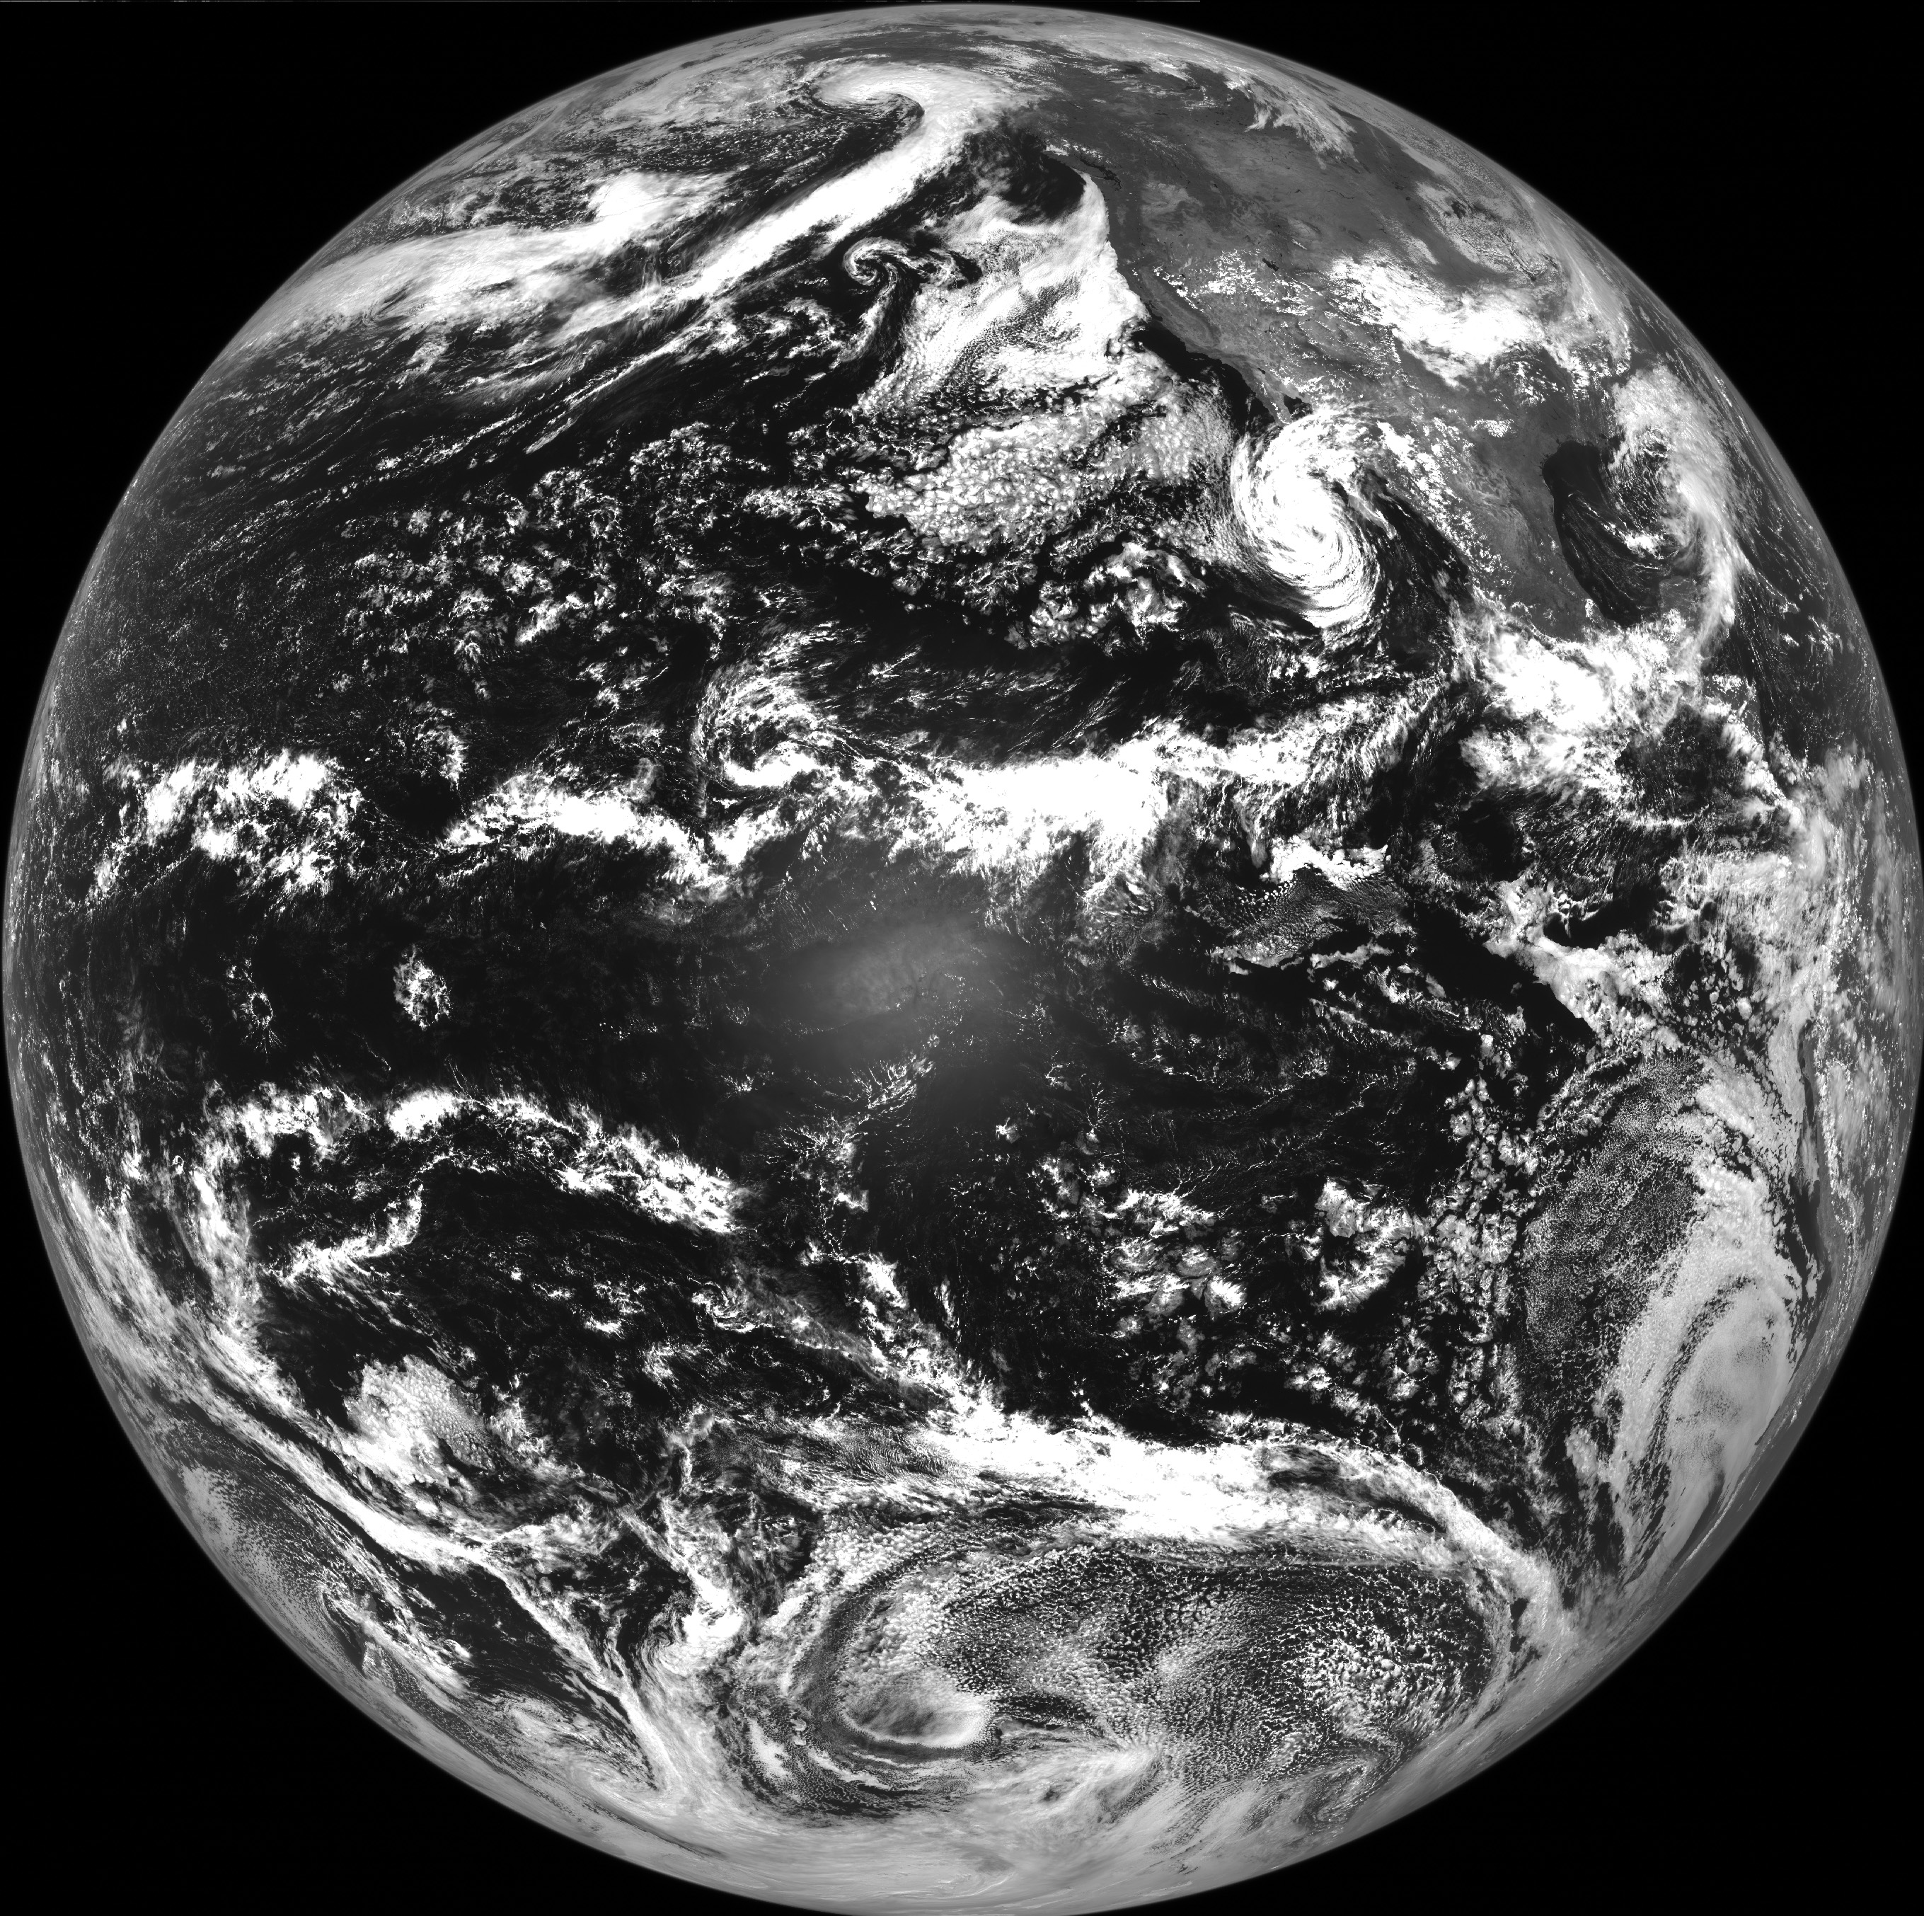
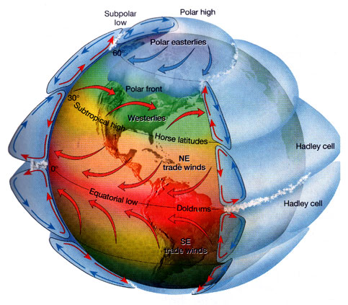
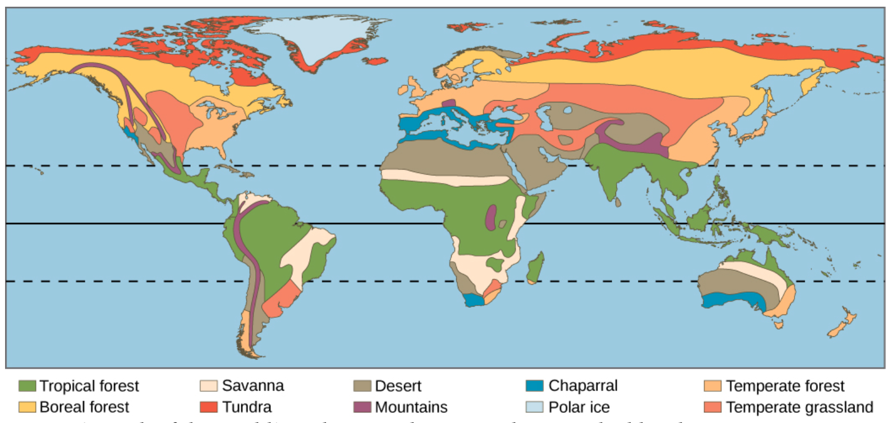
Hadley Cells
deserts
rainforests
deserts
Notes:
hurricanes DO NOT spin as the Hadley cell winds … smaller perturbations that peel off

Slide 17
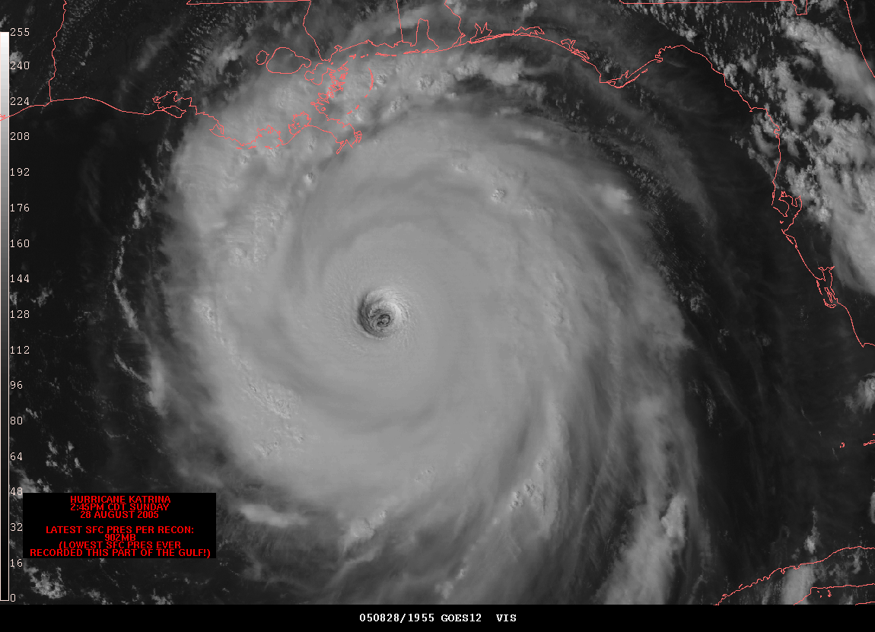

Slide 18
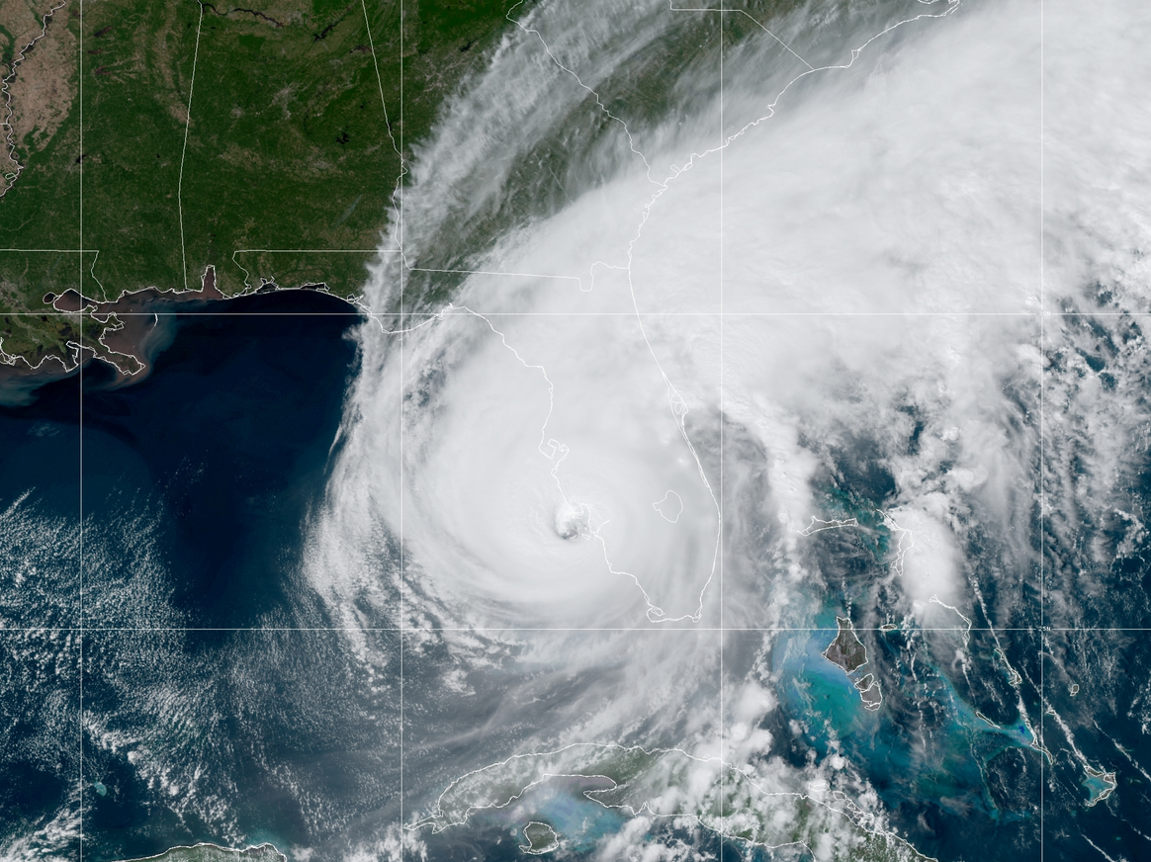
HURRICANE IAN
28 SEP 2022
MINIMUM PRESSURE 937MB

Slide 19
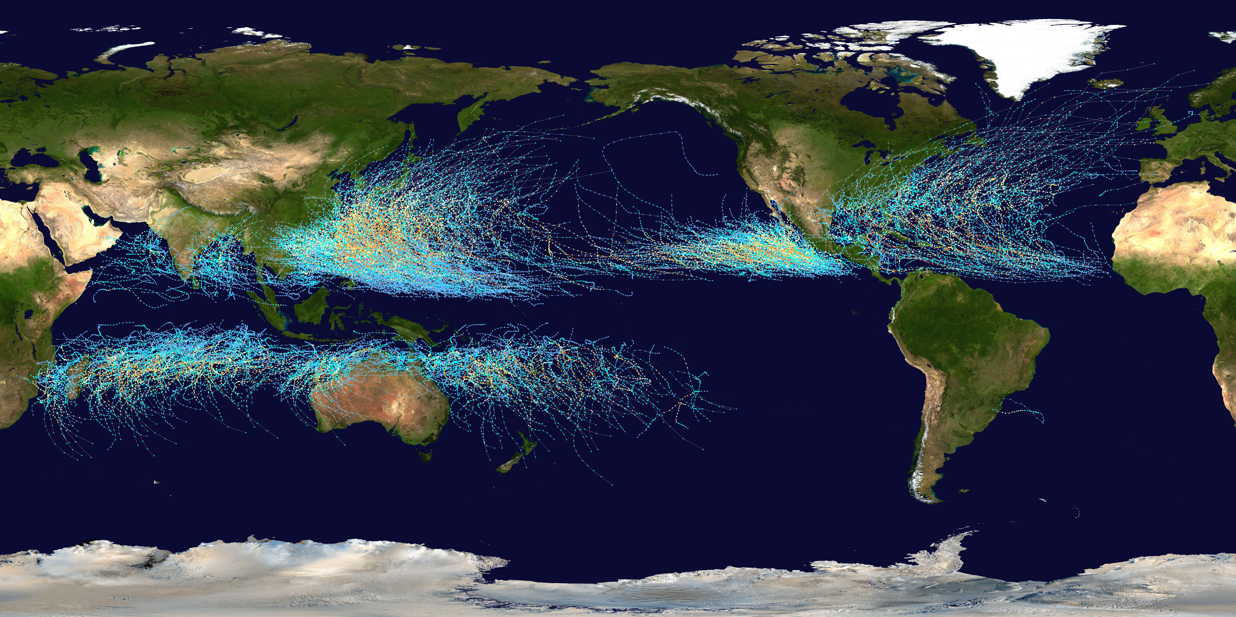
Storm Tracks 1985-2005
typhoons hurricanes
cyclones
?
Notes:
why no hurricanes in South America? --- colder water (Sun has to warm more water than in north) and strong wind shear (larger temp change from equator to south than to north, so more winds) prevent formation, as well as a lack of weather disturbances favorable for development in the South Atlantic Ocean

Slide 20
Weather: Terrestrials
VENUS
surface (0 km) winds are almost non-existent in isothermal lower atm
tropospheric winds (60 km) in same direction as planet rotates
circle Venus in 4 days … 100 m/s = 220 mi/hr
superrotating winds because Venus rotates once every 240 days
MARS
substantial condensation flows of CO₂ from one pole to another
strong thermal tide (day/night) winds … dune production
~50 m/s = ~100 mi/hr winds pick up dust and make dust devils
build to runaway dust storms
extreme topography leads to eddies
TITAN
constantly hazy
CH₄ clouds and rain
enough wind to create dunes
Notes:
dunes on Venus, Earth, Mars, Titan

Slide 21
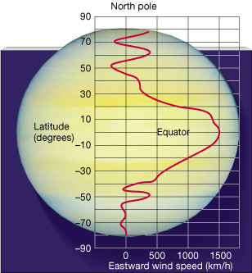
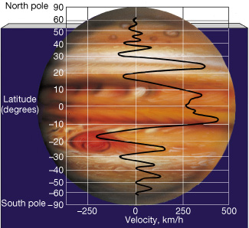
Weather: Jovians
JUPITER
multiple jet streams, at equator 350 km/hr (220 mi/hr)
symmetric around equator … convective cells ~ Hadley from the inside
zones = white ~ cold (high opacity) = high altitude
NH₃ ice
belts = dark ~ warm (low opacity) = low altitude
GRS at 600 km/hr (380 mi/hr)
SATURN
multiple jet streams, at equator 1400 km/hr (900 mi/hr)
symmetric around equator … convective cells ~ Hadley from the inside
N pole hexagonal vortex … S pole hurricane with eyewall
URANUS
three jet streams, up to 900 km/hr (560 mi/hr)
NEPTUNE
three jet streams, up to 2400 km/hr (1500 mi/hr)
we see thin upper layers (<1% R) of atmospheres …
Notes:
windy layers of Uranus and Neptune occupy the outermost 0.15 and 0.2 percent of their masses, respectively, suggesting that shallow processes drive those winds, such as swirling caused by moisture condensing and evaporating in the atmosphere

Slide 22
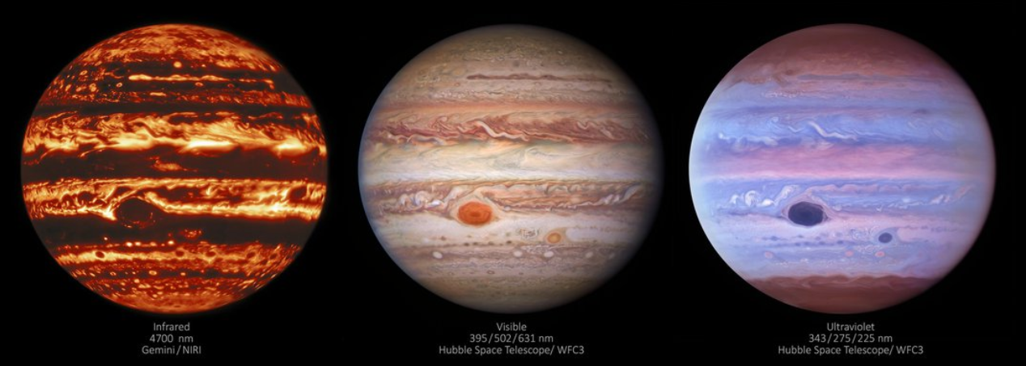
Weather: Jupiter’s Great Red Spot
What do we know?
long-lived … Schwabe in 1831 (Galileo 1610? Cassini 1665?)
large, but shrinking … 30,000 miles in late 1800s → 10,000 miles today
rotates clockwise in ~7 days
highest place on planet … upwelling, rotating hurricane … cold at 115K
at least 300 miles deep (Juno) … = 500 km, but not as deep as 3000 km streams
Why is it RED?
SSE!
Notes:
Cassini spacecraft found inconsistent belt/zone temperatures
https://science.nasa.gov/science-news/science-at-nasa/2014/28nov_sunburn/ C2H2 = acetlyene

Slide 23
Weather: Jupiter’s Great Red Spot
What do we know?
long-lived … Schwabe in 1831 (Galileo 1610? Cassini 1665?)
large, but shrinking … 30,000 miles in late 1800s → 10,000 miles today
rotates clockwise in ~7 days
highest place on planet … upwelling, rotating hurricane … cold at 115K
at least 300 miles deep (Juno) … = 500 km, but not as deep as 3000 km streams
Why is it RED (fades to gray when white clouds cover red)?
1. sulfur / phosphorous compounds
2. organic chemistry compounds … NH₃ + C₂H₂ blasted by UV … “sunburned”
3. tholins to make it really red
4. gravity / acoustic waves “crashing”
Notes:
Cassini spacecraft found inconsistent belt/zone temperatures
https://science.nasa.gov/science-news/science-at-nasa/2014/28nov_sunburn/ C2H2 = acetlyene

Slide 24
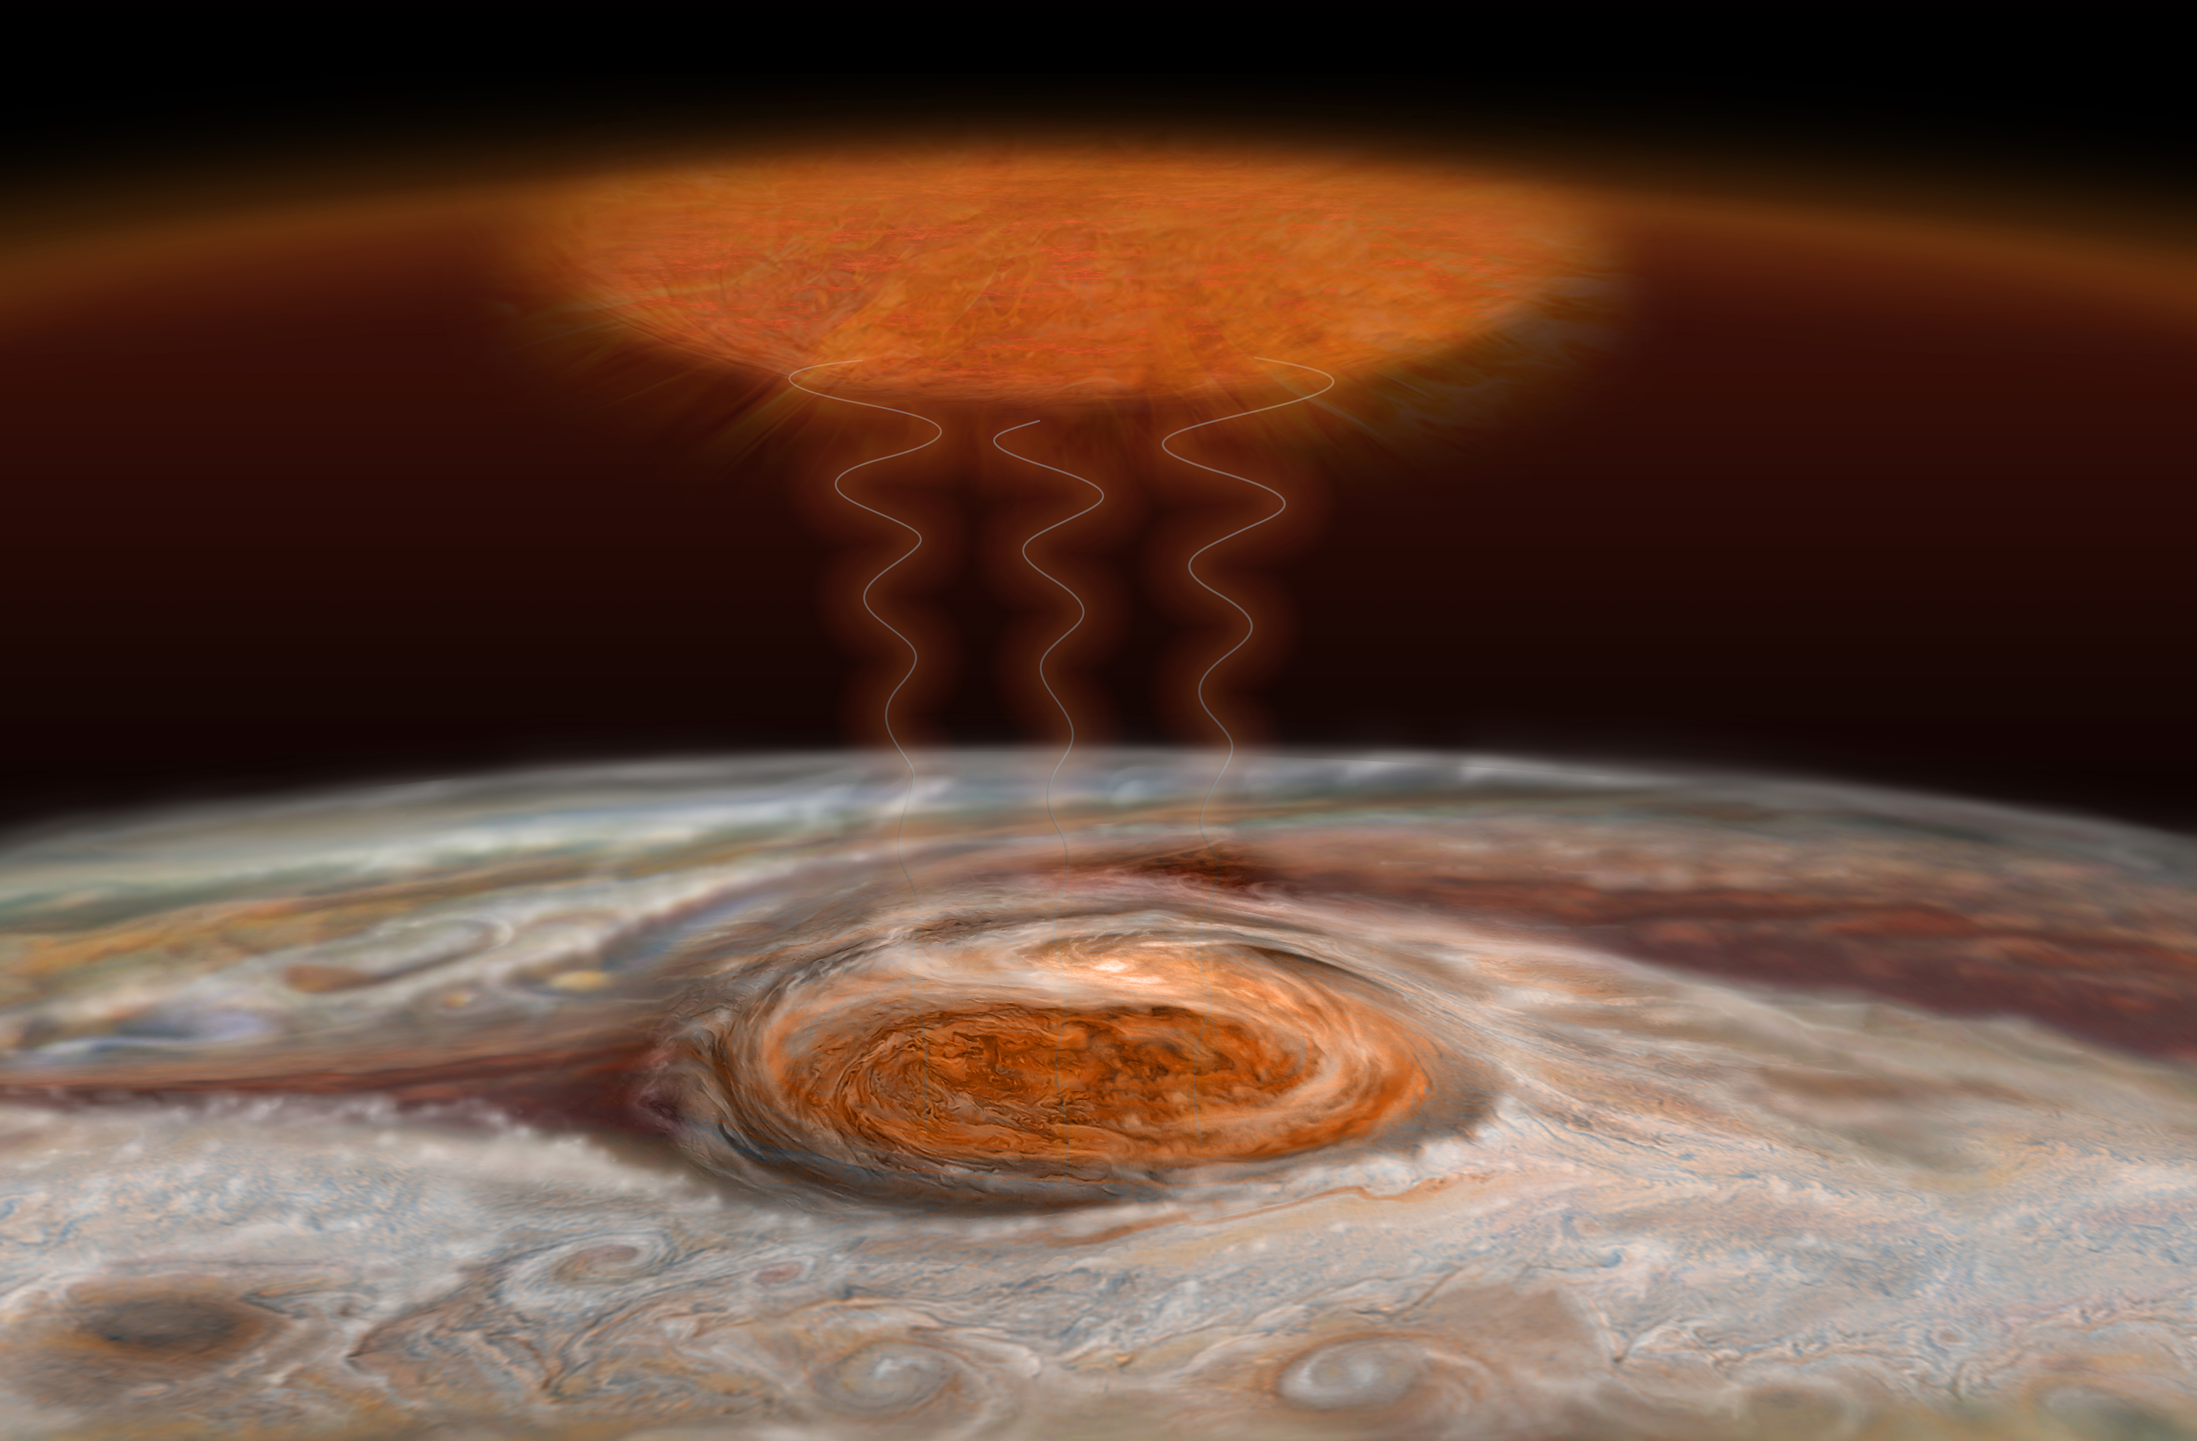
Great Red Spot: Cold + Hot
1600 K
new theory:
gravity and acoustic waves “crashing” in upper atm
O’Donoghue et al. 2016
115 K
125 K
Notes:
The storm in the Great Red Spot produces two kinds of turbulent energy waves that collide and heat the upper atmosphere. Gravity waves are much like how a guitar string moves when plucked, while acoustic waves are compressions of the air (sound waves). Heating in the upper atmosphere 500 miles (800 kilometers) above the Great Red Spot is thought to be caused by a combination of these two wave types “crashing,” like ocean waves on a beach.

Slide 25
Photochemistry: General
photodissociation and photoionization lead to chemical reactions in upper atm
outer electron shells blasted by photons with λ < 1000 Å
inner electron shells blasted by photons with λ < 100 Å
rates determined by J(z) = ∫ σ F e ^{-τν(z)/cosθ} dν
where σ is the photon absorption cross section at frequency ν
F is the solar flux density in photons cm⁻¹ s ⁻¹ Hz ^{–1} outside atm
generally
# surviving photons decreases from upper atm,
# molecules decreases from lower atm,
so, product concentration highest somewhere in the middle

Slide 26
Photochemistry: Earth
EARTH: oxygen chemistry
atomic oxygen production O₂ + ph → O + O λ < 1750 Å
ozone production
O₂ + O + X → O₃ + X 3-body reaction dominates
ozone destruction
O₃ + ph → O₂ + O λ < 3100 Å
O₃ + O → O₂ + O₂
O₃ + H → OH + O₂ not terribly important
O₃ + NO → NO₂ + O₂ NO₂ back to NO quickly … chain reaction
O₃ + Cl → ClO + O₂ ClO back to Cl quickly … chain reaction
The last one is the bad one…
At 30 km, where maximium O₃ is found, T ~ 260K …
Cl destruction rate is 1000 times NO destruction rate

Slide 27
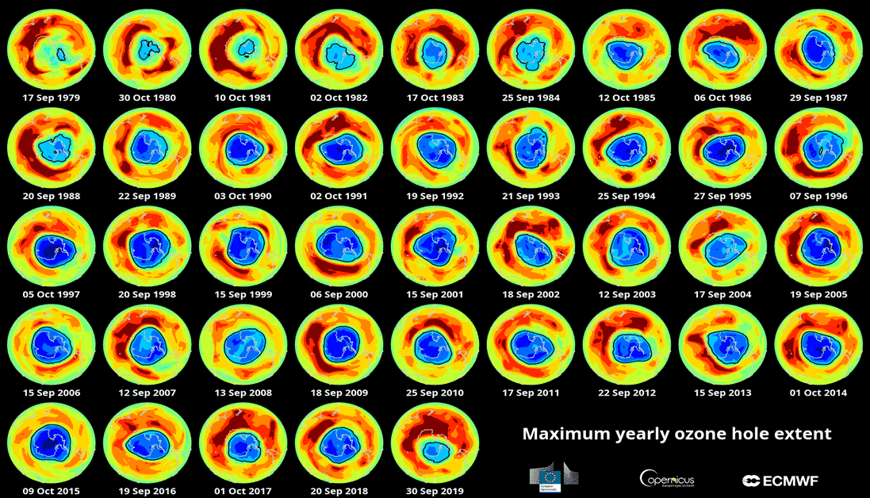
Ozone Depletion over 40 Years
Notes:
measured in Dobson units

Slide 28
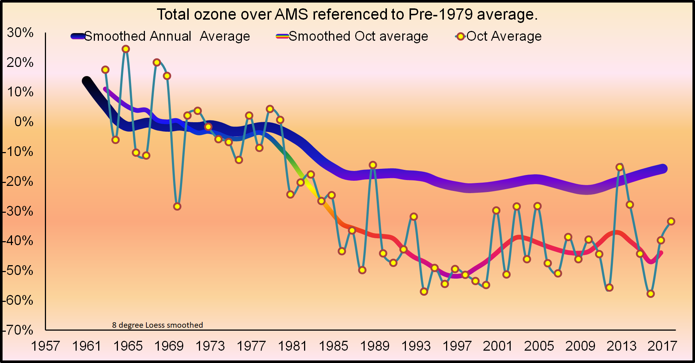
Ozone Stabilization
Amundsen Scott South Pole Station
Montreal
Protocol
https://www.esrl.noaa.gov/gmd/dv/spo_oz/ozdob.html
Notes:
Changes in Total Column Dobson Ozone measurements made at the Amundsen Scott South Pole Station (AMS) during 15-31 October. The y-axis shows ozone change (percent) from the pre-ozone hole reference level of 300 DU (averaged over 1962-1978). The dots are column ozone averages for the 15-31 October period measured from 1962 to 2017. The thin line is the Loess-smoother fit to the data. The record-long average thickness of the ozone layer over the South Pole is 260 DU (245 DU after 1979). If the ozone layer was compressed to a layer of pure ozone at the sea level, the thickness would be 2.6 (2.45) millimeters thick -- about 2 and half stacked dimes. If the entire atmosphere were to be also compressed, it would be about 8 kilometers (5 miles) thick.

Slide 29
Photochemistry: Venus and Mars
VENUS and MARS: carbon dioxide chemistry
carbon dioxide destruction
CO₂ + ph → CO + O λ < 1690 Å
carbon dioxide production (from broken H₂O)
CO + O + X → CO₂ + X very slow!
CO + OH (from H₂O) → CO₂ + H so CO not seen in abundance
VENUS: sulfuric acid chemistry
sulfuric acid production
SO₂ + O → SO₃ O from reaction above
SO₃ + H₂O → H₂SO₄ sulfuric acid

Slide 30
Photochemistry: Titan
TITAN: nitrogen and methane chemistry
N₂ battered by charged particles … not solar UV
CH₄ photodissociated by solar UV λ < 1600 Å
the many (highly toxic) products result in very thick smog layer:
hydrocarbons
C₂H₂ acetylene
C₂H₄ ethylene (converts quickly to acetylene + H₂)
C₂H₆ ethane
C₃H₈ propane
C₄H₁₀ butane
nitriles
HCN hydrogen cyanide
C₂N₂ cyanogen
HC₃N cyano acetylene
C₂H₃CN ethyl cyanide
and don’t forget the tholins … and little orange beings
Notes:
hydrocarbons other than CH4 and nitriles are all ppm/ppb

Slide 31
Photochemistry: Jovians
relevant molecular species are
C = 6 CH₄ Uranus and Neptune, primarily
N = 7 NH₃ Jupiter and Saturn, primarily
O = 8 H₂O
P = 15 PH₃
S = 16 H₂S
methane chemistry
CH₄ + ph → C₂H₂, C₂H₄, C₂H₆ … λ < 1600 Å
ammonia chemistry
NH₃ + ph → NH₂ λ < 2300 Å
NH₂ + NH₂ → N₂H₄ hydrazine haze
other reactions → N₂, HCN
phosphine chemistry
PH₃ + ph → … P₄ (red … GRS?) 1600 Å < λ < 2300 Å
hydrogen sulfide chemistry
H₂S + ph → … S₈, NH₄xSy, HxSy λ < 3170 Å
sulfur (yellow), ammonium polysulfide (orange), hydrogen polysulfide (brown)
Notes:
hydrazine is rocket fuel

Slide 32
Atmospheric Origin & Evolution
if the terrestrial atmospheres were primordial and all H and He lost, fractions =
63% CO₂
22% Ne
10% N₂
4% COS
trace Ar, Kr, Xe
but, all noble gases on Earth are down by 10⁶⁻¹⁰, so atm is not primordial!
secondary atm(s) generated by volcanic outgassing
asteroid/comet accretion
atm/crust interactions
biogenic processes
long-term changes Sun has increased L by 30% since 4.6 Gyr ago
planetary albedo changes
planetary obliquity/orbital eccentricity changes
Notes:
Ne 10 … Ar 18 ... Kr 36 … Xe 54
noble gases too heavy to escape via thermal processes, and should be much more prevalent if atm from solar nebula … so, atm must be secondary
COS = carbonyl sulfide

Slide 33
Earth’s 4 Atmospheres
1 = primordial H₂ He lost
H₂O NH₃ CH₄ UV splits → H gone
…bombardment? … H₂O added
2 = volcanic H₂O NH₃ CH₄ UV splits → H gone
N₂ N₂O nitrogen supply
(O highly reactive, so it disappears, leaving N₂)
CO₂ SO₂ into rocks/oceans
… Earth cools … H₂O condenses
3 = biogenic O₂ cyanobacteria invent photosyn.
O₃ chemically generated
4 = anthropogenic CO₂ CH₄ CFCs …

Slide 34
Solar System Explorers: 29 SEP
Give any feature seen in the spectrum of a Solar System object (not the Sun) that
makes that object’s emitted spectrum NOT a blackbody. Give the atomic/molecular
species and wavelength affected, e.g., CO₂ as an absorber on Earth at 15 microns.
1. Earth has CO2 absorption at various places
2. Earth has O3 at 0.5 microns
3. Venus has H2SO4
4. Mercury has CO2 at 1.6 microns
5. Mars has CO2 at 4.3 microns
6. Venus has PH3 at 2.7-3.6 / 4.0-4.8 / 7.8-11.5 microns
7. Titan specular reflection at 12.6 cm
8. Titan has CO at 4.7 microns
9. Earth has CH4 at 3.5 microns
10. Eris has CH4 absorption at 0.9 microns
11. Saturn has NH3 at 1.5 microns
12. Jupiter has CH4 at 0.7 microns
13. Titan has C2H2 at 3.1 microns
14. Pluto/Makemake have CH4 at 0.9m microns
15. Venus has PH3 at 1.1 mm … 40-60 km
16. Neptune has CH4 at 8-10 microns
17. Neptune has Lyman alpha at 1215 A
18. Callisto has B2O3 at 10.5 microns
19. Io has SO2 at 1.7 microns
20. Earth has H2O at 6 microns

Slide 35
Solar System Explorers 06 OCT
Describe something unique about any surface found in the Solar System (e.g. Earth has liquid H₂O on its surface.)
1.
2.
3.
4.
5.
6.
7.
8.
9.
10.
11.
12.
13.
14.
15.
16.
17.
18.
19.
20.

Slide 36
…………………………
Notes:
36

Slide 37
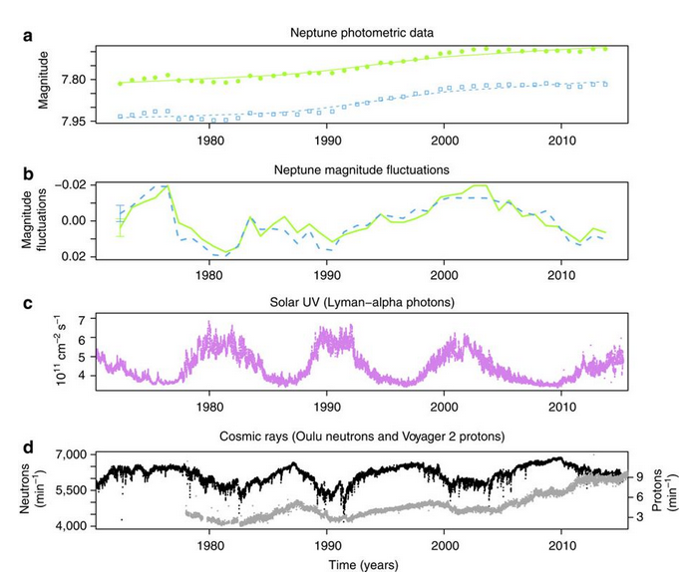
Seasonal Forcing at Neptune
atmospheric aerosols created
165 yr cycle
UV photons: 11 yr cycle
Galactic cosmic rays: 1-2 yr cycle
Aplin & Harrison 2016
Notes:
Galactic cosmic ray signal on 1-2 yr cycle is set of wiggles in mid 1980s
(a) Neptune brightnesses at 472 nm (blue squares) and 551 nm (green circles)
(b) Magnitude fluctuations after detrending (a) with the fit --- errorbars represent maximum offsets. (c)
(c) Solar Lyman-alpha (ultraviolet) radiation at 121.5 nm.
(d) Cosmic ray count rate at Earth’s surface (neutrons from Oulu, Finland and Voyager counts for cosmic ray protons >70 MeV (grey).

