Slide 1
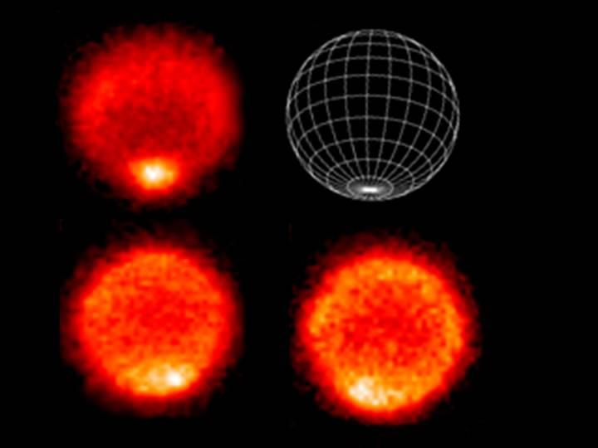
Where
is
this?
Notes:
These thermal images show a "hot" south pole on the planet Neptune (10K hotter than elsewhere). These warmer temperatures provide an avenue for methane to escape out of the deep atmosphere.
The upper left image samples temperatures near the top of Neptune's troposphere (near 100 millibar pressure, which is one-tenth the Earth atmospheric pressure at sea level). The hottest temperatures are indicated at the lower part of the image, at Neptune's south pole. The lower two images, taken 6.3 hours apart, sample temperatures at higher altitudes in Neptune's stratosphere. They do show generally warmer temperatures near, but not at, the south pole. They also show a distinct warm area which can be seen in the lower left image and rotated completely around the back of the planet and returned to the earth-facing hemisphere in the lower right image.
The images were obtained with the Very Large Telescope in Chile, using an imager/spectrometer for mid-infrared wavelengths on Sept. 1 and 2, 2006.

Slide 2
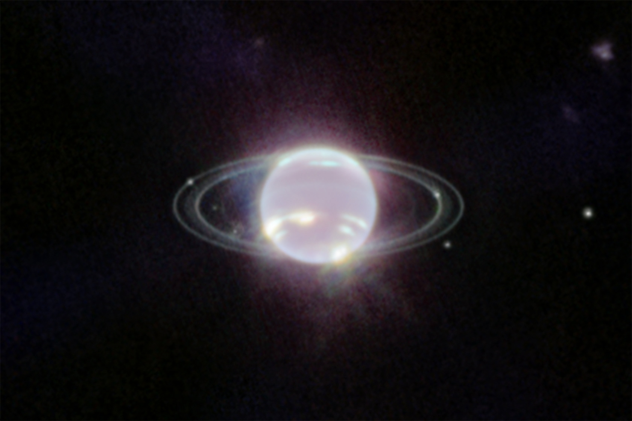
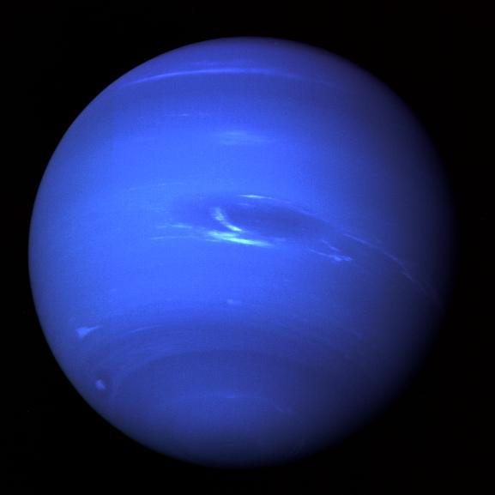
Planetary Atmospheres II
Notes:
Voyager 2 --- spot has vanished … white clouds are methane
JWST --- dark regions due to methane GAS absorption, bright spots and streaks are methane ICE clouds

Slide 3
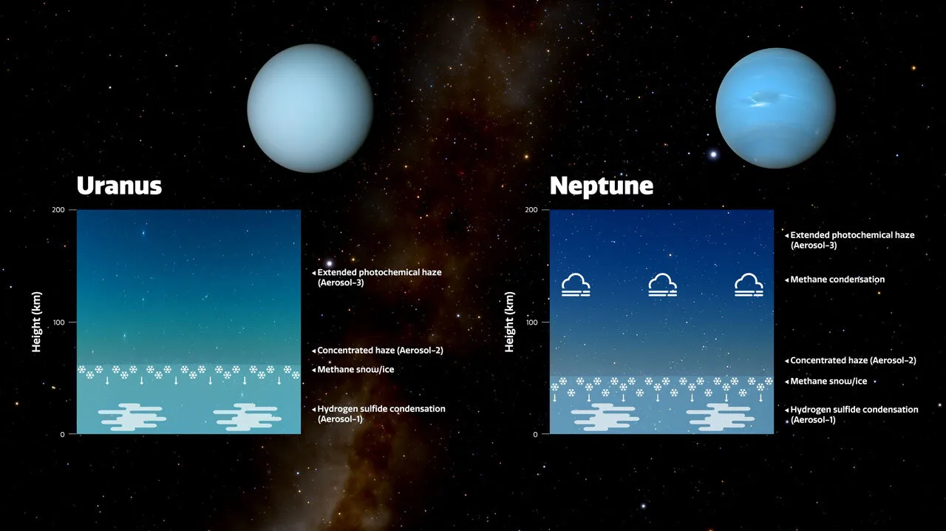
Planetary Atmospheres II
old idea: Neptune has more methane, which absorbs red light
new idea: excess haze in Uranus’ atmosphere makes it (slightly) paler
issue: why is Neptune as warm as Uranus?
Notes:
Because Neptune has a more active, turbulent atmosphere than Uranus does, the team believes Neptune’s atmosphere is more efficient at churning up methane particles into the Aerosol-2 haze layer and producing methane snow. This removes more of the haze and keeps Neptune’s Aerosol-2 haze layer thinner than it is on Uranus, meaning the blue color of Neptune looks stronger.

Slide 4

Announcement #1
VOTE!

Slide 5
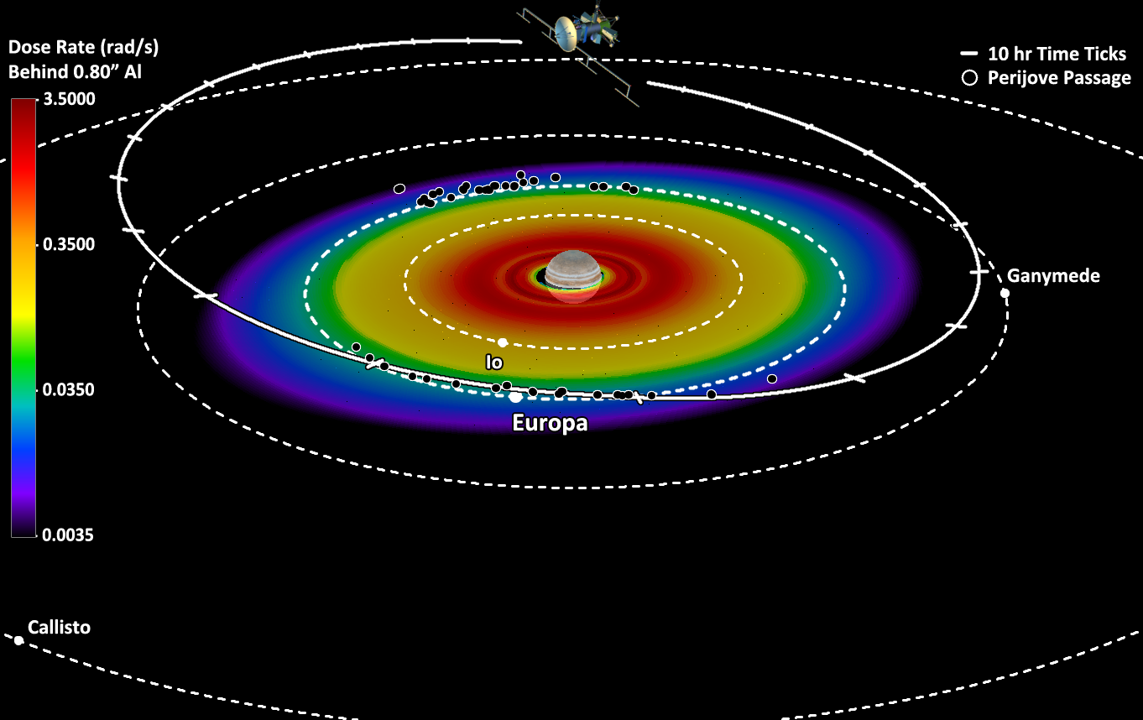
Announcement #2
Europa Clipper launch 10 OCT
Notes:
44 passes by Europa
arrives 2030 … JUICE (ESA) arrives 2031 … ha ha ha!

Slide 6
SSE!
In which layer of the Earth’s atmosphere do we live?
…
troposphere
Which Jovian planet has the deepest atmosphere
relative to planet radius?
…
Saturn
What molecule comprises more than 1% of
Titan’s and Uranus’ atmospheres?
…
CH4

Slide 7
16 Atmospheres
PLANETS OTHERS
comp (> 1%) P (bar) H (km) comp (> 1%) P (bar) H (km)
Mercury | O Na He | < 10 ⁻¹² | 13 to 95 | Moon | He Ar | 10 ⁻¹⁵ | 65
Venus | CO₂ N₂ | 92 | 16 | Io | SO₂ | 10 ⁻⁸
Earth | N₂ O₂ H₂O | 1.0 | 8.5 | Europa | O₂ | 10 ⁻¹²
Mars | CO₂ N₂ | 0.006v | 11 | Ganymede | O₂ | < 10 ⁻¹¹
Jupiter | H₂ He | 10 ⁺⁶ | 24 | Callisto | CO₂ O₂? | 10 ⁻¹¹
Saturn | H₂ He | 10 ⁺⁶ | 47 | Titan | N₂ CH₄ Ar | 1.5 | 20
Uranus | H₂ He CH₄ | 10 ⁺⁵ | 25 | Triton | N₂ | 10 ⁻⁵
Neptune | H₂ He CH₄ | 10 ⁺⁵ | 23 | Pluto | N₂ | 10 ⁻⁵ | 33
H_{P}(z) = kT(z) / g(z) μ m
Notes:
Terrestrial pressures at surface … Jovian pressures at base of molecular layers shown on p 276-277 figures in 2nd edition
Terrestrial scale heights at surface … Jovian scale heights at 1 bar
N2 has triple bond, so very stable
O2 has double bond
Titan has 98.4% N2, 1.6% CH4
Jovian scale heights larger because H2 and He are so light

Slide 8
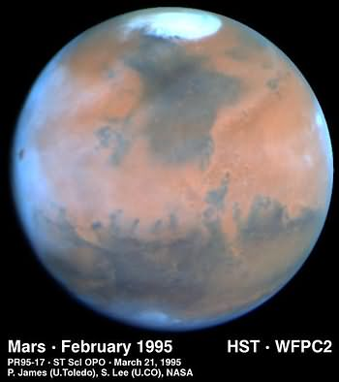
Mars

Slide 9
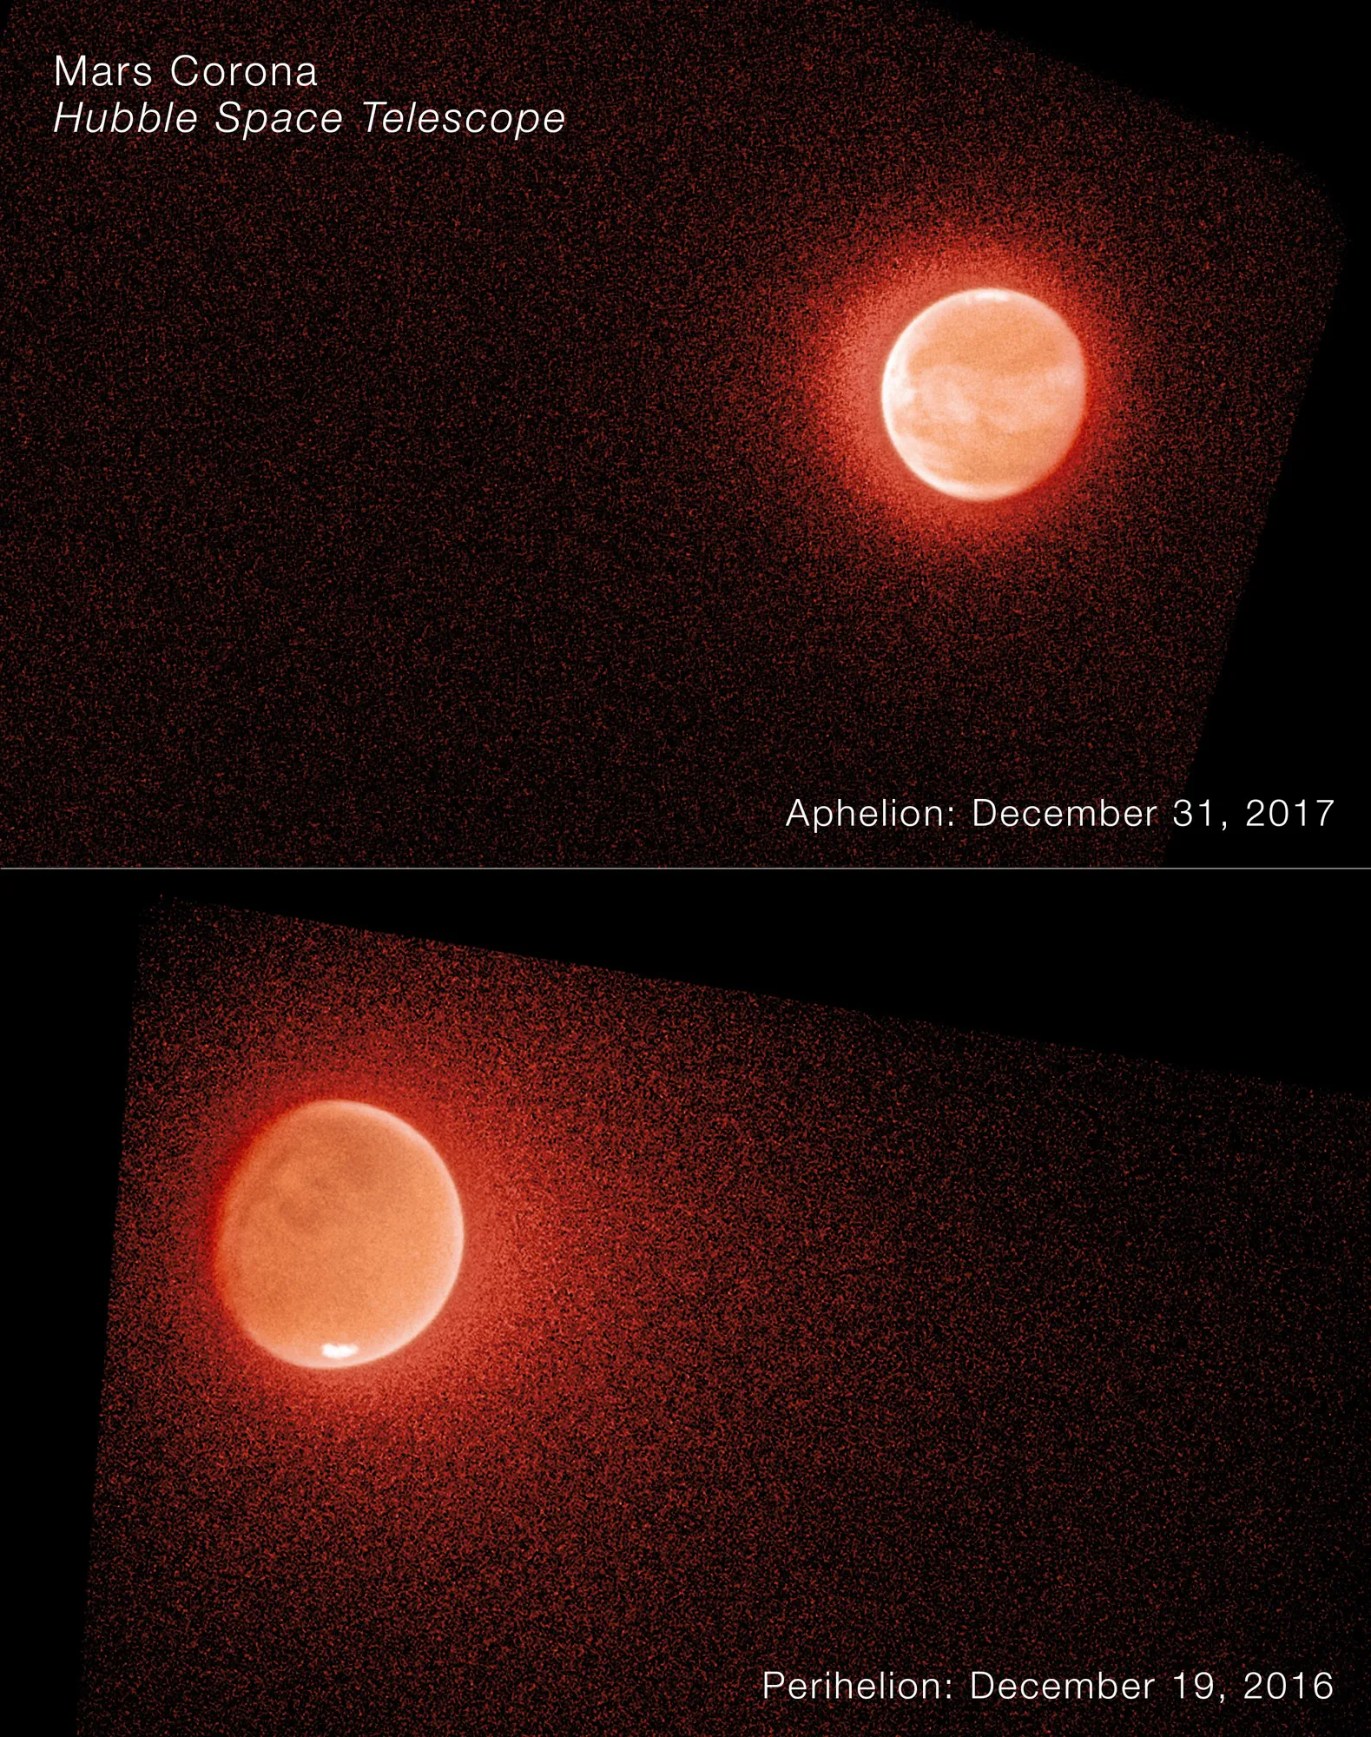
Mars by HST + MAVEN
Mars was wet
Mars now dry
H₂O split by UV
H and D escape
H escapes > D
perihel loss > aphel
D/H now tells us
how much H₂O lost
4-8X Earth D/H
…
10s-100s of meters?
Notes:
MAVEN = Mars Atmosphere and Volatile Evolution
https://science.nasa.gov/missions/hubble/nasas-hubble-maven-help-solve-the-mystery-of-mars-escaping-water/
https://www.science.org/doi/10.1126/sciadv.adm7499

Slide 10
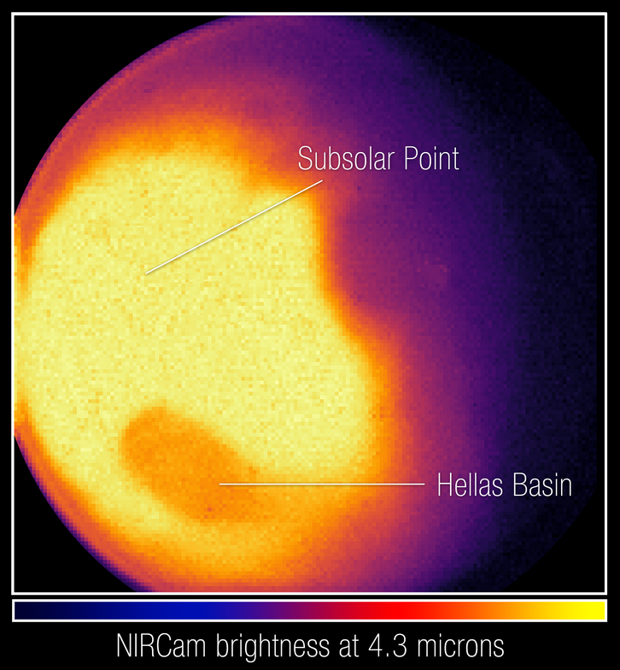
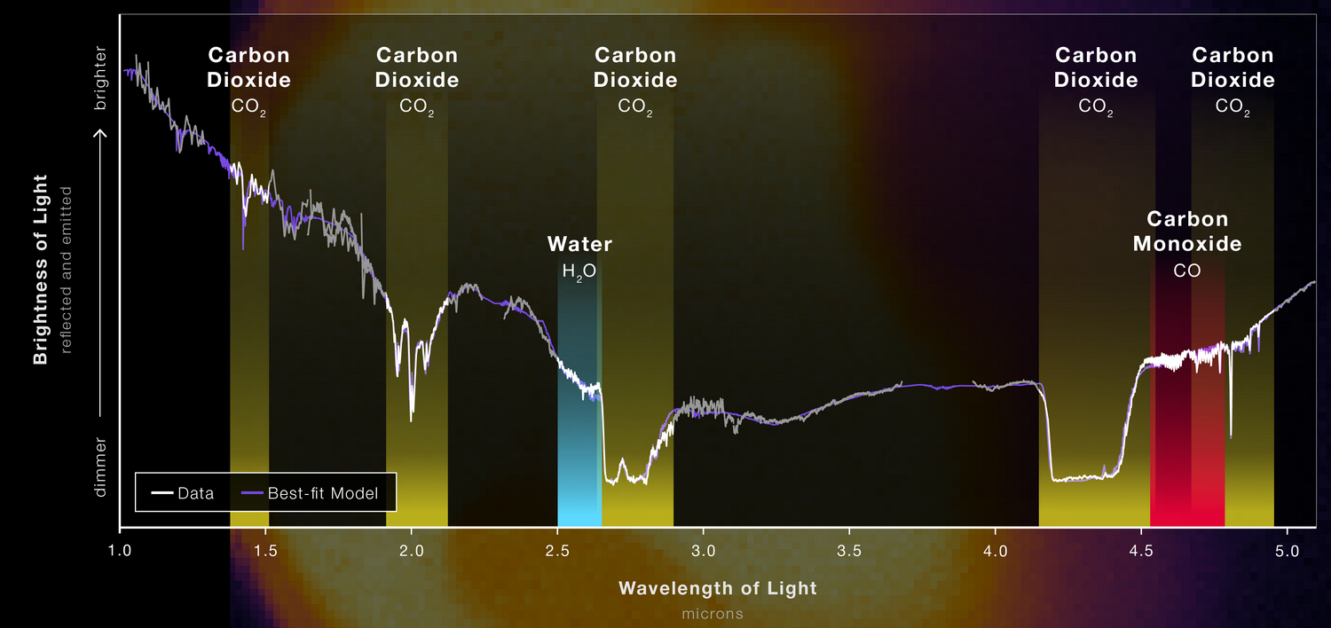
Mars by JWST
SSE!
reflected light
SSE!
thermal emission
Notes:
bright areas = warmest spots … Hellas is dark (looks cold) because it is (a) lower, (b) more CO2 air, (c) CO2 pressure broadening causes absorption

Slide 11
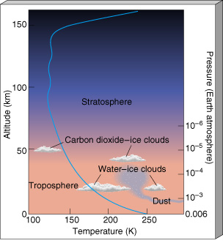
Mars
THERMO: low, uniform temp due
to CO₂ as efficient radiator and
rapid rotation
MESO: thick isothermal layer
[ STRATO: there really isn’t one! ]
TROPO: T swings from 200K-300K
eccentricity changes temp by 30K
dust typically heats by 10K
CO₂ cold-trapping changes P
X
Notes:
troposphere temperatures at the equator … polar temps are 130-190 K
Atmospheric cooling by CO₂ is created by radiative transfer in the 15 μm band. Under the breakdown of local thermodynamic equilibrium (non-LTE), collisions with atomic oxygen O facilitate energy exchange between the kinetic energy of CO₂ molecules (temperature) and their excited vibrational states. Hence, cooling rates are proportional to [O] abundances

Slide 12
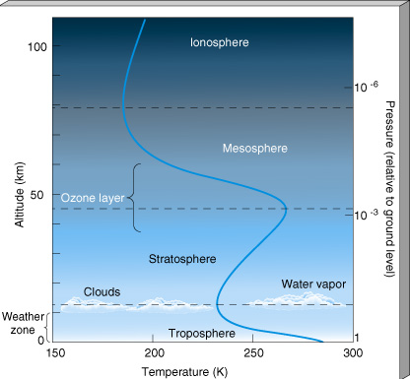
Mars vs. Earth : height
X

Slide 13
Mars vs. Earth : pressure
X
Notes:
Everest height 8.8 km
Olympus Mons height 25 km

Slide 14
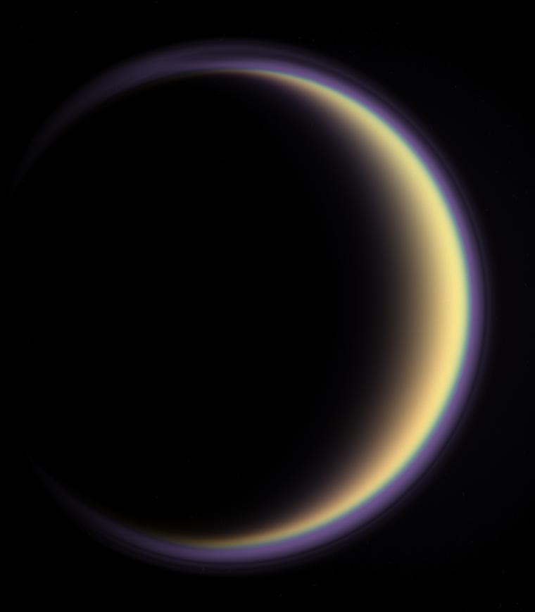
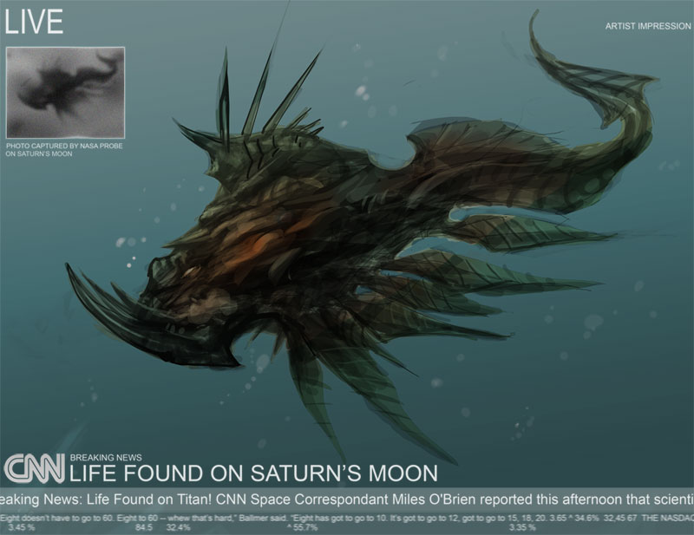
Titan

Slide 15
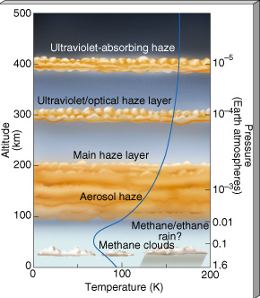
Titan
MESO/THERMO: hydrocarbon cooling, (HCN) so T drops
STRATO: up to 177K
TROPO: clouds … and rain?
similar overall atm structure to Earth
although deeper

Slide 16
Titan vs. Earth : height

Slide 17
Titan vs. Earth : pressure

Slide 18
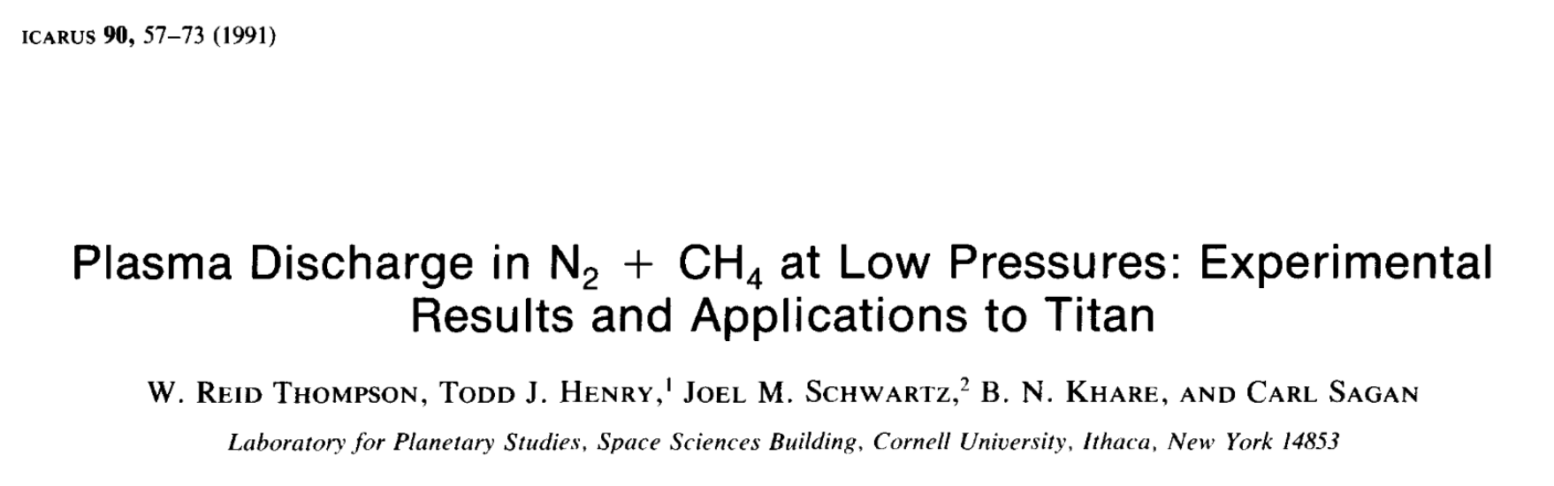
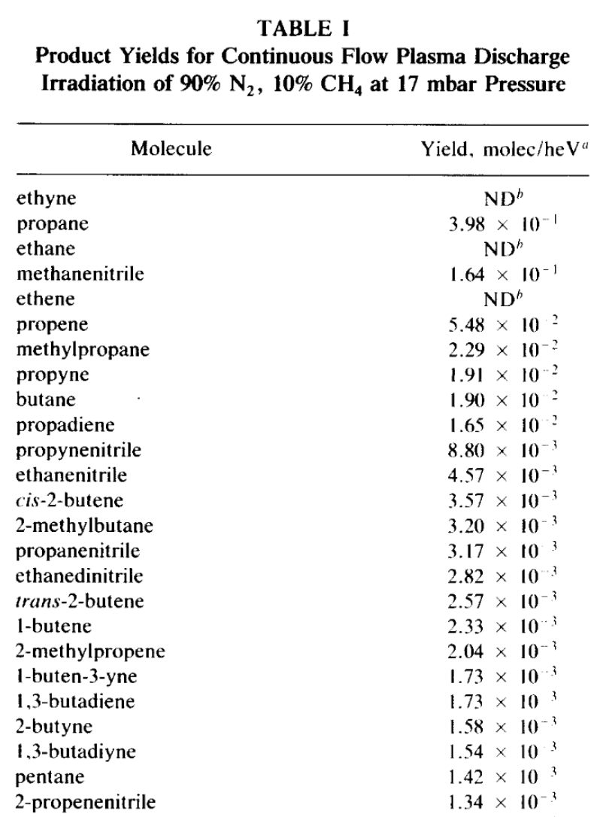
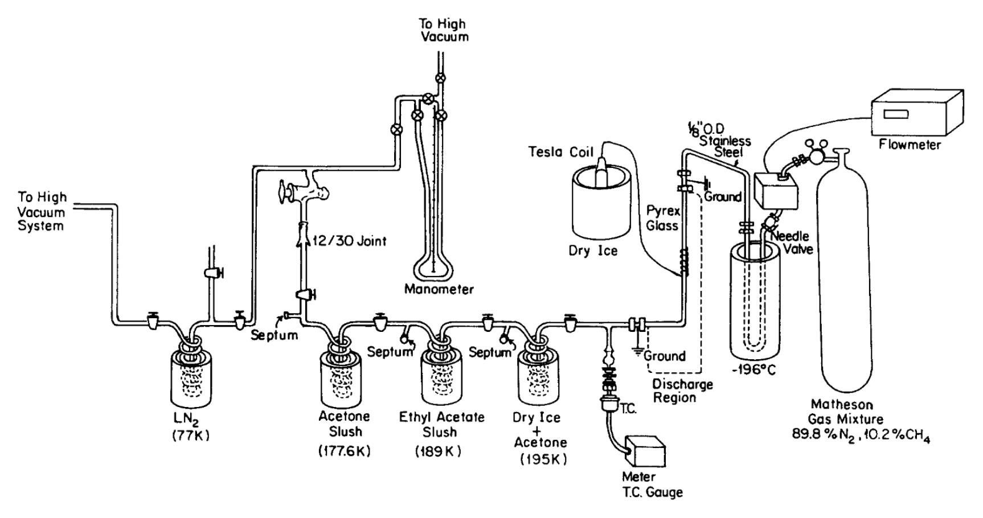
Titan’s Atmosphere
and many more

Slide 19
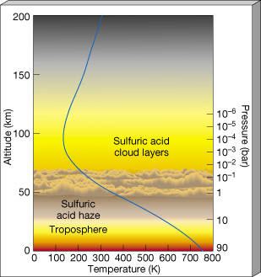
Terrestrial Atmospheres
note temperature structures --- Earth’s O₃ causes stratopause
pressure scale height: H_{P}(z) = kT(z) / g(z) μ m
μ = mean molecular weight (in amu)
m = 1.67 x 10⁻²⁴ g (one amu)
Venus Earth Mars Titan
H_{surf} 16 km 8.5 11 20
P_{100 km} 10⁻⁴ bar 10⁻⁶ 10⁻⁸ 10⁻²

Slide 20
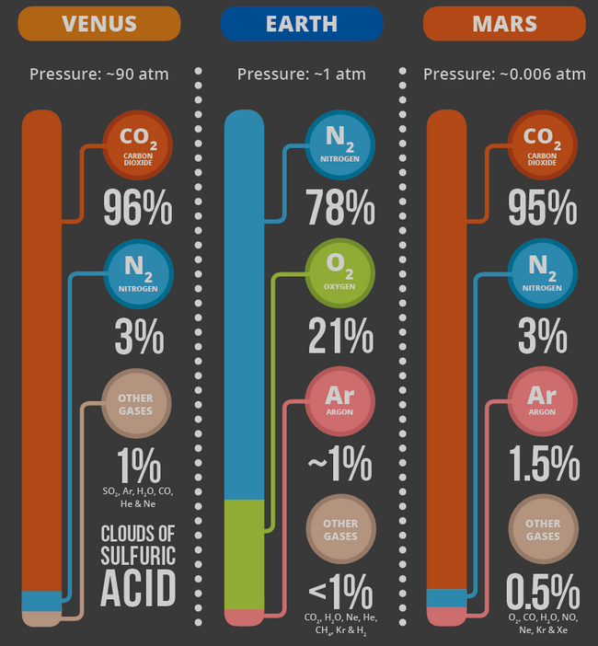
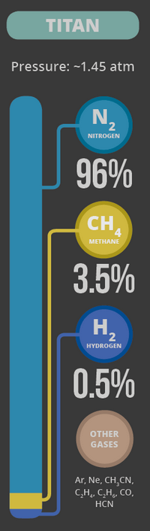
Atmospheric Composition
SPECTROSCOPY
line position … which gas?
line depth … how much?
line shape … moving? T? P?
WHAT TO LOOK FOR, WHERE TO LOOK
excitation/de-excitation typically in ultraviolet or visible
vibration typically in infrared
rotation typically in radio
GO THERE!
(GC)MS = (gas chromatograph) mass spectrograph
Earth, Moon, Venus, Mars, Jupiter, Titan
particularly good for He, Ne, Ar, N₂
Notes:
N2 has some emission lines in UV but nothing (?) in VIS/IR

Slide 21
Terrestrial Compositions
Earth Venus Mars Titan
N₂ 78% | CO₂ 97% | CO₂ 95% | N₂ 95-99%
O₂ 21% | N₂ 3% | N₂ 3% | CH₄ 1-5%
H₂O < 3% |  | Ar 2%
Ar 1%
at least
1%
CO₂ 421+ | SO₂ 100 | O₂ 1300 | H₂ 4000
Ne 18 | Ar 70 | CO 700 | C₂H₂ 189
O₃ 10 | H₂O 30 | H₂O < 100 | C₂H₆ 121
He 5 | CO 20 | H₂ 10 | CO 45
CH₄ 2 | He 12 | NO 3 | C₂H₄ 40
Kr 1 | O₂ 10 | Ne 3 | Ar 28
 | Ne 7 |  | C₃H₄ 4
ppm
Notes:
I have to keep updating CO2 on Earth …
C2H2 = acetylene, ethyne
C2H4 = ethylene
C3H4 = methylacetylene

Slide 22
SSE!
For each of the following worlds,
describe 2 aspects of the atmosphere that makes it unique
(compared to the others):
…
Venus
…
Mars
…
Titan
…
Earth

Slide 23
Terrestrial Atm Highlights
Earth
O₂ out of equilibrium + O₃ blanket
largest % atmospheric H₂O in Solar System
6 greenhouse gases
Venus
~100X Earth pressure
SO₂ from vulcanism
Mars
~1% Earth pressure … wimpy O₃ blanket, H₂O content
sublimation/condensation cycles
dust a major component
Titan
Earthlike structure and pressure, but puffed up
hydrocarbons + nitriles

Slide 24
Solar System Explorers: 03 OCT
How does the Sun affect objects in the Solar System?
1. Mercury’s magnetic field tornadoes
2. Mercury’s surface ablates because of tornadoes and creates an atmosphere
3. Sun holds the Moon in orbit
4. Radiation pressure pushes dust
5. Comets have xray emission because of solar wind
6. Solar wind severs parts of comets’ tails
7. UV/IR photons cause photoionization in many atmospheres
8. Tweaks asteroid rotations in various ways
9. Aurorae happen
10. Pioneer 11 experienced additional Sun-thrust
11. Cometary tail shapes created by solar wind
12. Neptune’s clouds change on 11 year cycle
13. Uranus’ clouds change because of location of Sun overhead
14. Mars’ atmosphere sublimates and condenses on diurnal cycle
15.
16.
17.
18.
19.
20.

Slide 25
Solar System Explorers: 10 OCT
Give any feature seen in the spectrum of a Solar System object (not the Sun) that
makes that object’s emitted spectrum NOT a blackbody. Give the atomic/molecular
species and wavelength affected, e.g., CO₂ as an absorber on Earth at 15 microns.
1.
2.
3.
4.
5.
6.
7.
8.
9.
10.
11.
12.
13.
14.
15.
16.
17.
18.
19.
20.

Slide 26
…………………………
Notes:
26

Slide 27
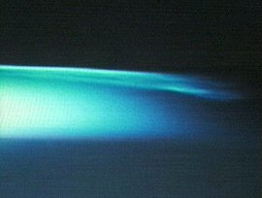
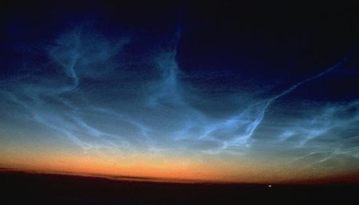
Earth Clouds
very highest clouds noctilucent
50-100 km altitude mesosphere
composition ice crystals
(nucleation on dust)
summer only H2O convected
dust (from volcanoes? meteorites?)
spreading south (global warming?)

