Slide 1
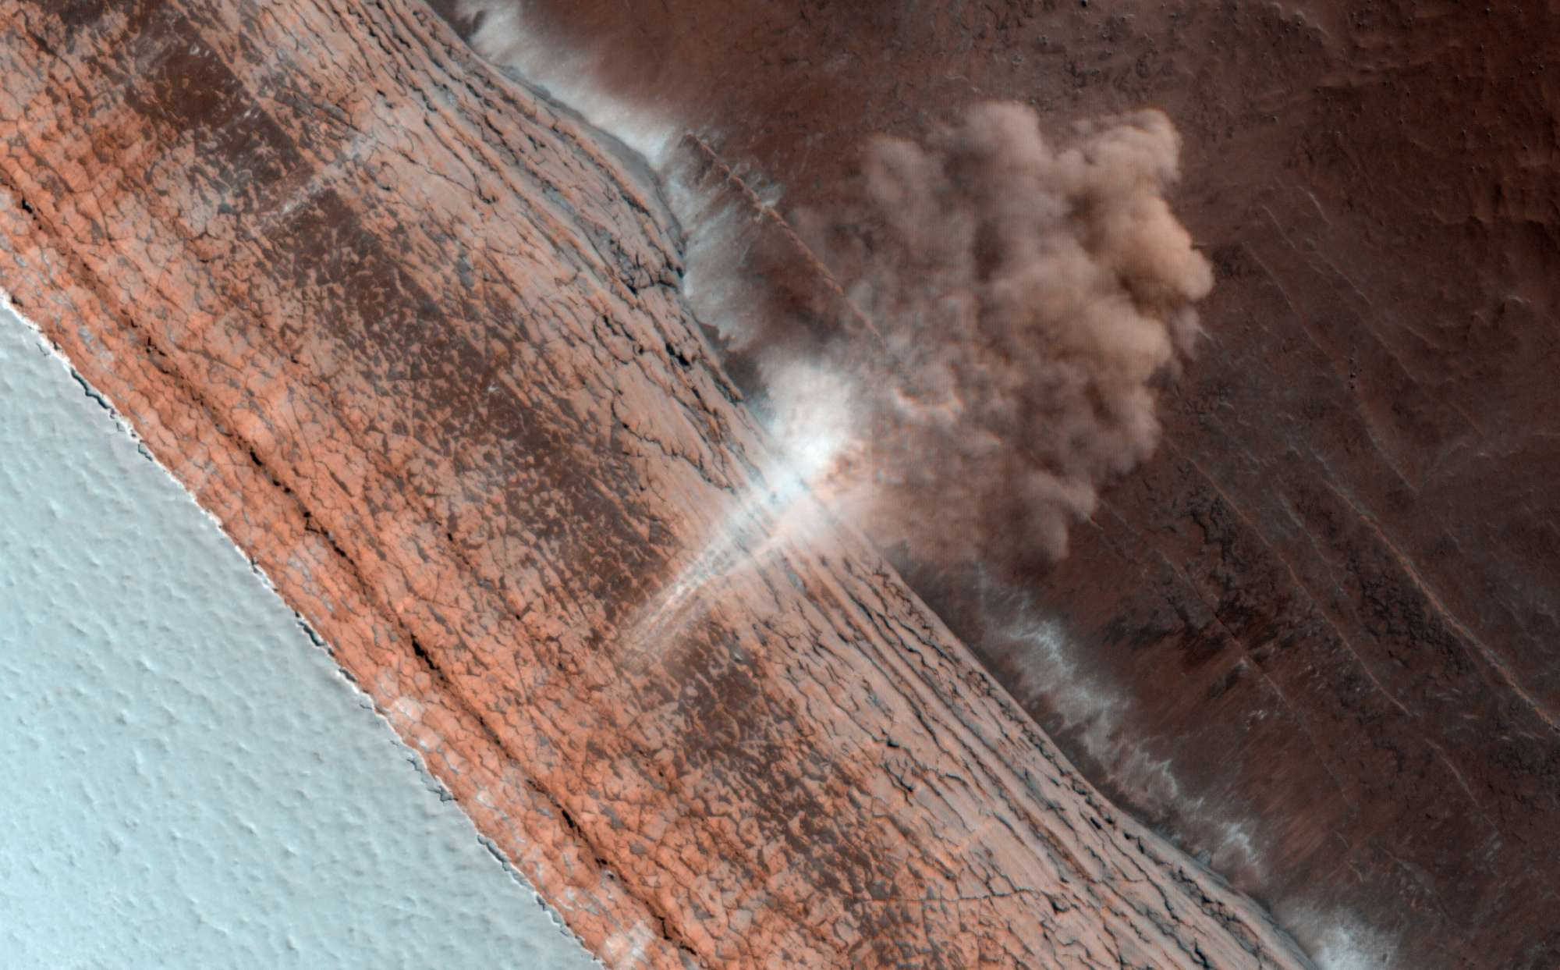
Planetary Surfaces II
Where is
this?
Notes:
Martian avalanche

Slide 2
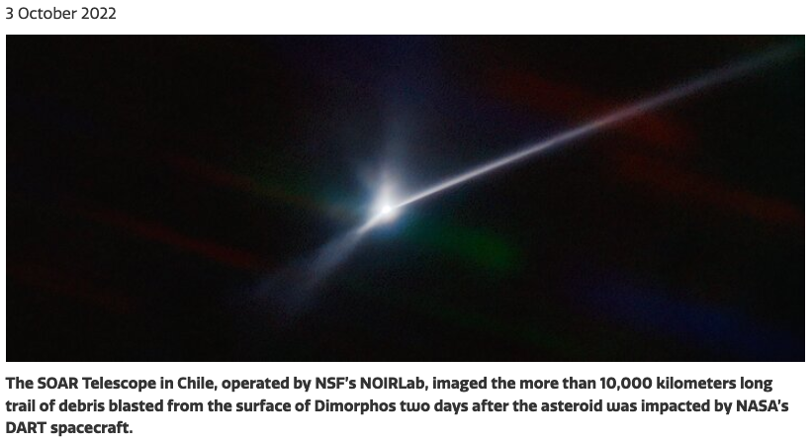
Didymos + Dimorphos
Notes:
Martian avalanche!

Slide 3
Solar System Explorers
1. What is the (annual) parallax of an Oort Cloud member at 0.2 parsecs?
…
2. If the Earth orbited an M1V dwarf (mass ~0.5 M) in 4 years, what would the semimajor axis of our orbit be?
…
3. If Titan has a temperature of 94 K, at what wavelength does it emit the most photons?
…
4. The Sun as a red giant will swell to ~100 times its present size and will drop in temperature to ~2900K. By how much will its luminosity be different than today’s?
…
5. Venus has V ~ $−$4 and is at a distance of ~10⁻⁶ parsec. What is its absolute magnitude M_{V}?
…
B. About how much more sunlight does the bright side of Mercury receive compared to Pluto?
…

Slide 4
Solar System Explorers Quiz N

Slide 5
Solar System Explorers
1. What is the (annual) parallax of an Oort Cloud member at 0.2 parsecs?
5 arcseconds
2. If the Earth orbited an M1V dwarf (mass ~0.5 M) in 4 years, what would the semimajor axis of our orbit be?
2 AU
3. If Titan has a temperature of 94 K, at what wavelength does it emit the most photons?
31 microns
4. The Sun as a red giant will swell to ~100 times its present size and will drop in temperature to ~2900K. By how much will its luminosity be different than today’s?
625X brighter
5. Venus has V ~ $−$4 and is at a distance of ~10⁻⁶ parsec. What is its absolute magnitude M_{V}?
V ~ 31
B. About how much more sunlight does the bright side of Mercury receive compared to Pluto?
10000 times more

Slide 6
Planetary Sciences Project
Level 0 … Topics … Thu 01 SEP
Level 1 … Outline … Thu 22 SEP
Level 2 … Draft #1 … Thu 13 OCT
Level 3 … Draft #2 … Thu 03 NOV
Presentations … in class … 15+17 NOV
Level 4 … Final Paper … Tue 29 NOV

Slide 7
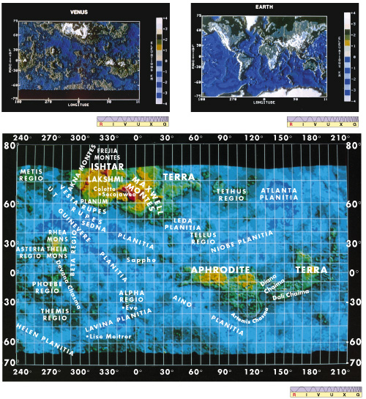
Venus vs. Earth
Venus has more piecemeal surface structure --- no plate tectonics to segregate?
landing site rocks are basaltic, not as weathered as Earth’s
8% highlands, 70% rolling uplands, 20% plains
high to low range 13 km, compared to Earth’s 20 km

Slide 8
Venus vs. Earth
Venera 13 (1982) ... lasted 127 minutes
Venera 14 (1982) … lasted 57 minutes
Notes:
USSR got pics from four Veneras = 9, 10, 13, 14

Slide 9
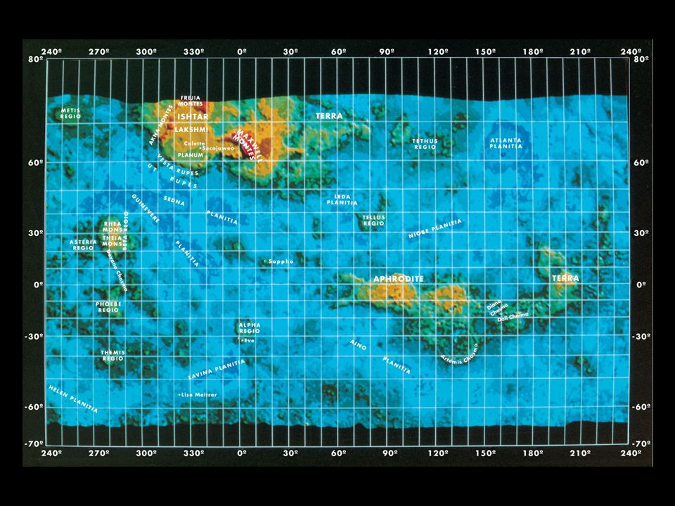
Venus Map
mapped to 100m by
Magellan
>1000 volcanic
features
(non-plate) tectonic
deformation
no craters < 3 km
surface 0.3-1.0 Gyr
younger than Mars
older than Earth
current volcanic activity … likely?

Slide 10
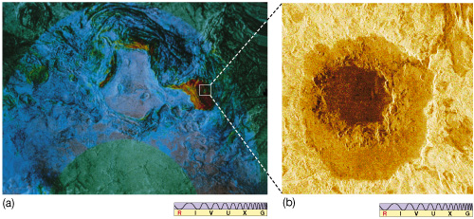
Ishtar Terra and Cleopatra Crater
Maxwell Montes is elevated red region Cleopatra impact crater
Notes:
originally thought to be volcanic … location in Maxwell Montes … lava flows to right
now thought to be impact … really?

Slide 11
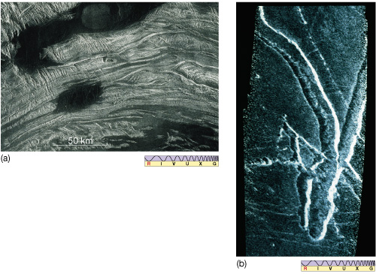
Tectonic/Volcanic Features
intersecting ridges indicate compression faulting
dark regions show lava flooding
lava channel

Slide 12
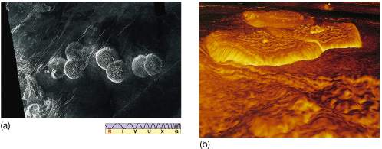
Pancakes
pancake domes 3D view looking toward right from
center of pancakes
20-50 km across … 100-1000 m high
very thick silicate flows on level surface
extrusion and subsequent surface stretching … and collapse(?)
Notes:
pancakes formed by extrusion (higher than surroundings) of thick lava through hole on level ground (symmetric); continued push from below forms rayed cracks

Slide 13
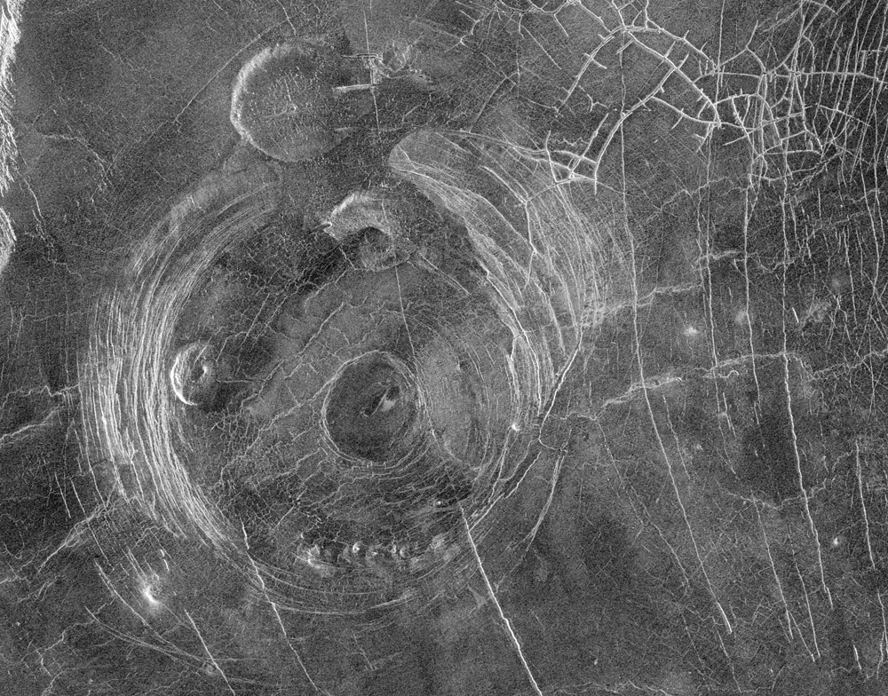
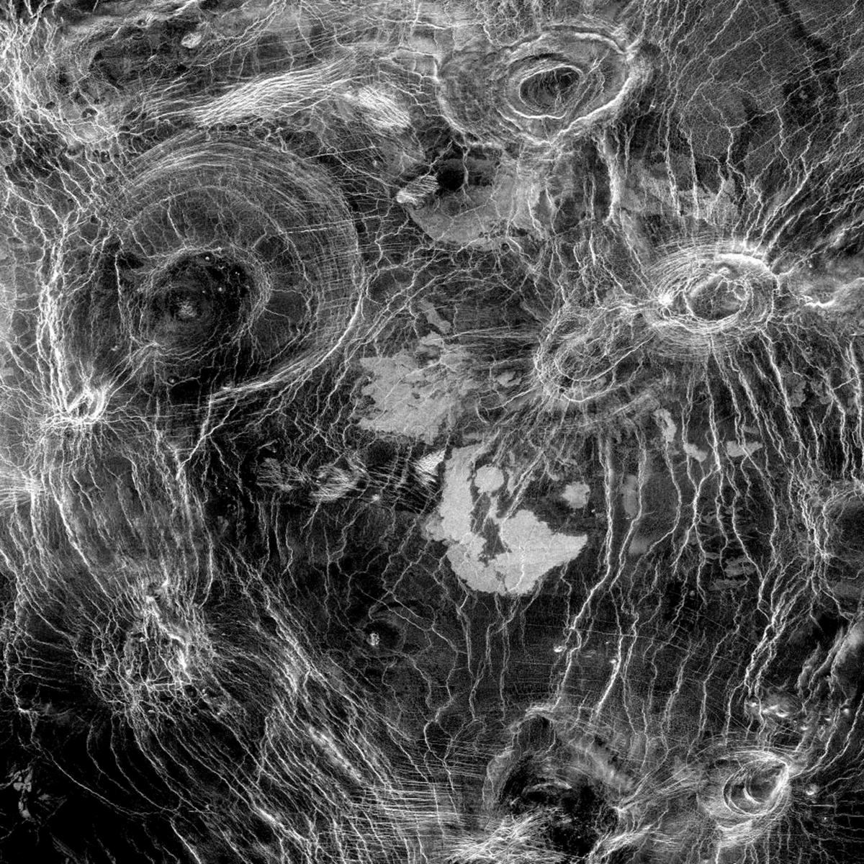
Coronae = Shield Volcanoes
Aine Corona
300 to 1000+ km across
upwelled mantle material
older than pancakes and craters
arachnoids look like coronae
but smaller
Notes:
coronae formed by upwelling magma below and collapse (centrally depressed)

Slide 14
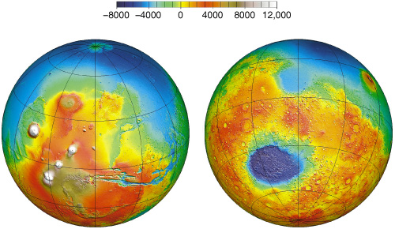
Mars Global View
meters
Tharsis volcanoes, Valles Marineris Hellas impact, southern mountains
Notes:
scale units are meters

Slide 15
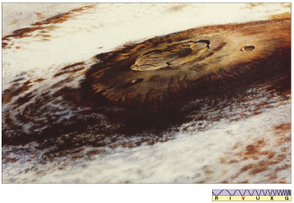
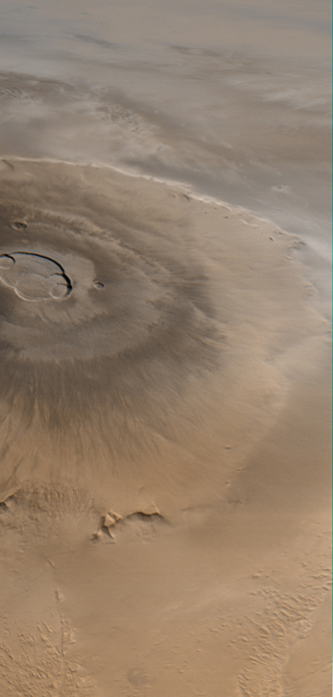
Mars Olympus Mons
largest volcano in the Solar System
part of Tharsis region = 4000 km wide, 10 km high
Oly Mons Mauna Loa
600 km across 120 km
27 km high 9 km
(18 km over plateau)

Slide 16
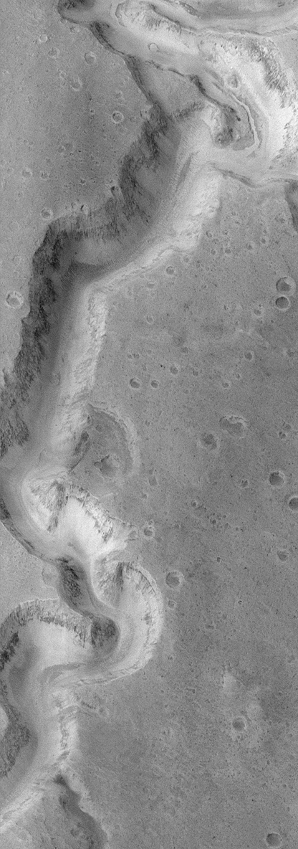
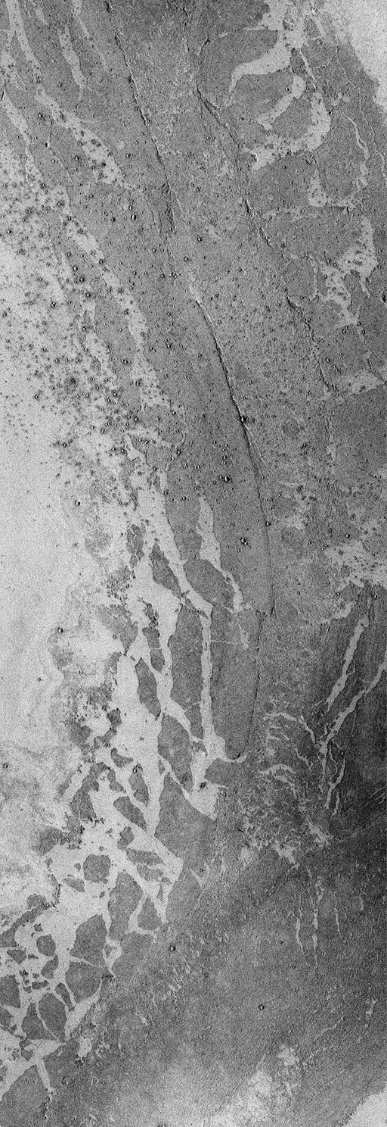
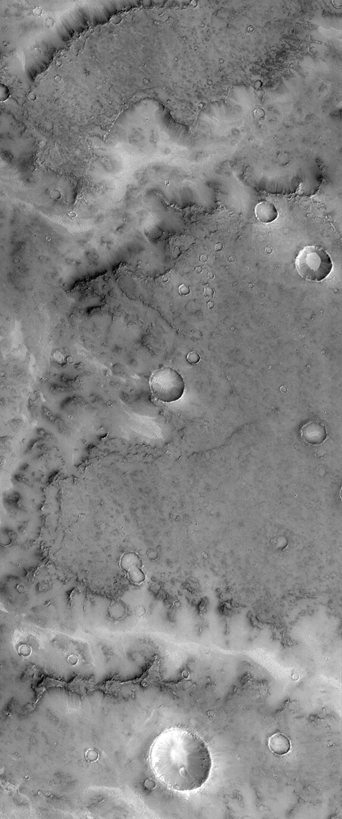
Mars Flows
water flow lava flow ???

Slide 17
Mars Highlights (mostly MGS)
1. evidence of remnant magnetic field
2. most accurate topographic map in Solar System, revealing pole-to-pole slope
(southern hemisphere 1-4 km higher than mean)
3. two distinct crustal thicknesses --- 32 km in north, 58 km in south
4. layering by both volcanic and water sloshing processes
5. sploshy craters are shallower than Moon’s
6. definitive water flow features --- channels, teardrop islands, dendritic systems,
flood plains
7. hematite deposits that likely occurred in hydrothermal environments
8. dunes, dust devils, etc., that directly show role of winds
9. evolution of polar caps
10. probable sub-surface H₂O in abundance
Notes:
two different surface compositions --- basaltic in south, andesitic in north (andesite has more Si than basalt) andesite is most common volcanic rock on Earth after basalt

Slide 18
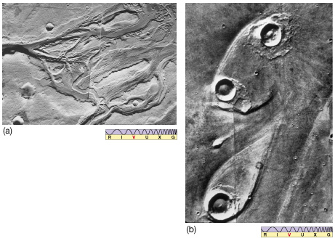
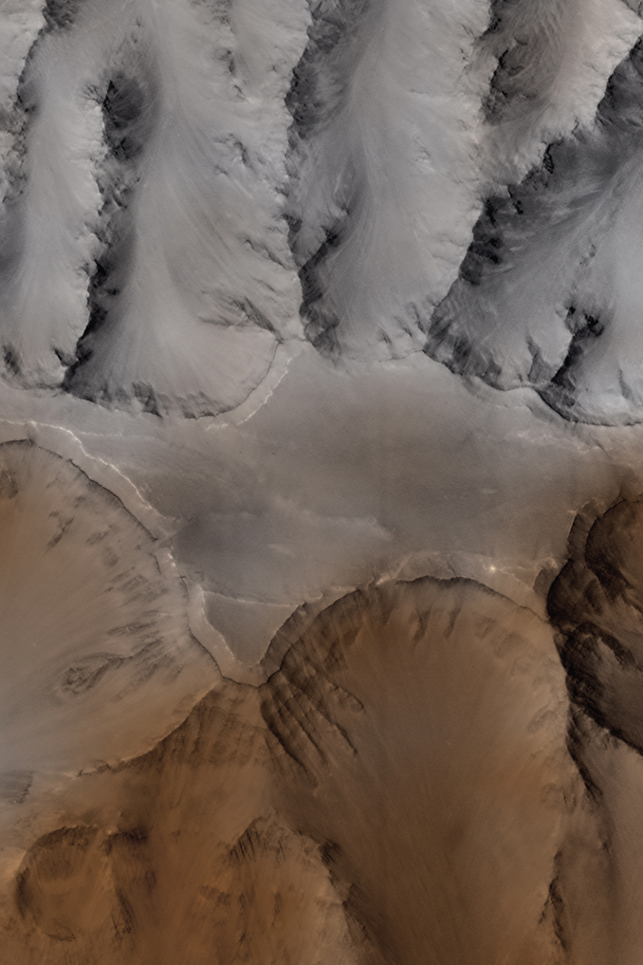
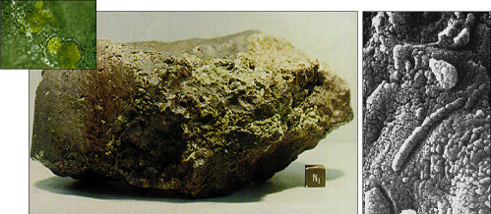
A Martian Vacation: H₂O

Slide 19
A Martian Vacation via Mars Reconnaissance Orbiter (MRO)

Slide 20
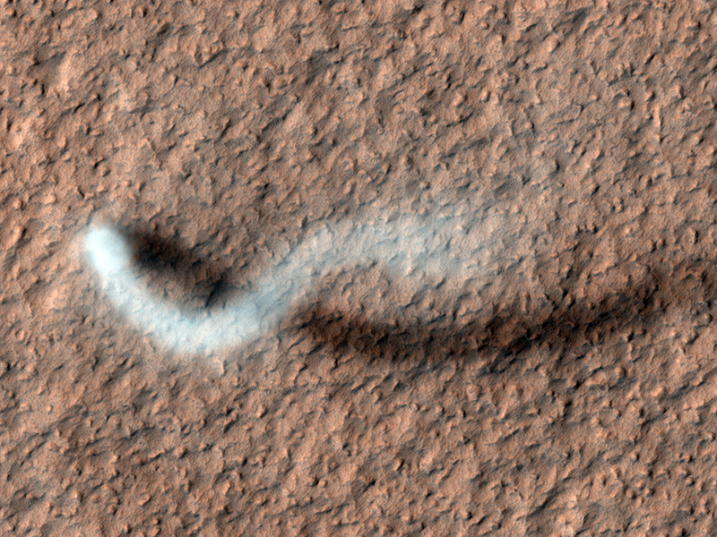
Dust Devil
Notes:
in Amazonis Planitia … 800 meters high … plume 30 meters in diameter

Slide 21
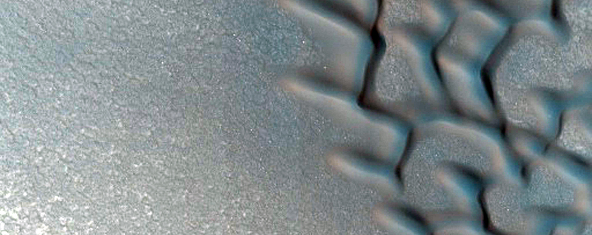
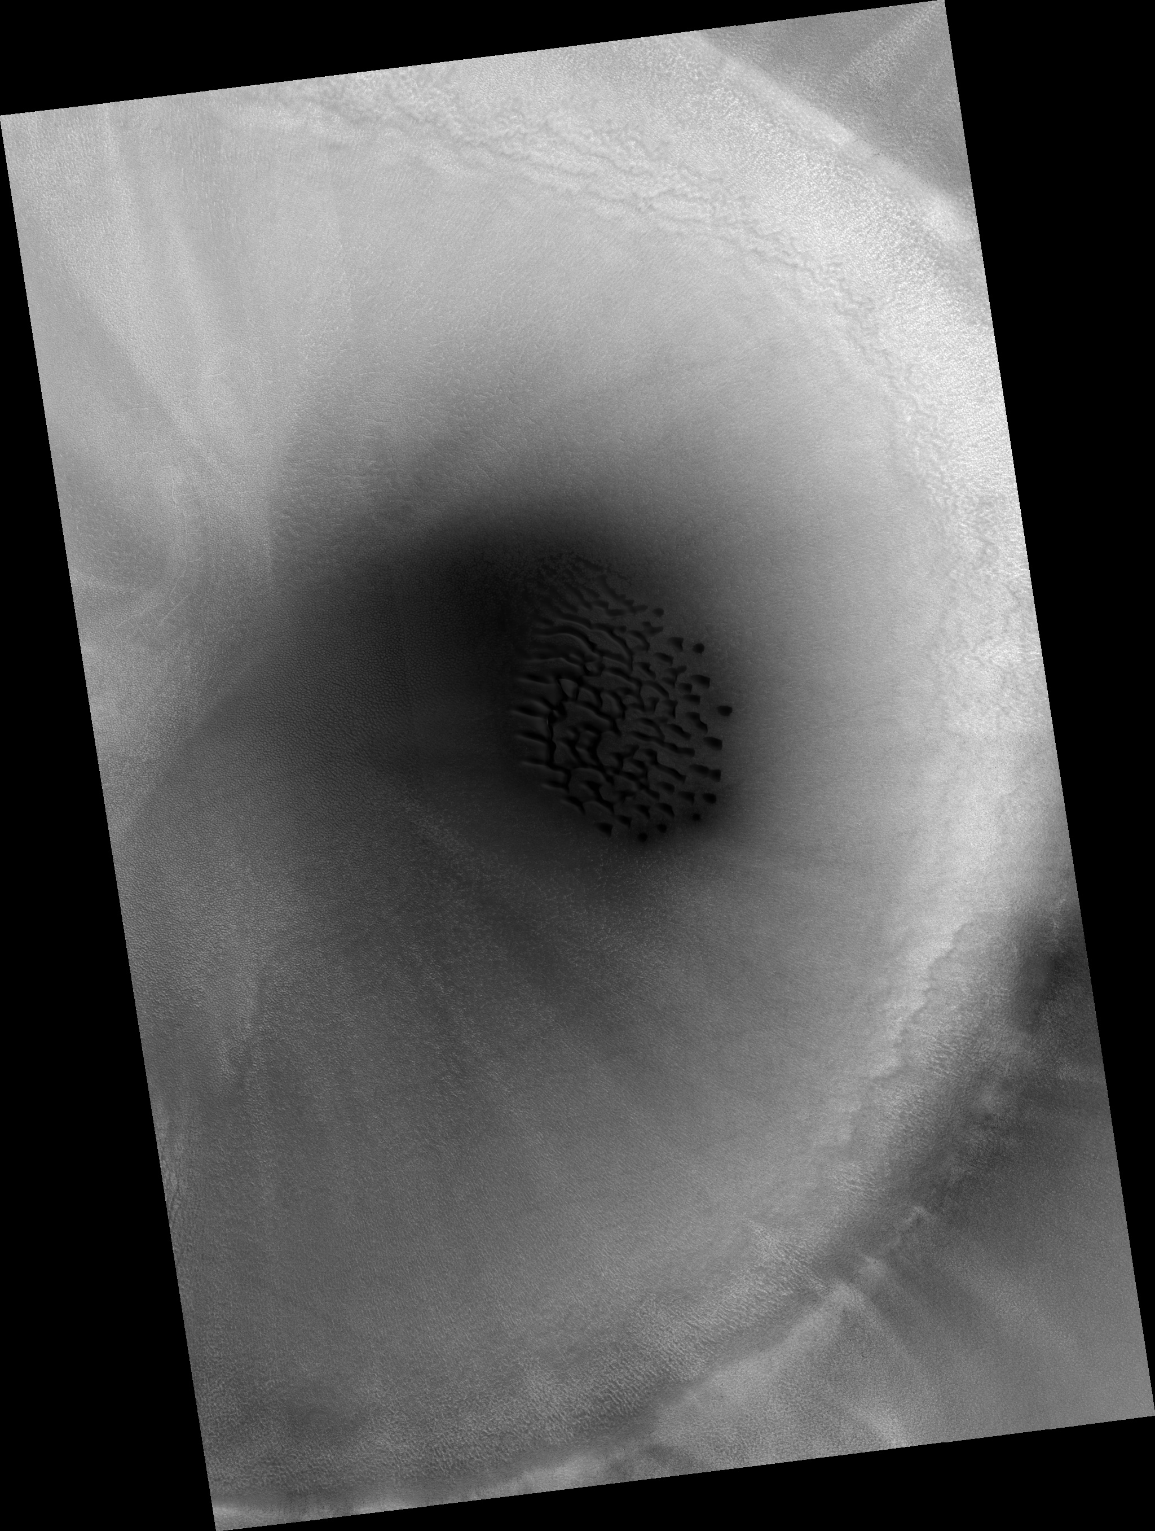
Crater Dunes
Notes:
in Arabia Terra … shallow cascades of dust … dark when fresh, then fade

Slide 22
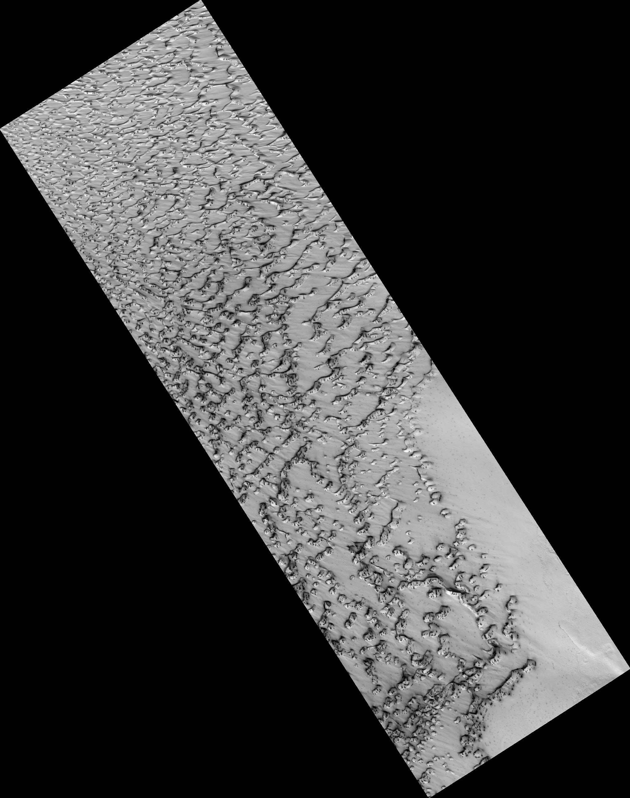
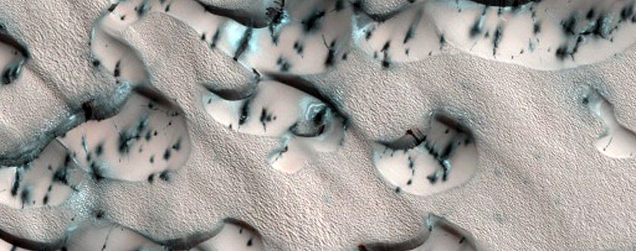
basaltic sand
Spring Sandfall
North Polar Erg
Notes:
in North Polar Erg … latitude 85 deg … resolution 1 meter … erg is Arabic for dunefield
dark = basaltic sand

Slide 23
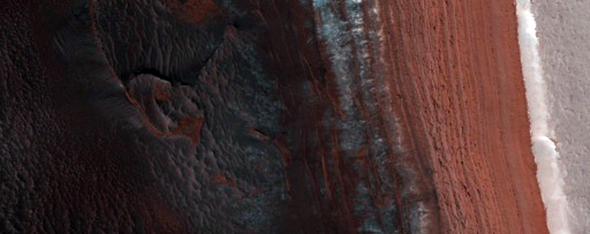
Steep Scarps
Avalanche Zone
Notes:
latitude 84 deg … resolution 1 meter

Slide 24
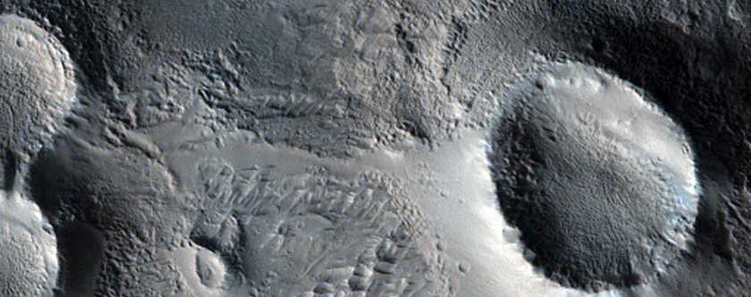
Olympus Mons
Cones

Slide 25
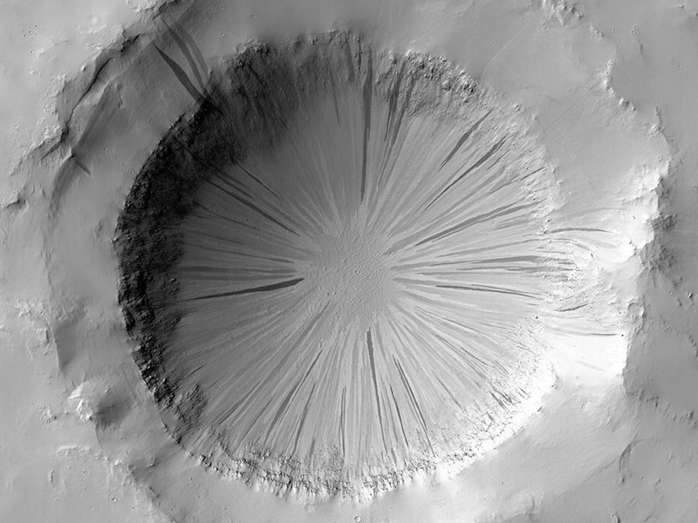
Slope Streaks
Notes:
in Arabia Terra … shallow cascades of dust … dark when fresh, then fade

Slide 26
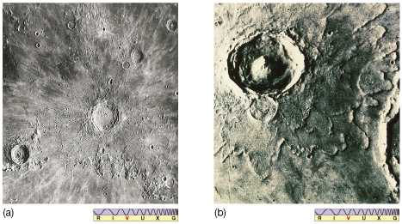
Not All Craters Alike
Moon Mars

Slide 27
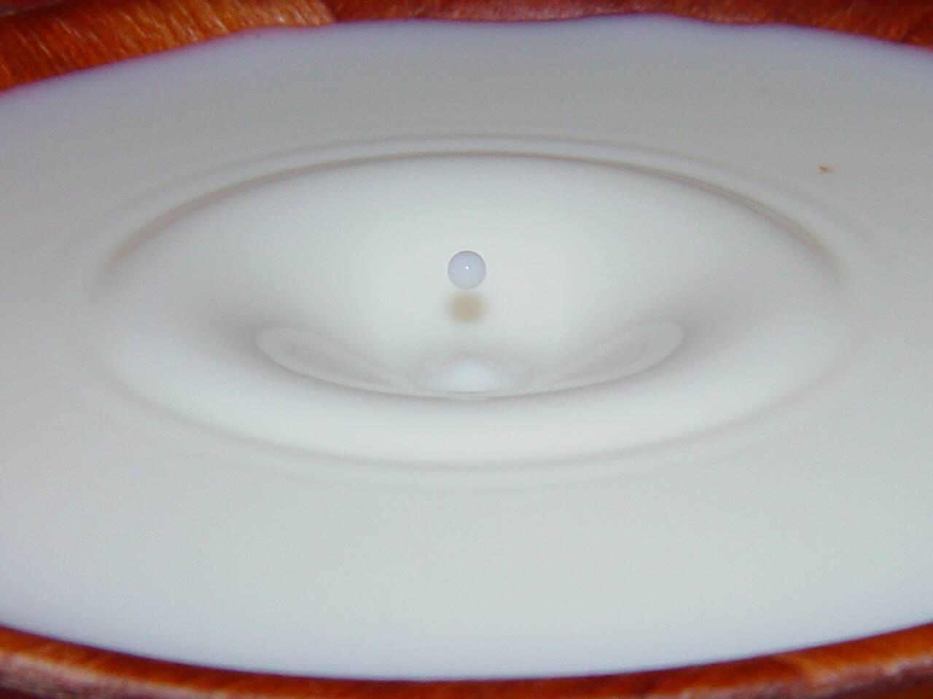
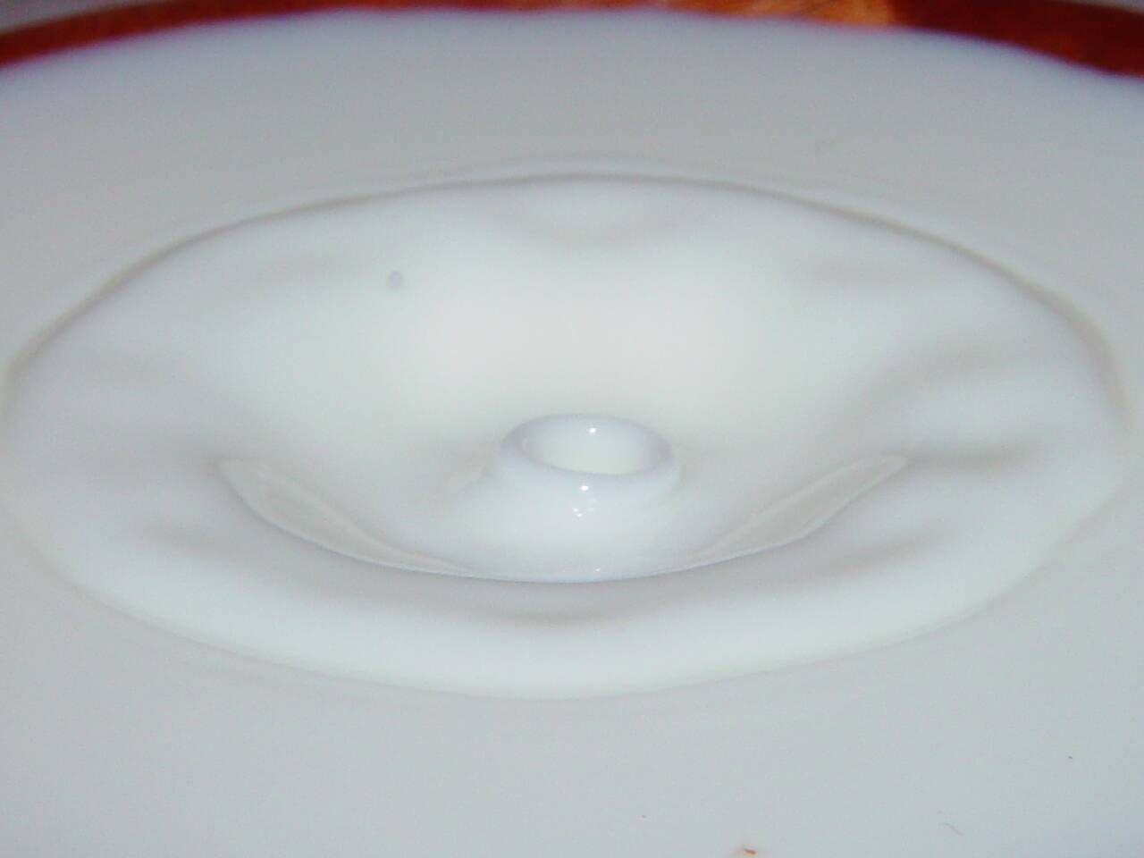
Surfaces via Cratering
cratering *SMACK*
five types
1. microcrater sub-cm micrometeorites, dust airless bodies
2. simple few km small impactors diameter:depth ~ 5:1
3. complex few 100 km large impactors central peak
4. basin 1000+ km giant impactors concentric rings
5. palimpsest mutated old craters (ice flows) / melted impact
Notes:
central peaks are formed by rock rebounding, being pushed back up by the strength of the underlying rock after the initial impact event … happens within minutes of the impact itself, even in craters 10s-km across
world’s gravity and composition determine transition sizes for different types

Slide 28
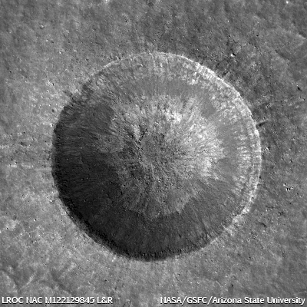
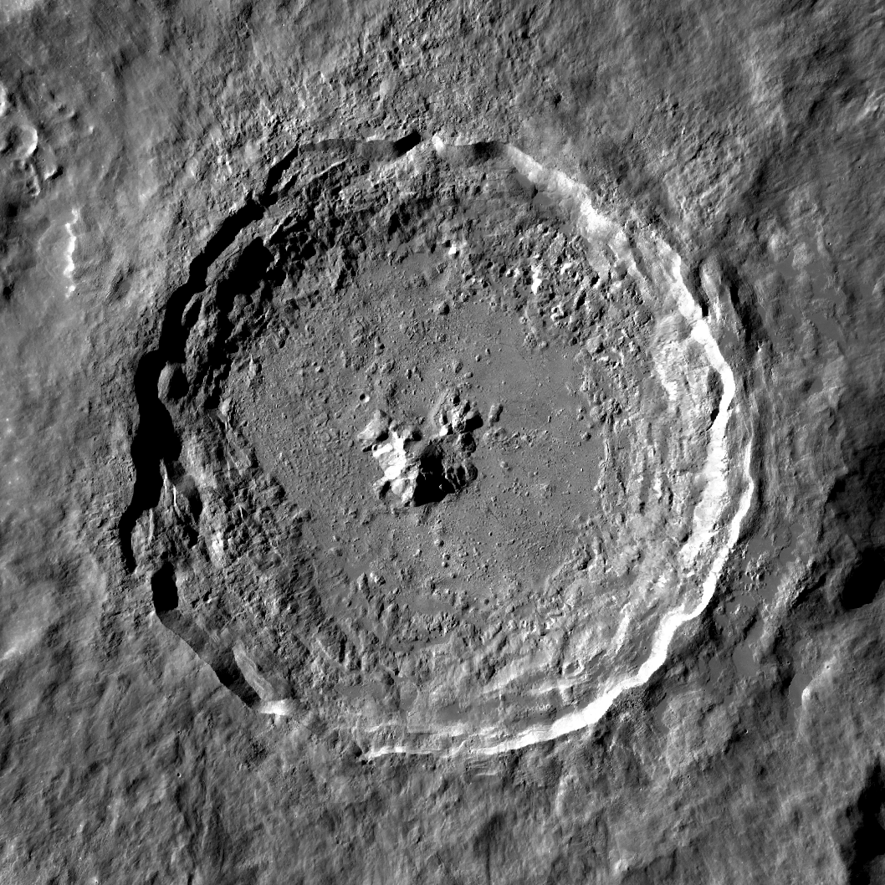
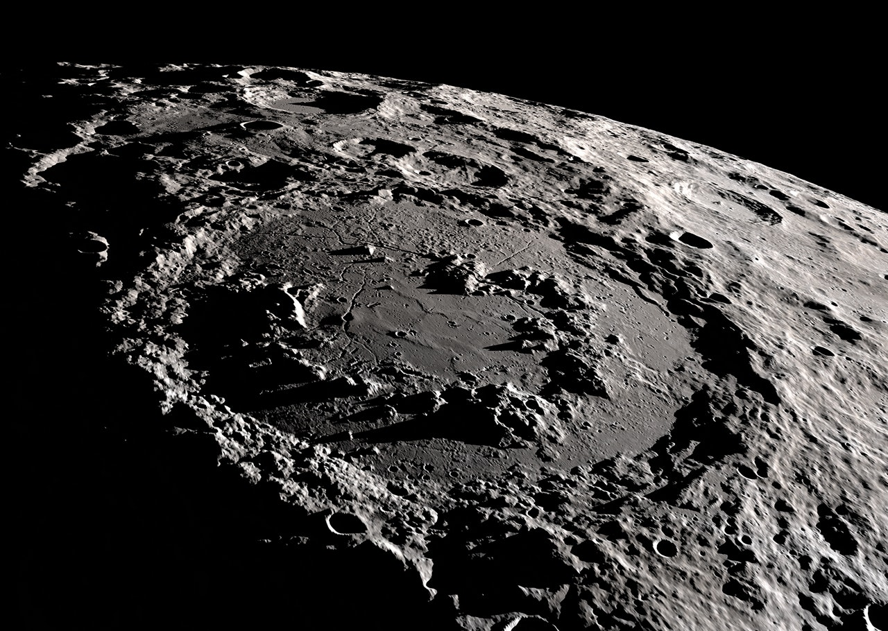
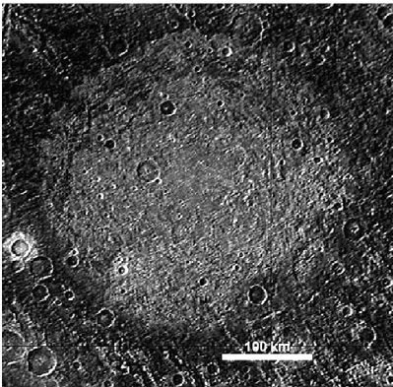
Surfaces via Cratering
simple = Linne
Moon
complex = Tycho
Moon
basin = Schrodinger
Moon
palimpsest = Memphis
Facula on Ganymede
Notes:
palimpsest = a manuscript or piece of writing material on which the original writing has been effaced to make room for later writing but of which traces remain … something reused or altered but still bearing visible traces of its earlier form.

Slide 29
Cratering Features
1. primary crater initial impact hole
2. ejecta blanket debris field to ~ 1 crater diameter beyond rim
rocky or sploshy
3. secondary craters rocks ejected from primary impact site
4. rays linear, formed by powdered/resolidified magma
5. breccia high T/P minerals found lining the crater walls
6. regolith produced by micrometeorites
7. focused features “weird terrain” on Mercury (not on icy worlds)

Slide 30
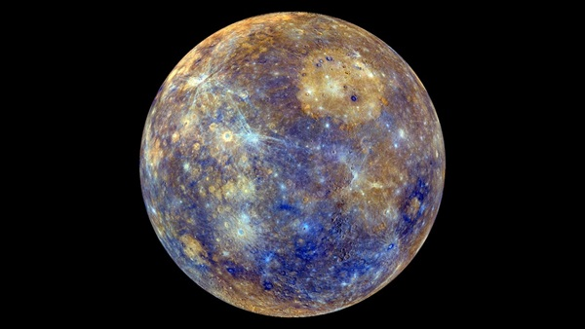
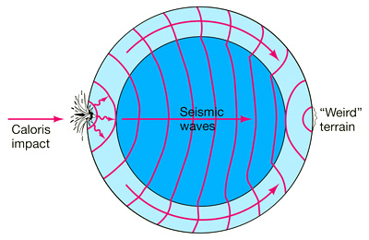
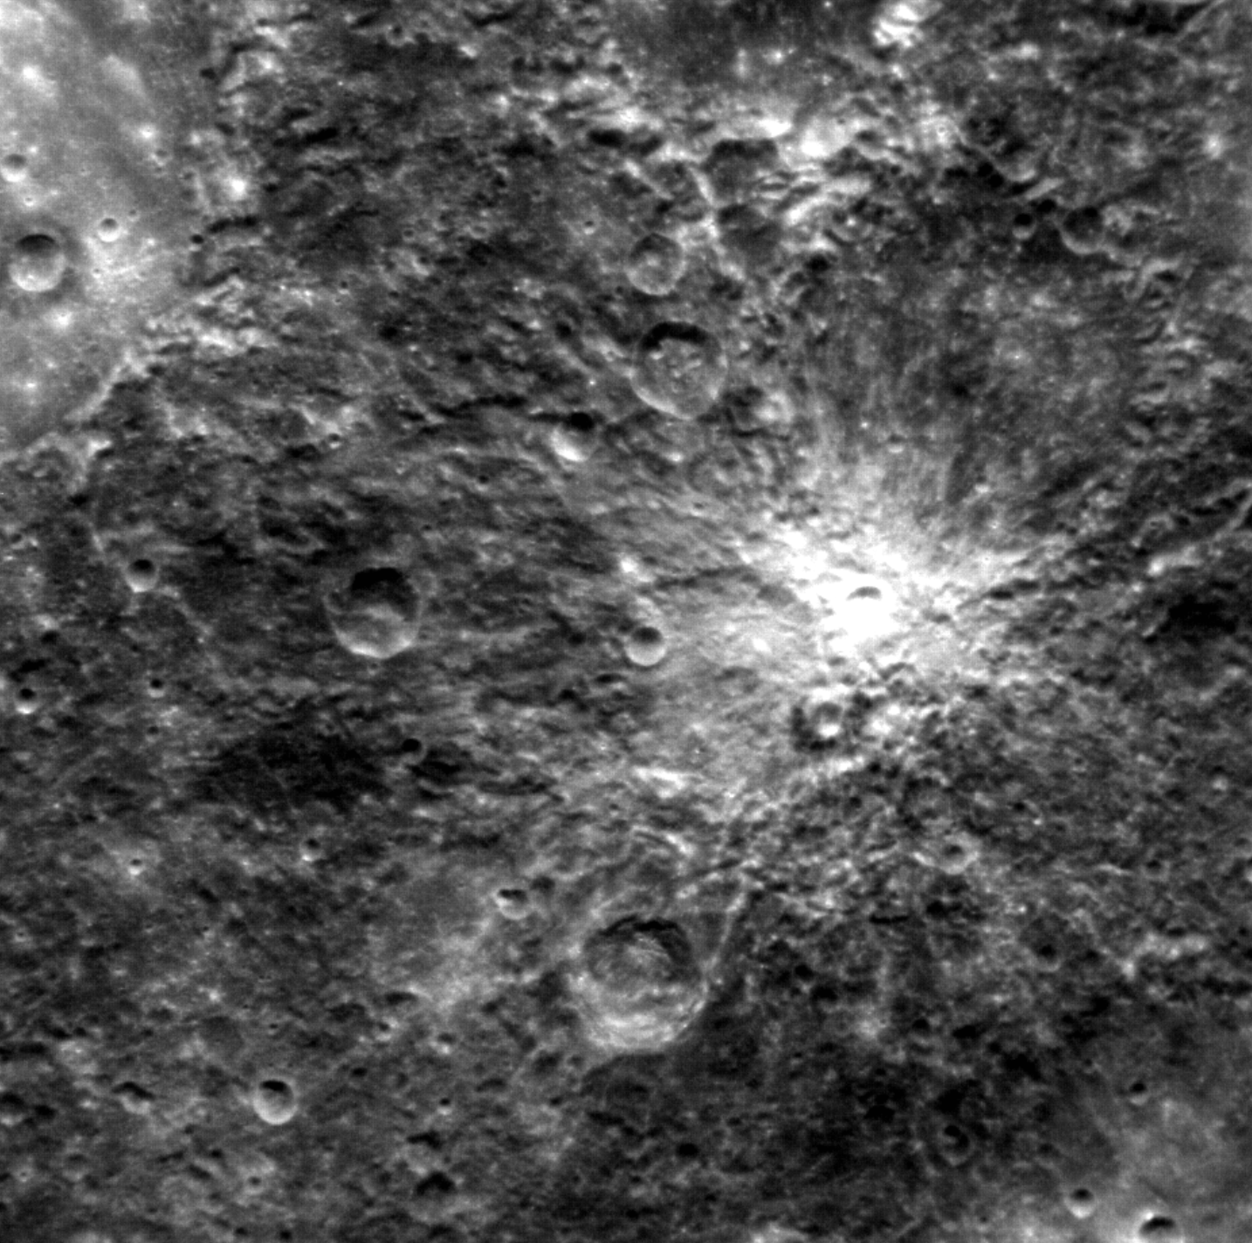
Mercury
Notes:
weird terrain on Mercury … rugged terrain that is hilly and lineated

Slide 31
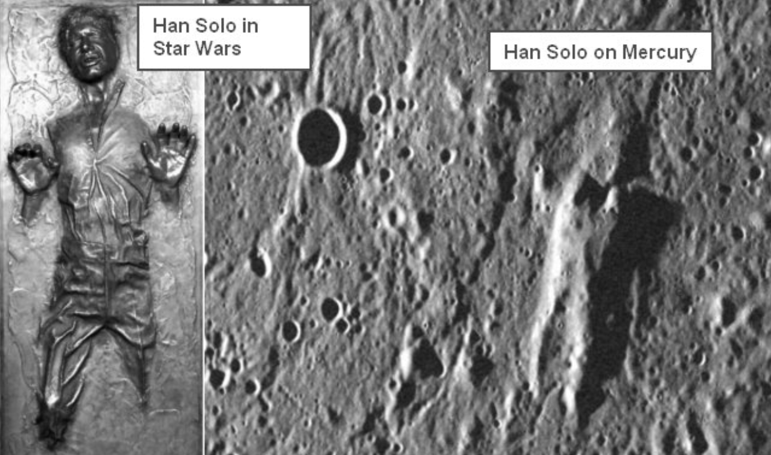
Mercury
Notes:
weird terrain on Mercury … rugged terrain that is hilly and lineated

Slide 32
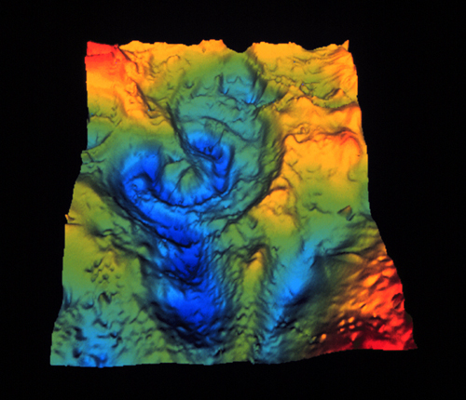
Chicxulub
65 million years ago…
crater on Yucatan Peninsula … 80/130/195 km in diameter for various rings
Notes:
add another picture of buried crater walls ???

Slide 33
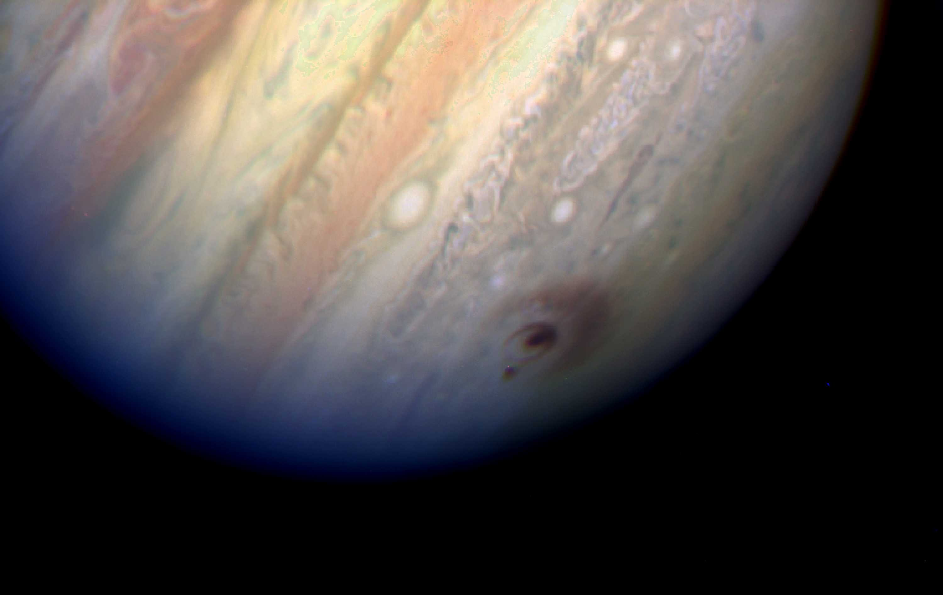
Chicxulub
65 million years ago…
crater on Yucatan Peninsula … 80/130/195 km in diameter for various rings
Cretaceous-Tertiary boundary (a.k.a. KT boundary)
10-100X normal iridium in sediments worldwide
confirmed by gravity anomaly measurements
impactor was 10 km in size
100 X energy of SL9 single impact … 10⁹ H bombs
scenario includes double shock wave (into Earth, back into impactor)
double fireball of (1) vaporized rock, then (2) CO₂ released from limestone
so many ways to die …
1. within a few thousand km, ignited plants and animals
2. HNO₃ (nitric acid) and H₂SO₄ (sulfuric acid) formed and rained down
3. tsunami spreads to wipe out coastal areas
4. dust in atmosphere doesn’t help …
… roughly 50% of species die

Slide 34
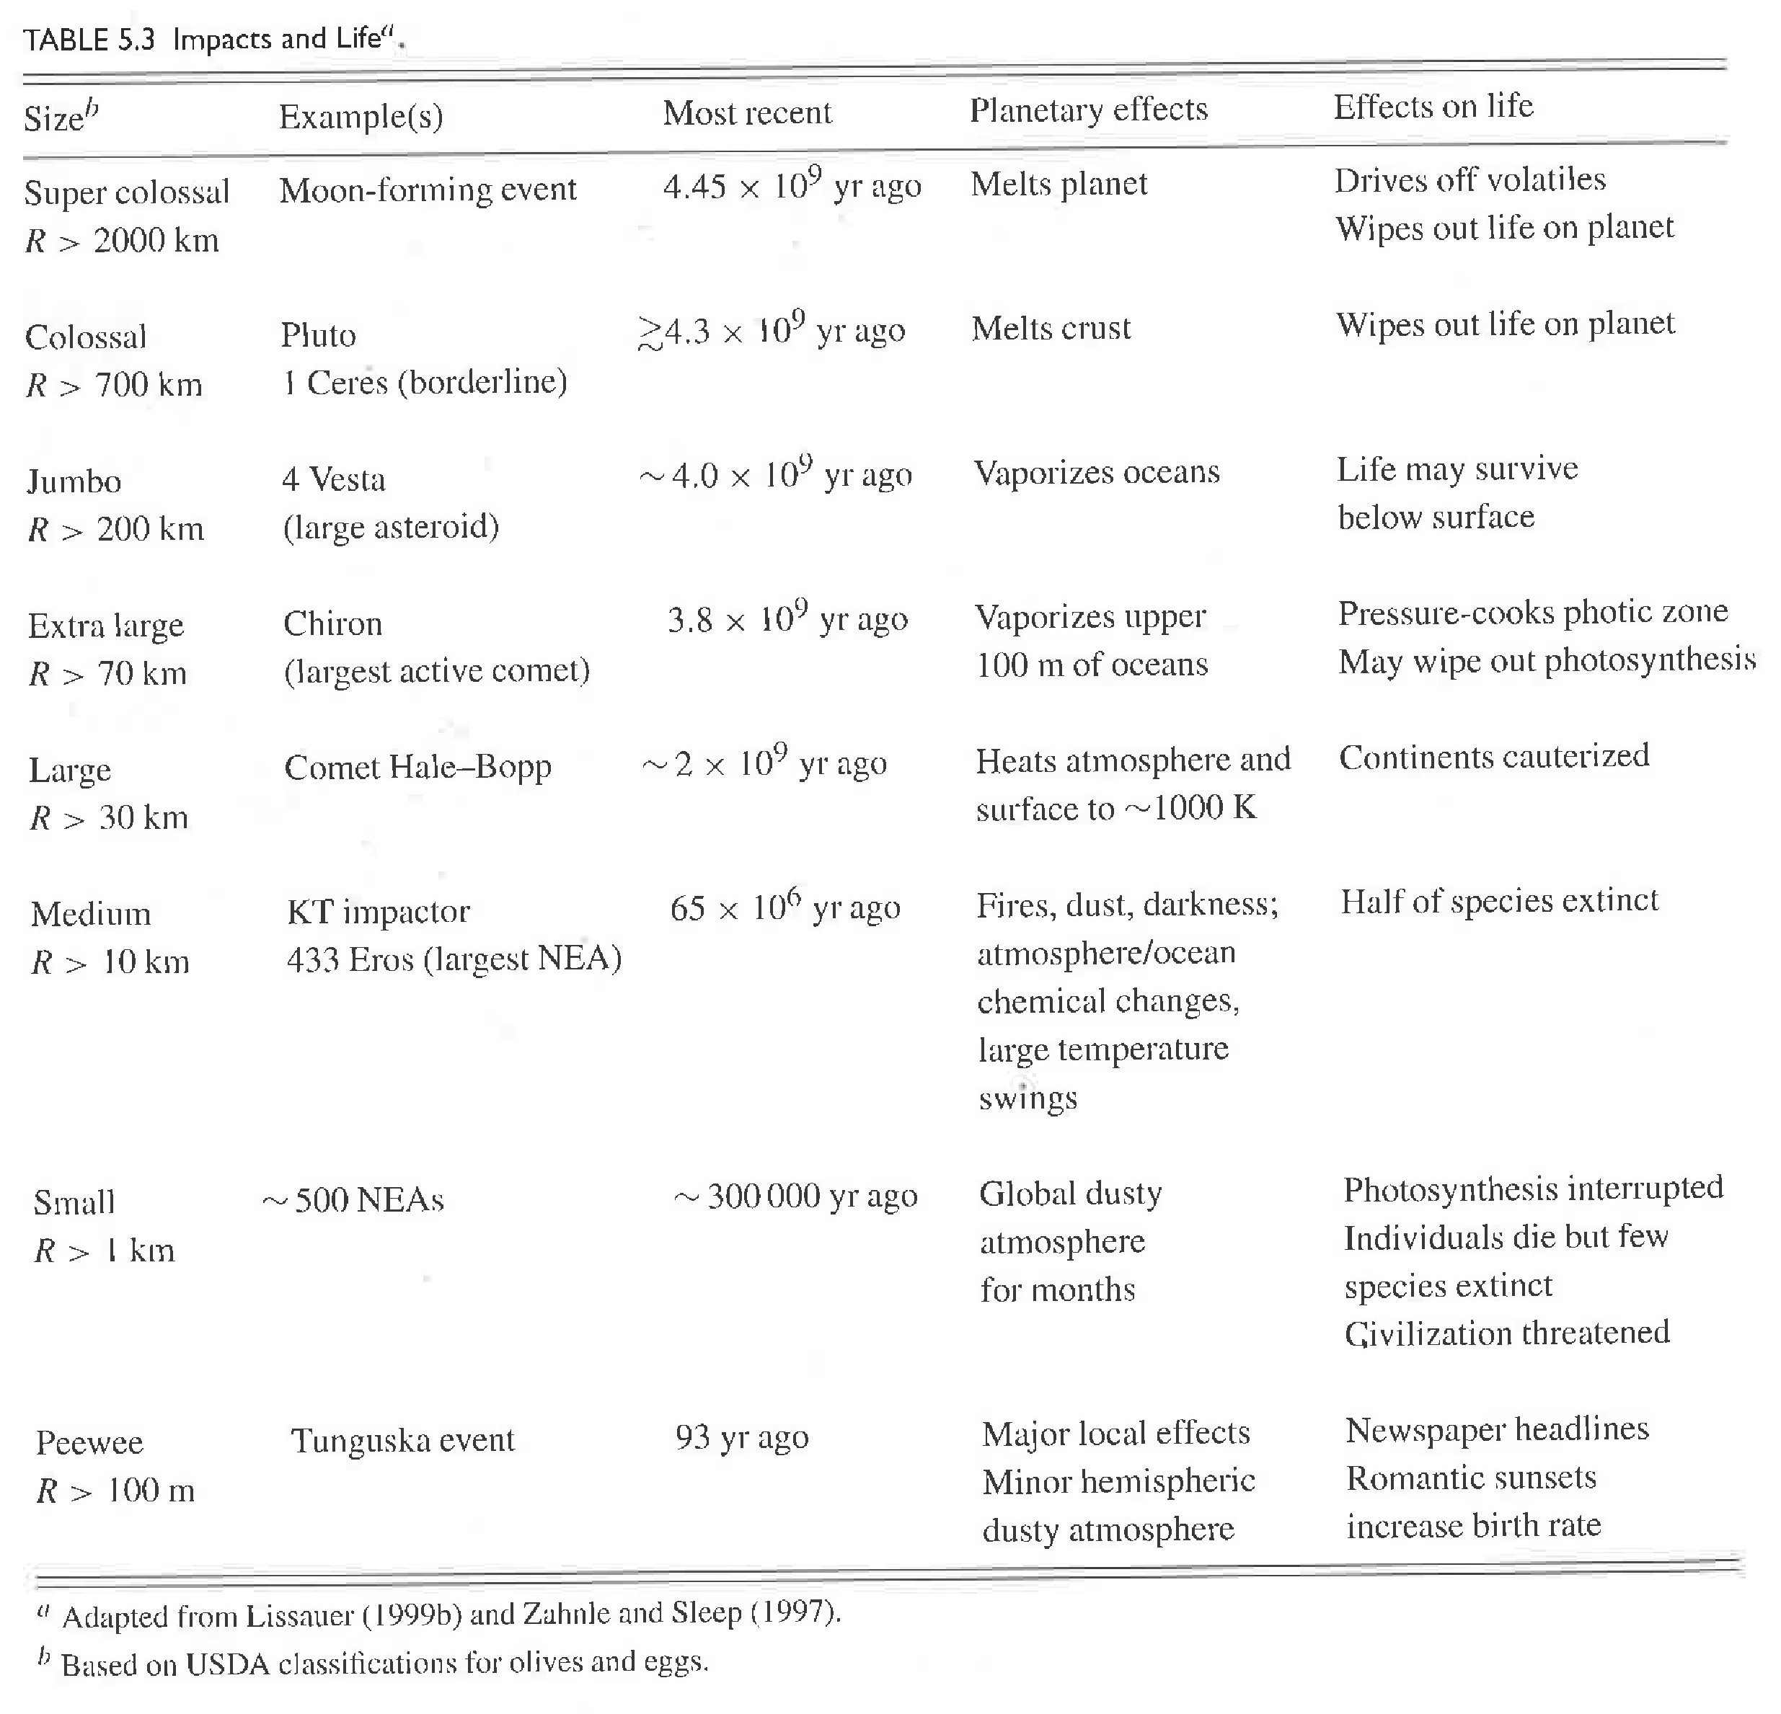
Cratering Impacts
Notes:
olives and eggs!
romantic sunsets … increase birth rate

Slide 35
Solar System Explorers 06 OCT
Name a location in the Solar System where surface processing is occurring.
Each process can be used only once. Describe how that surface is being
reprocessed, e.g. Earth’s land mass coastlines change because of liquid H2O.
1.
2.
3.
4.
5.
6.
7.
8.
9.
10.
11.
12.
13.
14.
15.
16.
17.
18.
19.
20.

Slide 36
…………………………
Notes:
36

Slide 37
Bye Bye Atlanta?
empirical formula for crater size (5.26b):
D = 1.8 ρm^{+0.11} ρp ^{–0.33} gp ^{–0.22} (2R) ^{+0.13} E ^{0.22} (sinθ) ^{+0.33}
ρm density of impactor
ρp density of planet
gp gravity of planet
R radius of impactor
E kinetic energy of impact
θ angle from horizontal (assume 45 deg impact)
2 point SSE bonus: what size meteorite needed to turn Atlanta → crater?
assume Atlanta 30 km circular target
(due Thursday)
Notes:
they do this in lab, so it’s sort of a repeat

