Slide 1
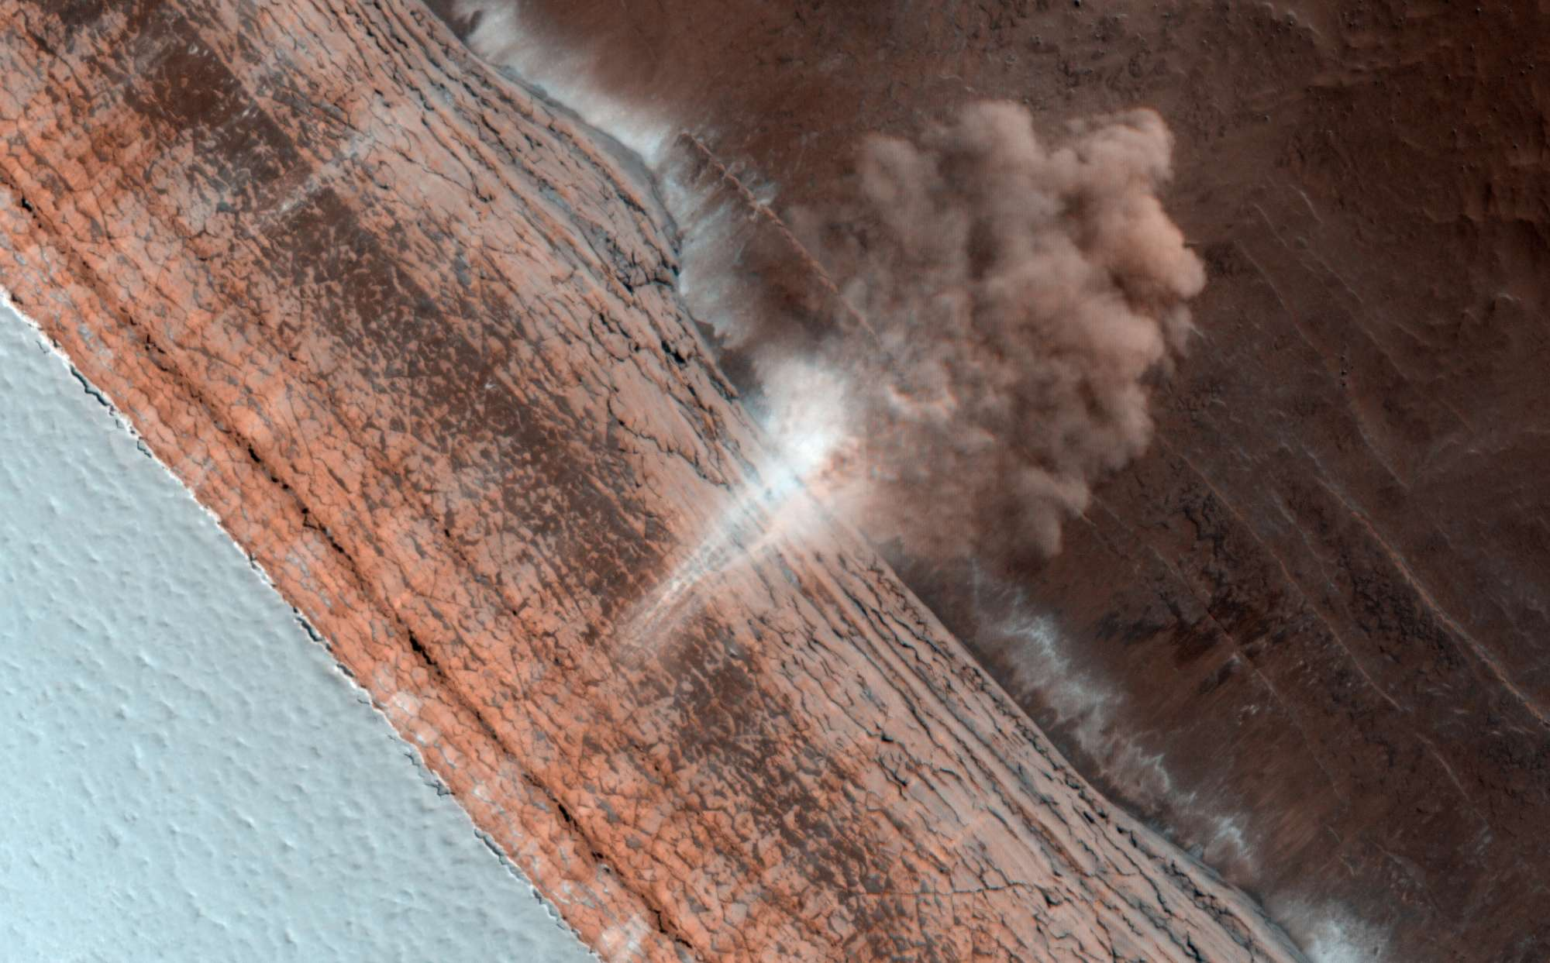
Planetary Surfaces II
Where is
this?
Notes:
Martian avalanche

Slide 2
Research Paper Level 1
Outline of your research project (worth 10 points)
10 pieces required:
1. Abstract 2+ sentences
2. Introduction 2+ sentences … why do we care?
3. Motivation 2+ sentences … why do YOU care?
4. Sections listed … Sample, Observations/Data, Results …
5. Discussion 2+ sentences
6. Tables 2+ listed
7. Figures 2+ listed
8/9/10. three REFEREED references
Abstract specifics about Results, numbers
Keywords at least 3
Introduction references!
Motivation why YOU care … say “I” … 5 sentences
Discussion bullets for key points
capitalize Solar System, Sun, Universe

Slide 3
Planetary Sciences Project
Level 0 … Topics … Tue 10 SEP
Level 1 … Outline … Tue 01 OCT
Level 2 … Draft #1 … Tue 29 OCT
Presentations … in class … 19+21 NOV
Level 4 … Final Paper … Thu 05 DEC
Final Exam … 2 Reviews … Tue 10 DEC

Slide 4
Research Paper Level 2
due Thursday, 29 OCT (before class)
paper starting to take shape (worth 10 points)
hand in printed copy
ultimate goal is 10 pages of text + 5 pages of Figures and Tables
10 points:
1. Abstract full draft
2. Introduction 8+ sentences, major references included
3. Motivation YOU
4/5. Sections all have bullets
6/7. Discussion 8+ sentences
8. Tables 2+ formatted with columns identified
9. Figures 2+ outlined/sketched, captions given
10. References at least 5

Slide 5
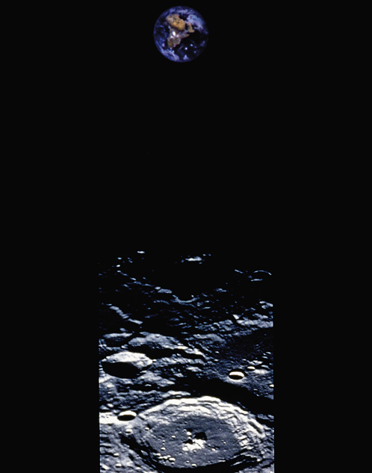
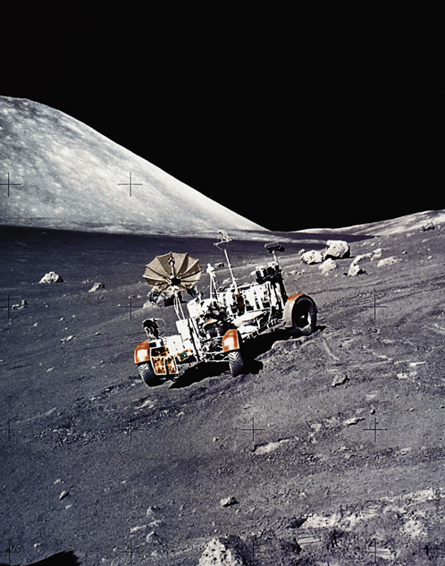
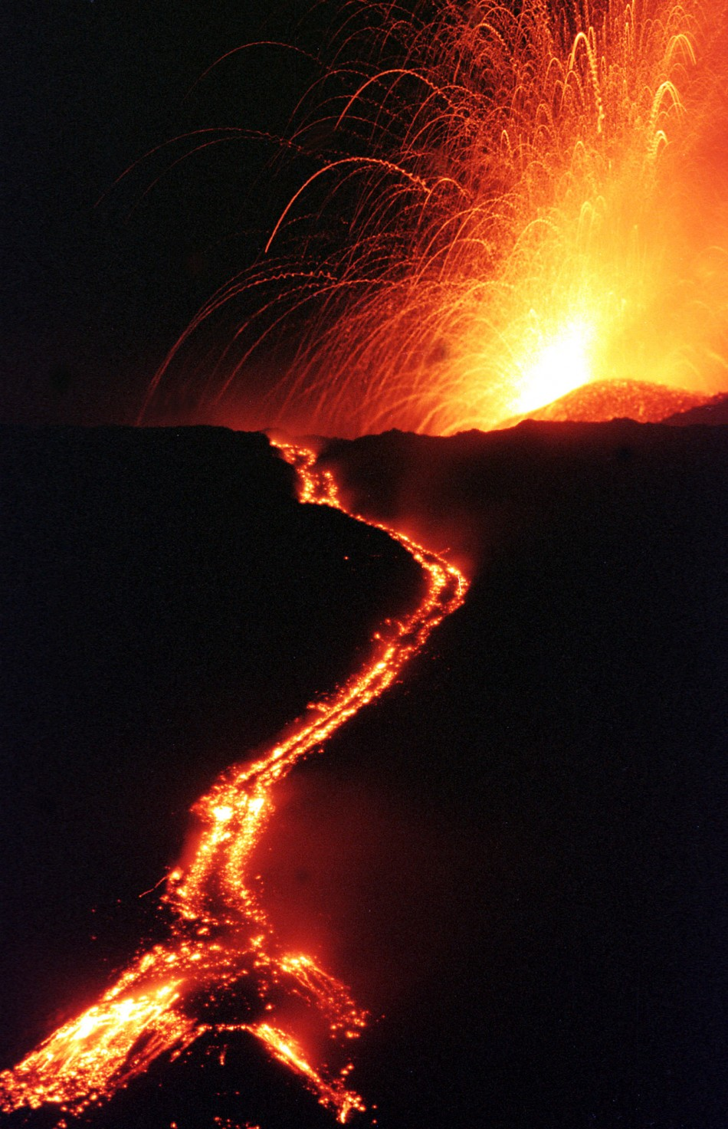
Earth vs. Moon
DEAD … or … ALIVE

Slide 6
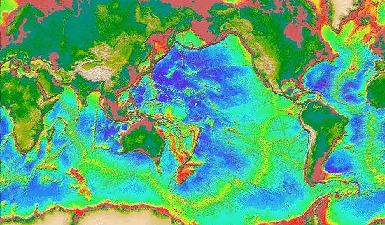
Earth: global topography
E
M
total relief … 19.8 km
Mariana Trench = – 36000 ft Mount Everest = + 29035 ft

Slide 7
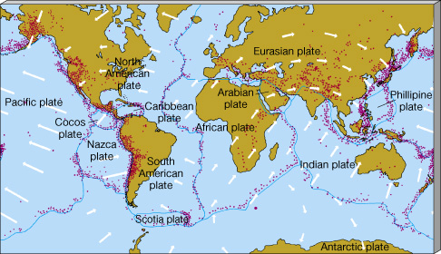
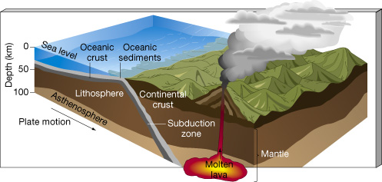
Earth
plate tectonics
15 plates
spreading ridges
subduction zones
A
C
L
A
M
Notes:
7 major plates and 8 minor plates
A CLAM = atmosphere, crust, lithosphere, asthenosphere, mesosphere (mantle includes LAM)
(geologists say lithosphere is bottom of crust because it moves with crust; asthenosphere doesn’t)
ocean crust denser than continental crust

Slide 8
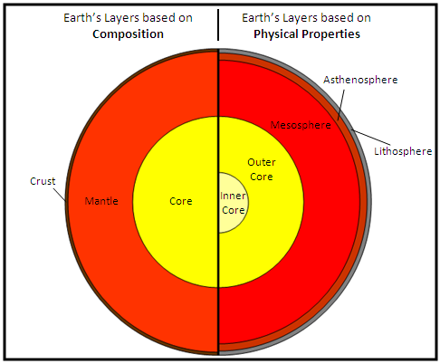

Slide 9
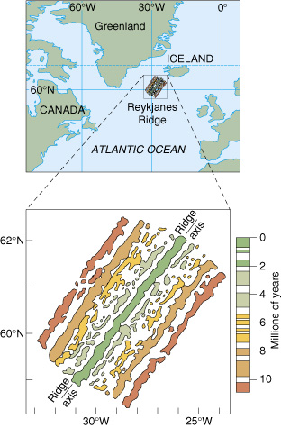
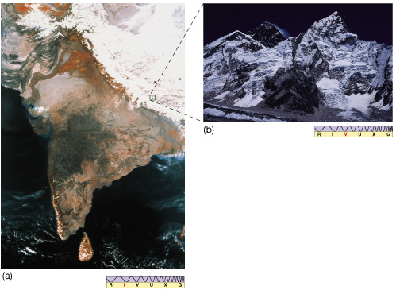
Earth: measuring changes
²³⁸_{U (Uranium) →} ²⁰⁶_{P (Lead)}
_{in 4.46 Gyr}
⁴⁰_{K (Potassium) →} ⁴⁰_{Ar (Argon)}
_{in 1.25 Gyr}
mountain building
flipping magnetic fields

Slide 10
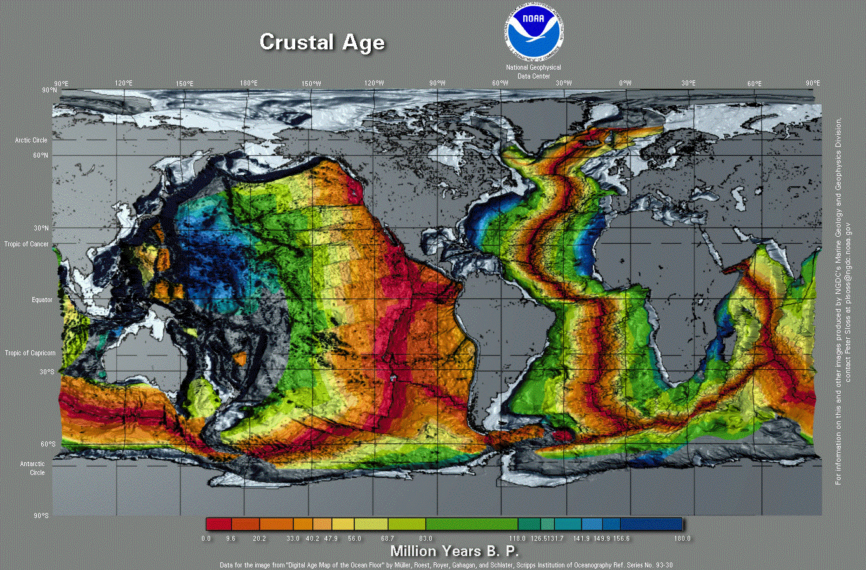
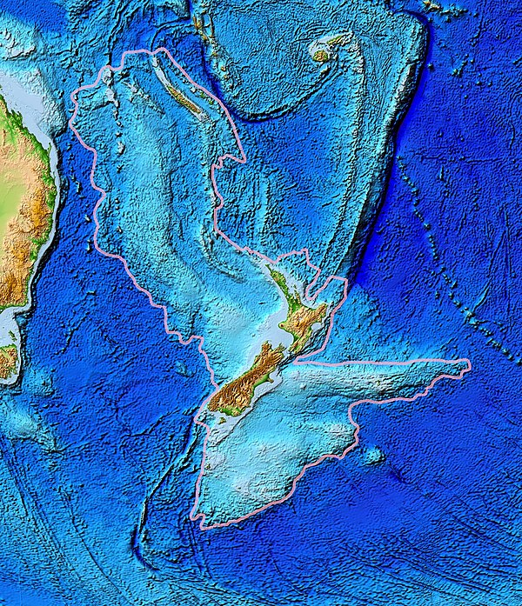
Earth: ocean crust age
SSE!
0 Myr ago 180 Myr ago
Notes:
range is 0 to 180 Myr
Zealandia

Slide 11
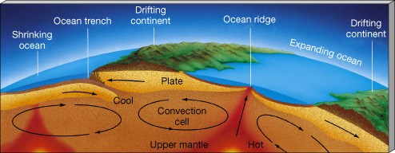
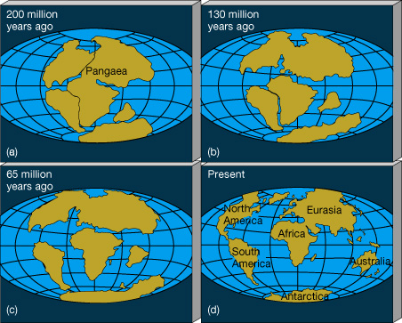
Earth: land conveyor belt
Laurasia
Tethys Sea
Gondwanaland
silicate crust is light and floats
oceanic crust is heavier

Slide 12
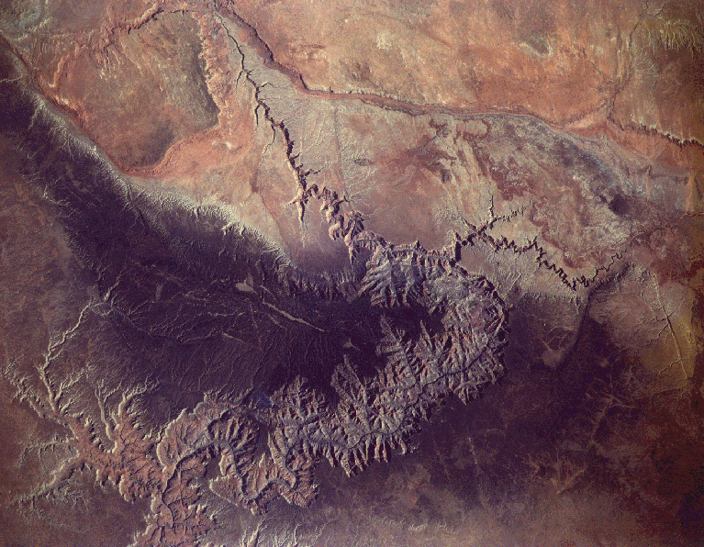
Earth: a major feature
SSE!
440 km long X 15 km wide X 1.5 km deep
Notes:
generally ~6 Myr old, but may have started 70 Myr ago … tectonic uplift then erosion by Colorado River

Slide 13
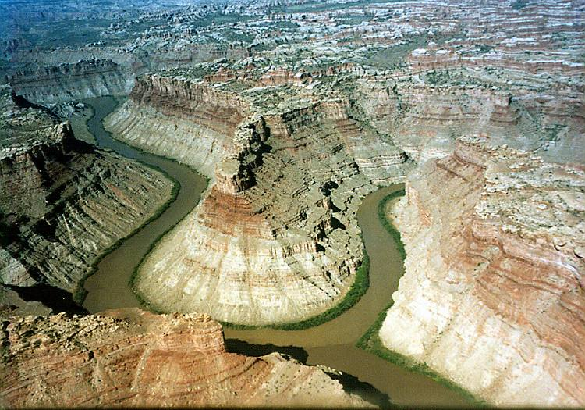
Earth: cause and effect!

Slide 14
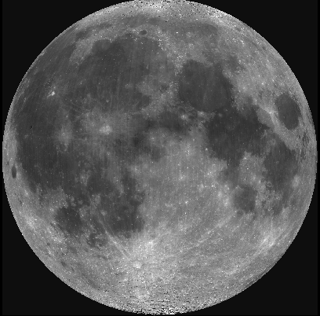
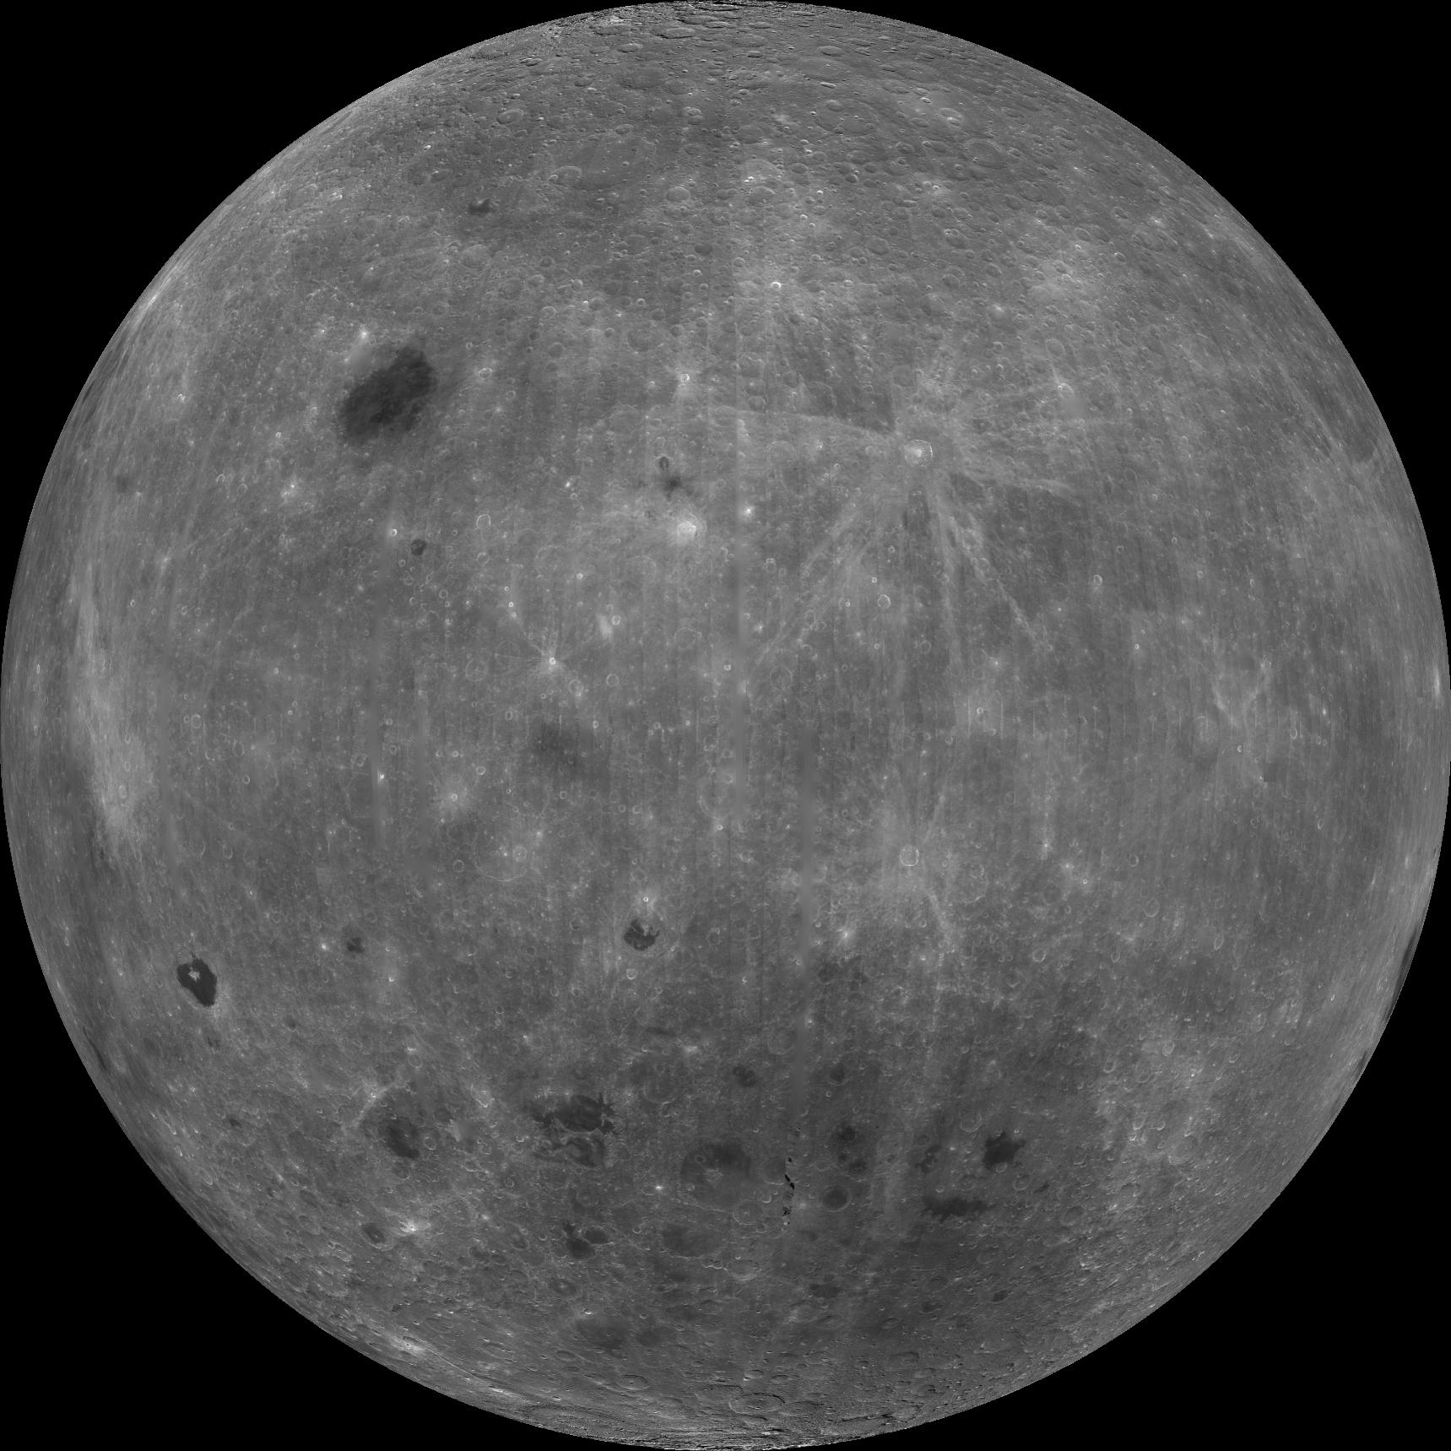
Moon: overall

Slide 15
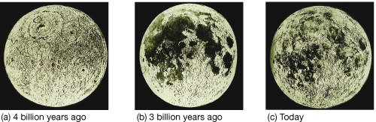
Moon: surface evolution
4.4 Gyr oldest highland rocks
> 3.9 Gyr bombardment, heating of surface
3.2 Gyr youngest mare material
< 3.2 Gyr cratering, regolith development

Slide 16
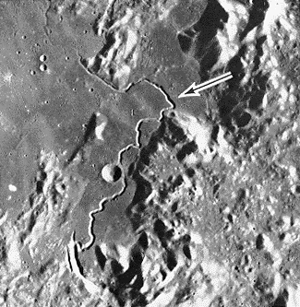
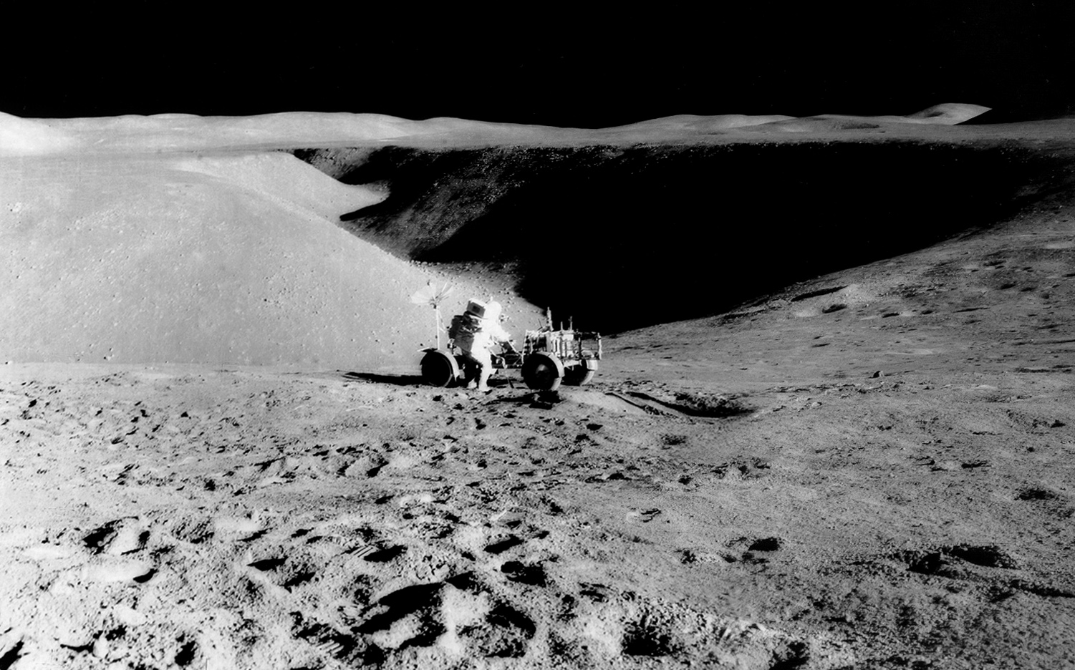
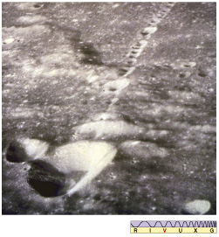
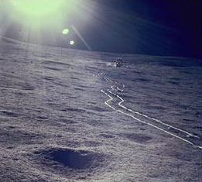
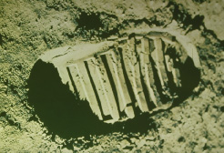
Moon: features
lava flow
collapsed
lava tube
Notes:
upper left and right = Hadley Rille with Apollo 15 landing site … lava flow
lower left … collapsed lava tube (likely)

Slide 17
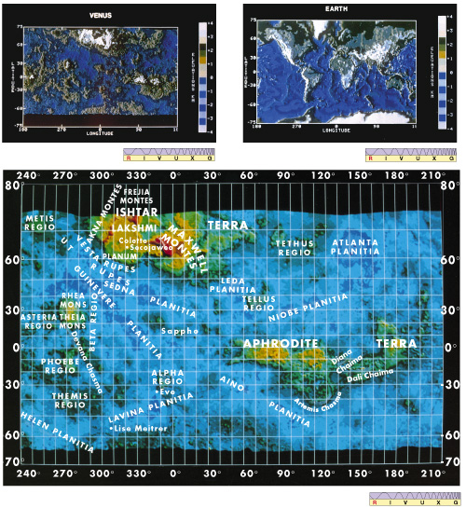
Venus vs. Earth
Venus has more piecemeal surface structure --- no plate tectonics to segregate?
landing site rocks are basaltic, not as weathered as Earth’s
8% highlands, 70% rolling uplands, 20% plains
high to low range 13 km, compared to Earth’s 20 km

Slide 18
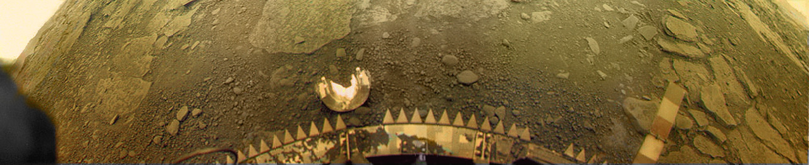
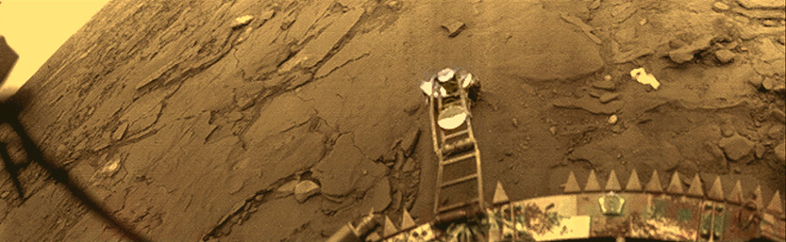
Venus vs. Earth
Venera 13 (1982) ... lasted 127 minutes
Venera 14 (1982) … lasted 57 minutes
Notes:
USSR got pics from four Veneras = 9, 10, 13, 14

Slide 19
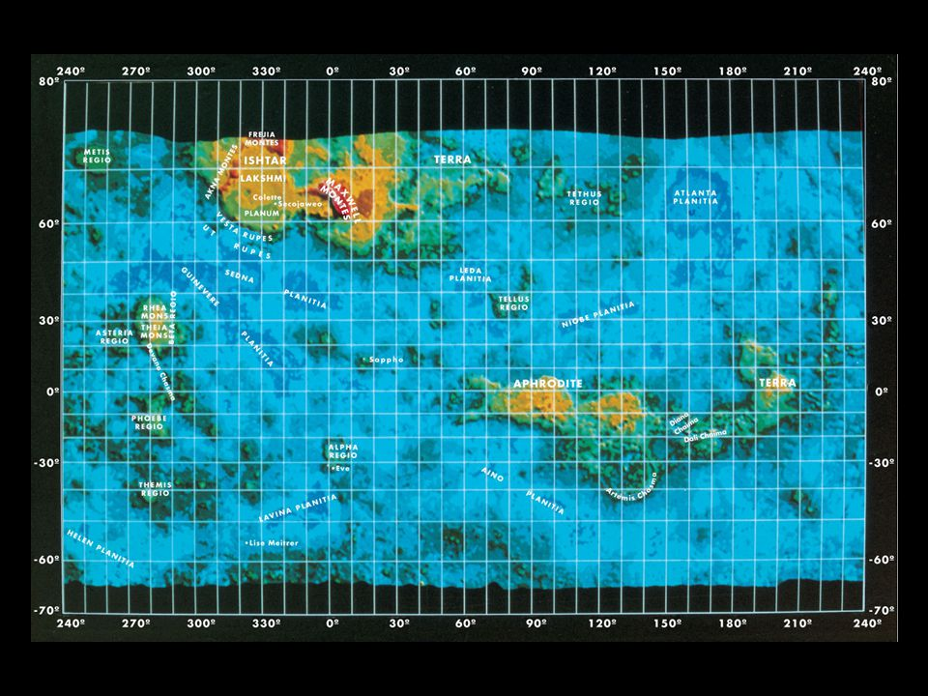
Venus Map
mapped to 100m by
Magellan
>1000 volcanic
features
(non-plate) tectonic
deformation
no craters < 3 km
surface 0.3-1.0 Gyr
younger than Mars
older than Earth
current volcanic activity … likely?

Slide 20
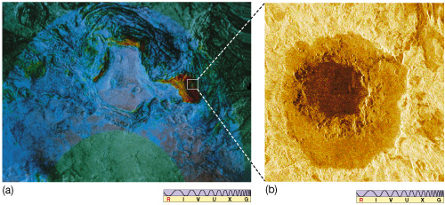
Ishtar Terra and Cleopatra Crater
Maxwell Montes is elevated red region Cleopatra impact crater
Notes:
originally thought to be volcanic … location in Maxwell Montes … lava flows to right
now thought to be impact … really?

Slide 21
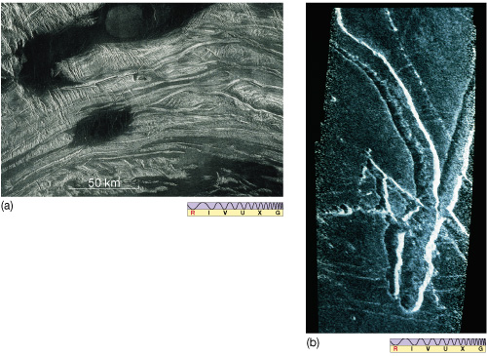
Tectonic/Volcanic Features
ridges indicate compression faulting
dark regions show lava flooding
lava channel

Slide 22
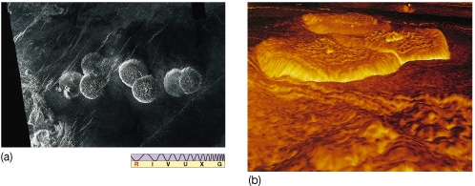
Pancakes
pancake domes 3D view looking toward right from
center of pancakes
20-50 km across … 100-1000 m high
very thick silicate flows on level surface
extrusion and subsequent surface stretching … and collapse(?)
Notes:
pancakes formed by extrusion (higher than surroundings) of thick lava through hole on level ground (symmetric); continued push from below forms rayed cracks

Slide 23
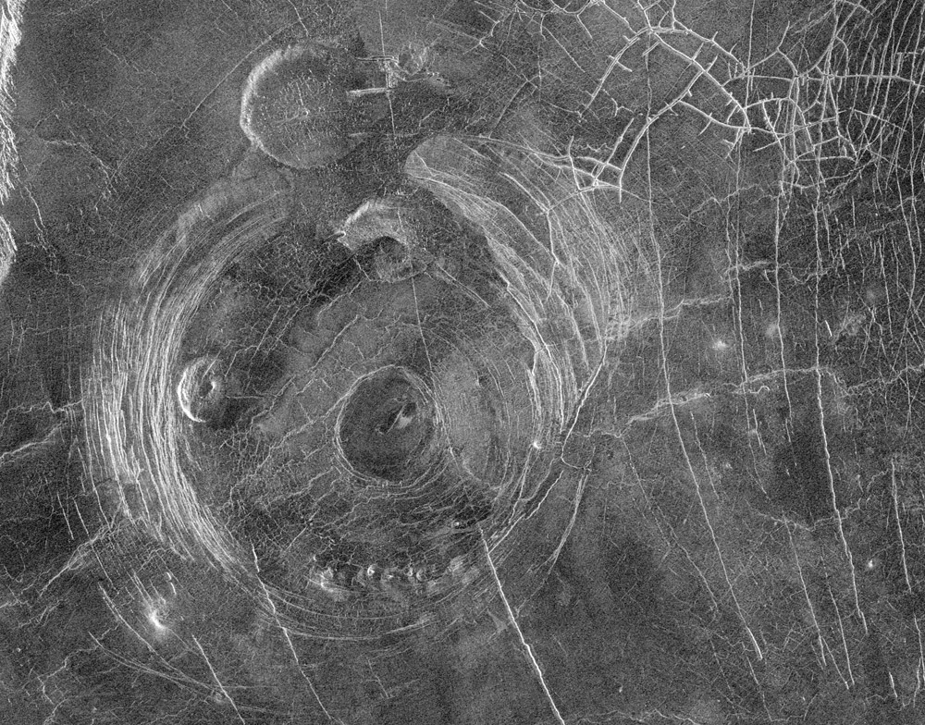
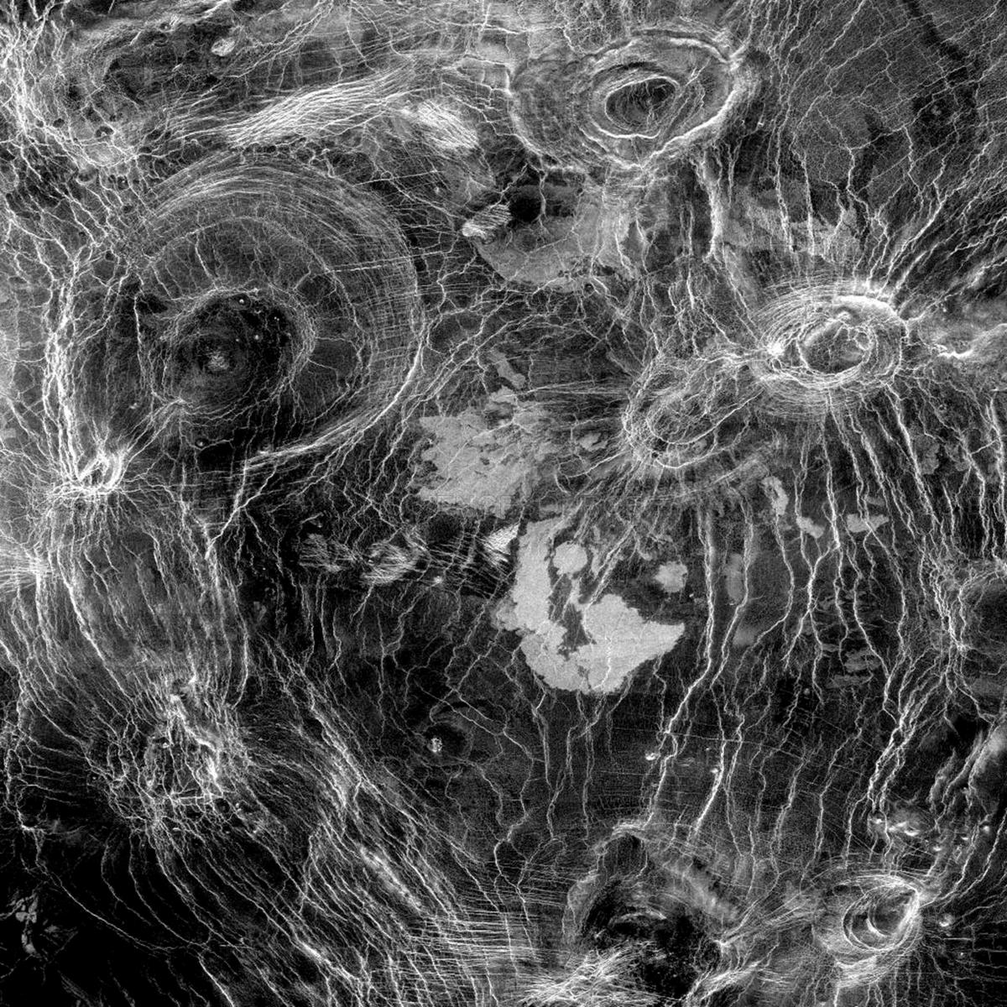
Coronae = Shield Volcanoes
Aine Corona
300 to 1000+ km across
upwelled mantle material
older than pancakes and craters
arachnoids look like coronae
but smaller
Notes:
coronae formed by upwelling magma below and collapse (centrally depressed)

Slide 24
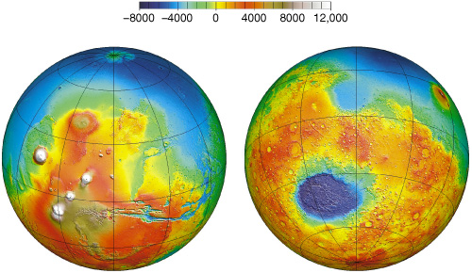
Mars Global View
meters
Tharsis volcanoes, Valles Marineris Hellas impact, southern mountains
Notes:
scale units are meters

Slide 25
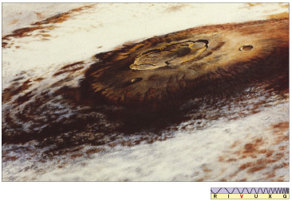
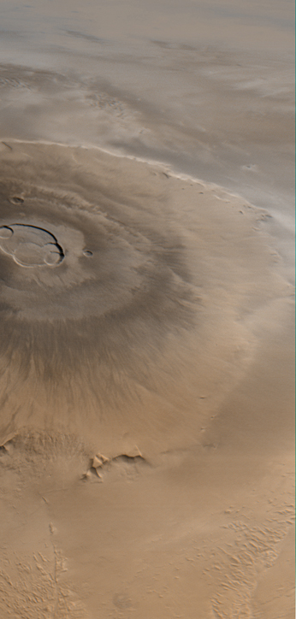
Mars Olympus Mons
largest volcano in the Solar System
part of Tharsis region = 4000 km wide, 10 km high
Oly Mons Mauna Loa
600 km across 120 km
27 km high 9 km
(18 km over plateau)

Slide 26
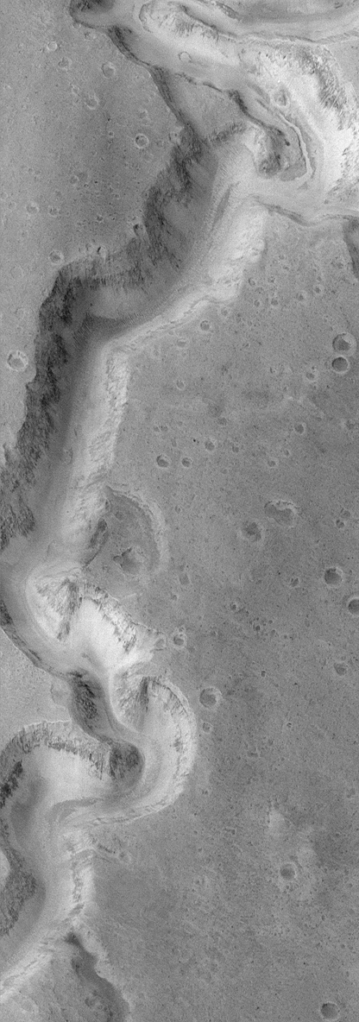
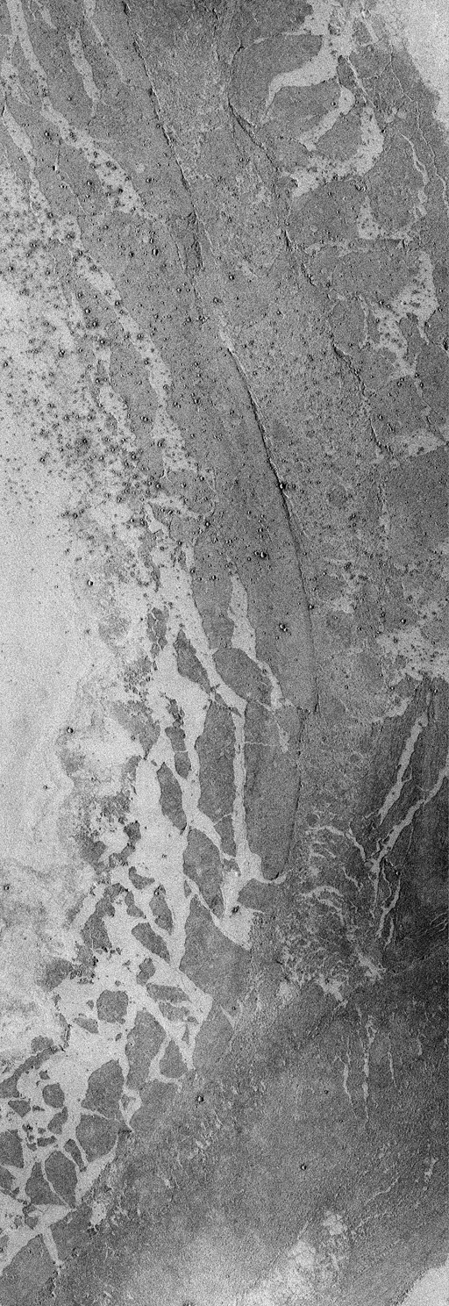
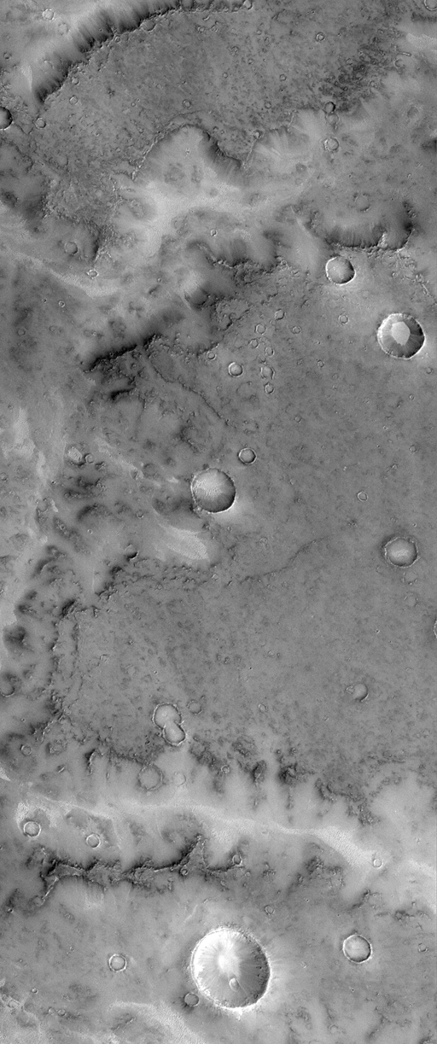
Mars Flows
water flow lava flow ???

Slide 27
Mars Highlights (mostly MGS)
1. evidence of remnant magnetic field
2. most accurate topographic map in Solar System, revealing pole-to-pole slope
(southern hemisphere 1-4 km higher than mean)
3. two distinct crustal thicknesses --- 32 km in north, 58 km in south
4. layering by both volcanic and water sloshing processes
5. sploshy craters are shallower than Moon’s
6. definitive water flow features --- channels, teardrop islands, dendritic systems,
flood plains
7. hematite deposits that likely occurred in hydrothermal environments
8. dunes, dust devils, etc., that directly show role of winds
9. evolution of polar caps
10. probable sub-surface H₂O in abundance
Notes:
two different surface compositions --- basaltic in south, andesitic in north (andesite has more Si than basalt) andesite is most common volcanic rock on Earth after basalt

Slide 28
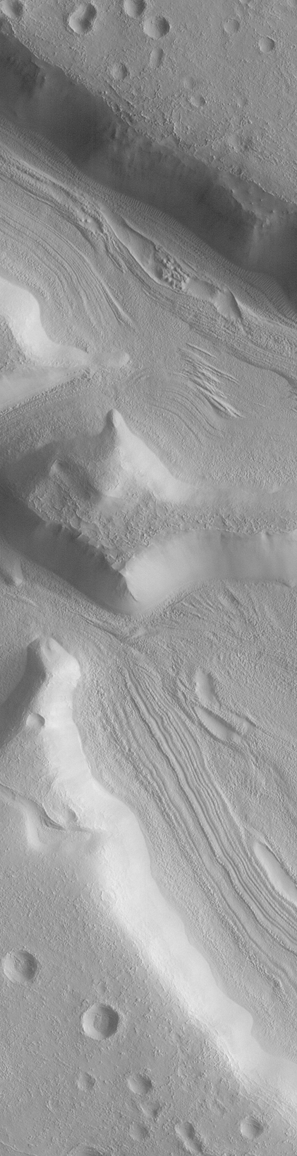
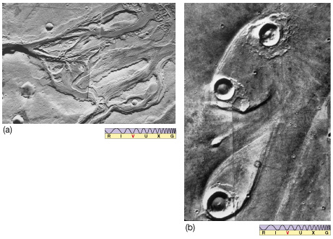
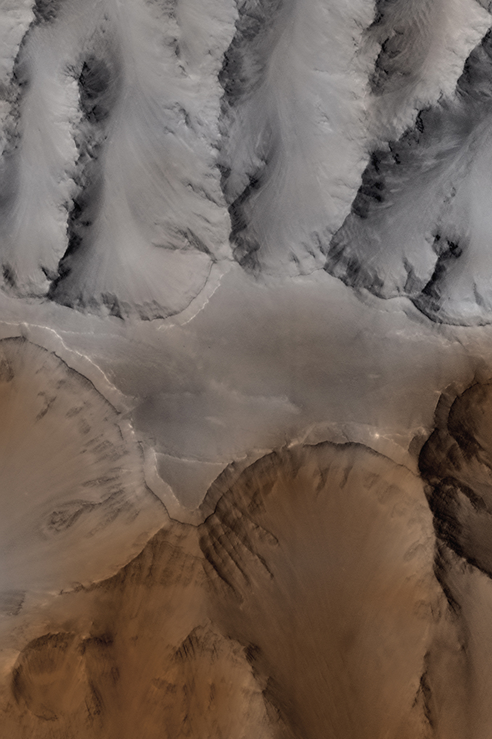
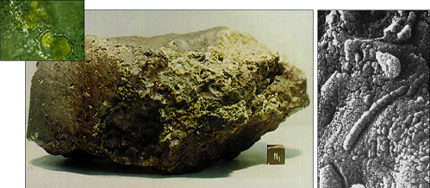
A Martian Vacation: H₂O

Slide 29
A Martian Vacation via
Mars
Reconnaissance
Orbiter
(MRO)

Slide 30
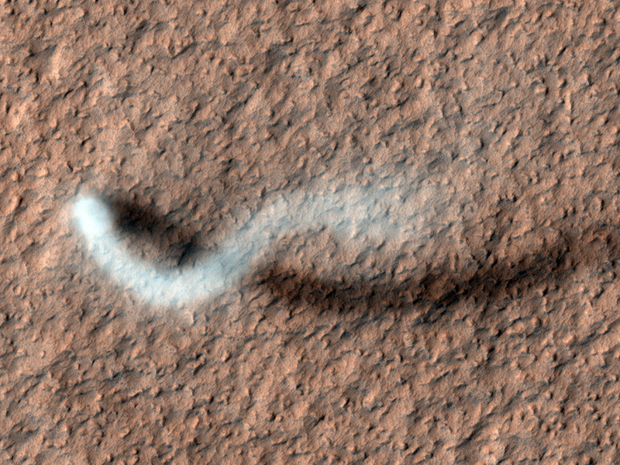
Dust Devil
Notes:
in Amazonis Planitia … 800 meters high … plume 30 meters in diameter

Slide 31
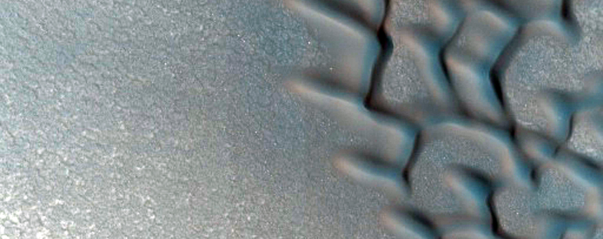
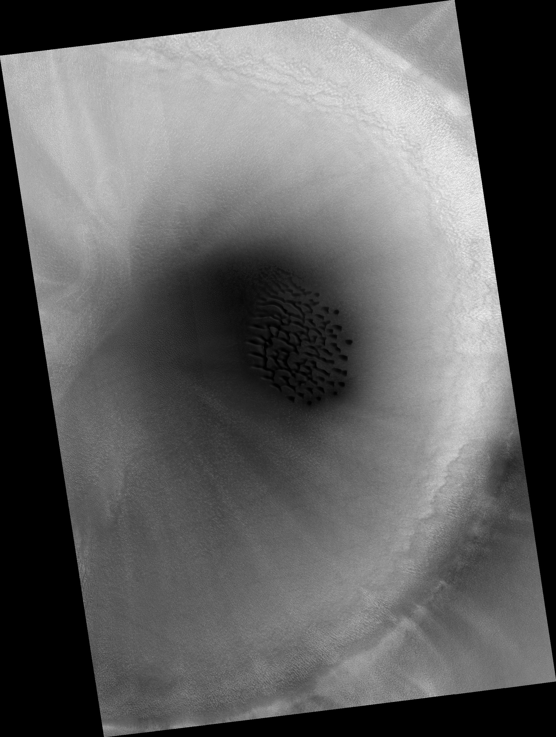
Crater Dunes
Notes:
in Arabia Terra … shallow cascades of dust … dark when fresh, then fade

Slide 32
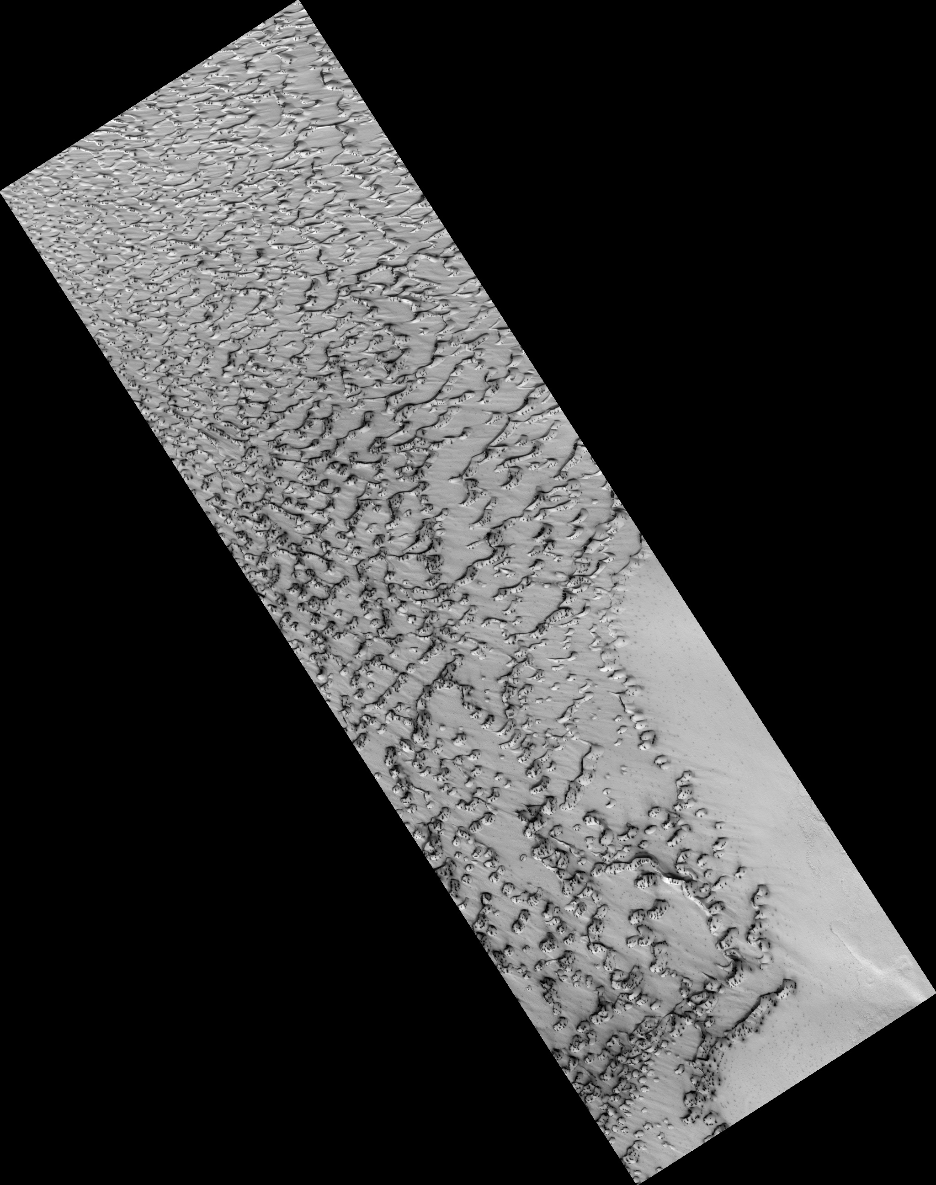
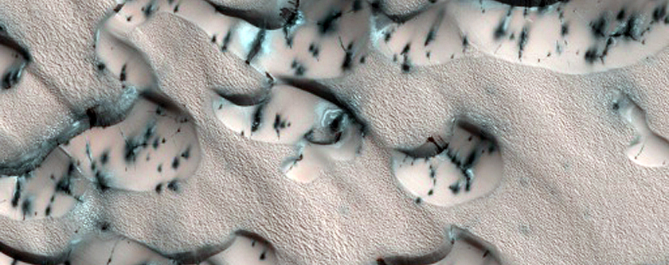
basaltic sand
Spring Sandfall
North Polar Erg
Notes:
in North Polar Erg … latitude 85 deg … resolution 1 meter … erg is Arabic for dunefield
dark = basaltic sand

Slide 33
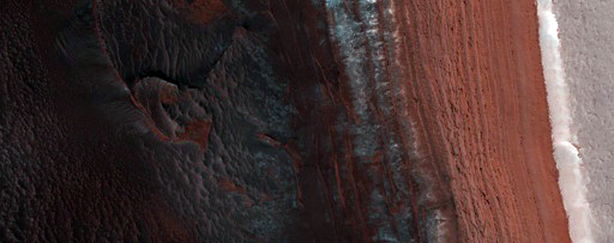
Steep Scarps
Avalanche Zone
Notes:
latitude 84 deg … resolution 1 meter

Slide 34
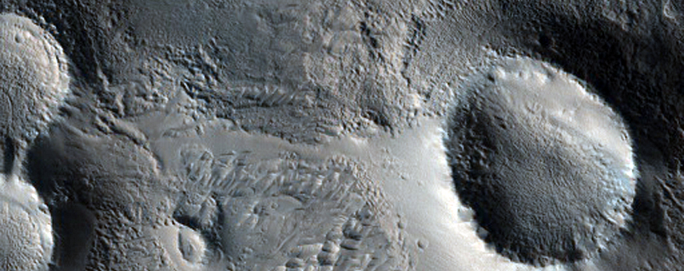
Olympus Mons
Cones

Slide 35

Slope Streaks
Notes:
in Arabia Terra … shallow cascades of dust … dark when fresh, then fade

Slide 36

Not All Craters Alike
Moon Mars

Slide 37
Solar System Explorers 17 OCT
Describe something unique about any surface found in the Solar System (e.g. Earth has liquid H₂O on its surface.)
1. Mercury sublimation by magnetic field tornadoes
2. Titan has methane lakes from rain
3. Mercury has scarps
4. Europa has cycloids in the ice
5. Mars has thinner crust in N than S
6. Ceres has Erebor with salty water
7. Hyperion has craters with no ejecta
8. Earth has life that makes incredibly stupid structures affecting the surface in bad ways
9. Makemake has pellets of frozen methane
10. Miranda appears to have broken apart and put back together
11. Earth has plate tectonics
12.
13.
14.
15.
16.
17.
18.
19.
20.

Slide 38
Solar System Explorers 24 OCT
Name a location in the Solar System where surface processing is/was occurring.
Each process can be used only once. Describe how that surface is or was
reprocessed, e.g. Earth’s land mass coastlines change because of liquid H₂O.
1.
2.
3.
4.
5.
6.
7.
8.
9.
10.
11.
12.
13.
14.
15.
16.
17.
18.
19.
20.

Slide 39
…………………………
Notes:
39

Slide 40

Solar System Explorers
1. What is the (annual) parallax of an Oort Cloud member at 0.2 parsecs?
…
2. If the Earth orbited an M1V dwarf (mass ~0.5 M) in 4 years, what would the semimajor axis of our orbit be?
…
3. If Titan has a temperature of 94 K, at what wavelength does it emit the most photons?
…
4. The Sun as a red giant will swell to ~100 times its present size and will drop in temperature to ~2900K. By how much will its luminosity be different than today’s?
…
5. Venus has V ~ $−$4 and is at a distance of ~10⁻⁶ parsec. What is its absolute magnitude M_{V}?
…
B. About how much more sunlight does the bright side of Mercury receive compared to Pluto?
…

Slide 41

Solar System Explorers Quiz N

Slide 42

Solar System Explorers
1. What is the (annual) parallax of an Oort Cloud member at 0.2 parsecs?
5 arcseconds
2. If the Earth orbited an M1V dwarf (mass ~0.5 M) in 4 years, what would the semimajor axis of our orbit be?
2 AU
3. If Titan has a temperature of 94 K, at what wavelength does it emit the most photons?
31 microns
4. The Sun as a red giant will swell to ~100 times its present size and will drop in temperature to ~2900K. By how much will its luminosity be different than today’s?
625X brighter
5. Venus has V ~ $−$4 and is at a distance of ~10⁻⁶ parsec. What is its absolute magnitude M_{V}?
V ~ 31
B. About how much more sunlight does the bright side of Mercury receive compared to Pluto?
10000 times more

