Slide 1
10/18
Greenhouse Effect
Human-Caused Climate Change (Consequences, Solutions)
10/20
Communicating About Climate Change
Climate Change & Astronomy
Andrew Couperus
10/18/22
(credit to Travis Rector for some slides)

Slide 2
Research Paper Level 2
due Thursday, 20 OCT (before class)
paper starting to take shape (worth 10 points +2 points if in 13 OCT)
use AAS LaTeX template on website
email .pdf
10 pieces required:
1. Abstract full draft
2. Introduction 8+ sentences, major references included
3. Motivation YOU
4/5. Sections all have bullets
6/7. Discussion 8+ sentences
8. Tables 2+ formatted with columns identified
9. Figures 2+ outlined/sketched, captions given
10. References at least 5

Slide 3
Where are we?
Notes:
Photo of Venus by Messenger spacecraft in 2007.

Slide 4
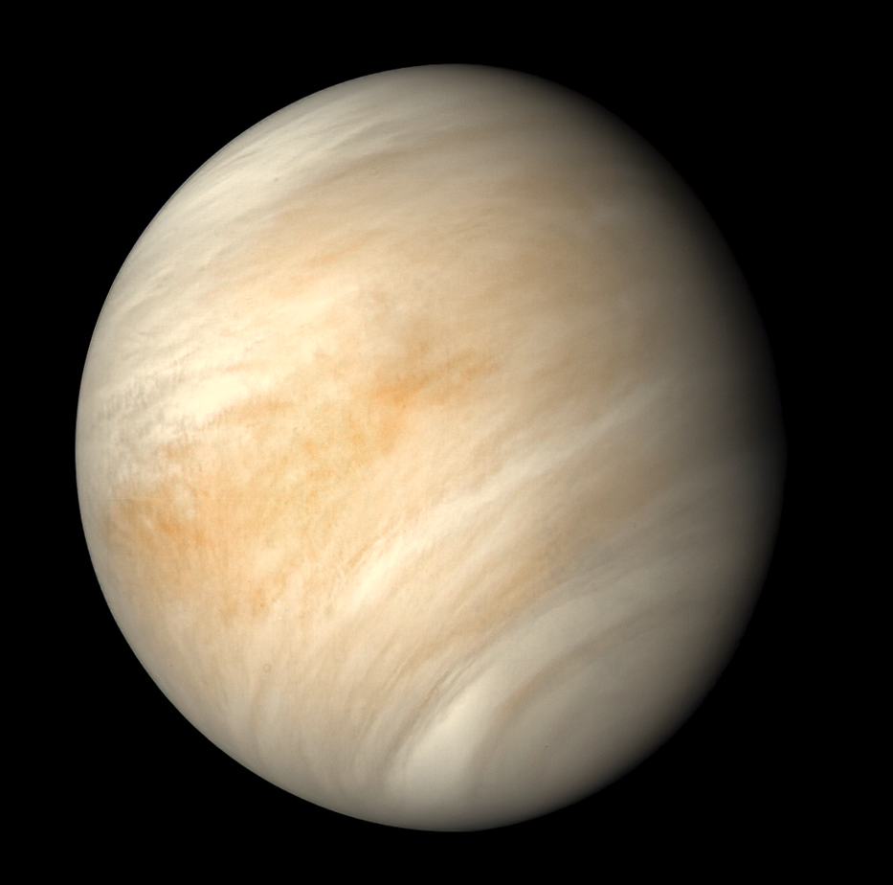
Where are we?
Notes:
Venus, taken by Mariner 10 spacecraft in 1974.

Slide 5
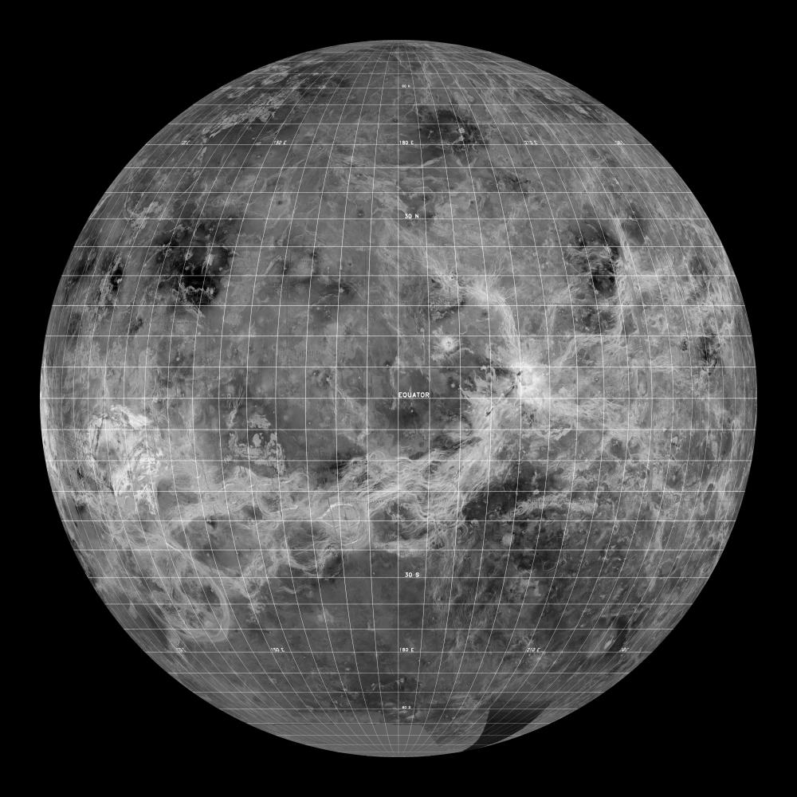
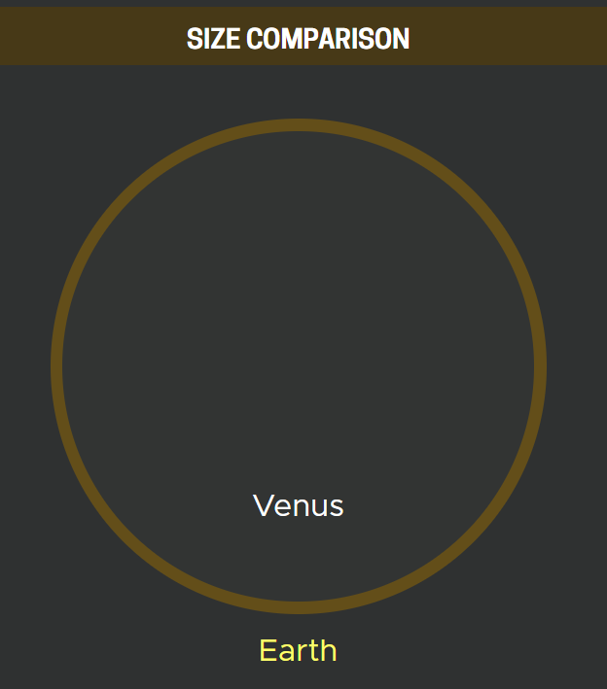
Venus
900 degrees Fahrenheit!
Notes:
-Soviet surface landers
-Surface T hot enough to melt lead

Slide 6
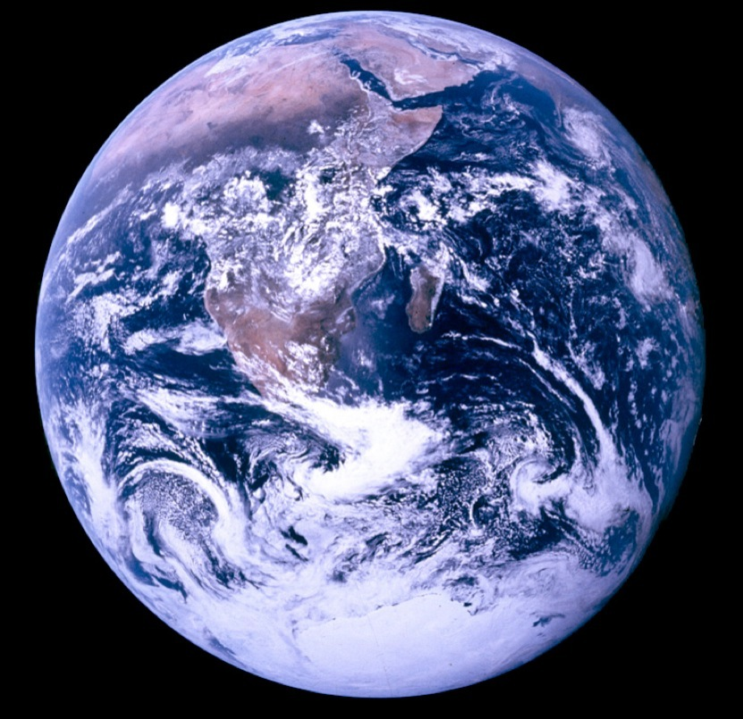
Venus
Venus
96.5% CO2
Earth
77% N + 21% O
Notes:
Venus has a runaway greenhouse gas effect, too much CO2 in atmosphere.

Slide 7
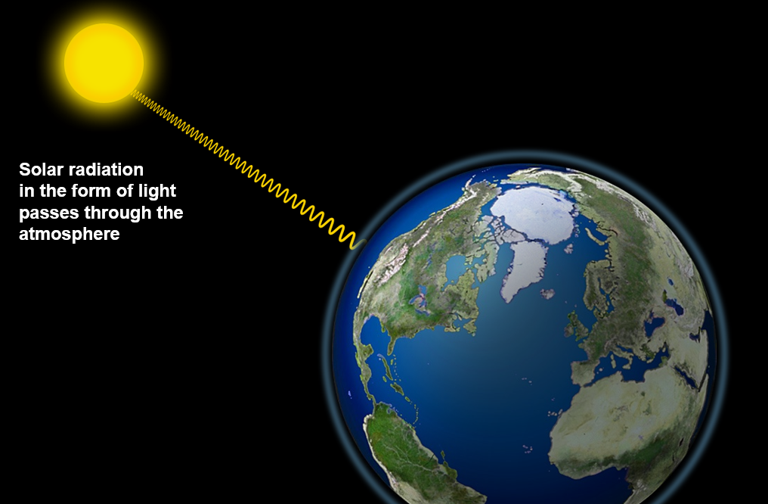
Greenhouse Effect
Notes:
In brief: Sunlight warms Earth, greenhouse gases slow the flow of heat from Earth into outer space. More gases = warmer planet surface. DON’T WANT TOO MANY BLANKETS!

Slide 8
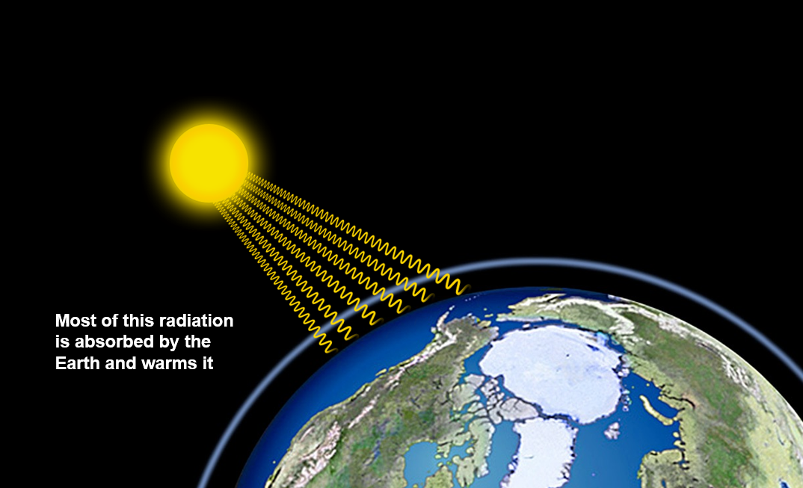
Greenhouse Effect

Slide 9
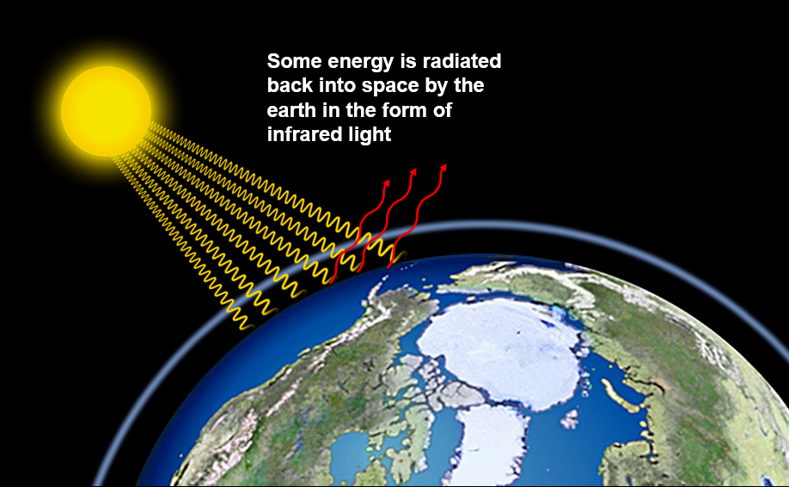
Greenhouse Effect

Slide 10
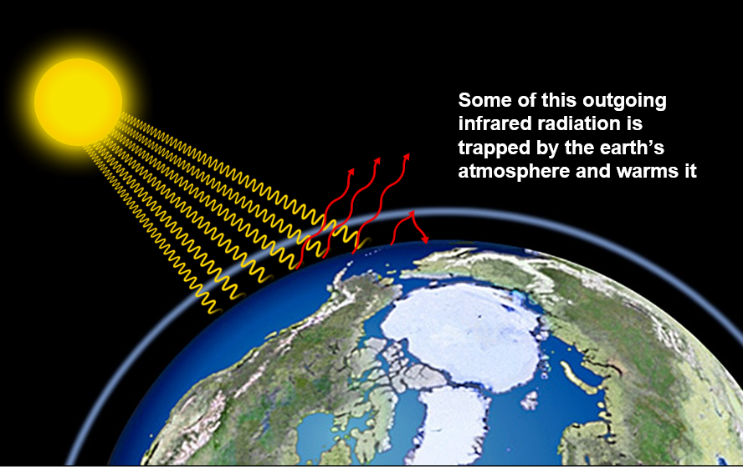
Greenhouse Effect

Slide 11
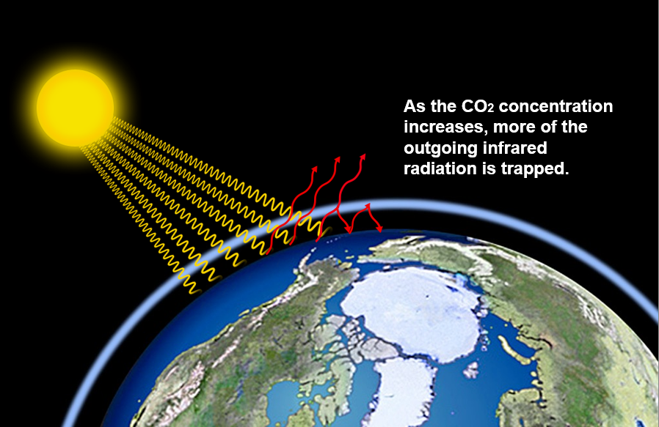
Greenhouse Effect

Slide 12
What gases?
CO2 – Methane (CH4) – Water Vapor (H2O) – Ozone (O3)

Slide 13
Notes:
-Have to go to space to avoid the atmosphere absorbing the IR light… because of water vapor and CO2 blocking the light.
-We sent JWST to space (in part) for the same physical reasons we have global warming.

Slide 15
Human-Caused

Slide 16
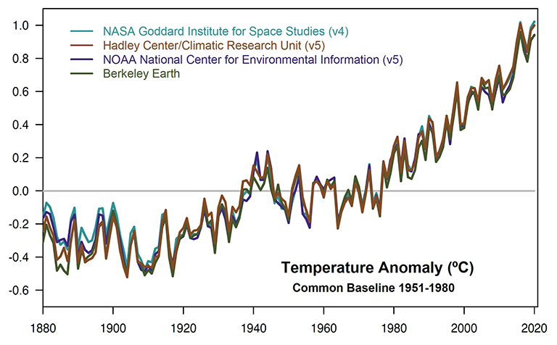
Temperature
Notes:
-Globally averaged combined land and ocean surface temperature, using independent sources.
-We have this large temperature increase we are observing. What is causing it?

Slide 17
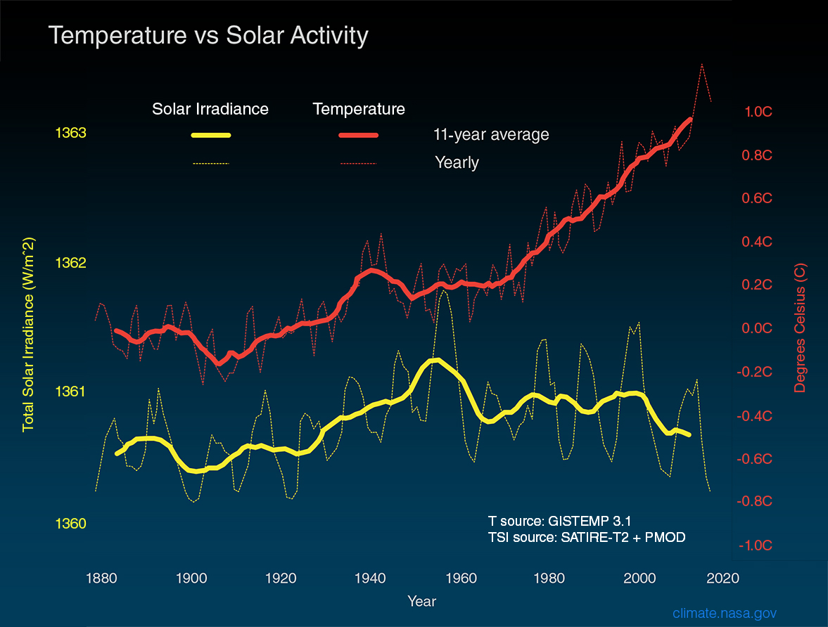
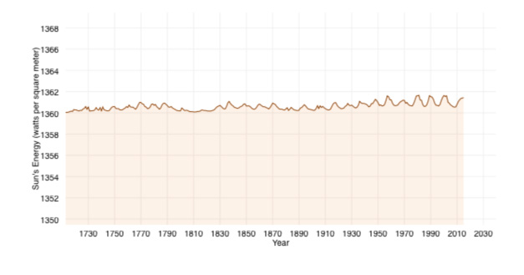
Sun?
Notes:
-Maybe the Sun is causing it? Nope.
-The Sun has actually dimmed during the last 50 years - the same timeframe when the Earth has warmed most dramatically. This and other pieces of evidence rule out the Sun as a factor in climate change.

Slide 18
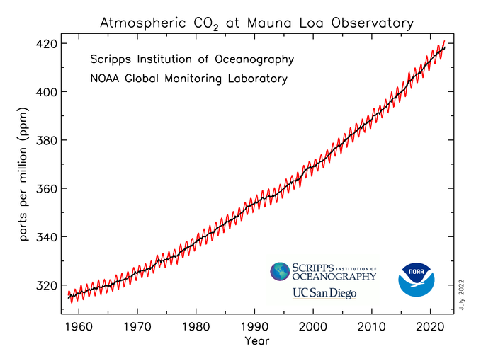
CO2? Hmm…

Slide 19
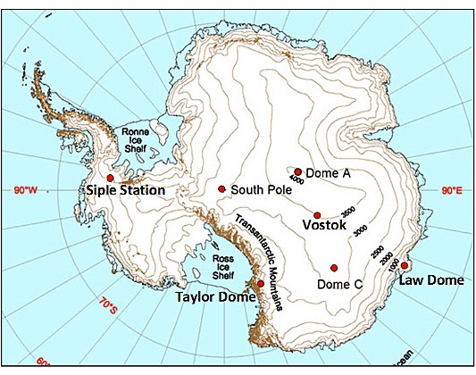
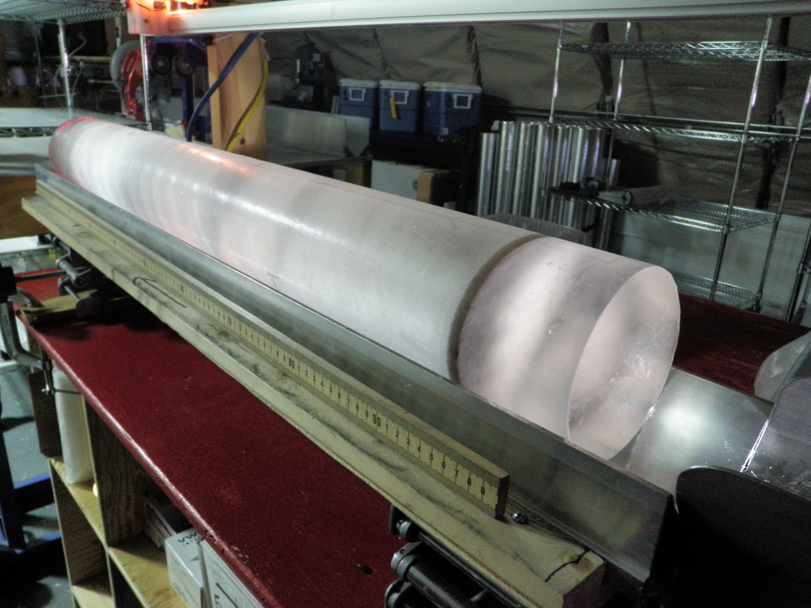
Ice Core Samples
Notes:
-EPICA Ice core samples for historic CO2 in atmosphere
-Go to depth of ~3200m, or ~2 miles.

Slide 20
CO2 Over Time
Notes:
-Milankovitch cycles – “natural” climate change
-How to get past temps = isotopic geochemical studies: O¹⁸ vs O¹⁶ in glacial cores --- warm means smaller fraction of O¹⁸ in glacial cores because it is heavy and does not evaporate from the oceans as easily … less gets dropped as snow
-also = tree rings, pollen distribution, annual mud layers in lakes, coral bed rings, fossils

Slide 21
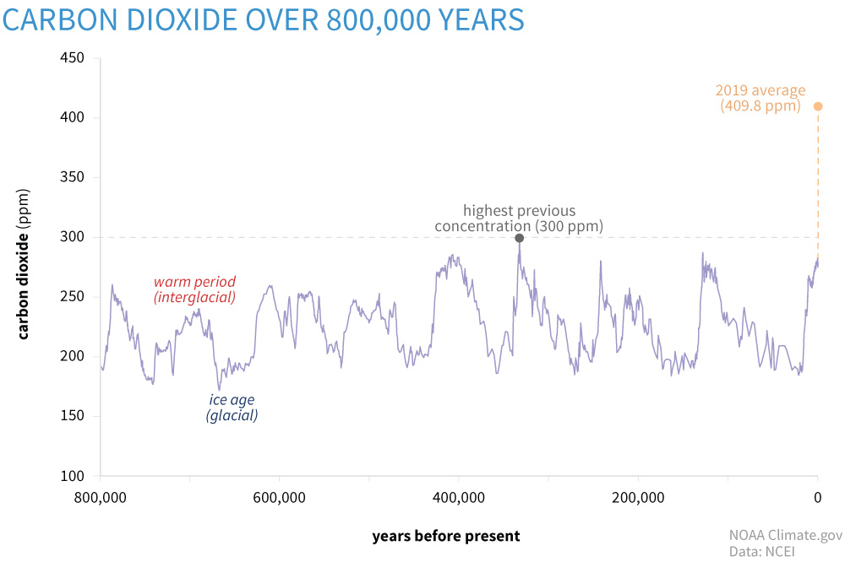
CO2 Over Time
Notes:
-Timescales! Problem isn’t just the change, it is HOW FAST it is changing.
-Earth’s climate does change naturally, but on timescales of thousands to millions of years. We are seeing changes on orders of years to decades! And scale of the change is much larger right now.

Slide 22
CO2 Over Time
Notes:
-Timescales! Problem isn’t just the change, it is HOW FAST it is changing.
-Earth’s climate does change naturally, but on timescales of thousands to millions of years. We are seeing changes on orders of years to decades! And scale of the change is much larger right now.

Slide 23
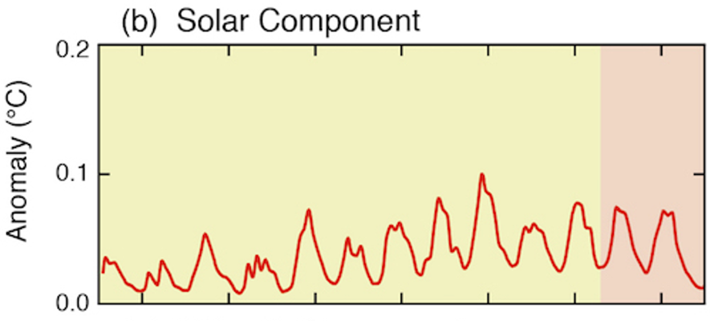
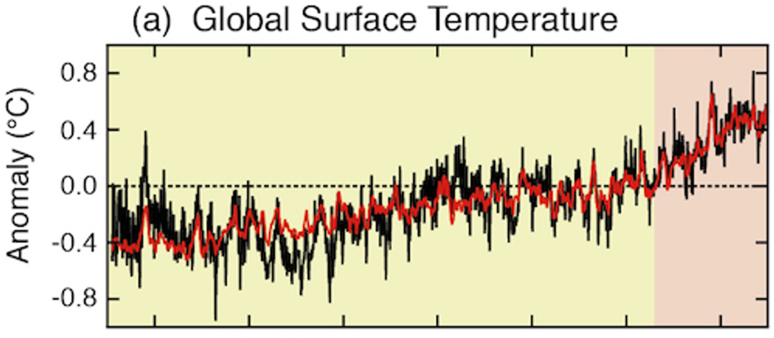
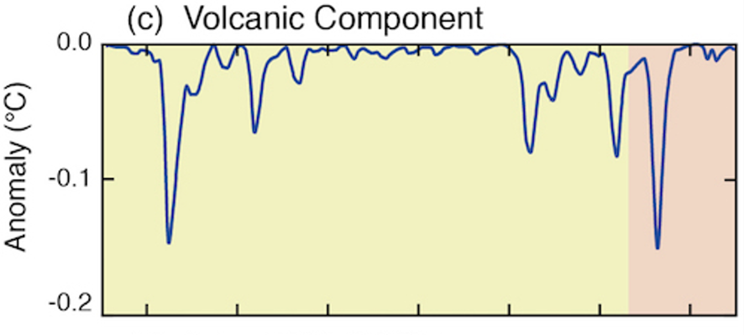
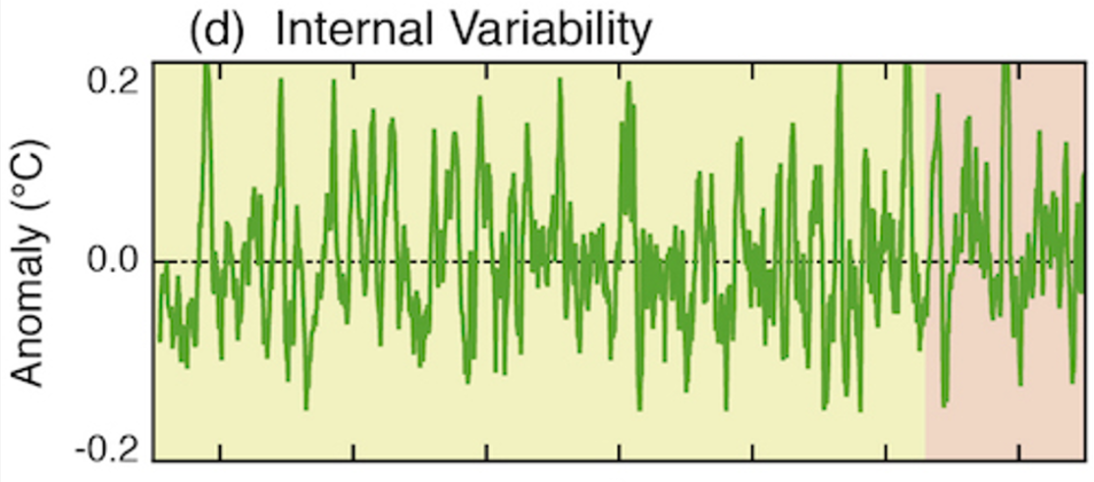
Rise in temperatures can only be explained by CO2 released from fossil fuels.
Notes:
-CO2 released by humans inducing a greenhouse effect is the only way to explain the rise in temperatures we are observing.

Slide 24
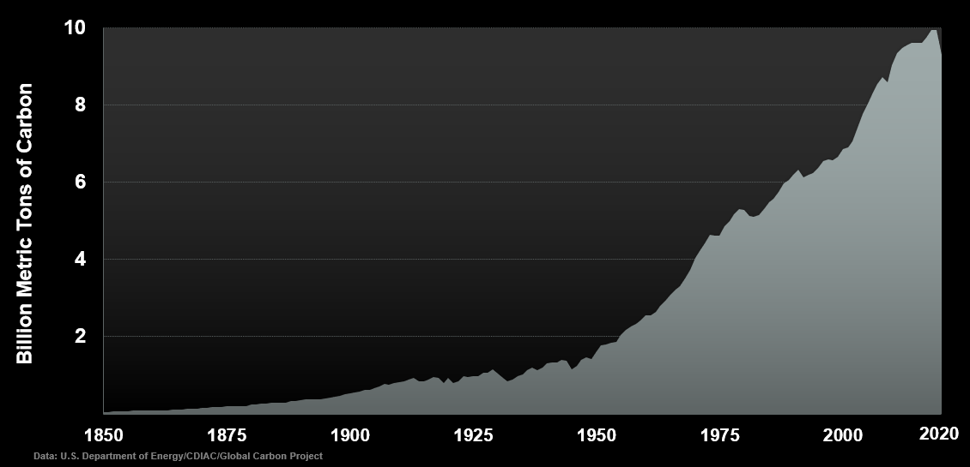
The burning of fossil fuels is the primary cause of Climate change.
Notes:
-Global carbon emissions from fossil fuels over time.

Slide 26
Consequences
(briefly…)

Slide 27
Northern Hemisphere Summer Temperatures Have Shifted
1951 – 1980
Cooler than average
Baseline (1951 - 1980) mean
Average
Warmer than average
Frequency of Occurrence
-5
-4
-3
-2
-1
0
1
2
3
4
5
6
Deviation from Mean
Data: James Hansen and Makiko Sato, July 2020
Notes:
-Northern Hemisphere, where we all live in Atlanta

Slide 28
Northern Hemisphere Summer Temperatures Have Shifted
1990 – 2000
Cooler than average
Baseline (1951 - 1980) mean
Average
Warmer than average
Extremely hot
Frequency of Occurrence
-5
-4
-3
-2
-1
0
1
2
3
4
5
6
Deviation from Mean
Data: James Hansen and Makiko Sato, July 2020
Notes:
-Northern Hemisphere, where we all live in Atlanta

Slide 29
Northern Hemisphere Summer Temperatures Have Shifted
2010 – 2020
Cooler than average
Baseline (1951 - 1980) mean
Average
Warmer than average
The “extreme” temperature events used to cover 0.1% of the land. Now they cover 22.1%.
Extremely hot
Frequency of Occurrence
-5
-4
-3
-2
-1
0
1
2
3
4
5
6
Deviation from Mean
Data: James Hansen and Makiko Sato, July 2020
Notes:
-Northern Hemisphere, where we all live in Atlanta

Slide 30
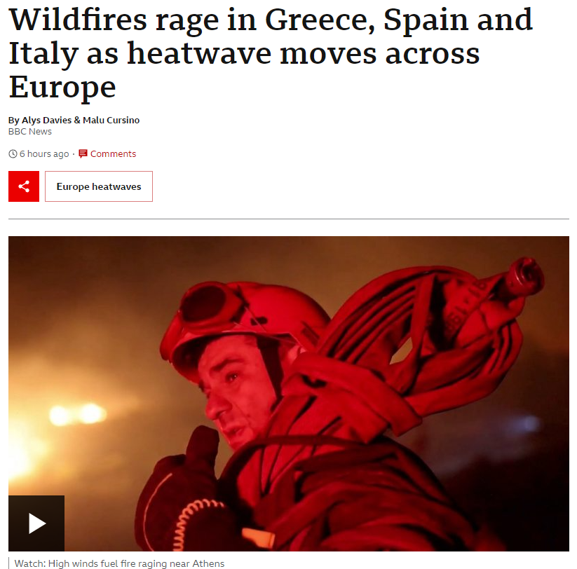
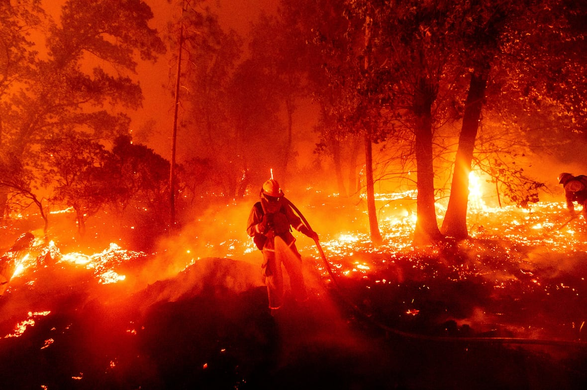
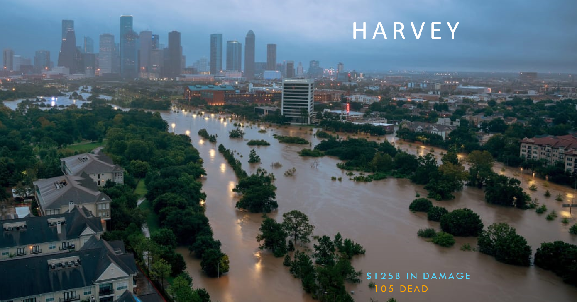
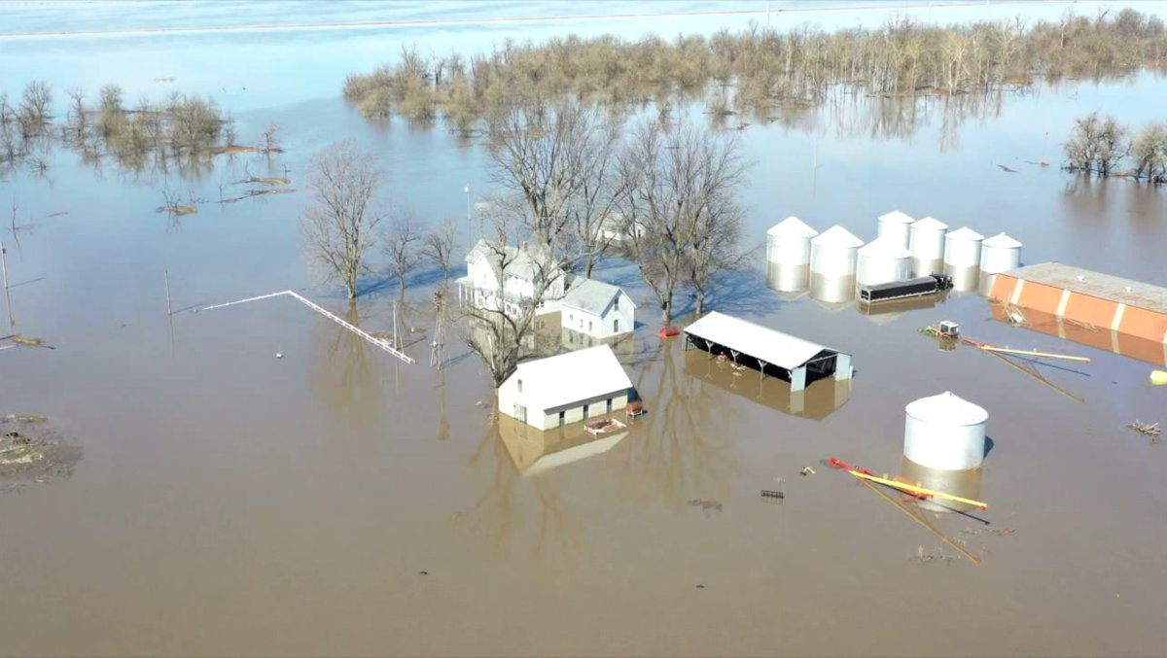
More Heat/Energy in the System
Severe climate and weather events become more common and more extreme
Notes:
-Heatwaves, wildfires, hurricanes, flooding

Slide 31
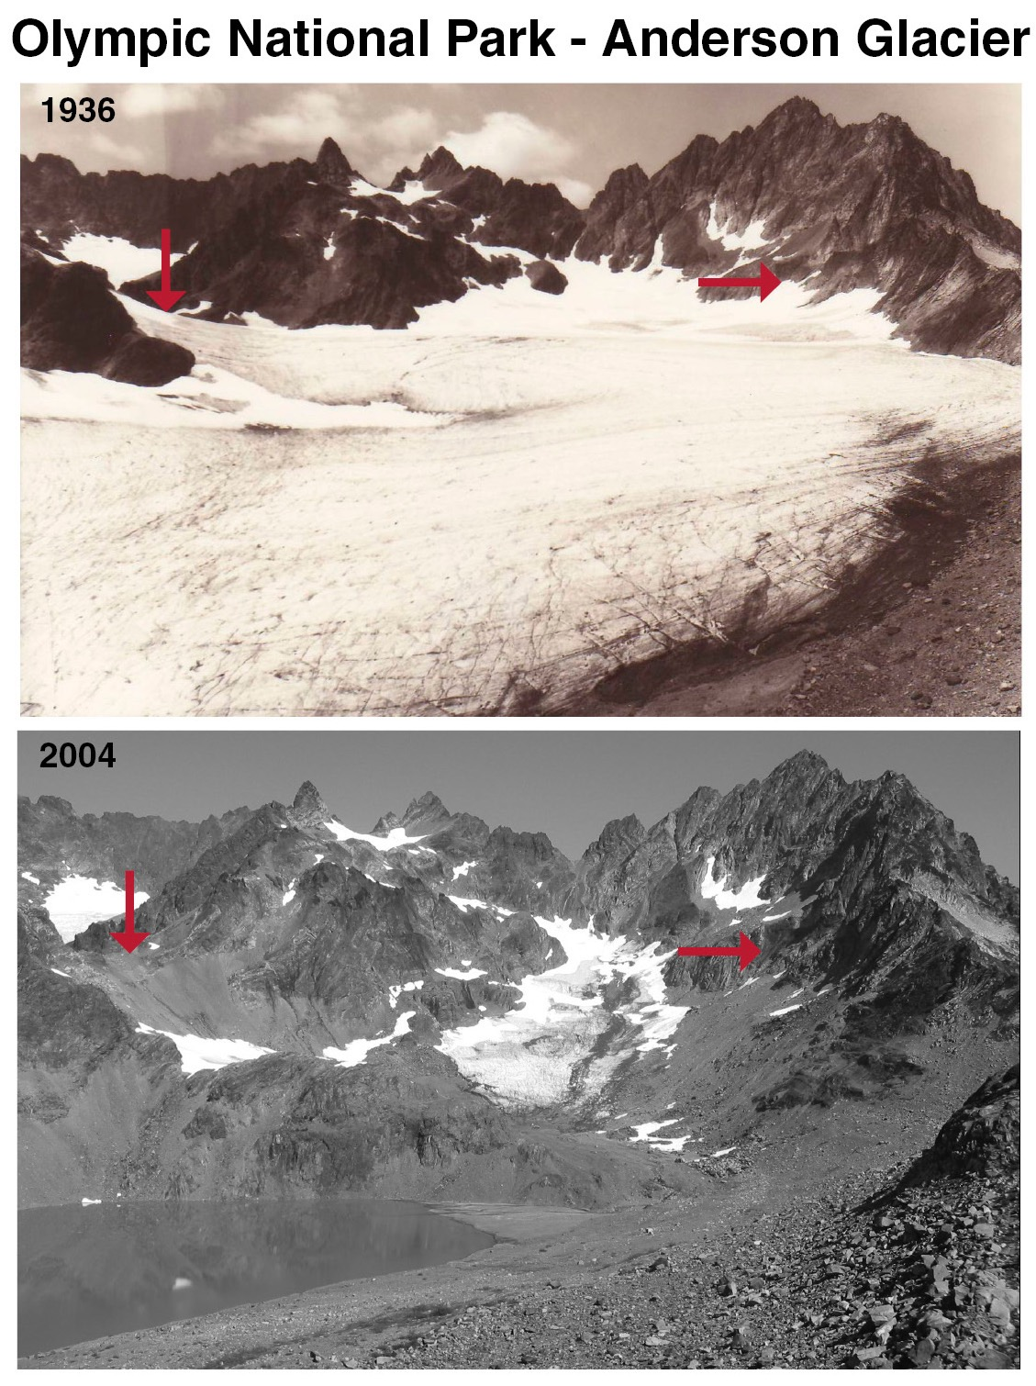
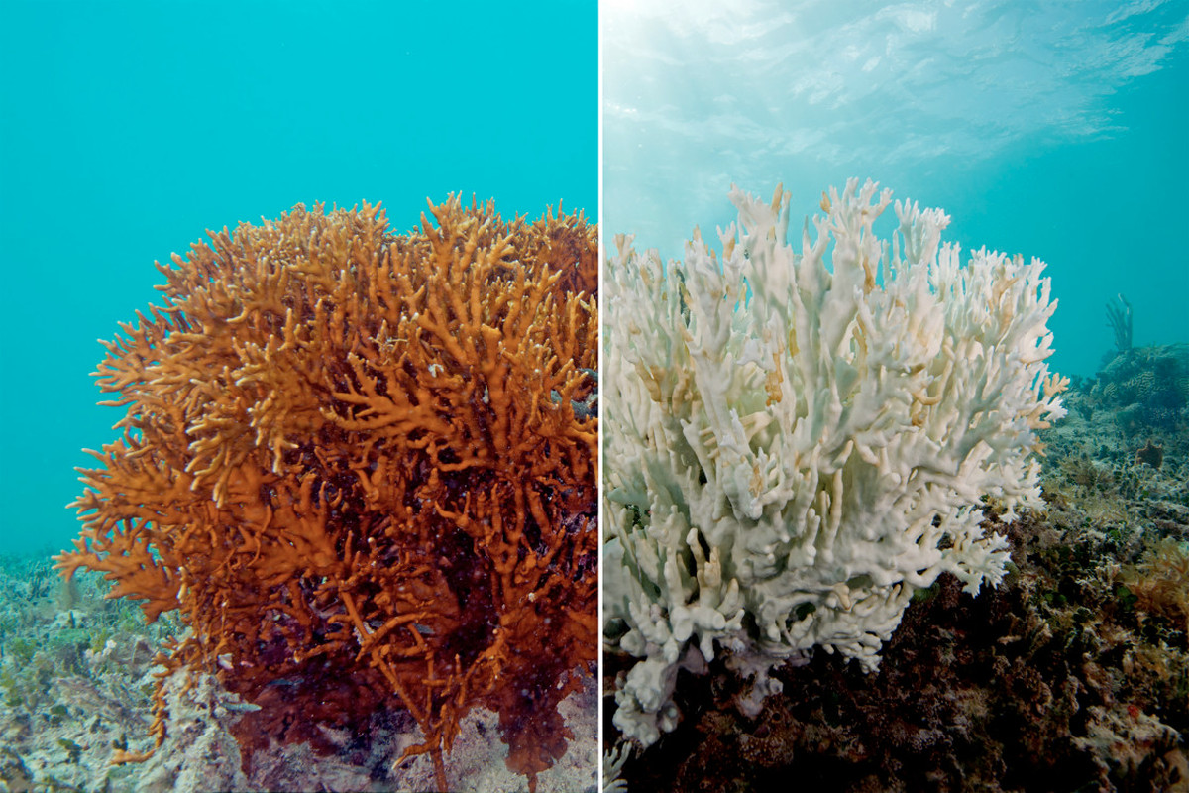
More Heat/Energy in the System
Notes:
-Ocean acidification and ecosystem disruption, melting sea ice causing water level rise.
-While 7m is extreme, it is not impossible.

Slide 32
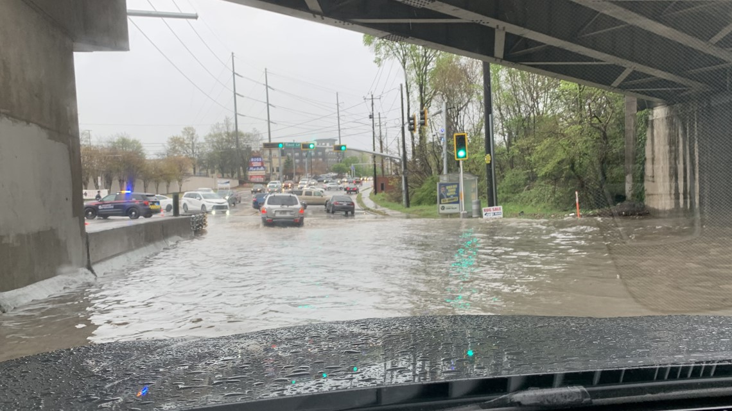
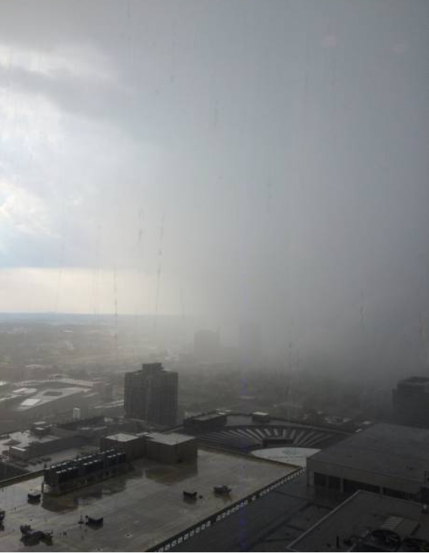
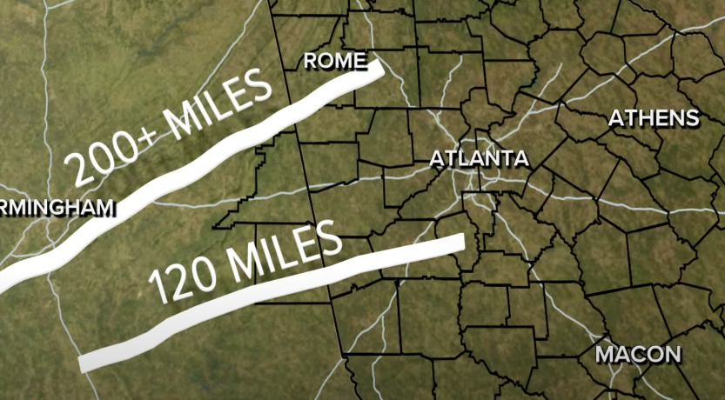
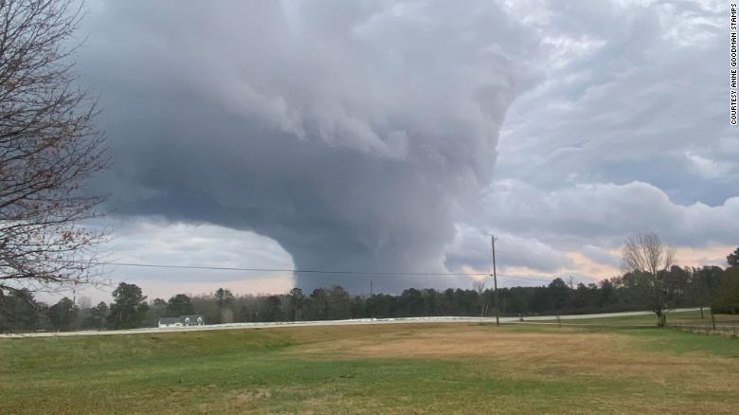
Atlanta, GA
Lindbergh area, April 2022
Atlanta, 2018
EF4, Newnan, March 2021
Covington, December 2021
Notes:
-Tornados in Covington and Newnan on the outskirts of Atlanta.
-Get worse rain bombs / microbursts as climate change puts more water into atmosphere, common in Atlanta!

Slide 33
The world could see up to 1 billion climate migrants.
The Lancet Countdown Report 2018
Notes:
-Lancet - we could see one billion climate migrants by the end of this century.

Slide 34
Don’t Ask: ”Did climate change cause this?”
Ask: ”did climate change make it worse?”

Slide 35
How has climate change impacted you?

Slide 36
Solutions
Hope…

Slide 37
Why?
Helping/saving us and other life – not the Earth
Protection, Responsible Management, Resilience
Climate Justice!
“Center all climate change actions on equity and community resilience. For many marginalized groups, history informs current challenges. Climate change worsens existing inequities.” – FEMA & NASA
Notes:
-Protect our resources and humanity from devastating losses and pain. Manage the environment responsibly, use resources in sustainable and fair ways for everyone. There are already cliamte impacts, so need to be resilient to those impacts.
-Resiliency is addressing the parts of climate change that are already here and yet to come, plan buildings around future worse weather etc.
-Climate change disproportionally impacts (and will impact) already historically marginalized groups. Climate Justice is social justice.

Slide 38
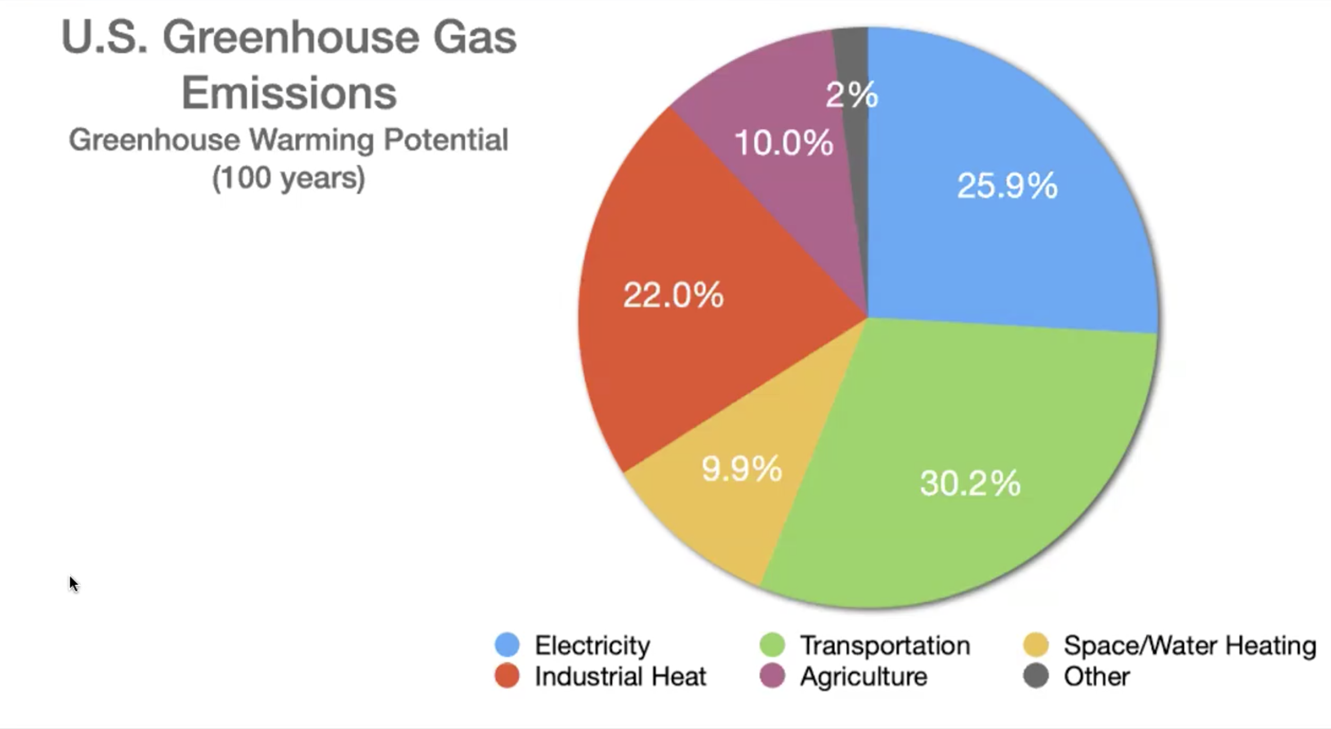
GHG Emissions

Slide 39
Alternate Energy
Sources of electricity that don’t produce CO2:
Solar
Wind
Hydropower
Hydrogen fuel cells
Geothermal
Nuclear
About 60% California electricity is now carbon free.

Slide 40
GHG Emissions

Slide 41
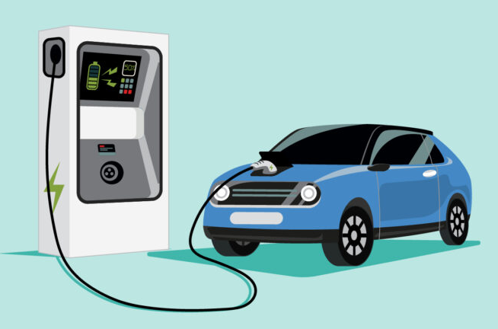
Alternate Energy
Sources that don’t produce CO2:
Electric motors*
Hydrogen*
*Assuming sources are carbon neutral.
Drive less!
City planning, public transit, zoning laws, all significantly important!
Electric motors 80-90% efficient
80 - 120 MPGe
Safer!
Better: Smoother/Quieter/Torque/Accel.
Notes:
-Electric vehicles are not a panacea solution alone. Still need to drive less overall, and urban planning matters a lot for this!

Slide 42
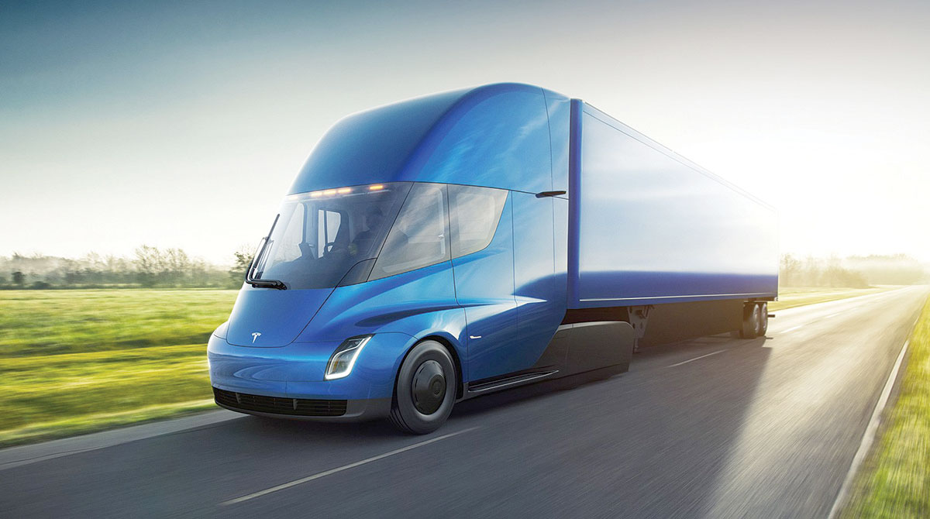
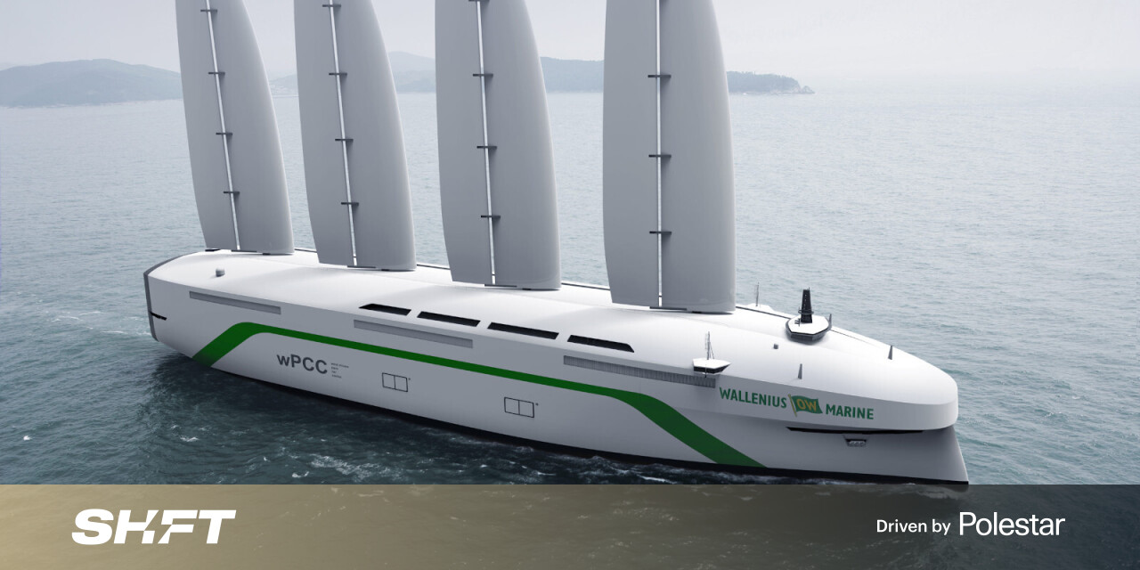
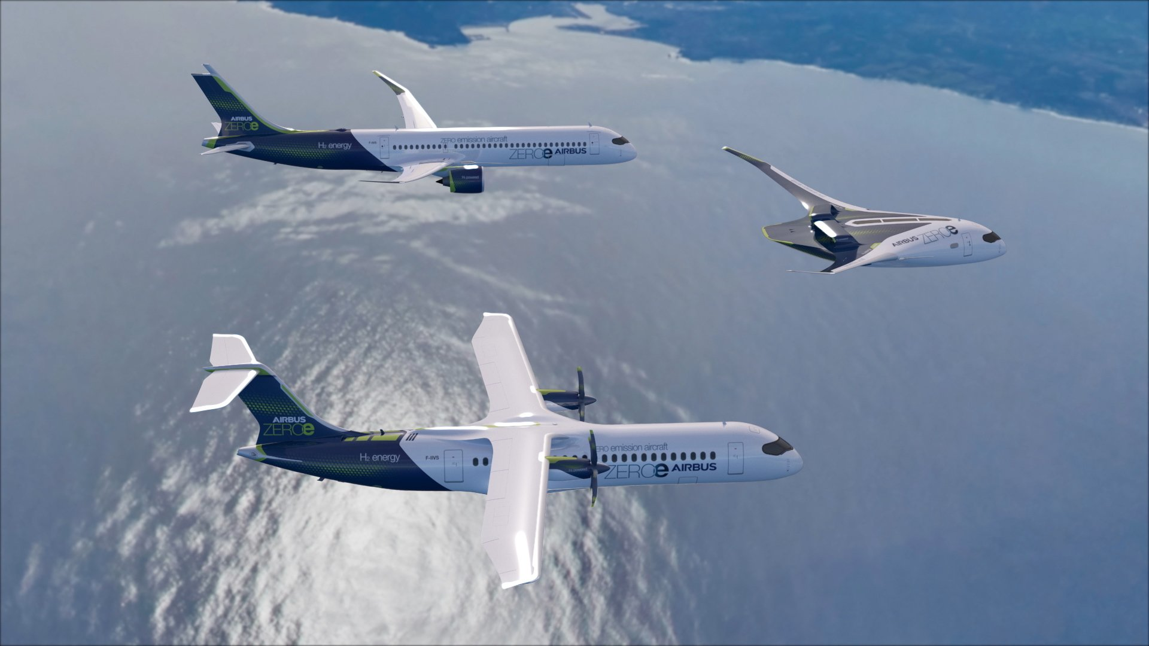
Alternate Energy
Notes:
-Electric semis. Wind-powered and hydrogen powered shipping boats. Hydrogen powered planes.

Slide 43
GHG Emissions

Slide 44
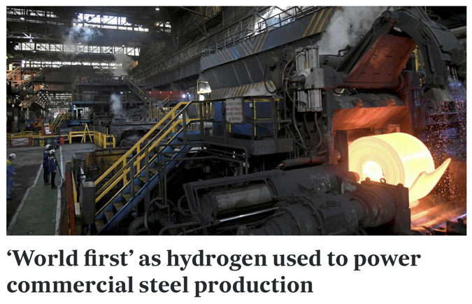
Alternate Energy
Heat Pumps*
Refrigerators and air conditioners
Reversable!
Highly efficient
*Using clean electricity
Industrial Heat
Excess wind/solar -> hydrogen
Hydrogen fuel for high temp processes

Slide 45
GHG Emissions
Notes:
-Can handle the majority of issues with technologies that already exist, just need to implement them at scale!

Slide 46
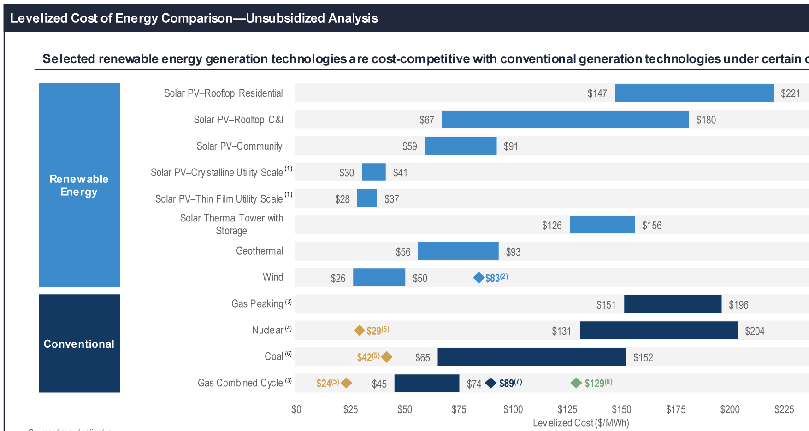
= operating costs for existing plants*
Offshore wind
20% “blue” H
20% “green” H
Notes:
-Solar and wind are about equal to or cheaper than conventional methods, and this continues to improve.
-Blue/green hydrogen are different ways of capturing hydrogen and using it in the gas cycle. Green involves electrolysis with renewable electricity sourcing it. Diamonds are at the high-cost case limits.
*= assuming I understood their captions correctly, it was in economics lingo I barely understood.

Slide 47
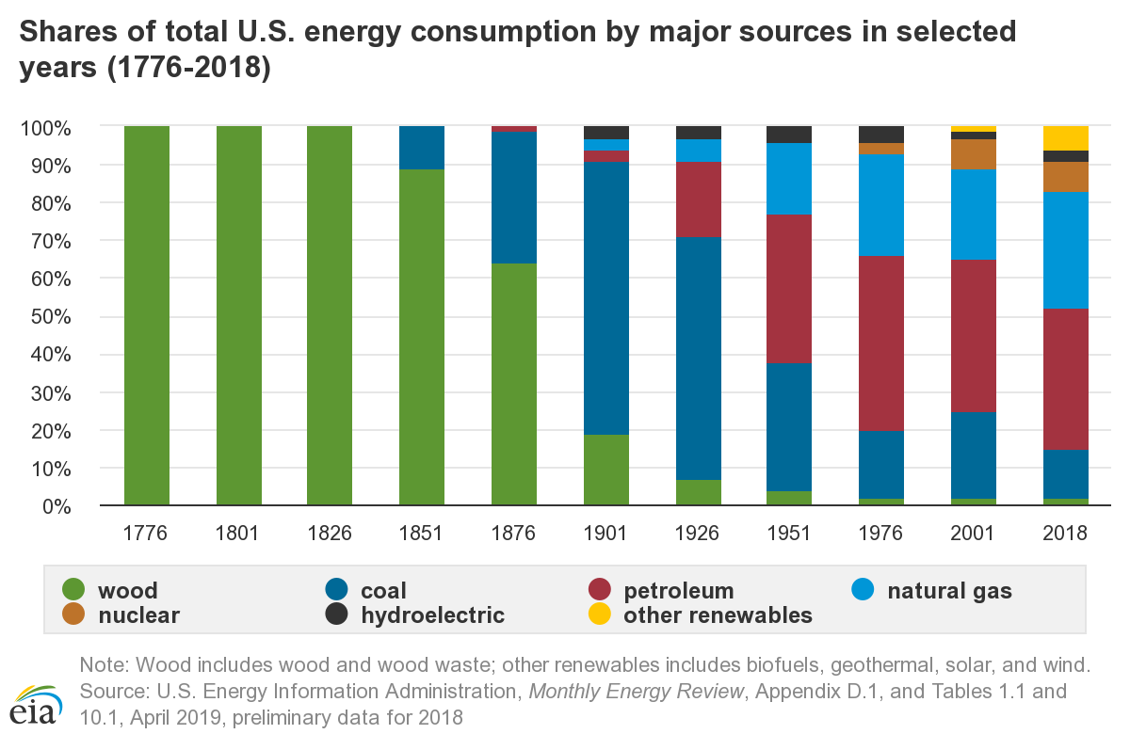
?
50 yr

Slide 48
What about
Carbon Offsets™ ?
It depends…
Carbon Offset – “a reduction or removal of emissions of carbon dioxide or other greenhouse gases made in order to compensate for emissions made elsewhere.”
Efficacy varies massively among projects
Some completely bogus, others good
Claims often misleading (positive PR)
Short-term vs. long-term reductions
Often forgets need for net emission reduction
Notes:
-They are often (but not always) like if you set your house on fire three times a day but also poured out three buckets of water every day too and said you were “fire neutral through water offsets”. Yes, the water is helping… but really you need to stop setting fires in the first place.

Slide 49
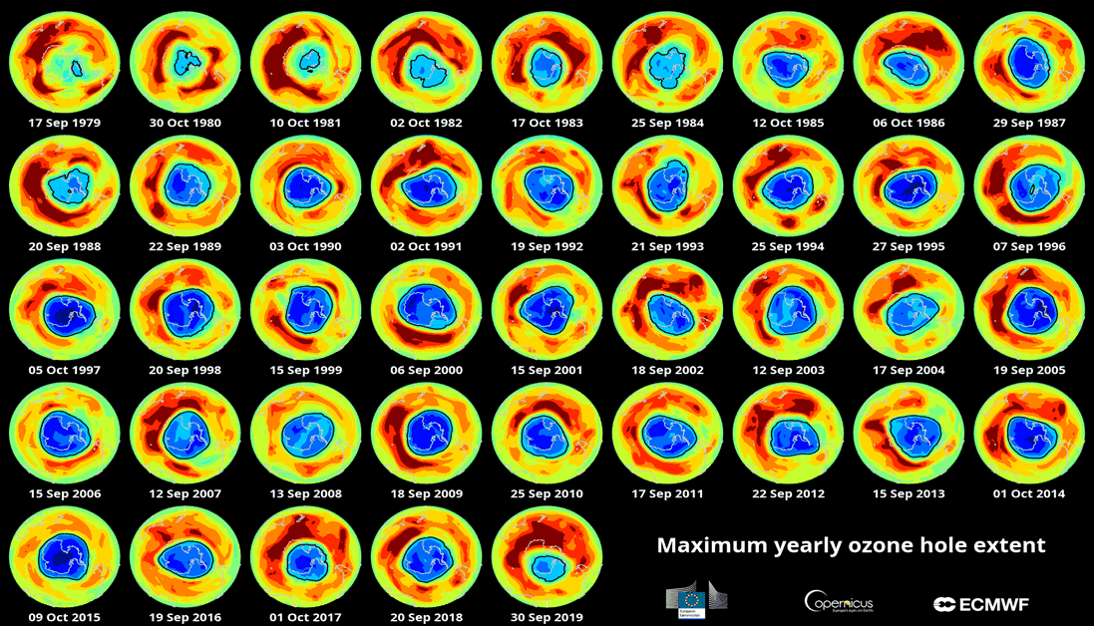
Ozone Depletion Over 40 Years

Slide 50
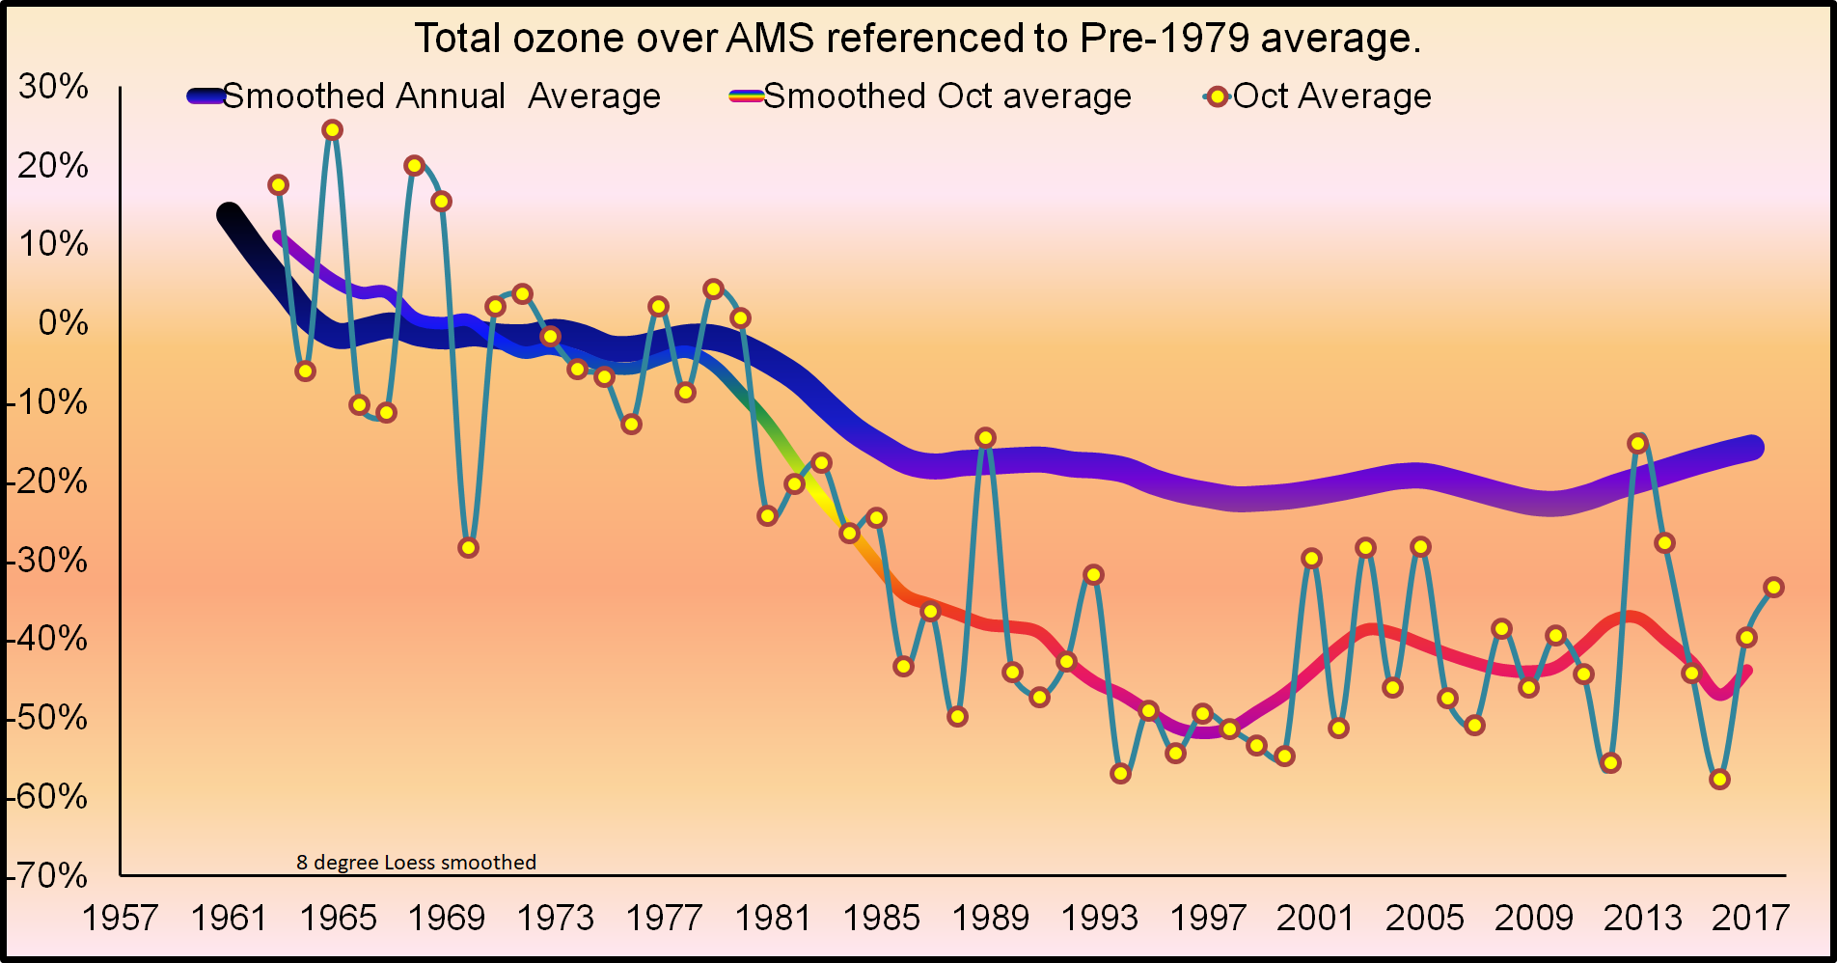
Ozone Stabilization
Montreal
Protocol

Slide 51
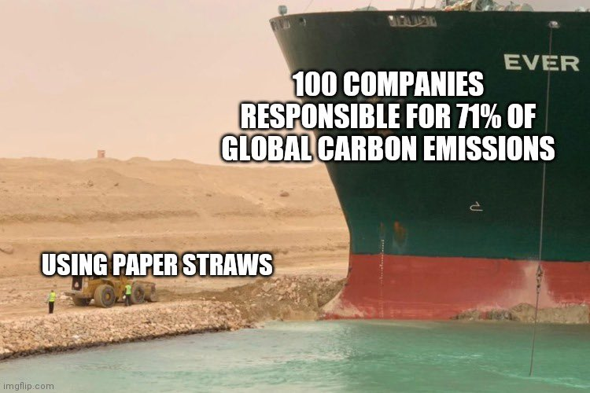
Notes:
-Messaging about climate change solutions tend to focus on austerity measures and guilting.
-However… “Personal changes help motivate and drive systemic changes”

Slide 52
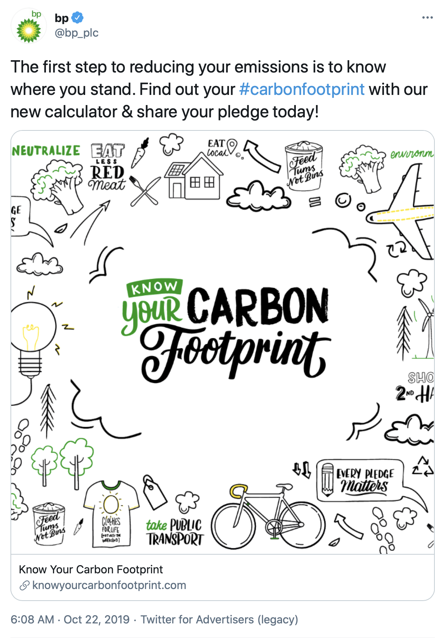
Notes:
-Why does an oil company want you to calculate your carbon footprint? Because they want to frame it as a question of personal choice (and blame); i.e., its not their fault for making it, it’s your fault for using it. They want to GUILT you!
-However… “Personal changes help motivate and drive systemic changes”, “They wouldn’t be doing this if you didn’t have any power!”, “They wouldn’t be trying to disinform you if it didn’t matter if you were informed!”

Slide 53
Personal Solutions
Here are personal choices you can make:
Fly less (virtual conferences)
Change your diet (less meat and cheese)
Divest from fossil fuels (personal bank accounts)
Reduce usage (e.g., electric cars, biking)
Install solar panels

Slide 54
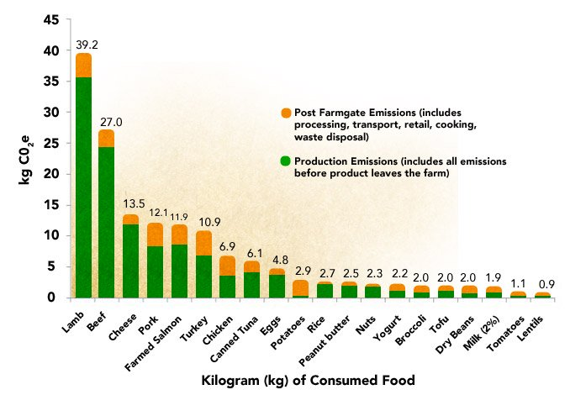
Diet

Slide 55
Community Solutions
You can also:
Contact your representatives
Vote! (early voting has begun)
Join a climate group (e.g., Citizens Climate Lobby)
Talk about it!
Motivate a group to which you already belong

Slide 56
Key points
Climate change is here. We’re already feeling effects.
We can still avoid worst consequences of climate change.
What we do in next 10-12 years is critical.
Climate change is a threat to world’s & Atlanta’s economy and culture.
There are solutions that will grow the economy.

Slide 57
Reasons for hope?

Slide 58
Solar System Explorers 20 OCT
What is a specific solution we have for addressing anthropogenic climate change or its impact? e.g., Convert cars from hydrocarbon fuels to electric-powered.
1.
2.
3.
4.
5.
6.
7.
8.
9.
10.
11.
12.
13.
14.
15.
16.
17.
18.
19.
20.

Slide 59
Extra

Slide 60
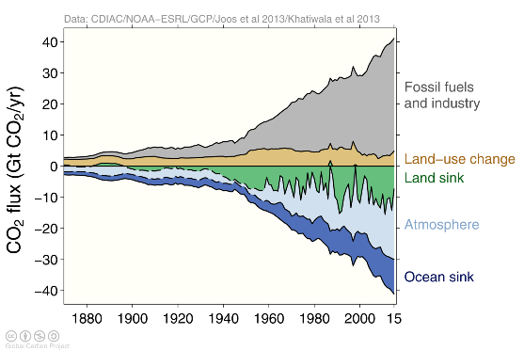
Sources and Sinks
Notes:
-Shows the RELATIVE proportions, so are each put side by side, not overlapping. For example, ocean sink is not all of the other area above it too, it’s just the blue part.

Slide 61
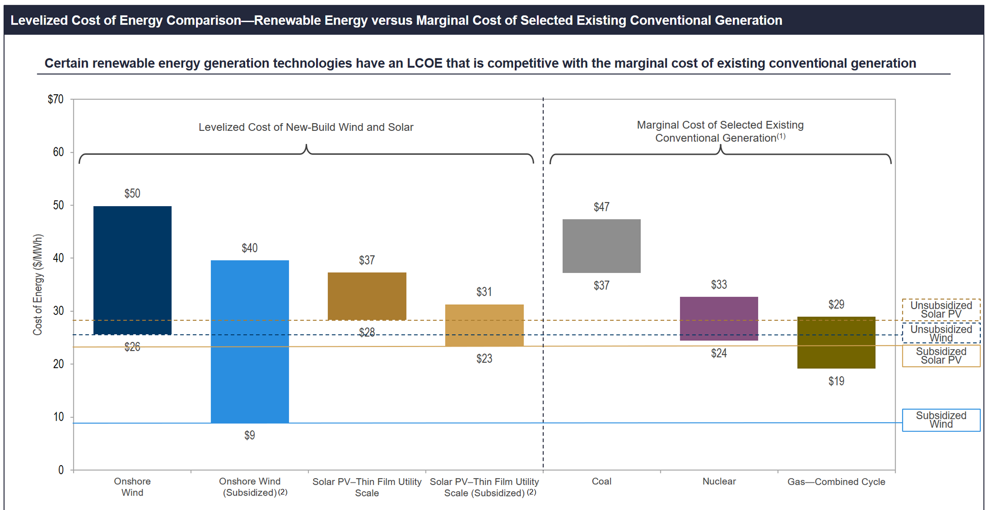

Slide 62
Ozone Stabilization
Montreal
Protocol

Slide 63
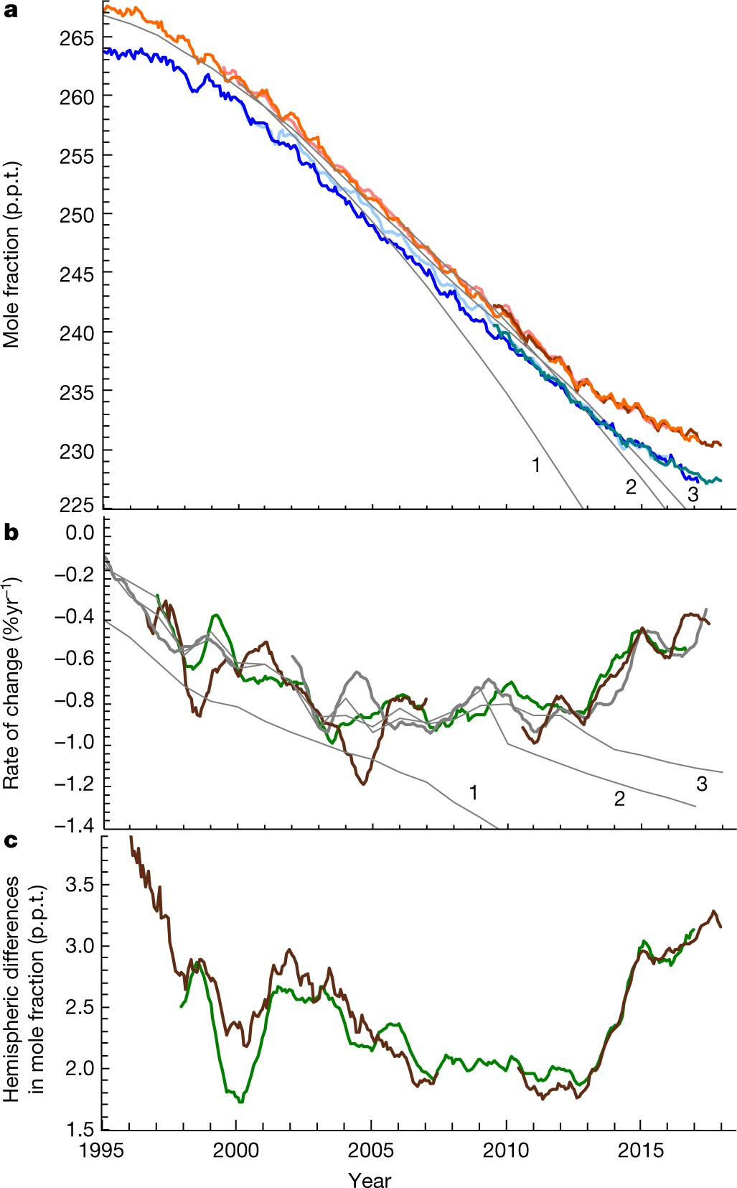
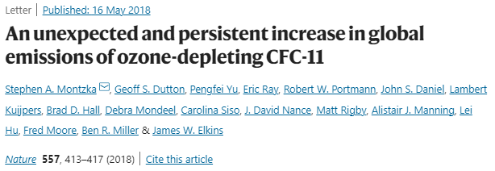
Except…
Notes:
“a, Hemispheric mean mole fractions estimated for the Northern (red lines) and Southern Hemispheres (blue lines); different shades of red or blue represent results from a total of three different instruments (see Methods). b, Inferred rate of change of the measured globally averaged mole fraction of CFC-11. c, Measured differences in hemispheric mean mole fraction of CFC-11 (North Hemisphere − South Hemisphere). In b and c, colours represent results from flask GC–MS (brown lines), flask GC–ECD (green lines) and, in b only, in situ GC–ECDs (thick grey lines). In a and b, the numbered thin grey lines represent projections from recent World Meteorological Organization (WMO) assessment scenarios (as global means) given the data available at the time the scenarios were created”

Slide 64
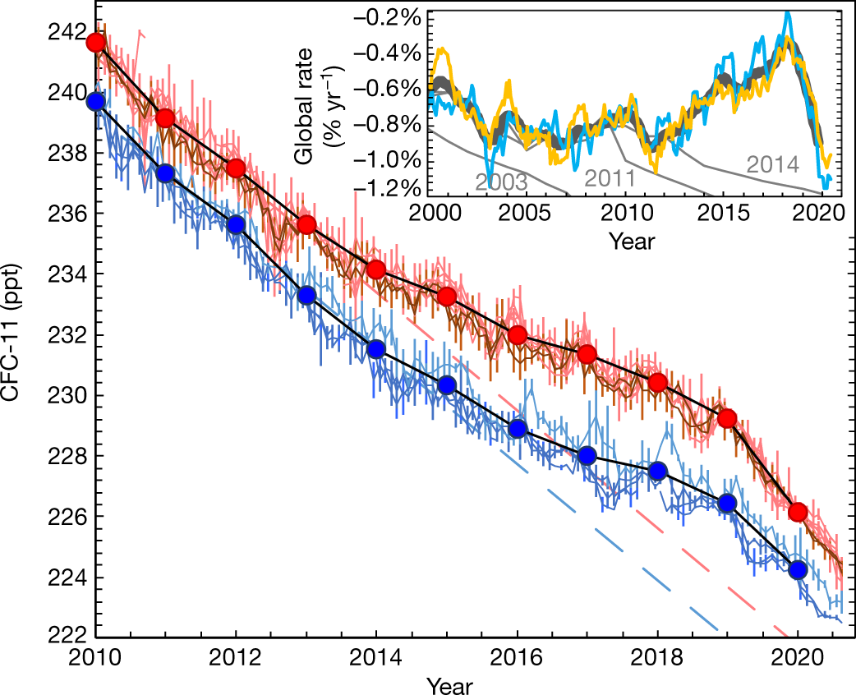
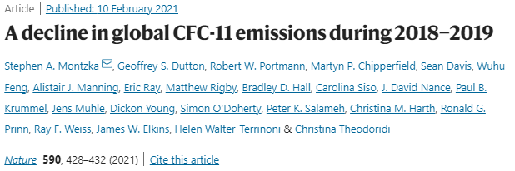
Except…
Notes:
“Monthly mean mole fractions and standard deviations (s.d.) measured at 12 remote sites from NOAA flasks by gas chromatography with mass spectrometry detection (GC-MS) (ref. ¹; Methods). Corresponding monthly means from the independent AGAGE measurement network^{27,28} (on-site analysis by chromatography coupled with electron capture detection (GC-ECD) at 5 remote sites) appear in Extended Data Fig. 1. Results from individual sites are shown as lines, and vertical bars represent 1 s.d. of all measurements in each month at each site (Southern Hemisphere sites are indicated by blue lines, sites within 0°−30° N as brown lines, and sites within 30°−90° N as red lines). Hemispheric 12-month means centred on 1 January of each year (Northern Hemisphere, red circles; Southern Hemisphere, blue circles; connected by black lines) are derived from results at 12 individual sites (Methods). Dashed lines indicate projections based on fits to hemispheric means during 2002−2012 (Northern Hemisphere, red; Southern Hemisphere, blue). The inset shows the global annual rates of change derived from NOAA (light blue; combined flask and in situ results) and AGAGE (yellow; in situ results) monthly means (as ln[Jan₂₀₂₀/Jan₂₀₁₉], plotted at 15 January 2020). These network-specific rates are averaged by month and displayed as annually smoothed values (thick grey line). The numbered thin solid lines represent scenario projections in recent World Meteorological Organization Scientific Assessment reports that did not consider any unreported CFC-11 production after 2010 (refs. ^{17,22,23}, with publication year of each report indicated).”

Slide 65
- CNN, May 2019
- CNN, Feb. 2021
Notes:
-Right figure is now 2019, showing decrease in emission after China clamped down on illegal production of CFC-11 emitted from industrial foam production.

Slide 66
CLIMATE CHANGE
Largest companies
Notes:
https://en.wikipedia.org/wiki/List_of_largest_companies_by_revenue

Slide 67
stages of denialism
CLIMATE CHANGE
“Climate change isn’t real.”
“Climate change is happening, but not by humans.”
“Climate change is actually a good thing!”
“China (or somebody else) is to blame.”
“Climate change is too expensive to fix.”
“There’s nothing we can do about it.”
“Ok, we’re doing something (but not really).”
“Greenwashing”

