Slide 1
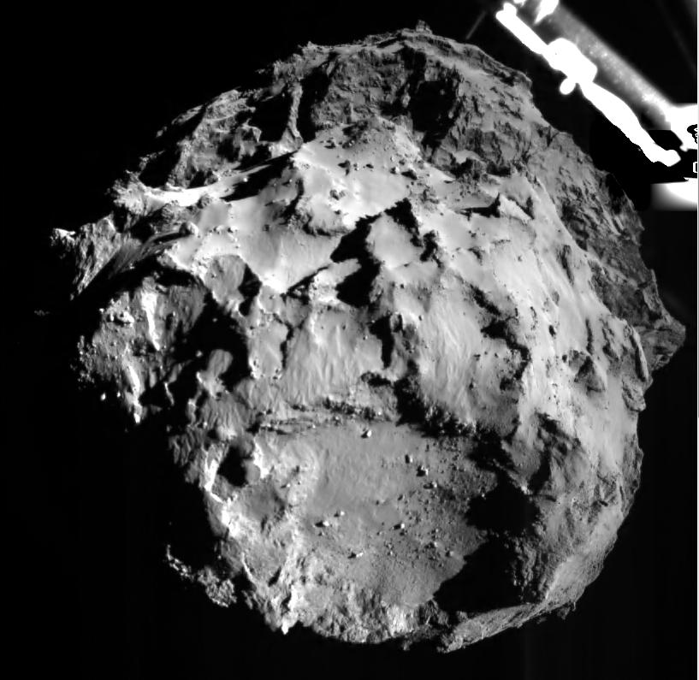
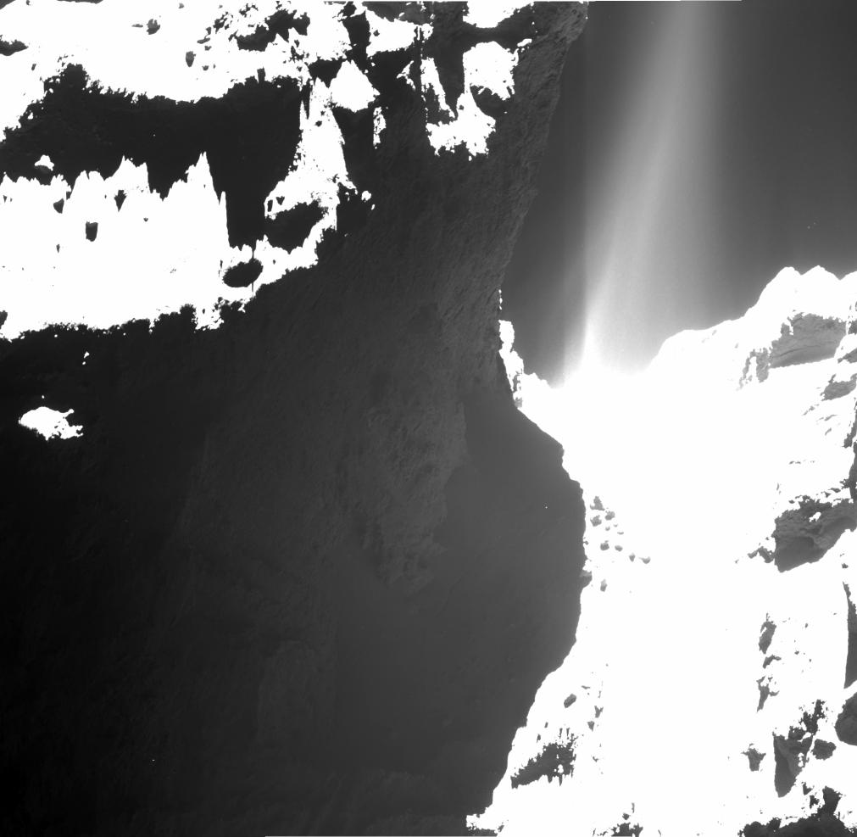
Where
is
this?
comet 67P/Churyumov-Gerasimenko
by the Philae lander
Notes:
This image of comet 67P/Churyumov-Gerasimenko was acquired by the Philae lander of the European Space Agency's Rosetta mission during Philae's descent toward the comet on Nov. 12, 2014. Philae's ROLIS (ROsetta Lander Imaging System) took the image at 14:38:41 UTC (6:38:41 a.m., PST) at a distance of approximately two miles (three kilometers) from the surface. The landing site is imaged with a resolution of about 10 feet (three meters) per pixel.
The ROLIS instrument is a down-looking imager that acquires images during the descent and doubles as a multispectral close-up camera after the landing. The aim of the ROLIS
experiment is to study the texture and microstructure of the comet's surface. It was developed by the German Aerospace Center's Institute of Planetary Research, Berlin.
The lander separated from the orbiter at 09:03 UTC (1:03 a.m. PST) for touch down on comet 67P seven hours later.
Data from the SESAME instrument determined that, rather than being "soft and fluffy" as expected, Philae's first touchdown site held a large amount of water ice under a layer of granular material about 25 cm (9.8 in) deep.^{[56]} It found that the mechanical strength of the ice was high and that cometary activity in that region was low. At the final landing site, the MUPUS instrument was unable to hammer very far into the comet's surface, despite power being gradually increased. This area was determined to have the consistency of solid ice^{[57][58]} or pumice.^{[59]}
In the atmosphere of the comet, the COSAC instrument detected the presence of molecules containing carbon and hydrogen. Soil elements could not be assessed, because the lander was unable to drill into the comet surface, likely due to hard ice.^{[60]} The SD2 drill went through the necessary steps to deliver a surface sample to the COSAC instrument,^{[57]} but nothing entered the COSAC ovens.^{[61]}
Upon Philae's first touchdown on the comet's surface, COSAC measured material at the bottom of the vehicle, which was disturbed by the landing, while the Ptolemy instrument measured material at the top of the vehicle. Sixteen organic compounds were detected, four of which were seen for the first time on a comet, including acetamide, acetone, methyl isocyanate and propionaldehyde.^{[62][63][64]}
Rosetta and Philae had been riding through space together for more than 10 years. Philae is the first probe to achieve soft landing on a comet, and Rosetta is the first to rendezvous with a comet and follow it around the sun. The information collected by Philae at one location on the surface will complement that collected by the Rosetta orbiter for the entire comet.
Rosetta is a European Space Agency mission with contributions from its member states and NASA. Rosetta's Philae lander is provided by a consortium led by the German Aerospace Center, Cologne; Max Planck Institute for Solar System Research, Gottingen; French National Space Agency, Paris; and the Italian Space Agency, Rome. NASA's Jet Propulsion Laboratory, a division of the California Institute of Technology, Pasadena, manages the U.S. participation in the Rosetta mission for NASA's Science Mission Directorate in Washington. Rosetta carries three NASA instruments in its 21-instrument payload.

Slide 2
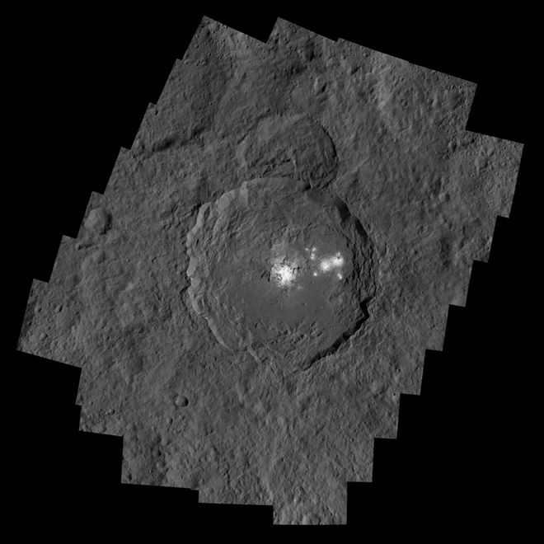
Where
is
this?
Ceres
Na₂CO₃
Notes:
Near-infrared spectra of these bright areas are consistent with a large amount of sodium carbonate, (Na₂CO₃) and smaller amounts of ammonium chloride (NH₄Cl) or ammonium bicarbonate (NH₄HCO₃). These materials have been suggested to originate from the recent crystallization of brines that reached the surface from below. In August 2020, NASA confirmed that Ceres was a water-rich body with a deep reservoir of brine that percolated to the surface in various locations causing the "bright spots", including those in Occator crater.

Slide 3
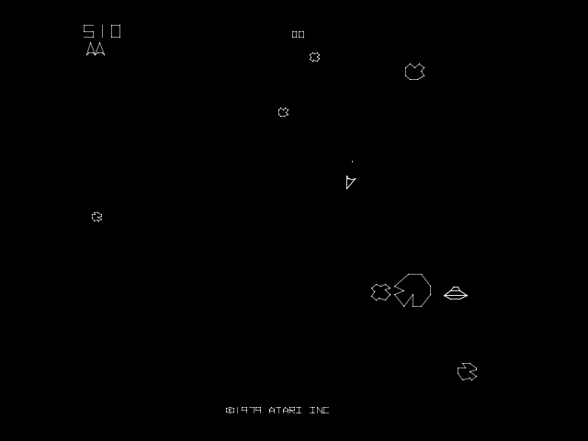
Where is this?

Slide 4
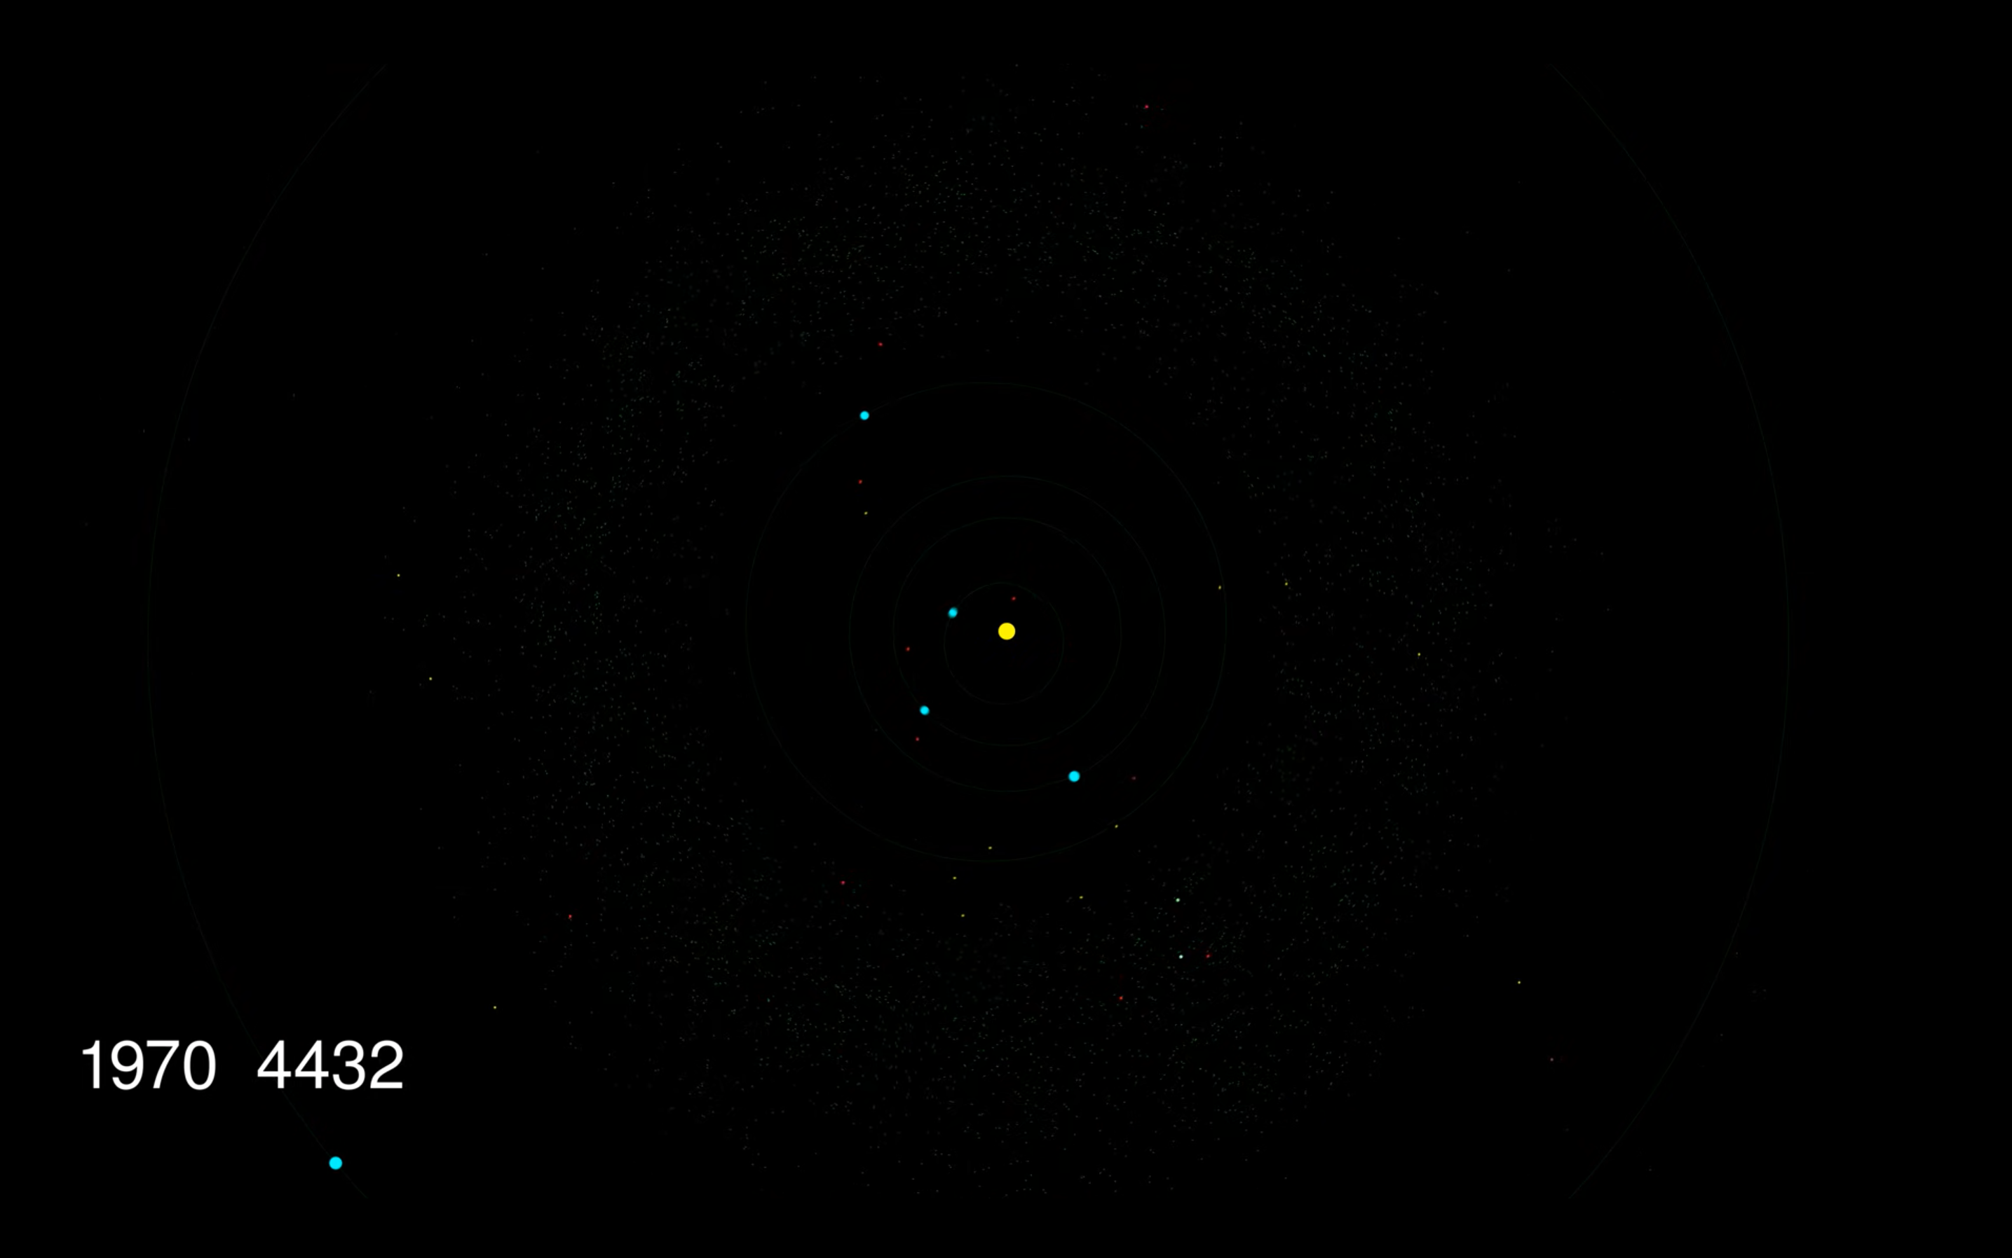
Minor Bodies
out to Jupiter
https://www.youtube.com/watch?v=BKKg4lZ_o-Y
Notes:
version 1 --- http://www.youtube.com/watch?feature=player_detailpage&v=ONUSP23cmAE

Slide 5
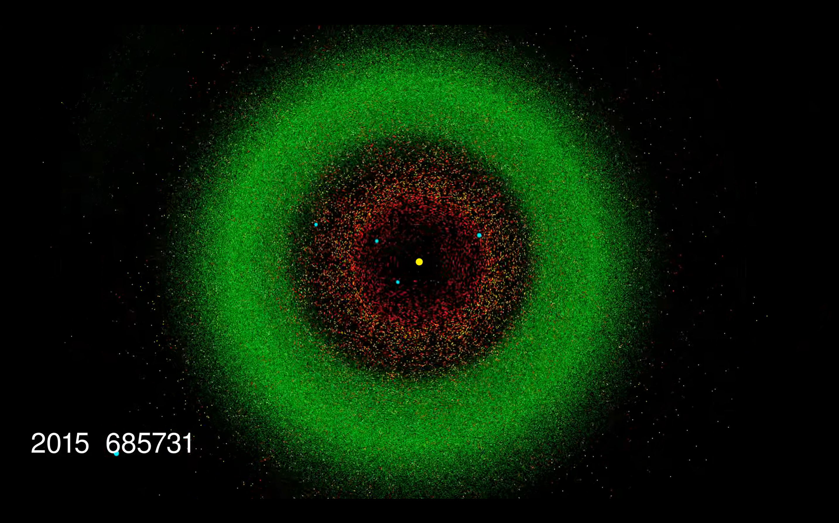
Notes:
version 1 --- http://www.youtube.com/watch?feature=player_detailpage&v=ONUSP23cmAE

Slide 6
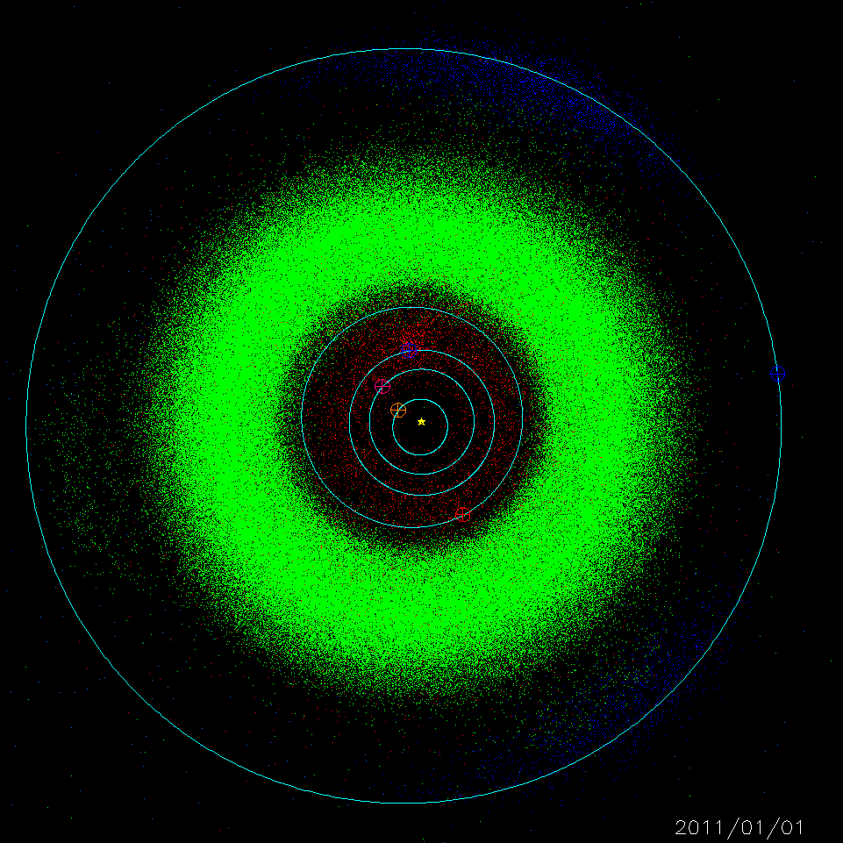
Minor Bodies
out to Jupiter
contributions
by Joey Chatelain
Notes:
date first presented by Joey 13 MAR 2012

Slide 7
SSE!
What defines a “Dwarf Planet”?
IAU RESOLUTION 5A (2006, Prague, Czech Republic)
(2) A “dwarf planet” is a celestial body that
(a)
(b)
(c)
(d)

Slide 8
Minor Bodies
Why “Dwarf Planet” instead of “Planet”?
IAU RESOLUTION 5A (2006, Prague, Czech Republic)
The IAU therefore resolves that planets and other bodies in our Solar System, except satellites, be defined into three distinct categories in the following way:
(1) A “planet” is a celestial body that (a) is in orbit around the Sun, (b) has sufficient mass for its self-gravity to overcome rigid body forces so that it assumes a hydrostatic equilibrium (nearly round) shape, and (c) has cleared the neighbourhood around its orbit.
(2) A “dwarf planet” is a celestial body that (a) is in orbit around the Sun, (b) has sufficient mass for its self-gravity to overcome rigid body forces so that it assumes a hydrostatic equilibrium (nearly round) shape, (c) has not cleared the neighbourhood around its orbit, and (d) is not a satellite.
(3) All other objects, except satellites, orbiting the Sun shall be referred to collectively as “Small Solar-System Bodies”. a.k.a. “minor bodies”
Notes:
William Herschel discovered Uranus in 1781
Giuseppe Piazzi discovered Ceres in 1801
His friend Carl Friedrich Gauss calculated its orbit
Herschel coined the term “Asteroid”

Slide 9
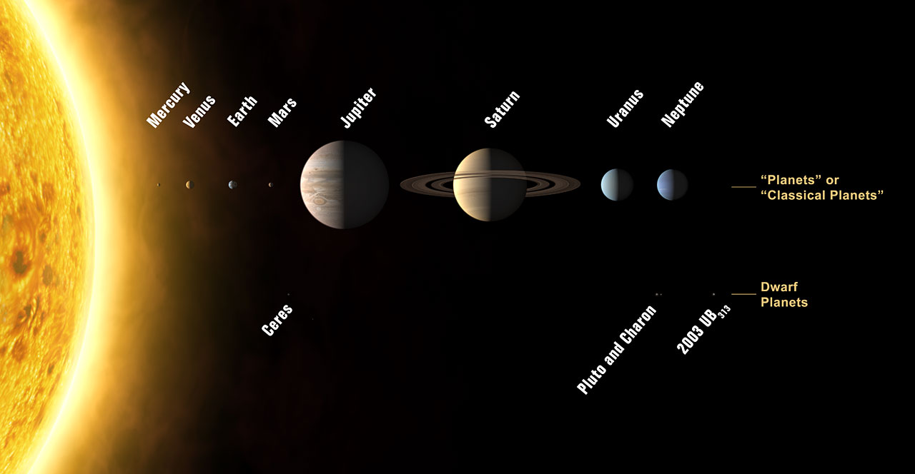
X
SSE!
Name the other 3 (or 7) dwarf planets.
Notes:
IAU recognizes 5 dwarf planets in 2022 = Ceres, Pluto, Eris, Makemake and Haumea
#s of DPs from Mike Brown’s website where last update was FEB 2021

Slide 10
X
Eris
Haumea
Makemake
likely
Gonggong
Quaoar
Orcus
Sedna
5 IAU-recognized dwarf planets
100 at least “likely” dwarf planets
1000 at least “possibly” dwarf planets
http://web.gps.caltech.edu/~mbrown/dps.html
Notes:
IAU recognizes 5 dwarf planets in 2022 = Ceres, Pluto, Eris, Makemake and Haumea
#s of DPs from Mike Brown’s website where last update was FEB 2021

Slide 11
Minor Bodies: Names
Where do the Minor Bodies get their names?
1. Object discovered:
Provisional Designation based on date + order of discovery
2003 UB₃₁₃ = year/half month/counting order
2. Orbit is well defined:
Proper Designation based on order of orbit determination
typically 4 oppositions
but not always … 134340 = Pluto
3. IAU decides to name object:
often classical, e.g., Roman goddesses and heroines
suggestions from the discoverer usually considered
2 Pallas or 3654 AAS
Notes:
The standard designation consists of the following parts, all of which are related to the date of discovery of the object: a 4-digit number indicating the year; a space; a letter to show the half-month; another letter to show the order within the half-month; and an optional number to indicate the number of times the second letter has been repeated in that half-month period.
1995 SA, 1995 SB, ..., 1995 SY, 1995 SZ, 1995 SA₁, ..., 1995 SZ₁, 1995 SA₂, ..., 1995 SZ₉, 1995 SA₁₀, etc.
Proper Designation typically takes 4 oppositions
Pluto was added to the minor bodies list as the 134340th object with an orbit

Slide 12
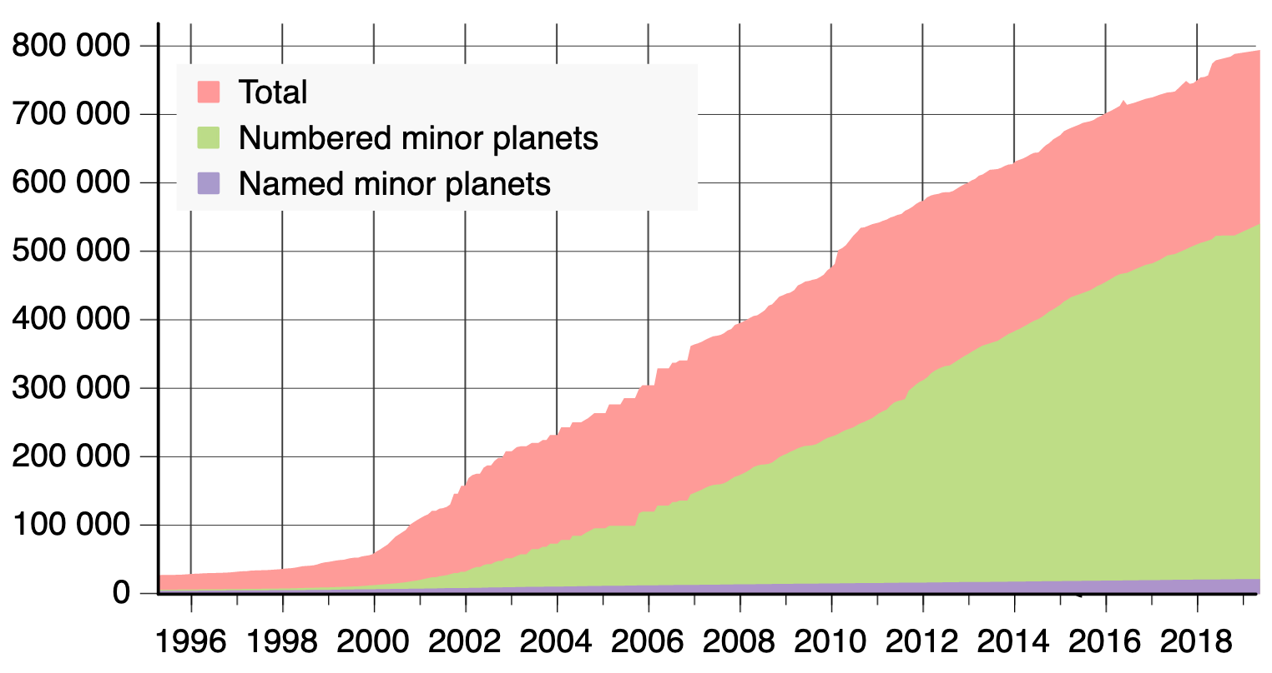
Minor Bodies: Inventory
Provisional
Proper

Slide 13
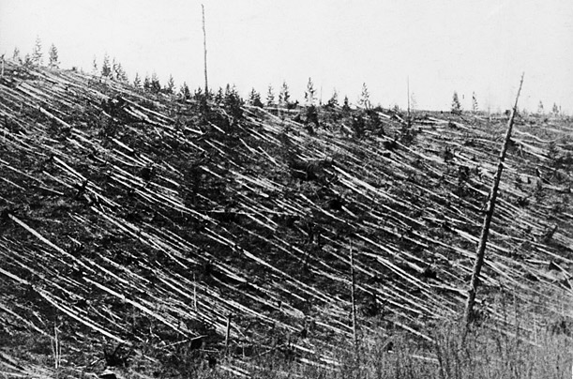
NEAs = Near Earth Asteroids
definition minor body with q < 1.3 AU
q is perihelion
first discovered 433 Eros (1898)
largest 1036 Ganymed (32 km)
population 30474 (JPL 2024 NOV 05)
Notes:
# NEAs with orbits

Slide 14
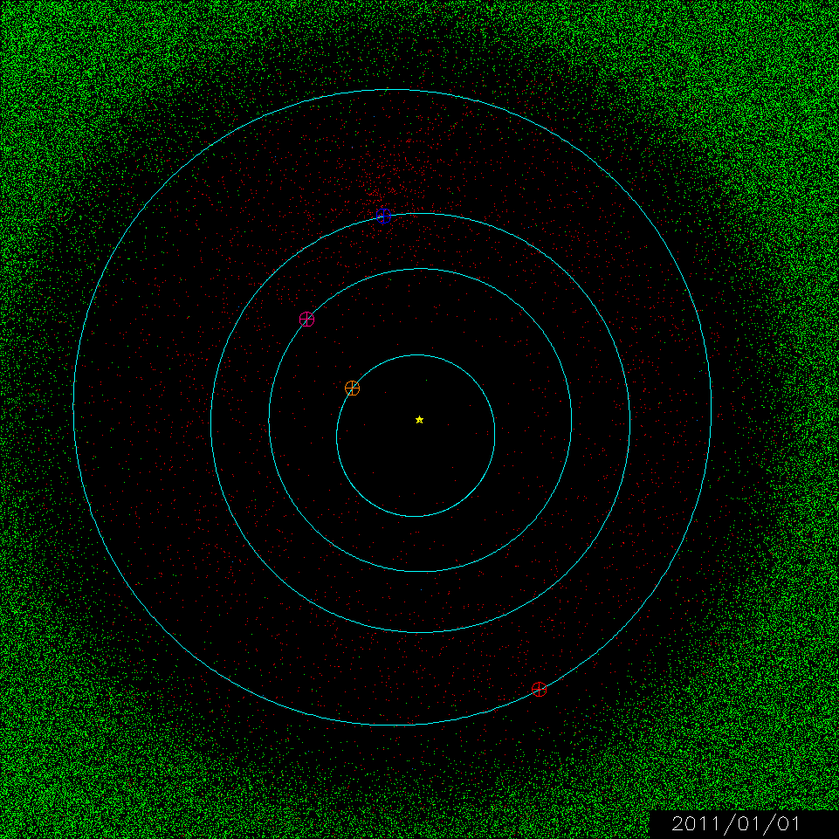
a = semimajor axis
q = perihelion dist
Q = aphelion dist
Atiras a<1 and Q<0.983
(33)
Atens a<1 and Q>0.983
(2886)
Apollos a>1 and q<1.017
(20573)
Amors: 1.017 < q < 1.3
(12965)
JPL 2024 NOV 05
Notes:
Atiras --- inside Earth’s orbit
Atens and Apollos --- Earth crossing
Amors --- outside Earth’s orbit but inside Mars’

Slide 15
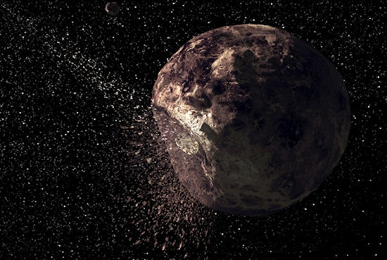
MBAs = Main Belt Asteroids
definition: a < 4.6 AU and q > 1.66 AU
1st discovered: Ceres (1801)
population: 1,333,565 (JPL 2024 NOV 05)
Notes:
> 4.6 AU is considered a Greek/Trojan out to 5.5 AU

Slide 16
SSE!
first 4 answers get +1 point
(limit 1 per customer)
Name any Main Belt Asteroid
other than Ceres.

Slide 17
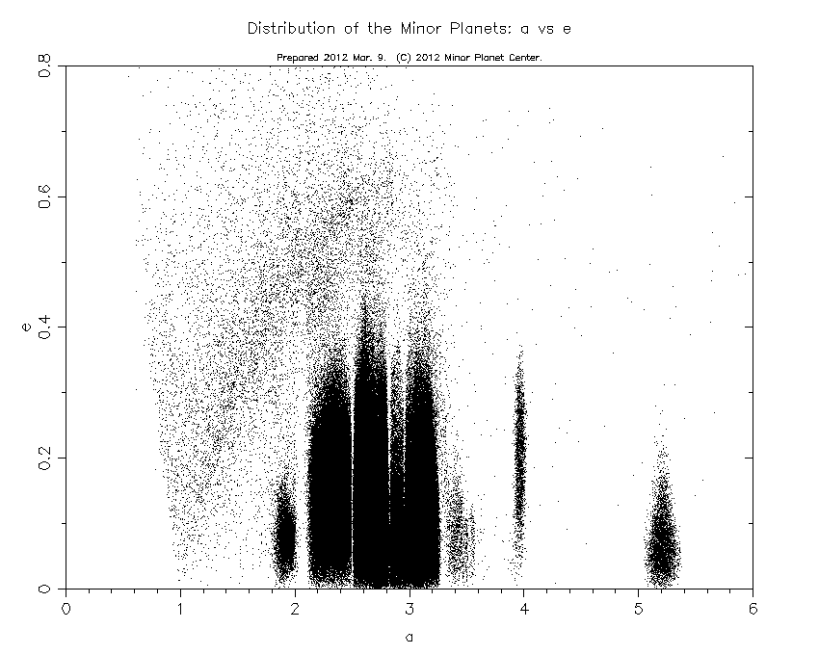
MBAs: Kirkwood Gaps
4:1
3:1
5:2
7:3
2:1
3:2
1:1
Hildas
Trojans
Notes:
caused by resonances with Jupiter, asteroids in gaps eventually get flung into Sun, planet or out of SS
Major gaps:
a=2.06—1:4 w/ Jupiter, also 9:4 w/ Mars
a=2.50 –2:7 (Hestia gap)
a=3.28—1:2 (Hekuba gap)

Slide 18
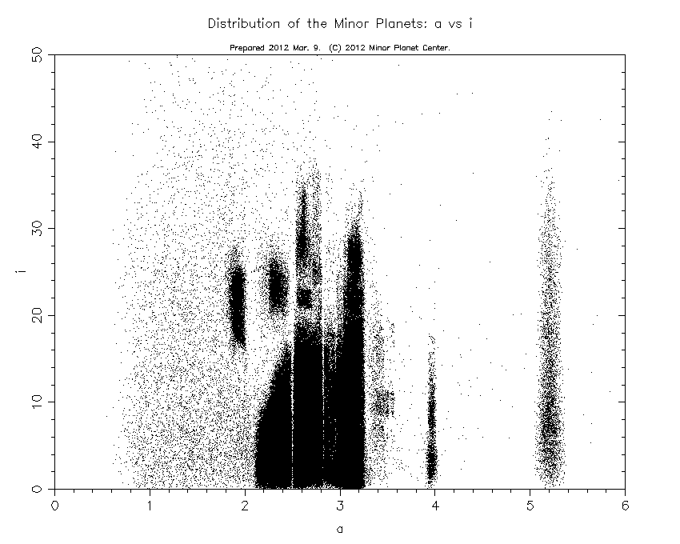
MBAs: Kirkwood Gaps
CollisionalFamilies
Hildas
purely dynamical not true “Family”

Slide 19
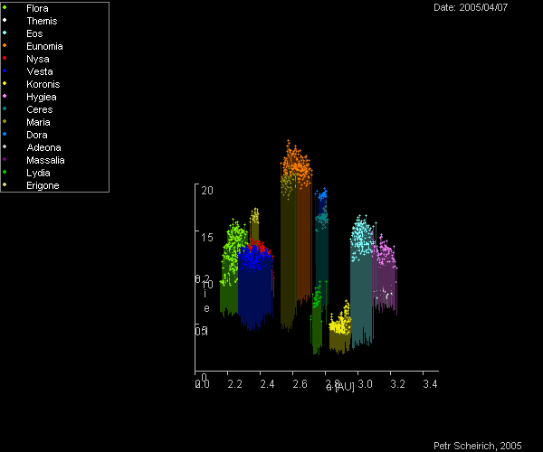
MBAs: Collisional
Families
similar properties:
a
e
i
taxonomic class

Slide 20
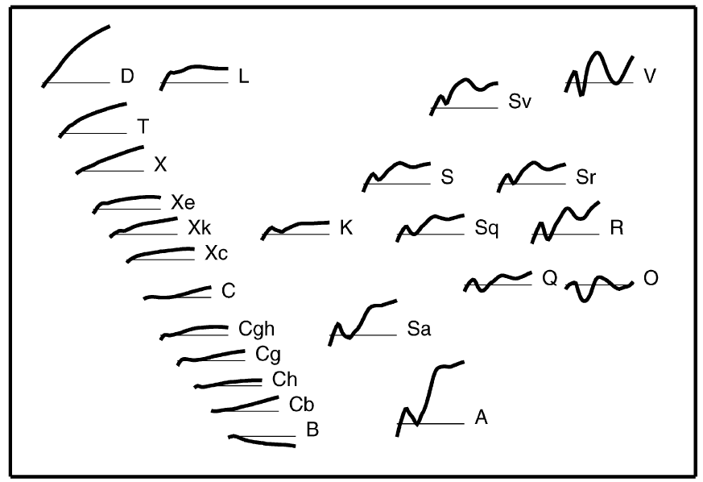
Type | Albedo² | Possible Mineralogy³ | Notes:
A | 0.13 to 0.40 | olivine-dominated achondrites | Belonging to fragmented objects ?
B | 0.04 to 0.08 | heated CI, CM chondrites; CV Chondrites
C | 0.03 to 0.09 | heated CI, CM chondrites; CV Chondrites | Notably the Themis and Hygiea families
D | 0.02 to 0.05 | Hydrated silicates + organics, Ices | Jupiter-Trojans and beyond
K | ~ 0.10 ? | CO, CV Chondrites
L |  | pallasite-like achondrites, metallic iron + pallasitic Olivine
Q | ~ 0.20 | Ordinary LL, H, L Chondrites | Currently only Earth-crossers
R | ~ 0.40 | pyroxene-olivine achondrite
S | 0.10 to 0.22 | pallasite-like achondrites, Ordinary LL, H, L Chondrites | Floras and Eunomias notably
T | 0.04 to 0.11 | organics + anhydrous Silicates, troilite
V | ~ 0.40 | basaltic achondrites | Vesta
Xe | 0.25 to 0.60 | aubrites, enstatite achondrites, hydrated silicates | Hungarias and inner edge of Belt N°1
X (formerly M ) | 0.10 to 0.18 | metallic iron, enstatite chondrites, CM, CR, CV chondrites | cores of fragmented asteroids ?
C … S … X types most common
C = chondrite … primitive/unmodified
~80% of asteroids
S = stony … silicates/nickel-iron
X = metallic (M) … nickel-iron
note change in albedos w/ classifications
*** careful when citing compositional change with semi-major axis ***
24 taxonomic classes defined 0.45-2.45μm
Notes:
primary trick of classifying Asteroids is to compare them to meteorites … define composition by comparing spectra
C-Group
S-Group
X-Group
S group= broad group of Asteroids that appear to be aged LL, H, and L chondrites, found primarily in Inner MB
Q group= LL, H and L OC that appear completely un-aged, only found near Earth
3 classes in 1970s = C,S,U
14 classes by 1984
24 classes now
LL= Low Iron, Low metals
L=Low Iron
H= High Iron

Slide 21
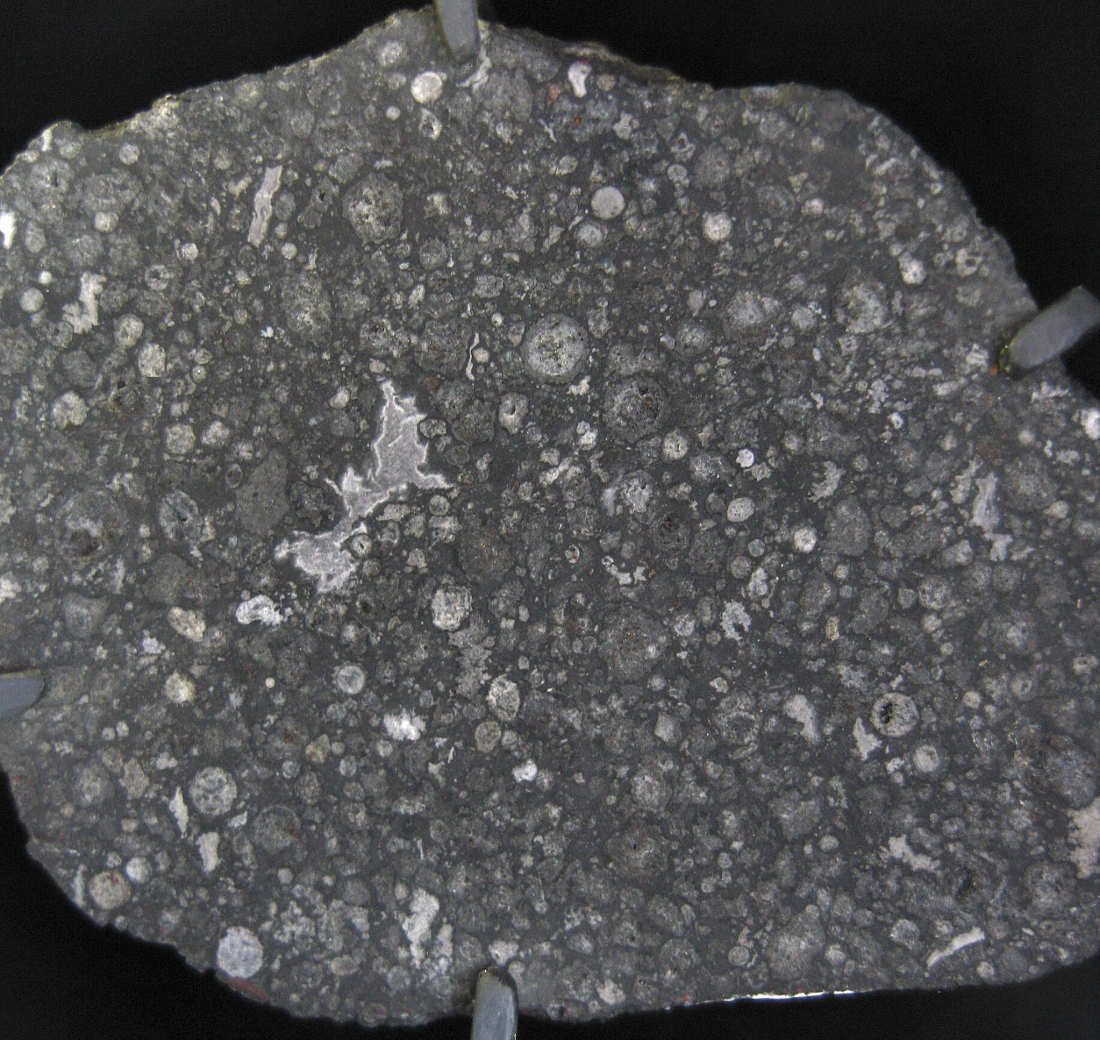
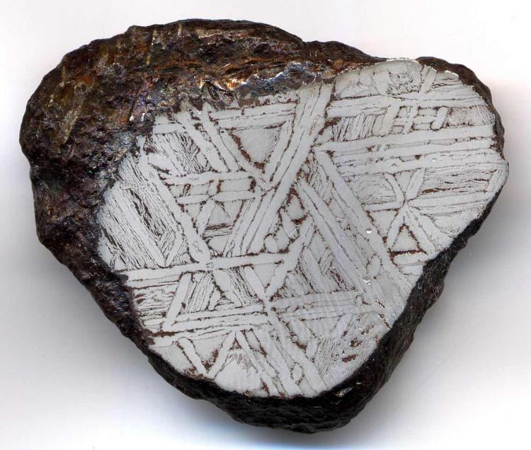
Minor Body
Interiors
Chondrites: meteorites containing or made from chondrules (round grains)
Achondrites: meteorites containing no chondrules (smooth interiors)

Slide 22
https://ukantarcticmeteorites.wordpress.com/meteorite-science/

Slide 23
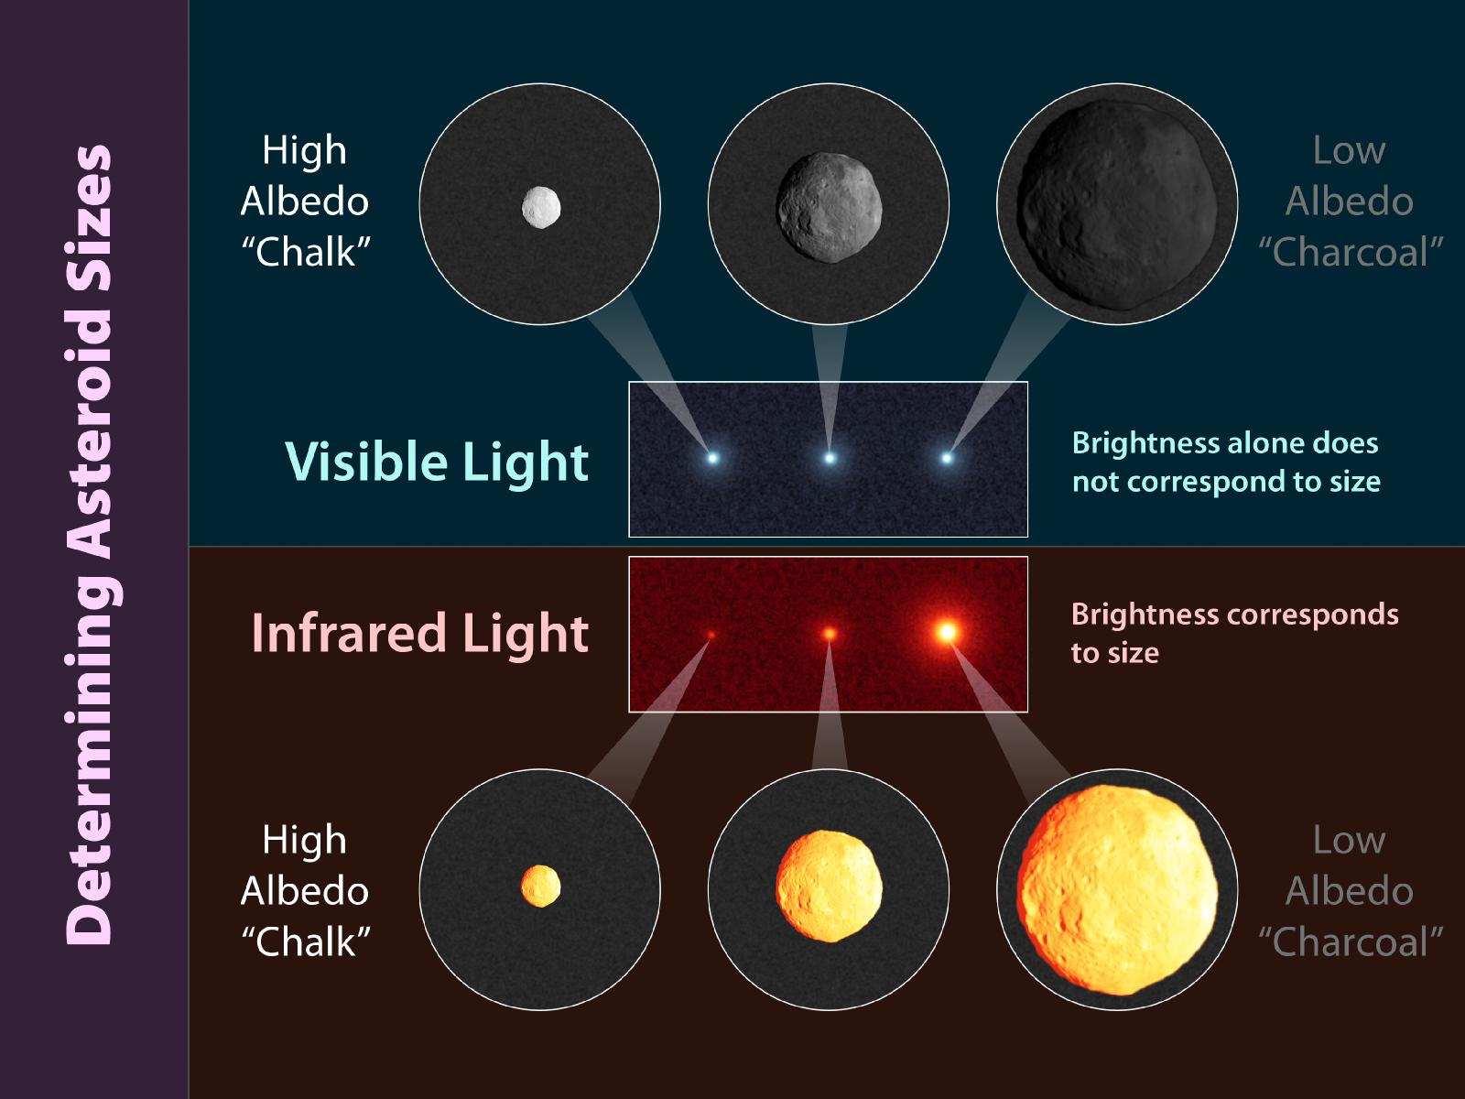
WISE

Slide 24
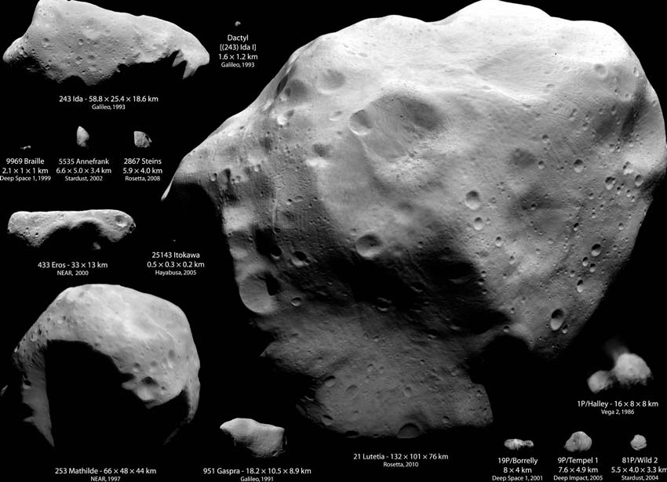
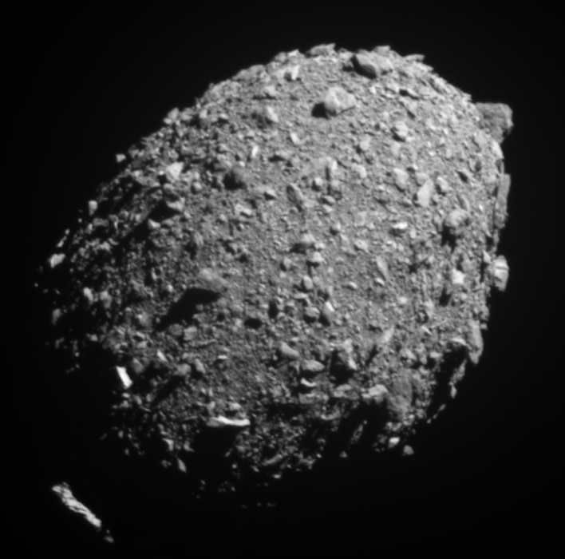
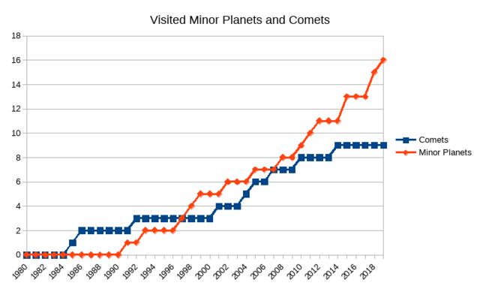
Dimorphos
~ 170 m

Slide 25
Dimorphos
~ 170 m

Slide 26
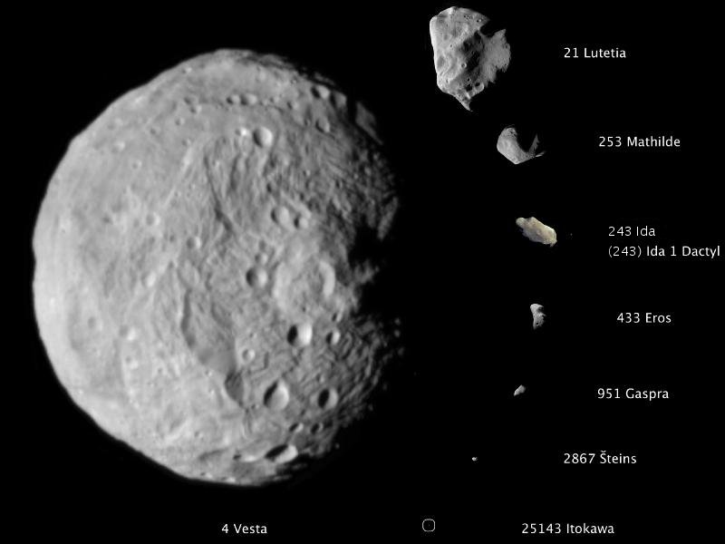
> Dimorphos

Slide 27
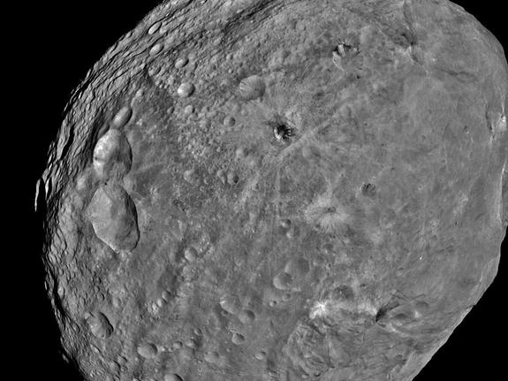
Vesta
a 2.4 AU
e 0.09
i 7.1º
Diam 530 km
Dens 3.42 g/cm³
Mass 0.4% M_{moon}
12% of MB
Notes:
Vesta is NOT considered a dwarf planet

Slide 29
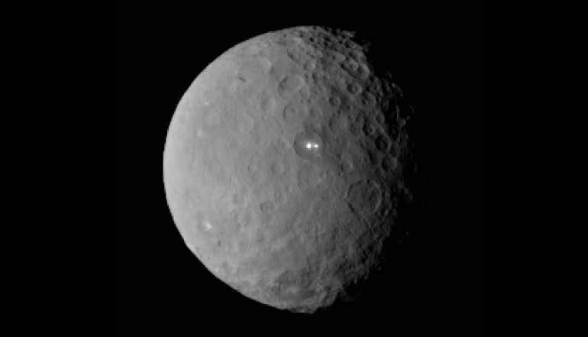
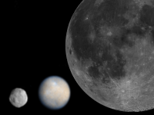
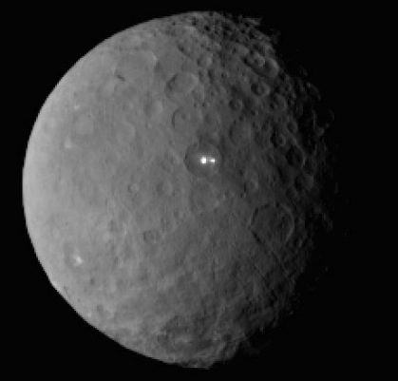
Ceres
a 2.8 AU
e 0.08
i 10.6º
Diam 952.4 km
Dens 2.08 g/cm³
Mass 1.3% M_{moon}
41 % of MB
https://www.nasa.gov/feature/jpl/new-ceres-images-show-bright-craters
Notes:
upper right = Vesta, Ceres, Moon
The bright spots in Ceres’s Occator Crater, which mystified scientists when first observed by the Dawn spacecraft in 2015, indicate the dwarf planet may harbor remnants of what was once a global subsurface ocean.
Dawn captured closeup, detailed images of the 57-mile- (92 km-) wide crater from a distance of just 22 miles (35 km) above the dwarf planet’s surface. After analyzing these images, scientists identified the deposits as sodium carbonate, a compound of sodium, carbon, and oxygen contained in salt water that erupted onto Ceres’s surface. That water subsequently evaporated, leaving behind the bright salty deposits.
Mission scientists determined the deposits originated in a deep, global underground ocean of salty water. Based on Ceres’s gravity, they analyzed its internal structure and concluded its subsurface ocean is several hundred miles wide and around 25 miles (40 km) deep.

Slide 30
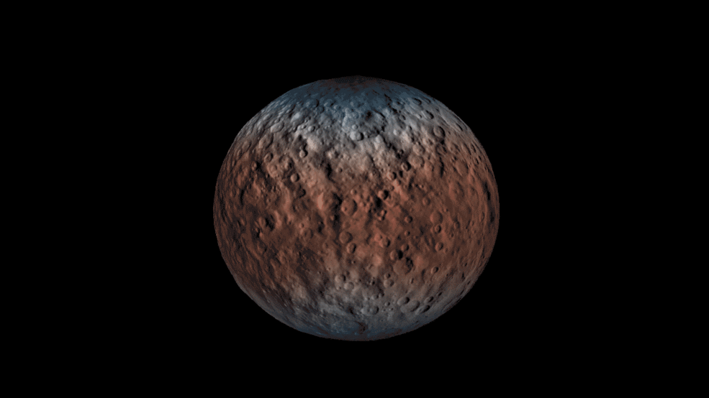
Ceres
hydrogen content: blue = high, red = low
implies H₂O ice nearer the surface at the poles
Notes:
neutron (?) detector probes ~1m deep

Slide 31
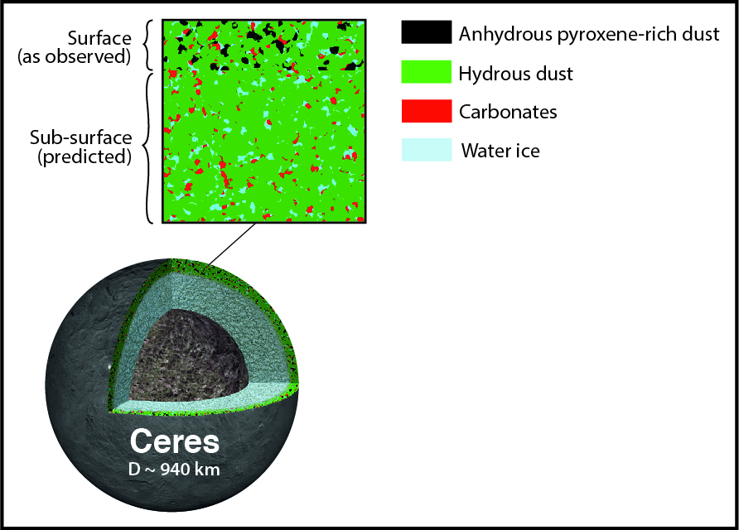
outer layers:
hydrated minerals
sodium carbonate bright spots
in Occator Crater, etc.
H₂O ice
ammoniated clays
organics
core:
H₂O ice over rock
Vernazza+ 2017:
dust coating from other asteroids
possibly formed in outer SS
Notes:
ammonia evaporates at Main Belt distance

Slide 32
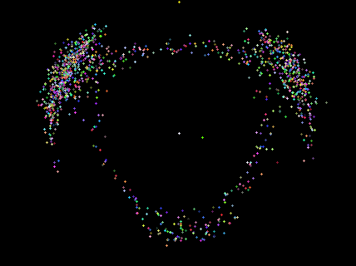
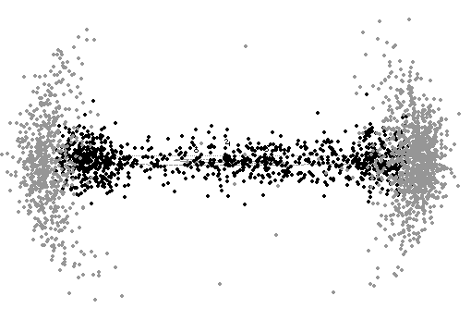
Trojans
(and Hildas)
Trojans 1:1 resonance with a planet
librating about L4 and L5 Lagrange points
Jupiter 1st discovered: 588 Achilles (1906)
largest: 624 Hektor (225 km)
Hildas: 3:2 Jupiter resonance at 4.0 AU, 0.0 < e < 0.3
some have cometary colors
Mercury 0
Venus 0
Earth 1(?)
Mars 16
Jupiter 13994
Saturn 0
Uranus 0
Neptune 31
Jup Greeks (L4): 8970
Jup Trojans (L5): 5024
all numbers from MPC
2024 SEP 28
Notes:
relative to Jupiter = yellow + at the top
maybe 2 Earth Trojans

Slide 33
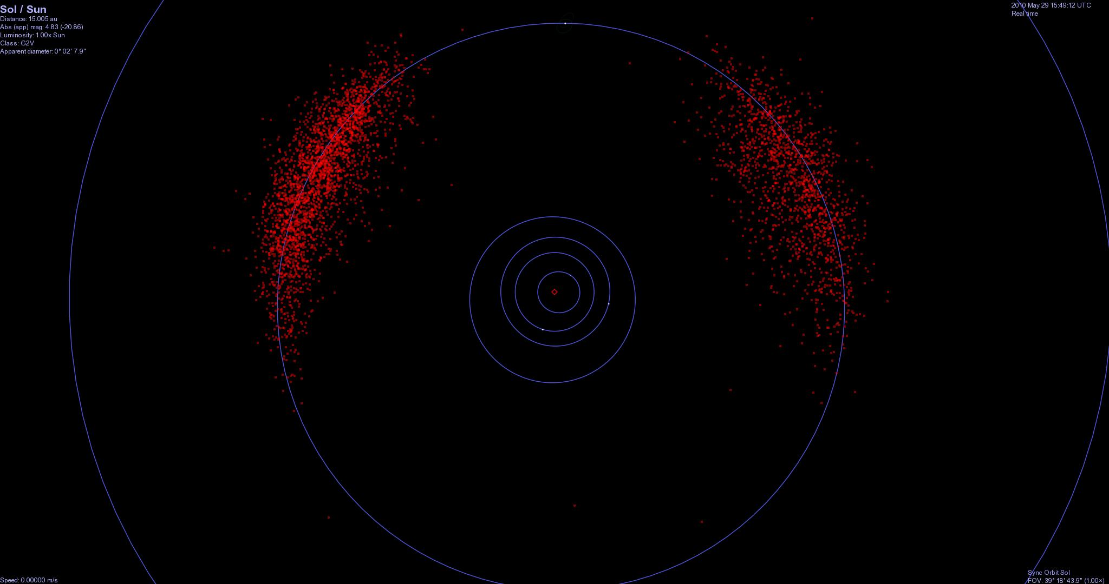
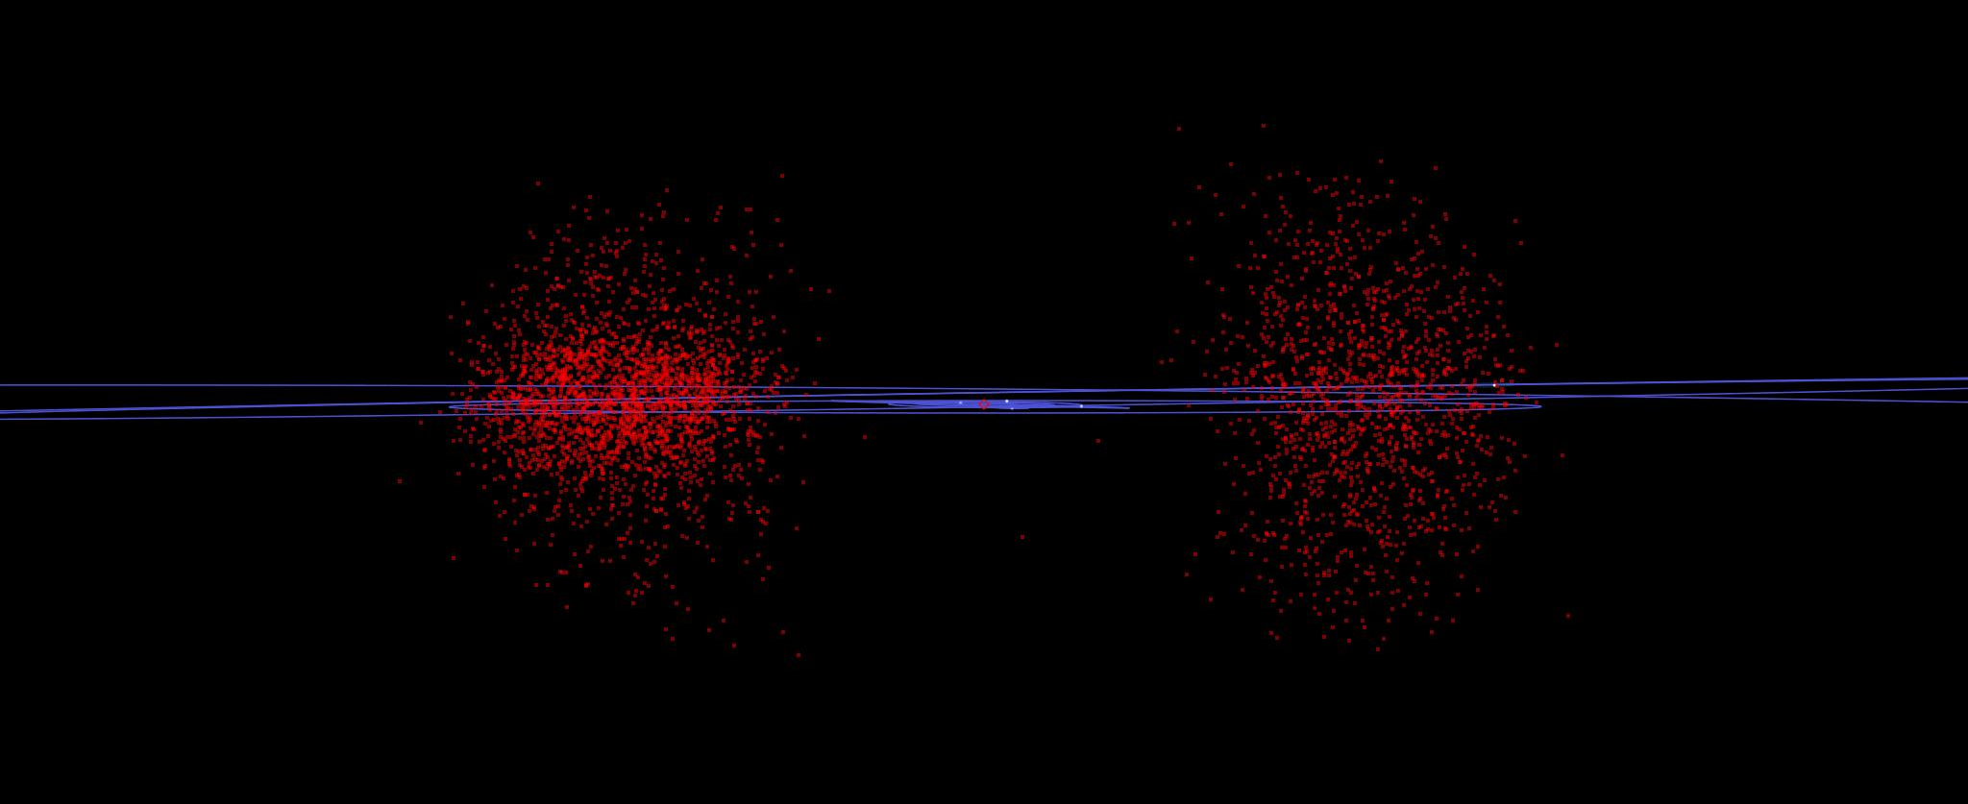
Greeks
Trojans

Slide 34
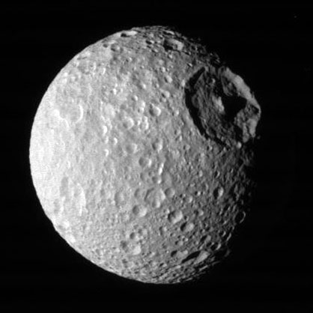
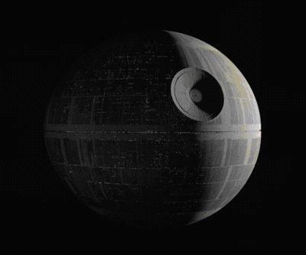
Moons
 | # of Moons
Earth | 1
Mars | 2
Jupiter | 95
Saturn | 145
Uranus | 28
Neptune | 16
TOTAL | 287
d >10km | 72
Moon (Mimas)
JPL Solar System Exploration webpage 2024 NOV 05
Imperial Battle Station

Slide 35
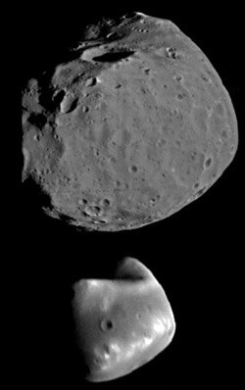
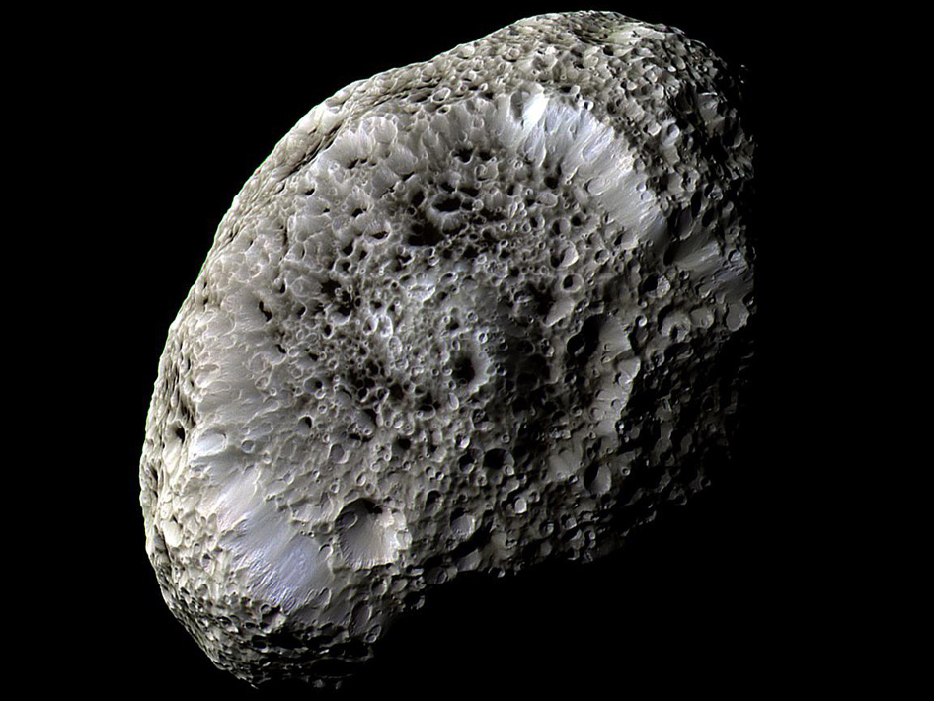
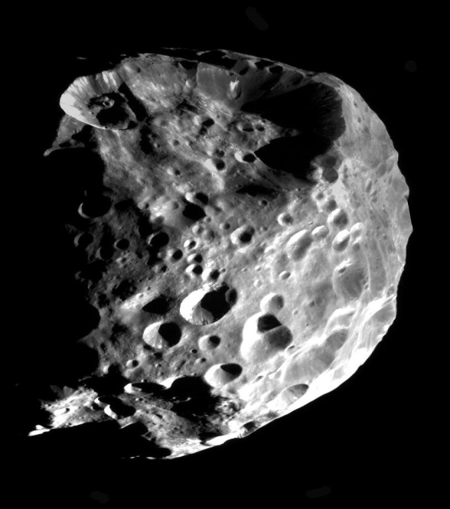
Deimos
Phobos
Hyperion
Sat
Phoebe
Sat
Jupiter’s inner four
Notes:
Phoebe wide, retrograde, inclined orbit at Saturn, ~200 km, albedo ~0.1 (very dark),
Phoebe ring contributes to Iapetus darkening
captured Centaur?
add Methone!

Slide 36
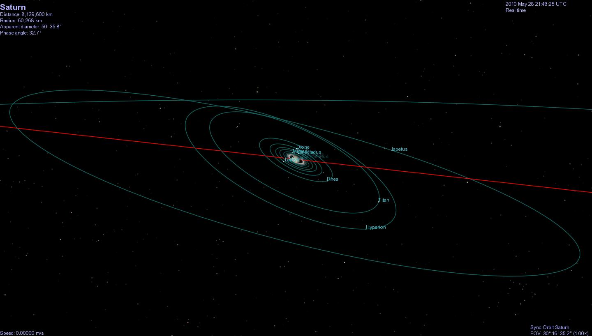
Saturn’s Regular Satellites
140 Saturn Radii

Slide 37
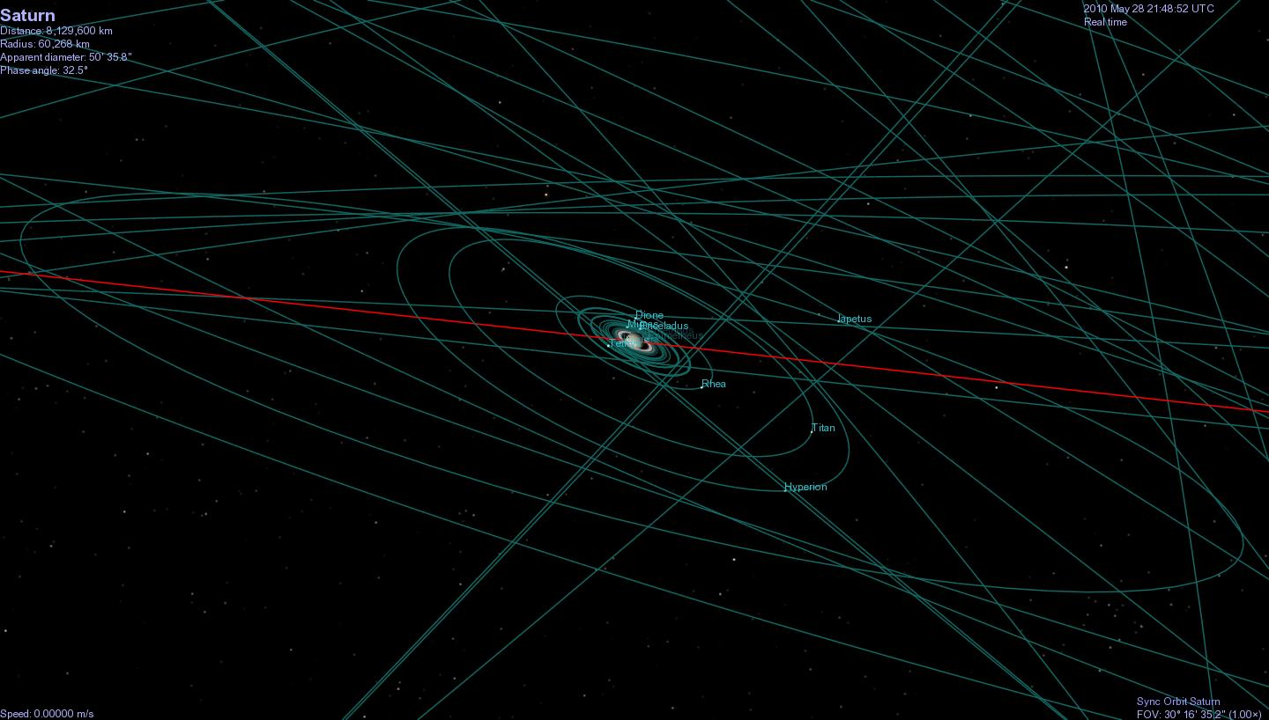
Saturn’s Irregular Satellites

Slide 38
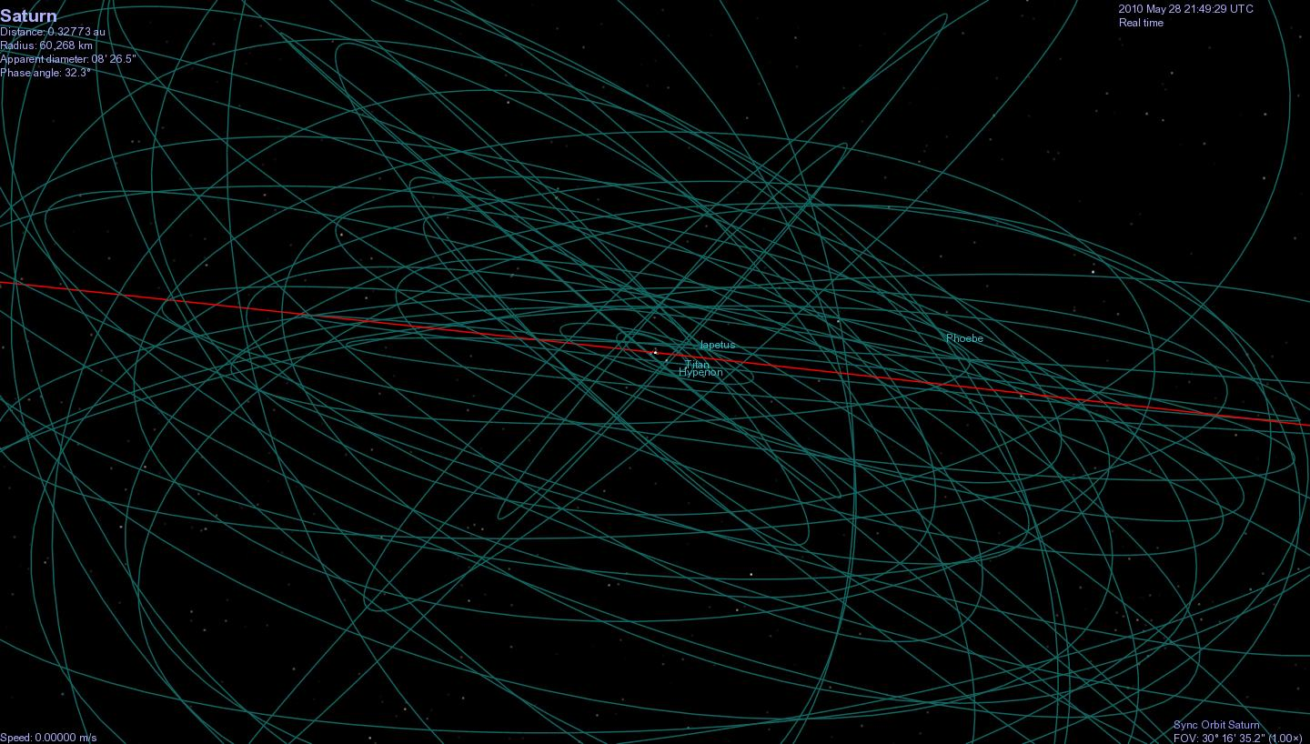
860 Saturn Radii

Slide 39
increasing
effort
Observation Method | Uses | Limitations
Astrometry | Determine Orbits, changes in Orbits, estimate mass through weak interactions | Need several observations to determine period (single shot surveys cannot do this), perturbations from interactions and changes in orbital elements may take many Periods to calculate each of which can take many years.
Optical Photometry | Colors, Broad spectra, Albedo, H, Discovery surveys | Often Faint, and constantly changing distance. Albedo impossible to decouple from Diameter.
IR Photometry | IR Colors, Broad IR Spectra, Thermal emission, Diameter | Often Faint, and constantly changing distance. Thermal emissivity, surface composition, orientation and rotation needed to accurately determine Diameter.
Spectroscopy | Composition, Classification | Faint and often featureless. Left with slope.
Light Curves | Rotation rate, spin axis, binaries (mass), rough shape, minimum density | Rotation periods range from hours to days. Need Rotation curves from several orientations to determine spin axis.
Phase Curves | Opposition effects, surface composition, cratering | Difficult to account for amplitude change due to rotation. Requires many measurements throughout year. Distant objects never reach high phase. Difficult to decouple coherent backscattering from crater shadowing effects.
Polarimetry | Surface texture and composition, Albedo | Peak phases required for composition measurements impossible for most objects. Faint objects difficult due to further limiting of light.
Radiometry | Inner properties, surface features, surface composition, rotation information, spin axis, size, shape | Requires bouncing radar pulse off object at multiple frequencies. Only possible for very large, or very nearby objects.
Stellar Occultation | Size, Shape | Do not even need to be able to see object, but requires precise timing and location. Multiple chords required for shape.
Lunar Occultation | Size, multiplicity | Proper phase moon has to occult target. Do need to see object with enough sensitivity to detect refraction.
Interferometry | Size, shapes, rotation information | Very difficult to detect faint objects, or capture moving objects.
Meteorite Sampling | Composition, Demographics | Atmospheric entry alters chemistry, only samples nearby objects easily.
In Situ Sampling | EVERYTHING | $$$$ Also, Sample return is tricky.

Slide 40
Solar System Explorers: 07 NOV
Name a minor body (no satellites) with an orbital semimajor axis greater than Mars’ (1.52 AU) and describe three of its physical characteristics, e.g., Hektor is ~400x200x200km in size, has density 1.0-2.4 g/cm³ and albedo 0.02-0.11.
1. …
2. …
3. …
4. …
5. …
6. …
7. …
8. …
9. …
10. …
11. …
12. …
13. …
14. …
15. …
16. …
17. …
18. …
19. …
20. …

Slide 41
…………………………
Notes:
41

Slide 42
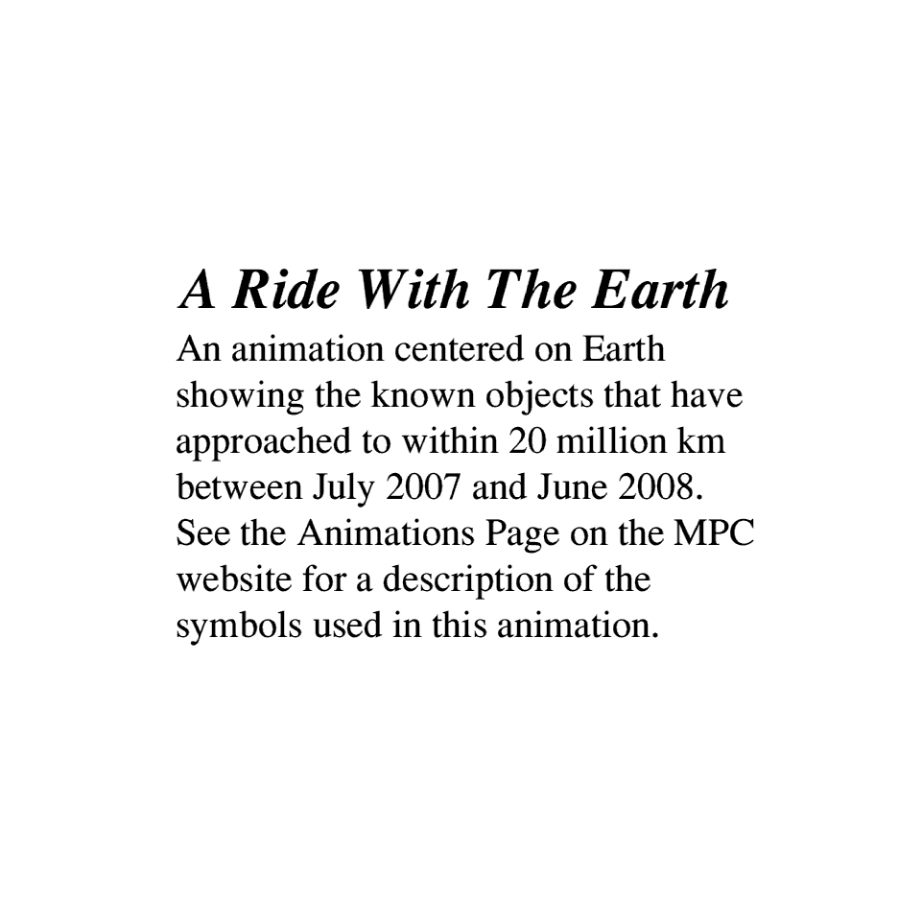
green < .13 AU
orange < .09 AU
red < .045 AU
filled: above ecliptic

Slide 43
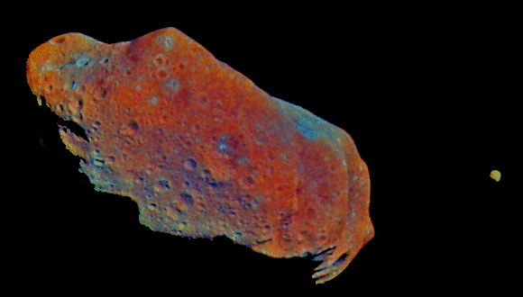
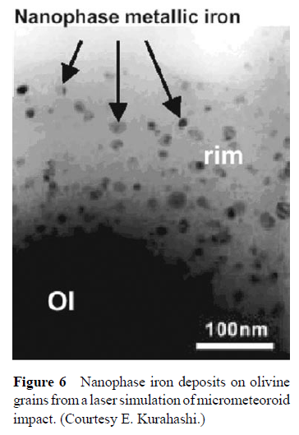
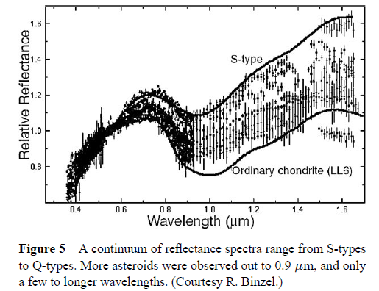
Ida in false color to show “younger” blue surfaces (recent impacts and quake regions) compared to “older” red areas.
Reddening
red
Dactyl, Ida’s moon
Chapman, C. R. Space weathering of asteroid surfaces (2004)
Notes:
How do we know Asteroids age at all?
1st, we can see basic evidence of older surfaces being redder, and newer surfaces being bluer
We see what appears to be a basic progression in the spectra of Q type (OC) to S type spectra
suggests that something gradually changes Q type asteroids into S type asteroids
mechanism for this change could possibly be micro-bombardment or solar wind implantation (SWI)
both mechanisms reduce olivine and create oxidized iron on surface of asteroids turning them red with time
SWI is thought to be a relatively rapid process, while micrometeorite bombardment is thought to be slow.
Galileo Flew by Ida on Aug. 28, 1993
Ida = S type, 31.4 km

Slide 44
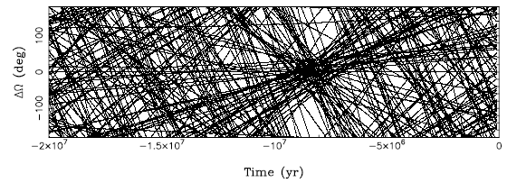
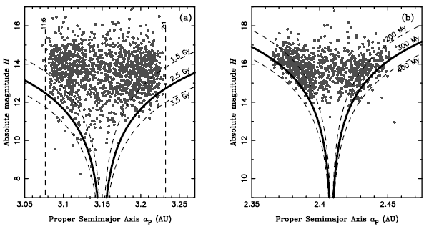
Two Methods for Family Ages
Nodal Longitudes for Veritas family converge at T≈8.3 Myr, suggesting most of family formed during catastrophic collision at that time.
Absolute Mag. H vs proper semi-major axis for (a) Themis, and (b) Massalia families. The V-shaped Curves are the maximal drift rates due to the Yarkovsky effect (anisotropic emission of thermal photons from a rotating body) assuming a tight initial orbit. Best fit for Themis is 2.5±1 Gyr, Massalia, 300±100 Myr.
Nesvorny et al. Recent Origin of the Solar System Dust Bands. (2003)
Notes:
to determine how much weathering takes place over time, ages are needed:
1. rough estimate can be taken from the general dispersion in a-e-i space because they all originated from a single progenitor
2. trace back orbits of asteroids in terms of longitudes for their nodes and an intersection point can be found when they all possessed the same orbit … it is likely that at this time, they were a single body
3. measure scatter in terms of semi major axes of Asteroid orbits
main culprit is Yarkovsky effect … Sun heats an asteroid that radiates heat as infrared photons as it rotates
Asteroid gets a certain momentum determined by the direction and speed of rotation, significant over millions of years
fit curves for the Yarkovsky effect on the absolute magnitude in H vs. semi major axis plot
1 sigma lines likely identify interlopers

Slide 45
H = Heliocentric Absolute Magnitude

