Slide 1
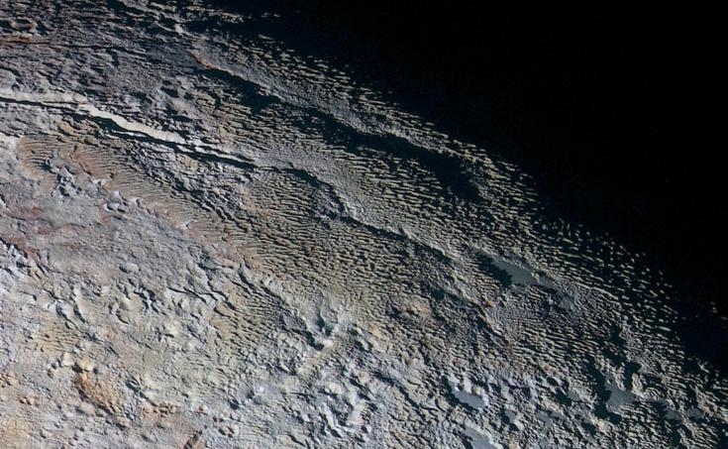
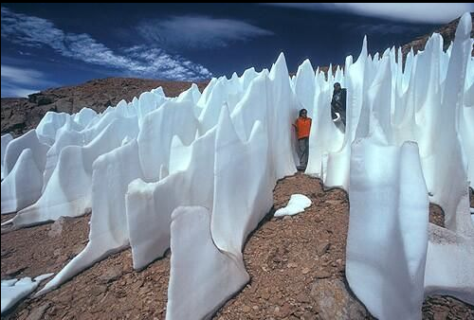
Where is this?
penitentes … only on Earth and Pluto
Notes:
Penitente
Snakeskin Terrain on Pluto: In this extended color image of Pluto taken by NASA's New Horizons spacecraft, rounded and bizarrely textured mountains, informally named the Tartarus Dorsa, rise up along Pluto's day-night terminator and show intricate but puzzling patterns of blue-gray ridges and reddish material in between. This view, roughly 330 miles (530 kilometers) across, combines blue, red and infrared images taken by the Ralph/Multispectral Visual Imaging Camera (MVIC) on July 14, 2015, and resolves details and colors on scales as small as 0.8 miles (1.3 kilometers).
The Penitentes are tall thin blades of hardened snow formation that points towards the direction of the sun. They form when the sun's rays turn snow directly into water vapor without melting it first, a process called sublimation. Penitentes are spikes of snow that form typically only in high-altitude areas, like Chile's Atacama Desert. They can get as tall as 20 feet in the right conditions. Their name comes from their resemblance to a group of monks who wear spiky hats.

Slide 2
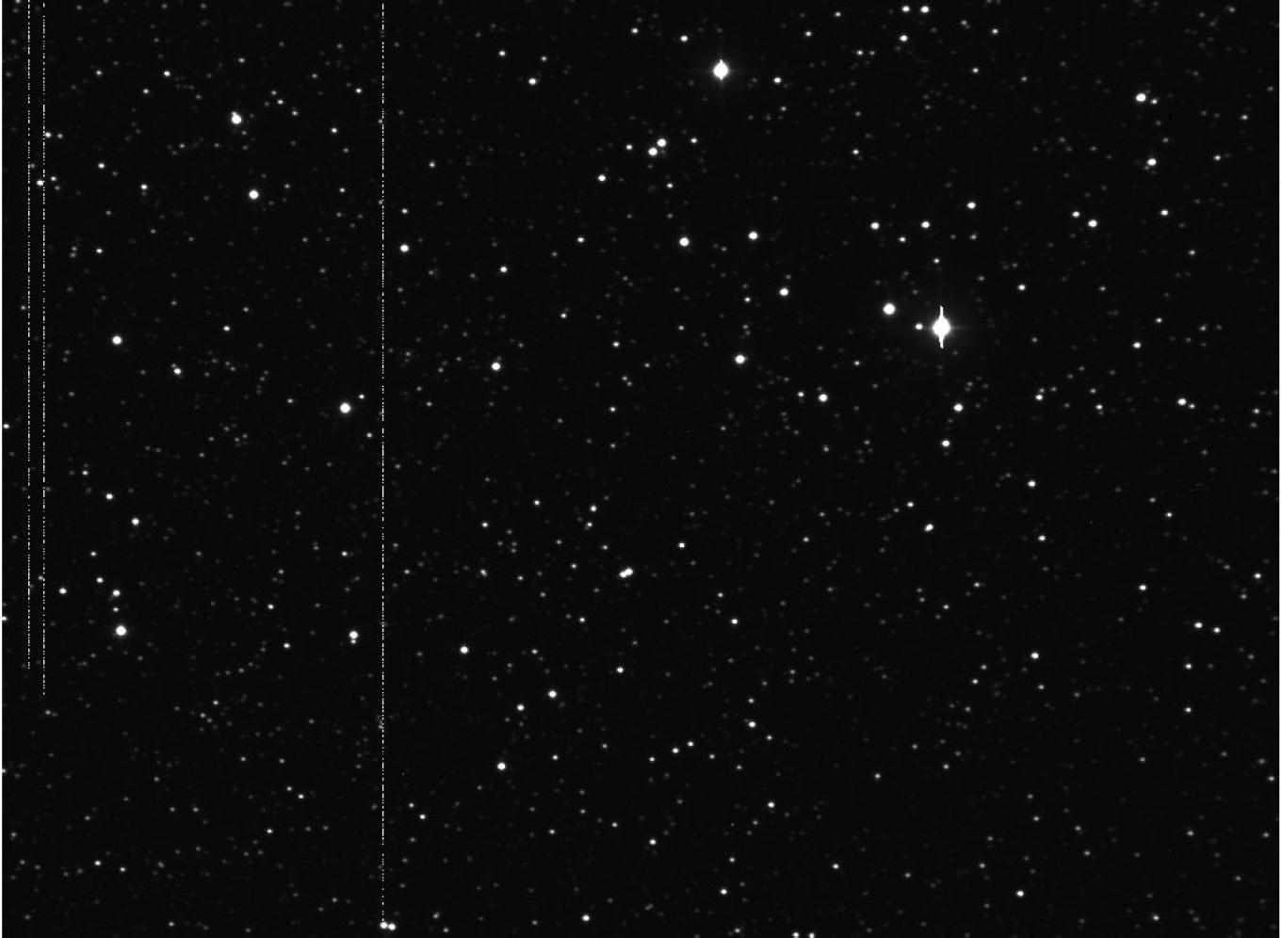
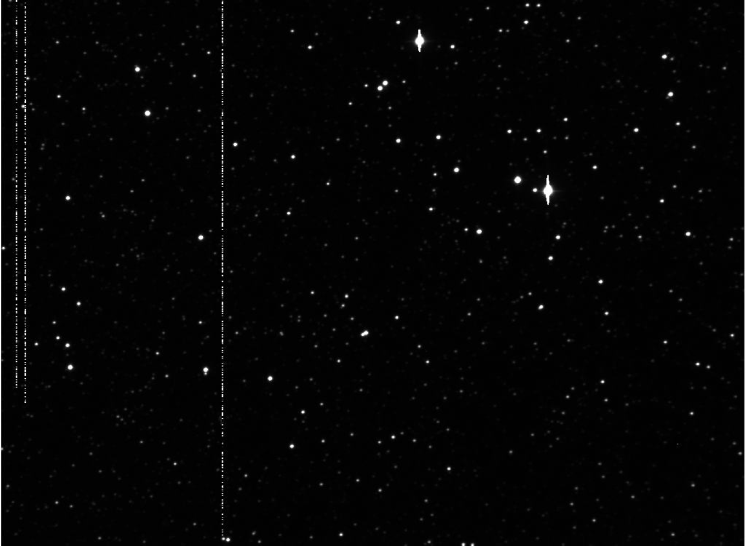
Minor Bodies
beyond Jupiter
contributions
by Nic Scott
Notes:
blink comparator ^ look here, up and left of double blip
I think this is Pluto …

Slide 3
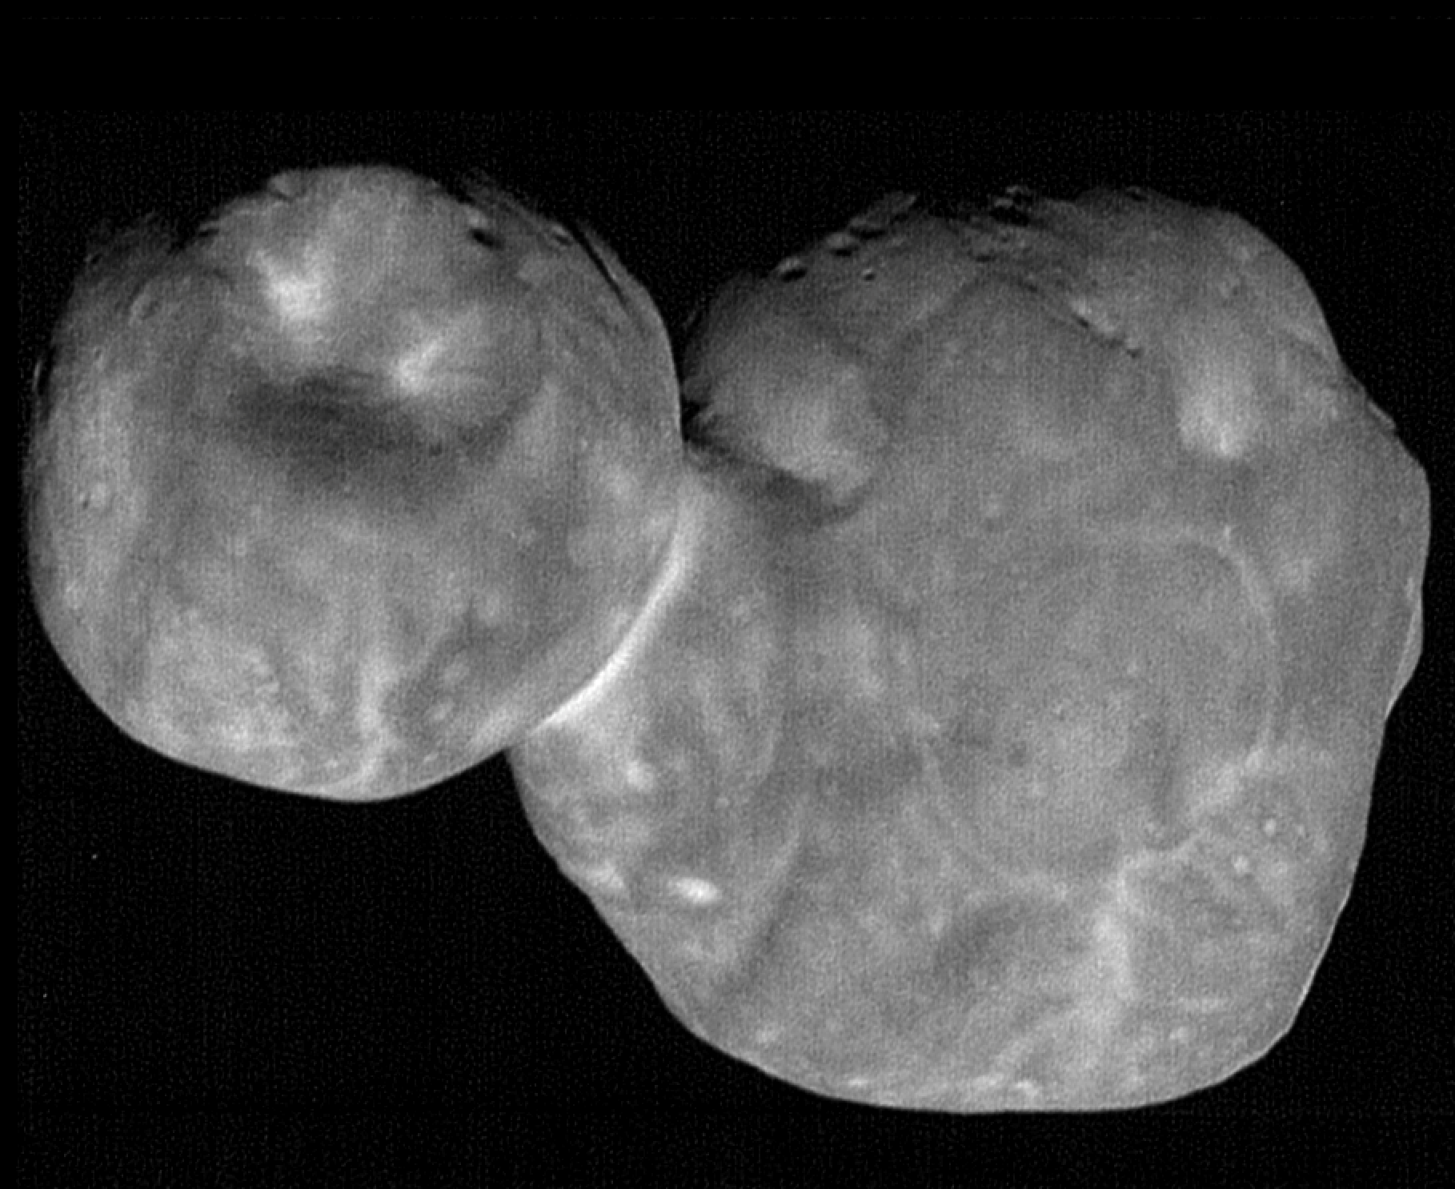
Minor Bodies
beyond Jupiter
486958 Arrokoth (Ultima Thule)

Slide 4
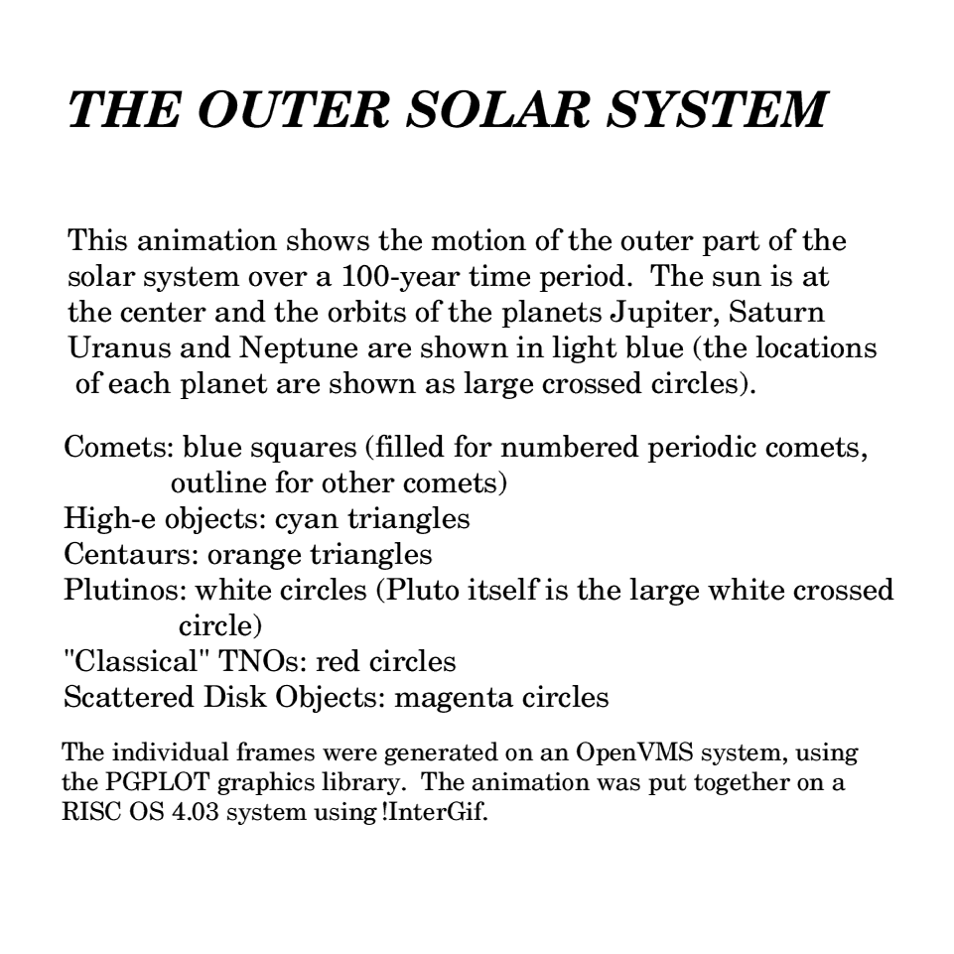
100 Years
Orange: Centaurs
Blue Box: Comets
Filled Box: JupComets
White Circle: Plutinos
Red Circle: TNOs
Magenta Circle: SDOs
Notes:
cyan triangles = Damocloids

Slide 5
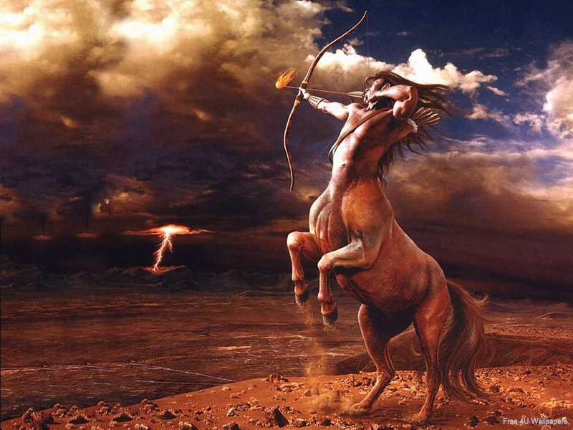
Centaurs

Slide 6
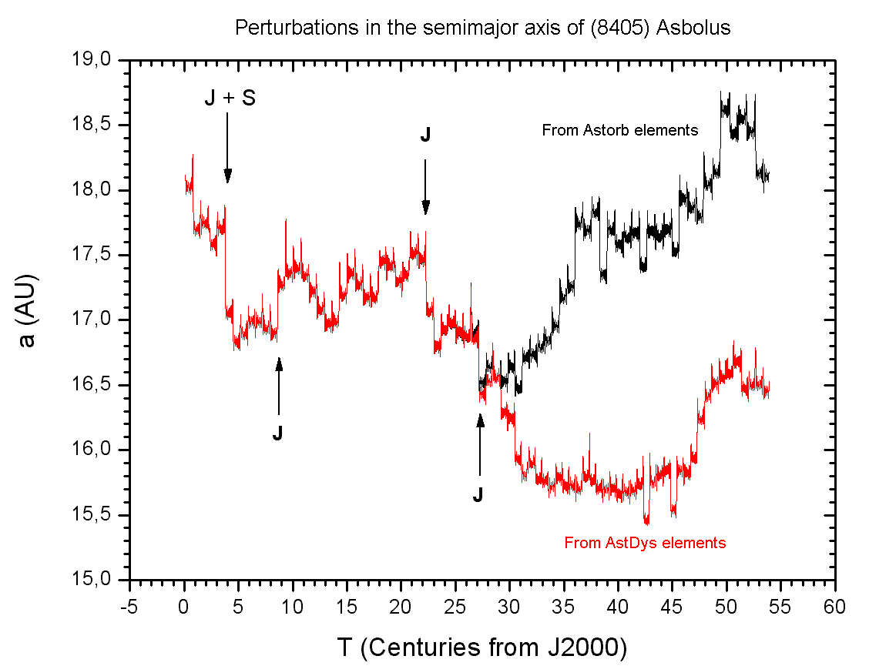
Centaurs
definition a = 5 to 30 AU … not in a 1:1 resonance with any planet
first discovered Hidalgo (1920) … Chiron (1977) --- rings
largest Chariklo (260 km) --- rings
population 856 (JPL 2024 NOV 07) … 677 (JPL 2022 OCT 26)
orbits typically stable
for only
a few million years
Notes:
dynamical classification
Hidalgo discovered first but not identified as part of new population of objects
Chiron and Chariklo both likely to have rings
Stansberry 2007
http://chemistry.unina.it/~alvitagl/solex/AsbolA.GIF

Slide 7
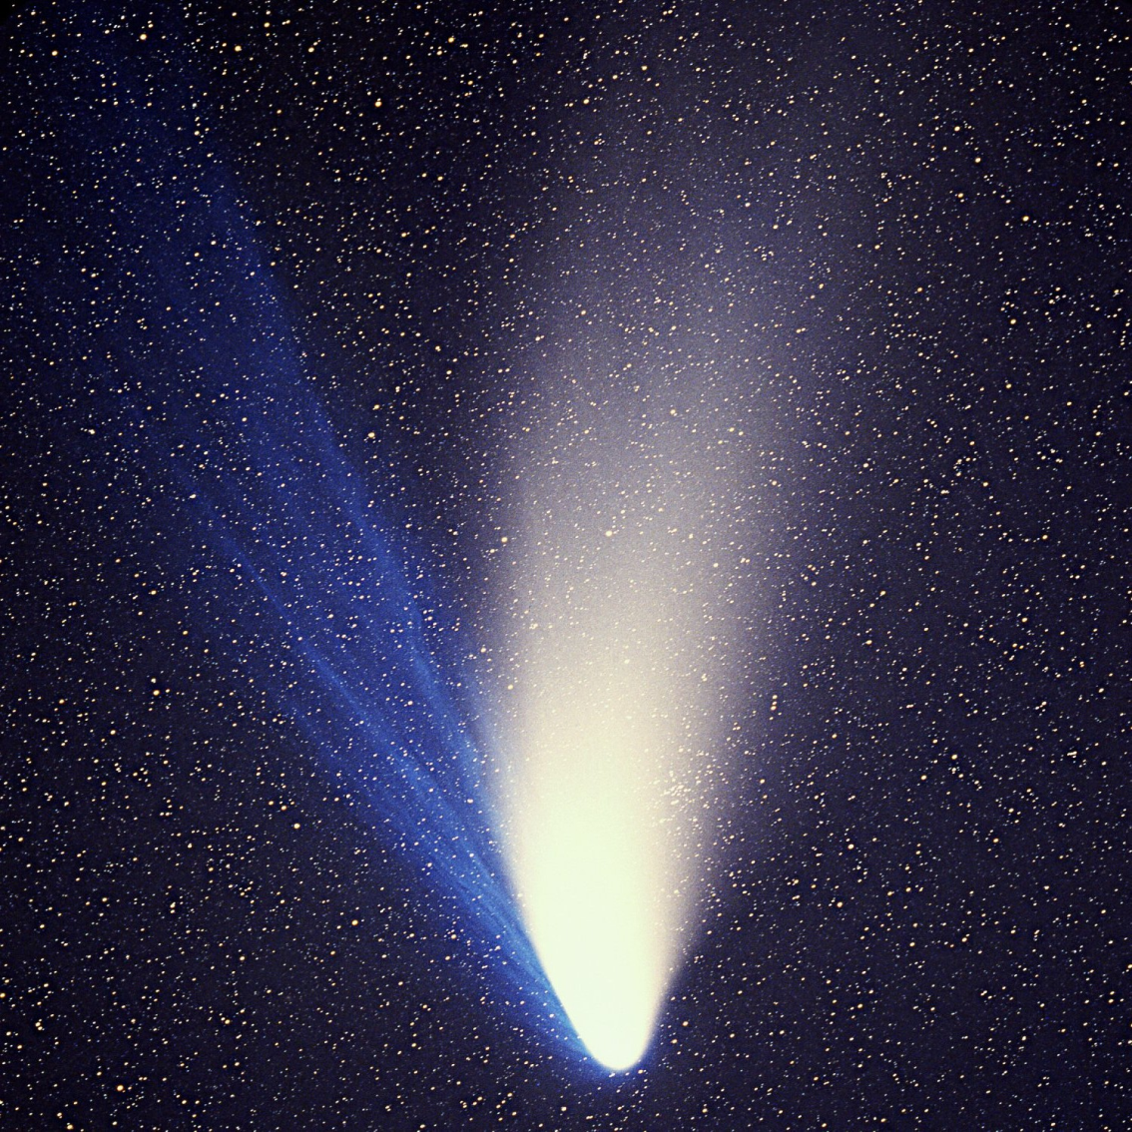
Comets
definition
an object for which a coma or
tail has been observed
careful …
Main Belt Comets
Centaurs
first recorded: Halley’s 239 BCE
largest: Hale-Bopp (60km)
Jupiter family comets: 824
Total population: 3975
(JPL 2024 NOV 07)
Hale-Bopp (1997)
JPL MBDB 3/12/12
Notes:
populations as of 3/8/2017

Slide 8
“TNOs” or “KBOs”
Kuiper’s original prediction: objects were scattered to the Oort cloud by Earth-sized Pluto
did not think objects presently existed
Edgeworth, Leonard, Whipple, et al. made similarly vague claims
none made accurate, precise predictions
observations do not support a single class of objects
Notes:
TNO means a > 30.1 AU (Neptune)

Slide 9
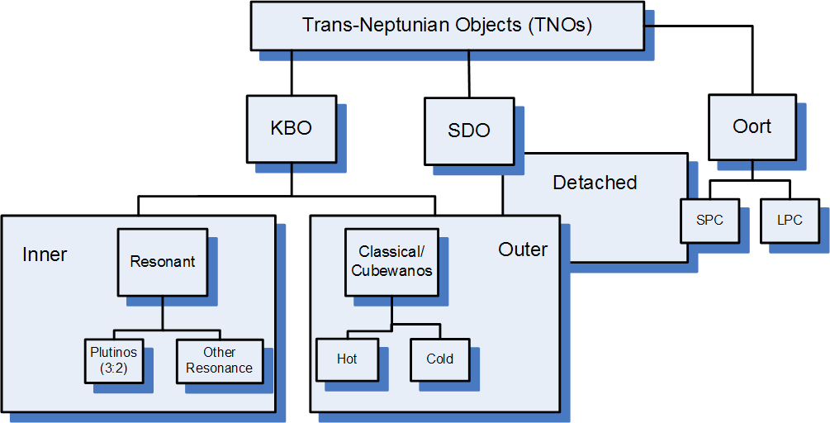
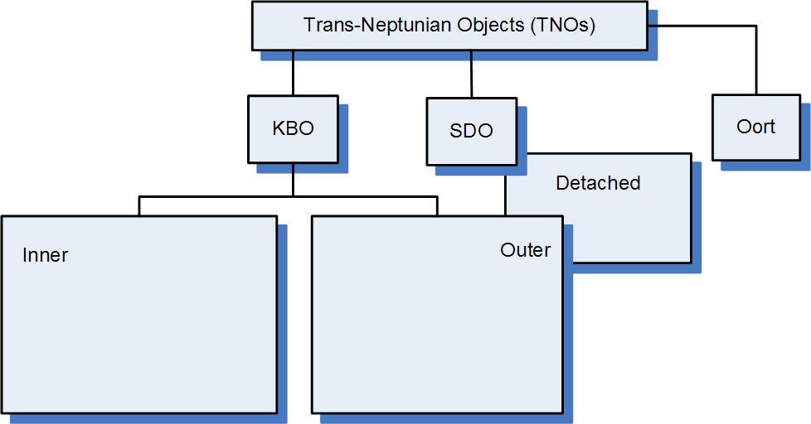
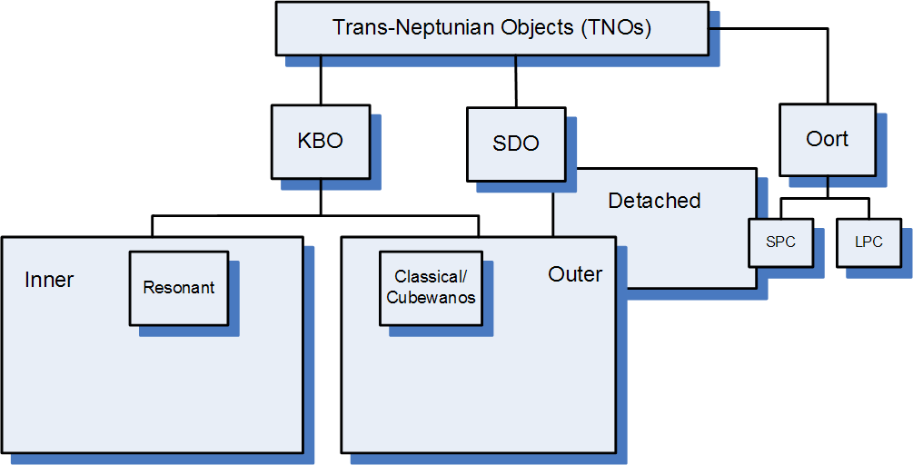
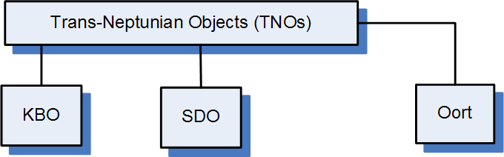
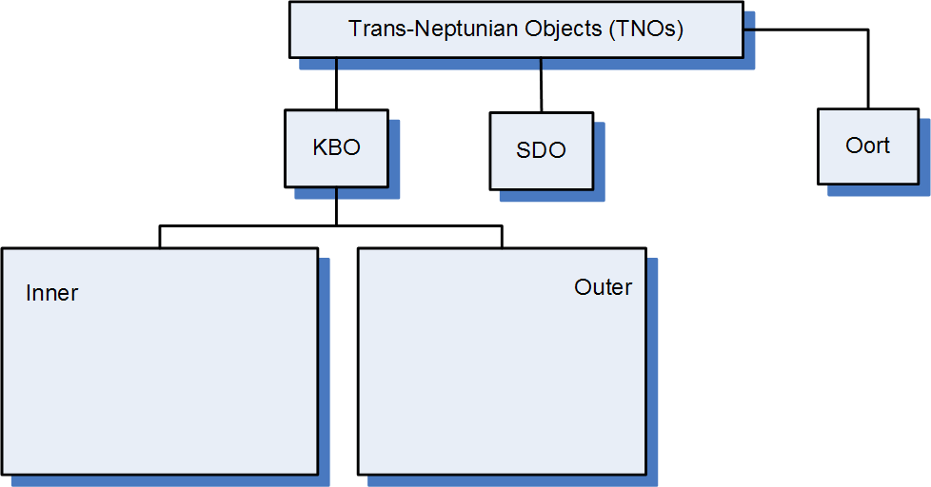
Notes:
Plutoids: dwarf planets beyond Neptune
SPC/LPC = short/long period comets
Cubwanos from 1993 QB1

Slide 10
SSE!
first 4 answers get +1 point
(limit 1 per customer)
Name any TNOs
other than Triton, Pluto, and Arrokoth.
(and Haumea)

Slide 11
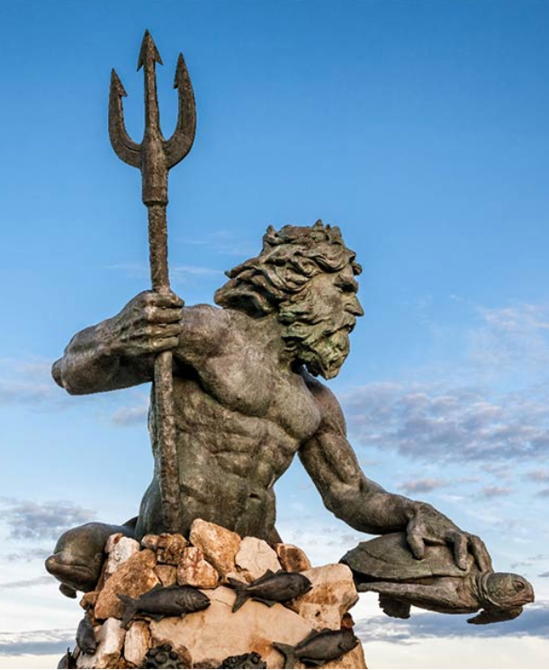
Trans-Neptunian Objects
Pluto disc. 1930 … Charon disc. 1977
QB₁ (Albion) disc. 1992 … Eris disc. 2003
a > 30 AU, most have perihelion > 30 AU
various dynamical classes
torus 10 AU thick at 50 AU (not disk)
source of Centaurs, Jupiter (short period) comets, some outer moons
5123 known (JPL 2024 NOV 07)
4210 known (JPL 2022 OCT 26)
70,000+ > 100 km thought to exist (Jewitt)
> 4% multiplicity
volatile ices that survived formation epoch 4.5 Gyr ago … diverse spectra … some atm

Slide 12
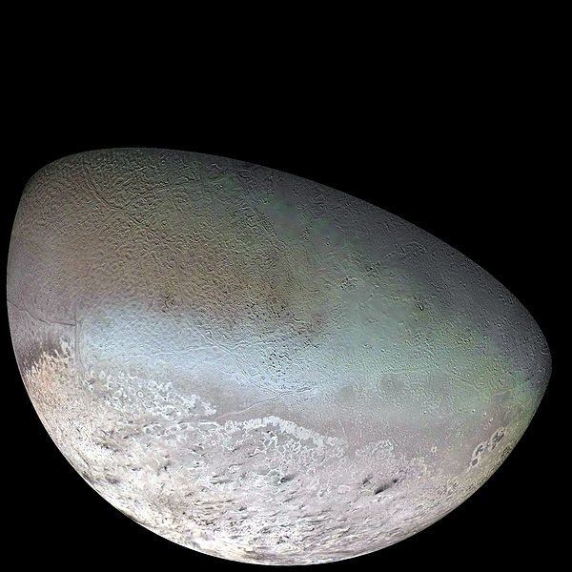
Triton
  retrograde orbit … captured during Neptune’s migration?
  density 2.06 g/cm³
  40% surface imaged … 60% silicates, 40% ices
  T ~ 40K (variable)
  cryovolcanism, “subsurface greenhouse effect”
    clear ice over dark substrate, 4K increase could produce 8 km plumes lasting 1+ yr
    (Soderblom et al. 1990)
  plumes make dark deposits, N₂ winds
  photolysis produced hydrocarbons

Slide 13
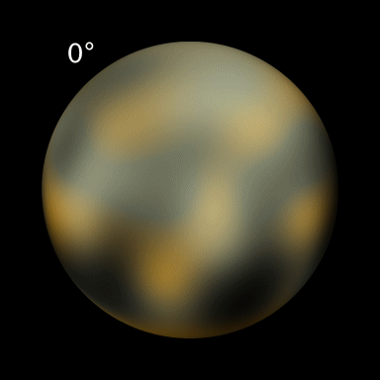
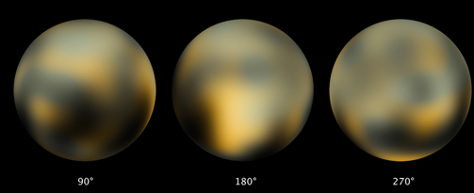
Pluto
Pluto + Charon ~ 20% mass of Moon
Pluto 1.86 g/cm³ … Charon 1.70 g/cm³
5 moons in system … formed by glancing impact?
not isothermal (T ~ 30-60K)
CH₄ + N₂ atmosphere ~1-30 microbar and shifts
low gravity … rapid atmospheric hydrodynamic escape
steep drop in occultation flux near surface … haze
uneven albedo
bright: N₂, CH₄, H₂O, CO ices
cryovolcanism?
dark: tholins?
UV processed N2 + CH₄
seasonal deposits?
Notes:
1ubar at 1250km radius
higher temp (~100K) in upper atmosphere
methane snow?

Slide 14
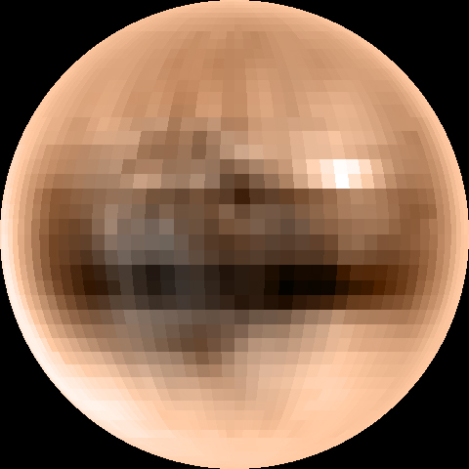
True Color Pluto (Young et al. 2001)

Slide 15
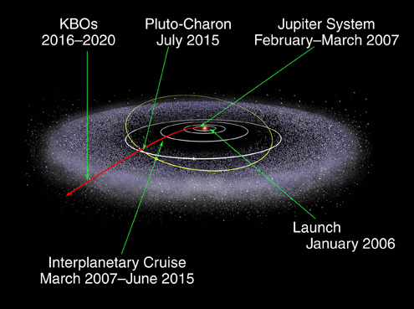
New Horizons

Slide 16
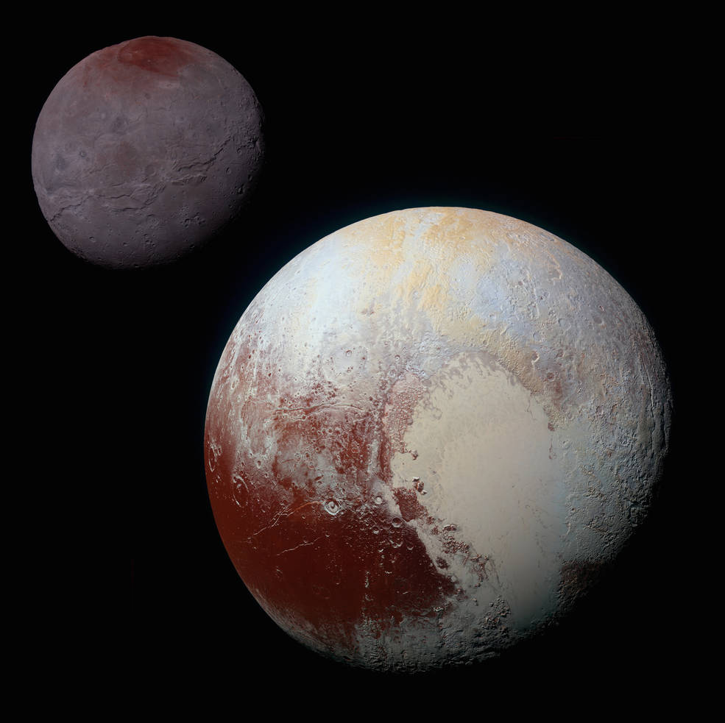
composite image
Pluto movie: https://www.youtube.com/watch?v=6l4kr36TzQ4&vl=en
Notes:
definitely play the movie … great stuff
likely won’t finish slides if you play this

Slide 17
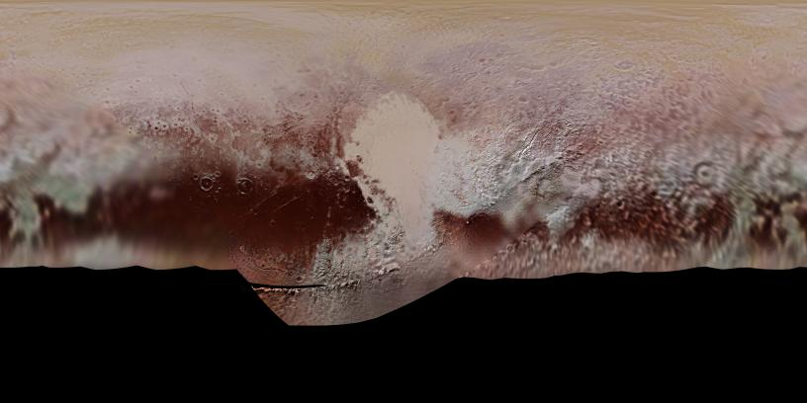
Pluto Map
no data

Slide 18
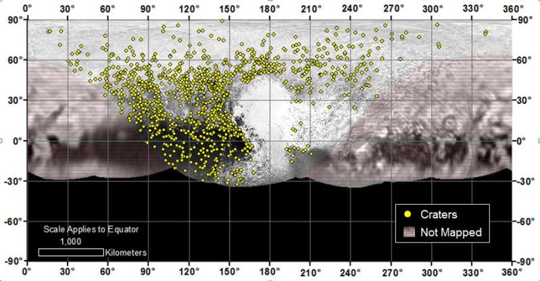
Pluto Map
no data

Slide 19
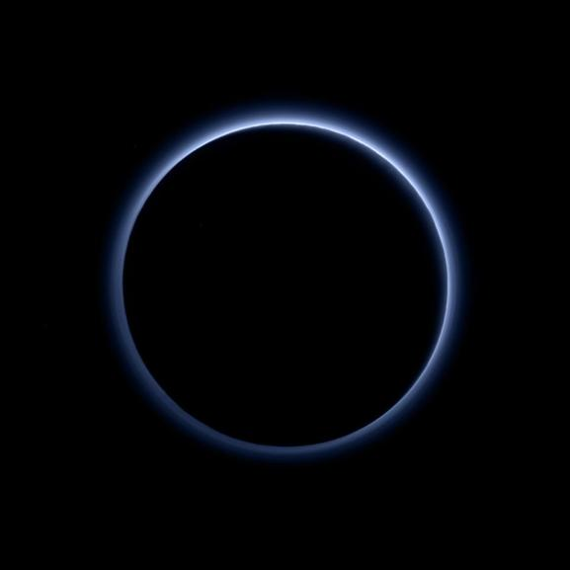
Pluto’s Atmosphere
as human eye
would see it
sunlight acting on N₂ + CH₄ → tholins
Notes:
Pluto's haze layer shows its blue color in this picture taken by the New Horizons Ralph/Multispectral Visible Imaging Camera (MVIC). The high-altitude haze is thought to be similar in nature to that seen at Saturn's moon Titan. The source of both hazes likely involves sunlight-initiated chemical reactions of nitrogen and methane, leading to relatively small, soot-like particles (called tholins) that grow as they settle toward the surface. This image was generated by software that combines information from blue, red and near-infrared images to replicate the color a human eye would perceive as closely as possible.

Slide 20
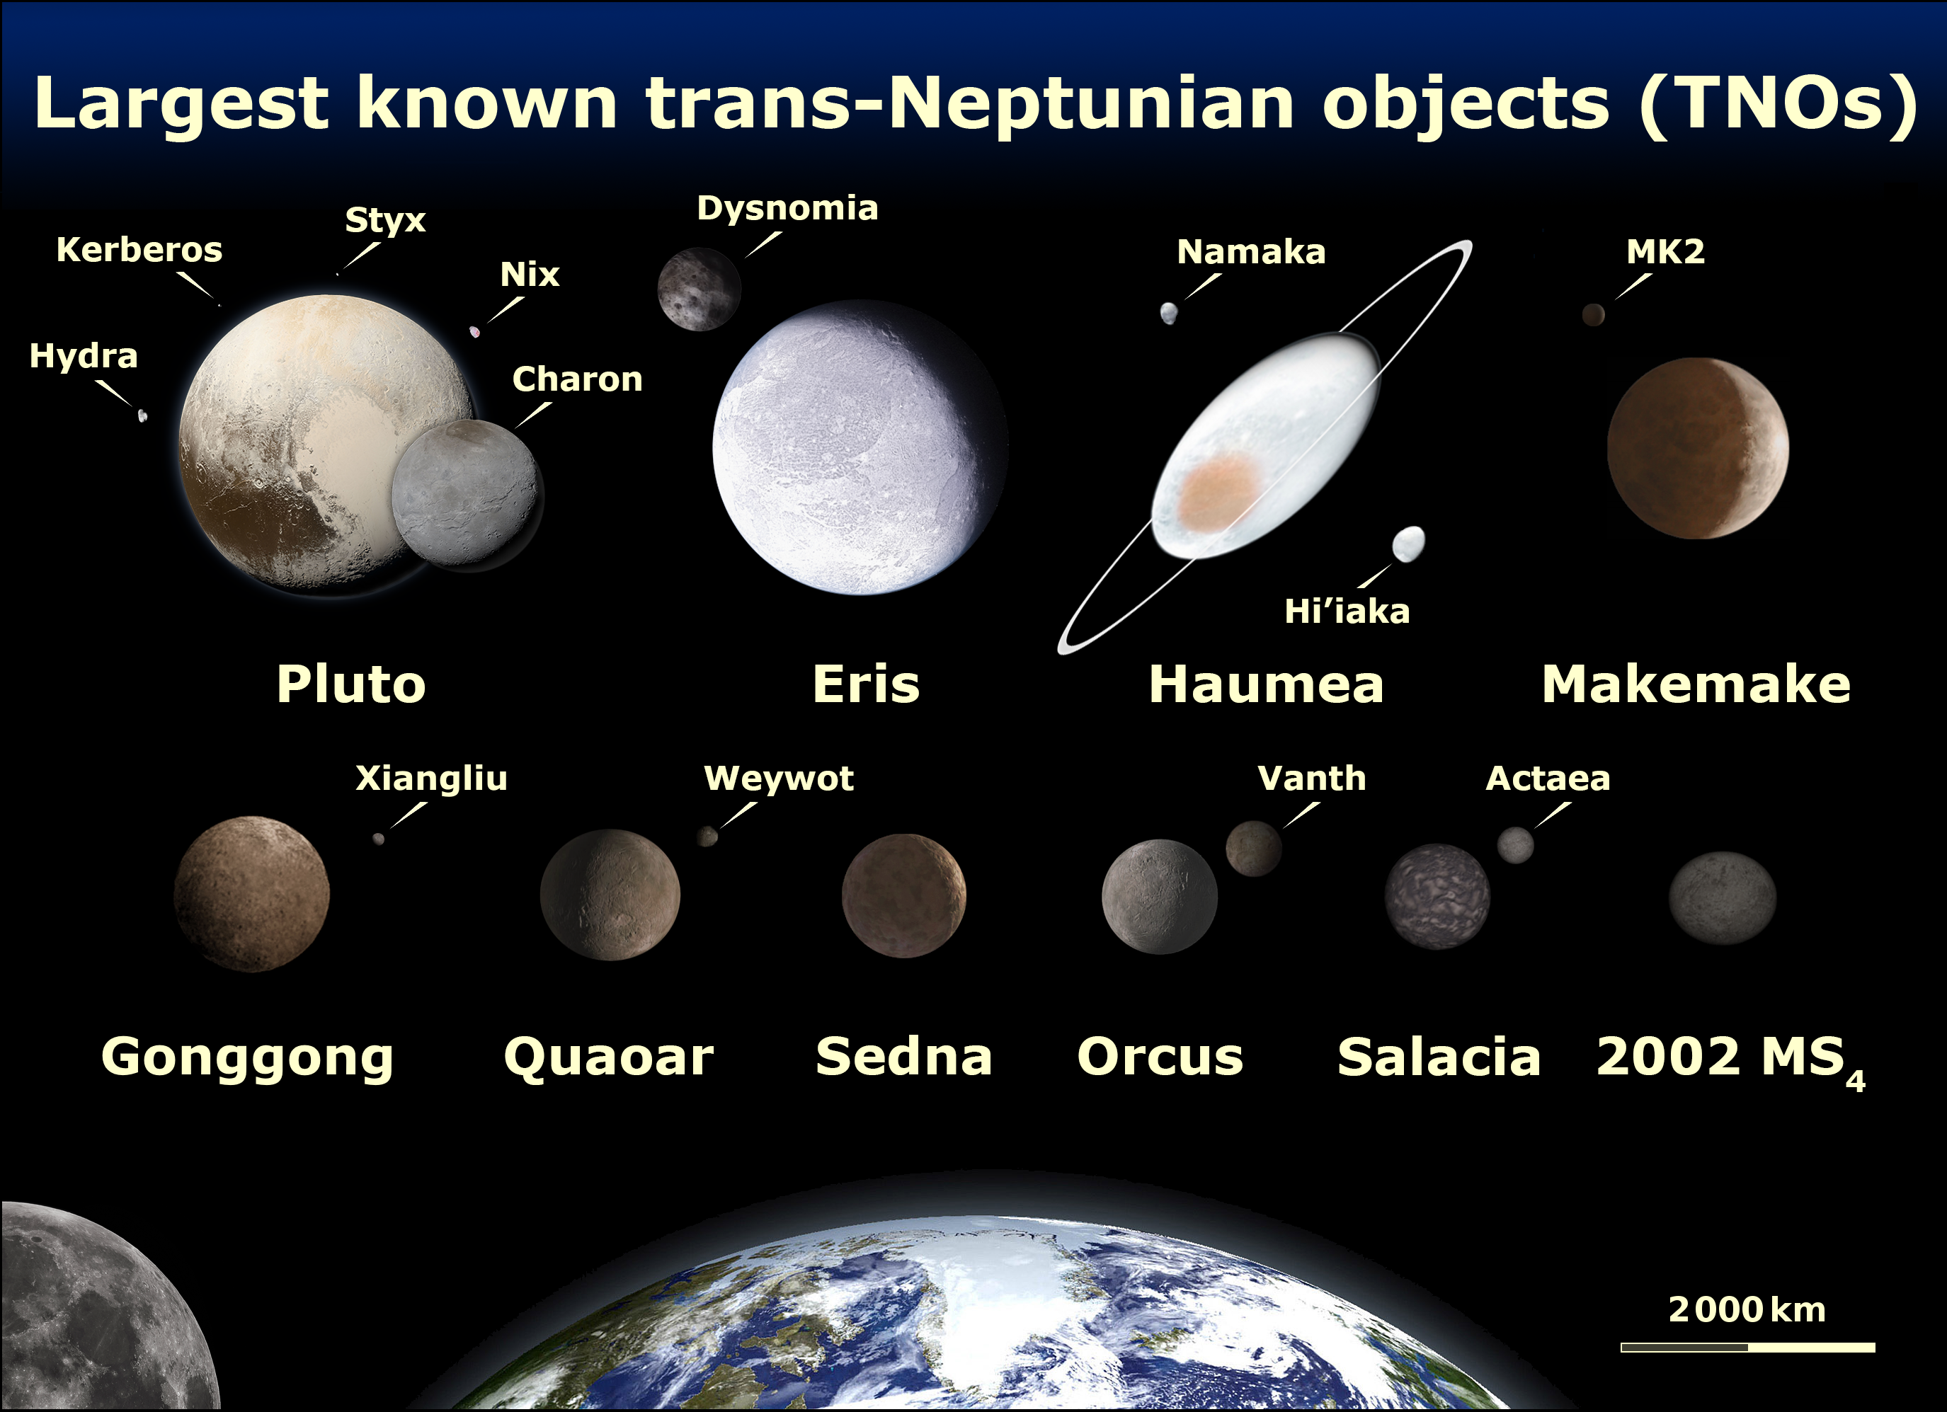
Notes:
Moon is 1.47X the diameter of Pluto

Slide 21


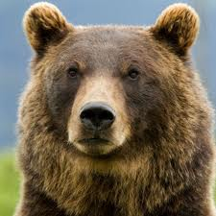

TNO Classes
Resonant Objects linked to Neptune
Classical KBOs orbit roughly where they formed
Scattered Disk Objects flung out by Jovian planets
Detached Objects unaffected by Neptune

Slide 22
Notes:
Plutoids: dwarf planets beyond Neptune
SPC/LPC = short/long period comets
Cubwanos from 1993 QB1

Slide 23
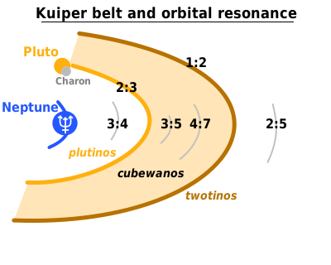
1. Resonant Objects
mean motion resonance with Neptune
“Plutinos” at 2:3
dynamically stable
Notes:
Pluto’s longitude of perihelion is separated from Neptune by 90 deg
what about the Tostinos?

Slide 24
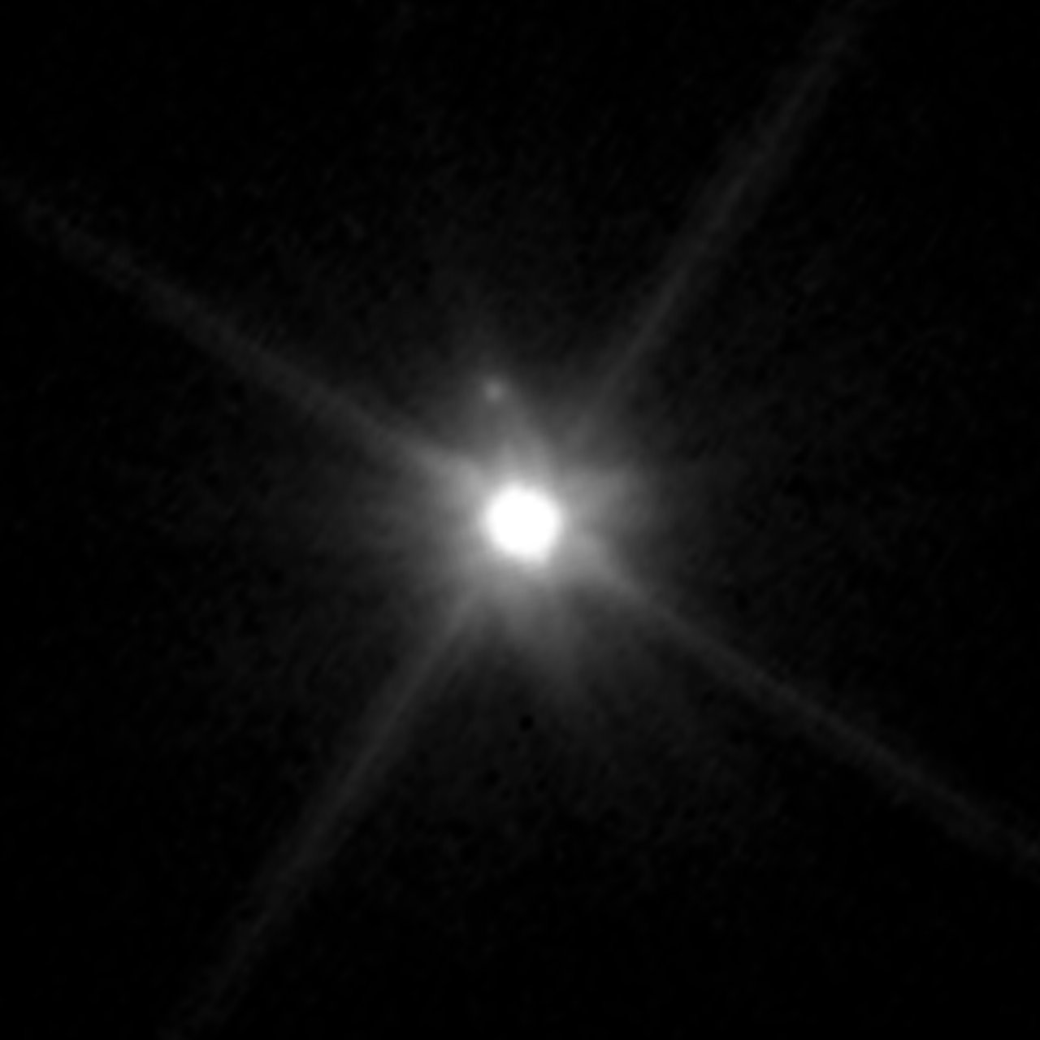
2. Classical KBOs
between 2:3 (39.5 AU) and 1:2 resonances (48 AU)
but not including those
two dynamical classes
“Cold” e < 0.1 and i < 10° … redder
“Hot” e > 0.1 and i up to 40°
Makemake and “MK2” … by HST 2015 APR
Notes:
classical Kuiper Belt has redder objects ... older surface
SDOs/detached objects tend to be pinker … formed in gas giant region and tossed, presumably

Slide 25
3. Scattered Disk Objects
~35 to 40 AU and beyond
source of Jupiter family comets
flung out when Neptune migrated outward
high eccentricity and inclination
first 1996 TL₆₆ … a = 89 AU, e = 0.58, i = 24°
also Eris … a = 68 AU, e = 0.44, i = 44°
scattered and being depleted … OR …
in higher order resonances and ~ stable
Notes:
classical Kuiper Belt has redder objects ... older surface
SDOs/detached objects tend to be pinker … formed in gas giant region and tossed, presumably

Slide 26
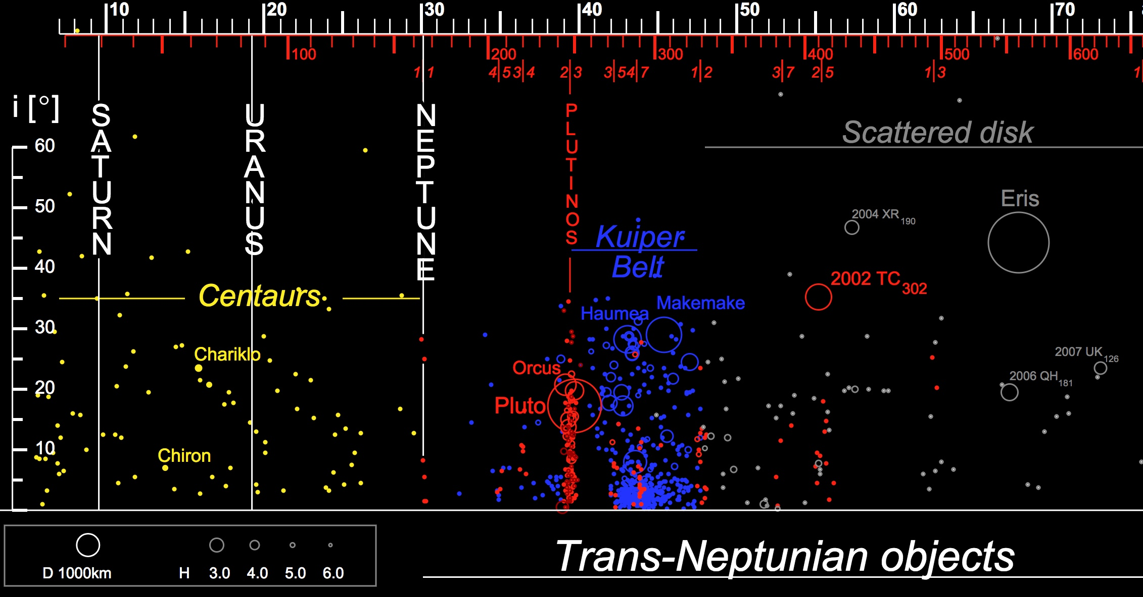
(Centaurs and)
Lions and Tigers and Bears

Slide 27
4. Detached Objects
extended scattered disk/inner Oort Cloud objects
resonances: 1:3, 2:7, 3:11, 5:22 and 4:79 and more
Sedna … a = 524 AU, e = 0.85, i = 12°
2000 CR₁₀₅ … a = 230 AU, e = 0.81, i = 23°
2012 VP₁₁₃ … a = 266 AU, e = 0.69, i = 24°
not emplaced via Neptune …
passing star … planet 9?
Notes:
2012 VP is the one that reinvigorated the planet 9 discussion

Slide 28
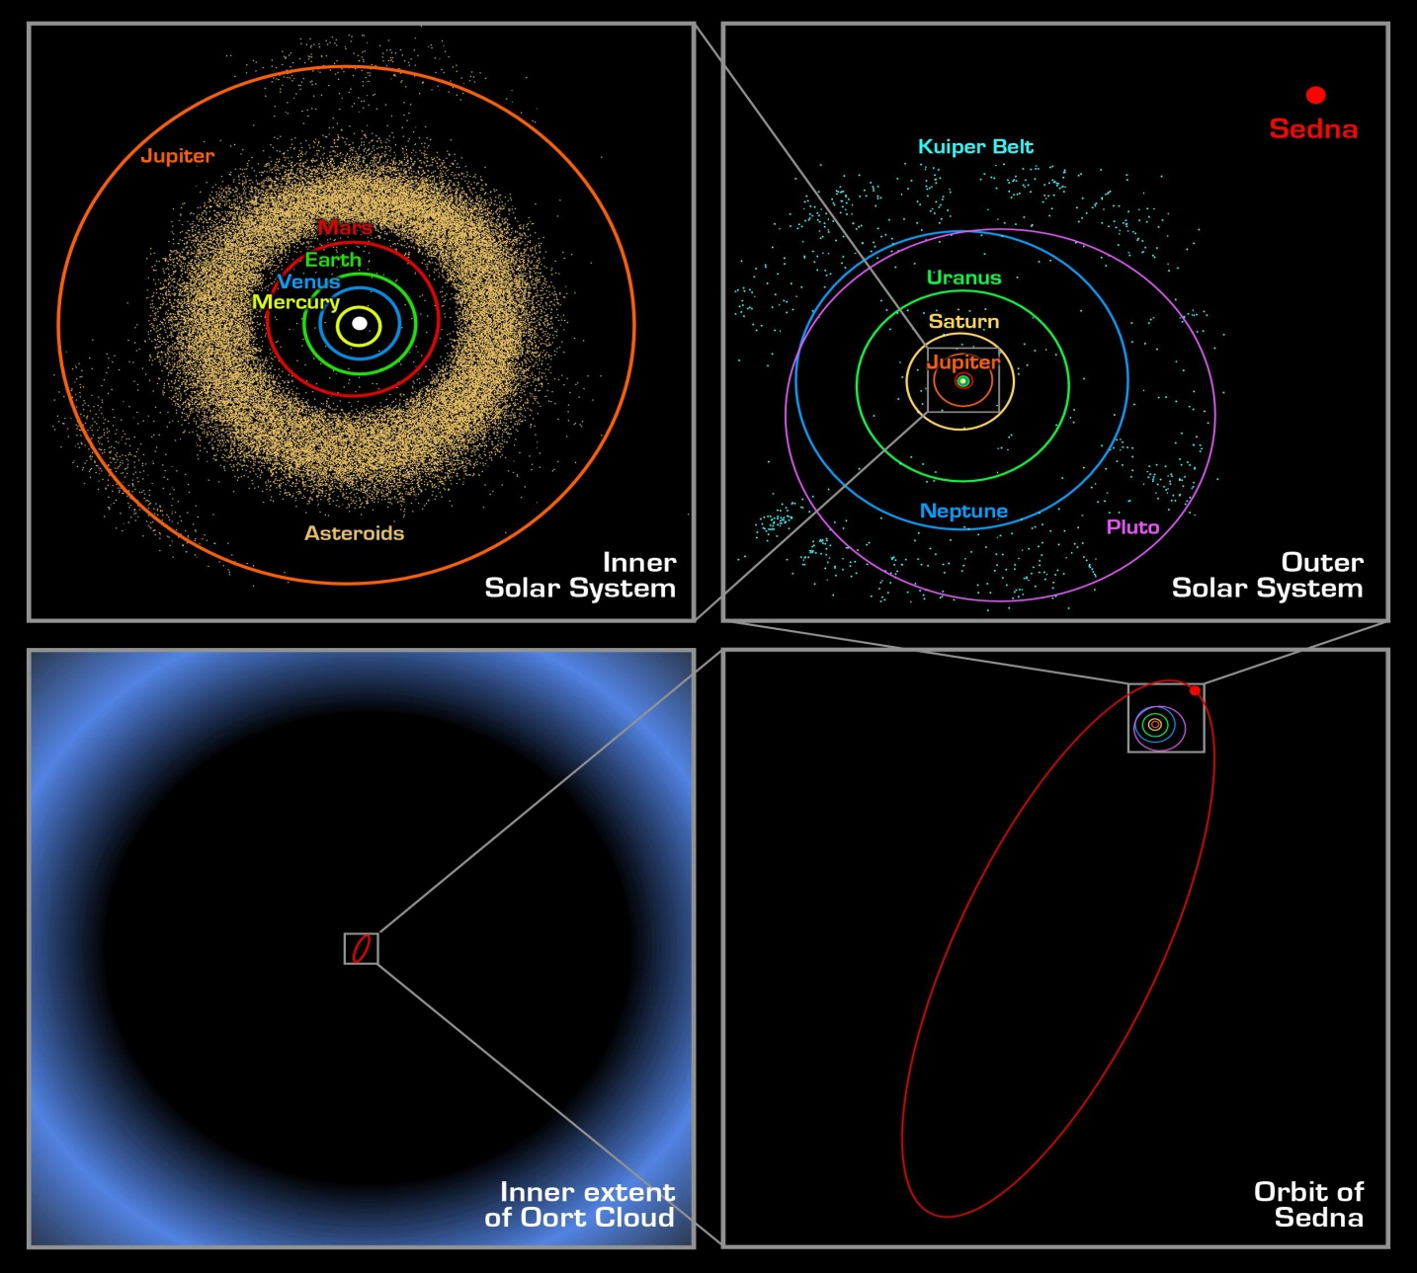
Sedna
P ~ 12,000 yr
e = 0.85
a ~ 524 AU
ap ~ 975 AU
pe ~ 75 AU

Slide 29
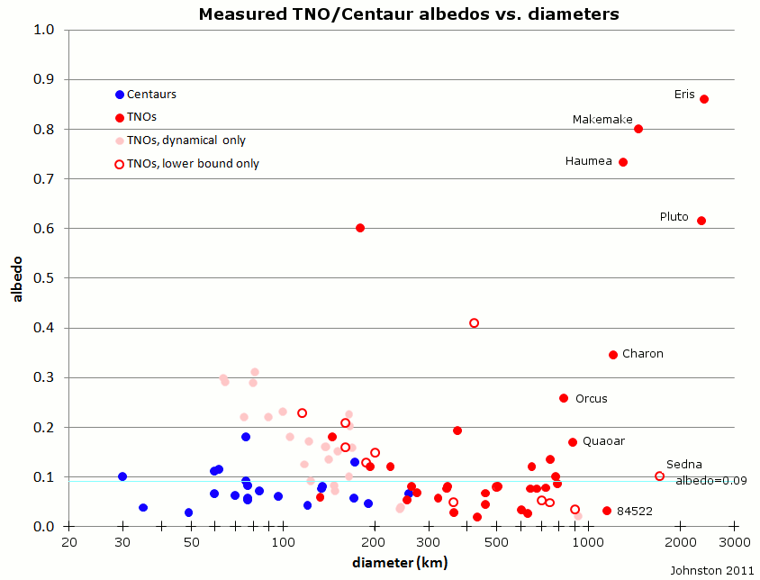
Notes:
Centaurs, 0.076 (21)
TNOs, over 1200 km in diameter, 0.576 (6)
TNOs, under 1200 km in diameter, 0.135 (64)
--better constrained only, 0.133 (53);
--thermal or direct measurement, 0.107 (29) (median 0.079);
--dynamical measurement only, 0.165 (24) (median 0.160).

Slide 30
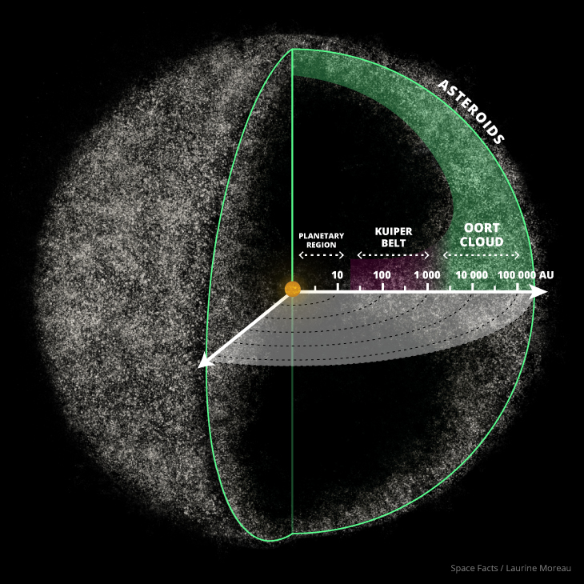
Oort Cloud
TNOs with aphelia > 1000 AU
2017 MB7 8114 ± 500 AU
2014 FE72 3390 ± 1400
2012 DR30 3248.7 ± 7.5
2016 FL59 2454 ± 250000 (33 day obs arc)
2005 VX3 2081 ± 430
2013 BL76 2064.1 ± 5.1
2015 TG387 2037 ± 340
2015 KG163 1612 ± 12
2006 SQ372 1547 ± 2
2013 SY99 1297 ± 41
2002 RN109 1126 ± 49
2013 AZ60 1062.00 ± 0.49
2000 OO67 1000.3 ± 3.8
probably no distinct boundary to Oort cloud
source of Halley family comets
Notes:
list shamelessly pulled from Wikipedia on 2018.1012

Slide 31
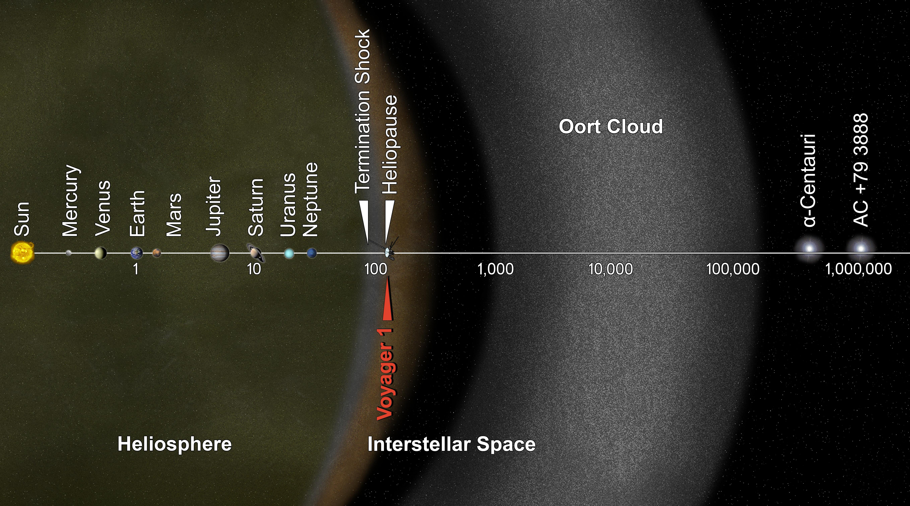
TNOs with aphelia > 1000 AU
https://commons.wikimedia.org/w/index.php?curid=28366203

Slide 32
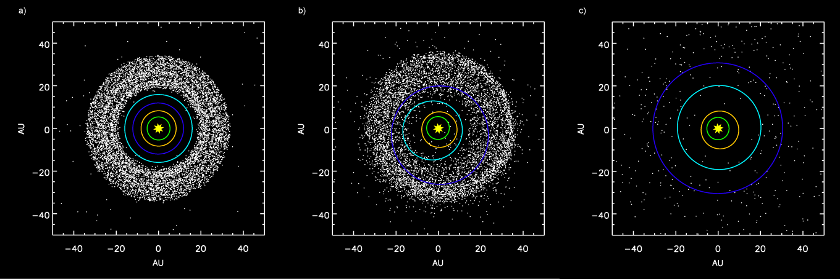
Nice Model Tsiganis et al. (2005) and Gnomes et al. (2005)
(left) before Jupiter/Saturn 2:1 resonance
(mid) scattering of Kuiper belt objects into the Solar System after the orbital shift of Neptune
(right) after ejection of Kuiper Belt bodies by Jupiter
Neptune migration of ∼7 or 8 AU over 10 Myr could account for the resonant populations
scattered disk explained by long term perihelic interactions with Neptune
accounts for late heavy bombardment period at 3.8-3.9 Gyr
explains Hot but not Cold classical KB
alternative is scattering and chaotic capture by an eccentric Neptune (Levison et al. 2008)

Slide 33
Solar System Explorers: 07 NOV
Name a minor body (no satellites) with an orbital semimajor axis greater than Mars’ (1.52 AU) and describe three of its physical characteristics, e.g., Hektor is ~400x200x200km in size, has density 1.0-2.4 g/cm³ and albedo 0.02-0.11.
1. Eris 2400km 2.52 g/cm3 0.99 albedo
2. Quaroar 10^21 kg 2 g/cm3 0.12 albedo
3. Haumea 1560km 2.6 g/cm3 0.66 albedo
4. Pluto 2377km 1.86 g/cm3 10^22 kg
5. Virginia 84km X class MBA 0.05 albedo
6. Makemake 1426km 1.4-3.2 g/cm3 0.95 albedo
7. Eleonora 10^19 kg 2.1-4.3 g/cm3 0.17 albedo 0.75 oblateness
8. [Charon 1212km 1.3 g/cm3 0.3 albedo – satellite]
9. …
10. …
11. …
12. …
13. …
14. …
15. …
16. …
17. …
18. …
19. …
20. …

Slide 34
Solar System Explorers: 14 NOV
Name any attribute (other than location or related to life) of a TEEEM member --Titan, Earth, Europa, Enceladus, Mars -- that sets it apart from all the others.
1. …
2. …
3. …
4. …
5. …
6. …
7. …
8. …
9. …
10. …
11. …
12. …
13. …
14. …
15. …
16. …
17. …
18. …
19. …
20. …

Slide 35
…………………………
Notes:
35

