Slide 1
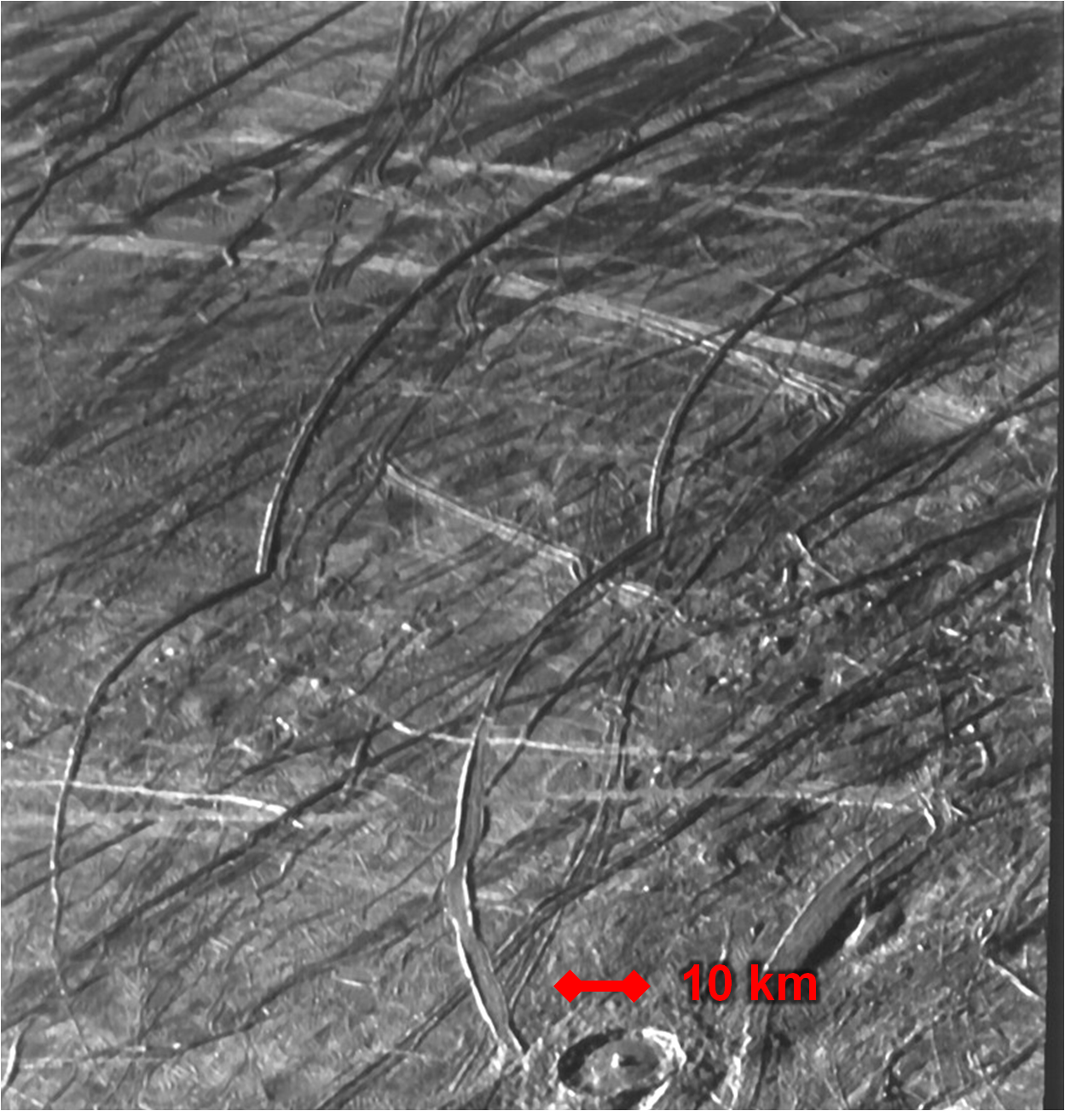
Where is this?

Slide 2
Solar System Explorers 01 NOV
1. What does it mean if the coefficient in the moment of inertia for a spherical world is less than 0.4 in the equation I = 0.4 MR²?
…
2. What is the BIG difference between the geoids of Earth and Mars?
…
3. What are two internal heat sources in planets and moons in the Solar System?
…
4. Which terrestrial planet has the largest portion of its interior as a core?
…
5. Which Galilean moon definitely does NOT have a subsurface H₂O ocean?
…
B1. Name two reasons why Europa is thought to have a liquid ocean.
…
B2. Which is the MOST differentiated, the Sun, Jupiter, or Saturn?
…
Notes:
ohmic heating --- results from the dissipation of an induced electric current

Slide 3
Solar System Explorers 01 NOV

Slide 4
Solar System Explorers 01 NOV
1. What does it mean if the coefficient in the moment of inertia for a spherical world is less than 0.4 in the equation I = 0.4 MR²?
not a uniform (solid) sphere, differentiated interior
2. What is the BIG difference between the geoids of Earth and Mars?
gravity traces surface features on Mars but not Earth
3. What are two internal heat sources in planets and moons in the Solar System?
radioactive decay, gravitational (accretion/differentiation), tidal, ohmic
4. Which terrestrial planet has the largest portion of its interior as a core?
Mercury
5. Which Galilean moon definitely does NOT have a subsurface H₂O ocean?
Io
B1. Name two reasons why Europa is thought to have a liquid ocean.
features indicative of thin ice sheets, geysers/plumes,
weak magnetic fields, spins faster now/in the past than synchronous
B2. Which is the MOST differentiated, the Sun, Jupiter, or Saturn?
Sun (I = 0.07 MR²) … Jupiter (0.28) … Saturn (0.21)
Notes:
ohmic heating --- results from the dissipation of an induced electric current

Slide 5
Solar System Explorers: 03 NOV
Name a minor body (no satellites) with an orbital semimajor axis greater than Mars’ (1.52 AU) and describe three of its physical characteristics, e.g., Hektor is ~400x200x200km in size, has density 1.0-2.4 g/cm³ and albedo 0.02-0.11.
1. …
2. …
3. …
4. …
5. …
6. …
7. …
8. …
9. …
10. …
11. …
12. …
13. …
14. …
15. …
16. …
17. …
18. …
19. …
20. …

Slide 6
Planetary Sciences Project
Level 0 … Topics … Thu 01 SEP
Level 1 … Outline … Thu 22 SEP
Level 2 … Draft #1 … Thu 13 OCT
Level 2 … Draft #1 … Thu 20 OCT
Level 3 … Draft #2 … Thu 03 NOV
Presentations … in class … 15+17(+21) NOV
Level 4 … Final Paper … Fri 02 DEC

Slide 7
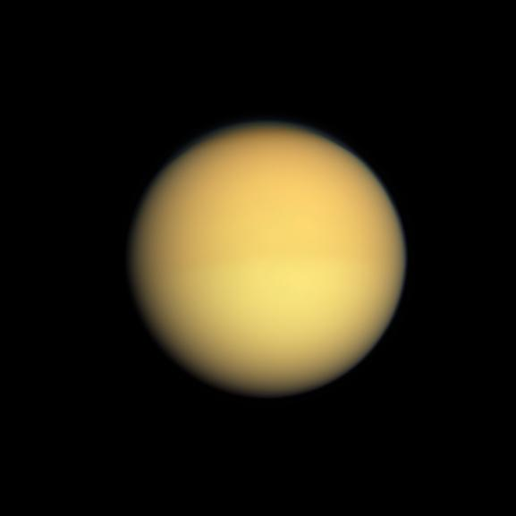
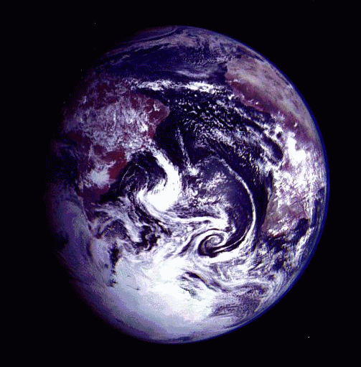
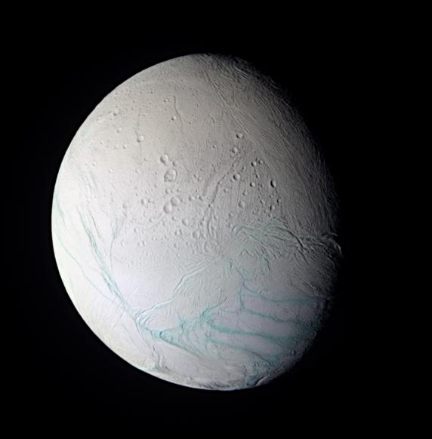
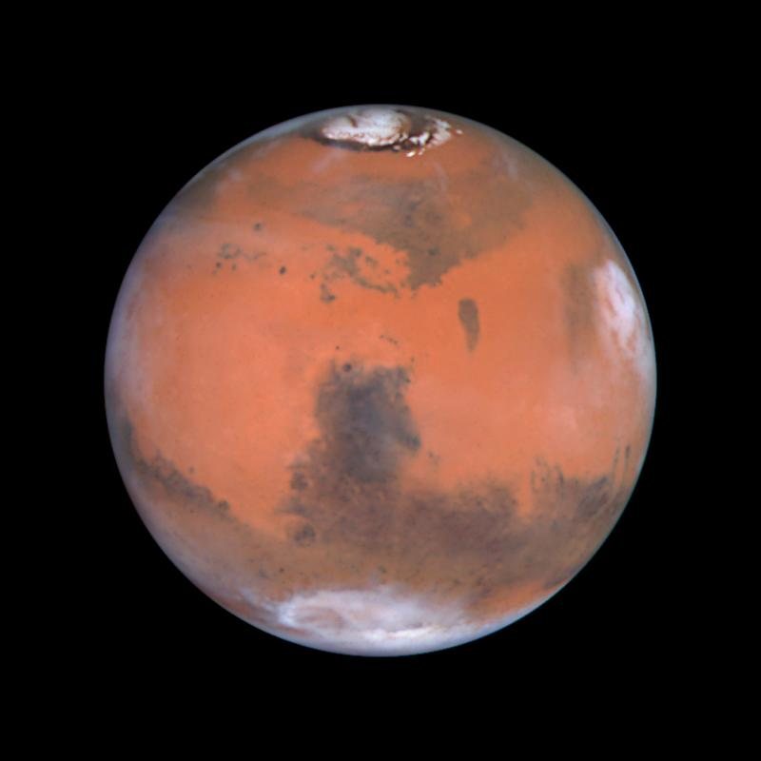
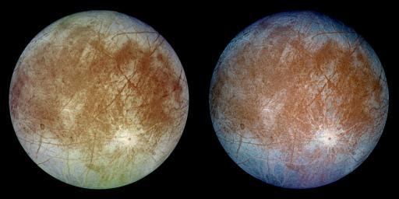
TEEEM I: Locations for Life?

Slide 8
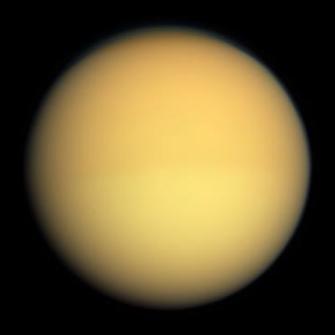
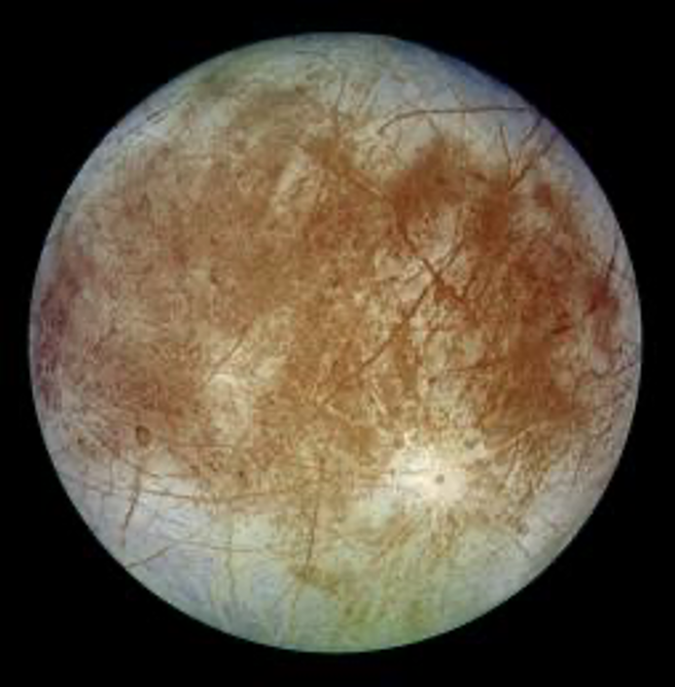
A Pseudo Evolutionary Sequence
Titan --- primitive world, primitive atmosphere
Earth --- middle-aged world, multiple atmospheres
Enceladus --- fighting Snowball Earth
Europa --- Snowball Earth equivalent
Mars --- post Snowball Earth with
evaporated ice surface

Slide 9
Earth
Basics 1.00 AU, 1.00 year orbit, e = 0.017
d = 12742 km, density 5.5 g/cm³ (highest in S.S.)
Environment 1.0 AU, most solar radiation of 5 TEEEMates
large moon
Atmosphere primarily N₂ + O₂
many trace compounds…and changing
Surface still active, 4.6 Gyr after formation
blue/white/brown/green regions
Anomalies giant impact (Moon)
Snowball Earth … tectonic system escape
greenhouse warming … multiple atmospheres
life (warning: impacts … bye bye dinosaurs)

Slide 10
Earth’s 4 Atmospheres
1 = SSE!
2 = SSE!
3 = SSE!
4 = SSE!

Slide 11
Earth’s 4 Atmospheres
1 = primordial
2 = volcanic
3 = biogenic
4 = anthropogenic
H₂ He lost
H₂O NH₃ CH₄ UV splits → H gone
H₂O added? … bombardment?
H₂O NH₃ CH₄ UV splits → H gone
N₂ N₂O nitrogen supply
(O highly reactive, so it disappears, leaving N₂)
CO₂ SO₂ into rocks/oceans
H₂O condenses … as Earth cools
O₂ cyanobacteria invent photosyn.
O₃ chemically generated
CO₂ CH₄ CFCs …

Slide 12
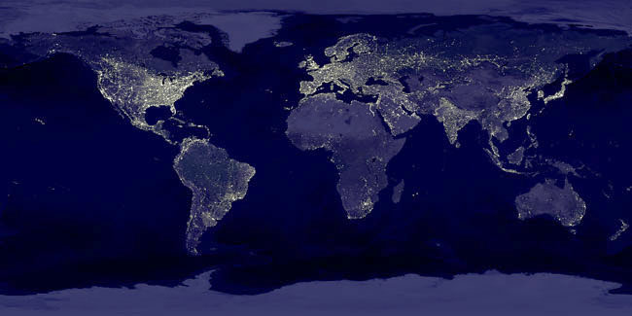
Earth at Night

Slide 13
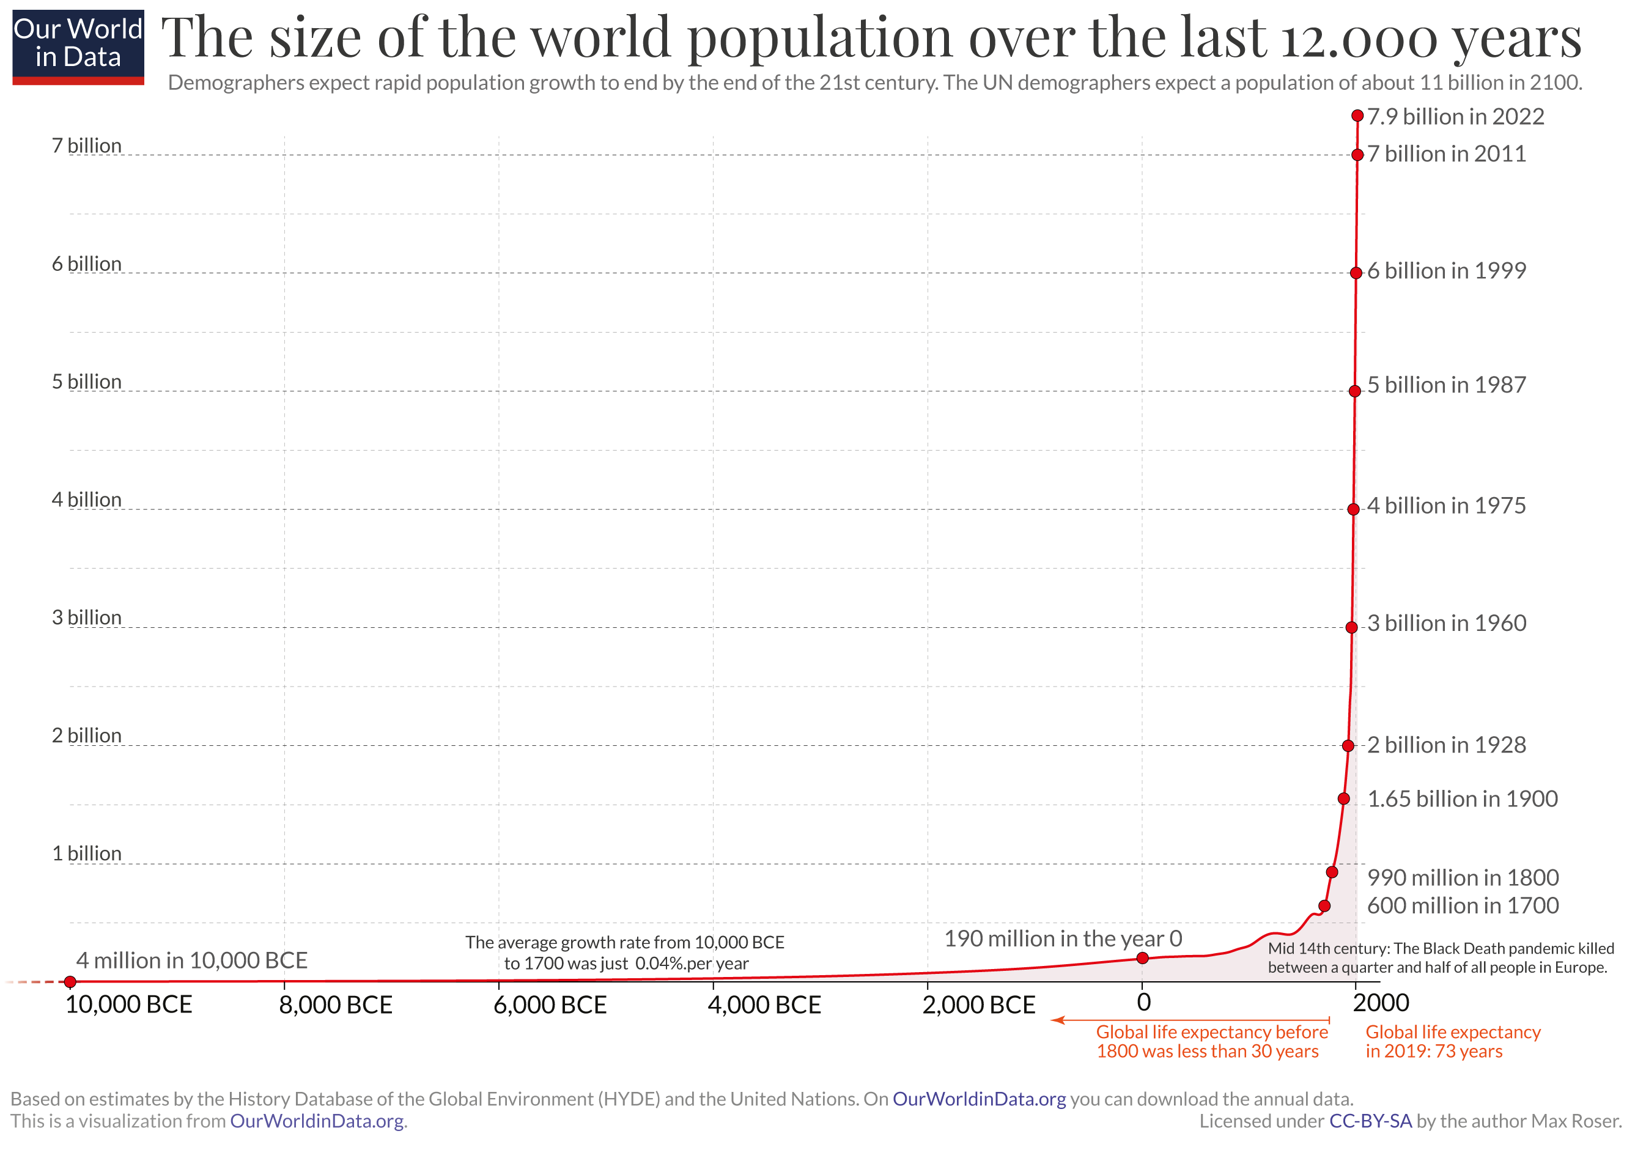
Human Population
~12 yr
12 yr
12 yr
12 yr
15 yr
32 yr
Notes:
Arrow 1 = Black Plague
Arrow 2 = 1918 Avian Flu

Slide 14
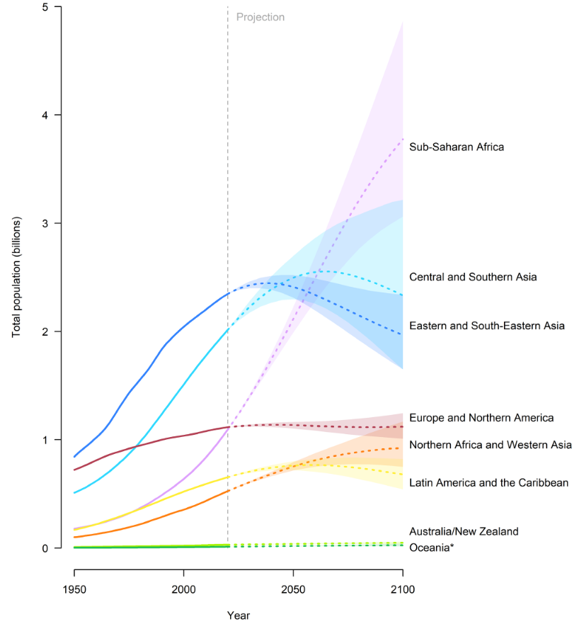
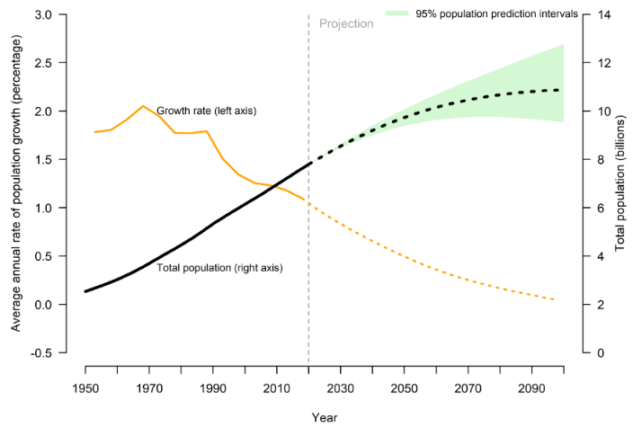
Human Population
U.N. World Population Prospects 2019

Slide 15
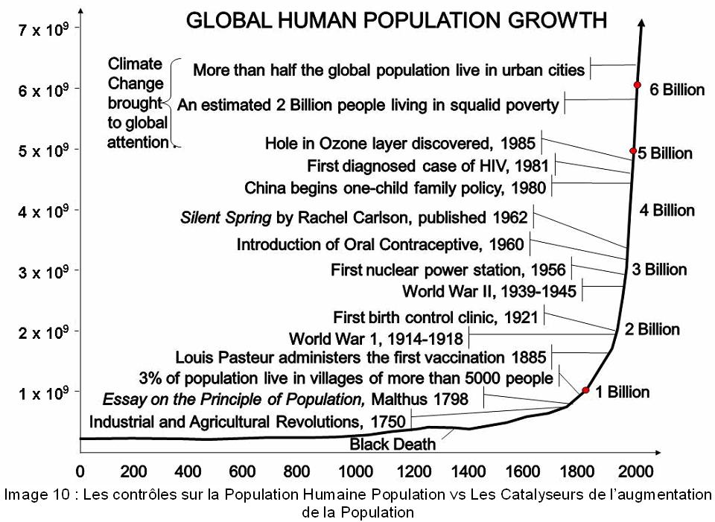
Human Population
Will this organism have to go somewhere else?
Notes:
none of these things have stopped the population growth

Slide 16
Welcome to Mars
Notes:
Hubble picture

Slide 18
Mars
Basics 1.52 AU, 1.88 year orbit, e = 0.093
d = 6780 km (0.53 Earth), density 3.9 g/cm³
Environment surface temp 150-310 K
seasons: flux change 44% + 24 deg tilt
Atmosphere 0.01 bars at surface
95% CO₂, 3% N₂, 2% Ar, traces of O₂, H₂O, CO
large seasonal variations due to icecap sublimation
freezes out at night, dust
Atm History 1. thick, dense, blue skies and rain
2. liquid H₂O + rocks take CO₂ out of atm, Mars cools
3. H₂O freezes, less greenhouse, Mars cools more
4. no tectonics … Snowball Mars
5. UV splits CO₂, N₂, H₂O … light products lost

Slide 19
Mars
Surface iron oxide dust, rubble fields, fine sand, huge features
Valles Marineris 4000x120x7 km (GC: 500x20x2 km)
Olympus Mons (d = 700 km, h = 25 km ~ 80,000 feet)
N icecap large (200K) / S icecap small (150K)
N hemi low, 3 Gyr old / S hemi high, 4 Gyr old
water features
Anomalies chaotic tilt because no stabilizing moon, but Tharsis?
proximity to asteroid belt
Notes:
icecaps may have somewhat different compositions based on cold-trap differences because of Mars’ orbital eccentricity
N mostly H2O, S mostly CO2

Slide 20
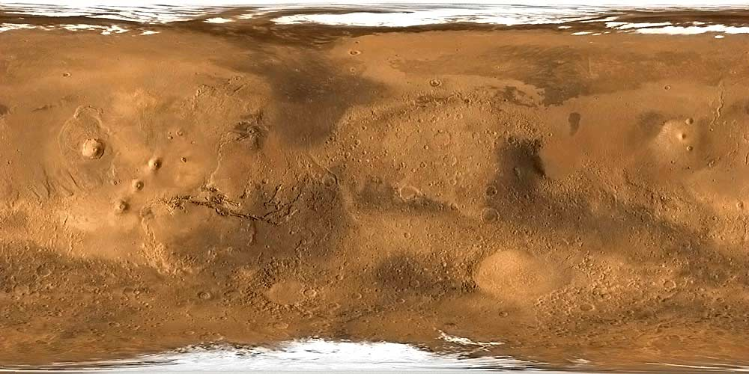
Mars
Notes:
what are all the white spots? clouds?

Slide 21
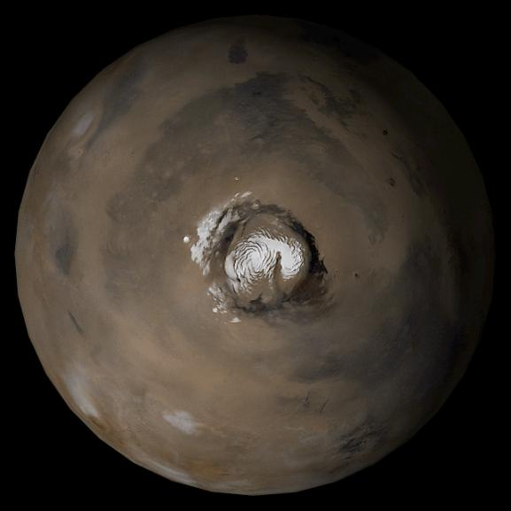
Mars North Pole
Notes:
~1000 km across
primarily H2O ice … 1m thick CO2 temporary cap

Slide 22
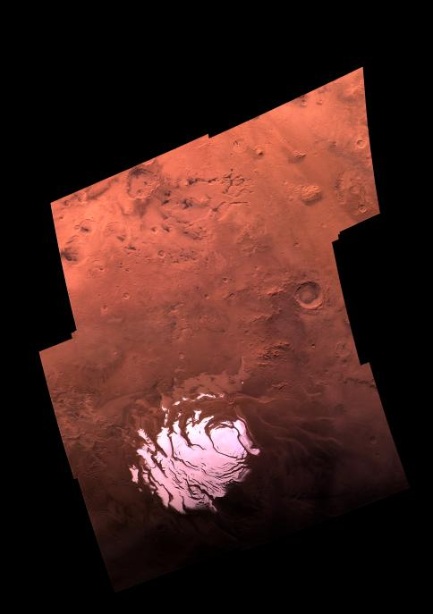
Mars South Pole
top CO₂ seasonal ice cap
25% of atm/yr
next H₂O residual ice cap
next H₂O/dust layers
most of caps
bottom basal unit
Notes:
~400 km across … minimum size (southern summer)
primarily H2O ice … 8m thick CO2 permanent cap
mosaic taken by Viking on September 28, 1977

Slide 23
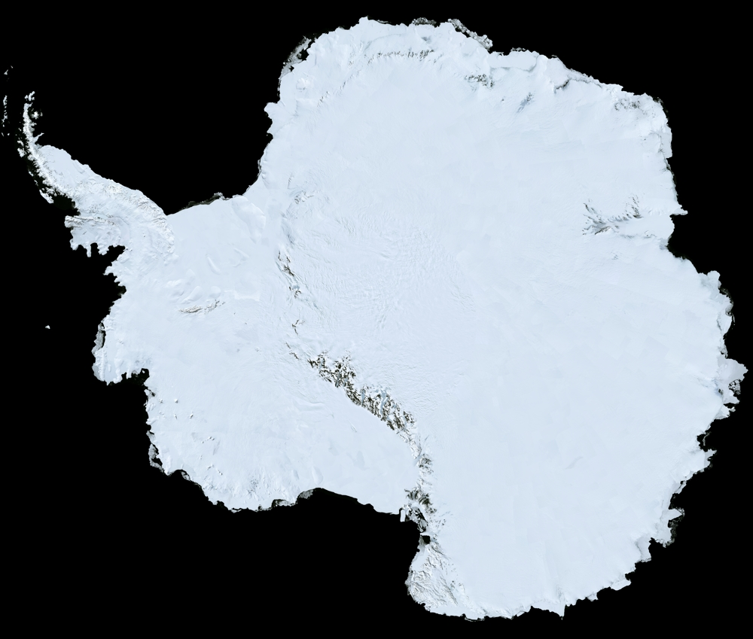
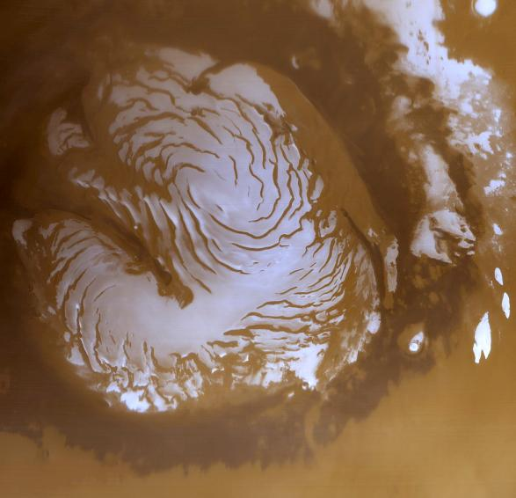
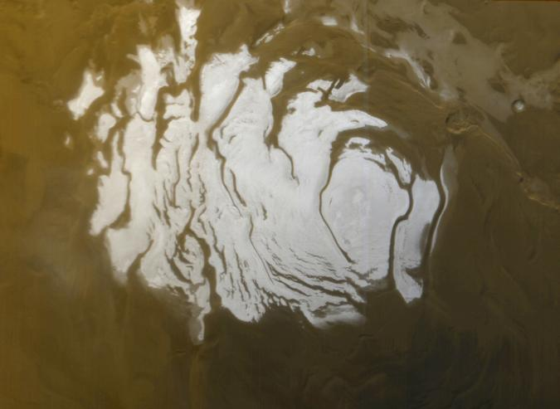
Ice Caps
Mars North
Mars South
Notes:
Mars north during summer = 1100 km
Mars south during summer = 400 km
Antarctica ~all year = 5000 km

Slide 24
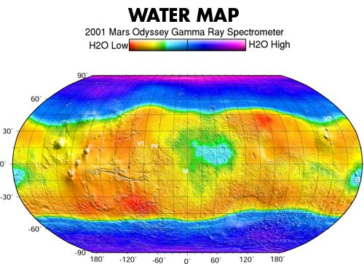
Martian Water

Slide 25
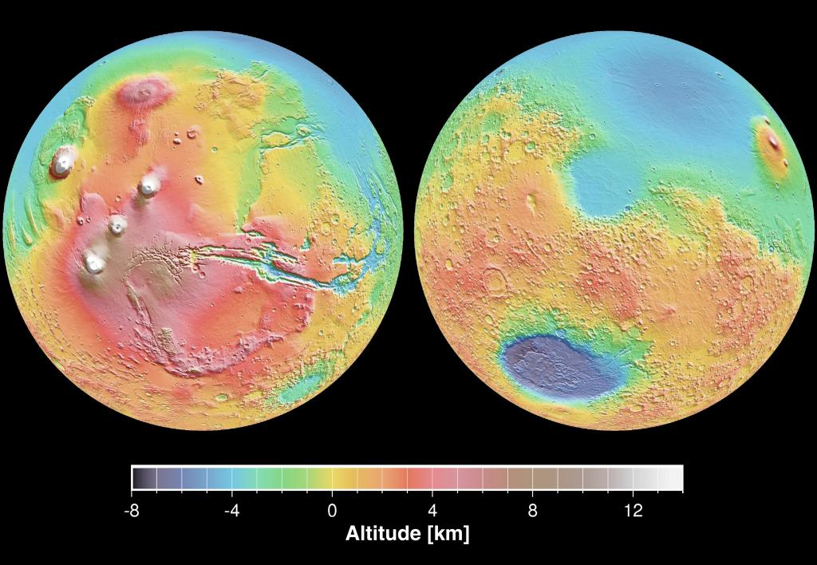
Martian Elevations

Slide 26
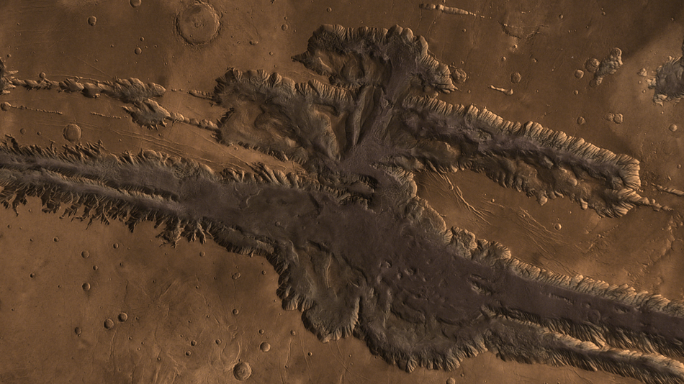
Martian Valles Marineris
https://www.youtube.com/watch?v=JUbQM47QXwQ

Slide 27
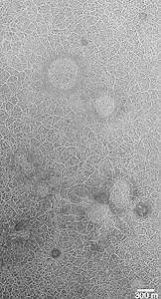
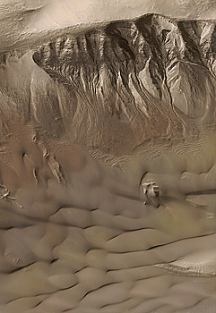
Water on Mars
water
water
everywhere?

Slide 29
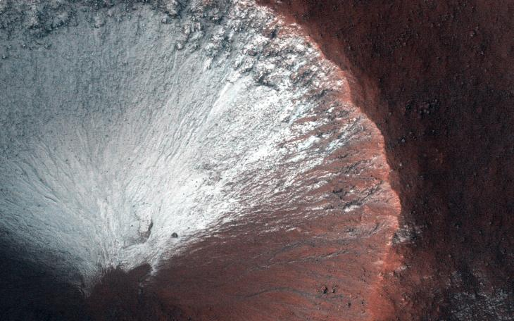
H₂O
Frost
Notes:
later pictures show it gone

Slide 30
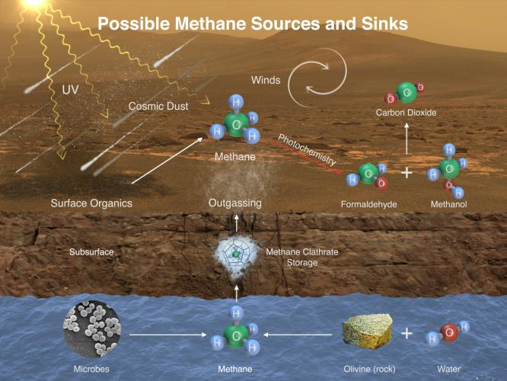
Methane

Slide 31
Lava Flows
Notes:
The circular feature is nearly 2 kilometers (1.2 miles) wide. It looks like a circular island surrounded by a "sea" of smooth-looking lava flows. The Athabasca region contains some of the youngest lava flows on Mars. Therefore, it is highly possible that volcanism played a role in creating this feature.
Perhaps lava has intruded underneath this mound and pushed it up from beneath. It looks as if material is missing from the mound, so it is also possible that there was a significant amount of ice in the mound that was driven out by the heat of the lava. There are an array of features like this in the region that continue to puzzle scientists.
HiRISE is one of six instruments on NASA's Mars Reconnaissance Orbiter.

Slide 32
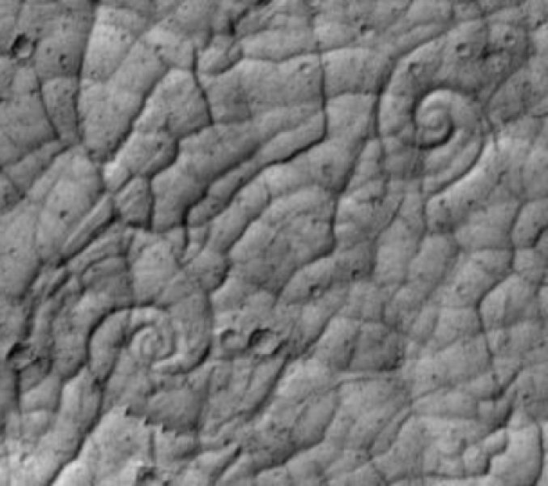
Lava Flows
Notes:
Cooling lava on Mars can form patterns like snail shells when the lava is pulled in two directions at once. Such patterns, rare on Earth, have never before been seen on Mars. This image shows an area in a volcanic region named Cerberus Palus.

Slide 33
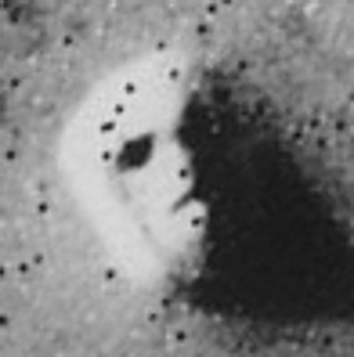
Fun (?) at Mars
Viking 1 1976
MGS
MRO
Notes:
The rocky outcropping that creates the illusion is approximately a mile across and bears a resemblance to buttes or mesas from the American West. It likely formed from a combination of landslides and collected debris.

Slide 34
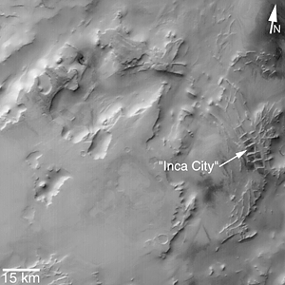
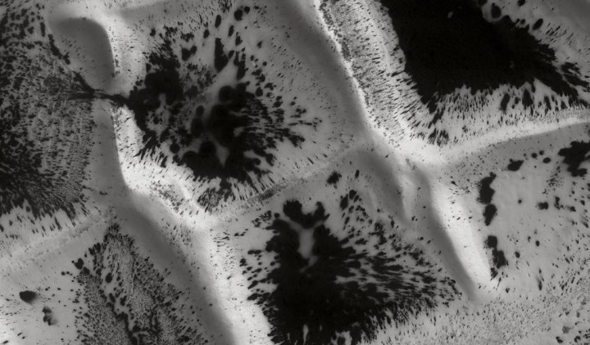
Fun (?) at Mars
Notes:
These terrains have nothing reminiscent of a city or of the Inca. Their size—several kilometers—is the best proof of that. The nature of this polygonal network, unique on Mars, remains poorly understood, but seems to be linked to volcanic dykes. These terrains are close to the South pole and undergo springtime defrosting in dark patches that become progressively larger as temperatures climb.

Slide 35
Mars

Slide 36
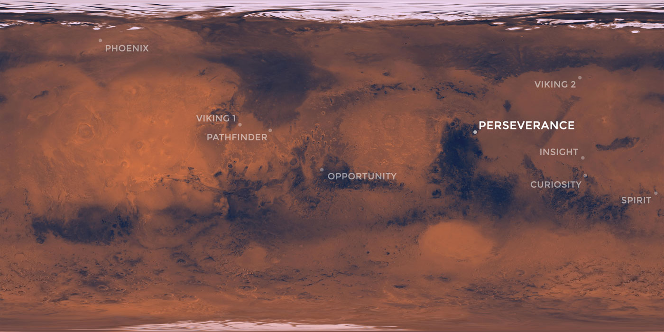
9 Mars Landings
2008
arctic soil
1976
1976
2021
4G rover
helicopter
2018
seismometer
1997
1G test rover
2004
2G rover
2012
3G rover
2004
2G rover

Slide 37
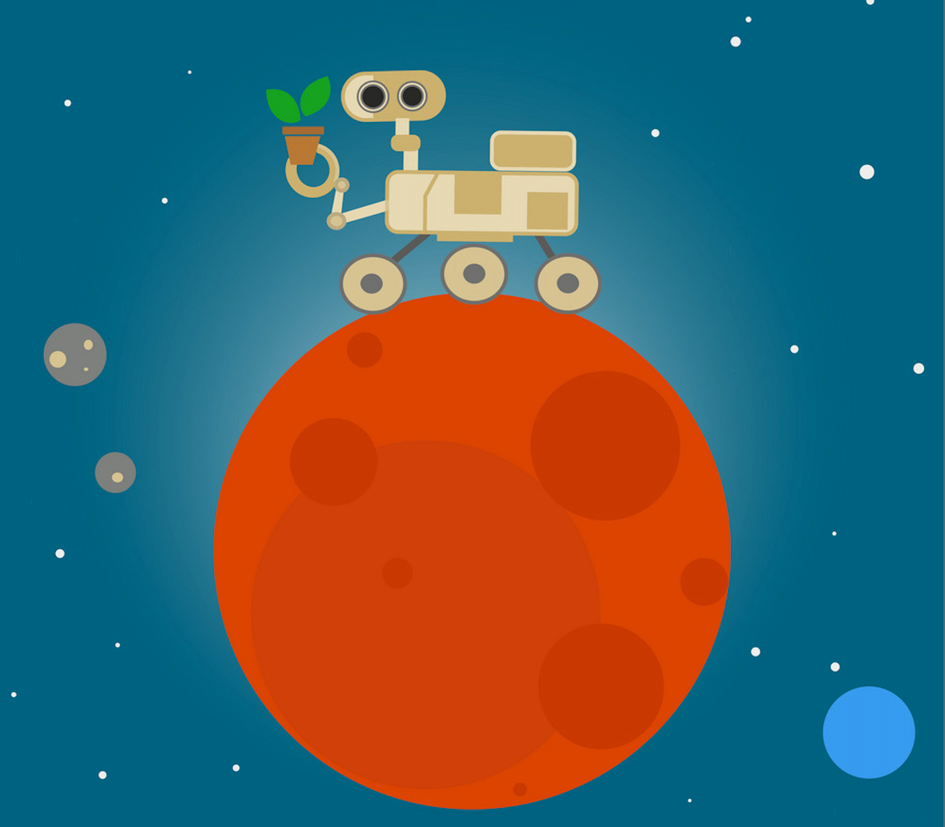
Mars Rovers
1G MP/Sojourner 1997 rover test technology ok
2G Spirit 2004 to 2010 geologist Mars had H₂O
2G Opportunity 2004 to 2018 geologist Mars had H₂O
3G Curiosity 2012 to now 7 cameras ancient lakes
4G Perseverance 2021 to now 23 cameras sample return
microphones
helicopter
Notes:
MP = Mars Pathfinder
Perseverance = 687 day nominal mission

Slide 38
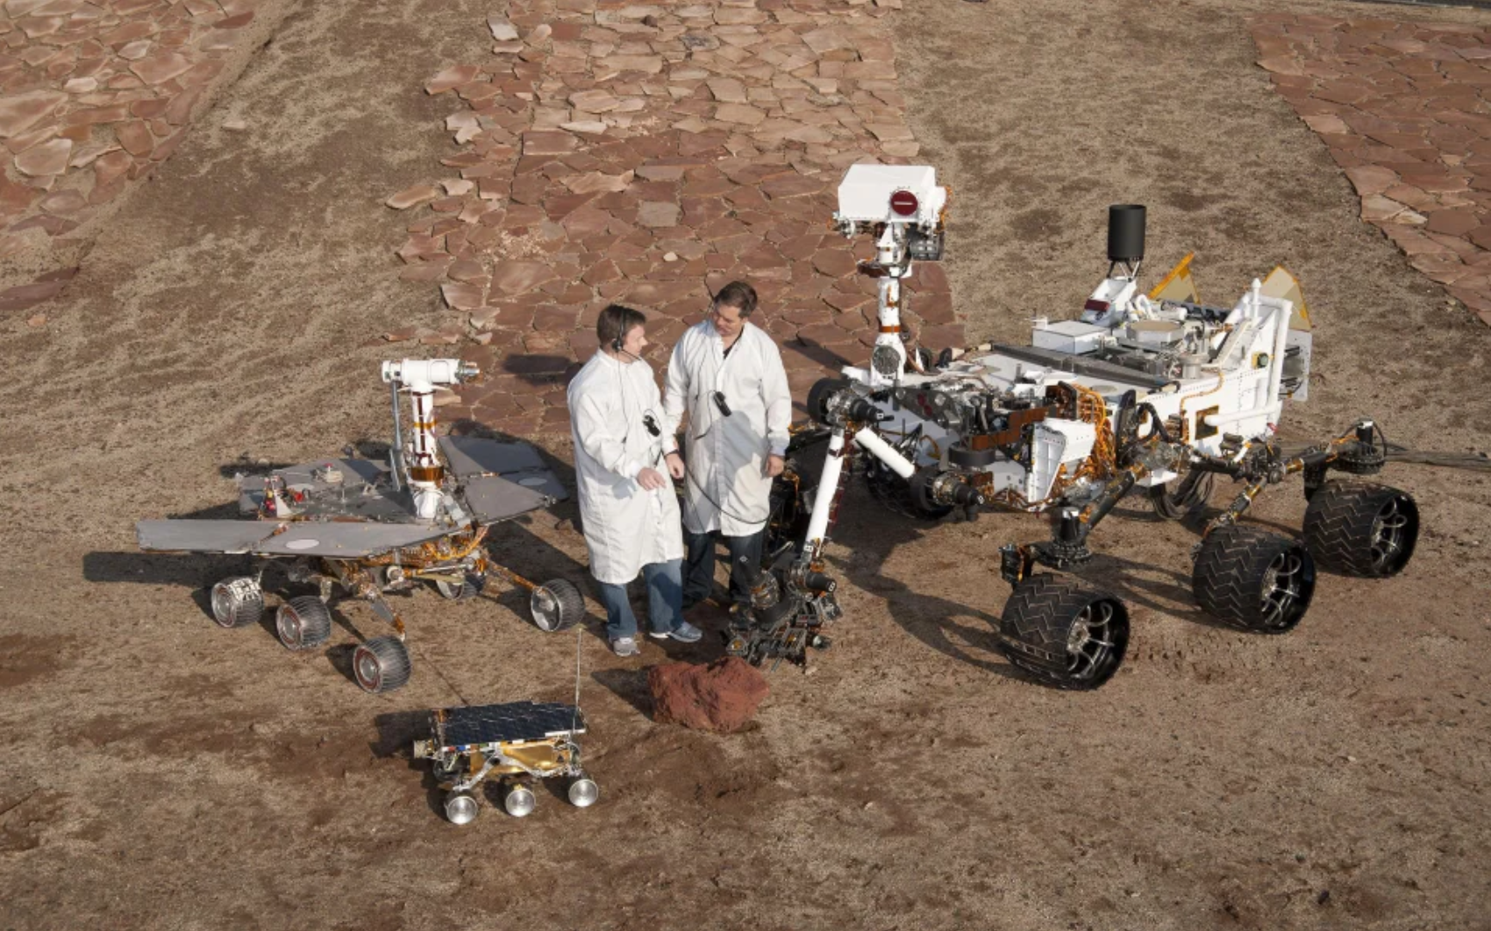
Mars Rovers
3G
Curiosity 2012-now
organic compounds
methane variability
2G
Spirit 2004-2010
Opportunity 2004-2018 (!)
geology … Mars had (lots of) H₂O
1G
MP/Sojourner
1997 (83 days)
rover test … technology ok
Notes:
MP = Mars Pathfinder
Perseverance = 687 day nominal mission

Slide 39
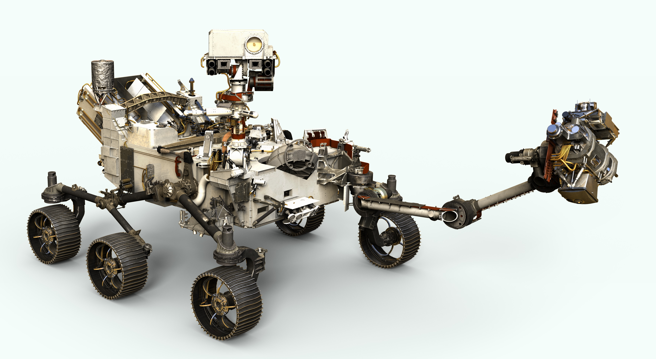
Perseverance
mock video https://www.youtube.com/watch?v=c9RFiTo9TFM
real landing https://www.youtube.com/watch?v=4czjS9h4Fpg
helicopter https://www.youtube.com/watch?v=y5niGi4k9vQ
Notes:
larger, narrower, wheels than Curiosity

Slide 40
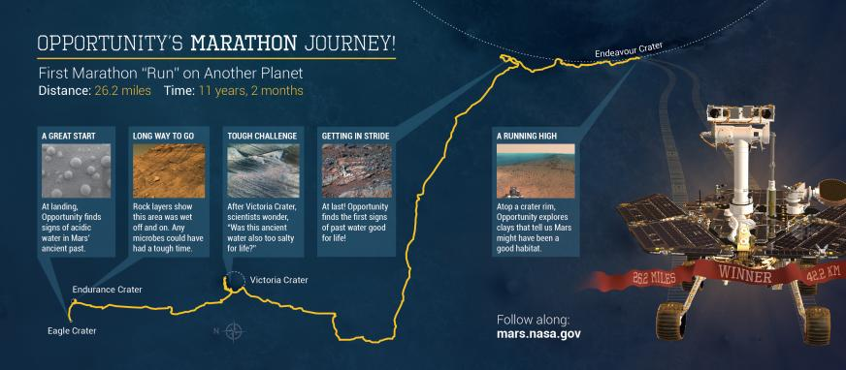
Opportunity’s Marathon
2004
Opportunity finally went to sleep on June 10, 2018 … 28.06 miles
Notes:
covered 26.2 miles as of March 2015
exceeded operation plan by ~14 years … plan was to last 90 sols
done in by dust storm of 2018

Slide 41
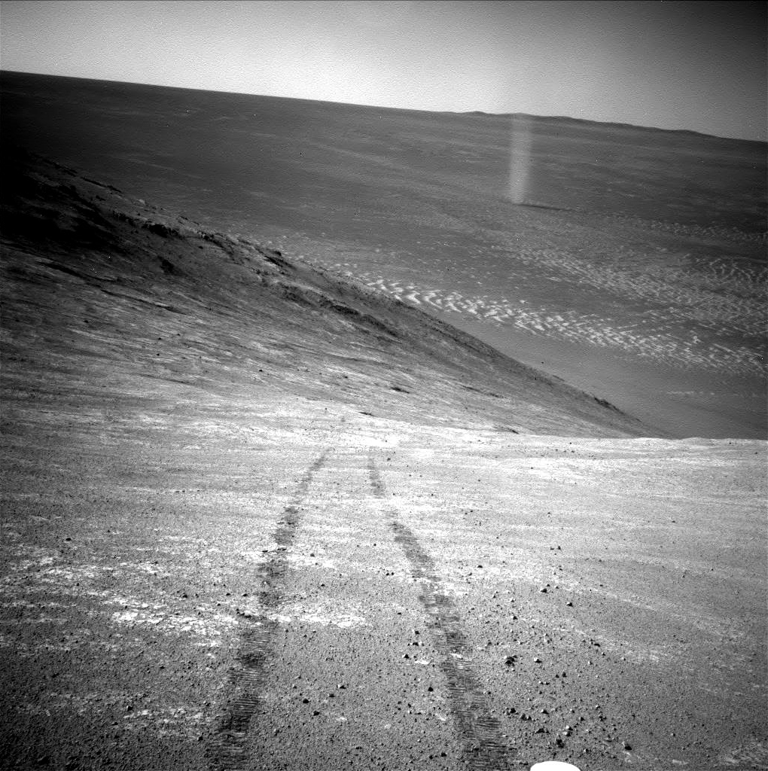
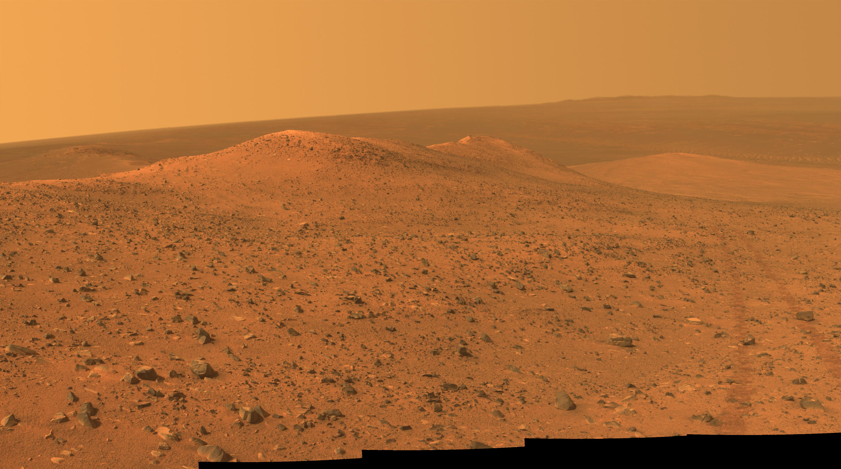
Views of Mars by Opportunity

Slide 42
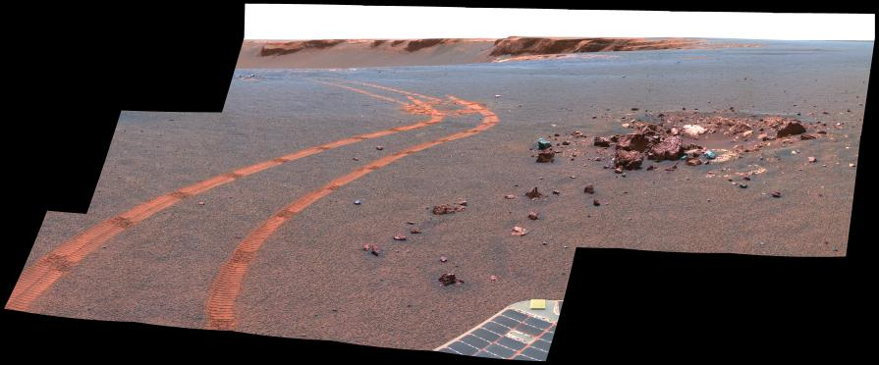
Views of Mars by Opportunity

Slide 43
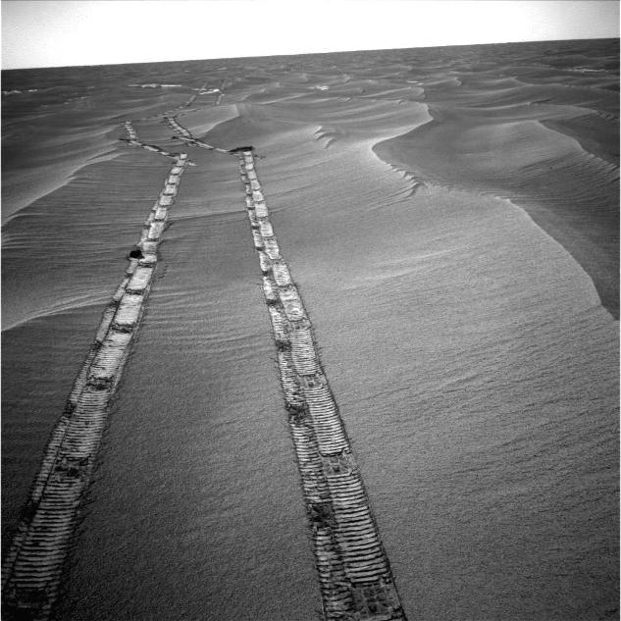
Views of Mars by Opportunity

Slide 44
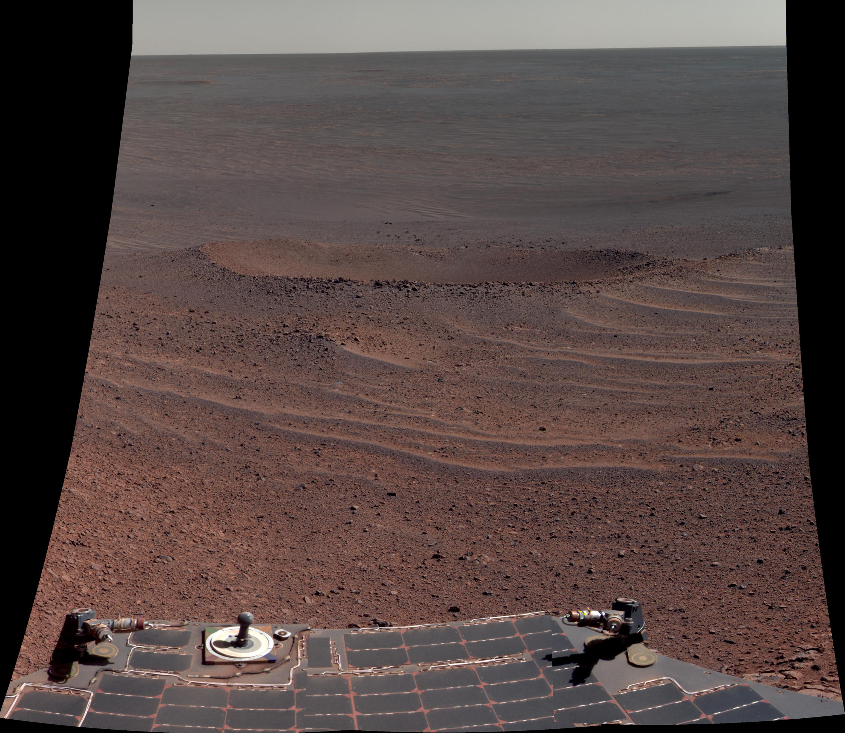
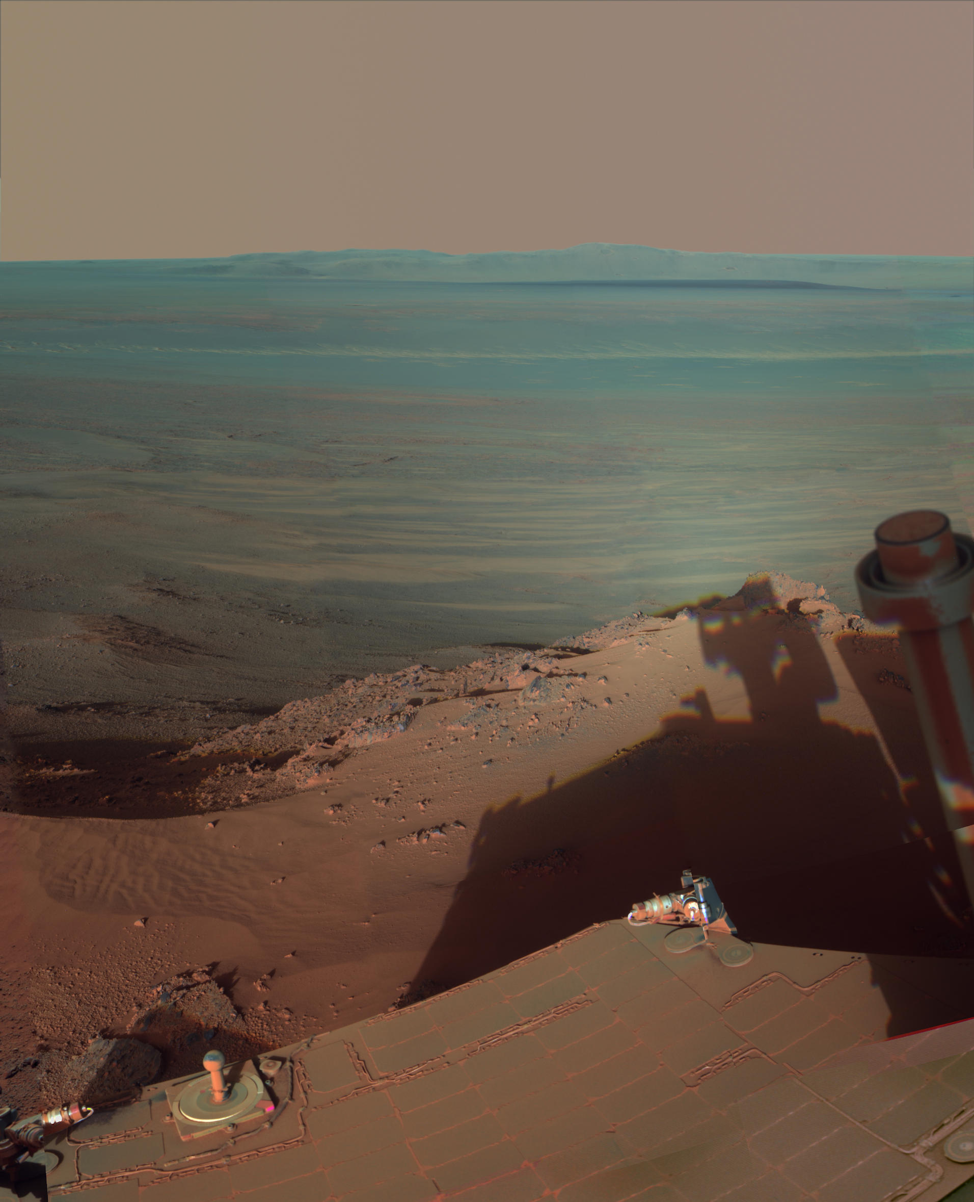
Views of Mars by Opportunity

Slide 45
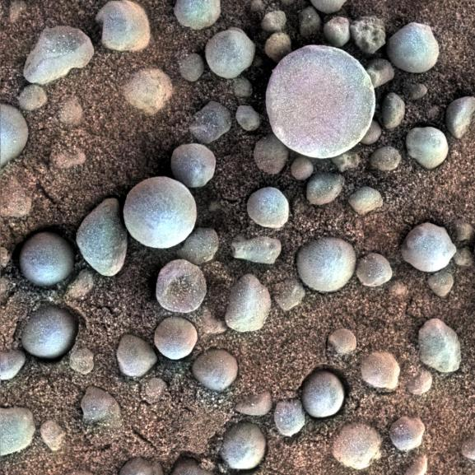
Blueberries
hematite-rich
formed in acidic water
Notes:
acidic water bad for life

Slide 46
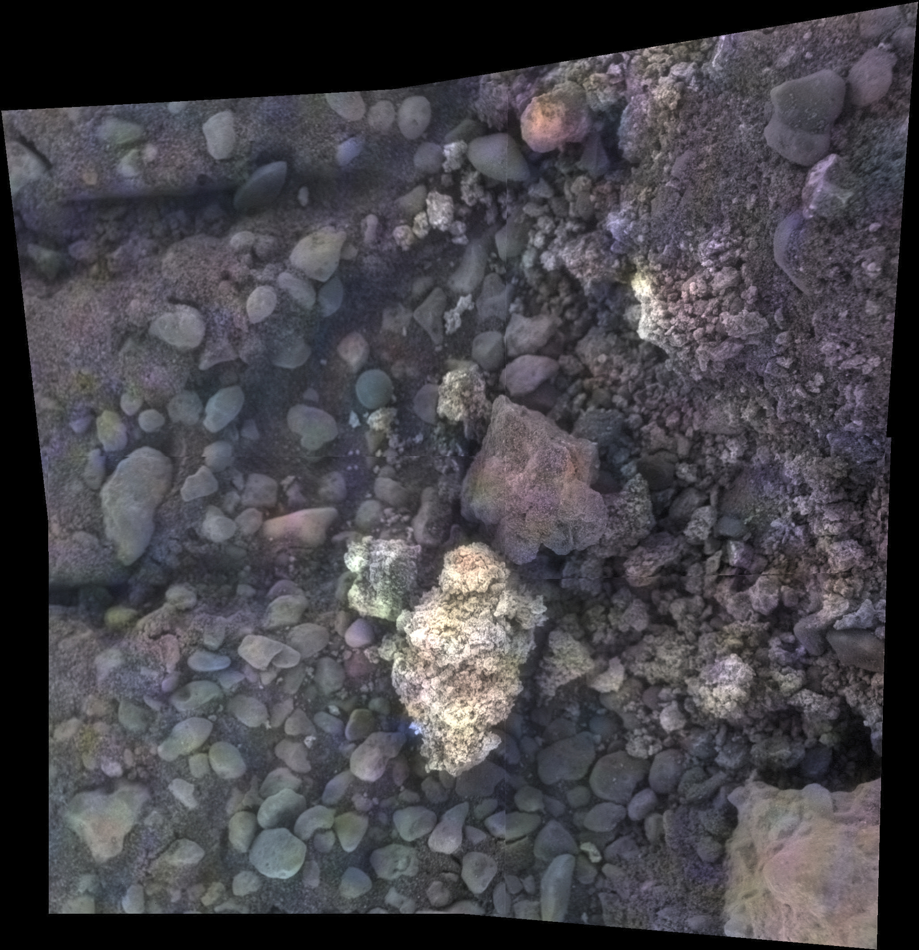
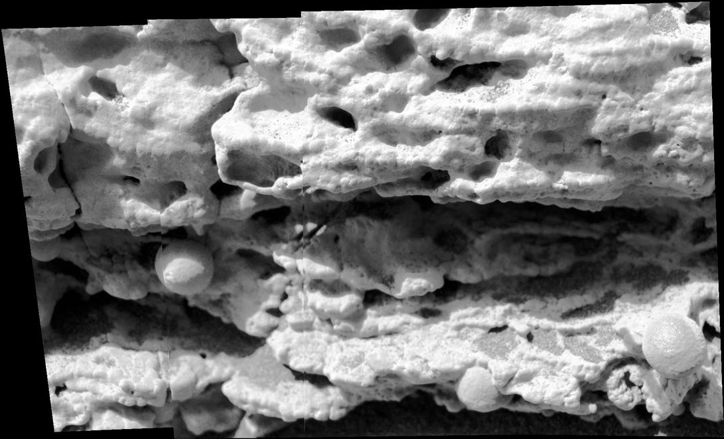
Views of Mars by Opportunity
Notes:
2 inches across

Slide 47
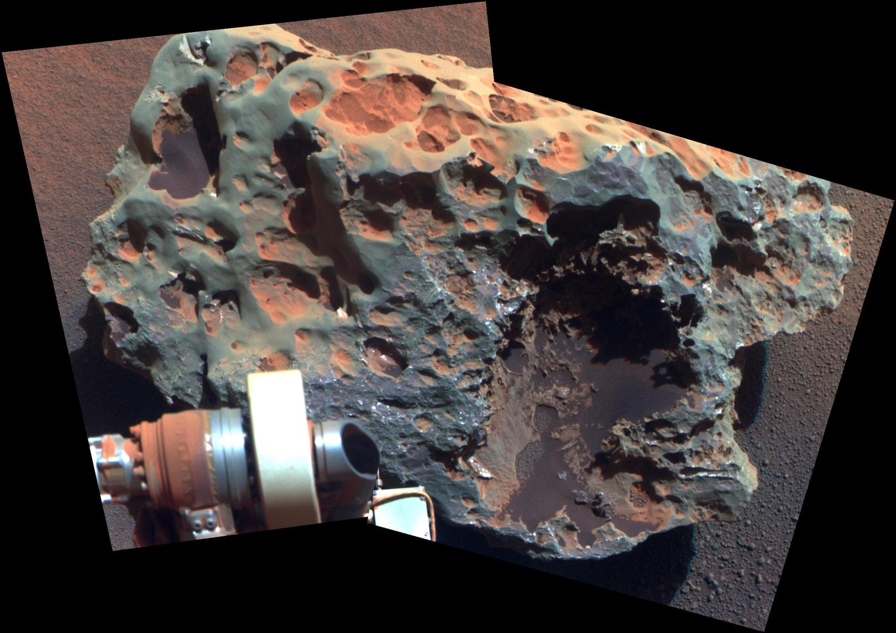
Views of Mars by Opportunity
nickel-iron meteorite … about 2 feet across
Notes:
Block Island meteorite

Slide 48
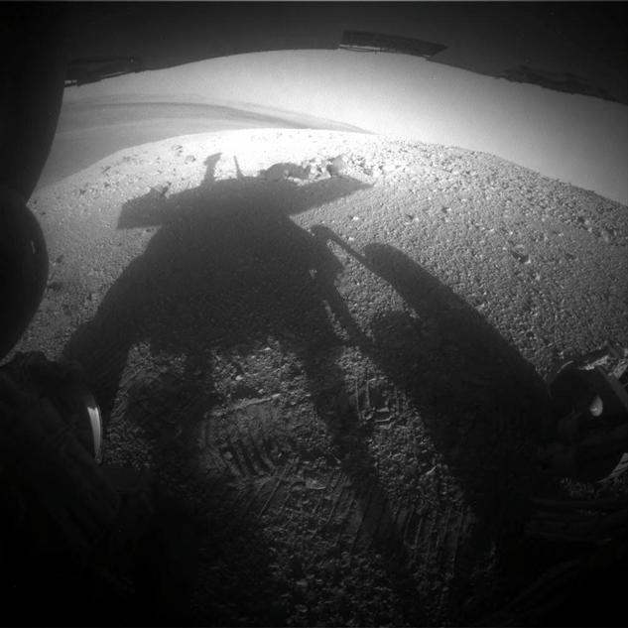
Views of Mars by Opportunity

Slide 49
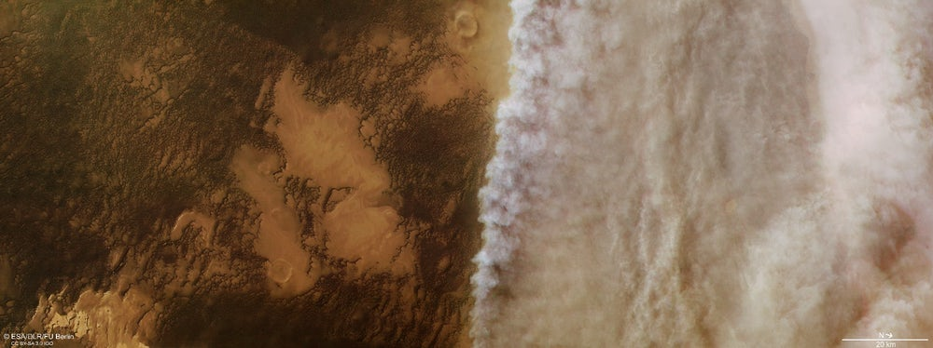
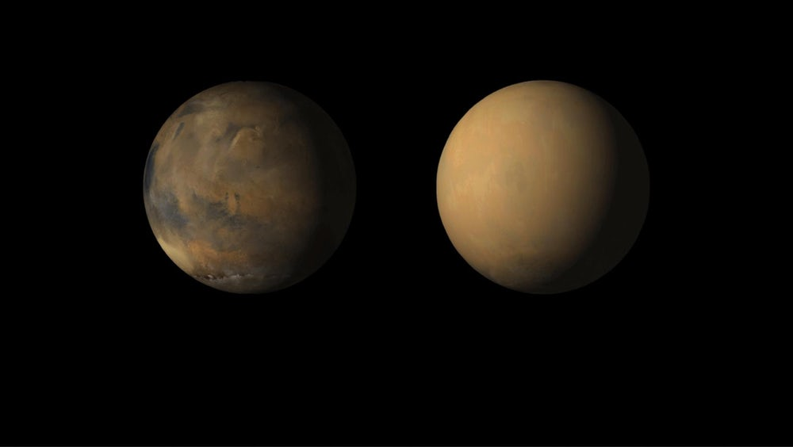
Dust Storm of Mars 2018
ESA’s Mars Express: north polar cap
09 OCT 2018: No signal from Opportunity has been heard
since Sol 5111 (June 10, 2018). As stated previously, it is
expected that Opportunity has experienced a low-power
fault, a mission clock fault and an up-loss timer fault. The
science team has been listening for the rover over a broad
range of times using the Deep Space Network (DSN) Radio
Science Receiver since loss of signal.

Slide 50
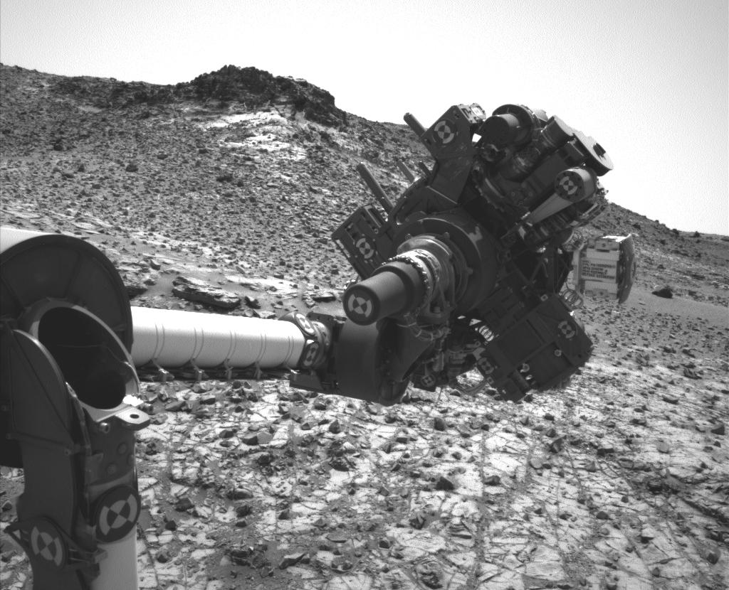
Spirit/Opportunity Discoveries
past Mars warm/wet
sedimentary rocks
hematite blueberries
acidic water
clay minerals
neutral water
pure silica
hot springs/vents

Slide 51
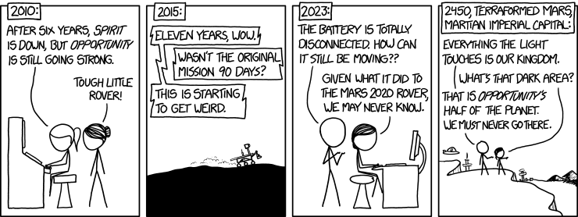
The Realm of Opportunity

Slide 52
Views of Mars by Curiosity

Slide 53
Views of Mars by Curiosity
Notes:
true color

Slide 54
Views of Mars by Curiosity

Slide 55
Views of Mars by Curiosity
Notes:
true color … rocks are purple

Slide 56
Views of Mars by Curiosity
Notes:
true color … rocks are nearly black

Slide 57
Views of Mars by Curiosity
Notes:
layered rocks

Slide 58
Views of Mars by Curiosity
calcium sulfate,
sodium, magnesium
hematite
Notes:
Curiosity left vs. Opportunity right

Slide 59
Views of Mars by Curiosity
Notes:
Phobos eclipsing Sun

Slide 60
Views of Mars by Curiosity

Slide 61
Curiosity Discoveries
organic compounds
“young” jarosite
durable water
bio useful fixed nitrogen
not N₂
methane variability
heavy H/C/Ar isotopes
atm lost
Notes:
jarosite --- even as much of the surface of Mars was becoming dry, some liquid water remained below the surface in the Gale crater environment, extending the period of habitability for any Martian microbes that might have existed
fixing nitrogen means converting it from N2, which is not useful to most life, to something that can be used, like NH3
Mars' present atmosphere enriched in the heavier isotopes of hydrogen, carbon, and argon. These measurements indicate that Mars has lost much of its original atmosphere and inventory of water, lost to space from top of atm.

Slide 62
…………………………
Notes:
62

Slide 63
Human Population
Notes:
1960 dip is China’s Great Leap Forward (that didn’t go so well) … Great Chinese Famine

Slide 64
Martian Dust Storms

Slide 65
Possible Landing Site

