Slide 1
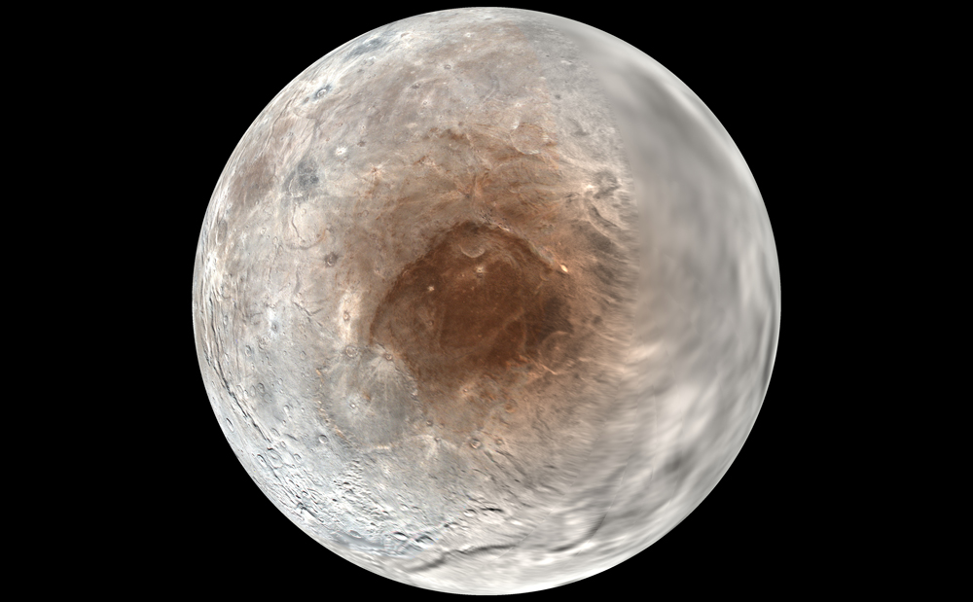
Where is this?
Notes:
CHARON

Slide 2
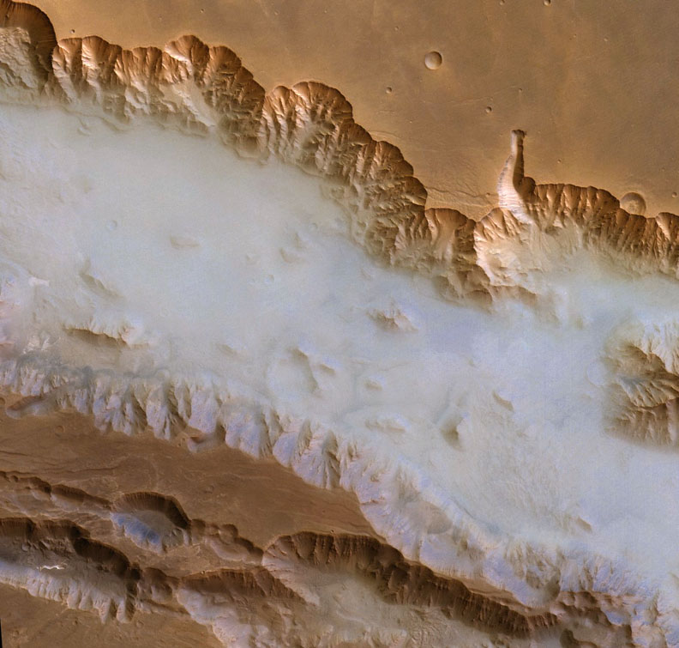
Where
is
this?
Notes:
MARS: morning sun vaporizes water that condensed in the shadows the previous night

Slide 3
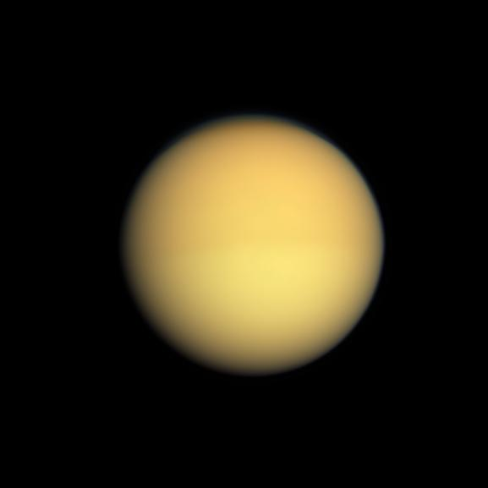
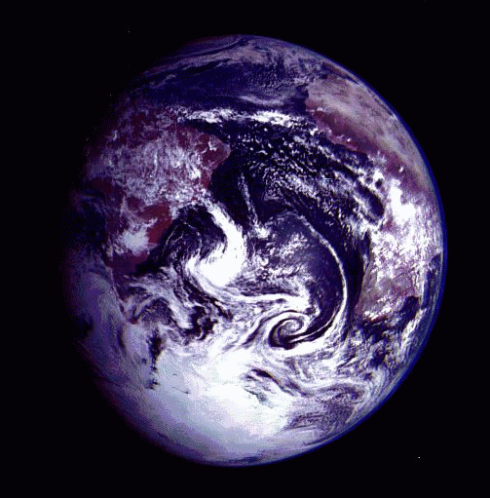
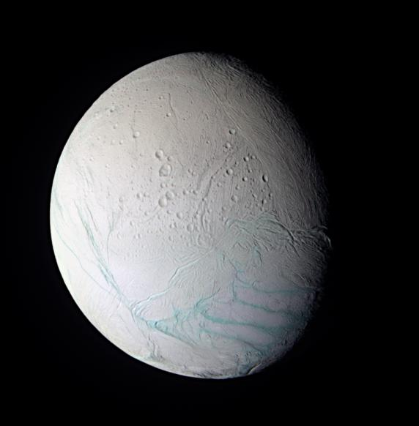
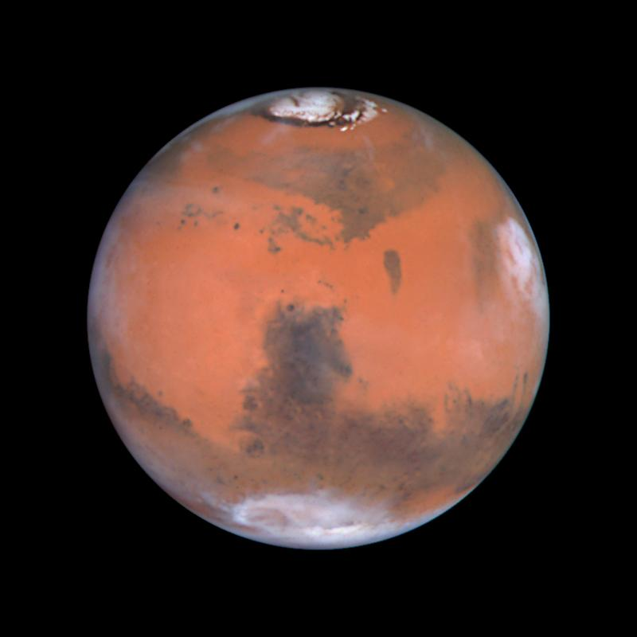
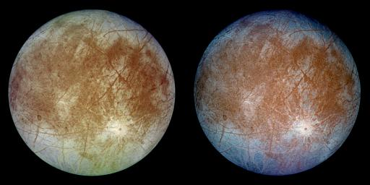
TEEEM II: Locations for Life?

Slide 4
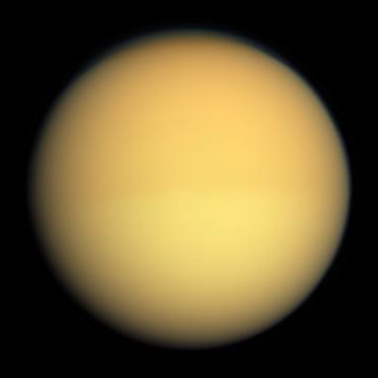
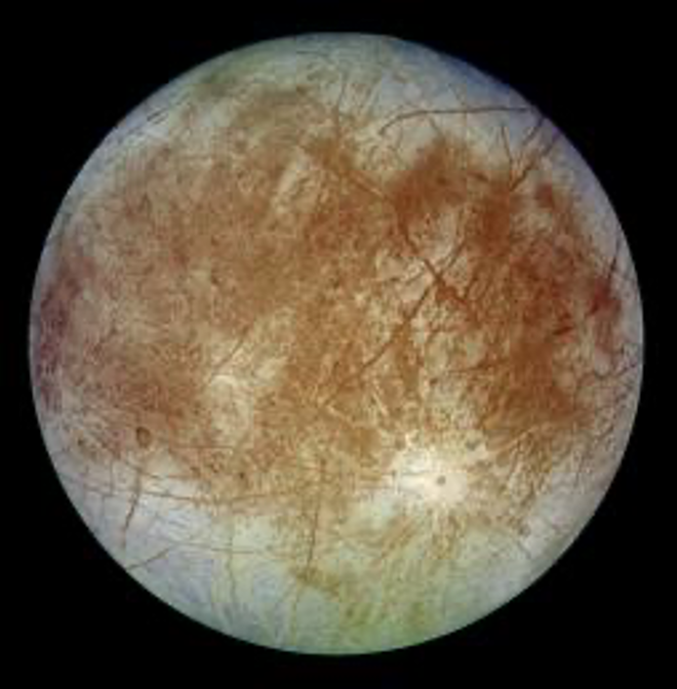
A Pseudo Evolutionary Sequence
Titan --- primitive world, primitive atmosphere
Earth --- middle-aged world, multiple atmospheres
Enceladus --- fighting Snowball Earth
Europa --- Snowball Earth equivalent
Mars --- post Snowball Earth with
evaporated ice surface

Slide 5

Welcome to Europa
Welcome to Europa

Slide 6
Europa
Basics 5.20 AU, 3.6 day orbit, e = 0.009, 9.4 Jup radii
d = 3122 km (0.25 Earth), density 3.02 g/cm³
Environment 5.2 AU, extreme radiation from Jupiter magnetosphere
Atmosphere tenuous O₂ + O₃ + extended Na
H₂O bombarded by energetic ions
H₂+ O₂…H₂ escapes
O₂ builds up…permeates regolith…trapped in voids
bubbles containing “microatmospheres”
UV photons produce O₃ in the bubbles
Surface few craters, prevalent cracking, ice floes, 60-130K
Anomalies tidal heating, resurfacing, Jupiter radiation environment
subsurface ocean likely more H₂O than Earth!
Notes:
Na may be coming from salty ocean

Slide 7
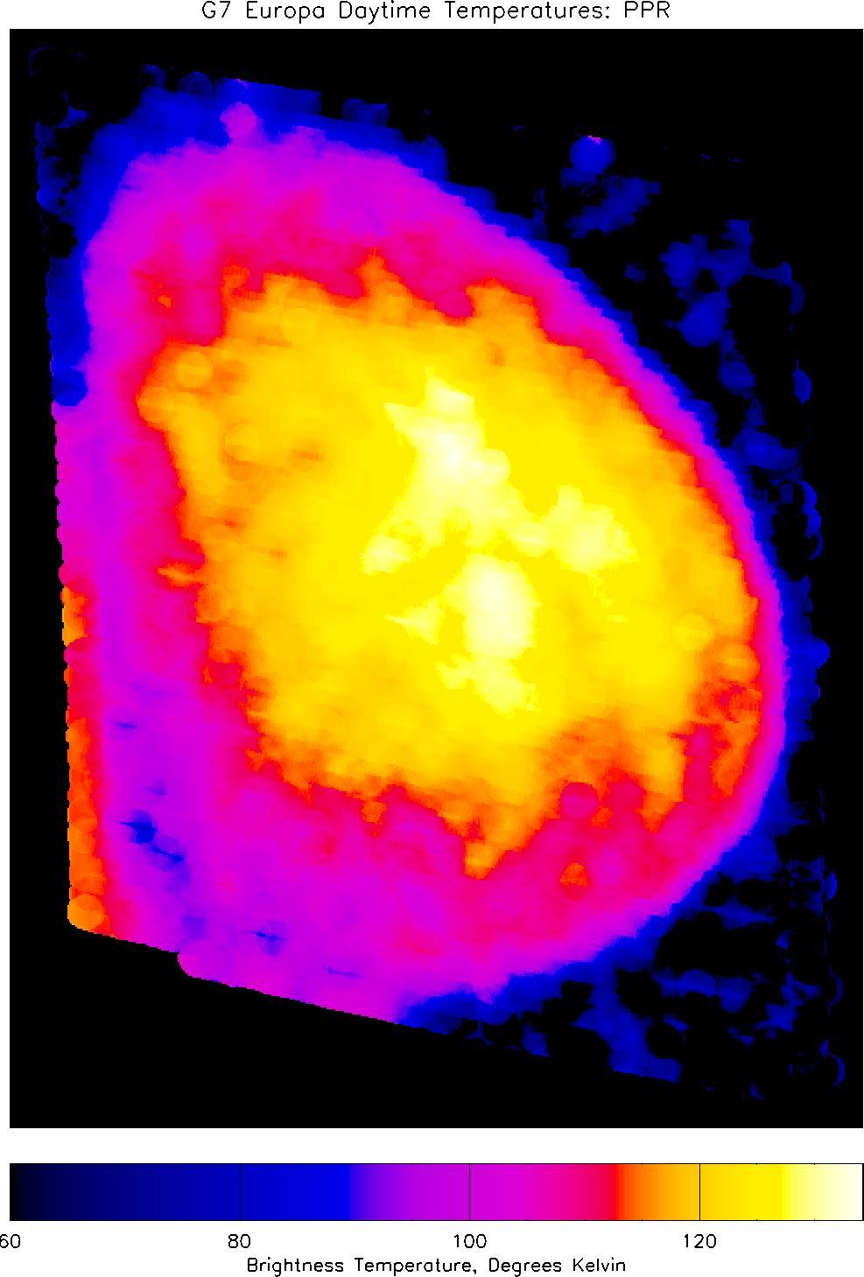
Europan Temperatures
27 micron image by Galileo
high day temp 130 K
low temp 60 K
Notes:
weird shape due to relative motion of Galileo and moon
Jupiter produces orange in lower left

Slide 8
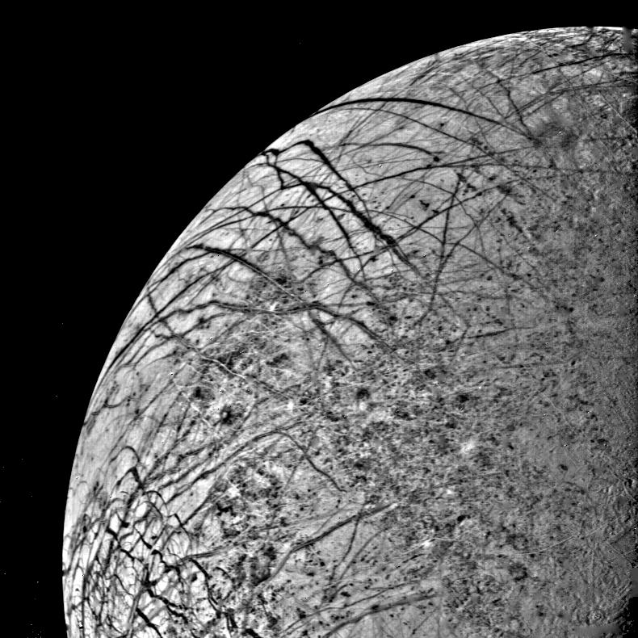
Europa Approach
Notes:
taken by Voyager 2

Slide 9
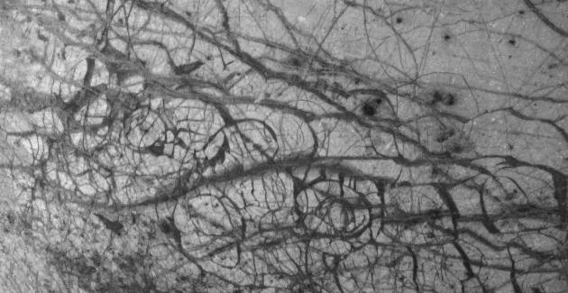
Europan Ice Floes
smallest features 1 mile across, plates 20 miles across
Notes:
taken by Galileo June 27, 1996
smallest features 1 mile across, plates 20 miles across

Slide 10
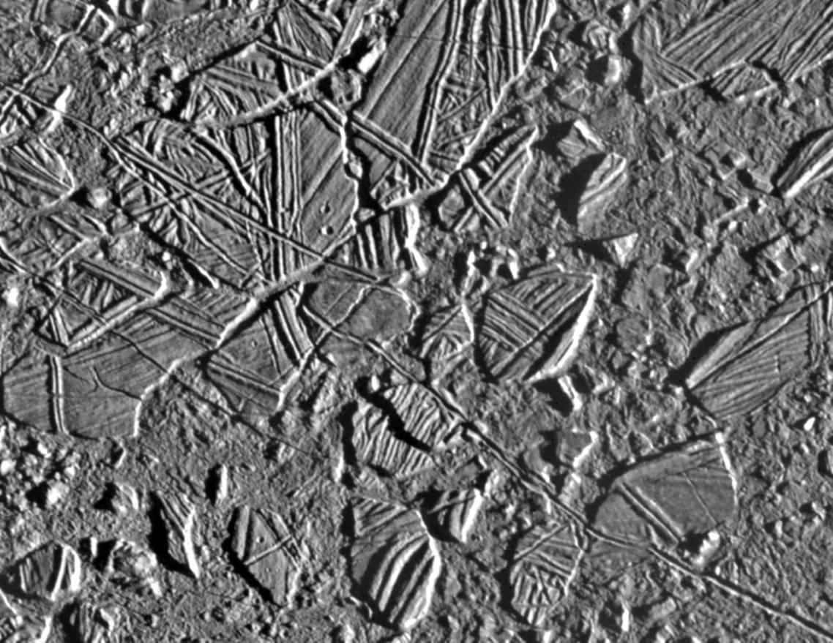
Europan Chaotic Terrain

Slide 11
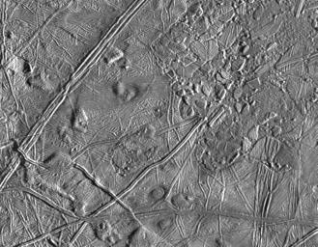
Europan Mixed Terrain

Slide 12
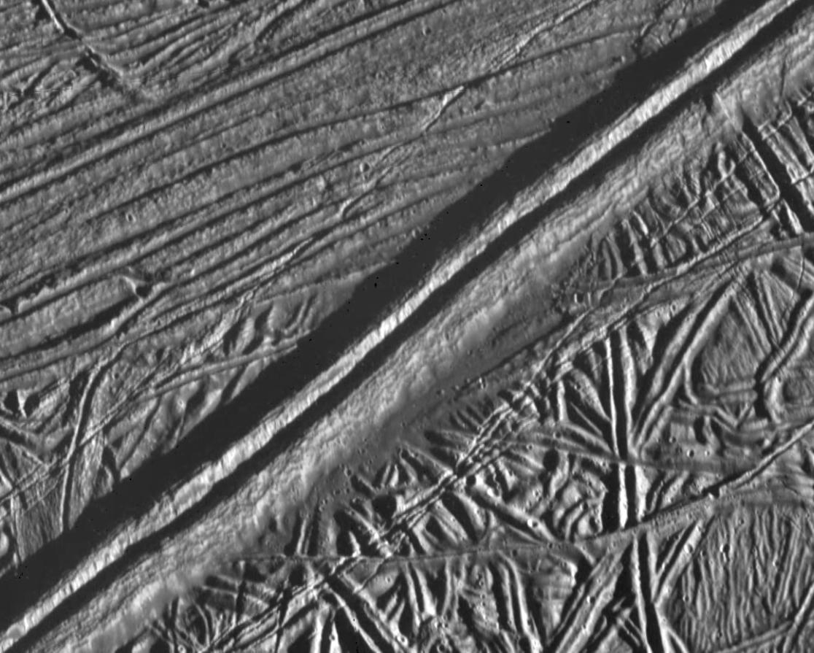
Europan Double Ridge
14x17 km
20 m/pixel
ridge 2.6 km wide, 0.3 km high
Notes:
illuminated from the right
taken by Galileo, February 20, 1997

Slide 13
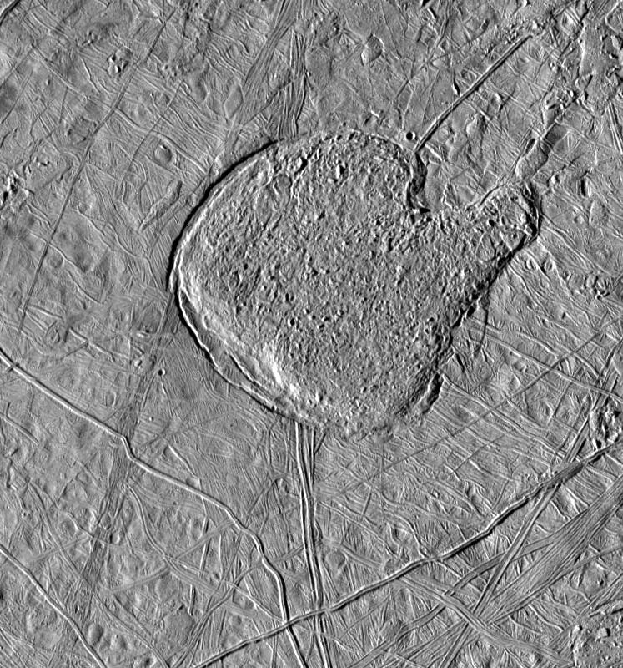
Europan Mitten
175x180 km
235 m/pixel
Notes:
taken by Galileo, May 31, 1998

Slide 14
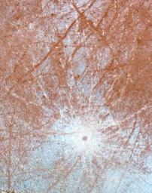
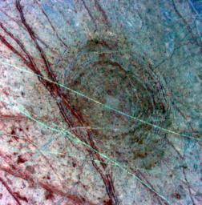
Europan Impact Craters

Slide 15
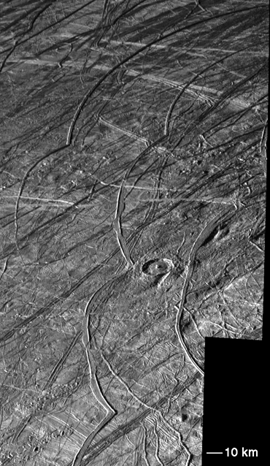
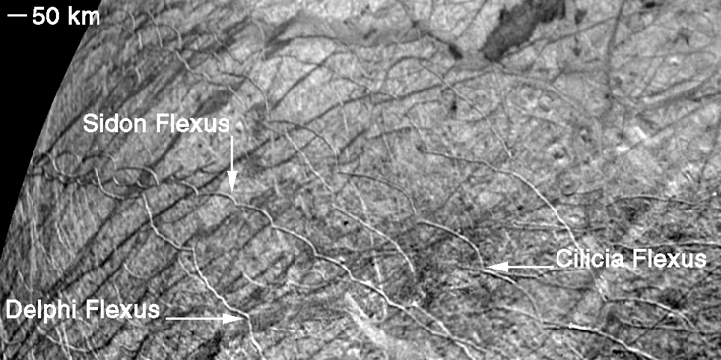
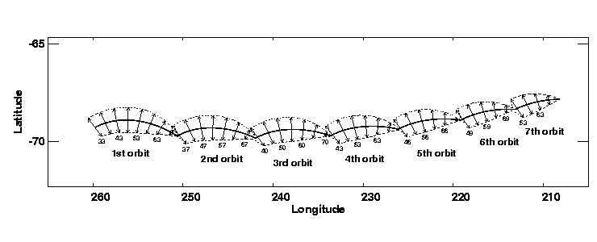
Europan Cycloids
Notes:
As Europa orbits Jupiter, the amplitude and orientation of its tidal bulge varies with an 85 hour period. Resulting diurnal tides due to Europa's orbital eccentricity may be a significant source of stress on Europa's ice shell. Global tidal stress models have been developed to explain the formation and global patterns of linear features on Europa [3,5,6,7,8]. To explain the formation of cycloidal features we use the Greenberg et al. [5] diurnal stress calculations. This model assumes a thin ice shell on top of a global ocean which experiences a ~30 meter change in tidal amplitude over 42.5 hours.
In addition to the diurnal stress model [5], three additional parameters are required to model cycloidal features: a) the amplitude of the stress field required to initiate cracking, b) the amplitude of the stress field where cracking halts, and c) the horizontal crack propagation velocity. The maximum diurnal tensile stress is ~1 bar, however, most regions are not stressed so much. Considering that cycloidal features have been observed at numerous locations on Europa, we assume that crack initiation begins at 0.7 bar, which would allow these features to form at many latitudes and longitudes. Once the crack begins to form we assume that less stress is required for it to continue to propagate. Crack propagation continues until the tensile stress drops below a minimum value (we assume 0.4 bars). Finally, if the horizontal crack propagation is slow, e.g. at a few km per hour, it follows the orientation of the rotating diurnal stress field. This velocity is also consistent with forming cusps spaced between 75-150 km. Variations in the parameters to initiate and stop cracking (~0.1 bar), and variations in the crack velocity need to be invoked to model observered cycloidal features at different orientations and locations.
When the tensile stress reaches 0.7 bar, crack initiation begins in the direction perpendicular to the orientation of the tensile stress. Once the crack is initiated we follow its propagation perpendicular to the local tensile stress. The curvature and length of each arcuate segment depends on the propagation speed; values between 2-4 km/hour (a slow walk) give geometries similar to those observed on Europa. We recalculate the stress field for each new position on the surface. As long as the tensile stress perpendicular to the crack remains above 0.4 bar the crack continues to form (Fig. 2). Eventually the stress drops below 0.4 bar, and the crack stops. Later crack propagation begins again once the tensile strength 0.7 bar is reached. Because a crack cannot propagate more than ~100 km per orbit, and because the diurnal stress field does not change dramatically over that distance, the next crack initiation begins approximately one orbital period after the initial propagation (Fig. 2). This forms the characteristic cusp associated with cycloidal features because the azimuthal orientation of the tension when the crack starts up again is nearly perpendicular to the orientation of the tension when the crack stopped on the previous orbit. Cycloids are formed over the successive orbits until the crack reaches a zone in the stress field where the tension never reaches the failure criteria or a geologic unit unfavorable for the crack to cross.

Slide 16
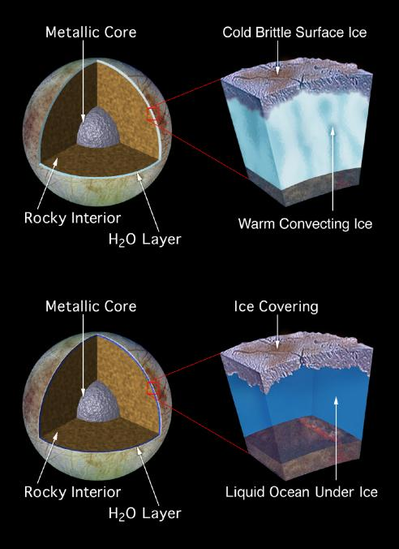
Thin or Thick Ice?
ESA’s
Jupiter Icy
Moon Explorer
(JUICE)
launch 2023
arrives 2031
Europa + Ganymede
+ Callisto
NASA’s
Europa Clipper
launch 2024
arrives 2030
45 flybys
Europa only
Notes:
Europa Clipper objectives:
1. Ice shell and ocean: Confirm the existence, and characterize the nature, of water within or beneath the ice, and processes of surface-ice-ocean exchange.
2. Composition: Distribution and chemistry of key compounds and the links to ocean composition.
3. Geology: Characteristics and formation of surface features, including sites of recent or current activity.
4. Landing site for lander.

Slide 17
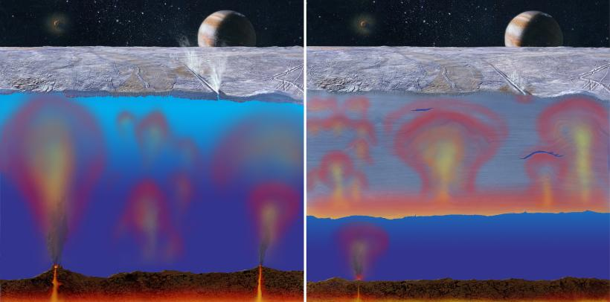
Thin or Thick Ice?
art by Michael Carroll
Notes:
thin ice leads to direct cracking … thick ice leads to more glacial flow and deeper tidal stresses in the ice
more geysers if thin ice

Slide 18
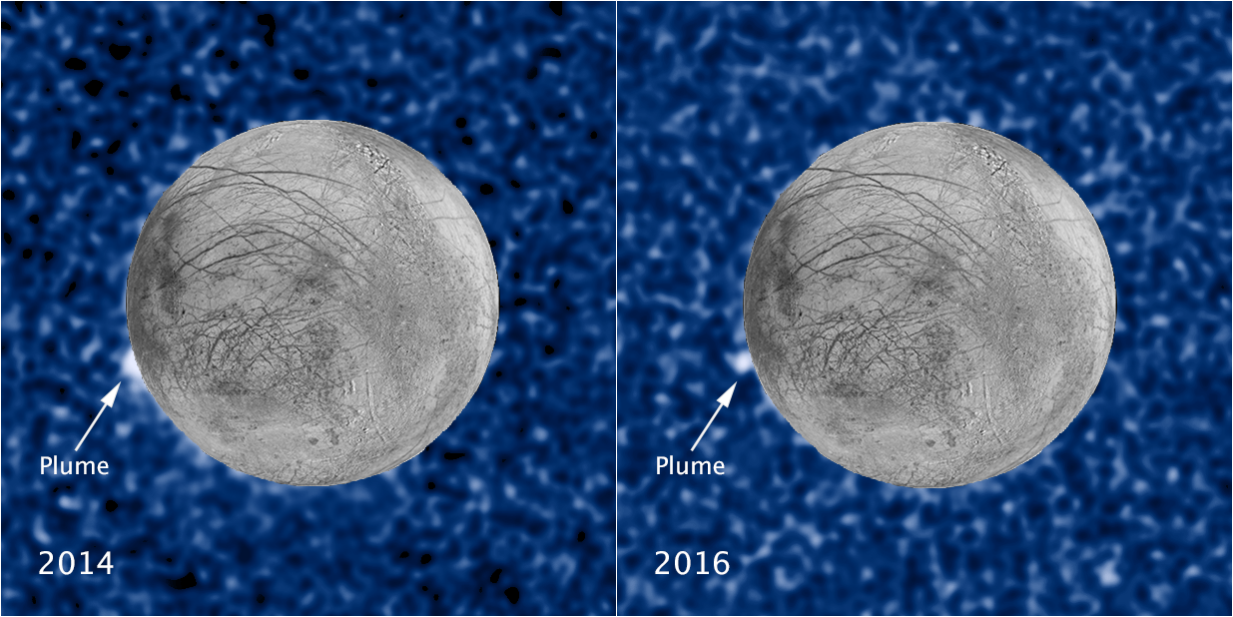
Europa’s Geysers
surface imaged
by Galileo
HST-STIS in UV as Europa passed in front of Jupiter
50 −100 km high … location matches warm spot seen by Galileo

Slide 19
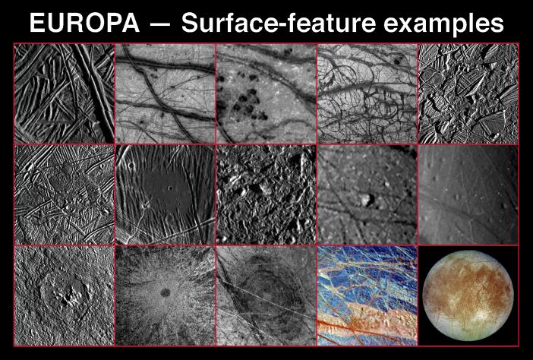

Slide 20
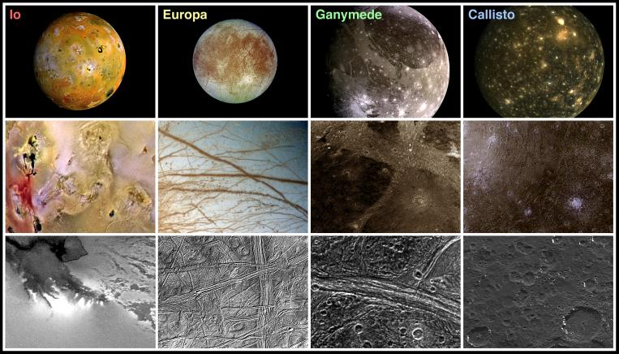
Not all Galileans Alike…
3.53 3.02 1.94 1.85

Slide 21
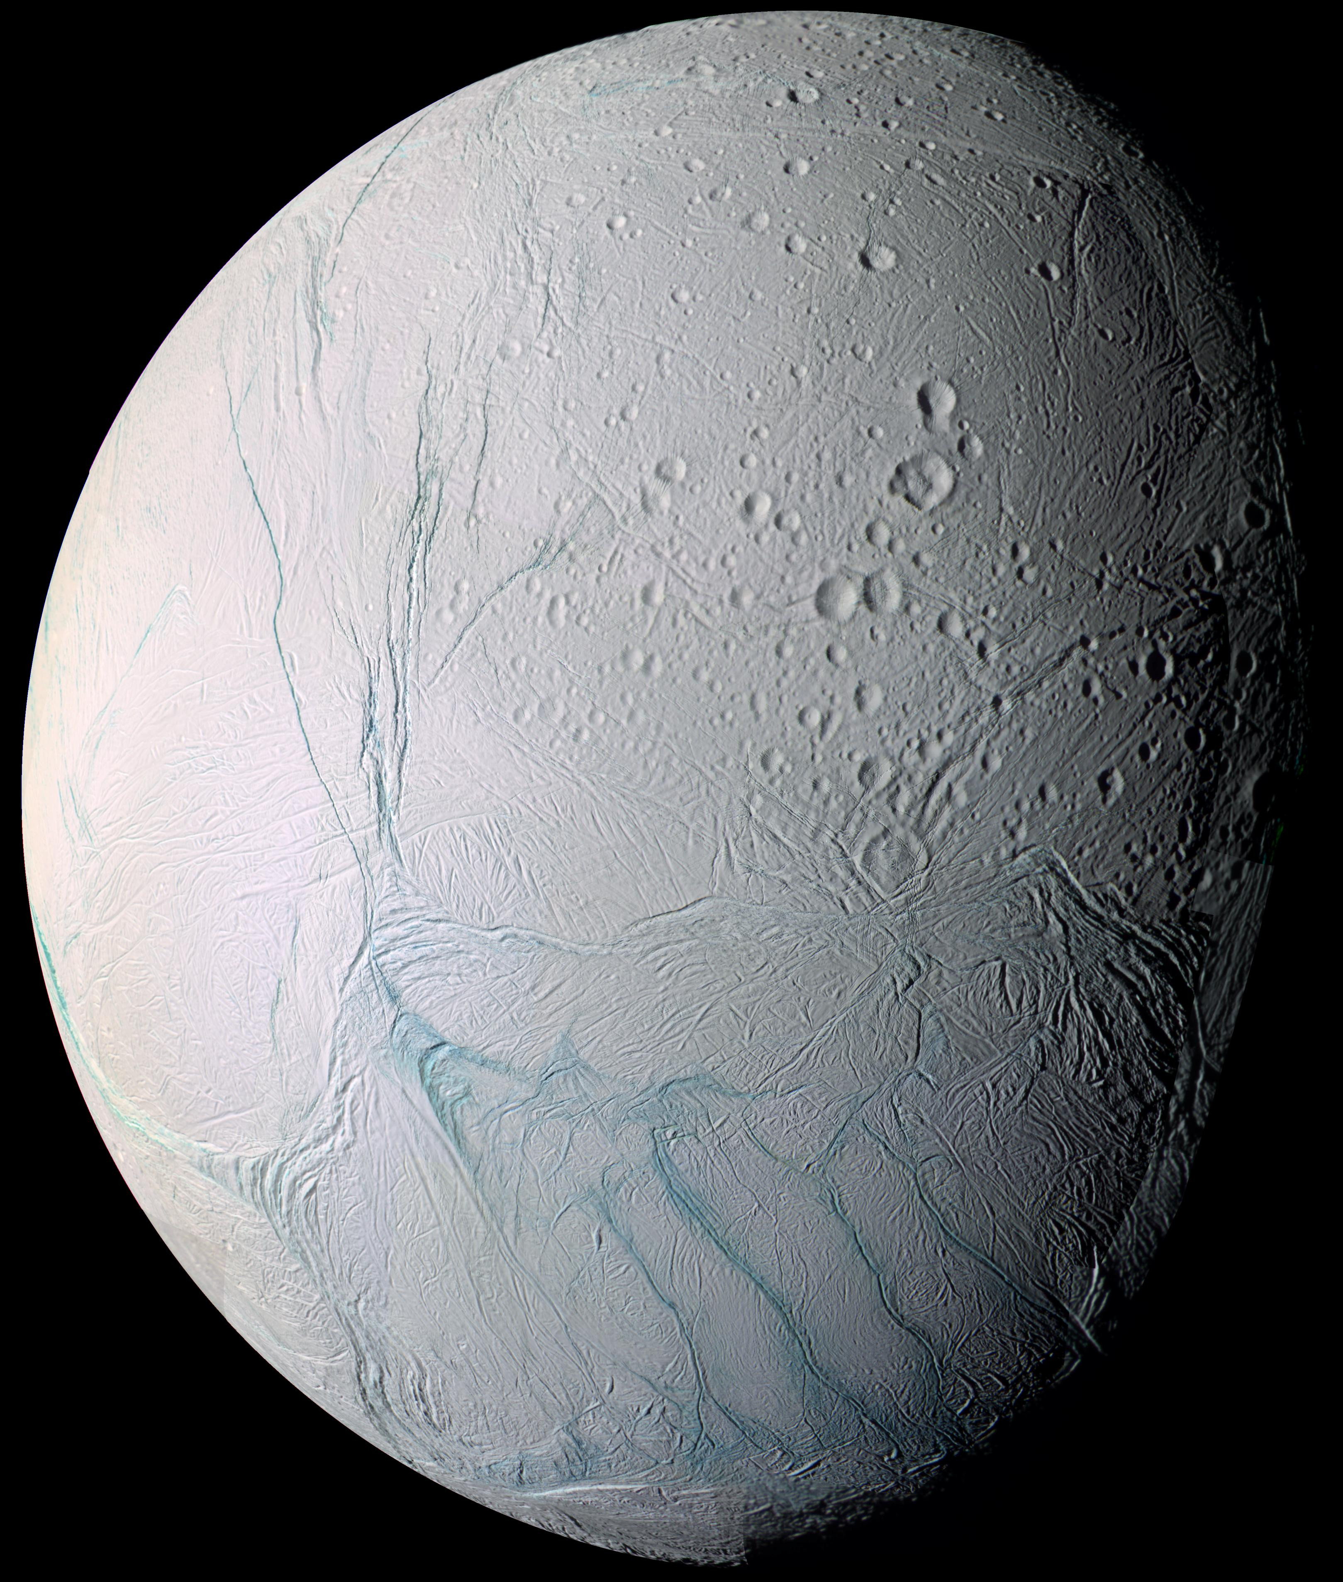
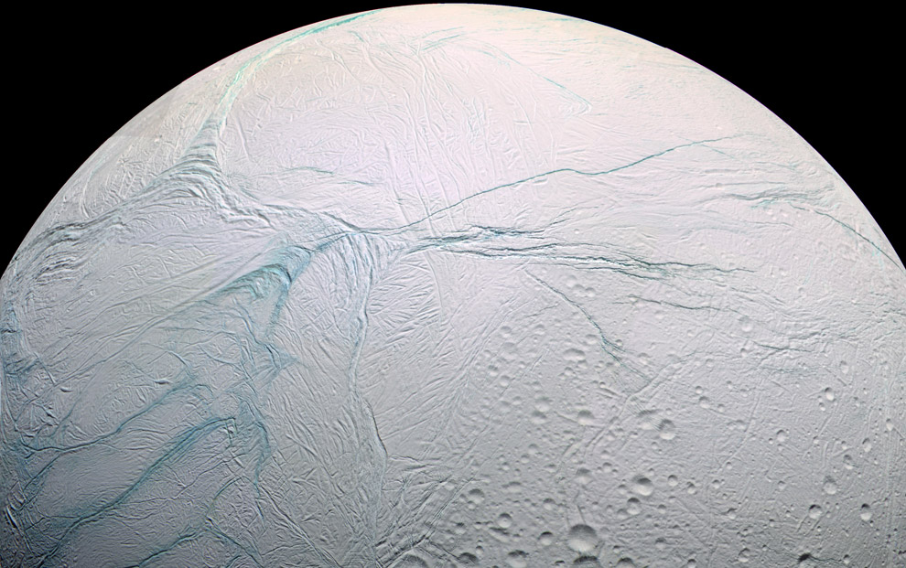
Welcome to Enceladus
Welcome to
Enceladus

Slide 22
Enceladus
Basics 9.54 AU, 1.37 day orbit, e = 0.00452, 3.9 Sat radii
d = 504 km (0.04 Earth), density 1.61 g/cm³
albedo ~ 1.00
Environment some radiation from Saturn magnetosphere, Sun
Atmosphere minimal, but containing H₂O (ion/neutral mass spec+UV imaging spec)
Surface 72 K … 180 K tiger stripes (infrared spectrometer)
5 types of terrain (cameras): craters (not larger than 35 km),
plains, fissures, corrugated terrain, other deformed
Interior interior liquid via tidal heating (Saturn vs. moons)
Enceladus:Tethys 1.370d:1.888d … not resonant
Enceladus:Dione 1.370d:2.737d … 2:1 resonant
Anomalies produces Saturn’s E ring (cosmic dust analyzer)
Notes:
Enceladus owes its geysers not only to the tides of Saturn but also to a resonance with Dione, a moon that lies beyond it. Saturn's strong tides ought to make Enceladus's orbit a perfect circle, but Enceladus revolves around Saturn twice in the same time Dione does once, so Dione's periodic gravitational tugs keep the path of Enceladus slightly elliptical.
The water geysers of Enceladus spew the most material when the small moon ventures farthest from Saturn. The geysers' strength depends on Saturn's tide --- the tiger stripes are all oriented in one direction, and according to the models, in part because of the particular orientation of the tiger stripes, the cracks are pulled open when Enceladus is furthest from the planet and slammed shut when it's closest to the planet.

Slide 23
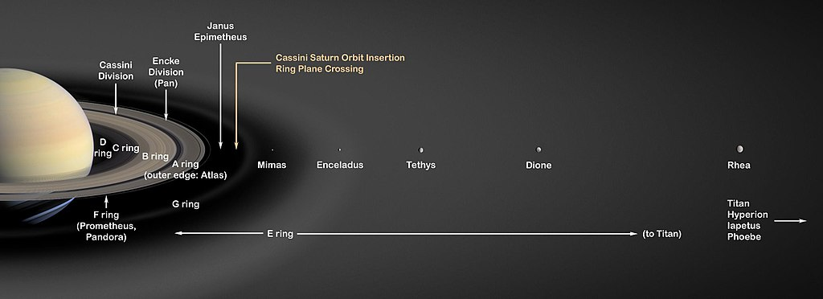
The Saturn System
e = 0.005 0.000 0.002
Notes:
Enceladus-Dione resonance causes elliptical orbits
Tethys is circular orbit, not in resonance

Slide 24
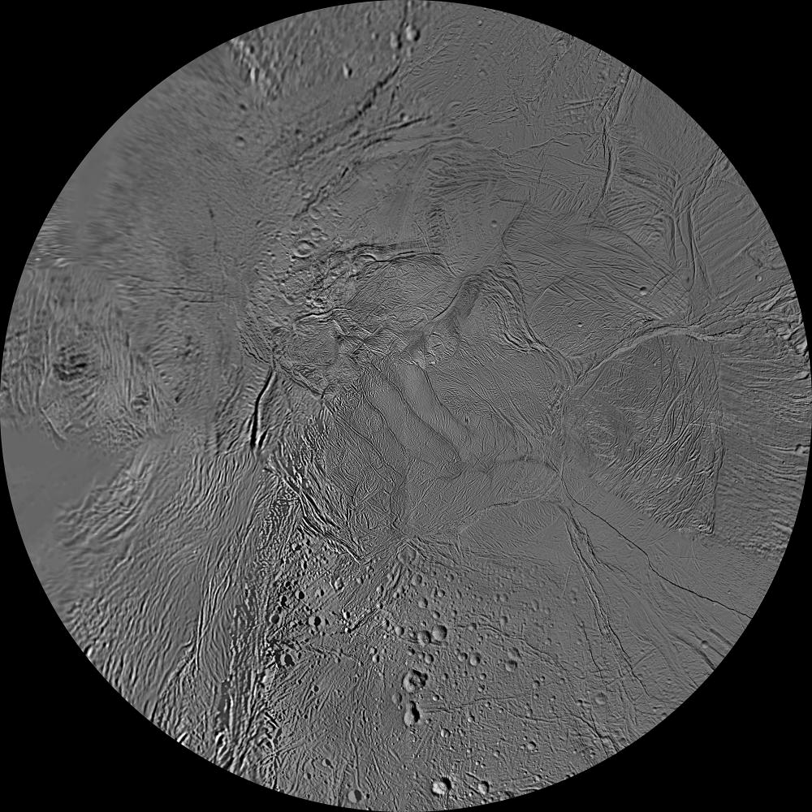
Enceladus: South Pole
not many craters
Notes:
resolution better than 1 km/pixel

Slide 25
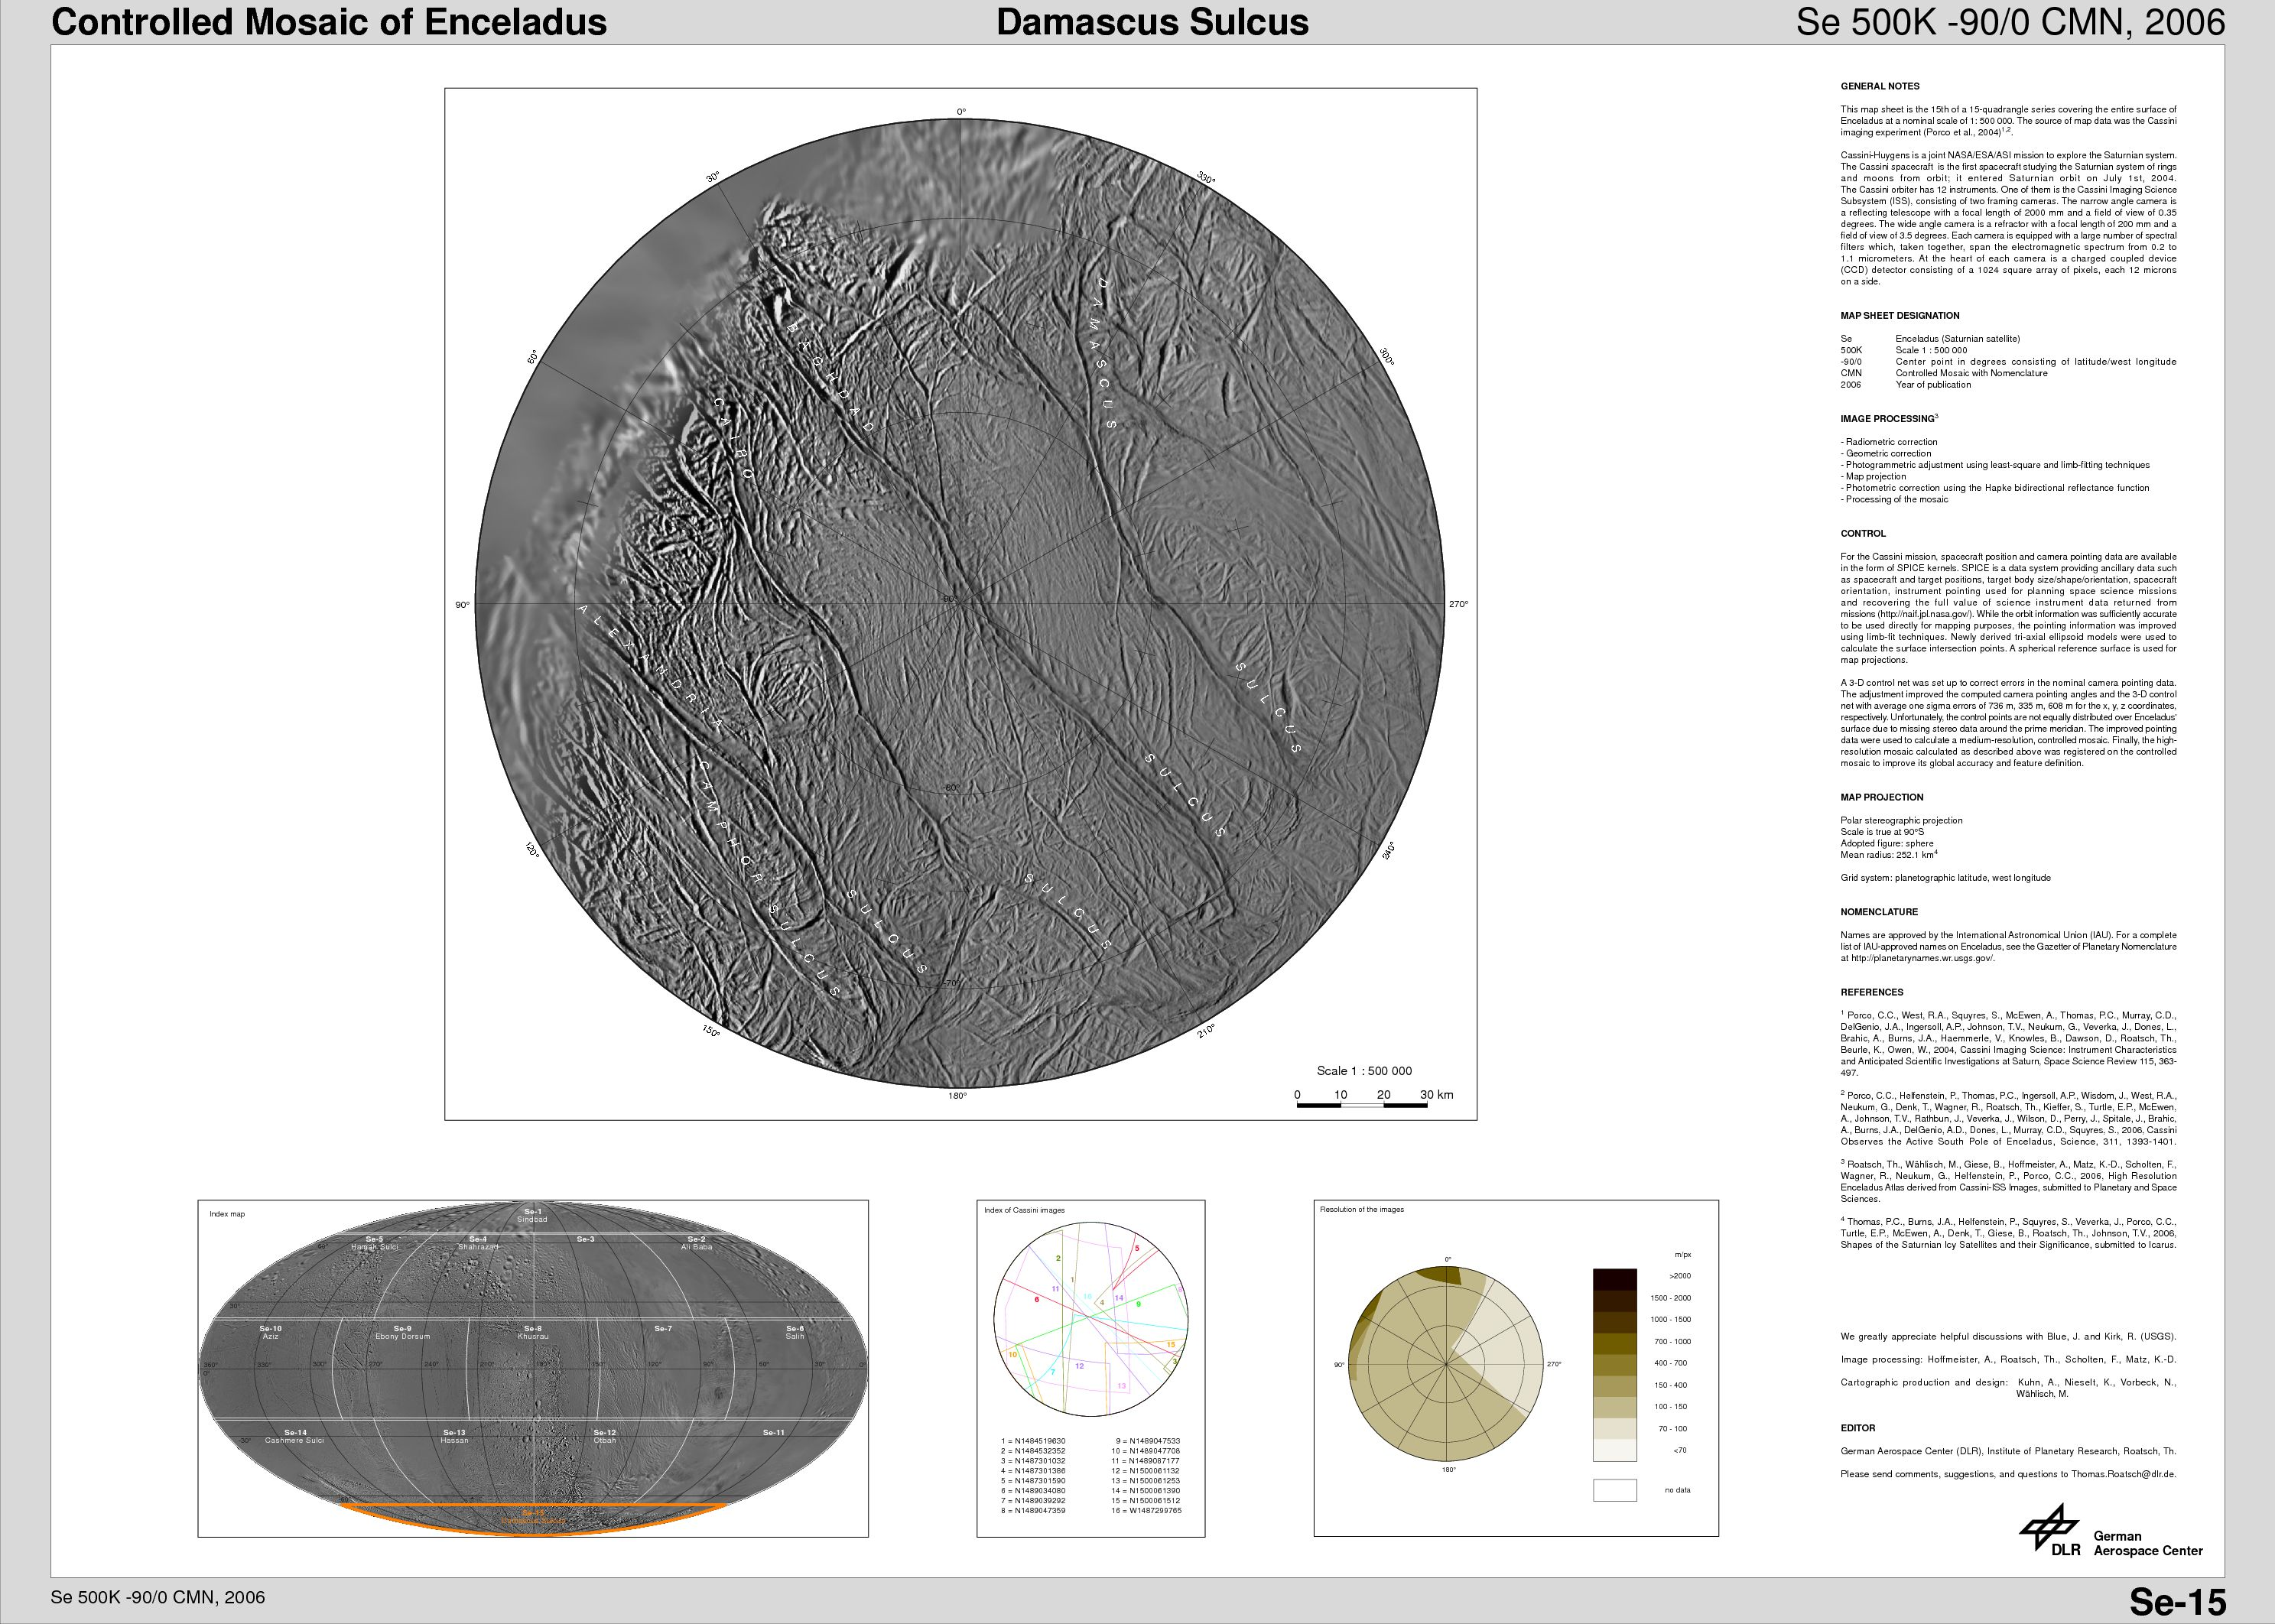
Enceladus: South Pole
sulcus:
groove or fissure
Damascus
Baghdad
Cairo
Alexandria
Camphor
Notes:
sulcus --- as in a groove in the brain
Baghdad runs nearly through south pole

Slide 26
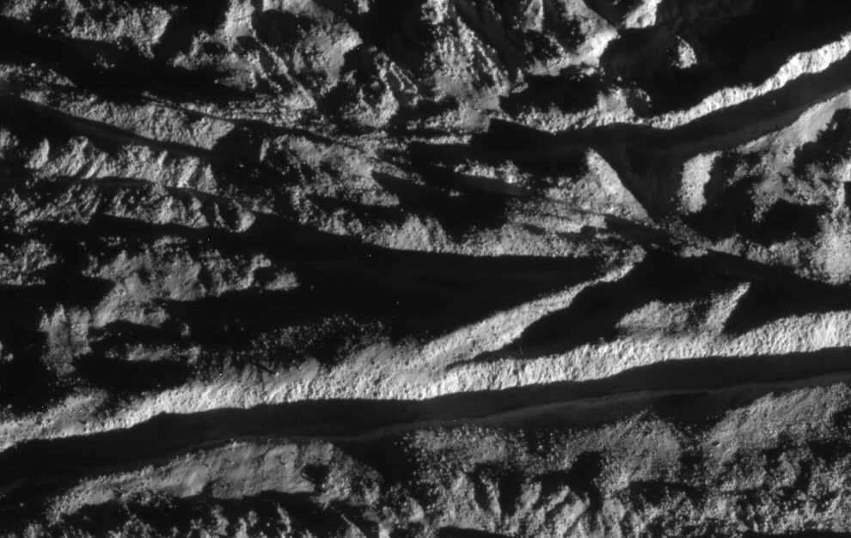
Enceladus: Cairo Sulcus
Cairo Sulcus at resolution 18 m/pixel
Notes:
Cairo Sulcus is trench near bottom

Slide 27
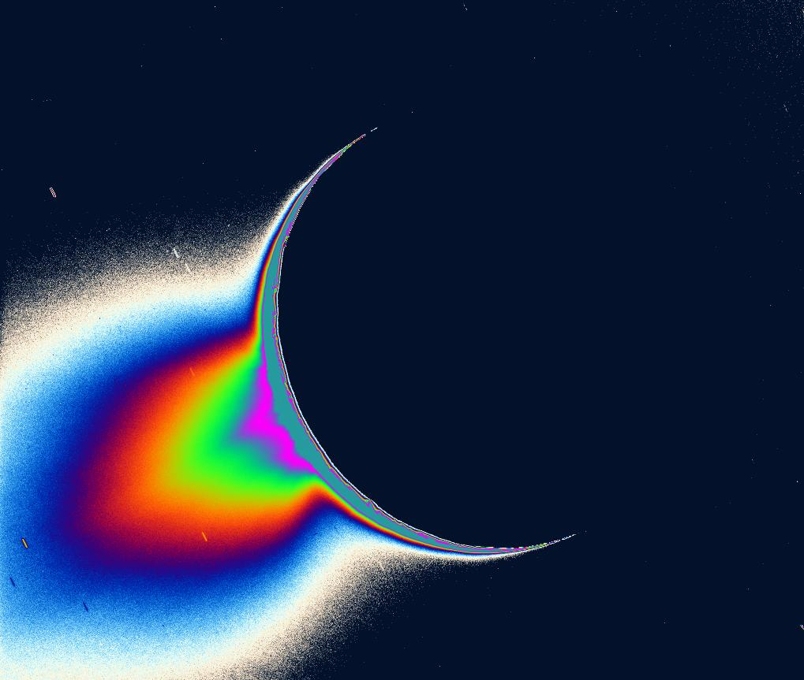
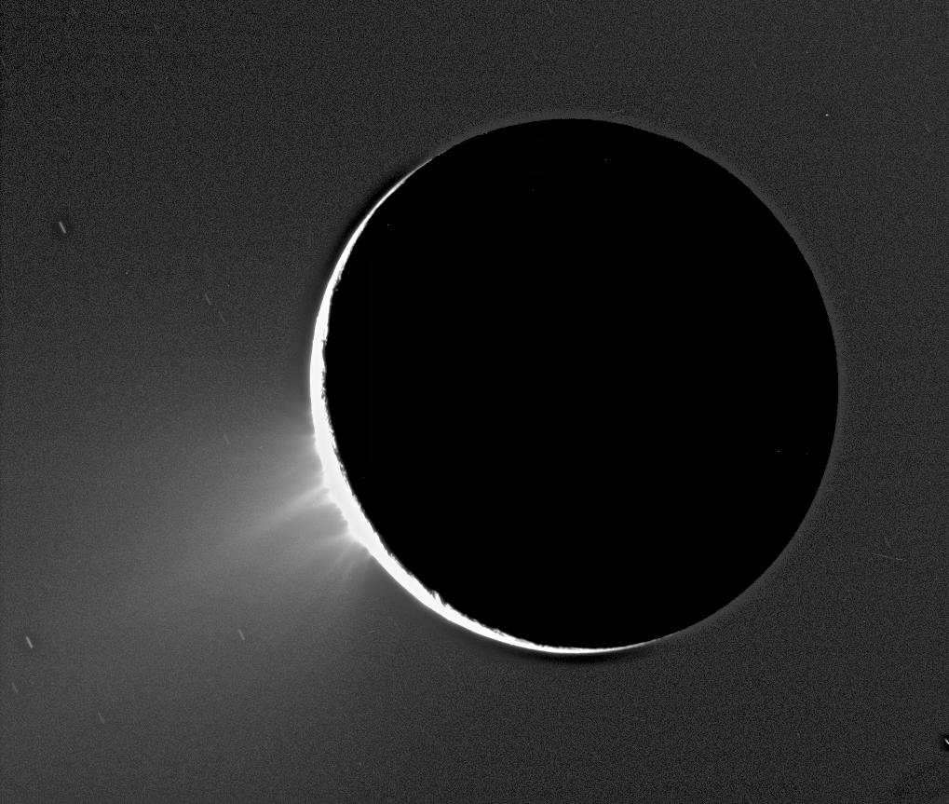
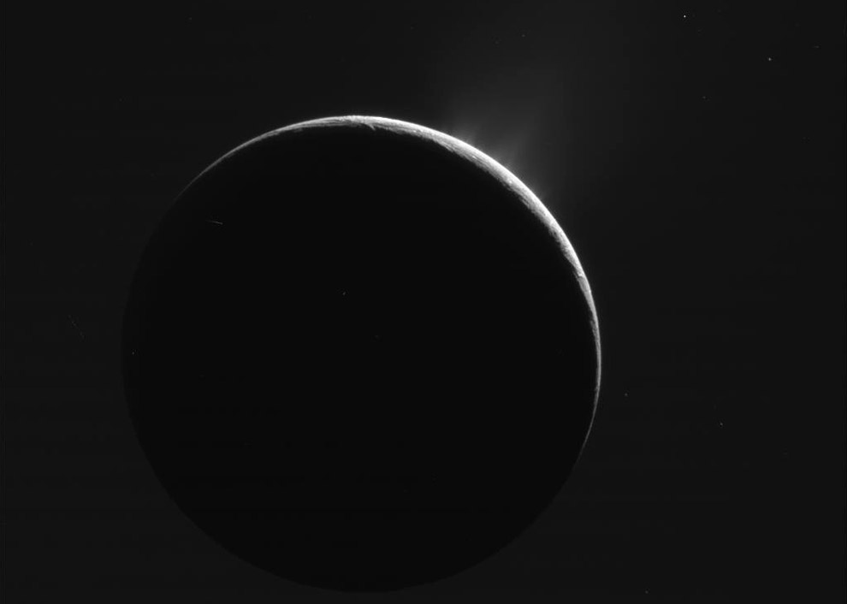
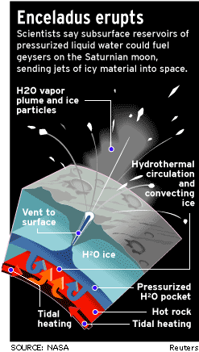
Enceladus Erupts

Slide 28
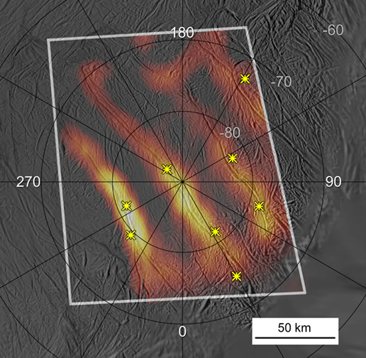
Enceladus: Tiger Stripes
IR spectrometer
12-16 microns
150 km long
highest temps 180 K
* plume jets
Notes:
composite infrared spectrometer on 12 MAR 2008 at lambda 12-16 microns

Slide 29
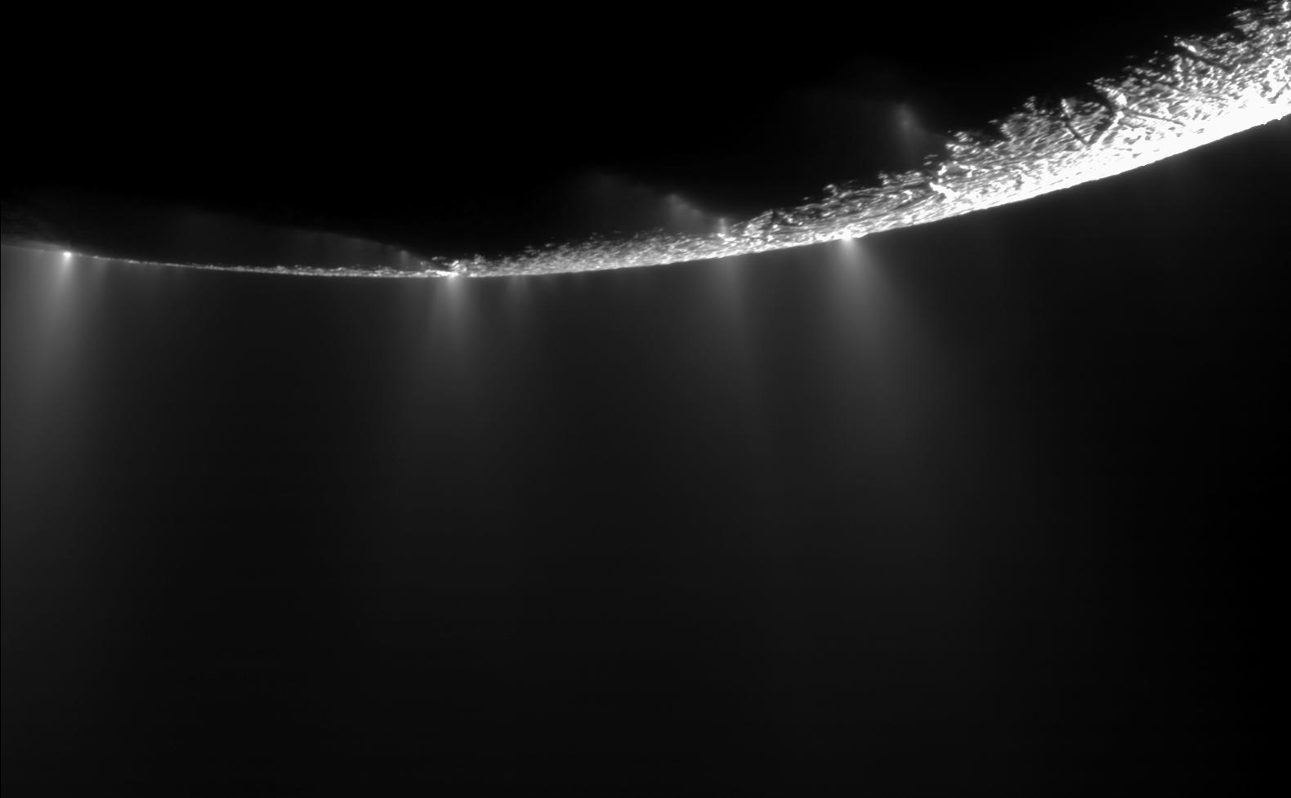

Slide 30
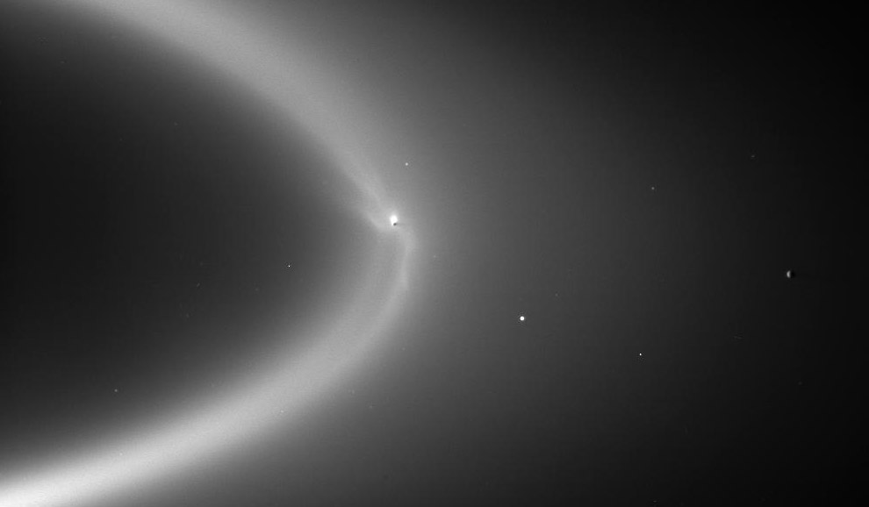
Enceladus: E Ring
Enceladus
504 km
Tethys
1071 km
Notes:
Enceladus:Tethys orbital periods 1.370:1.888 … not really resonant
Enceladus:Dione orbital periods 1.370:2.737 … 1:1.9978

Slide 31
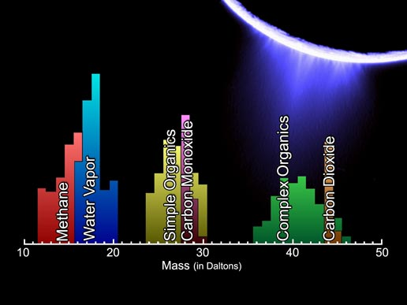
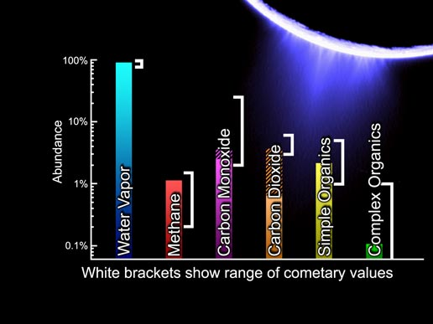
Enceladus: Plume Chemistry
Enceladus:
Plume Chemistry
Notes:
mass spectrum by Cassini’s Ion and Neutral Mass Spectrometer on 12 MAR 2008
Daltons ~ sum of protons and neutrons
chemistry is comet-like

Slide 32
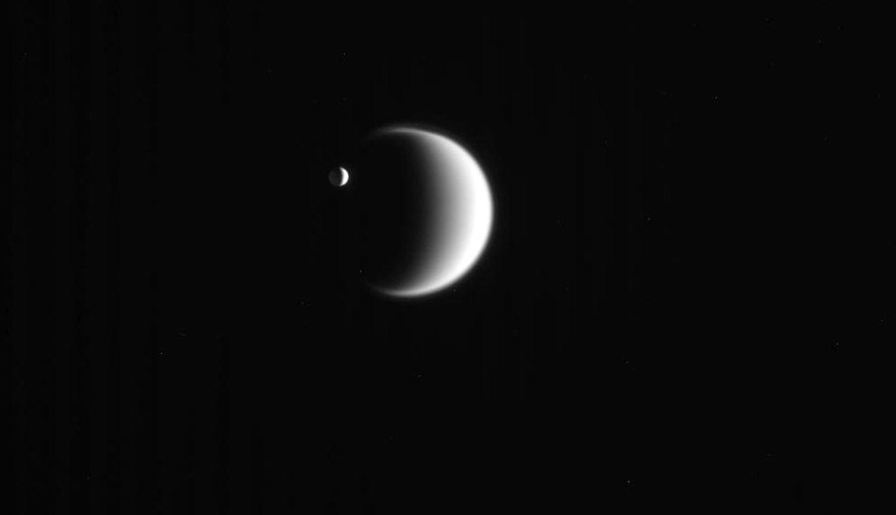
Enceladus and Titan
504 km
5150 km

Slide 33
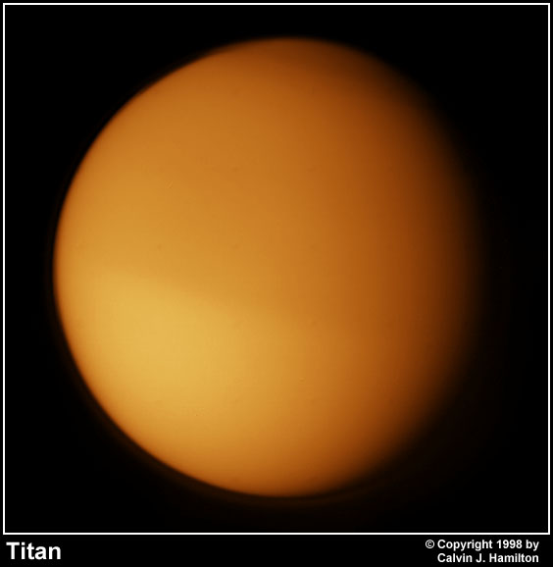
Welcome to Titan
Welcome to Titan

Slide 34
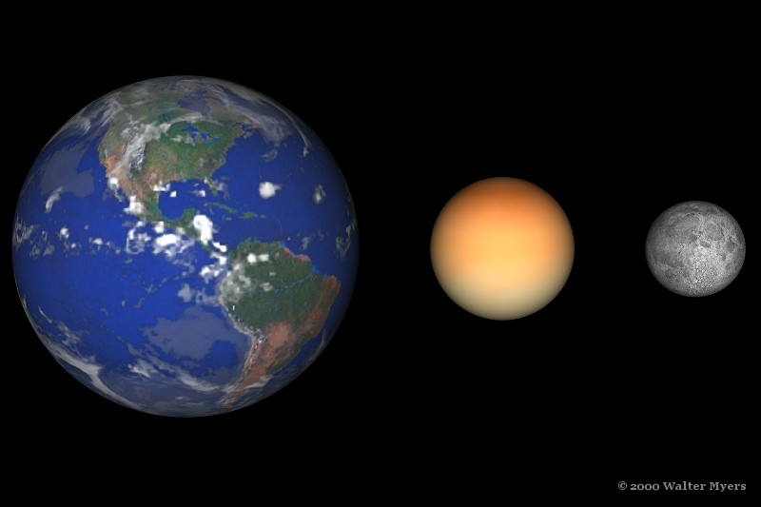
Titan

Slide 35
Titan
Basics 9.54 AU, 15.9 day orbit, e = 0.029, 20.3 Sat radii
d = 5150 km (0.40 Earth), density 1.88 g/cm³
Environment some radiation from Saturn magnetosphere, Sun
Atmosphere 1.6 bars at surface
N₂ + CH₄ + trace compounds
cold temp allows H₂O to lock in NH₃ and CH₄
interior radioactivity warmed/warms out NH₃ + CH₄
hydrocarbons + nitriles (HCN)
Surface 95 K, can’t see it in optical, but features in infrared
density … rocky core + ice
methane/ethane lakes and rain … organic sediment
Anomalies only moon with substantial atmosphere

Slide 36
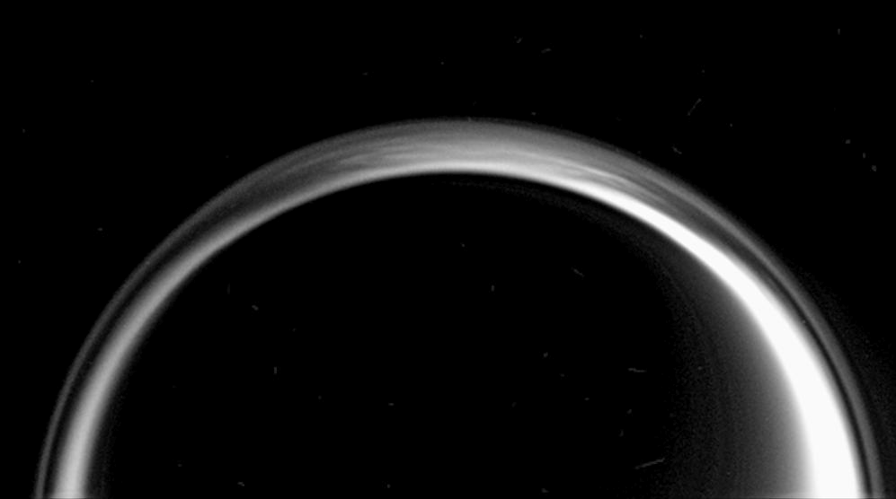
Titan Smog Layers

Slide 37
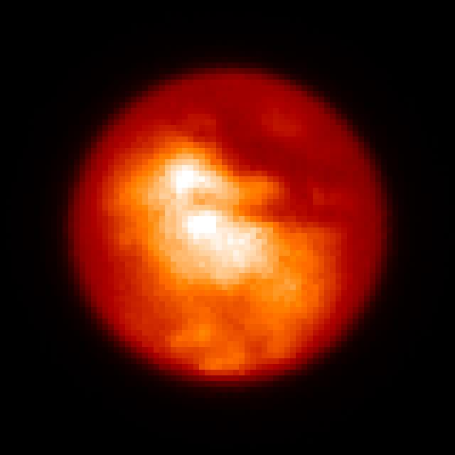
Titan Surface (Clouds?) from Earth

Slide 38
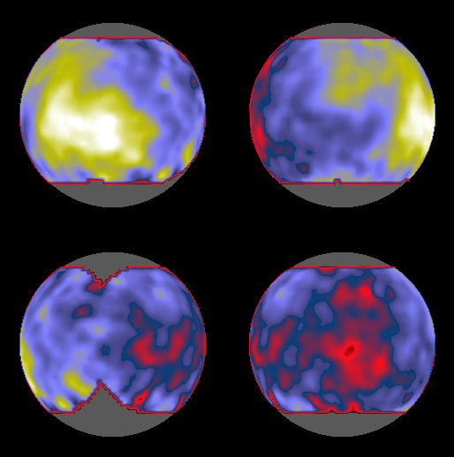
Titan Map from Earth

Slide 39
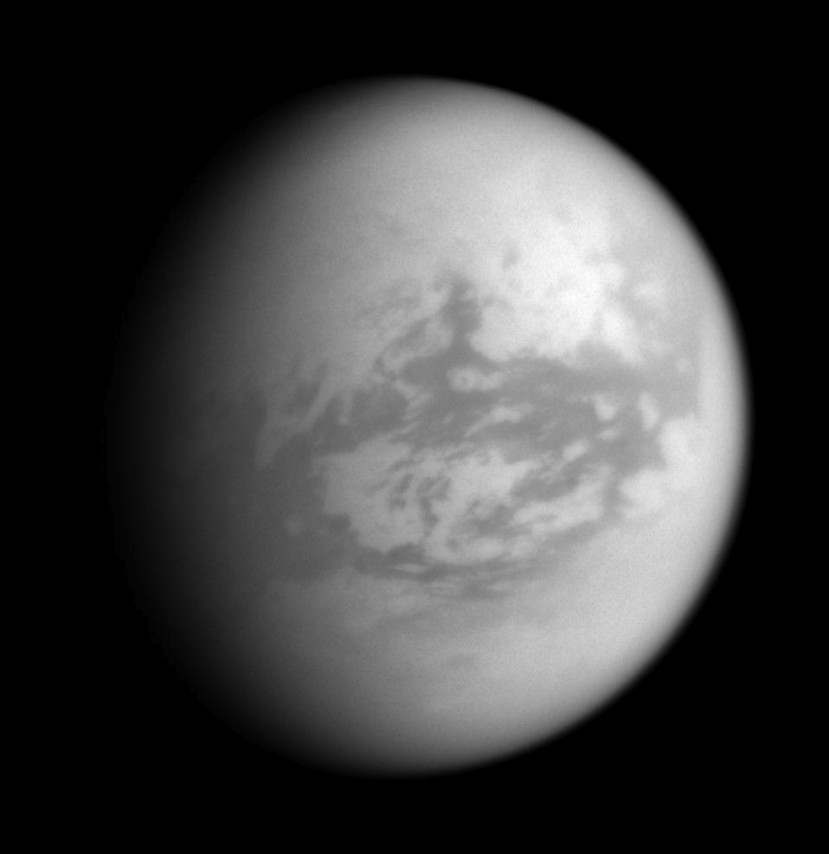
Titan Surface from Cassini

Slide 40
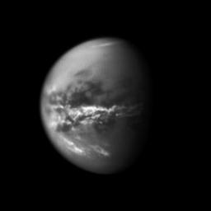
Methane Clouds

Slide 41
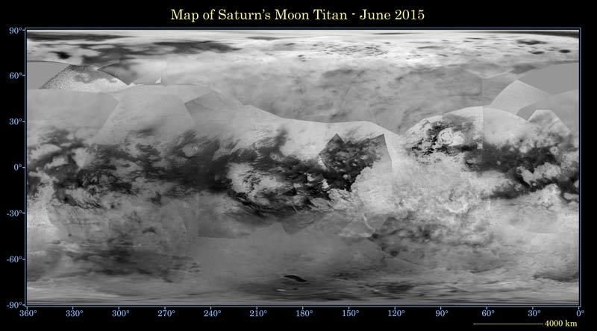
Titan Map from Cassini 2015
density is 1.88 g/cm³ … part rock, part ice
few craters … surface less than 1 Gyr old
liquid CH₄/C₂H₆ lakes near poles cover ~1% of surface and change size
imaged at 9380 A

Slide 42

Titan: Xanadu
Xanadu
rough surface
bright in radar
5 km wide
Notes:
active riverbeds with CH4, or dry arroyos? unknown
resolution ~ 1 km

Slide 43

Titan: 70deg N
Titan: 70deg N
(m)ethane sea?
Xanadu
Notes:
active riverbeds with CH4, or dry arroyos? unknown
resolution ~ 1 km

Slide 44

Titan Craters
Ethane Sea?
Menrva Crater
D = 440 km
1500 x 850 km
Notes:
two types of radar used … very few craters, none with D < 20 km
Menrva is correct spelling

Slide 45


Titan Dunes
nearly circle the globe from
30N to 30S
Ethane Sea?
Ksa
Xanadu
930 x 350 km
636 x 225 km
Notes:
white areas are likely elevated mountains

Slide 46


Titan’s N Lakes
+ 3 Seas
Notes:
north pole seas … largest is Kraken Mare

Slide 47



Notes:
north pole seas … largest is Kraken Mare

Slide 48

Ontario Lacus (slightly smaller than Earth L. Ontario)
hills 1km high
Ethane Sea?
delta
bay
930 x 350 km
Notes:
caption says “a combination of methane, ethane, and propane”

Slide 49

Rain-filled Lakes
nope
yup
Notes:
caption says “a combination of methane, ethane, and propane”

Slide 50


Sunlight off Kraken Mare
Notes:
VIMS on Cassini, specular reflection confirms liquid! inset shows Kraken Mare rotated to 12 o’clock

Slide 51

Titan Touchdown!
https://www.youtube.com/watch?v=9L471ct7YDo
Notes:
WATCH Titan landing video!

Slide 52



Titan Touchdown!
https://www.youtube.com/watch?v=9L471ct7YDo
Notes:
WATCH Titan landing video!

Slide 53

Titan Rain

Slide 54
Solar System Explorers: 14 NOV
Name any attribute (other than location or related to life) of a TEEEM member --Titan, Earth, Europa, Enceladus, Mars -- that sets it apart from all the others.
1. Earth has a H2O cycle with rain
2. Enceladus makes the E ring
3. Earth is tectonically active
4. Mars has recurring slope linaea that are seasonal
5. Europa has chaotic terrain made out of H2O ice
6. Enceladus has by far the lowest gravity
7. Europa is getting a buttcial
8. Mars has araneiform terrain from sublimating CO2
9. Mars has chaotic obliquity
10. Earth has highest temp
11. Mars has aurorae at all latitudes
12. Mars is the only atmospheric big loser
13. …
14. …
15. …
16. …
17. …
18. …
19. …
20. …

Slide 55
Solar System Explorers: 21 NOV
Describe any crazy extremophile found on Earth.
1. …
2. …
3. …
4. …
5. …
6. …
7. …
8. …
9. …
10. …
11. …
12. …
13. …
14. …
15. …
16. …
17. …
18. …
19. …
20. …

Slide 56
…………………………
Notes:
56

