Slide 1
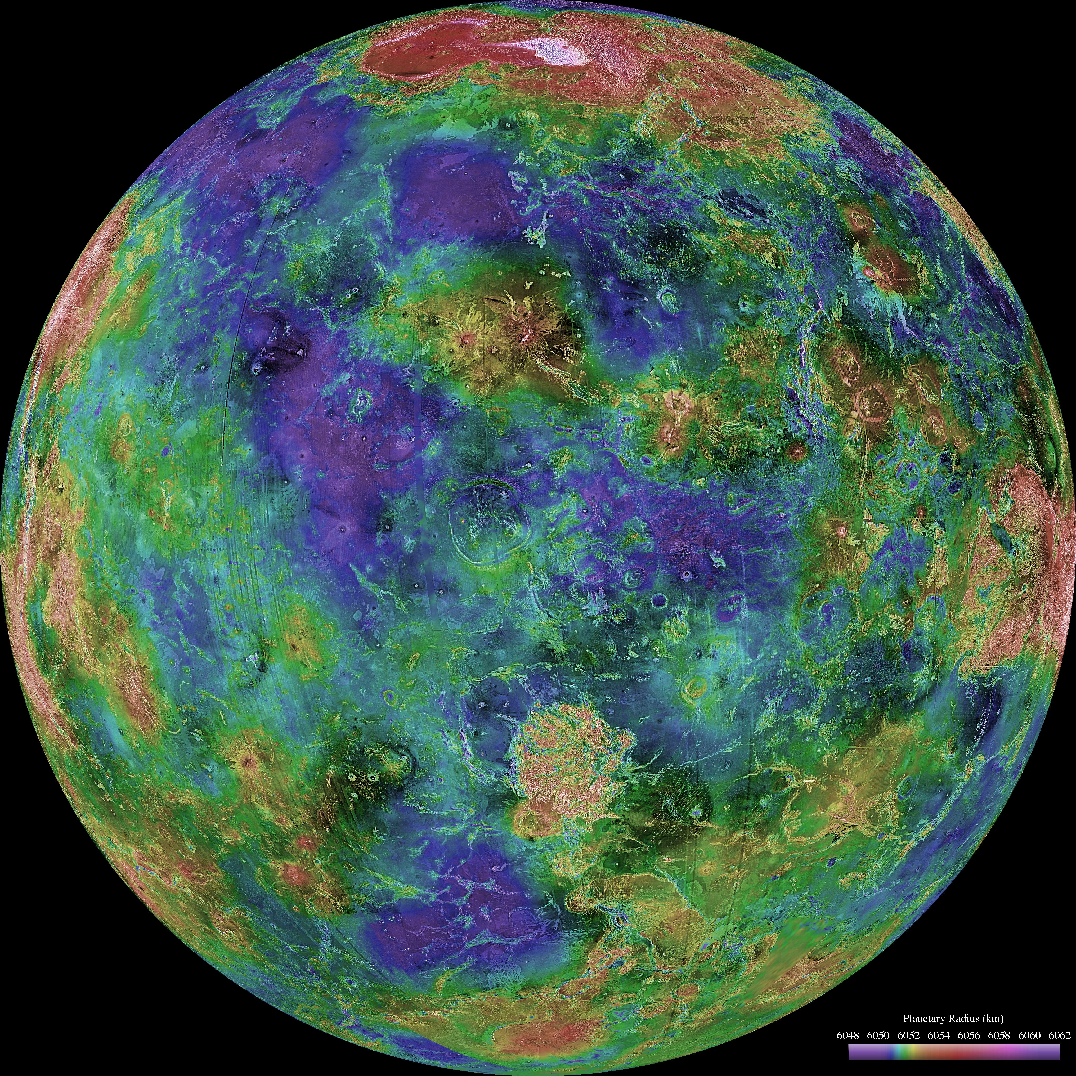
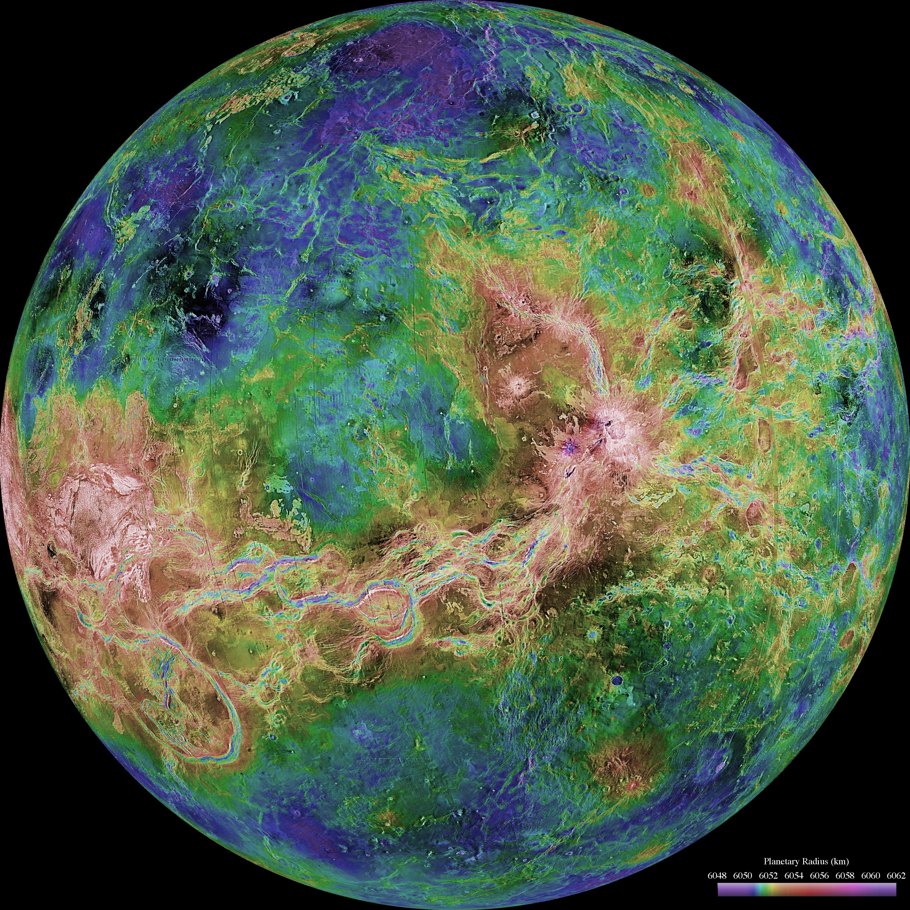
Where is this?
Notes:
Left: high point near pole is Ishtar Terra
Right: high point of spaghetti is Aphrodite Terra
VENUS by Magellan: revealed by more than a decade of radar investigations culminating in the 1990-1994 Magellan mission, is centered at 0 degrees east longitude (left) and 180 degrees (right). The Magellan spacecraft imaged more than 98% of Venus at a resolution of about 100 meters; the effective resolution of this image is about 3 km. A mosaic of the Magellan images (most with illumination from the west) forms the image base. Gaps in the Magellan coverage were filled with images from the Earth-based Arecibo radar in a region centered roughly on 0 degree latitude and longitude, and with a neutral tone elsewhere (primarily near the south pole). The composite image was processed to improve contrast and to emphasize small features, and was color-coded to represent elevation. Gaps in the elevation data from the Magellan radar altimeter were filled with altimetry from the Venera spacecraft and the U.S. Pioneer Venus missions. An orthographic projection was used, simulating a distant view of one hemisphere of the planet.

Slide 2
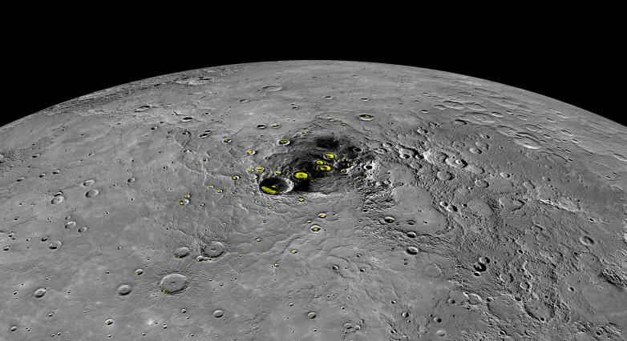
Where is this?
northern hemisphere H₂O ice
Notes:
MERCURY: by Messenger, yellow indicates H2O seen from Earth

Slide 3
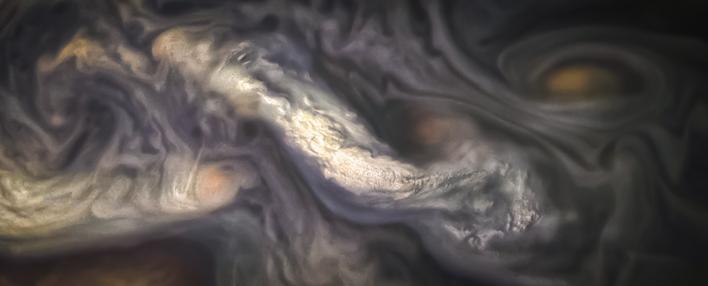
Where is this?
Notes:
JUPTER: by Juno 16 July 2018 … North Temperate Belt, one of Jupiter's eye-catching atmospheric bands. When the image was taken this week, Juno was just 3,900 miles (6,200 km) above the top of the planet's clouds.

Slide 4
Solar System Explorers: 21 NOV
Describe any crazy extremophile found on Earth.
1. …
2. …
3. …
4. …
5. …
6. …
7. …
8. …
9. …
10. …
11. …
12. …
13. …
14. …
15. …
16. …
17. …
18. …
19. …
20. …

Slide 5
Solar System Explorers: 21 NOV
Name the 2 favorite things that you learned in ASTR 8850 this year.
1. …
2. …
3. …
4. …
5. …
6. …
7. …
8. …
9. …
10. …
11. …
12. …
13. …
14. …
15. …
16. …
17. …
18. …
19. …
20. …

Slide 6
Solar System Explorers: 22 NOV
A mysterious game of fun …
1. …
2. …
3. …
4. …
5. …
6. …
7. …
8. …
9. …
10. …
11. …
12. …
13. …
14. …
15. …
16. …
17. …
18. …
19. …
20. …

Slide 7
The Future
papers
due
5pm
papers
out to
refs
reviews
due
5pm
grades
due
23
24
talks
T u r k e y T i m e

Slide 8
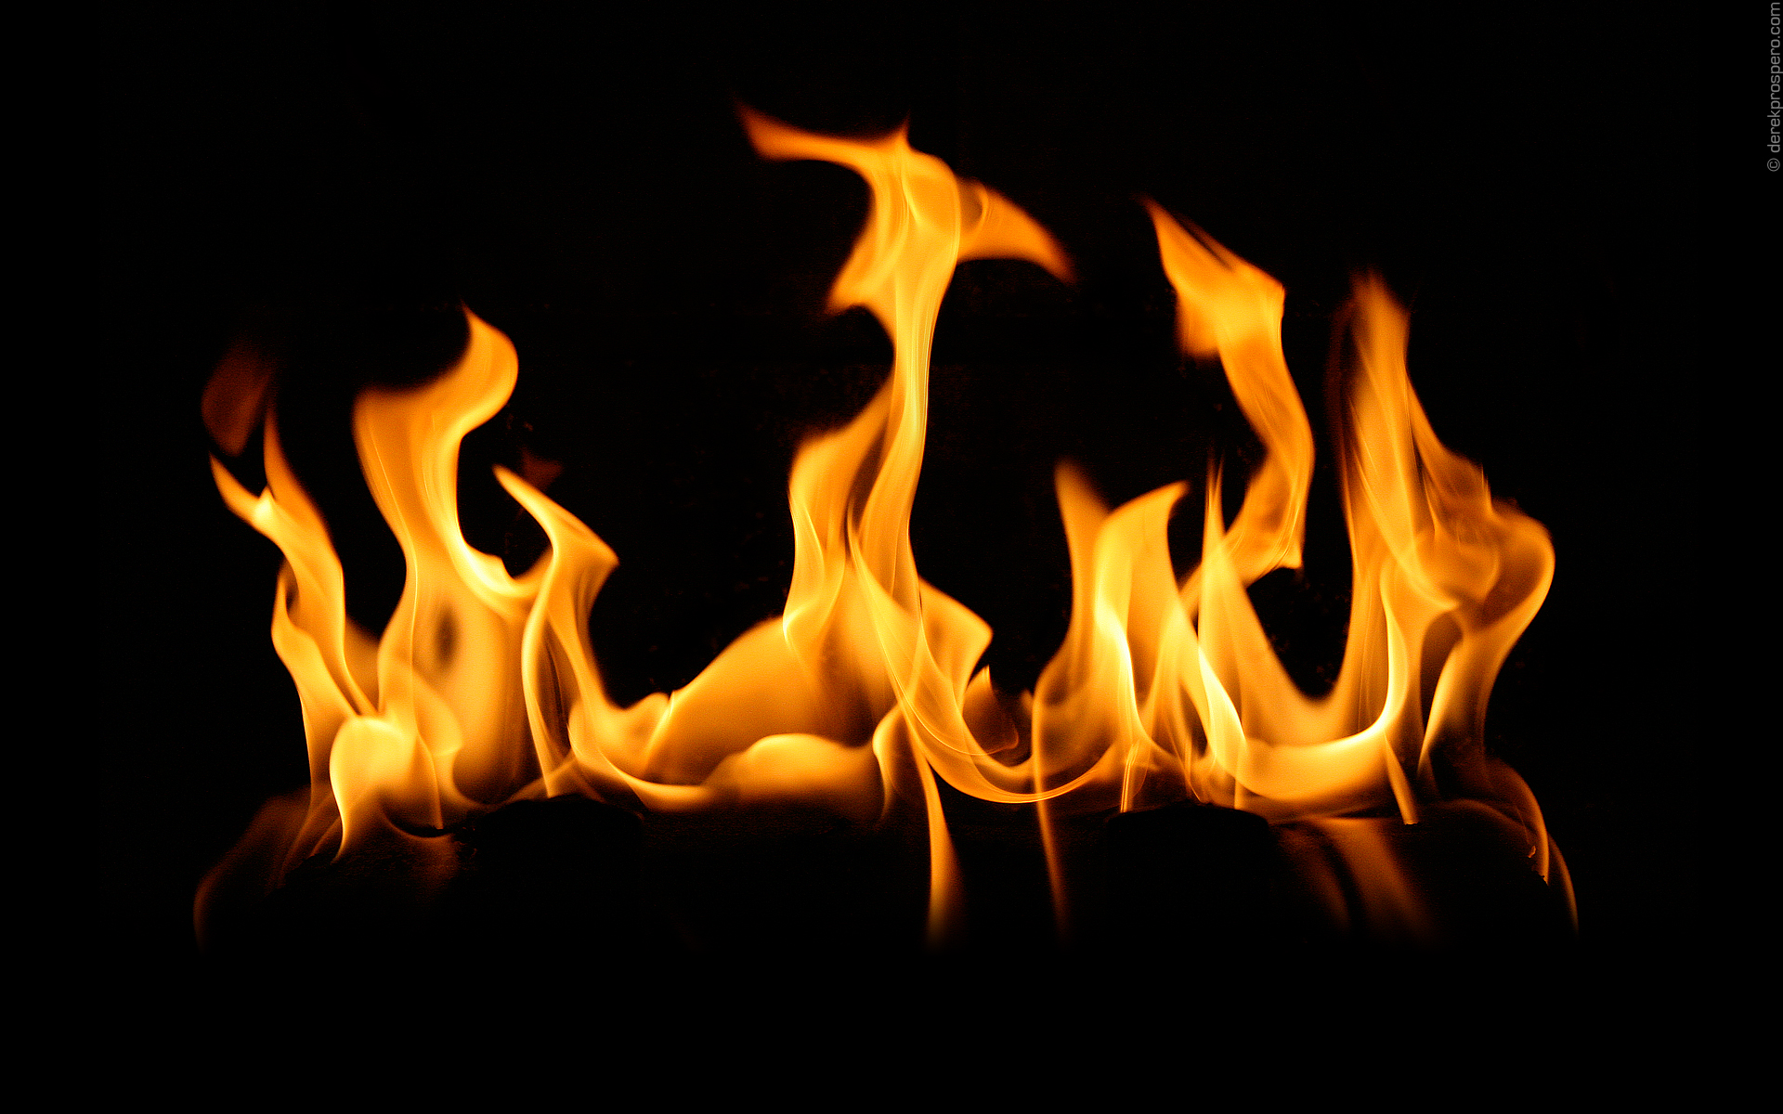
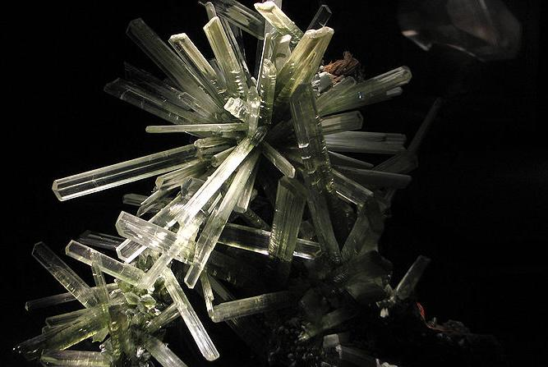
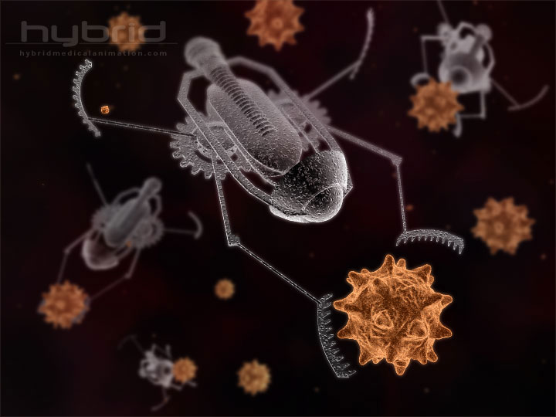
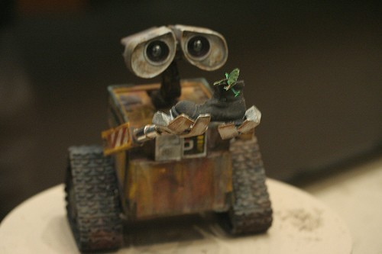
What is
Life?

Slide 9
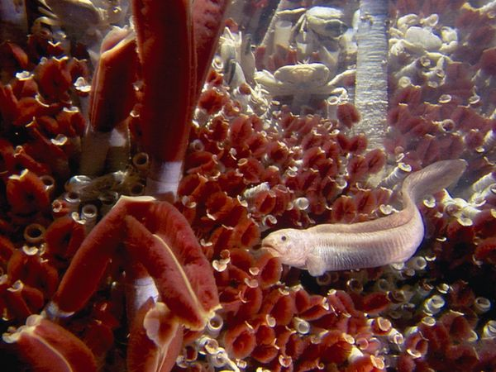
photo: Emory Kristof
Notes:
Mid-Atlantic Ridge with tubeworms, eelpout fish, and crabs

Slide 10
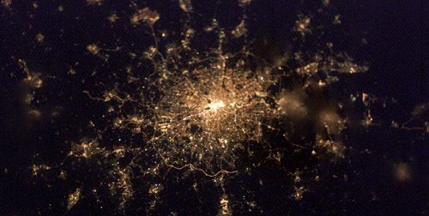

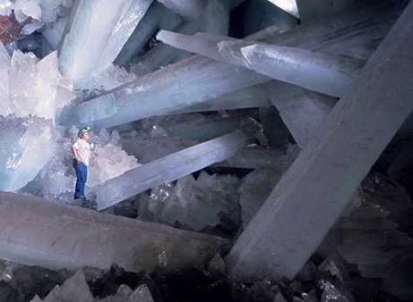
Definition of Life
1. moves
water, sandstorm
2. grows
mountains, crystals
3. reacts
waves, snowmelt
4. defends
fire, avalanche
5. metabolizes
fire
[may have preceded RNA/DNA]
6. reproduces
crystals do, mules don’t
* 7. organized
violates entropy
more organized than surroundings
membrane/wall
* 8. evolves
generational
reacts to environmental changes
Notes:
Cave of Crystals in Mexico

Slide 11
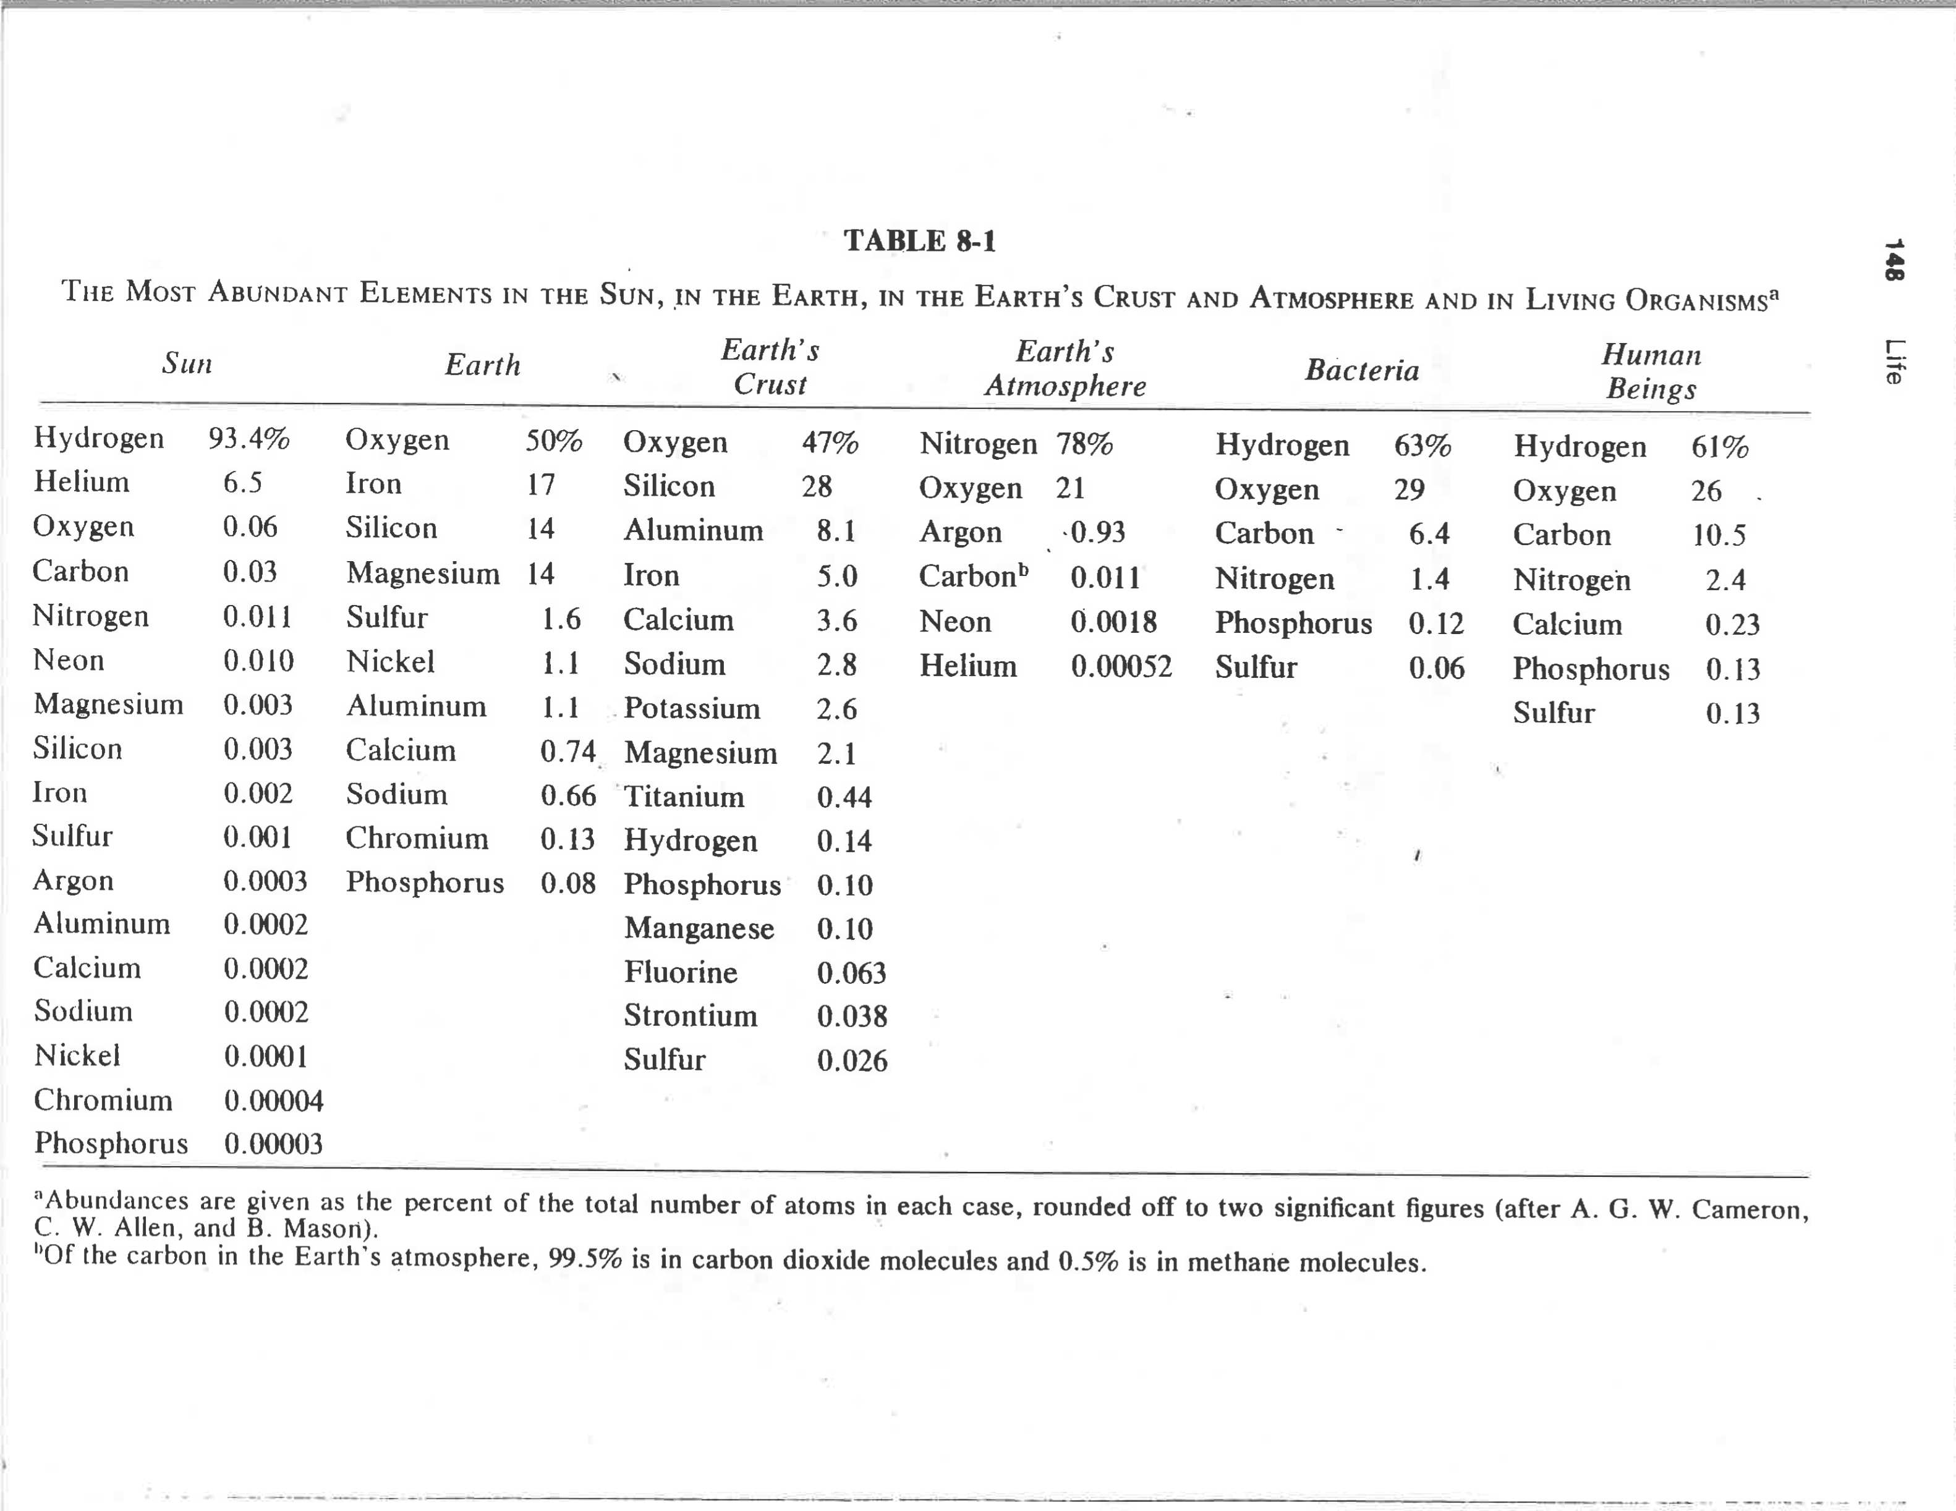
Universal Compositions
Oxygen is everywhere, but
Carbon is RARE
from The Search for Life in the Universe (Goldsmith & Owen, 1980)

Slide 12
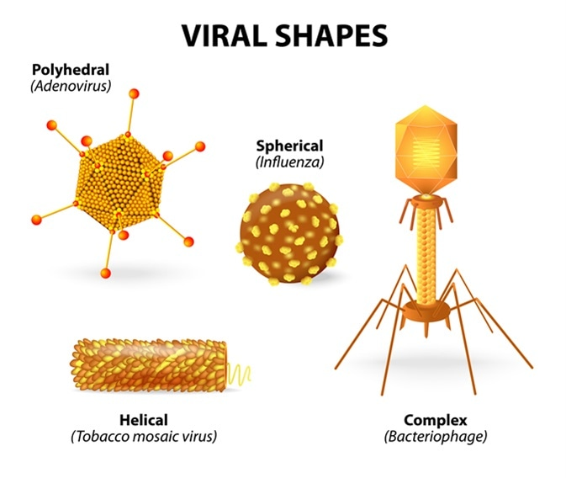
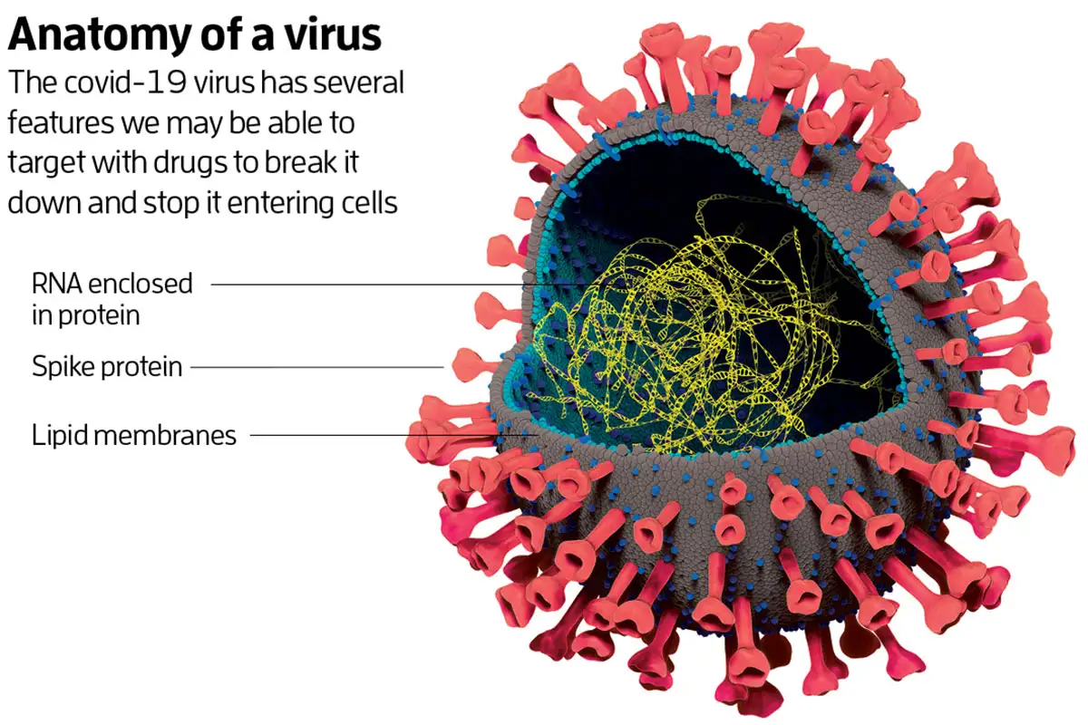
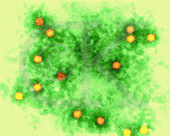
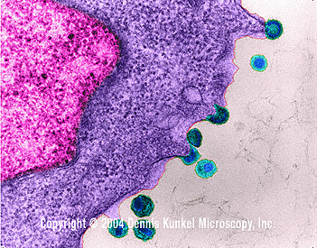
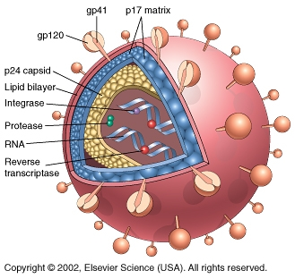
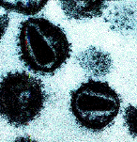
Not Life
central idea of chemical evolution --- life developed from non-life
any evidence? … viruses
compare to molecules and cells:
intermediate size
some genetic info in RNA/DNA
reproduce only in host
polio virus 7741 bases
“a chemical with a life cycle”
Notes:
lower left are three images/schematics of HIV
gp120 is glycoprotein with molecular weight of 120 kDa … essential for virus entry (the “key”) into CD4 cells = white blood cells = T-cells… ~1500 nucleotides long, corresponding to ~500 amino acid “residues” because 3 nucleotides/aa
Polio virus synthesized in lab in 2002 – first ever synthetic virus

Slide 13
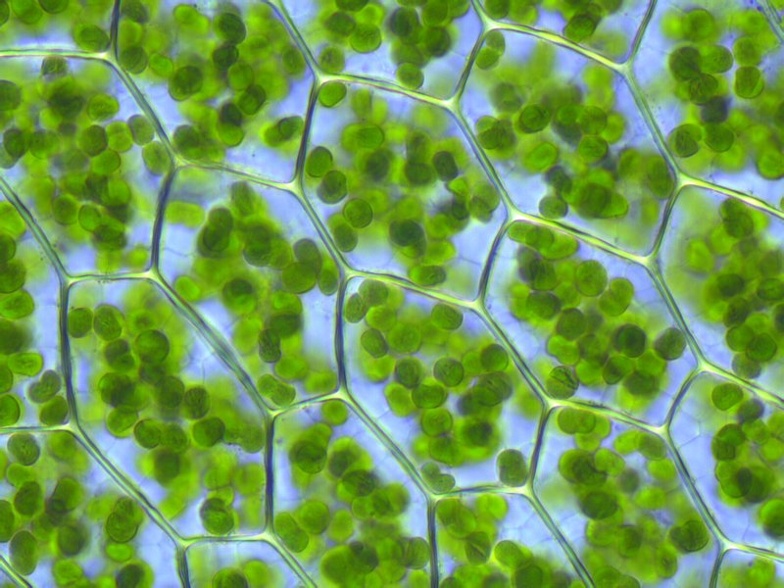
Small But Mighty Life: Cyanobacteria
1. developed proteins, RNA, DNA
2. invented photosynthesis
6 CO₂ + 6 H₂O + sunlight → C₆H₁₂O₆ + 6 O₂ + energy
3. created O₂, poisoned competitors
note that prokaryotes show evidence of Earth’s oxidation
some die in O₂, some don’t care about O₂, some must have O₂
effectively all eukaryotes need O₂
4. learned to use the O₂
aerobic 18X more efficient energy production than anaerobic
chloroplasts = photosynthesizing cyanobacteria
mitochondria = O₂ breathing cyanobacteria that invaded eukaryotes
Notes:
aerobic uses O2 to make energy, anaerobic does not
https://www.syfy.com/syfy-wire/only-multicellular-life-form-that-doesnt-need-oxygen
chloroplasts contain chlorophyll where photosynthesis takes place
The main role of chloroplasts is to conduct photosynthesis, where the photosynthetic pigment chlorophyll captures the energy from sunlight and converts it and stores it in the energy-storage molecules ATP and NADPH while freeing oxygen from water. They then use the ATP and NADPH to make organic molecules from carbon dioxide in a process known as the Calvin cycle.

Slide 14
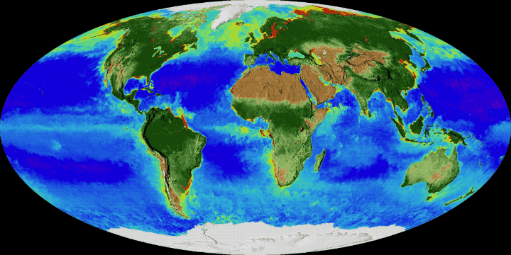
Chlorophyll on Earth
plant life from 1997-2017
lots of vegetation = dark green … lots of phytoplankton = red
https://phys.org/news/2017-11-planet.html
Notes:
A new NASA visualization shows 20 years of continuous observations of plant life on land and at the ocean’s surface, from September 1997 to September 2017. On land, vegetation appears on a scale from brown (low vegetation) to dark green (lots of vegetation); at the ocean surface, phytoplankton are indicated on a scale from purple (low) to yellow (high). This visualization was created with data from satellites including SeaWiFS, and instruments including the NASA/NOAA Visible Infrared Imaging Radiometer Suite and the Moderate Resolution Imaging Spectroradiometer.
Read more at: https://phys.org/news/2017-11-planet.html#jCp

Slide 15
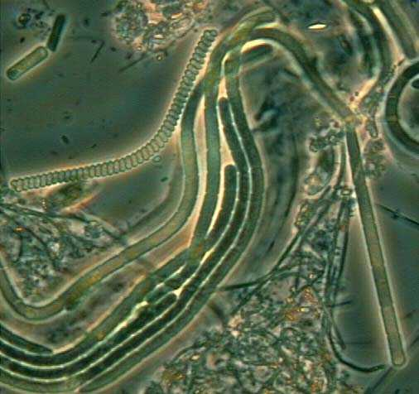
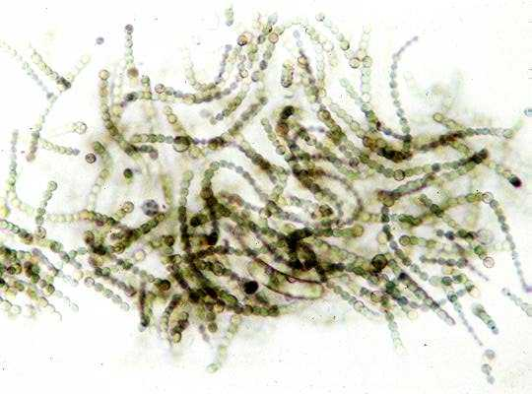
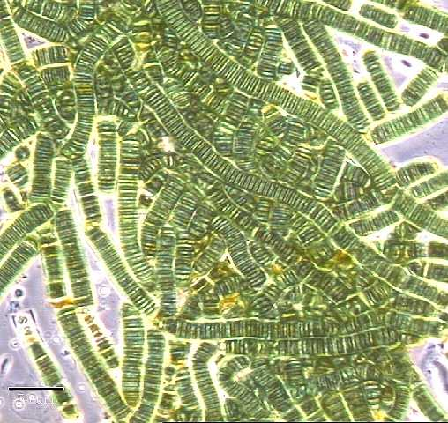
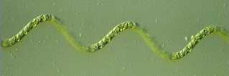
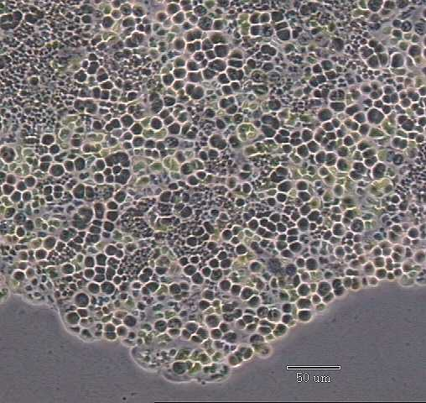
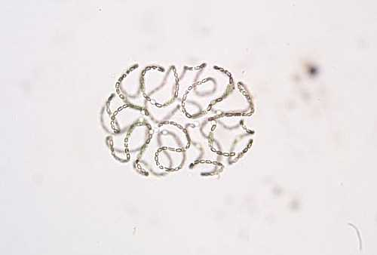
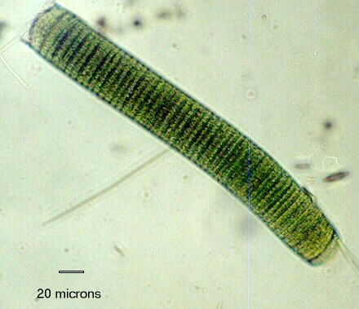
Cyanobacteria Portraits

Slide 16
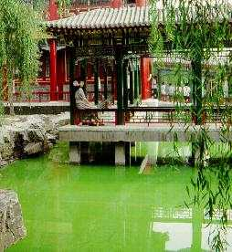
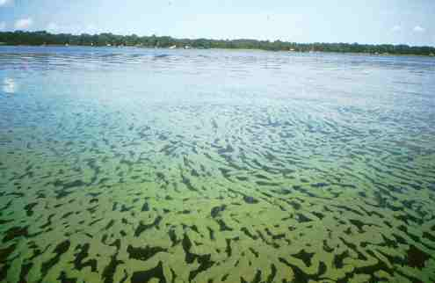
Cyanobacteria: You’ve Seen Them

Slide 17
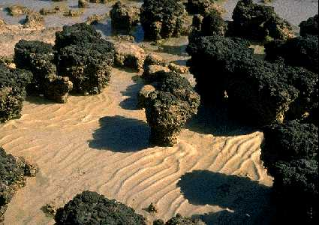
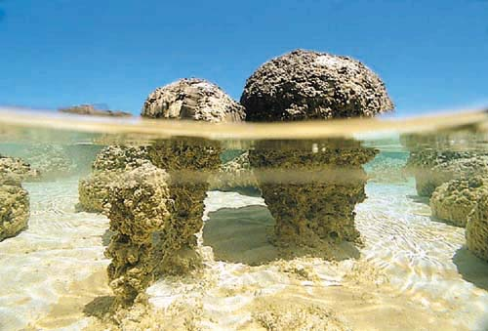
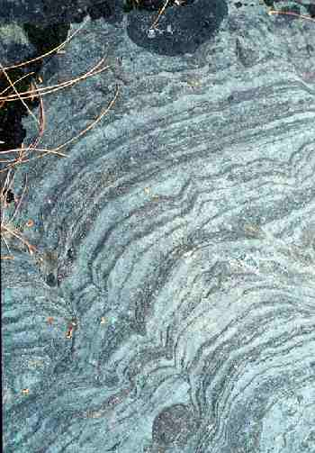
Stromatolites
stromatolites are structures left by cyano colonies
(claims) date back to 3.7 Gyr
cells live in mats/reefs, sediments + CaCO₃ trapped
cyanobacteria move up
O₂ producers on top, O₂ avoiders on bottom
fossils show the life processes of cyanobacteria
only seen now in hypersaline environments
Notes:
cyanobacteria photosynthesis depletes CO2 in surrounding H2O, which precipitates CaCO3
in rare cases, mineral-rich solution fossilizes the cyanobacteria … but usually not

Slide 18
Life on Earth
I. carbon based, made up primarily of CHON
ratios in organisms terribly out of balance relative to the Sun and Earth
II. requires liquid H₂O for fuel transport
III. requires energy … traceable back to Sun in nearly every case
IV. history of simple to complex form evolution
keep in mind extremophiles that violate norms:
size 0.1 microns to 10 meters (factor of 10⁸)
temperature –20 C to +113 C
pH acid 1.0 to alkaline 11.5 (liquid H₂O at 7.0)
pressure 0.01 to 1100 atmospheres
radiation 0 to 5 million rads (humans dead at 1000 rads)
example: 3 km down in rock, 300 atm, +60 C, eat H₂ and CO₂
some not linked to photosynthesis at all

Slide 19
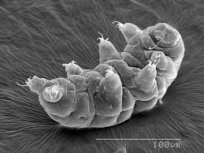
Life on Earth
Notes:
more than 1000 species … look in moss/lichen to find them
survive freezing temperatures, radiation, even a trip to outer space
go without water for 10 years, surviving as a dessicated shell

Slide 20
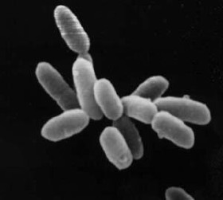
Life’s Environmental Requirements
1. solid surface
CHON found in abundance
2. atmosphere and/or ocean
mixing, solubility
protection from photons gamma, x-ray, UV
protection from particles solar wind, cosmic rays
protection from impacts (some)
3. stability
radiation orbital dynamics
temperature greenhouse effect
“escape” Snowball Earth … living planet
4. energy source(s)
Notes:
halobacteria are not really bacteria … they have been reclassified as haloarchaea … they were assigned to the domain Bacteria before the domain Archaea was recognized … require high salt concentrations to grow

Slide 21
Energy Sources in Solar System
SSE!
SSE!
SSE!
SSE!

Slide 22
Energy Sources in Solar System
nuclear fusion
hydrogen → helium
solar radiation
greenhouse effect
differentiation
gravitational settling
radioactive decay
volcanism
tidal heating
friction from direct tides
stressing via orbital resonances
charged particles
from Sun or planet
charged particle imbalance
lightning
ohmic heating
Io deep in Jupiter magnetosphere
… lead to … metabolism
photosynthesis, respiration, eating

Slide 23
Case for Life As We Know It
+ no shortage of locations with varying environments
+ plenty of energy from stars, impacts, weather
+ raw materials, CHON, are ubiquitous
+ evidence of chemical evolution found in meteorites
+ DNA made of a few basic molecules (bases/sugars/phosphates)
+ significant evidence of evolutionary adaptability
+ time
o no evidence that there is no life
– series of unlikely accidents required?
– the Universe can be an unforgiving place
– no experiment has produced a living organism (but, virus made)
– no evidence that there is life!
but, it is early in the game

Slide 24
Solar System Locations for Life
1 star Sun
4 terrestrial planets Mercury, Venus, Earth, Mars
2 gas giant planets Jupiter, Saturn
2 ice giant planets Uranus, Neptune
7 large moons Moon, Io, Europa, Ganymede,
Callisto, Titan, Triton
small moons, asteroids, Phobos, Ceres, Amalthea,
comets, TNOs, dust Rhea, Enceladus, Titania, Proteus,
Pluto, Charon
WHICH ARE THE BEST OPTIONS?
Notes:
Titania = Uranus’ largest moon, #8 in SS, diam 980 mi
Proteus = Neptune’s second largest moon, diam 260 mi

Slide 25
Solar System Locations for Life
1 star Sun
4 terrestrial planets Mercury, Venus, Earth, Mars
2 gas giant planets Jupiter, Saturn
2 ice giant planets Uranus, Neptune
7 large moons Moon, Io, Europa, Ganymede,
Callisto, Titan, Triton
small moons, asteroids, Phobos, Ceres, Amalthea,
comets, TNOs, dust Rhea, Enceladus, Titania, Proteus,
Pluto, Charon

Slide 26
…………………………
Notes:
26

Slide 27
Five Major Steps to Earth Life
COLLECT MATERIALS
MAKE/GET AMINO ACIDS
MAKE RNA and DNA
MAKE REPRODUCTIVE FORMS
EVOLVE LIFE FORMS

Slide 28
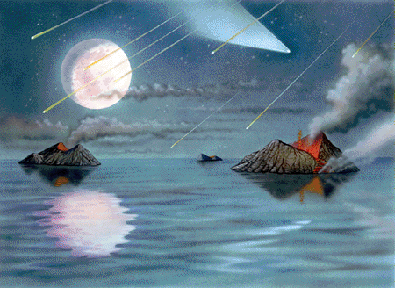
Step 1 to Earth Life
COLLECT MATERIALS CHON (+ a little S and P)
Earth’s original atmosphere … H₂ He lost
Earth’s atmosphere evolution …
comets + volcanoes (+ life)
H₂O condenses
NH₃ CH₄ UV split, H lost
CO₂ SO₂ rocks absorb
N₂ N₂O O₂ builds up
GRADE: A

Slide 29
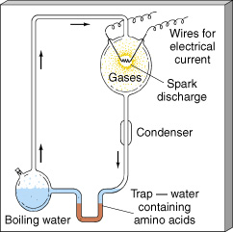

Step 2 to Earth Life
II. MAKE/GET AMINO ACIDS
from chunks? meteorites have > 50 amino acids inside
14,000 molecular compounds found in Murchison
from dust? glycine found in giant molecular clouds ???
from soup? Miller-Urey experiment produces amino acids
originally
H₂ + NH₃ + CH₄
and H₂O
→
revised
CO₂ + N₂
and H₂O
GRADE: A
Notes:
Both DNA and proteins are long molecules made from strings of shorter building blocks. While DNA is made of nucleotides, proteins are made of amino acids, a group of 20 different chemicals with names like alanine, arginine, and serine. The genetic code enables a cell to translate the nucleotide language of DNA into the amino acid language of proteins.
In the genetic code, each group of three nucleotides—known as a "triplet" or "codon"—stands for a specific amino acid. For example, GCA stands for alanine, AGA stands for arginine, and AGC stands for serine. There are 64 possible codons, but only 20 amino acids, so more than one codon may code for a single amino acid. For example, GCA, GCC, and GCG all mean alanine.
All the amino acids found in the Murchison meteorite have been synthesized in laboratory experiments by the action of electric discharge on a mixture of methane, nitrogen, and water with traces of ammonia.
Schmitt-Kopplin, Philippe et al. 16 February 2010 "High molecular diversity of extraterrestrial organic matter in Murchison meteorite revealed 40 years after its fall" (PDF). PNAS. 107 (7): 2763–2768

Slide 30
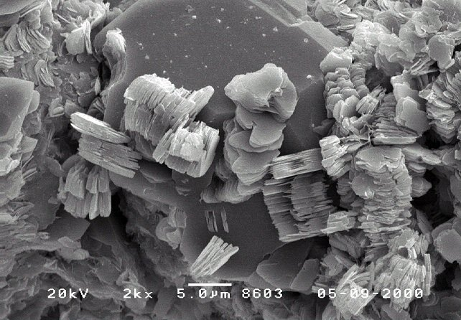
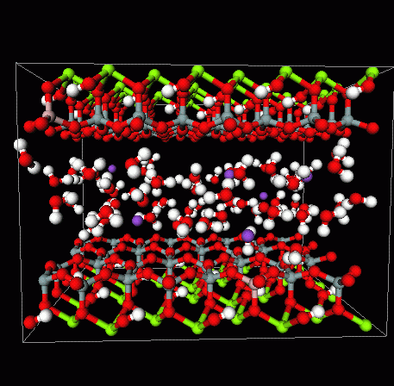
Step 3 to Earth Life
III. RNA (and DNA)
cold? stable compounds, ice lattice
nice? concentration of compounds, clay lattice
hot? early start, pyrite lattice
kaolinite
GRADE: B

Slide 31
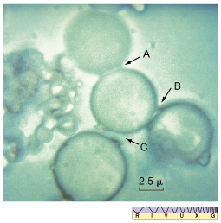
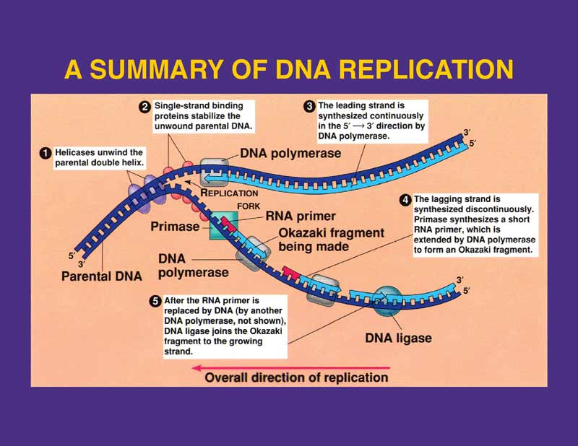
Step 4 to Earth Life
IV. MAKE REPRODUCTIVE FORMS
organization into cells
replication required
happened > 3.5 Byr ago!
GRADE: C

Slide 32
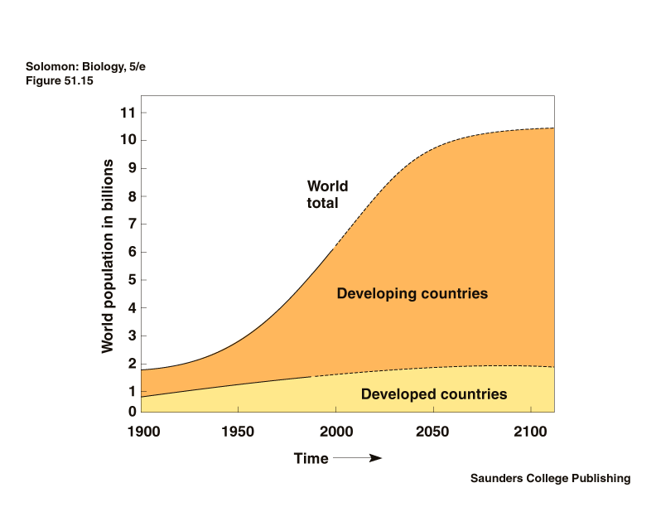
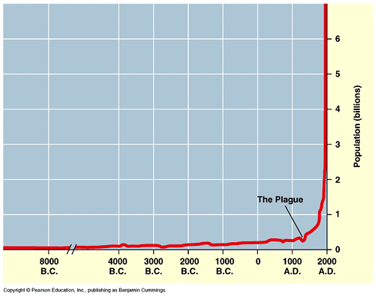
Step 5 to Earth Life
EVOLVE LIFE FORMS
changes via mutations
extensive fossil record
current day changes (moths, hemophilia, bacteria, plankton, YOU)
GRADE: A

Slide 33
Five Major Steps to Earth Life
COLLECT MATERIALS GRADE: A
MAKE/GET AMINO ACIDS GRADE: A
MAKE RNA and DNA GRADE: B
MAKE REPRODUCTIVE FORMS GRADE: C
EVOLVE LIFE FORMS GRADE: A

Slide 34
Todd’s Top 10 Tips for Talks
Match the time of your talk to the time allocated.
Watch the “um”s and other useless sounds/words.
Use the fewest words possible per slide.
4. Be sure that all Figure details are legible from the back of the room.
5. Be careful with red and green in deference to our color-challenged friends.
6. If you must have an equation, describe each variable clearly.
7. Use pauses to great effect.
8. Use gestures appropriately, but not frantically.
9. Move, and use lack of movement to great effect.
10. Enjoy your topic … or don’t bother!
Notes:
34

Slide 35
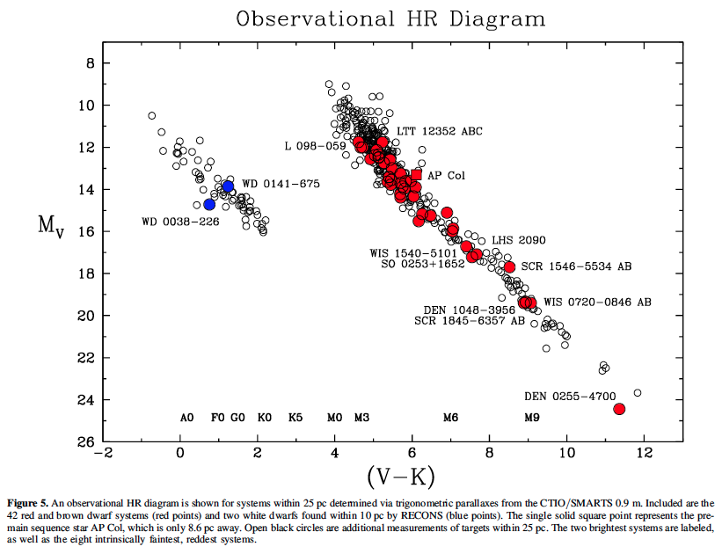
Level 2 Paper Comments

Slide 36
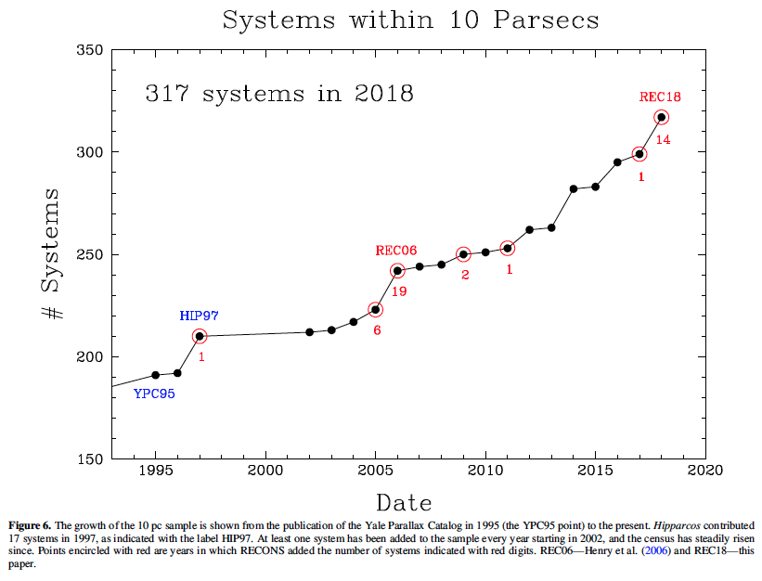
Level 2 Paper Comments

Slide 37
Level 2 Outline Comments
Font Size: \documentclass[arguments]{aastex63} … NOT [preprint] style
8-10 pages of text + 5 pages of Refs/Figures/Tables
Overall RESEARCH paper, not REPORT … sophisticated language, cleaned up
Dates Received = Sep 24; Revised = Oct 20; Accepted = Dec 8
Abstract data rich, NUMBERS, specific RESULTS
Key words: http://astrothesaurus.org/thesaurus … Mars (1007); Astrobiology (74)
Introduction background information … MANY REFERENCES
Tables/Figures at least two of each
must refer to them in text and describe carefully … Why?
Figures must have detailed captions … SCIENTIFIC, LEGIBLE
Discussion may use bullets to call out key things to remember
General Sun, Solar System, Earth, Moon, Galaxy
Galileo, Cassini, New Horizons, Curiosity
that vs. which since vs. because
SPELLCHECK ALWAYS!

Slide 38
SSE!
Which TEEEMate has the highest density?
…
Earth
5.5 g/cm³
Which TEEEMate has the lowest density?
…
Enceladus
1.6 g/cm³
Which TEEEMate is LEAST LIKELY to have geysers?
…
Mars
Which TEEEMate has the oldest surface?
…
Mars
Notes:
Mars is really only SS object with density ~4

