Slide 1
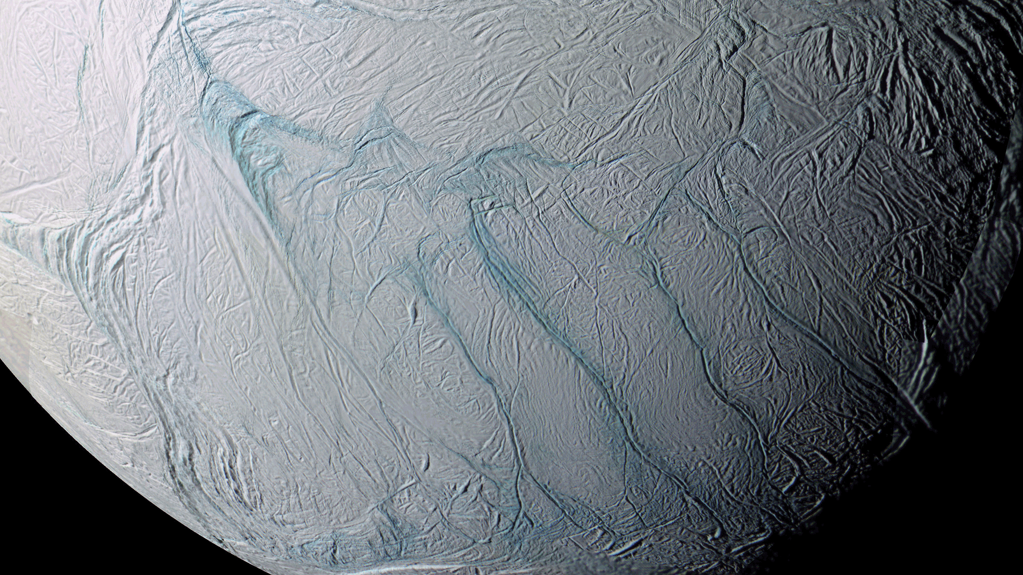
Where is this?
1
Notes:
Enceladus

Slide 2
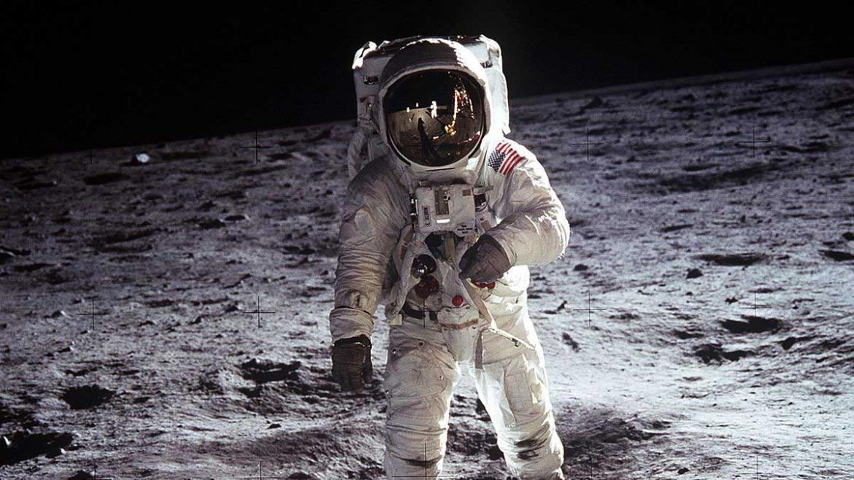
Where is this?
2
Notes:
Moon

Slide 3
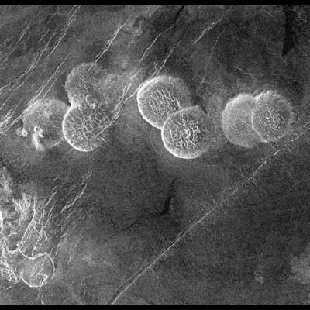
Where
is
this?
3
Notes:
Venus

Slide 4
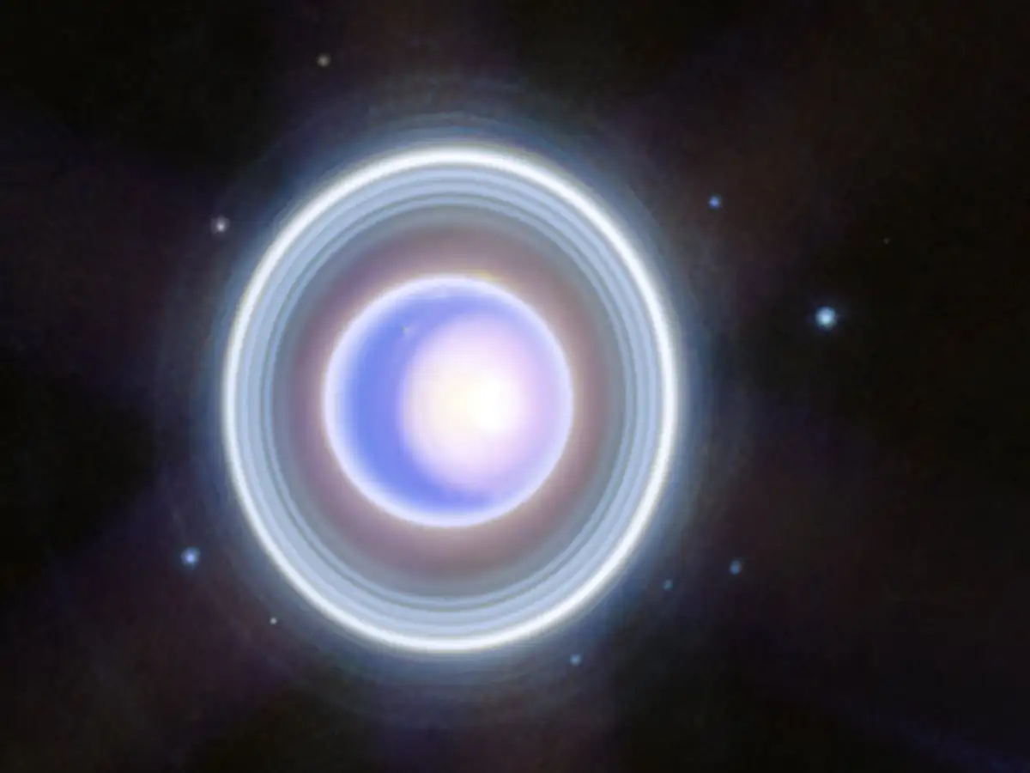
Where
is
this?
4
Notes:
Uranus

Slide 5
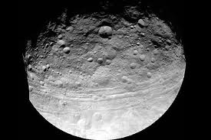
Where is this?
5
Notes:
Vesta

Slide 6
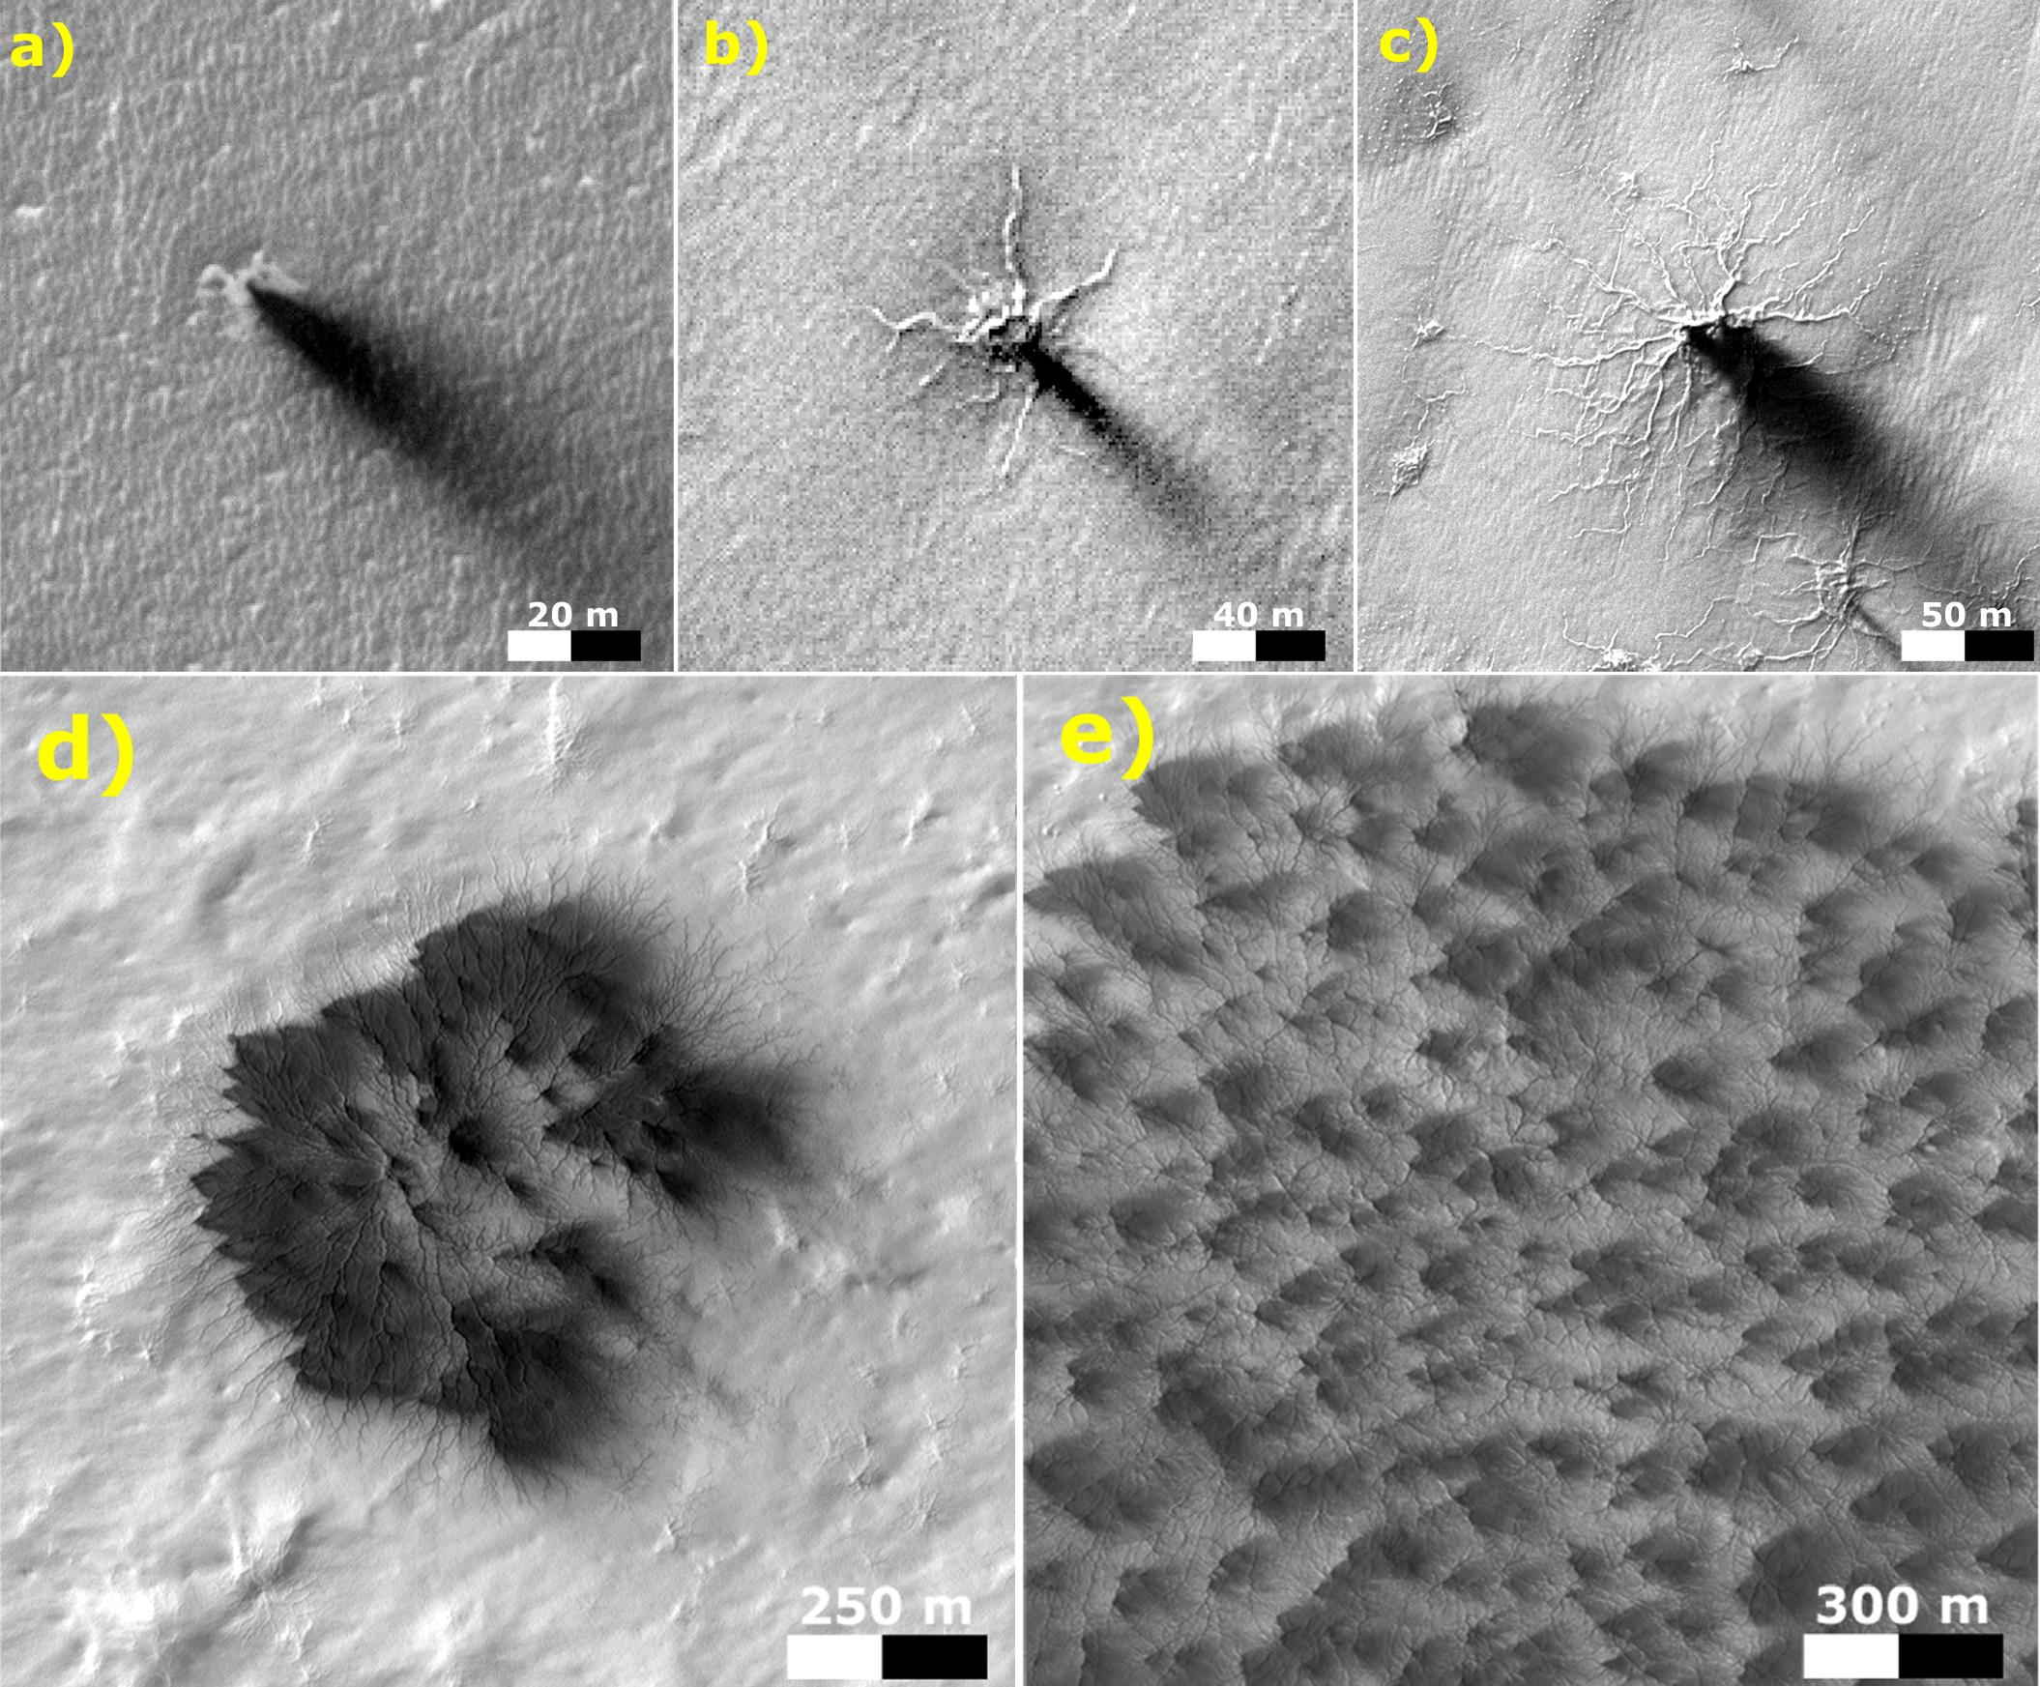
Where is this?
6
Notes:
Mars

Slide 7
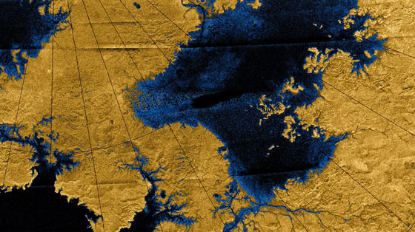
Where is this?
7
Notes:
Titan

Slide 8
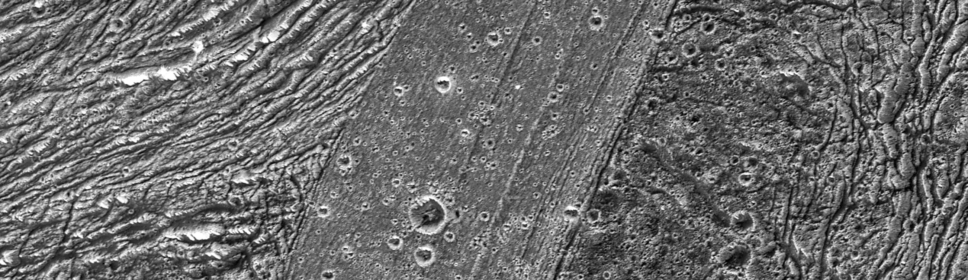
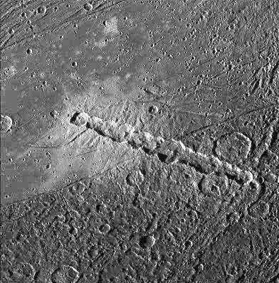
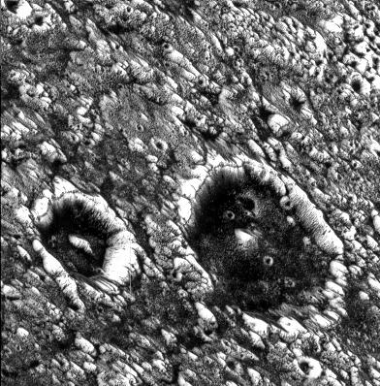
Where is this?
8
Notes:
Ganymede

Slide 9
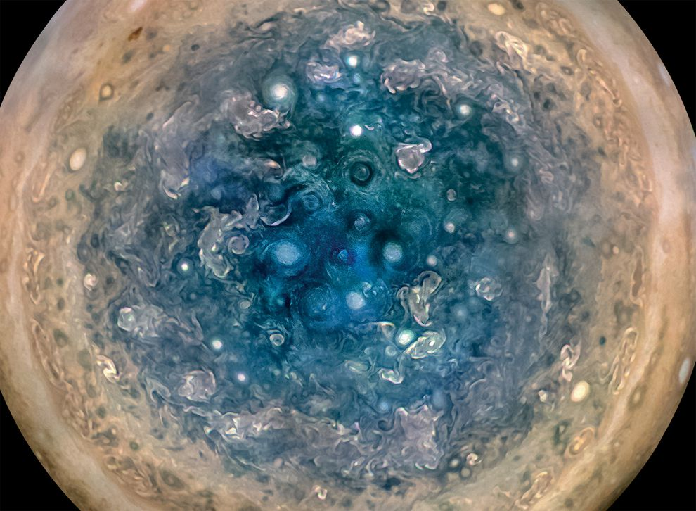
Where is this?
Where is this?
9
Notes:
Jupiter

Slide 10
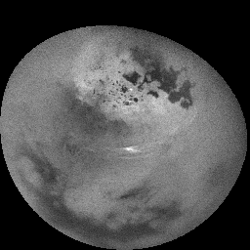
Where is this?
11 hour movie
10
Notes:
Titan

Slide 11
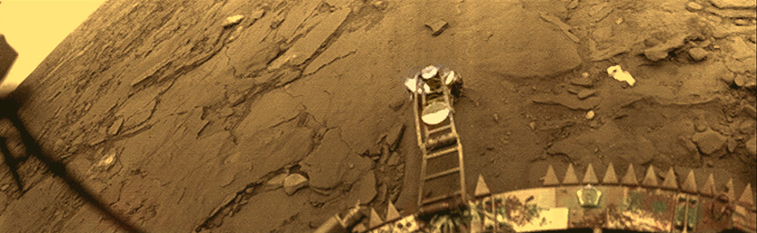
Where is this?
11
Notes:
Venus

Slide 12
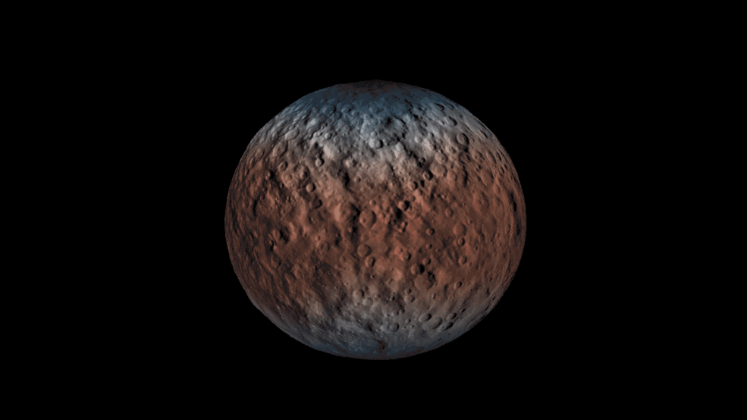
Where is this?
12
Notes:
Ceres

Slide 13
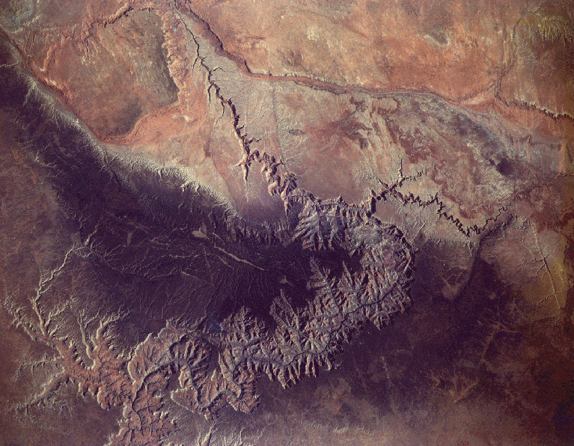
Where is this?
13
Notes:
Earth -- Grand Canyon

Slide 14
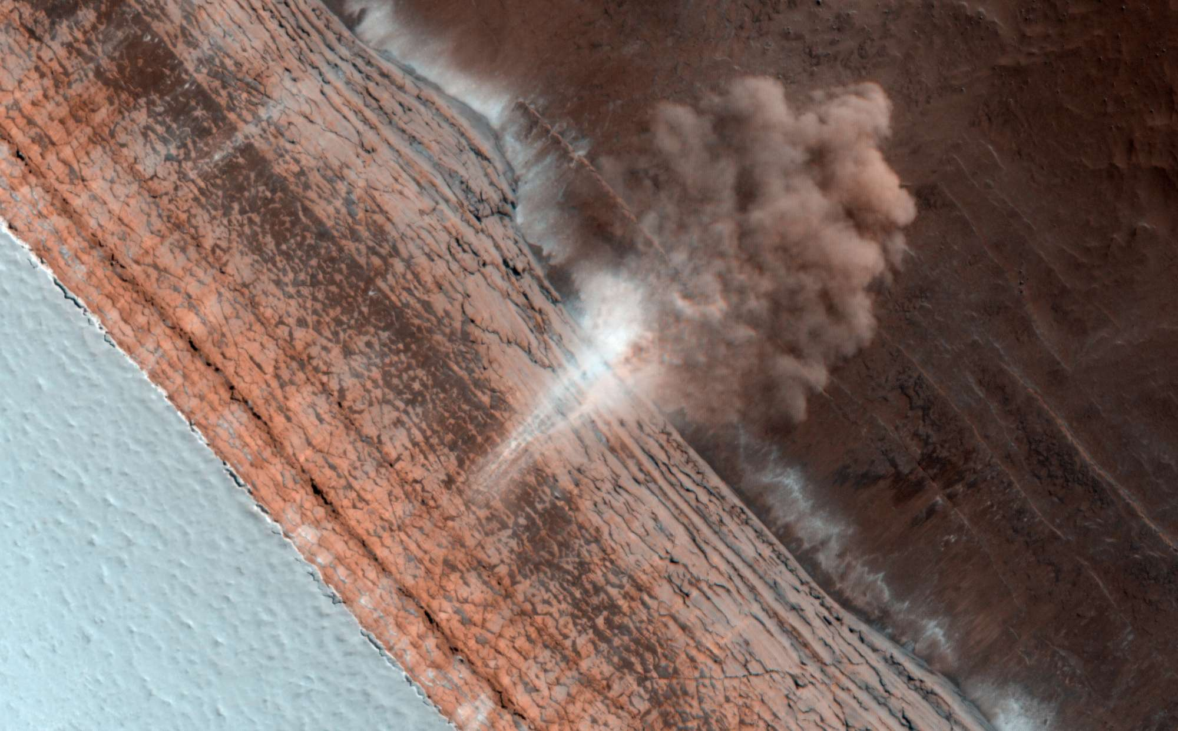
Where is
this?
14
Notes:
Mars

Slide 15
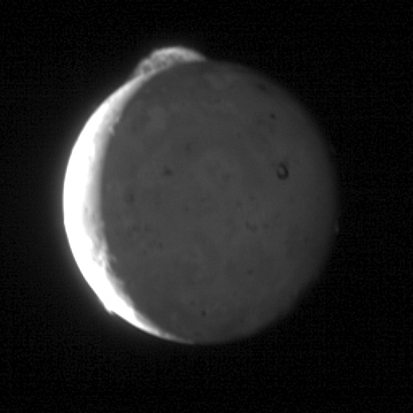
Where is this?
15
Notes:
Io

Slide 16
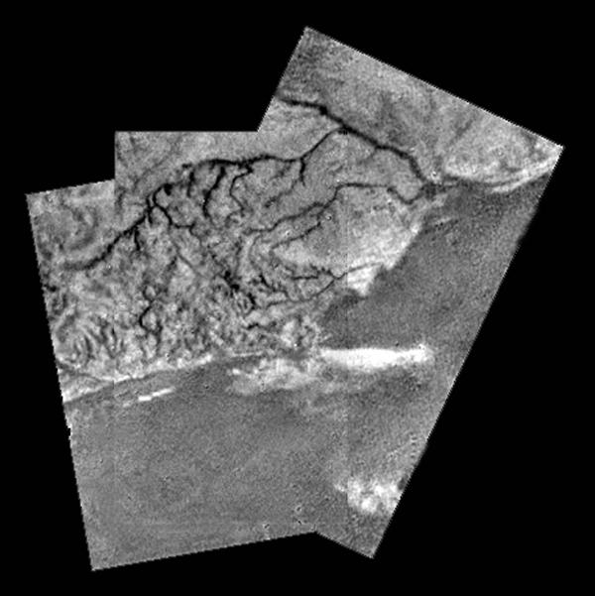
Where
is
this?
16
Notes:
Titan

Slide 17
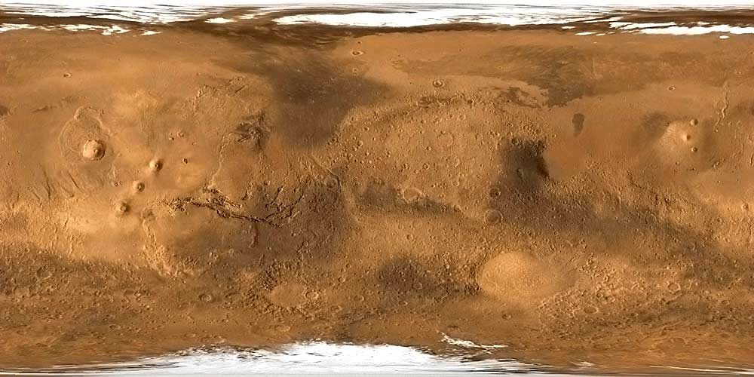
Where is this?
17
Notes:
Mars

Slide 18
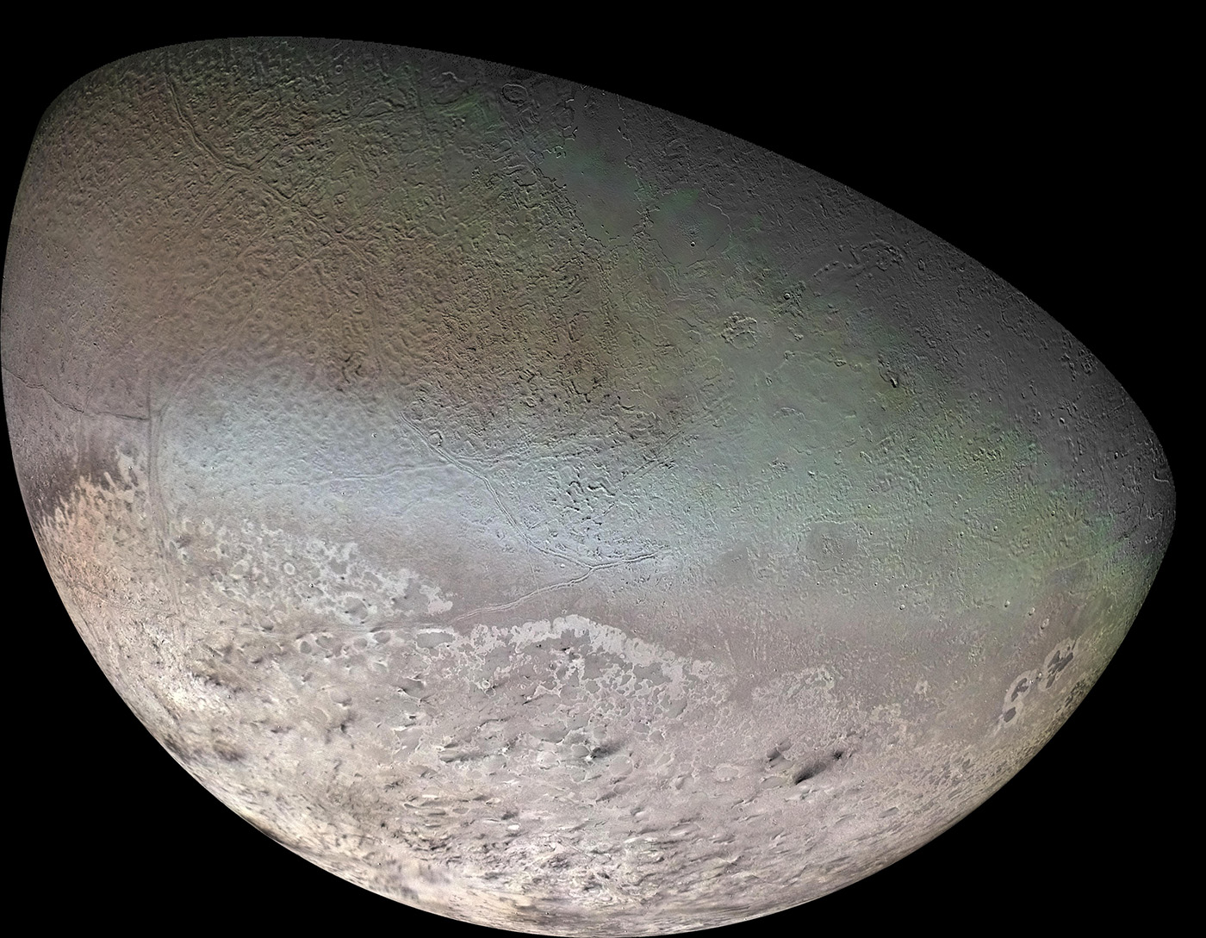
Where
is
this?
18
Notes:
Triton

Slide 19
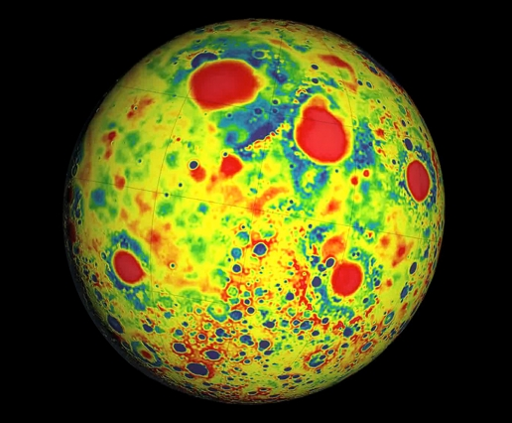
Where
is
this?
19
Notes:
Moon

Slide 20
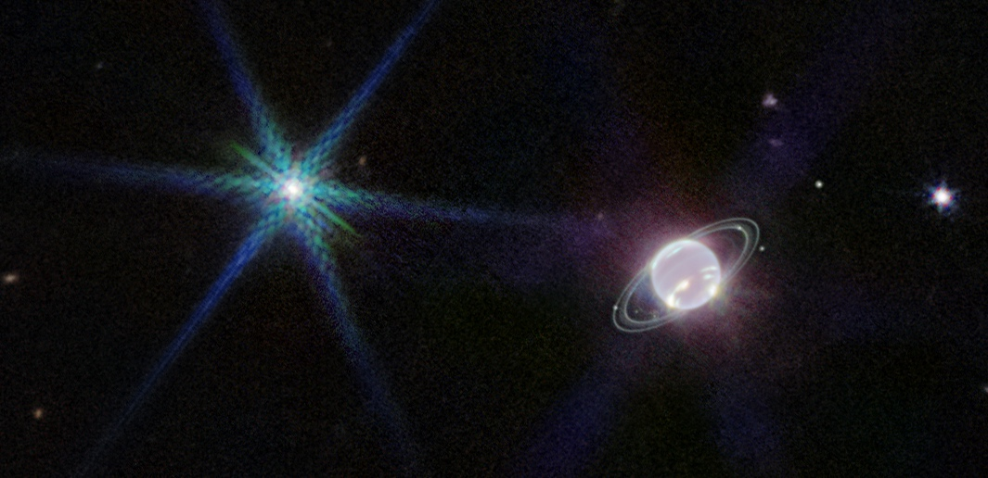
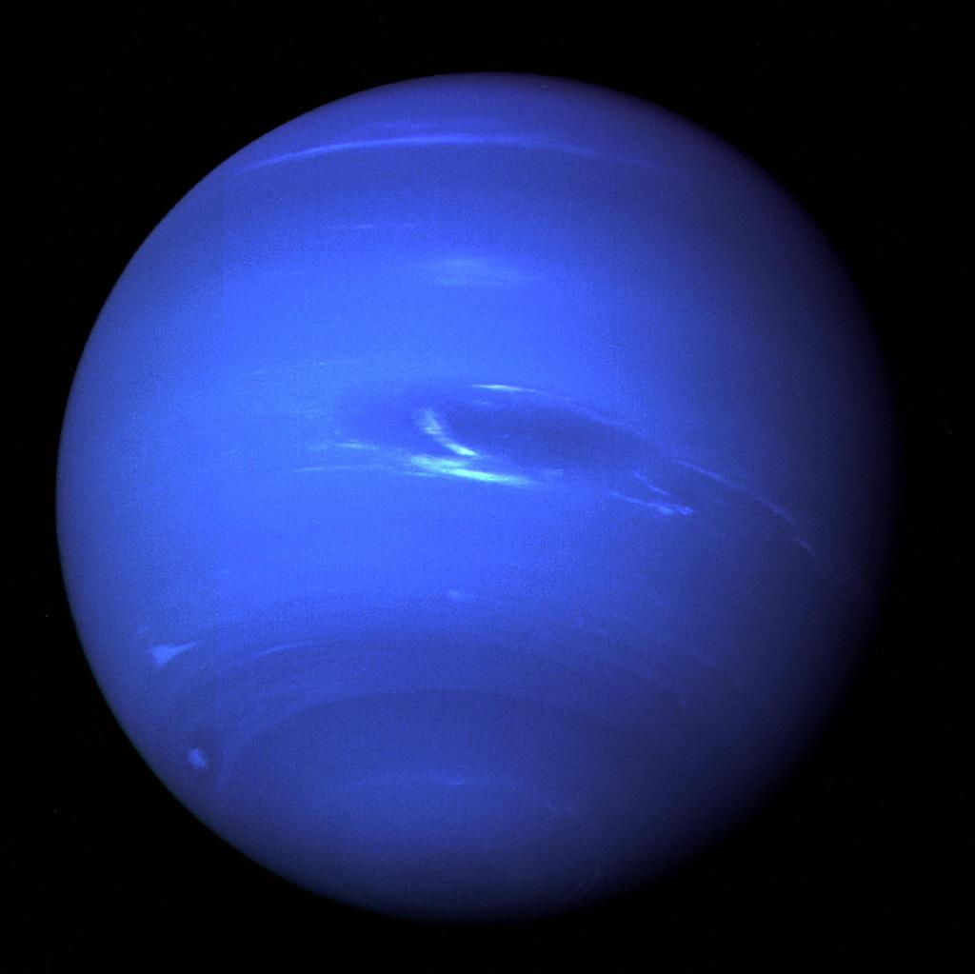
Where
is
this?
20
Notes:
Neptune

Slide 21
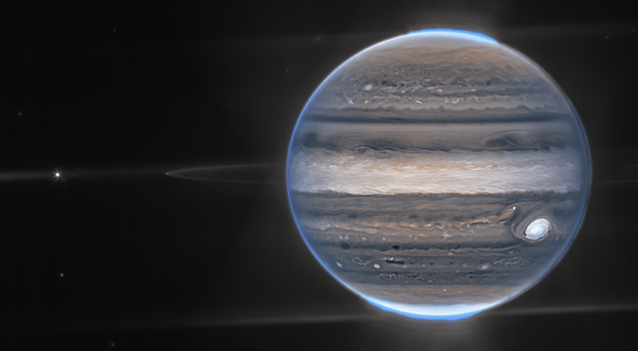
Where is this?
21
Notes:
Jupiter

Slide 22
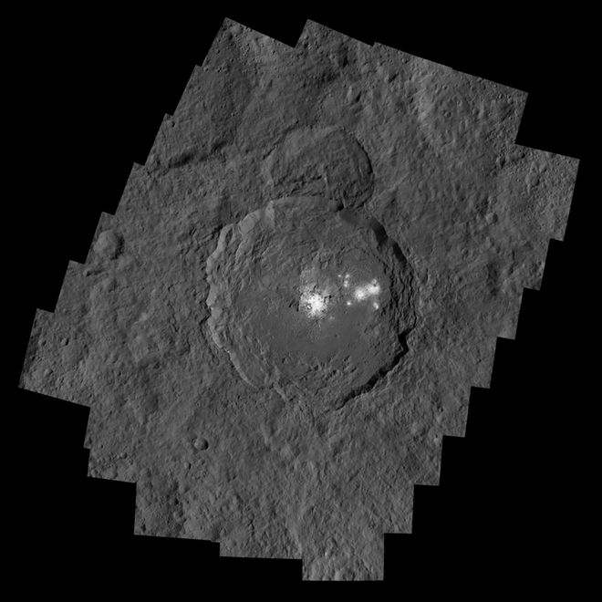
Where
is
this?
22
Notes:
Ceres

Slide 23
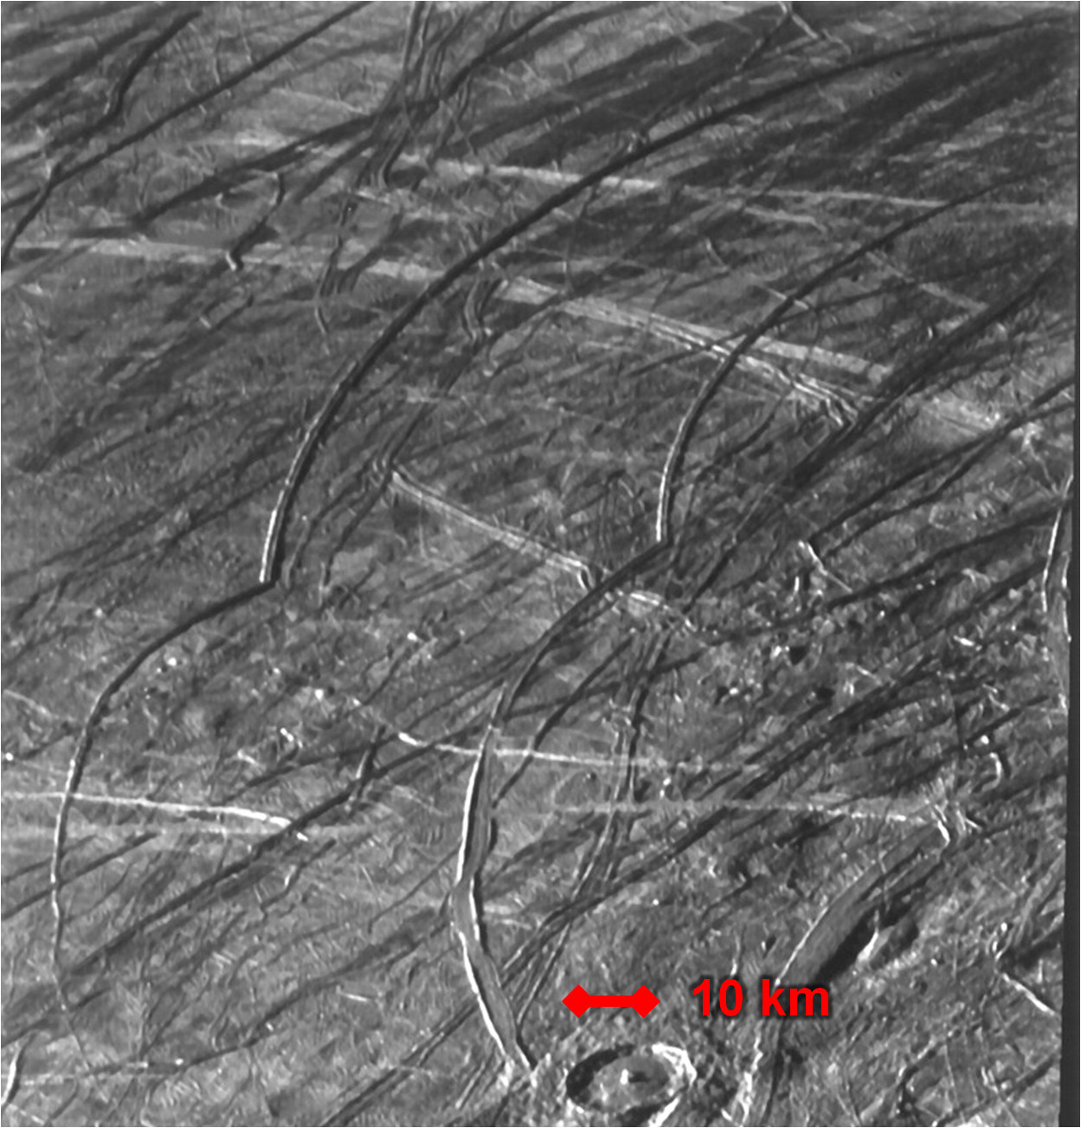
Where
is
this?
23
Notes:
Europa

Slide 24
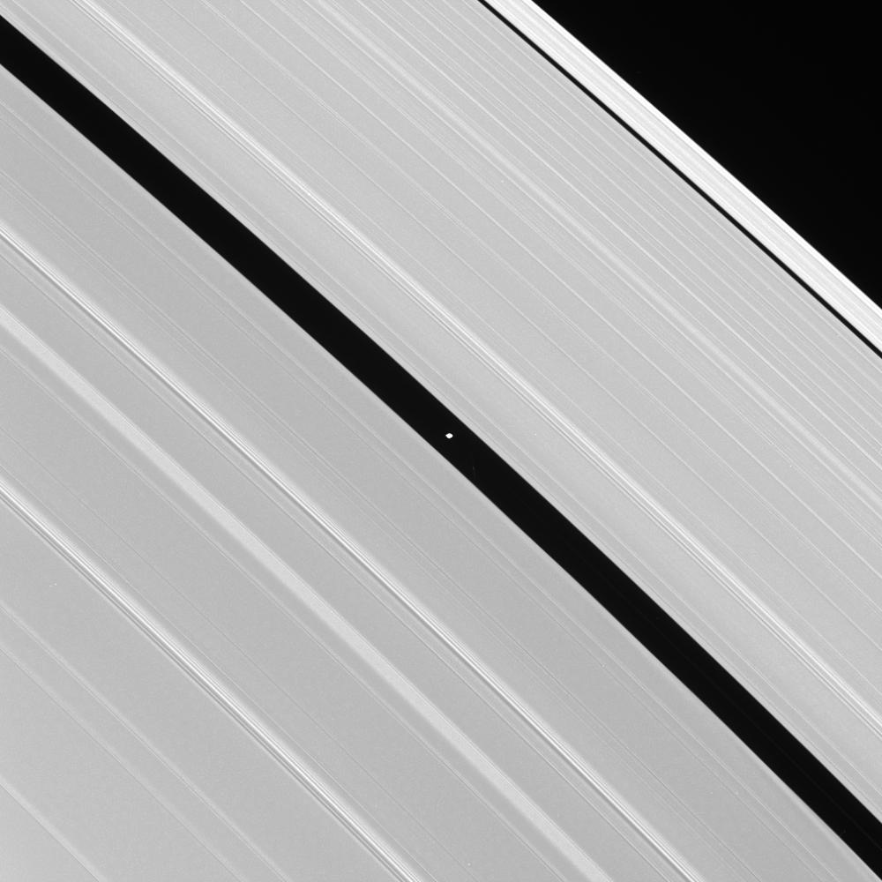
Where
is
this?
24
Notes:
Saturn

Slide 25
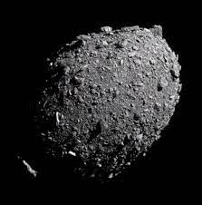
Where is this?
25
Notes:
Dimorphos

Slide 26
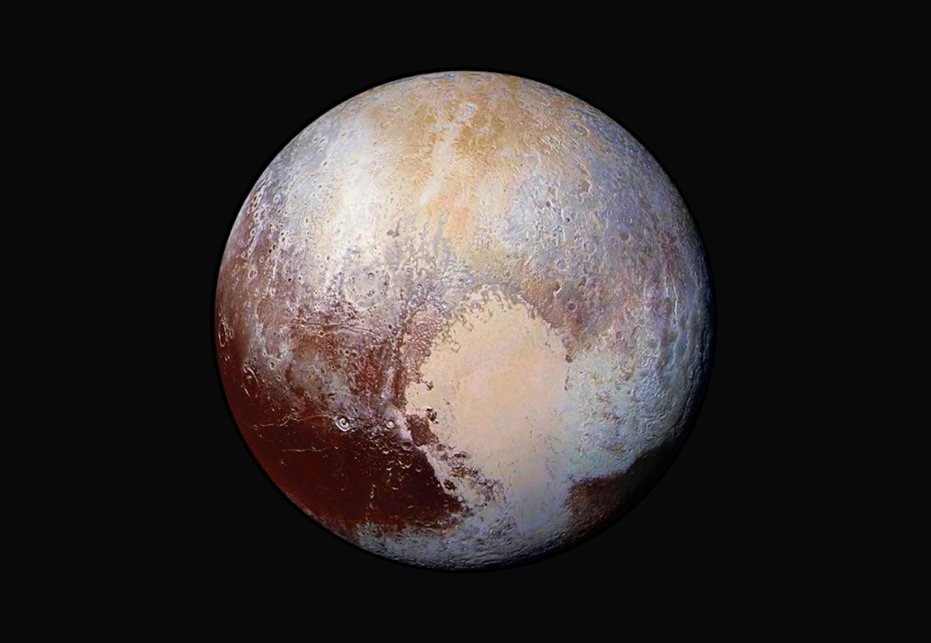
Where
is
this?
26
Notes:
Pluto

Slide 27
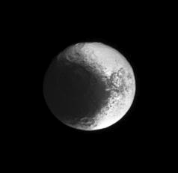
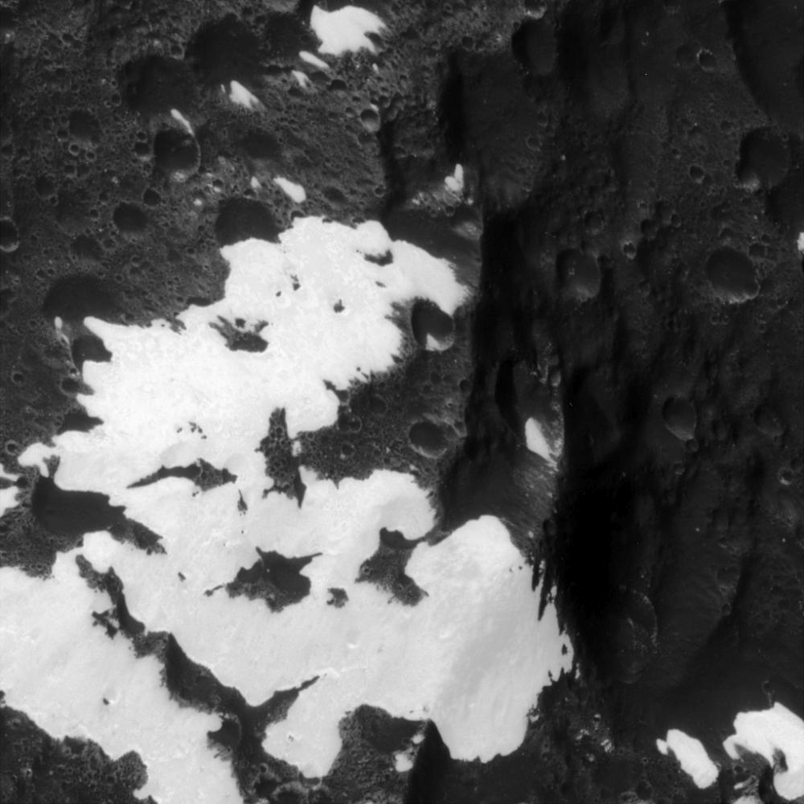
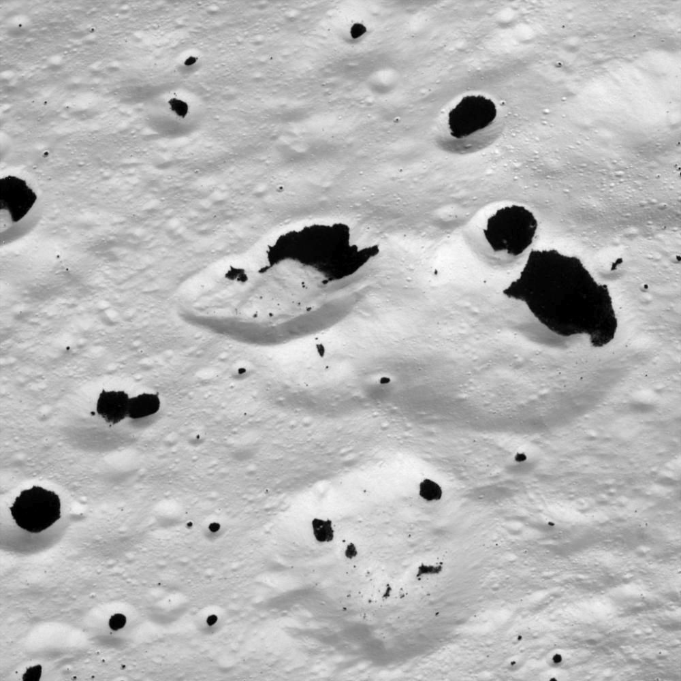
Iapetus
Where is this?
27
Notes:
Iapetus

Slide 28
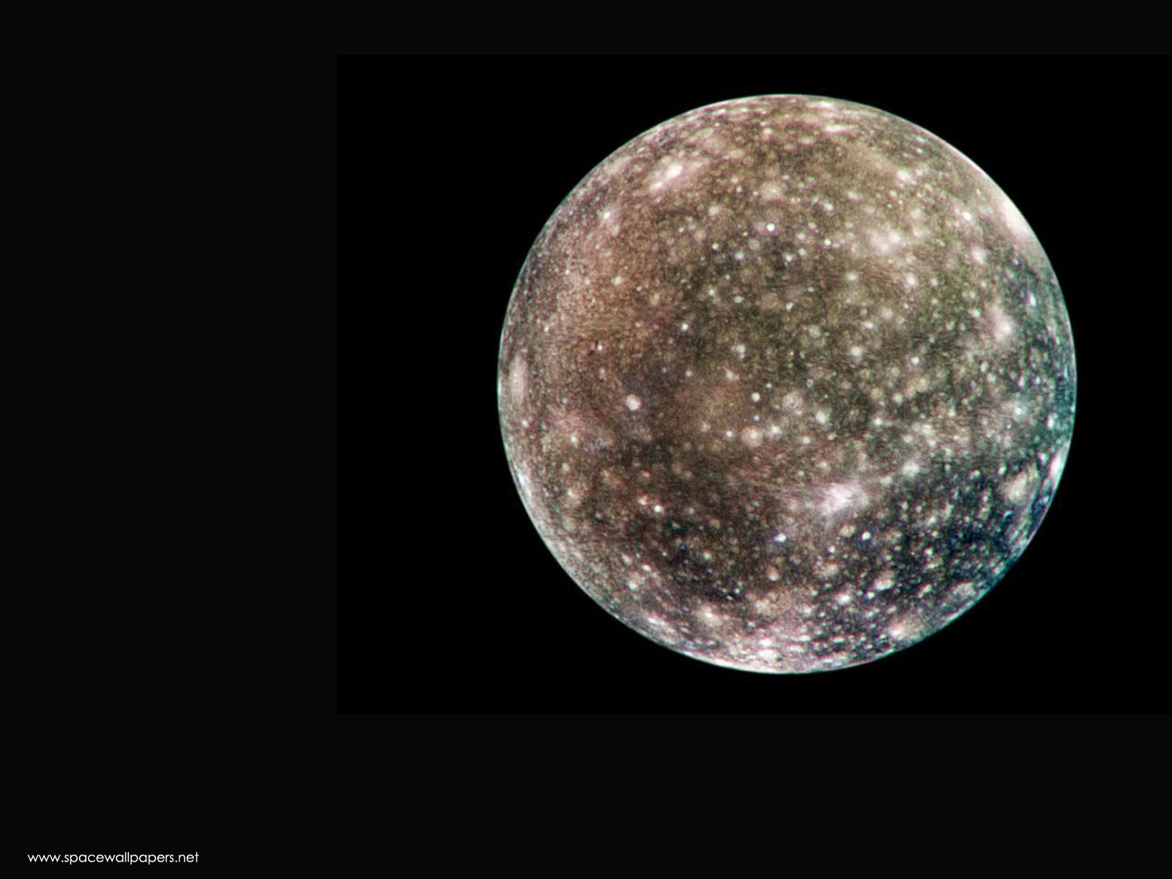
Callisto
Where
is
this?
28
Notes:
Callisto

Slide 29
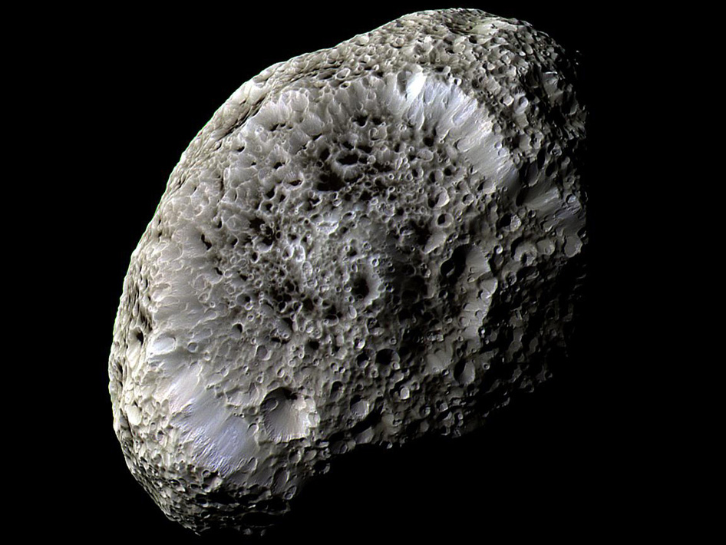
Where
is
this?
29
Notes:
Hyperion

Slide 30
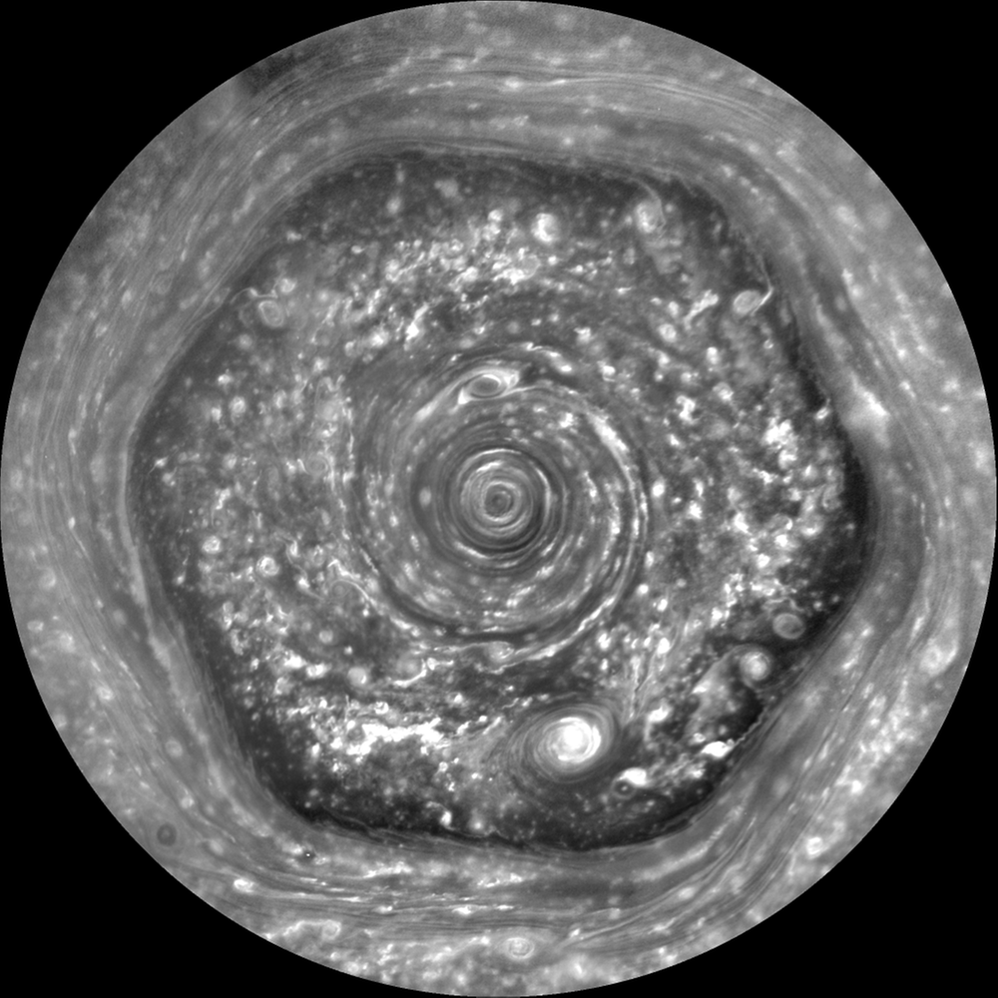
Where is this?
30
Notes:
Saturn

Slide 31
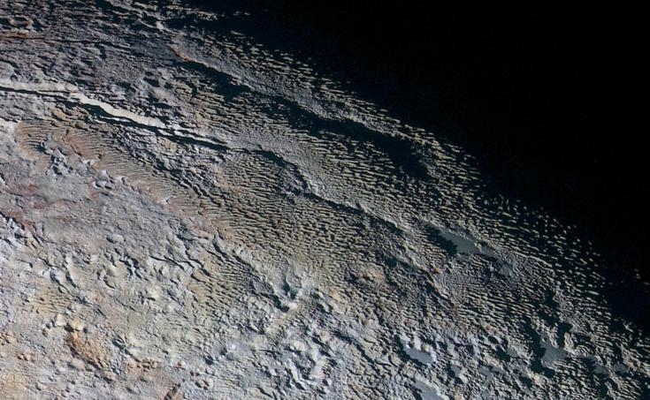
Where
is
this?
31
Notes:
Pluto

Slide 32
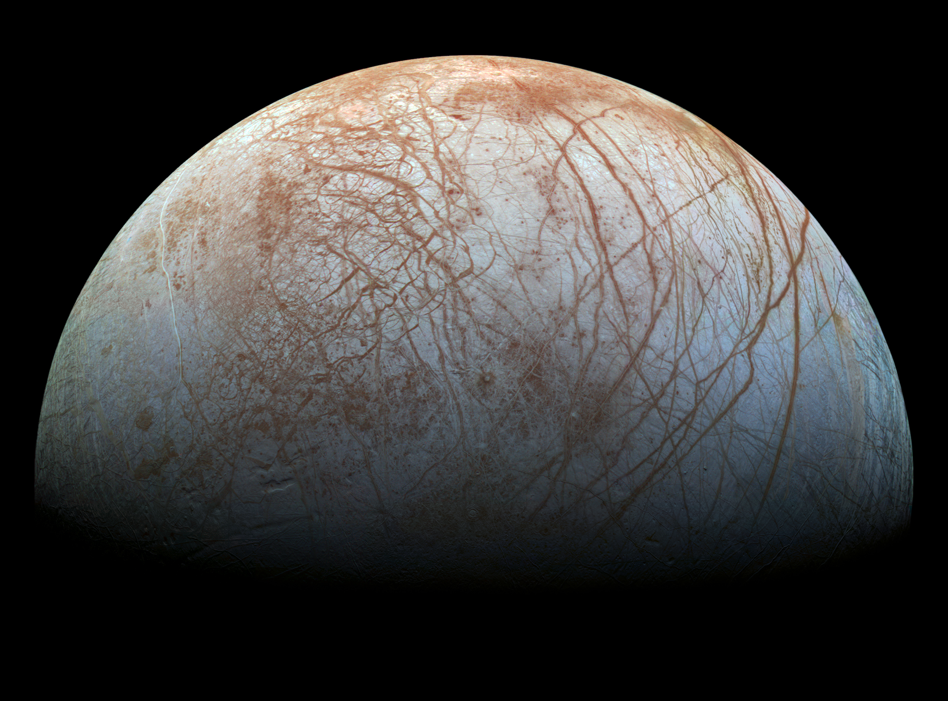
Where is this?
32
Notes:
Europa

Slide 33
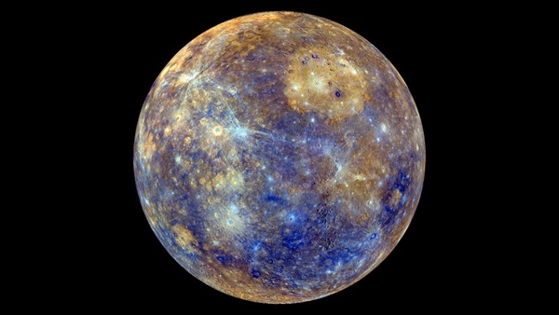
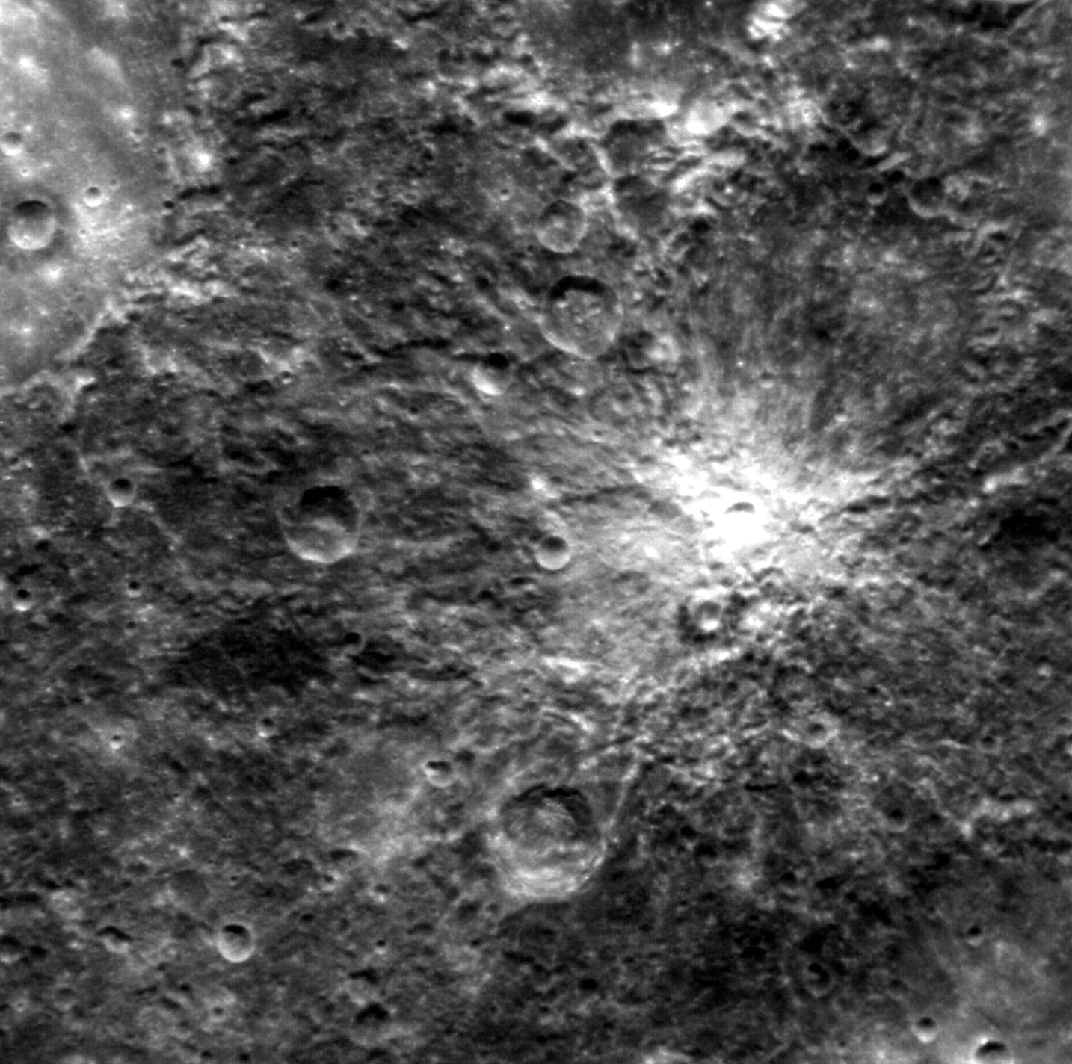
Where is this?
33
Notes:
Mars -- Valles Marineris

Slide 34
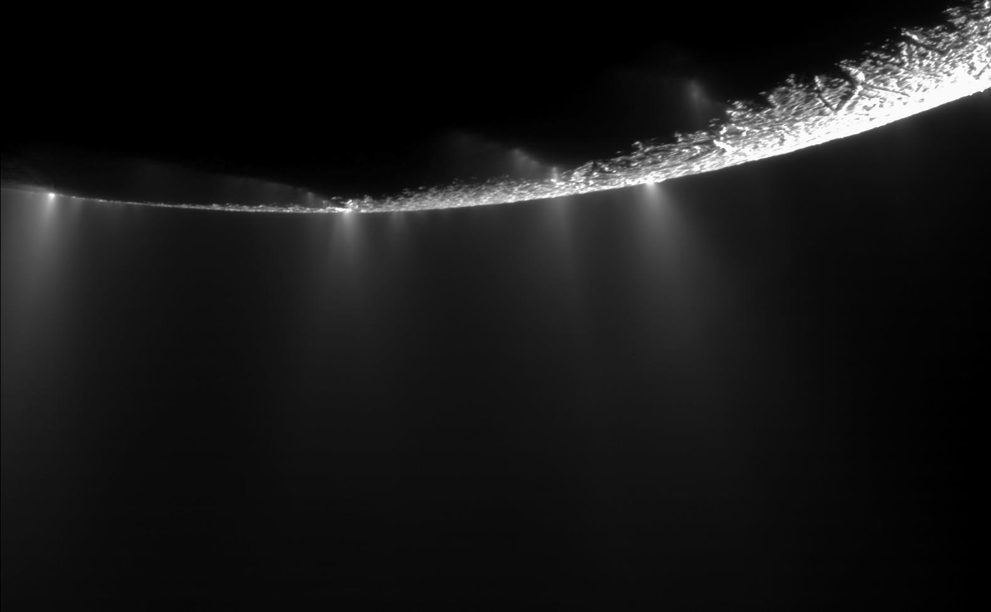
Where is this?
34
Notes:
Enceladus

Slide 35
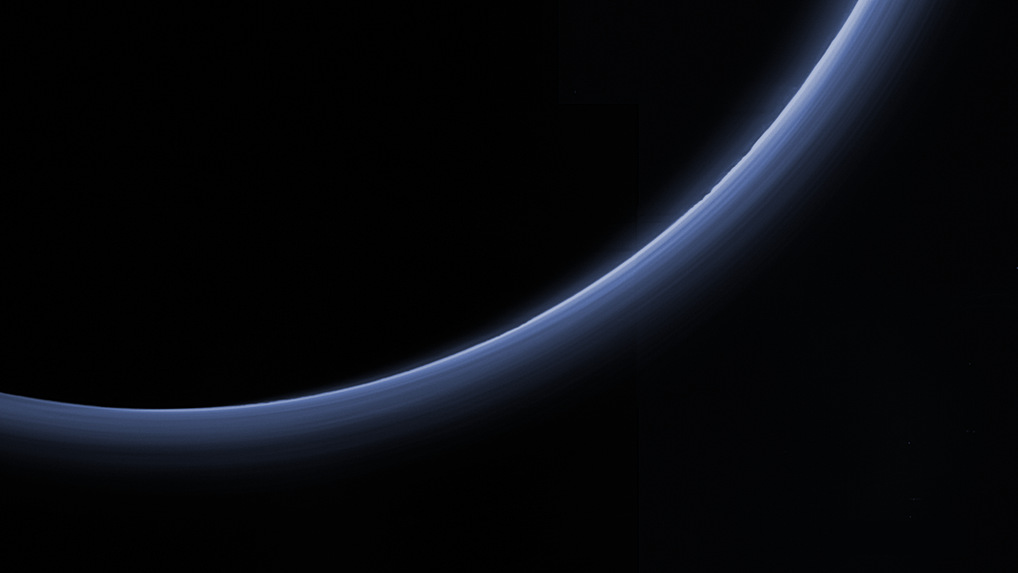
Where is this?
35
Notes:
Pluto
These thermal images show a "hot" south pole on the planet Neptune (10K hotter than elsewhere). These warmer temperatures provide an avenue for methane to escape out of the deep atmosphere.
The upper left image samples temperatures near the top of Neptune's troposphere (near 100 millibar pressure, which is one-tenth the Earth atmospheric pressure at sea level). The hottest temperatures are indicated at the lower part of the image, at Neptune's south pole. The lower two images, taken 6.3 hours apart, sample temperatures at higher altitudes in Neptune's stratosphere. They do show generally warmer temperatures near, but not at, the south pole. They also show a distinct warm area which can be seen in the lower left image and rotated completely around the back of the planet and returned to the earth-facing hemisphere in the lower right image.
The images were obtained with the Very Large Telescope in Chile, using an imager/spectrometer for mid-infrared wavelengths on Sept. 1 and 2, 2006.

Slide 36
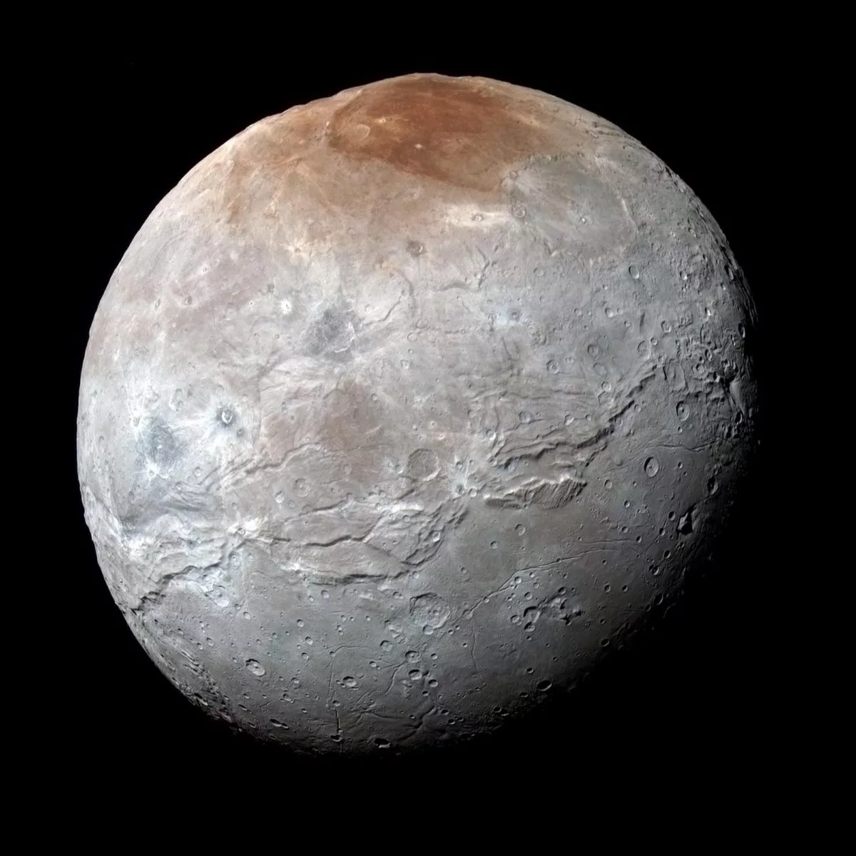
Where is this?
36
Notes:
Charon

Slide 37
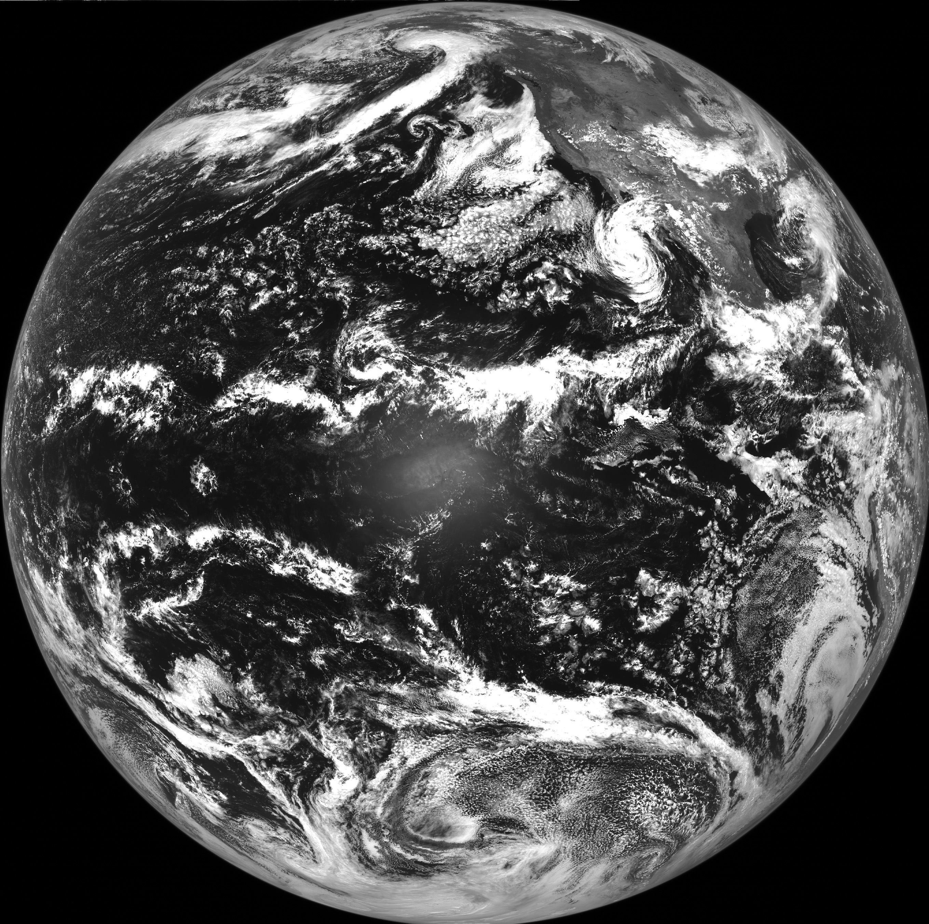
Where is this?
37
Notes:
Earth

Slide 38
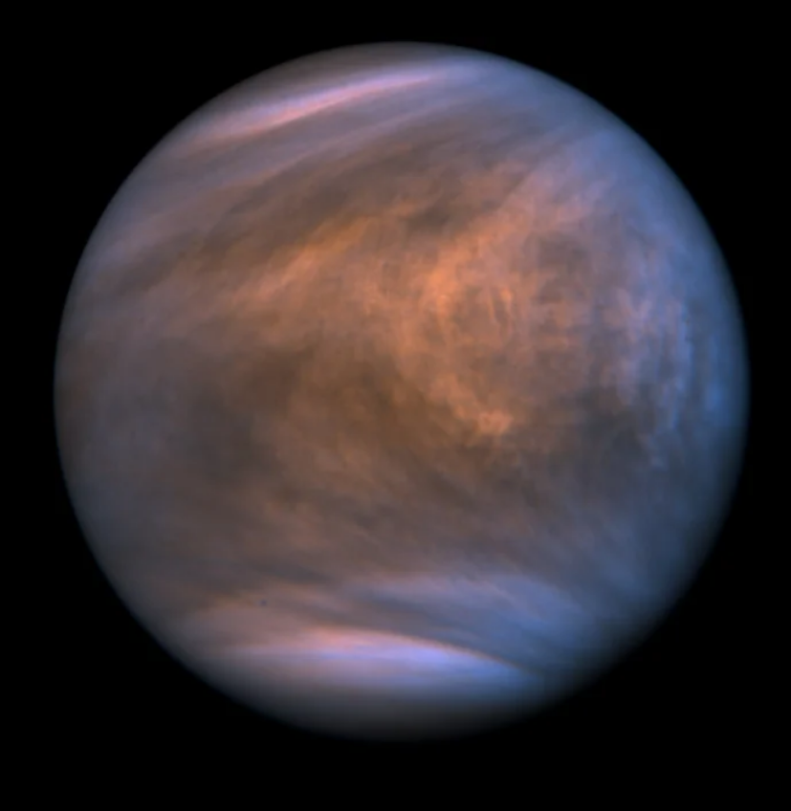
Where is this?
38
Notes:
Venus

Slide 39
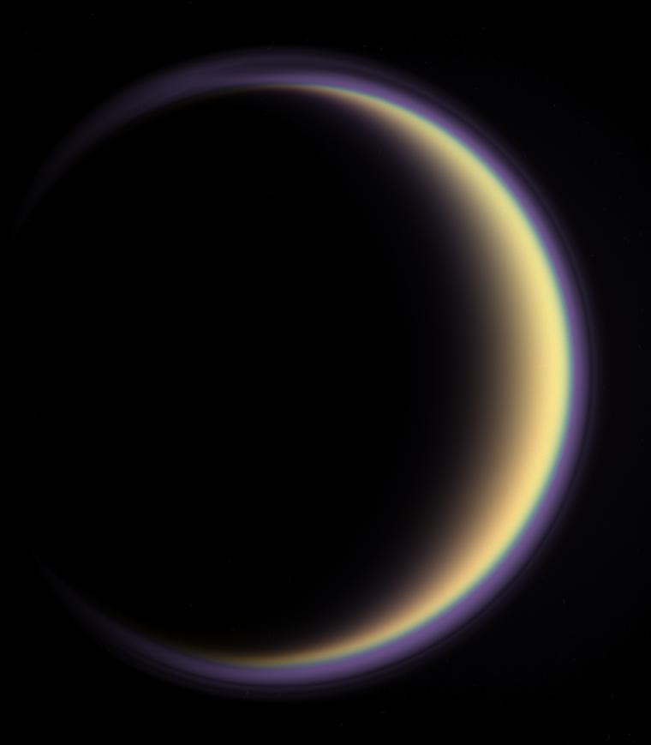
Where
is
this?
39
Notes:
Titan

Slide 40
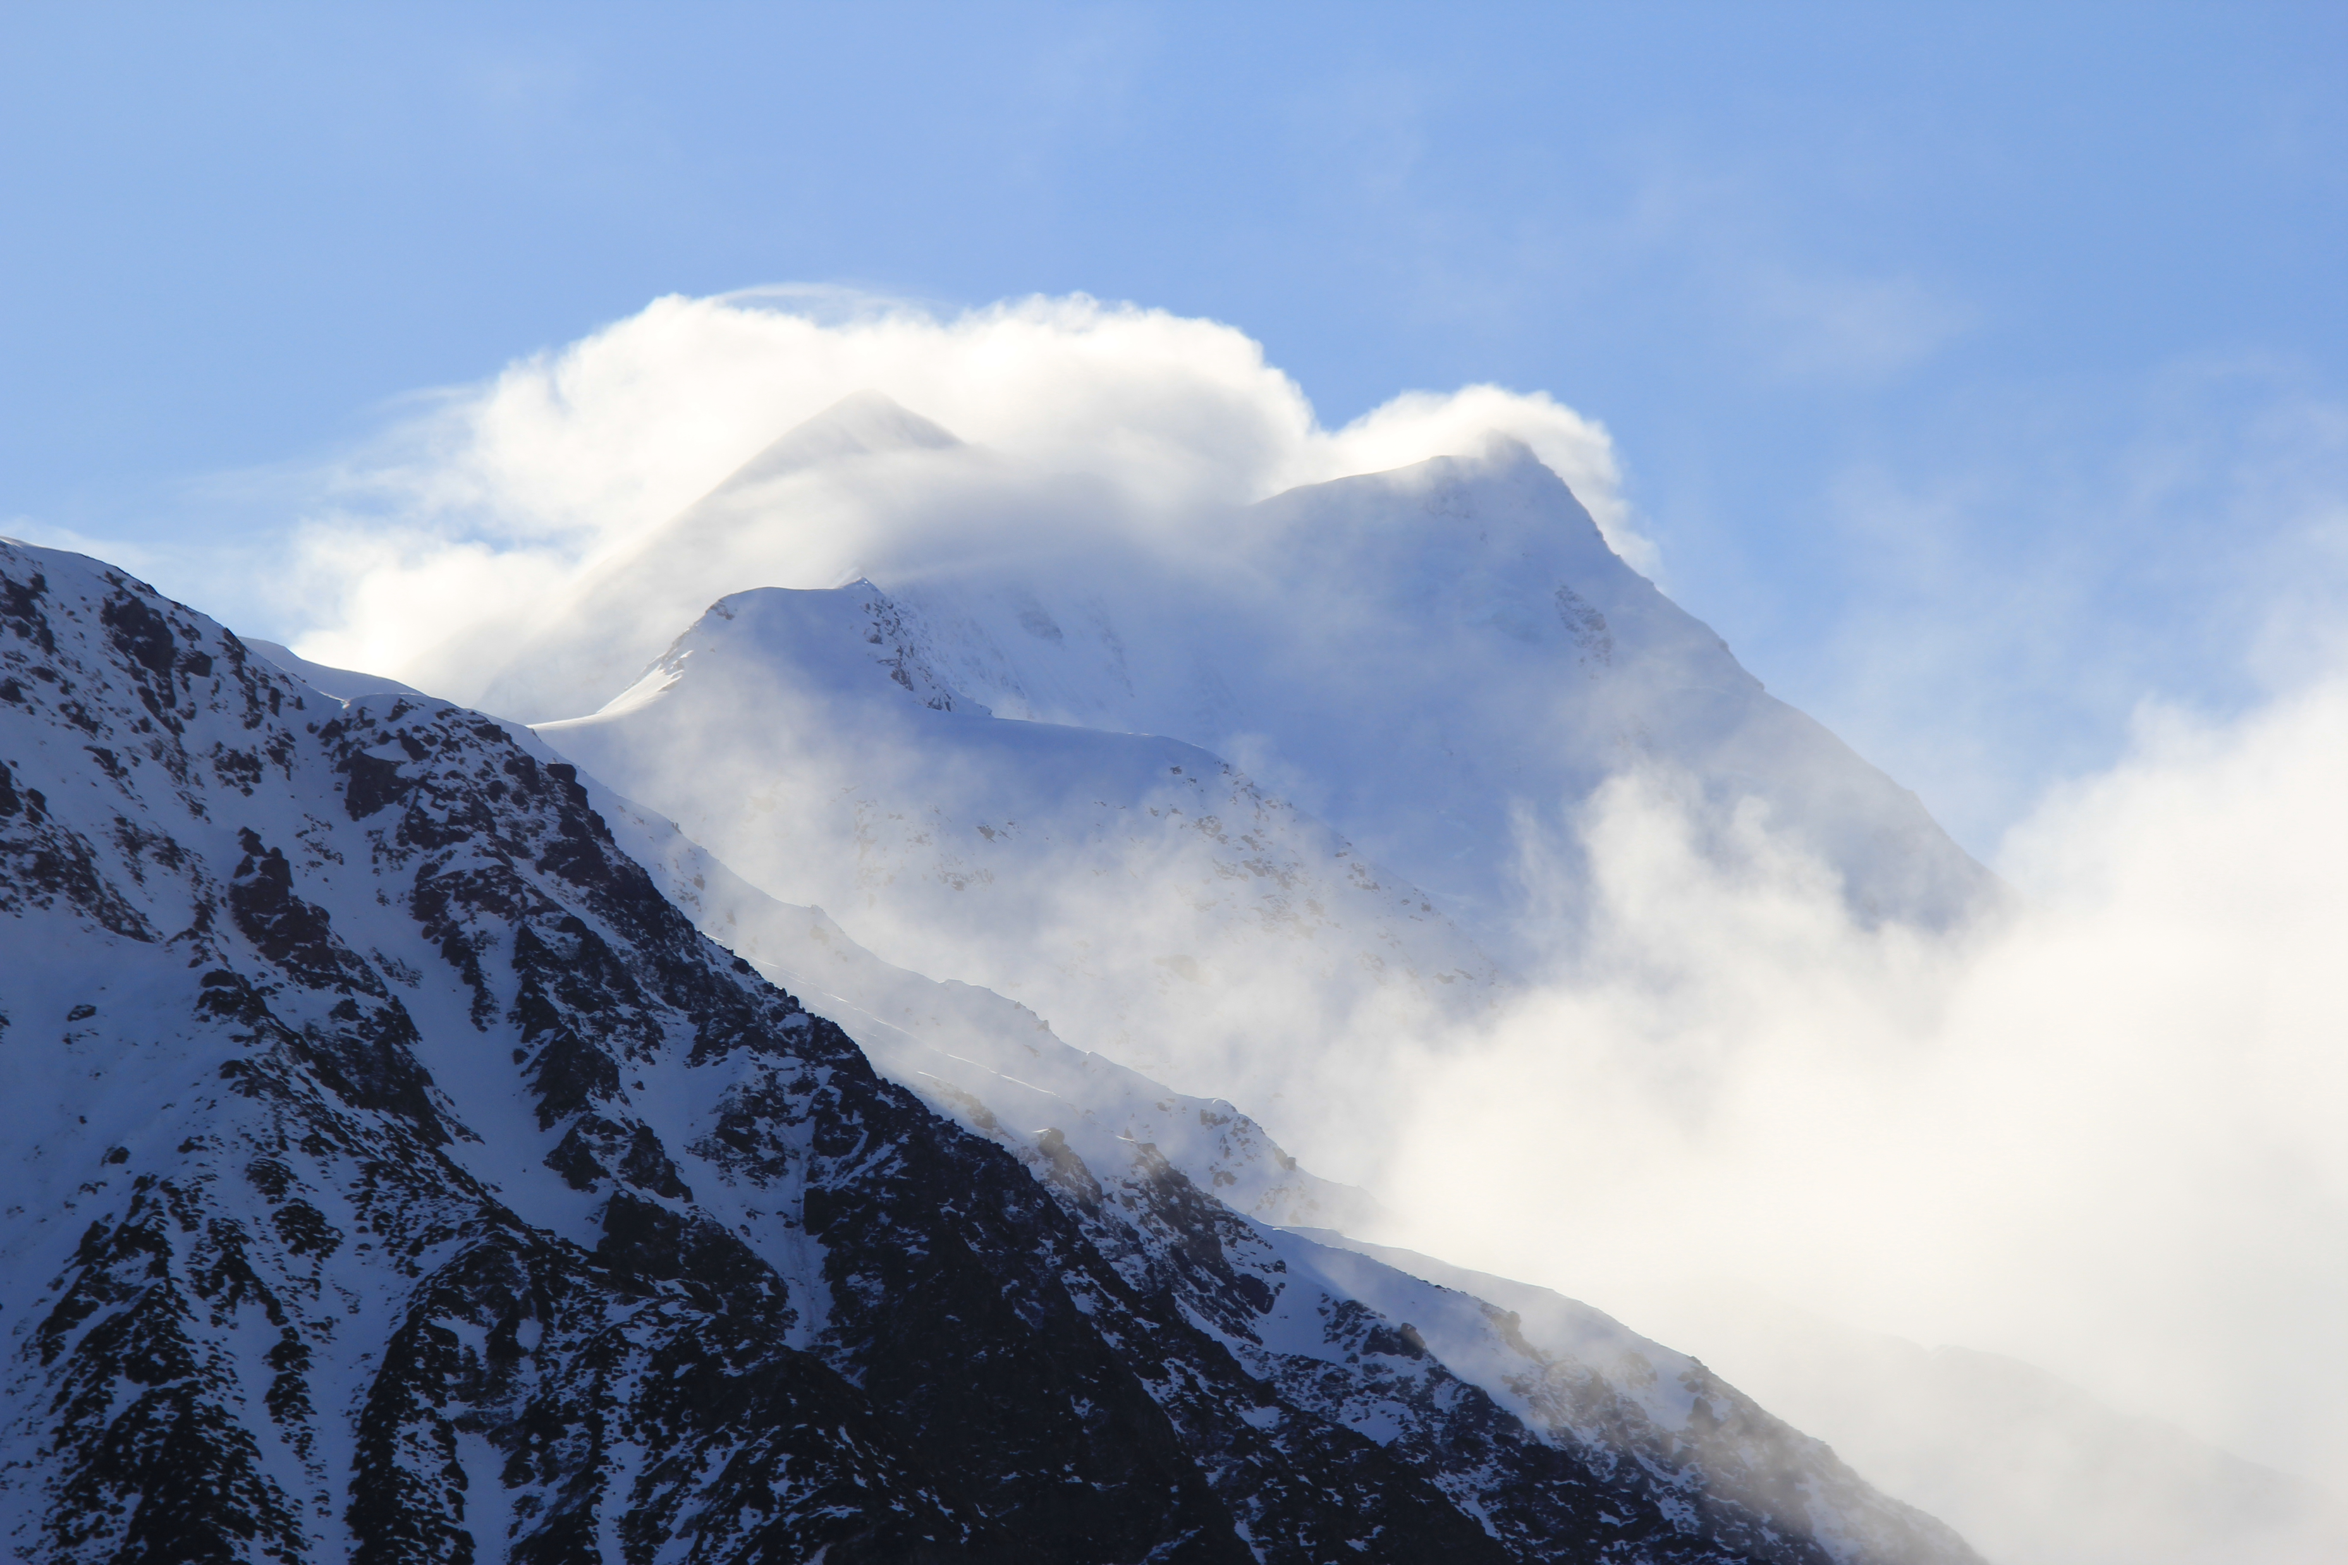
Where
is
this?
40
Notes:
Earth – Mt. Cook in New Zealand

Slide 41
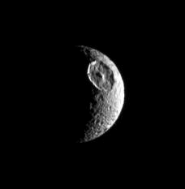
Where is this?
B1
Notes:
Mimas

Slide 42
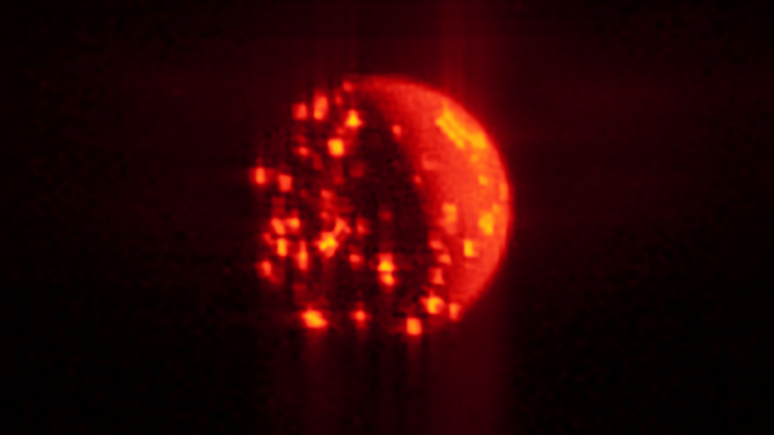
Where is this?
B2
Notes:
Io -- infrared by Juno

Slide 43
Well Done
Solar
System
Explorers!

Slide 45
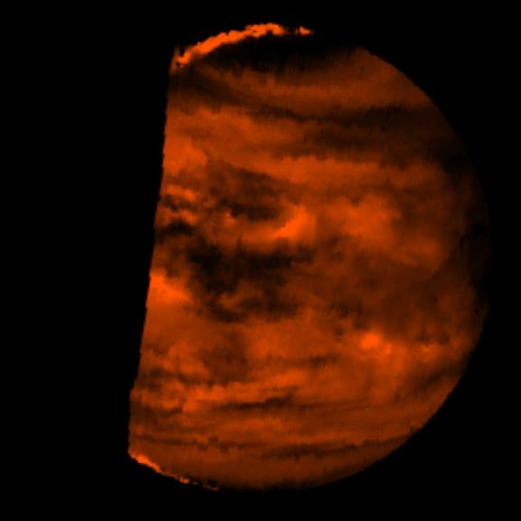
Where is
this?
??
Notes:
Venus

Slide 46
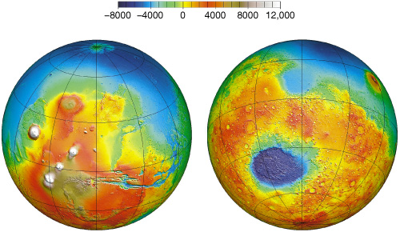
Where is this?
B1
Notes:
Mars

Slide 47

Where is this?
B2
Notes:
Europa

Slide 48

Where is this?
Notes:
This bulls-eye view of Neptune's small dark spot (D2) was obtained by Voyager 2's narrow-angle camera. Banding surrounding the feature indicates unseen strong winds, while structures within the bright spot suggest both active upwelling of clouds and rotation about the center. A rotation rate has not yet been measured, but the V-shaped structure near the right edge of the bright area indicates that the spot rotates clockwise. Unlike the Great Red Spot on Jupiter, which rotates counterclockwise, if the D2 spot on Neptune rotates clockwise, the material will be descending in the dark oval region. The fact that infrared data will yield temperature information about the region above the clouds makes this observation especially valuable.

Slide 49

Where is this?
B2
Notes:
EARTH BY TERRA: On March 3, 2015, Chile's Villarrica volcano erupted, forcing the evacuation of thousands of people. The eruption deposited a layer of ash over the volcano's eastern slope, blanketing and darkening the normal winter snow cover. Black flows on the other flanks are mud and ash flows. Vegetation is displayed in red colors.
The thermal infrared image shows hot spots (white colored) at the summit crater, indicating continuing volcanic activity. The ash blanket is warmer (brighter) than the cold snow (black). The image covers an area of 13.5 by 16.5 kilometers, and is located at 39.4 degrees south, 71.9 degrees west.

Slide 50

Where is this?
Notes:
Earth – radio telescope in China

