Slide 1

RKSTAR
Project
recons.org
Todd J. Henry

Slide 2

RKSTAR Project
Q1: Where are all types of companions to K dwarfs found?
stars
brown dwarfs
jovian planets
terrestrial planets
Q2: How do orbits compare for various populations?
star formation
planet formation
brown dwarf formation
Q3: What are the characteristics of stars similar to the Sun?
masses
ages … lithium … variability … rotation
metallicity
STATISTICAL RESULTS
RKSTAR

Slide 3
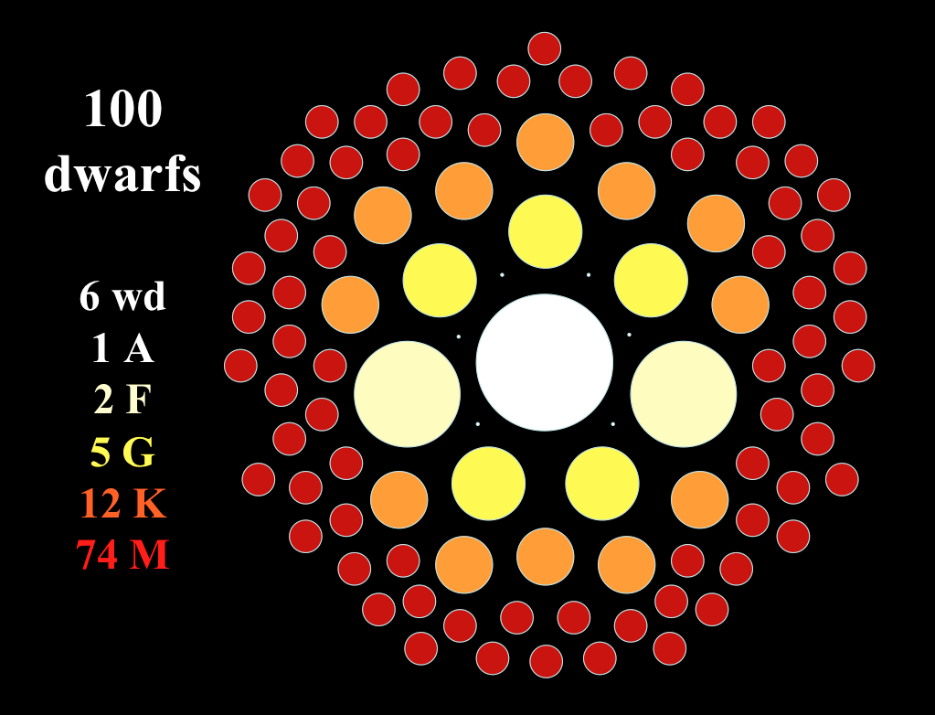
K Dwarfs = 12% of Stars

Slide 4
1. Sample
1. RKSTAR (RECONS K Stars) Sample
total of 5059 stars = 50 pc, all sky
http://www.astro.gsu.edu/~thenry/RKSTAR/
2. Wide Survey
goal is 5059 stars = 50 pc, all-sky
3. Speckle Survey
goal is 1265 stars = 40 pc, equatorial
maybe 2555 stars = 50 pc, equatorial
4. Radial Velocity Survey
goal is 300 (+172) stars = 30 pc, equatorial K-KIDS
maybe 514 (+248) stars = 30 pc, equatorial Gaia
5. Characterization Survey
goal is 1265 stars = 40 pc, equatorial
RKSTAR

Slide 5
Three Spatial Surveys

Slide 6
2. Wide Survey
10000 AU cutoff needed
two stars with parallaxes of 23.921 mas and 23.918 mas
41.8042724 pc and 41.80951585 pc
1082 AU apart in depth
then, there is the projected separation
separation + parallax + proper motion matches needed
characterization needed
  are Gaia + 2MASS data enough?
other photometry?
new observations
multiplicity of new companions should be done

Slide 7
 | Number of candidate companions based on parallax criteria
Search Radius (") | 3 | 2 | 1 | None | Total
10 | 0 | 0 | 293 | 4750 | 5043
20 | 0 | 2 | 385 | 4656 | 5043
30 | 0 | 4 | 431 | 4608 | 5043
50 | 0 | 4 | 472 | 4567 | 5043
70 | 0 | 5 | 499 | 4539 | 5043
Comments:
Duplicates in list
Different epochs
RKSTAR targets within 10” so current results are overcounting candidate companions
Need to rethink approach….

Slide 8
3. Speckle Survey
Wave 1
  50 pc equatorial from Hipparcos = 1046 stars
  PAPER1 = stellar companions
  PAPER2 = new orbits?
Wave 2
40 pc equatorial from Gaia DR2 = 1265 stars
PAPER3 = P vs. e plot
Wave 3
  50 pc equatorial from Gaia DR3 = 2555+ stars

Slide 9
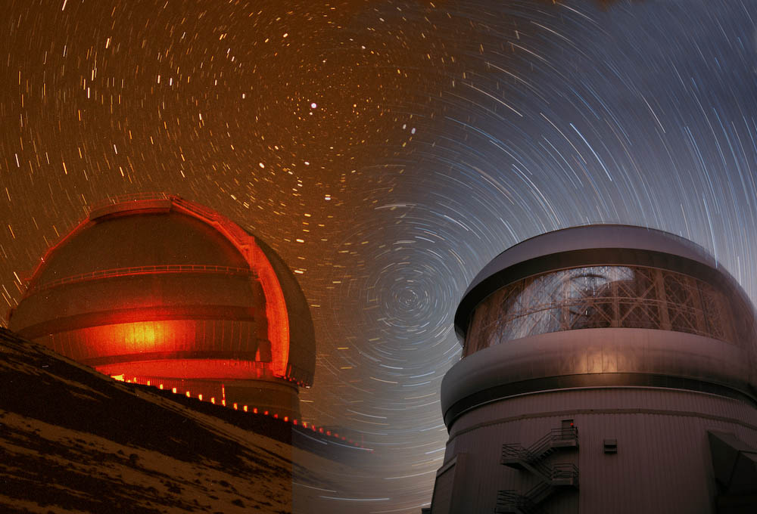
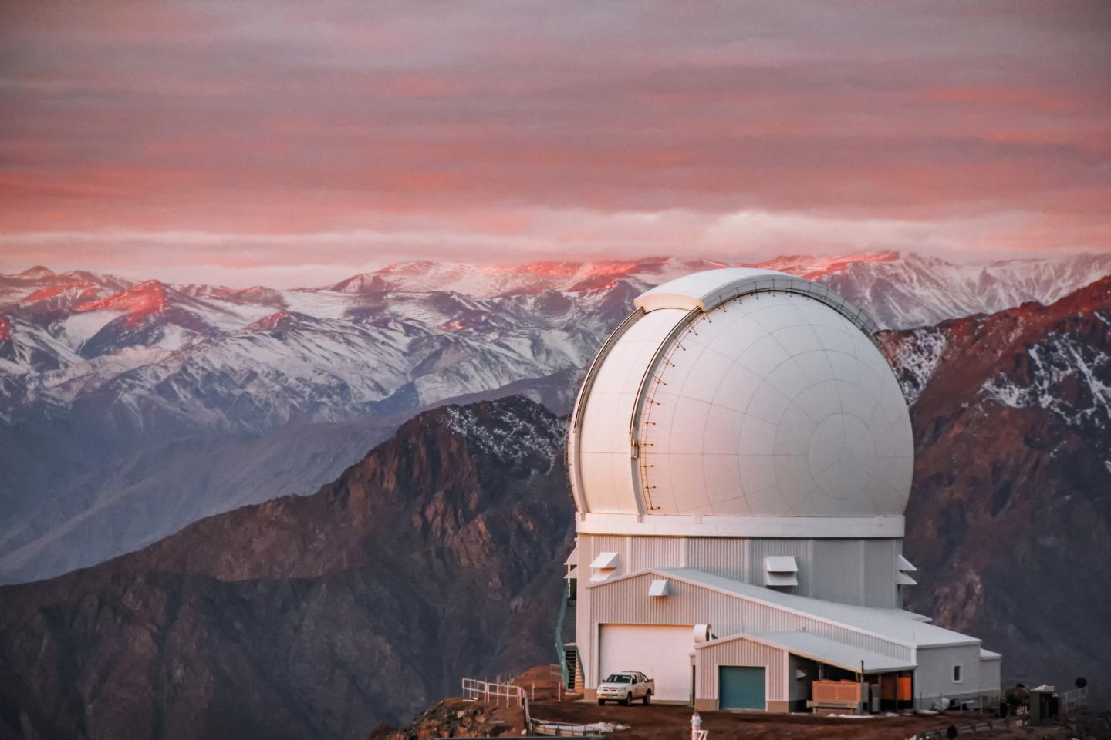
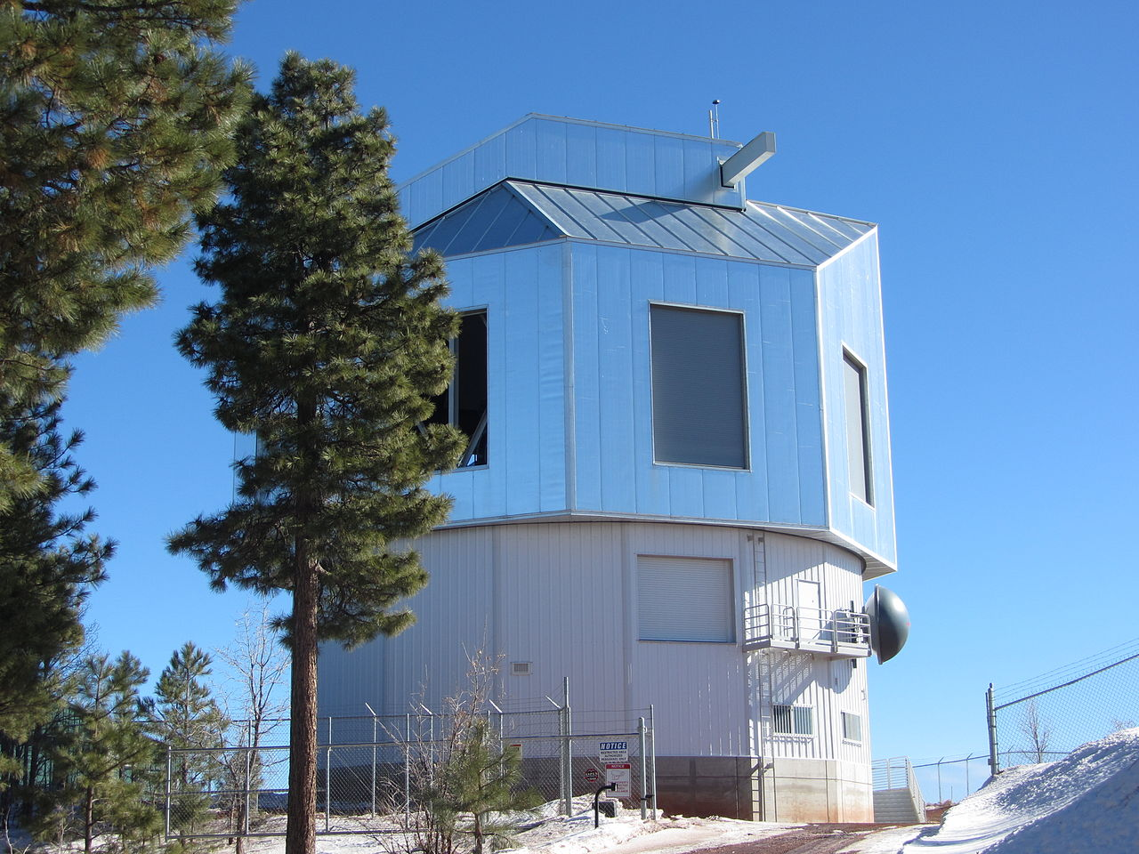
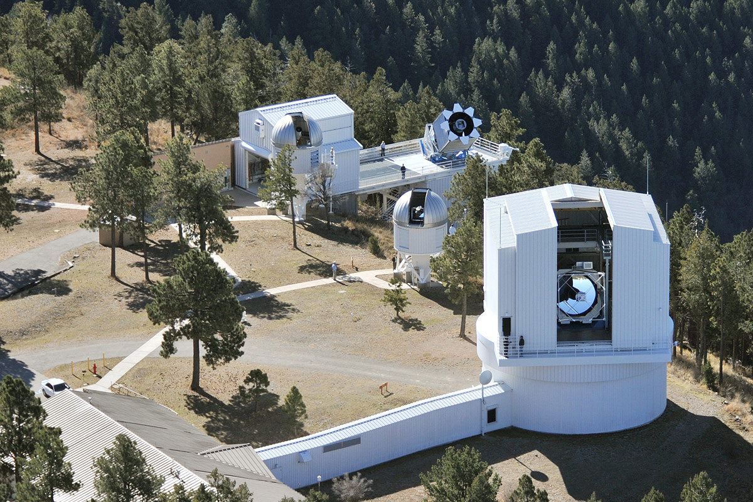
1200 × 800
Gemini-South/North 8.1m SOAR 4.3m
Lowell Discovery 4.3m Apache Point 3.5m
Lowell Discovery 4.3m SOAR 4.3m

Slide 10
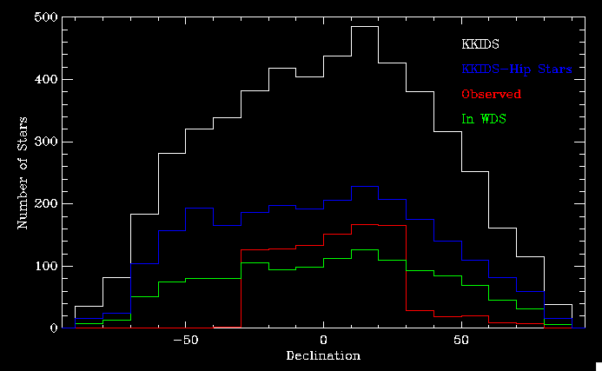
3. Speckle Survey

Slide 11
3. Speckle Survey

Slide 12
4. Radial Velocity Survey
Wave 1
  30 pc equatorial from Hipparcos = 472 stars
  300 by RECONS + 172 by others
  PAPER1 = 5 exoplanets and CHIRON capabilities
  PAPER2 = 88 perturbations
  PAPER3 = synthesis of RECONS + others
Wave 2
25 pc equatorial from Gaia DR2 = 579 stars
360 by RECONS + 219 by others
PAPER4 = RV + speckle detections?
Wave 3
  30 pc equatorial from Gaia DR2 = 762 stars
  514 by RECONS + 248 by others

Slide 13
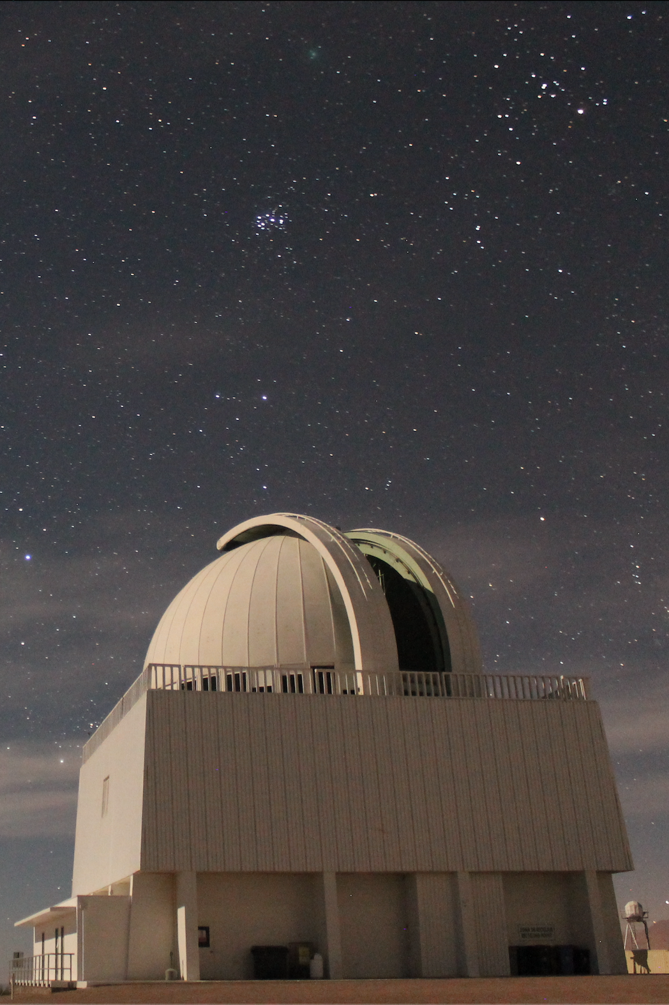
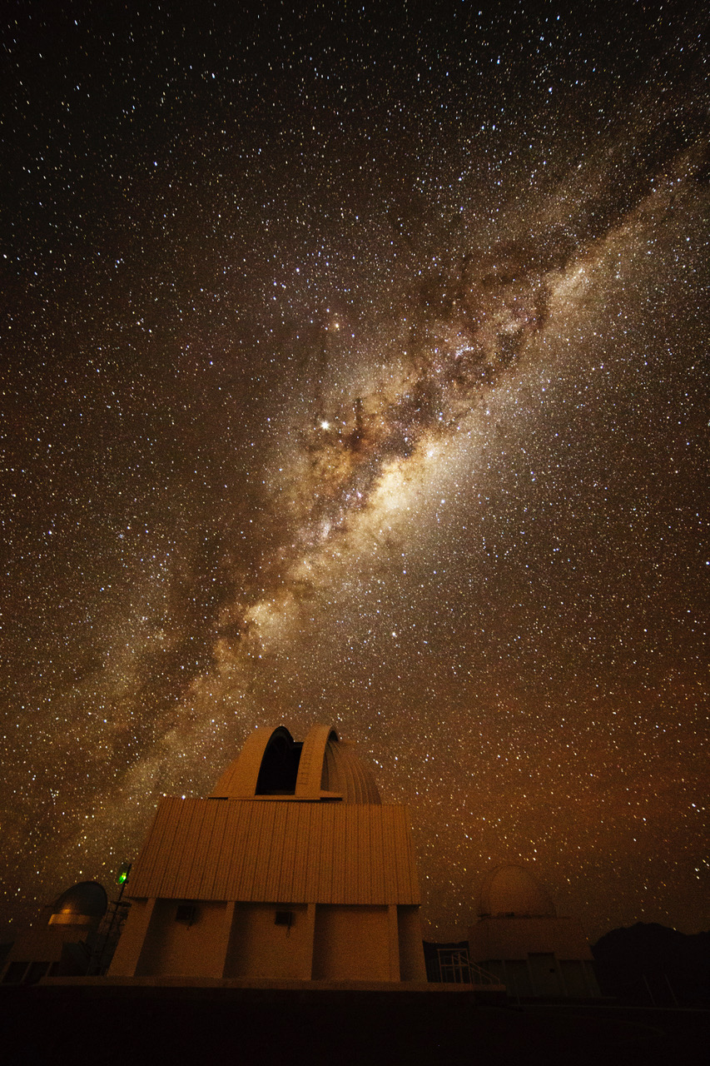
CTIO/SMARTS 1.5m
radial velocities
CTIO/SMARTS 0.9m
imaging

Slide 14
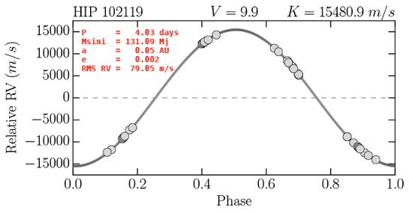
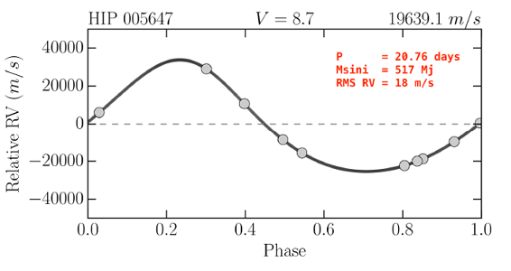
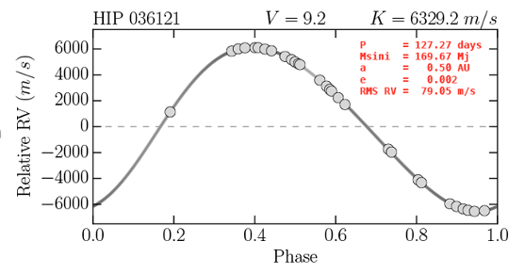
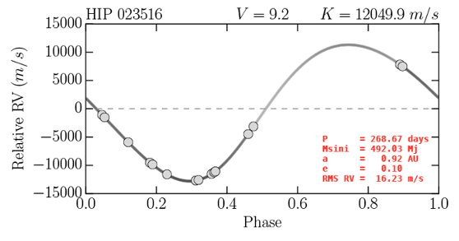
4. Radial Velocity Survey
photo: R. Hinojosa photo: T. Rector

Slide 15
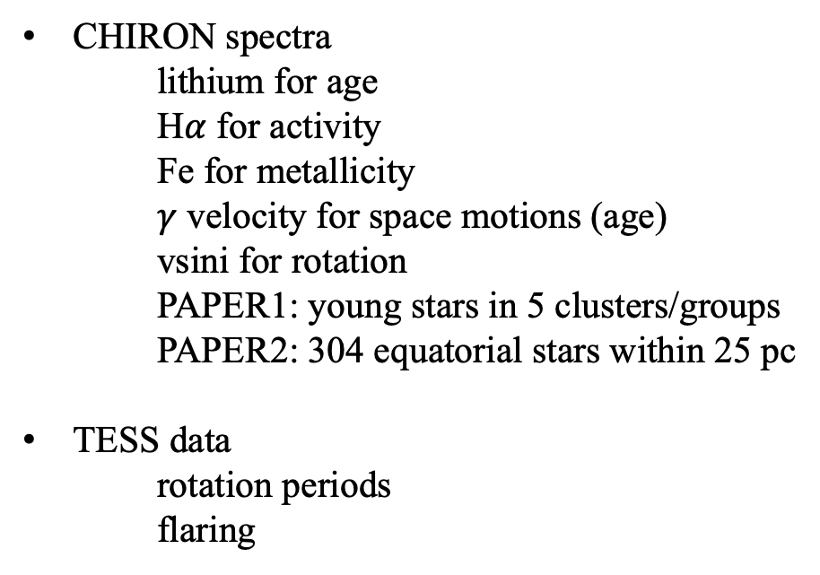
5. Characterization Survey
CHIRON spectra
lithium for age
H$α$ for activity
Fe for metallicity
$γ$ velocity for space motions (age)
vsini for rotation
  PAPER1: young stars in 5 clusters/groups
  PAPER2: 304 equatorial stars within 25 pc
TESS data
rotation periods
flaring

