Slide 1

RKSTAR
Project
recons.org
Todd J. Henry

Slide 2

RKSTAR Project
Q1: Where are all types of companions to K dwarfs found?
stars
brown dwarfs
jovian planets
terrestrial planets
Q2: How do orbits compare for various populations?
star formation
brown dwarf formation
planet formation
Q3: What are the characteristics of stars similar to the Sun?
masses
ages … lithium + variability + rotation + space motions
metallicity
STATISTICAL RESULTS
RKSTAR

Slide 3
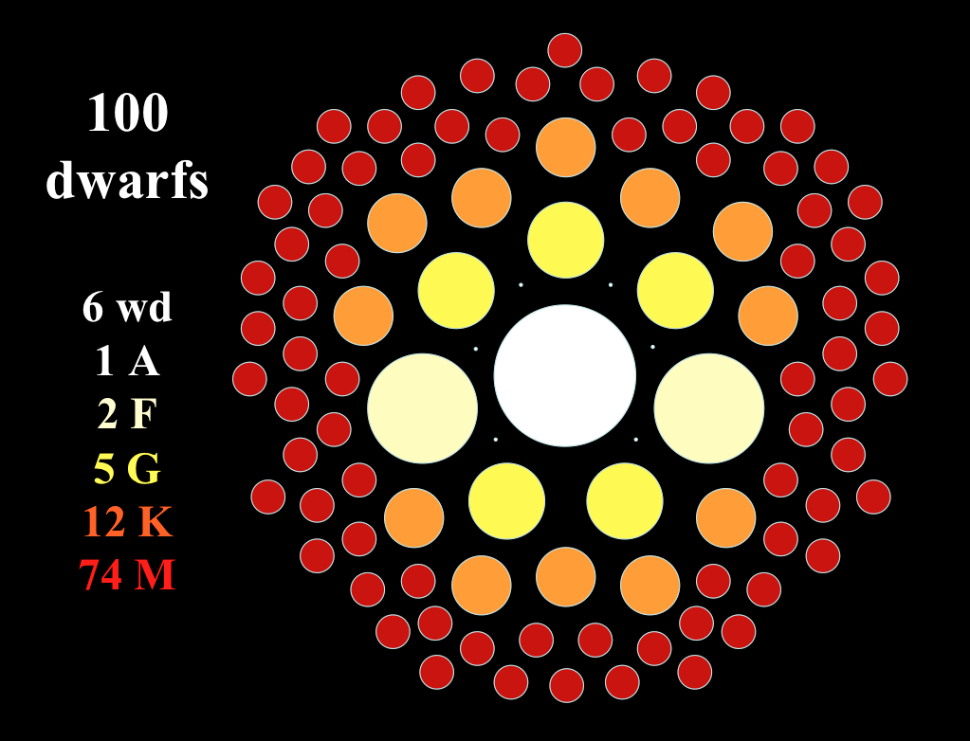
K Dwarfs = 12% of Stars

Slide 4
1. Sample
1. RKSTAR (RECONS K Stars) Sample
total of 5059 stars = 50 pc, all sky
http://www.astro.gsu.edu/~thenry/RKSTAR/
2. Wide Survey
goal is 5059 stars = 50 pc, all-sky
3. Speckle Survey
goal is 1265 stars = 40 pc, equatorial
maybe 2555 stars = 50 pc, equatorial
4. Radial Velocity Survey
goal is 300 (+172) stars = 30 pc, equatorial K-KIDS
maybe 514 (+248) stars = 30 pc, equatorial Gaia
5. Characterization Survey
goal is 1265 stars = 40 pc, equatorial
RKSTAR
TO DO: revise sample with Gaia EDR3

Slide 5
4 Surveys = 3 Spatial + 1 Characterization

Slide 6
2. Wide Survey
separation + parallax + proper motion matches needed
10000 AU for separation
??? for parallax
??? for proper motion
characterization needed
  are Gaia + 2MASS data enough?
other photometry?
PAPER1 = stellar companions
new observations
multiplicity of new companions should be done
TO DO: finalize matching criteria
TO DO: check WDS for new vs. known

Slide 7
3. Speckle Survey
Wave 1
  50 pc equatorial from Hipparcos = 1046 stars
  PAPER1 = stellar companions (Henry, refereed)
  PAPER2 = new orbits (Horch, submitted)
Wave 2
40 pc equatorial from Gaia DR2 = 1265 stars
PAPER3 = statistical study? / detailed P vs. e?
Wave 3
  50 pc equatorial from Gaia DR3 = 2555+ stars
TO DO: enter LDT + GemS results from FEB 2021
TO DO: submit GemS proposal for 2021B
TO DO: get datasets from SCSU for Ellie Lincoln’s tests

Slide 8
4. Radial Velocity Survey
Wave 1
  30 pc equatorial from Hipparcos = 472 stars
  300 by RECONS + 172 by others
  PAPER1 = 9 exoplanets and CHIRON capabilities
  PAPER2 = 88 perturbations
  PAPER3 = synthesis of RECONS + others
Wave 2
25 pc equatorial from Gaia DR2 = 579 stars
360 by RECONS + 219 by others
PAPER4 = RV + speckle detections?
Wave 3
  30 pc equatorial from Gaia DR2 = 762 stars
  514 by RECONS + 248 by others
TO DO: resubmit PAPER1
TO DO: check observations needed for PAPER2

Slide 9
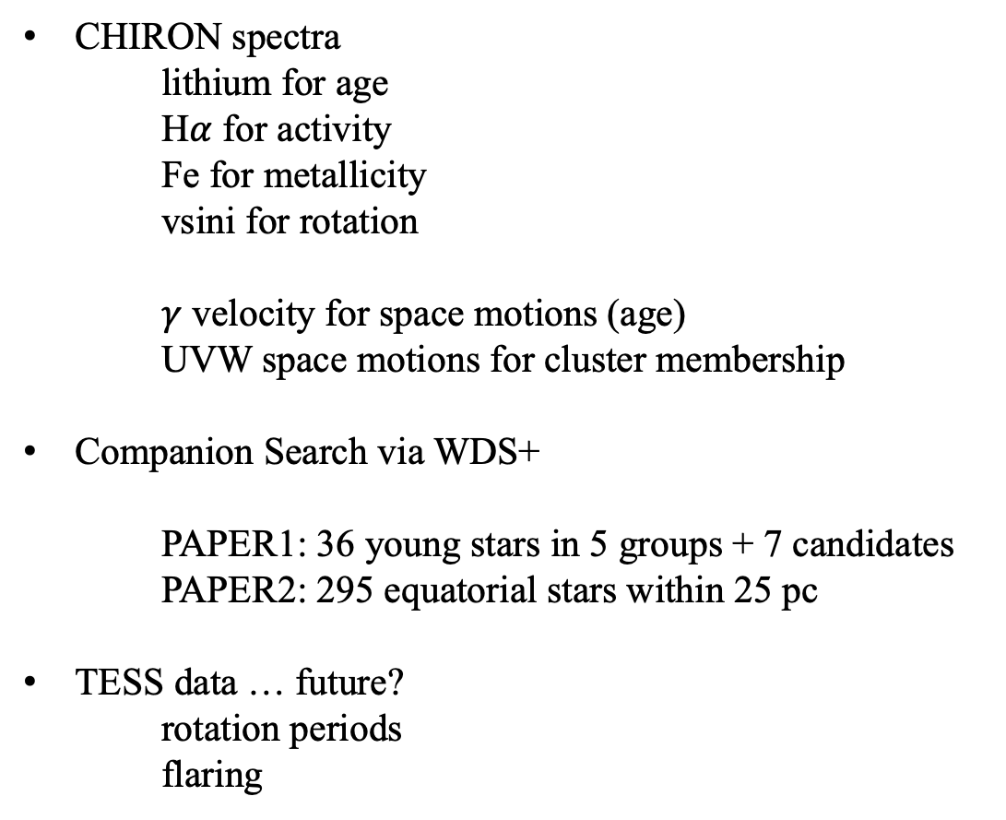
5. Characterization Survey
CHIRON spectra
lithium for age
H$α$ for activity
Fe for metallicity
vsini for rotation
$γ$ velocity for space motions (age)
UVW space motions for cluster membership
Companion Search via WDS+
  PAPER1: 36 young stars in 5 groups + 7 candidates
  PAPER2: 295 equatorial stars within 25 pc
TESS data … future?
rotation periods
flaring
TO DO: submit PAPER1

Slide 11
 | Number of candidate companions based on parallax criteria
Search Radius (") | 3 | 2 | 1 | None | Total
10 | 0 | 0 | 293 | 4750 | 5043
20 | 0 | 2 | 385 | 4656 | 5043
30 | 0 | 4 | 431 | 4608 | 5043
50 | 0 | 4 | 472 | 4567 | 5043
70 | 0 | 5 | 499 | 4539 | 5043
Comments:
Duplicates in list
Different epochs
RKSTAR targets within 10” so current results are overcounting candidate companions
Need to rethink approach….

Slide 12
3. Speckle Survey

Slide 13
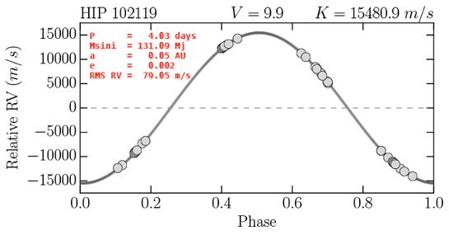
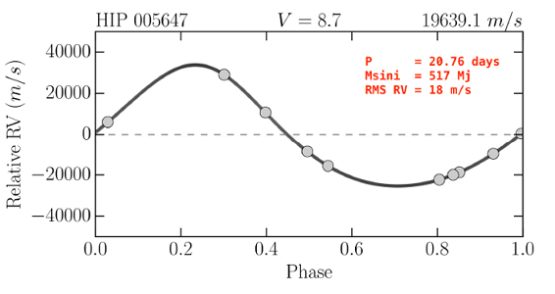
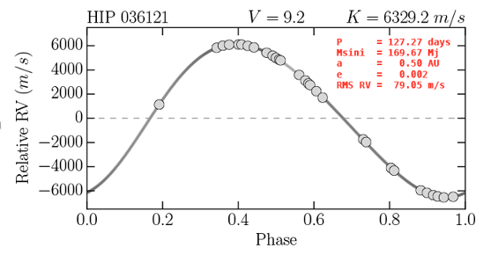
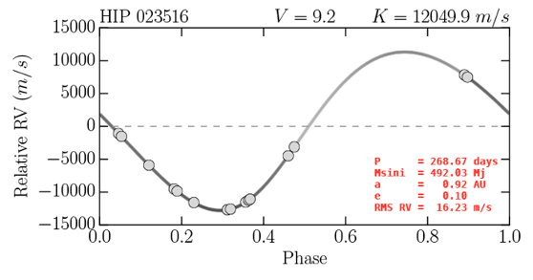
4. Radial Velocity Survey
photo: R. Hinojosa photo: T. Rector

